Slide 1
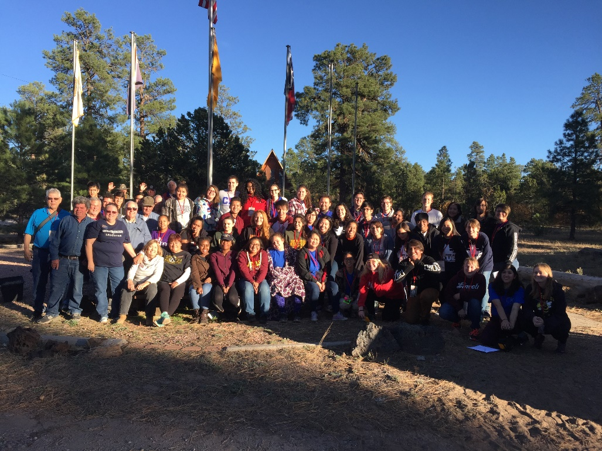
SWDK Foundation Update March 2018
President
Marge Carrithers

Slide 2
How is the SWDK Foundation Doing?

Slide 3
Financials/Updates
This past year the Foundation completed a $14,000 roof replacement on the multipurpose building at Kamp Kiwanis
The Board approved the purchase of a $4200 swing set for the picnic area with two handicapped bucket swings- donations helped us purchase two swing sets

Slide 4
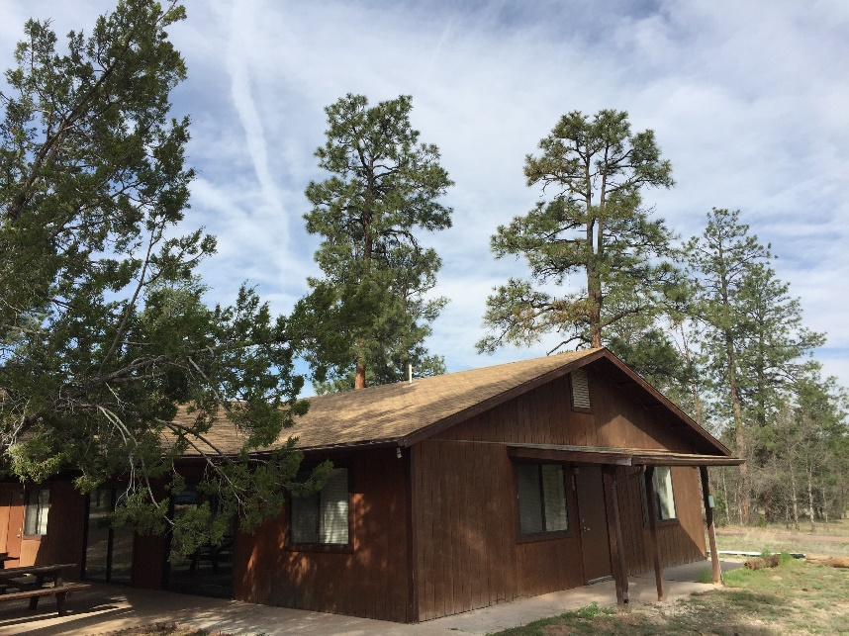
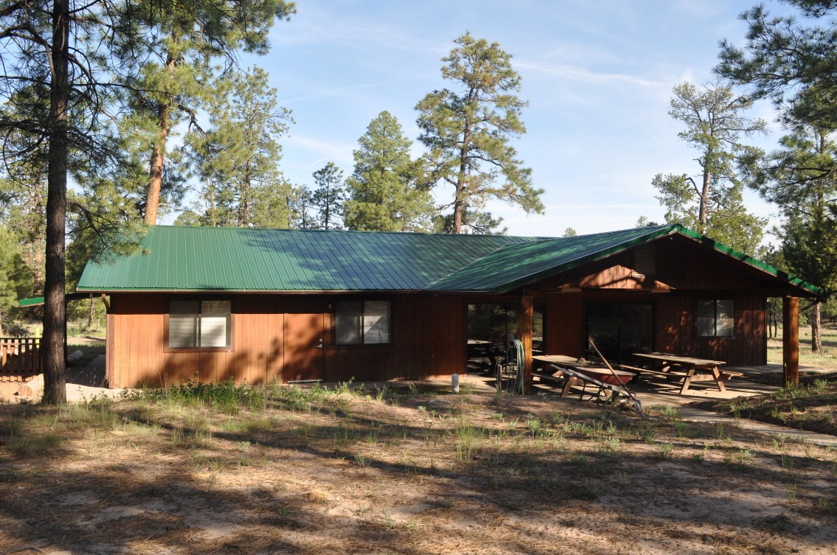
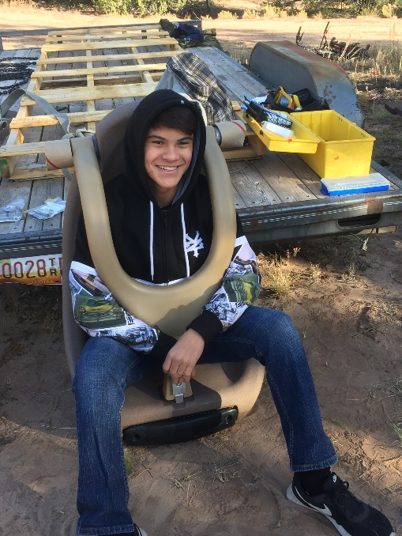

Slide 5
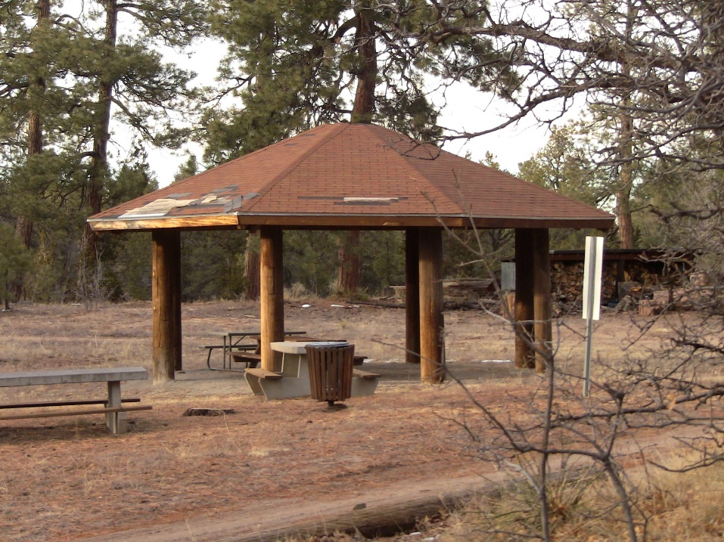
Governor Projects- 2017-18 Siding on Dorms and gazebo roof

Slide 6
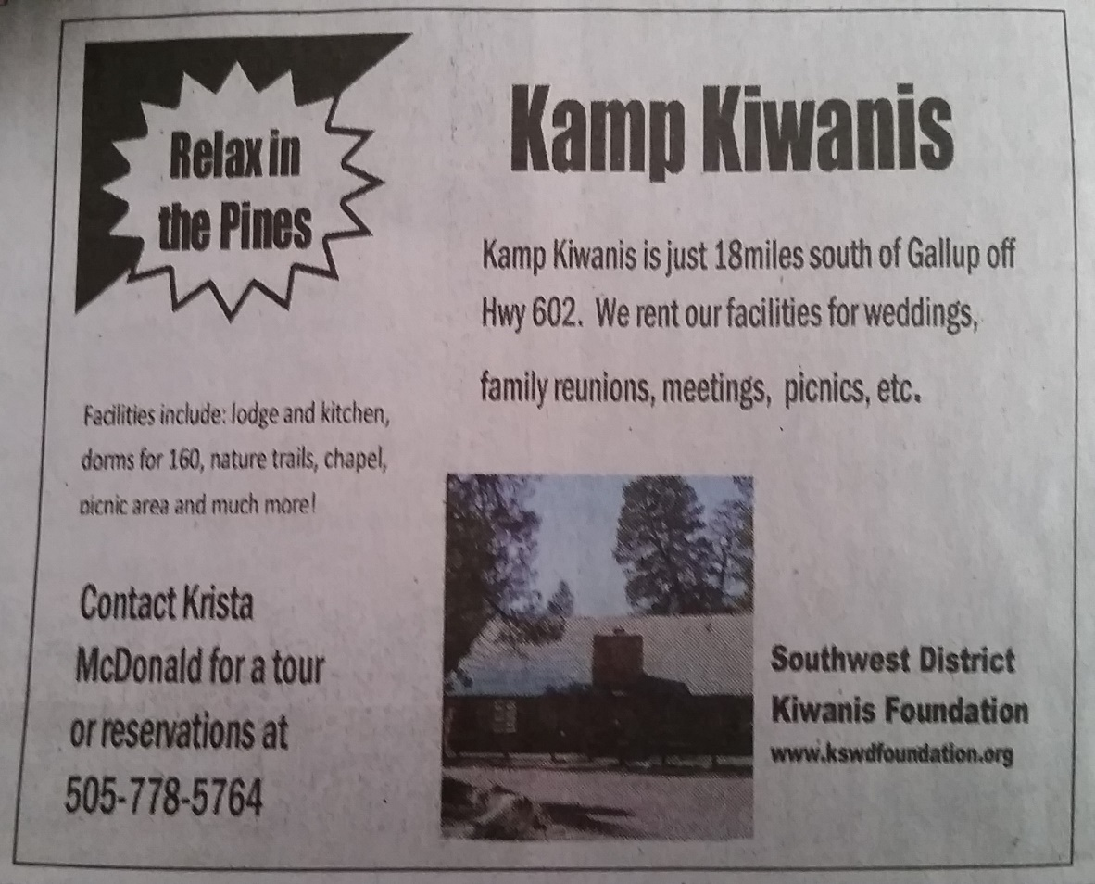
Kamp Kiwanis Ad brings customers and weddings

Slide 7
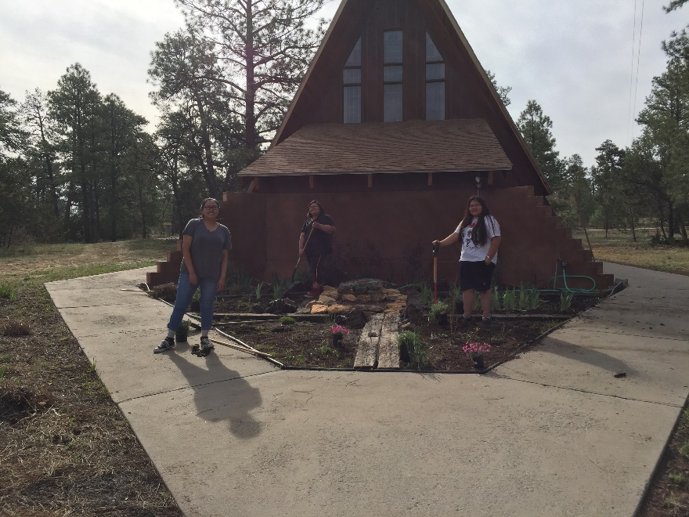
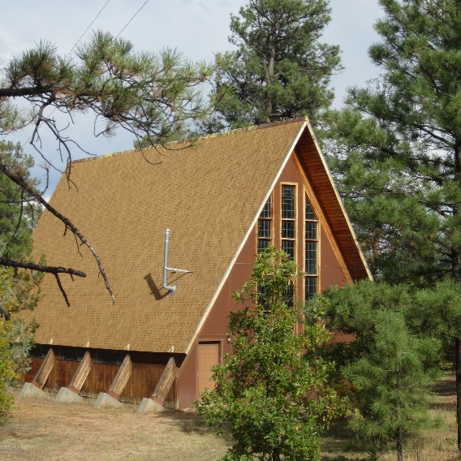
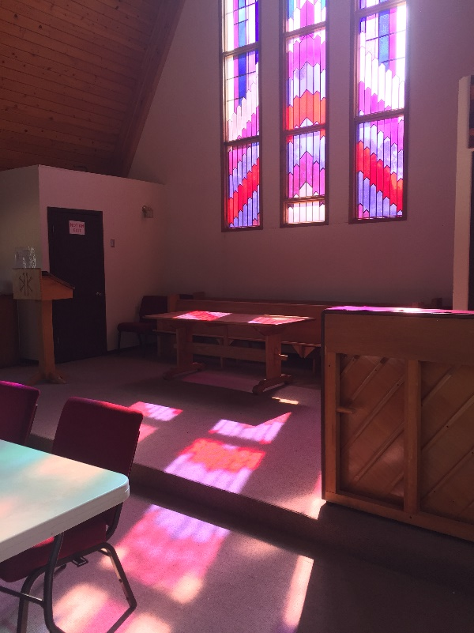
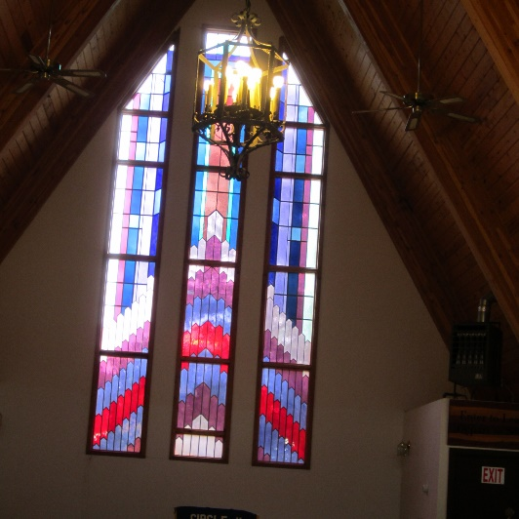
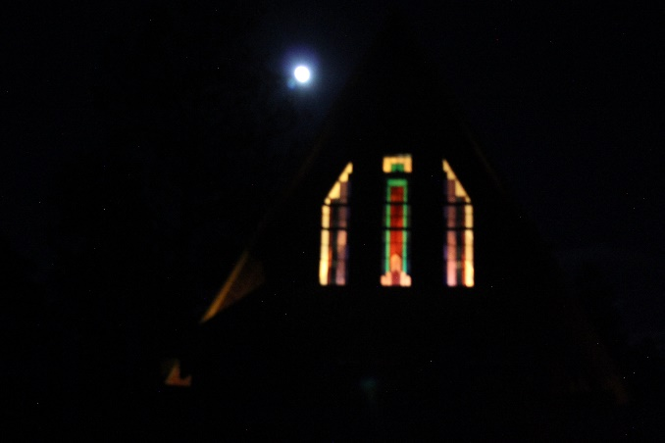
Our wonderful chapel

Slide 8
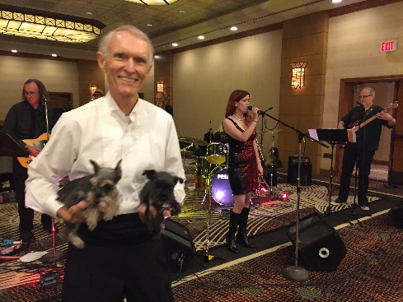
Updates
Thanks to Governor Ed Verburg for his support of the Foundation!
We still need donations to support Kamp Kiwanis, the Foundation and Key Leader
Thanks for your annual donations –you make our Foundation great!
Please become a sustaining member of the Foundation for only $50

Slide 9
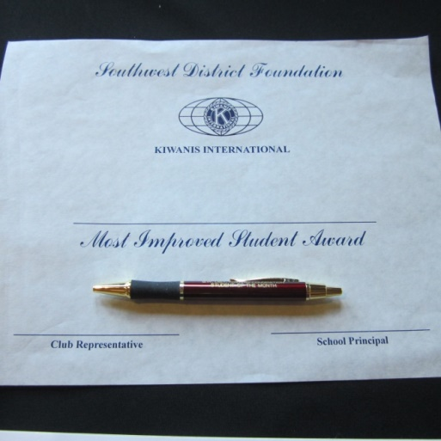
Programs I
Kiwanis Across Borders Grants- $2000- Joe DeBlasi
Scholarships-Dean Bartoo and Joan Skinner- 4 this year- Stephanie Carasco
Student Recognition Program- about 30 grades/schools participating- Marge Carrithers

Slide 10
Programs II
Support for CKI
Support for Key Club
Sponsor for Key Leader training February 16-18, 2019
Kamp Kiwanis, near Vanderwagen, NM

Slide 11
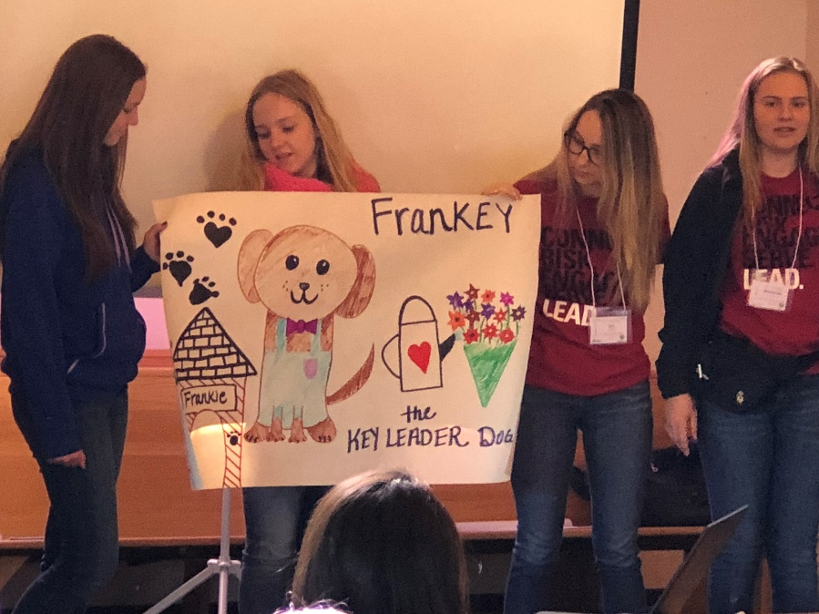
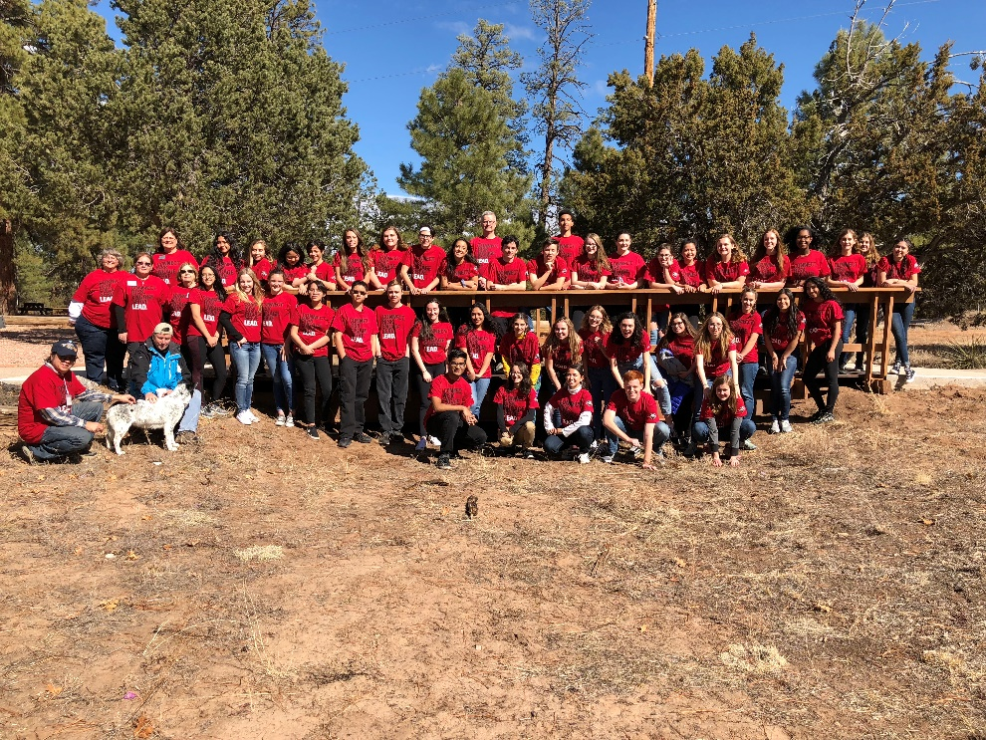
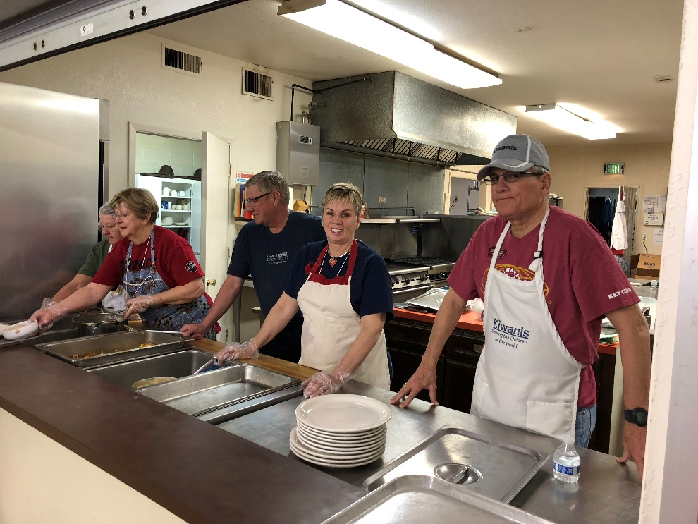
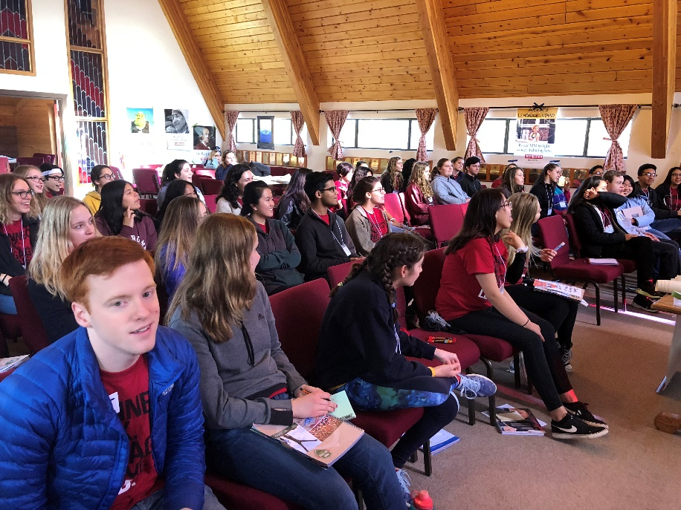

Slide 12
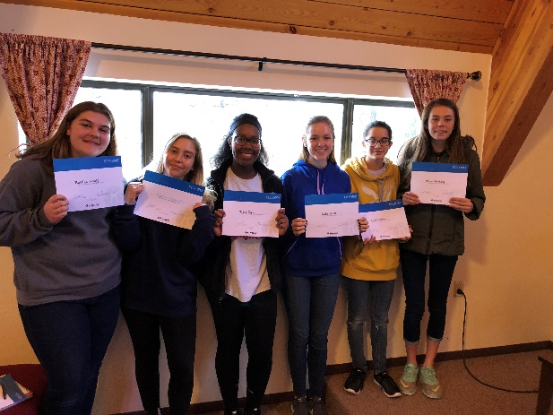
Key Leader Feb. 16-18, 2019 at Kamp Kiwanis, NM
Please remember to add Key Leader back to your club budgets for the 18-19 fiscal year
Key Club registration is $225 per student/ other students $250- may be scholarships
Register on line- link will be on our website at swdkfoundation.org
8th grade through high school
Please consider sponsoring a student or contributing to the Key Leader Scholarship Fund/SWDK Foundation-contact Jim Sowers at diamondjimbob@gmail.com

Slide 13
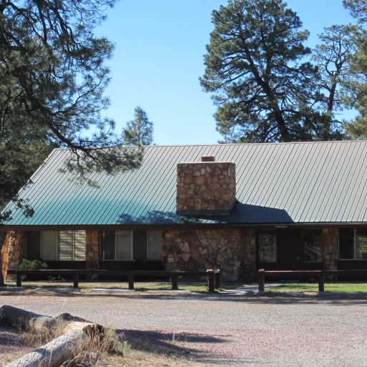
Kamp Kiwanis
Bob Morrell-Chairman of Kamp Operations Committee
See website for needs and wants list for Kamp Kiwanis: www.kswdfoundation.org
Kamp Brochure on website as well as outdoor classroom flyer.
Please “like” our Facebook page at Southwest District Kiwanis Foundation.

Slide 14
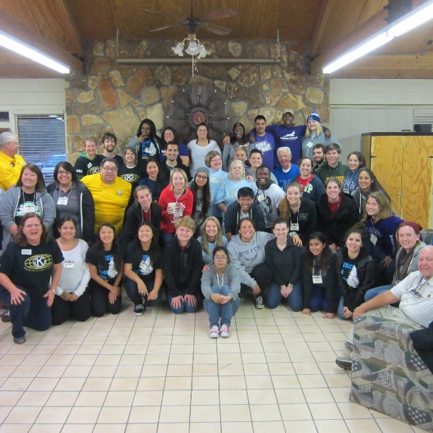
Video Tour of Kamp Kiwanis
Check out a video tour of Kamp Kiwanis and the CKI leadership training:
http://youtu.be/SS70Pb1Vda4
just 13 minutes and a great program for your clubs.

Slide 15
Southwest District Kiwanis Foundation
Every member of the Southwest Kiwanis District is a member of the Foundation
We provide umbrella coverage for about 60 clubs in our 501c(3) group
You can help by being a Sustaining member, a legacy member, buying a Kachina, or just making a donation.
Thanks for your support- let’s have an amazing year!!
#Kids Need Kiwanis!

Slide 16
How is the SWDK Foundation Doing?
Thanks to our wonderful Southwest District Kiwanians and their support, we are doing well!

Slide 17
“We are Family”

