Slide 1
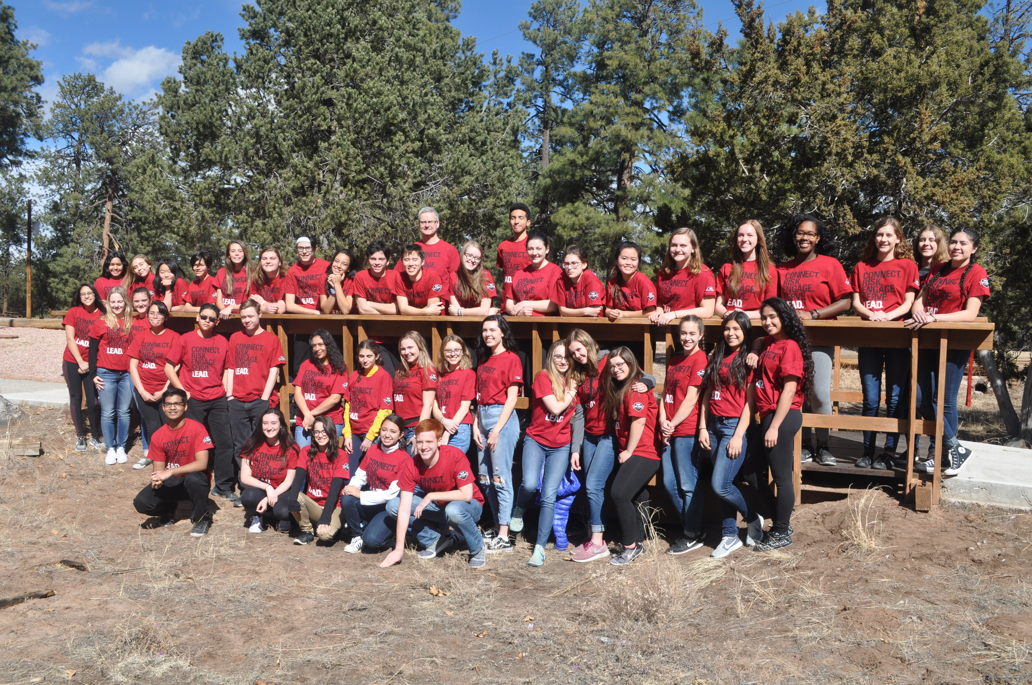
State of the Foundation 2018
By Marge Carrithers - President

Slide 2
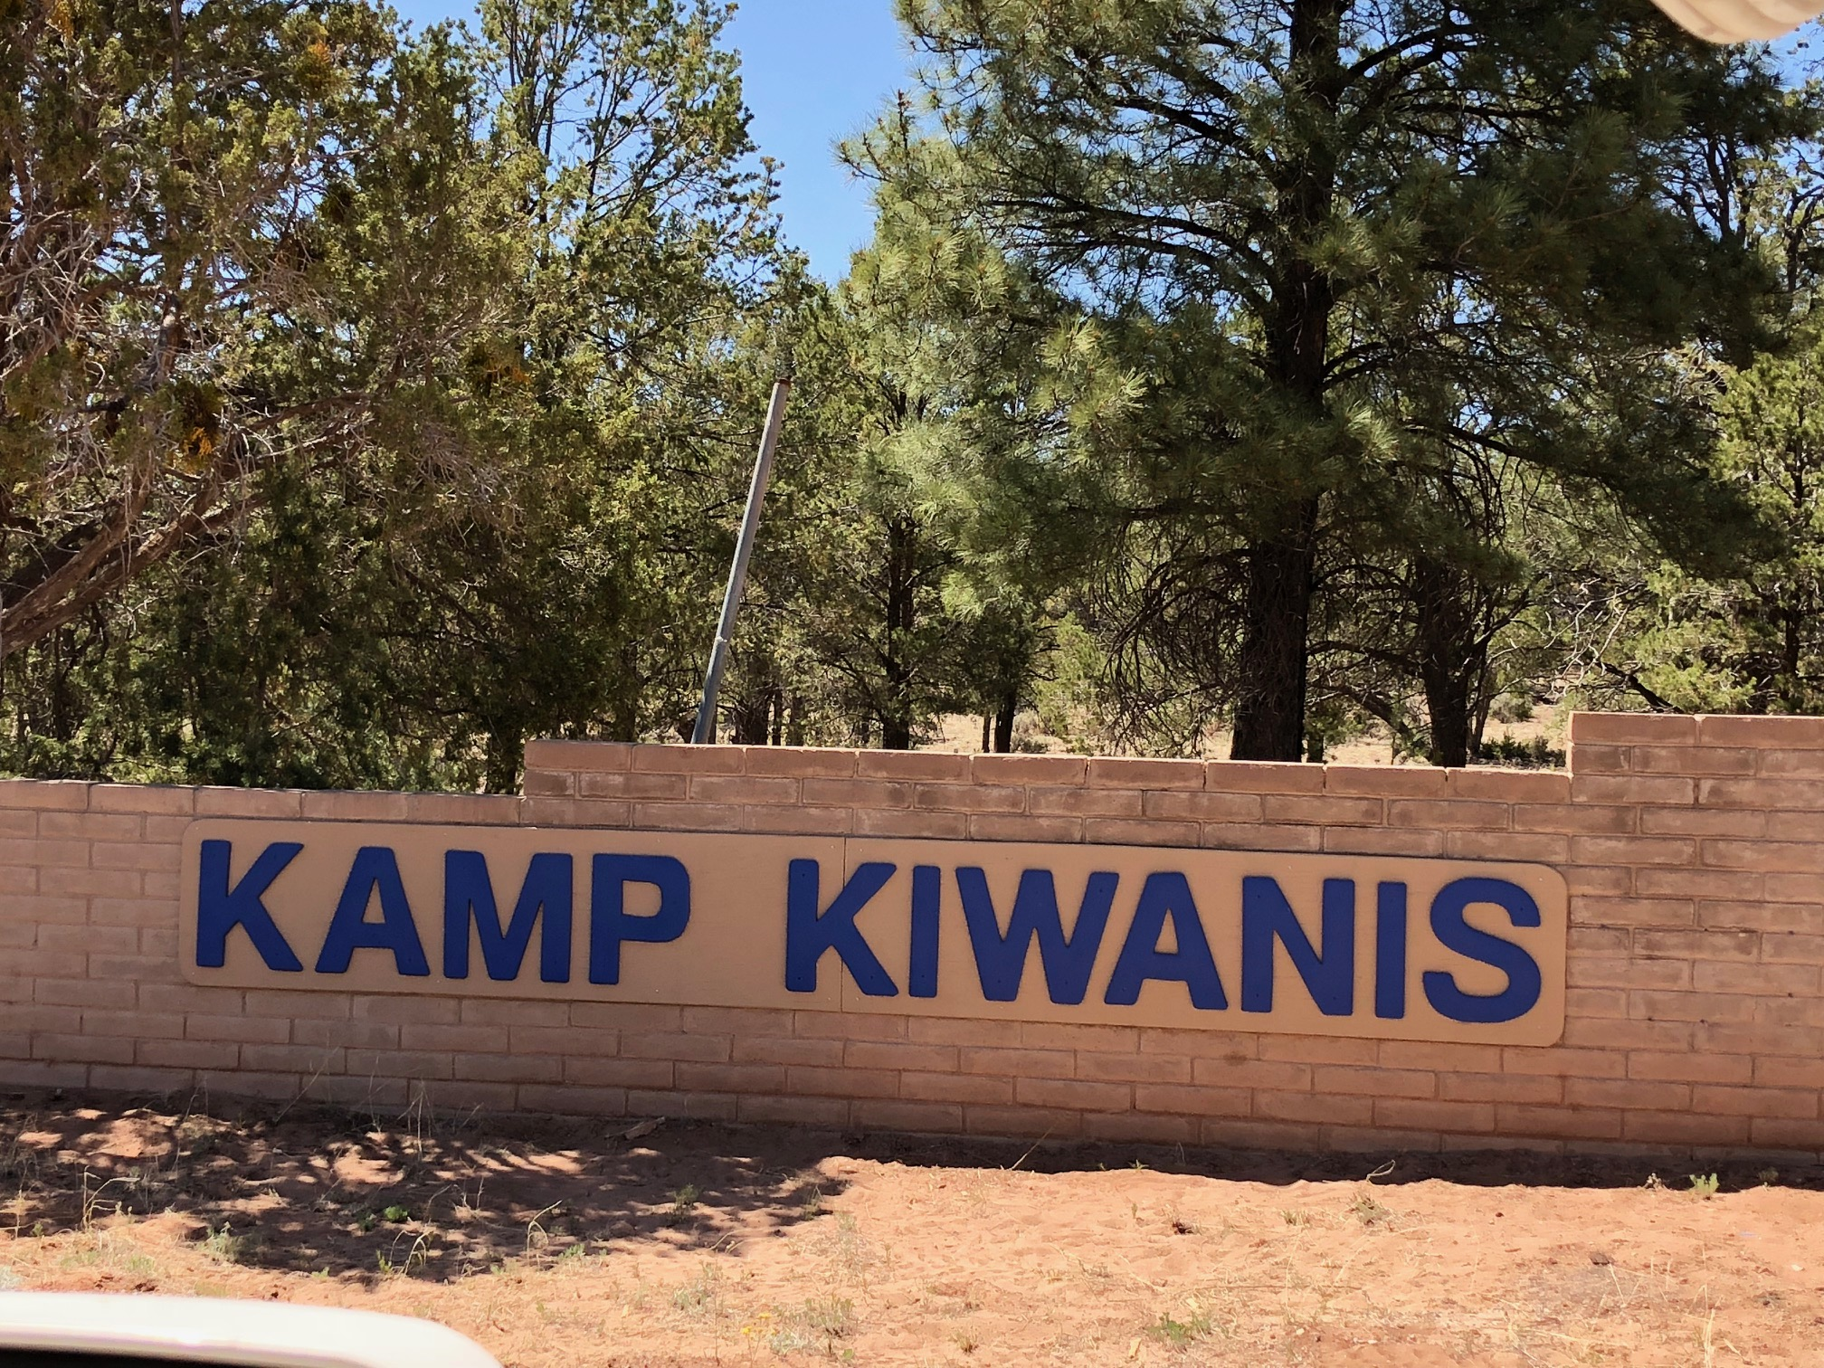
Accomplishments 17-18
· Kamp Kiwanis Improvements on Target– about 1400 people used Kamp
Kiwanis last year!
A. Replacing siding on two dorm buildings—$8000– Governor project
B. Installation of two sets of swings which include ADA swings– completed
C. Received donations for replacing windows-$900- Juniper, gazebo reroof-
$7200 Carefree Kiwanis
D. Resurface bath and shower floors for dorms—$4,000– in progress
E. Received $2500 donation from KI Children’s fund for Kamp Improvements

Slide 3
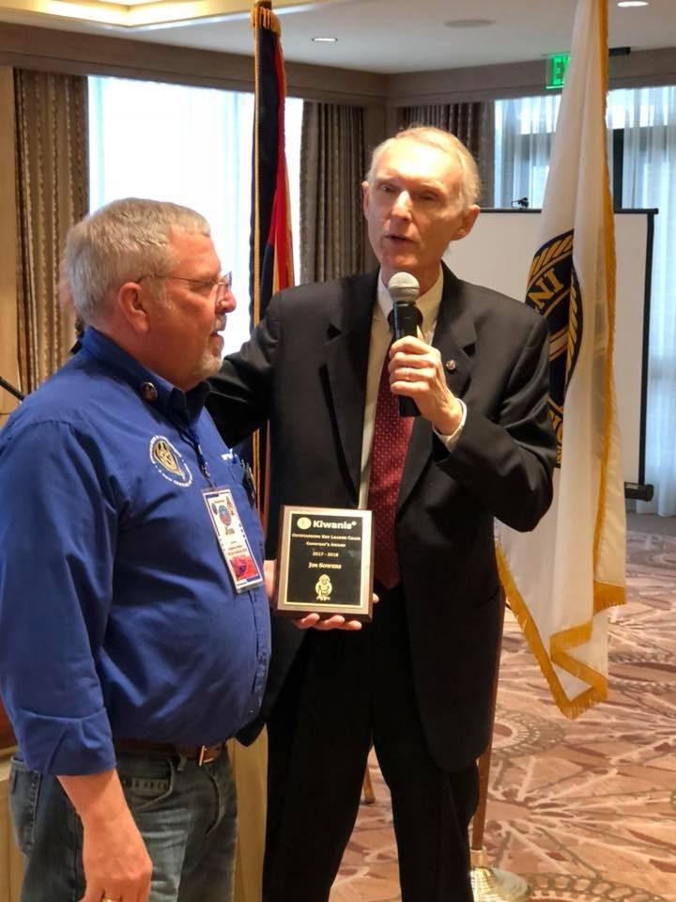
Accomplishments Continued
F. Placed ads in the Gallup newspaper– increased bookings and
weddings– 9 weddings last year!
G. New climbing net for Challenge Course/ new sign on entrance of
Kamp/ New sofas donated by Carefree Kiwanis
· Support for CKI to attend ICON- $2500
· Support for Key Club officers/Governor to attend Int. convention—$2795
· Agreed to sponsor Key Leader Training at Kamp Kiwanis Feb. 17-19, 2018-
$7,000 commitment– 46 students attended this year!

Slide 4
Check it out- Key Leader 2018

Slide 5
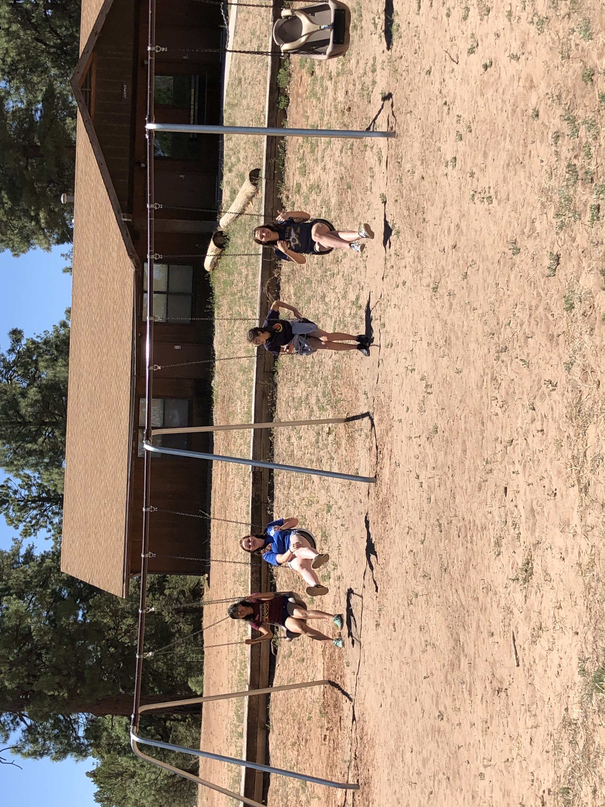
Kamp Kiwanis new ADA swings

Slide 6
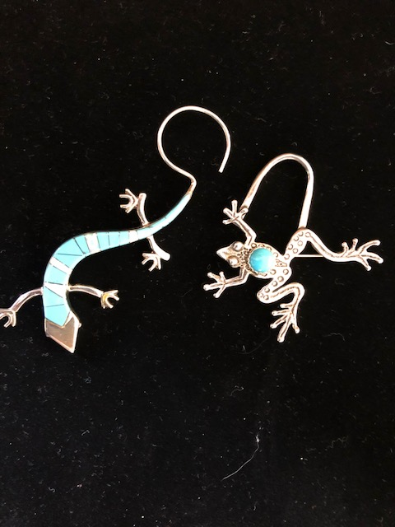
Accomplishments Continued
· Scholarships presented to : four students—$3000
· Student Recognition Program—working well in about 30 schools or
grades
· Kachinas presented this year—10
· NEW TURQUOISE AWARD –fundraising initiative $650, forms
and sample items on our website.
· Sustaining Members—290

Slide 7
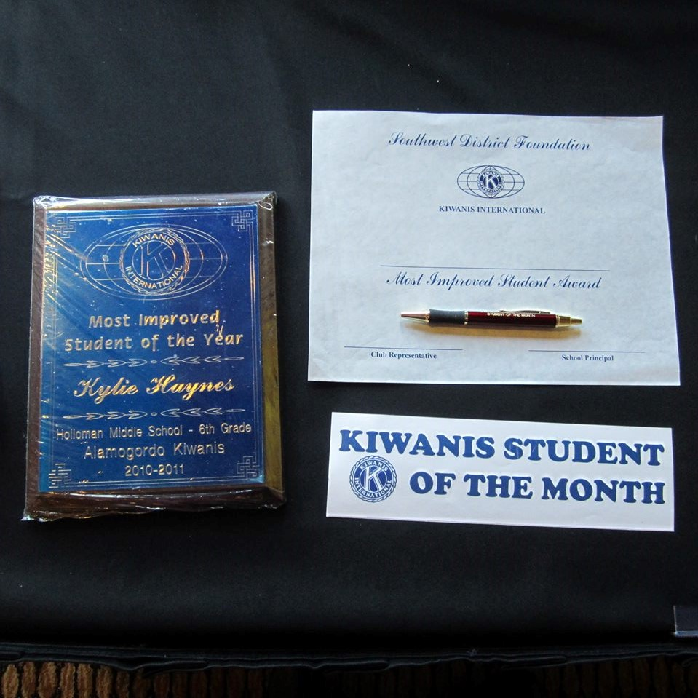
Student Recognition in Silver City

Slide 8
NEWS FLASH!!
I AM GETTING OLD…☺
Time to withdraw from my IRA account.

Slide 9
Consider Donating from IRA to SWDK Foundation and save on Taxes
Donations I will make anyway
Example
My church
SWDK Foundation
If I donate from my IRA to a 501c3, I will save on taxes.
Talk to your financial advisor, it is easy, you just notify them of your donation, how much, and EIN numbers.
IRA annual withdrawal
$5000 – 20% taxes owed - $1000
Donate $1000 straight from IRA to a 501c3
Taxes owed on $4000 @ 20% =$800
I will pledge the money through the Foundation Legacy Society for the next several years.

Slide 10
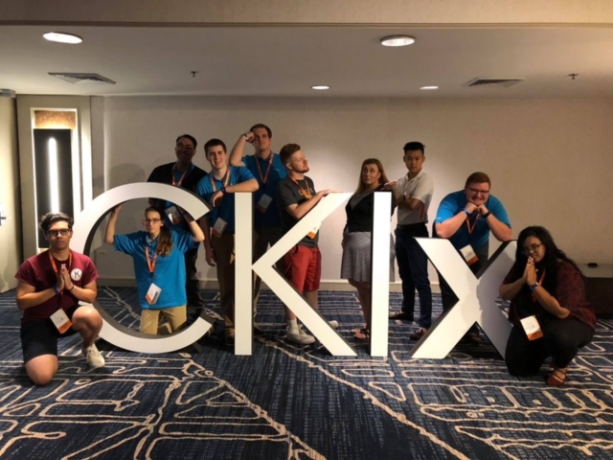
SW CKI at ICON

Slide 11
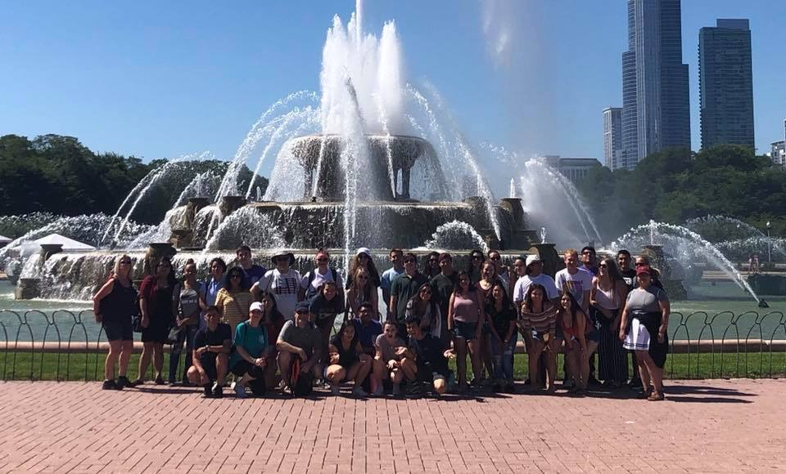
SW Key Club at ICON- Chicago

Slide 12
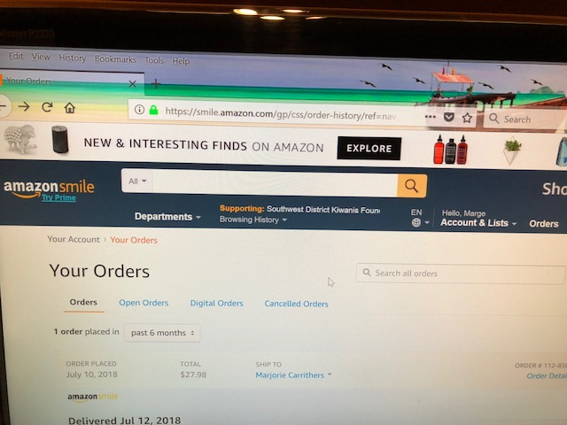
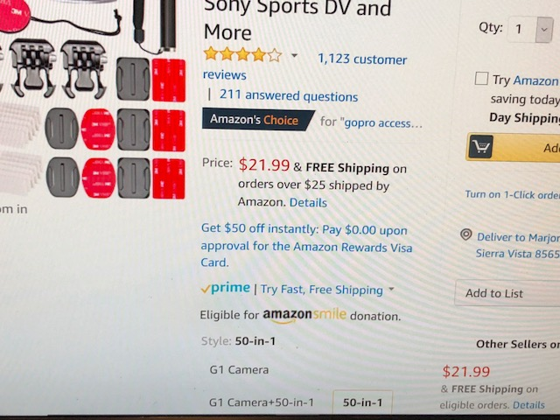
Please choose SWDK Foundation as your Amazon Smile Charity and we get .5%
Step One – Follow link to Smile.amazon.com – and log in
https://smile.amazon.com/ch/23-7393201
Select Southwest District Kiwanis Foundation as your Charity.
Shop in your regular manner – items that quality will say so-

Slide 13
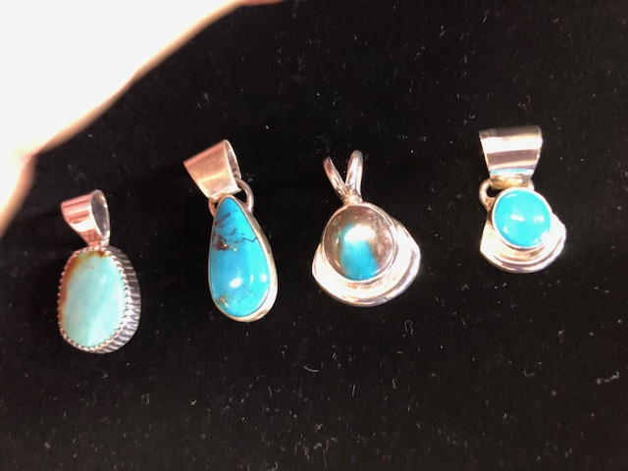
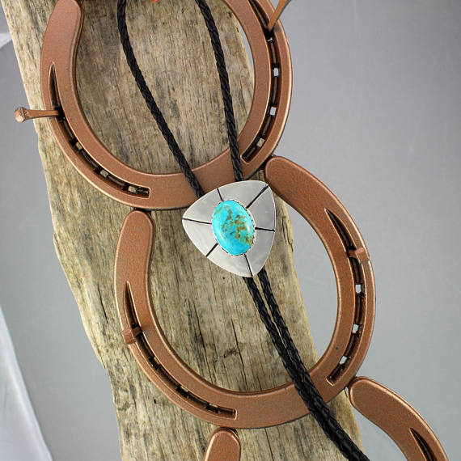
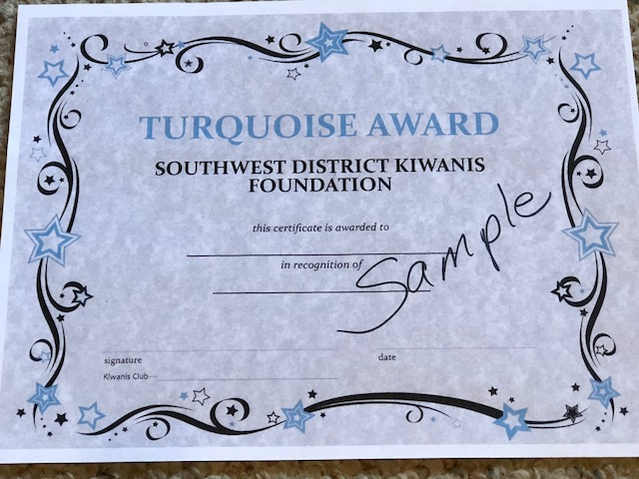
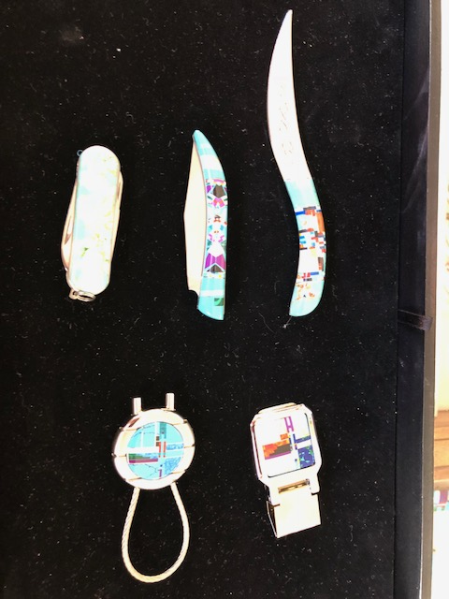
What is New?
More money for scholarships - $4,000
Roadrunner Silent Auction Grant - $1500- due Feb. 1st – to support Youth
Turquoise Award – Certificate and turquoise Jewelry for $650

Slide 14
What is New?
Smile.Amazon.com account set up
Please register your high school students for Key Leader, Feb. 16-18, 2019, links available soon
Thanks to our wonderful 19 Board of Directors and 5 Officers, 4 Ex Officio members- current, future, and past Governors, and our 4 advisors for your service to the Foundation!! You all rock!

Slide 15
Check out our Website and Facebook pages and please “like” our Facebook page
· Website— at https://www.swdkfoundation.org
· Facebook page at Southwest District Kiwanis
Foundation
https://www.facebook.com/swdkfoundation

Slide 16
Thank You for Your Support of Our Foundation- Sustaining Members, Legacy Society, Kachina Recipients, and Blazer and Turquoise Award Recepients!
53 Kiwanis clubs in the southwest district are in our irs group exemption

Slide 17
“We are Family”

