Slide 1
The Energy Sector of Liberia
August 2024

Slide 2
Content
The Energy Sector of Liberia
P.4
Contributions of Development Partners
P.6
Why the Private Sector Needs to Invest
P.8
Opportunities Amidst Challenges
P.10
Necessary Regulations for Investment
P.12
Deloitte’s Commitment
P.14

Slide 3
Ladies and Gentlemen,
It is an honor to be here today to discuss the transformative power of Deloitte in delivering unparalleled support to the power sector, with a special focus on the vibrant yet challenging energy sector of Liberia. Our aim is not just to highlight Deloitte's capabilities but to emphasize the pressing need for private sector investment and the vast opportunities that lie ahead in Liberia’s energy landscape.
Deloitte globally is a leading provider of professional services to electric power companies and electric and gas utilities. We are the market leader in services to independent power producers and serve many of the largest regulated utilities.
Deloitte offers industry-tailored auditing, tax, consulting, and financial advisory services, as well as over 15 dedicated service lines to the Electric Power industry, including energy trading, regulatory services, e-Business, risk management, environmental liability, mergers and acquisitions, project finance, operational optimization, IT systems, structured finance, carbon trading, transaction due diligence, and valuation services. Deloitte’s work under Power, Utilities and Renewables falls under Deloitte’s broader industry classification of Energy, Resources, and Industrials.
Eunice Biritwum

Slide 4
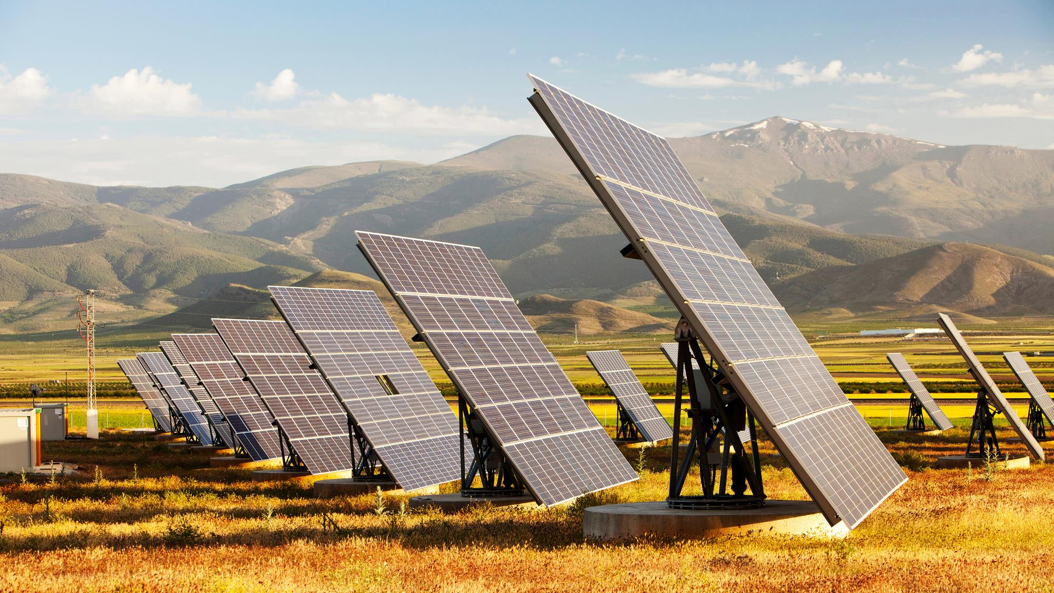
The Energy Sector of Liberia

Slide 5
The Energy Sector of Liberia
Liberia, a nation rich in natural resources and human potential, faces significant challenges in its energy sector, with limited access to electricity and heavy reliance on traditional biomass and imported fossil fuels. Despite recent progress from less than 2 percent in 2010 to 31.8 percent in 2022 according to the World Bank, access to reliable and affordable electricity remains limited. This lack of access hampers economic growth, social development, and overall quality of life.

Slide 6
Contributions of Development Partners

Slide 7
Contributions of Development Partners
Over the years, development partners have played a pivotal role in Liberia’s energy sector:
1
2
3
1.Infrastructure Projects
2.Capacity Building:
3.Policy Support
Organizations like the World Bank, EU, IFC, GEF, UNDP and the African Development Bank have funded major infrastructure projects, improving generation, distribution capacities, expanding energy access
Various programs such as the recent USAID West Africa Energy Program of which Deloitte was the implementing agency, IRENA, AfREC, have been initiated to build local capacity, ensuring that the skills and knowledge required to manage and maintain energy infrastructure are developed locally.
Development partners such as USAID have also provided support in energy sector reform, policy formulation, creating a conducive environment for sustainable energy development
These international agencies have contributed to Liberia's energy sector development through funding, technical assistance, and capacity-building programs, helping to address energy access, renewable energy, and energy infrastructure challenges.

Slide 8
Why the Private Sector Needs to Invest

Slide 9
Why the Private Sector Needs to Invest
The government of Liberia, alongside its development partners, has laid the groundwork for progress, while international agencies are indeed playing a crucial role in supporting Liberia's energy sector. Despite these contributions, the journey towards a robust energy sector in Liberia is far from complete. The private sector’s involvement is crucial to bridging the gap between current capabilities and future needs. It is imperative for private investors to step in, leveraging the foundation laid by development partners to create a resilient and dynamic energy sector. The magnitude of the challenge calls for robust private sector participation. The private sector contributions are still essential for several reasons:
1.Capital and Expertise: The private sector brings in much-needed capital and technical expertise, driving efficiency and innovation in energy projects
.
2.Sustainability Private investments ensure sustainable development through competitive practices and accountability.
3.Job Creation: Investments spur economic activities, creating jobs and fostering local talent.
4.Economic Growth: Reliable energy is a catalyst for industrial growth, attracting more investments and stimulating the economy.

Slide 10
Opportunities Amidst Challenges

Slide 11
Opportunities Amidst Challenges
The challenges in Liberia's energy sector present unique opportunities for investors:
1.Renewable Energy:
1
Liberia’s abundant natural resources, such as sunlight and water, offer vast potential for renewable energy projects, including solar and hydropower.
2.Infrastructure Development
There is a significant need for infrastructure development, including grid expansion and modernization, which presents numerous investment opportunities
2
3
3.Off-grid Solutions
Given the dispersed population, off-grid and mini-grid solutions are viable investment opportunities, providing decentralized and efficient power supply

Slide 12
Necessary Regulations for Investment

Slide 13
Necessary Regulations for Investment
To attract and sustain private investment, it is essential to have the right regulatory framework in place:
1.Public-Private Partnership (PPP) Policy:
A robust PPP policy is critical, providing clarity and assurance to private investors. It defines roles, responsibilities, and risk-sharing mechanisms, fostering a collaborative approach to infrastructure development
2.Regulatory Certainty:
Clear, transparent, and consistent regulatory policies are necessary to build investor confidence. This includes streamlined processes for project approvals, tariffs, and incentives.
ITGC Review
3.Supportive Legal Framework:
Laws that protect investments and intellectual property, enforce contracts, and ensure fair competition are essential to creating a conducive business environment.
4.Stable Land Tenure System:
Which would make land rights and access to land predictable and streamlined for power infrastructure projects.

Slide 14
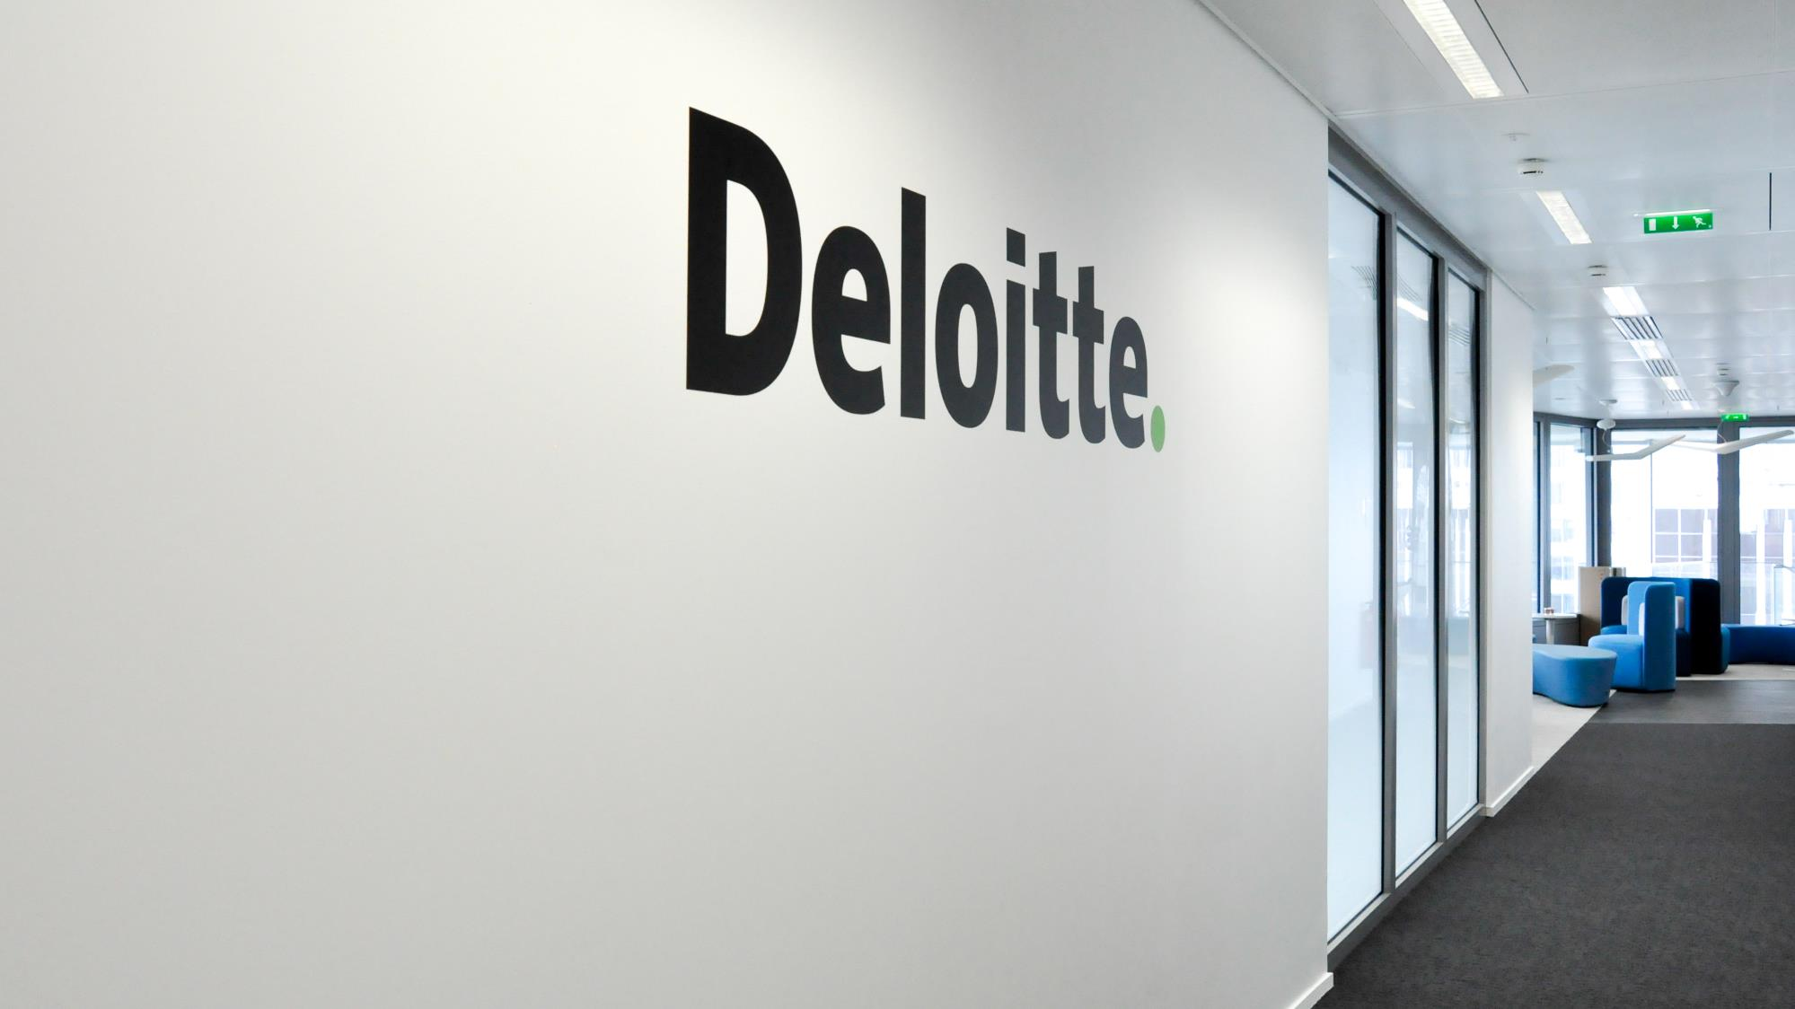
Deloitte’s Commitment

Slide 15
Deloitte’s Commitment
At Deloitte, we are committed to supporting the power sector in Liberia through our extensive experience and expertise. Our capabilities span the entire energy value chain, from strategic advisory and project management to financial structuring and technology implementation. We bring a deep understanding of the local context combined with global best practices, ensuring that our solutions are tailored, sustainable, and impactful.

Slide 16
Deloitte’s Commitment
For example, as part of the just-ended USAID Power Africa West Africa Energy Program, our team at Deloitte was instrumental in
A
Helping Ghana’s Ministry of Energy implement an Inventory Management System that allowed the Ministry and its contractors to better track the release of equipment and material to support ongoing electrification projects.
B
Promoting Productive Uses of Electricity in rural farming communities in Northern Ghana through accessing grants for equipment such as solar water pumping systems which helped local agri-businesses to scale up their production and engage more female small-holder farmers in sourcing raw material for processing.
C
The Deloitte team’s design and creation of the ready-board tool helped to reduce electrical wiring costs
D
Ghana’s Energy Commission being enabled to update the country’s long-term Integrated Power Sector Master Plan as a result of support from Deloitte
E
Providing training and capacity building in project finance principles and techniques to the Volta River Authority’s Projects
F
Assisting 20 strategic Ministries, Departments and Agencies to conduct energy audits that provided recommendations for no-and low-cost energy efficiency interventions to reduce energy usage in the facilities, and then followed up with training on energy management techniques at 5 of the MDAs, thus helping to reduce electricity demand.

Slide 17
Deloitte’s Commitment
These are just a few examples of the capabilities Deloitte’s energy consulting team provide with respect to technical expertise and support to strategic decisions-making, sustainability policies, market and regulatory design, investment decisions, all the while meeting our client’s needs with innovative solutions that provide robust economic prospects, and keeping in mind the need to be at the forefront of the energy transition.
In conclusion, the energy sector of Liberia presents a compelling case for private sector investment. The challenges are significant, but so are the opportunities. By leveraging Deloitte’s capabilities and fostering a collaborative approach with development partners and the private sector, we can drive the transformation of Liberia’s energy landscape, powering a brighter and more prosperous future for all.
Thank you.

