Slide 1


Slide 2

QC Control Process
Place order
Production
Inspection of each process
IPQC routing inspection
Full-inspection
FQC test
Packing
QA random inspection
Warehousing
Check
Customer Dissatisfaction
Shipment
Improvement
Customer Satisfaction

Slide 3
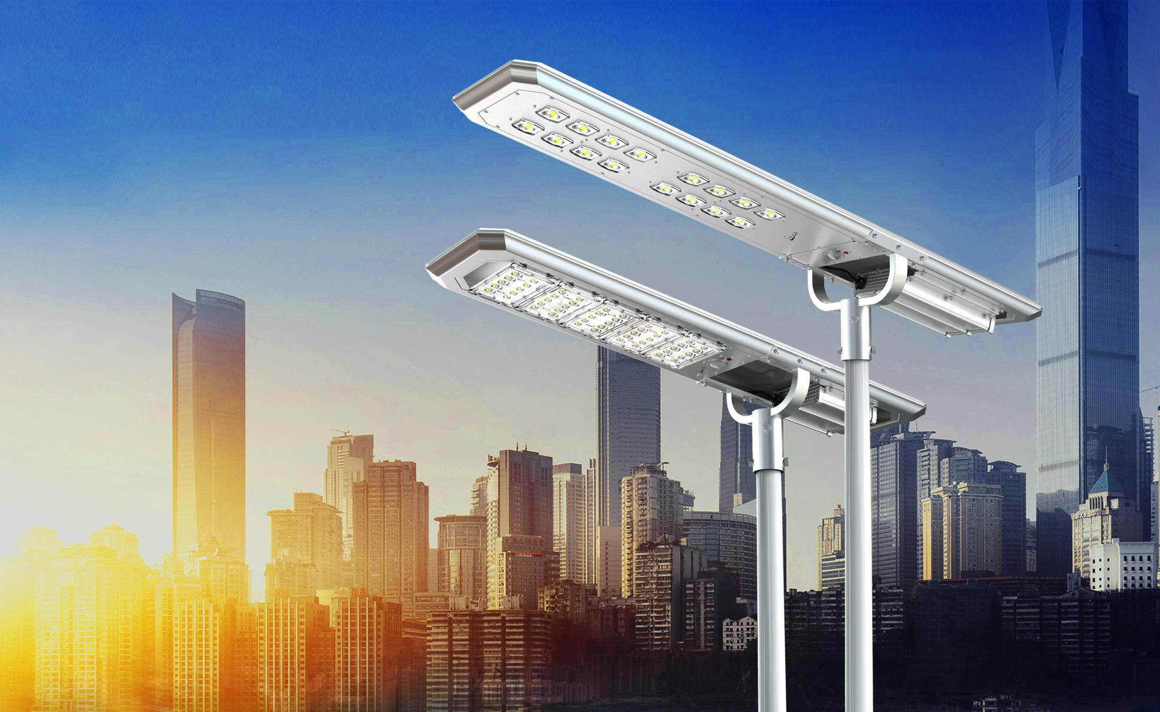
ATLAS Series

Slide 4
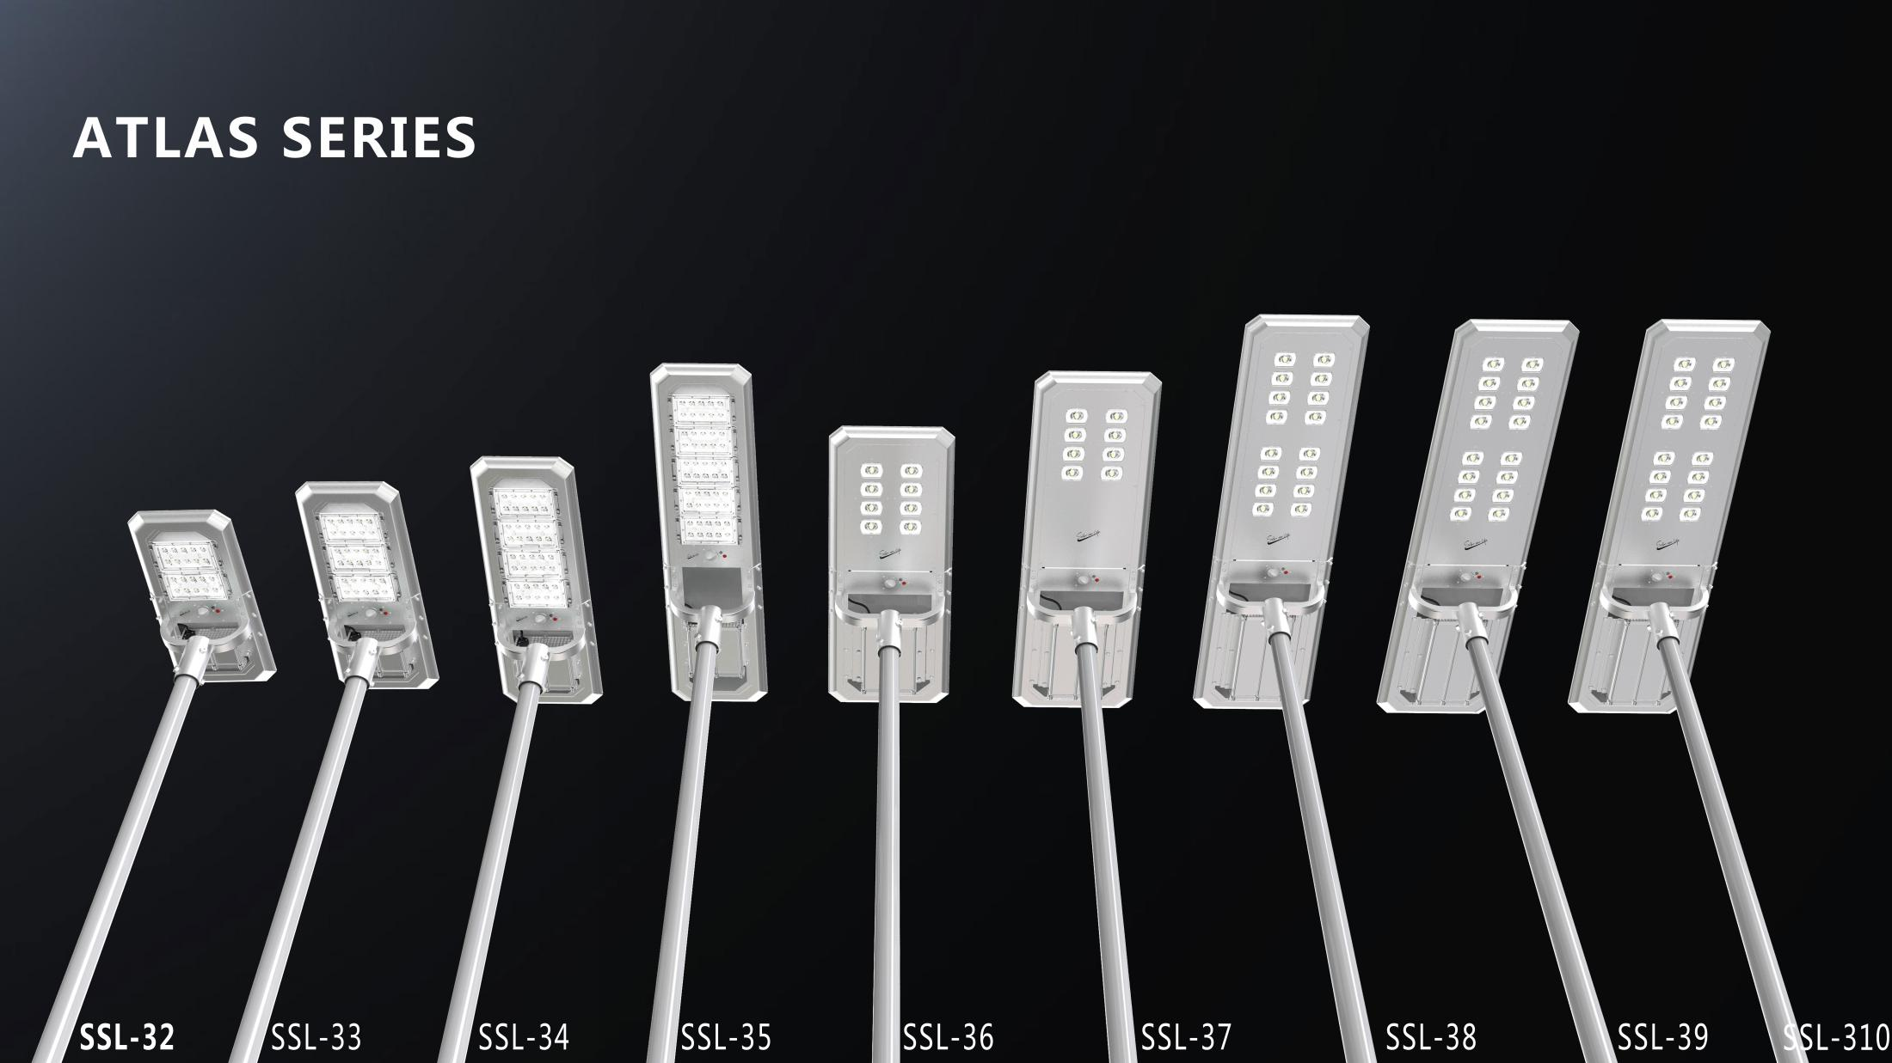

Slide 5
How to select a good solar light product ?
Integrated design Solar light mainly consist of three main components : Battery (life time 2- 8 years ) ,led (over 10 years ), solar panel (over 10 years )
From above , we can know That the main concern is Battery .
Why same kinds battery will have big different lifetime ?
During using.Battery charging life will decay quickly under high temperature ( battery will suffer high temperature from solar ultraviolet light and solar panel heating )-- The "Double high temperature" is the main killer of solar street light, and it is also the disadvantage (shortage) for all solar light . That is mean : A good solar light product . It's not only to have high class battery , but also need Good technology for battery temperature control system .
SRESKY solar street light choose A class Li-ion Battery : 1500 circles (low class battery only 500 circles ) and also do many steps to protect battery from high temperature.

Slide 6



Advantages of ATLAS SERIES

Slide 7

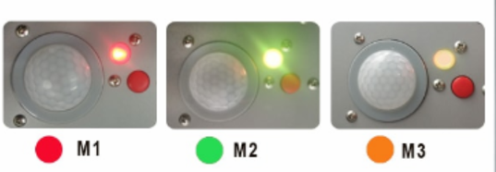
3 lighting mode to choose as below:
M1: 30% brightness +PIR till dawn
M2: 5 hrs 100% brightness + 5 hrs PIR with 25% dim light + 70% brightness till dawn
M3: 70% brightness till dawn
Mark:
M1: this mode with motion sensor all night.
M2: this mode,after first 5 hours ,will be in dim with motion sensor
M3: this mode keep constant 70% brightness all night

Slide 8
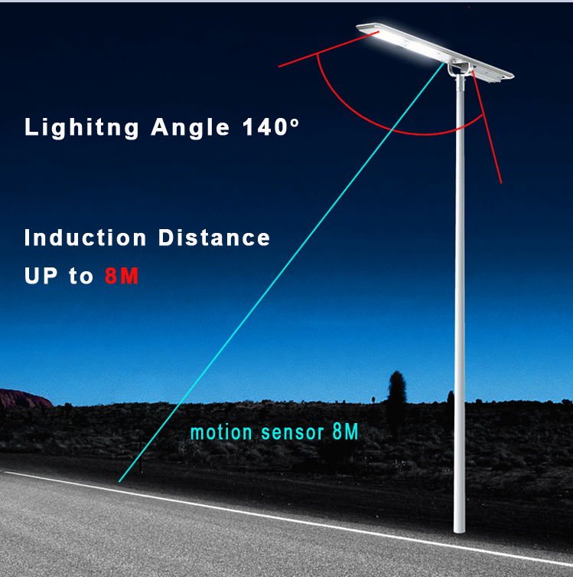
140°lighting angel.
When in M1 mode,when people pass full brightness for 30S. When no people,in dim brightness.

Slide 9
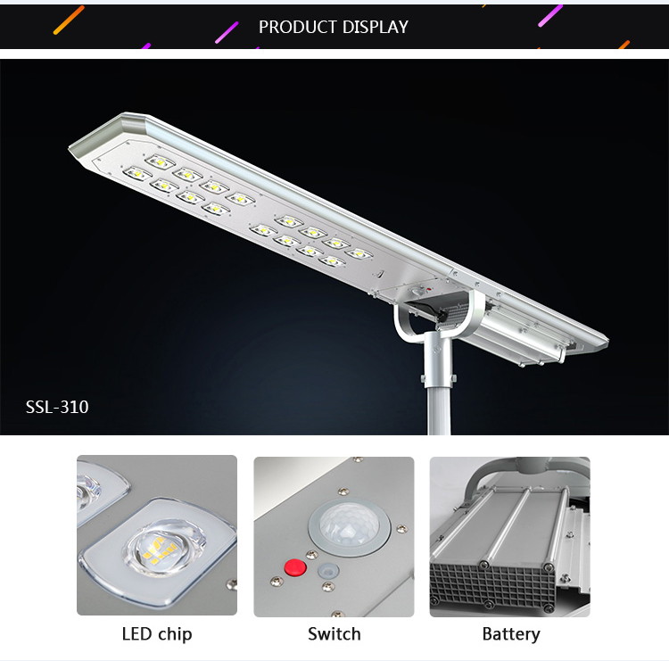
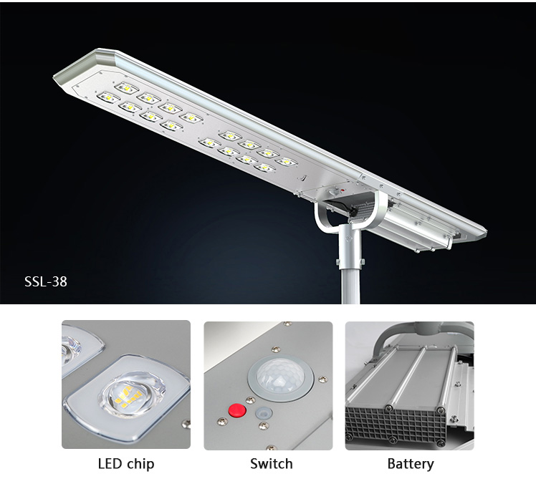
What materials we use for main parts?
1. LED is Osram chip from Germany which is 160lm/w.
2. Solar panel is imported from Taiwan, transfer rate is over 18.5%.
3. Battery is grand A 18650 power Lithium battery, 1500 cycles/ 8-10 years life time,

Slide 10

How to prolong lighting time in Rainy/cloudy days?
What is ALS2.0(patent invent) technology ?
ALS full name: Adaptive Lighting System , it is a new technology developed by Sresky and a solution for short lighting time in solar industry to prolong the lighting time in cloudy / rainy days.As you know, if rainy or cloudy for 4-5days, the battery can not be charged fully,then the light will off after 2-3days,the clients will complain if the lights has any problem.We explore this technology to solve this problem and prolong lighting time to 5-7 nights.
How does this ALS Technology work?
When there is a cloudy/rainy day and lack of enough sunshine charging, ALS technology will make a calculation smartly for the battery capacity then control the led output to save battery energy to ensure the lamp never stop lighting in rainy/cloudy day . The working method similar like frequency-alterable air-conditioner, save energy and prolong the working time.

Slide 11
Your're professional, as you know battery is the most important part for solar lights,it's like the heart for human beings.
But the killer for battery is high temperature especially in your country.
Below is 5 step we do to protect the battery from high temperature damage:
1.Put battery cell in low/high temperature room to select the ones meet our standard.
2.(voltage ,resistance are similar )Then we assemble them together to reach the max1.Put battery cell in low/high temperature room to select the ones meet our standard.
2.(voltage ,resistance are similar )Then we assemble them together to reach the max input.
3.We will put the whole battery pack in high temperature machine(65℃) to check if it work normal.
4.We put anti-heat cotton to wrap the pack to prevent temperature to reach the battery pack.For example, if outside temperature reach more than 50℃, it will take 2-3hours to reach the battery.
5.The last importance point is we use temperature switch between solar panel and battery, if inside temperature more than 50℃, the switch will power off,the solar panel stop to charge the battery.Till the temperature lower than 45, it will connect again.

Slide 12

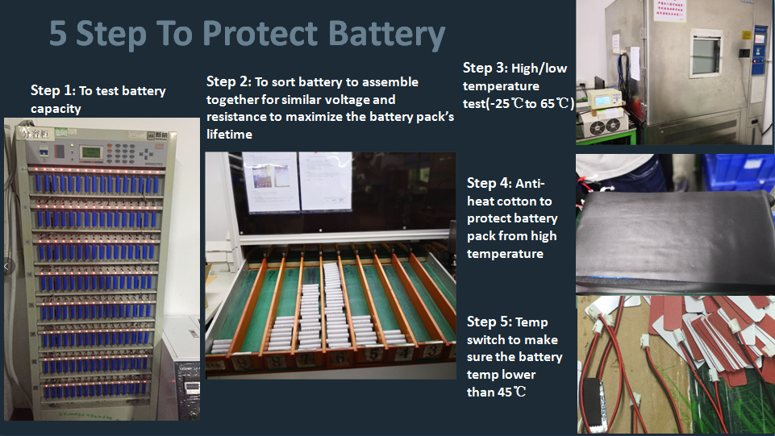

Slide 13
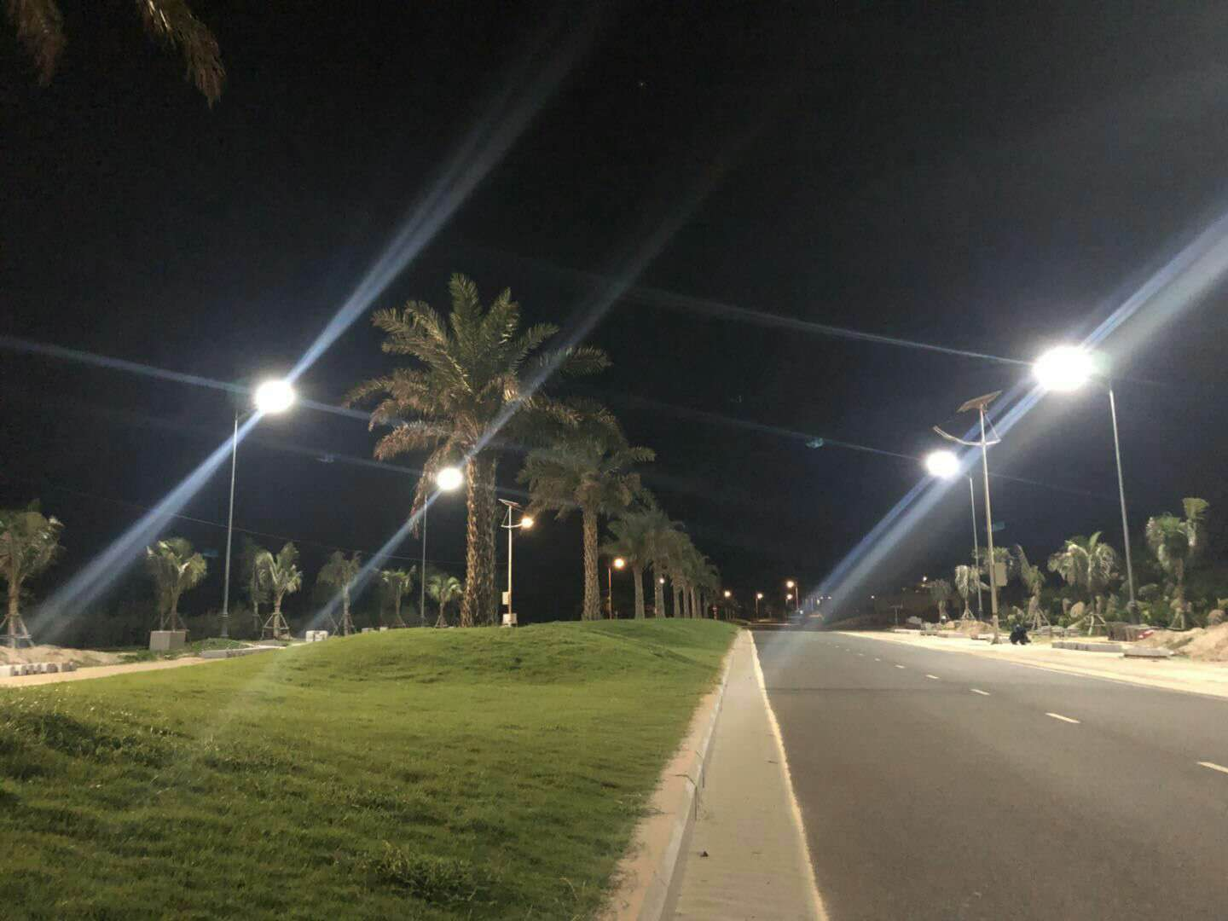
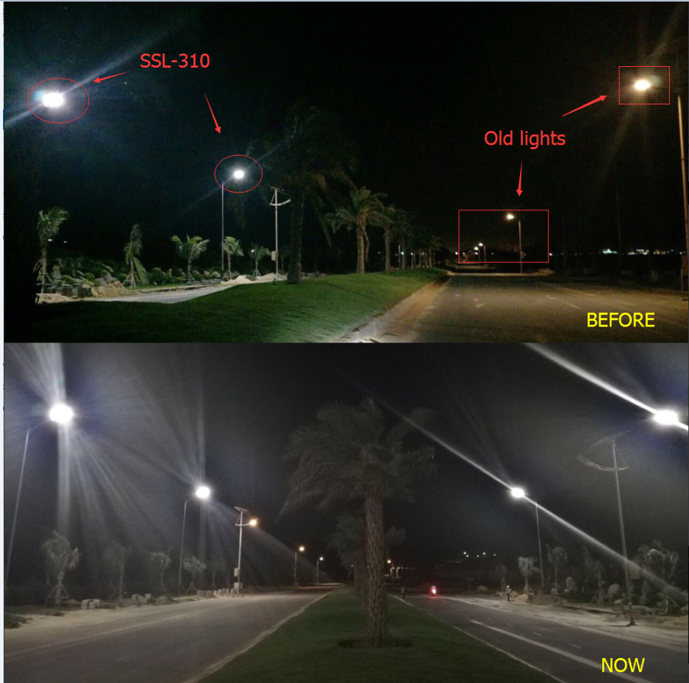
Project case
100W SSL-310 for Vietname project.

Slide 14
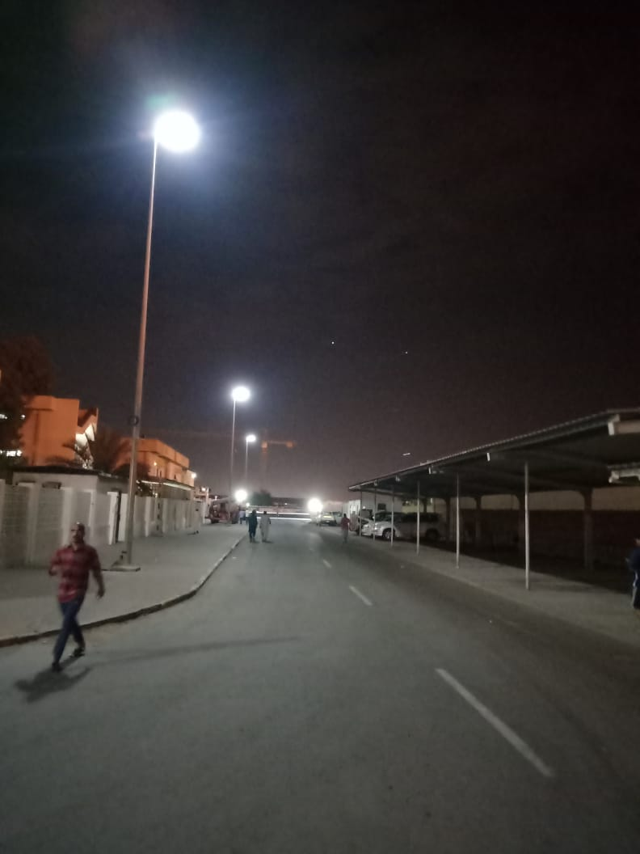
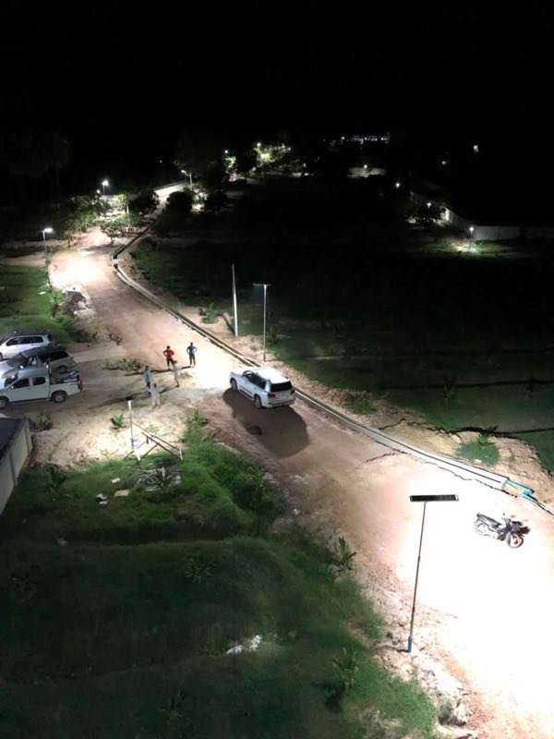
Project in Nigeria 100W SSL-310

Slide 15
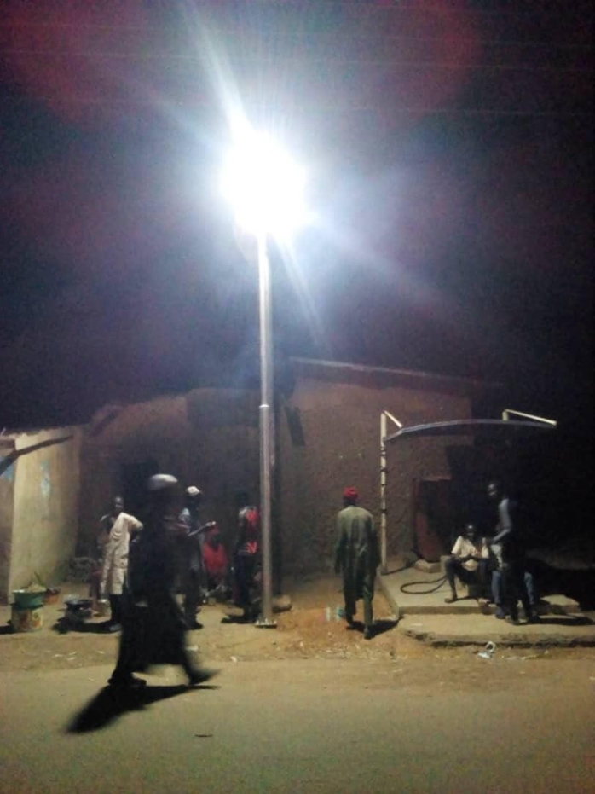
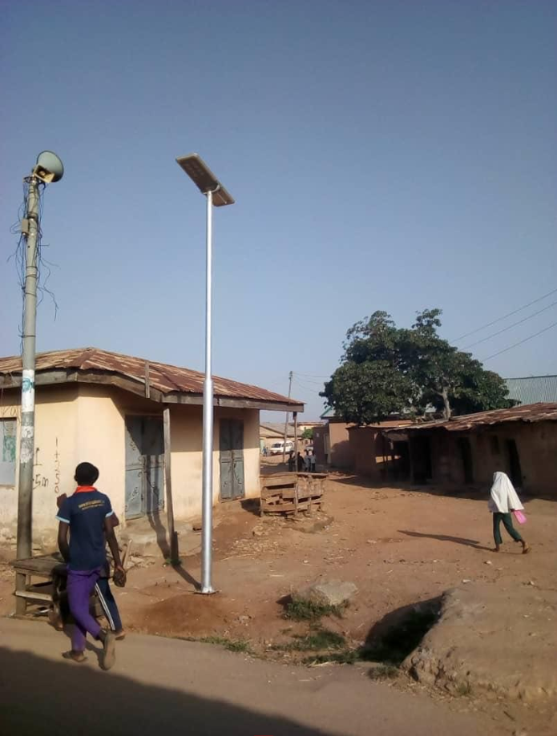
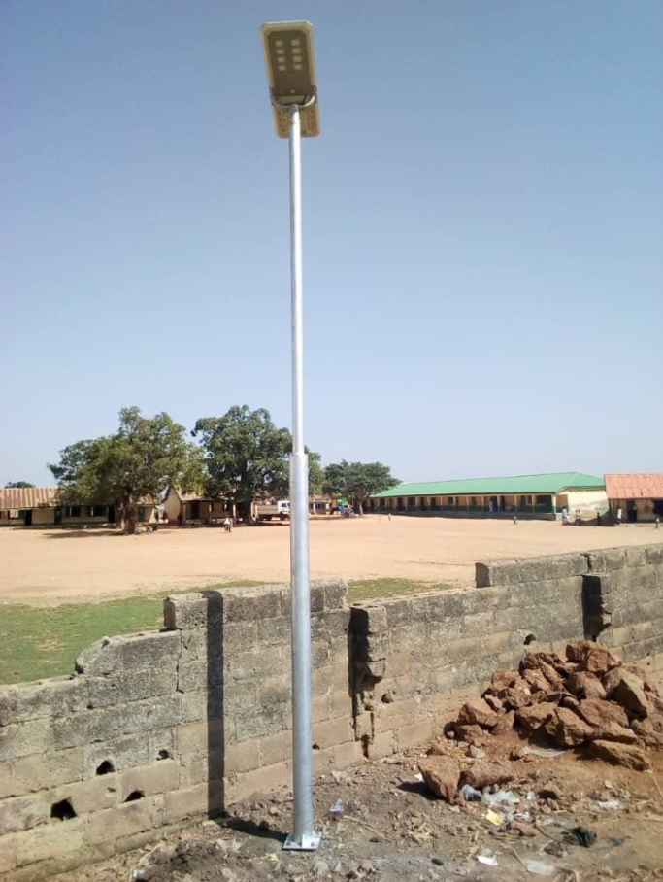
60W SSL-36 in Nigeria project

Slide 16
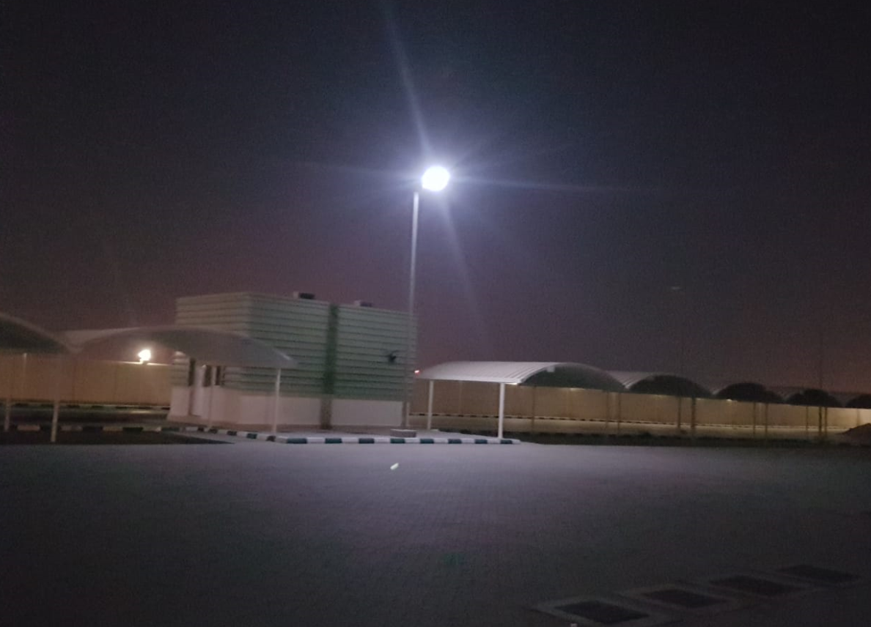
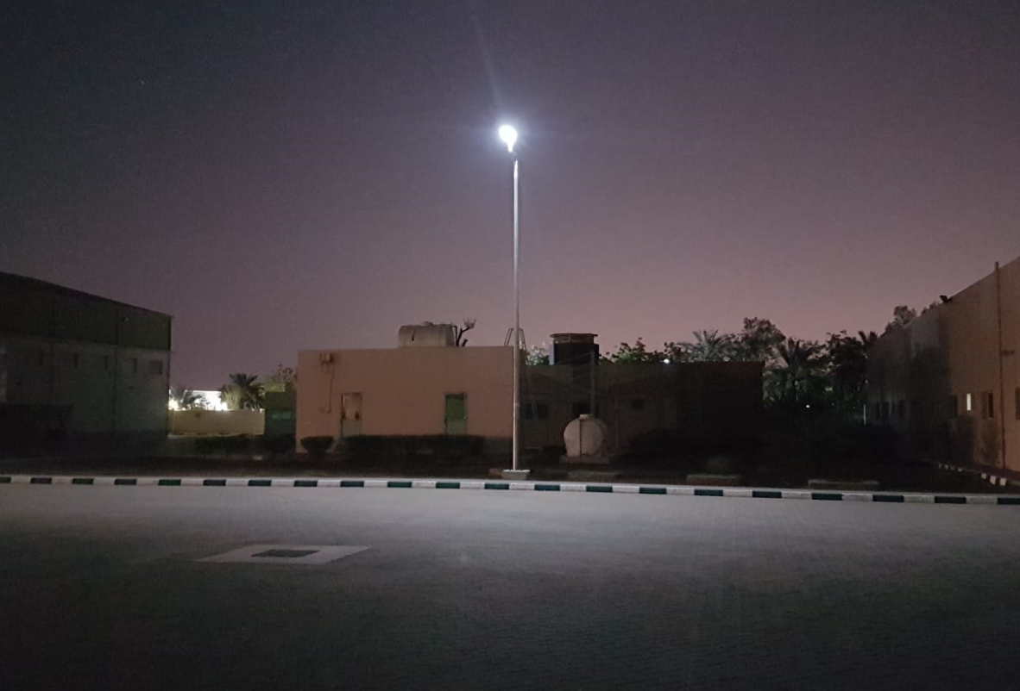
40W SSL-34 in Dubai

