Slide 1

An Introduction
to NABCRMP’s CoachLoop Program
with
NABCRMP CoachLoop Information Session | October 19, 2023
Notes:
Jennifer D. Newton: Good evening, everyone, and thank you so much for joining us today. It's truly heartening to see such a keen interest in our CoachLoop program, which we believe holds immense potential in shaping the future of risk management and compliance through impactful mentorship.
I am Jennifer D. Newton, the Founder and CEO of CoachLoop. I've poured my passion and dedication into this initiative because I firmly believe in the power of mentorship. It's transformative, it's enlightening, and it's one of the best ways we can collectively uplift and guide the next generation of professionals in our field.
Before we dive in, I'd like to mention that today's session is being recorded. For those who'd like to revisit the content or share it with colleagues, the recording and a copy of the slides will be available on our website shortly after this presentation.
Now, let's dive deep into what CoachLoop is all about, and how you, as a part of the NABCRMP community, can benefit from and contribute to its success. I’ll leave some time at the end for Q&A

Slide 2

NABCRMP's CoachLoop Program: Advancing DEI in Compliance & Risk Management
1. Diversify Talent Pools:
Objective: Enrich the compliance and risk management fields with a wider range of perspectives.
Strategy: Actively seek, mentor, and elevate professionals from diverse backgrounds.
2. Inclusive Leadership:
Objective: Create leaders who value and understand the importance of diversity at every organizational level.
Strategy: Offer tailored mentorship programs focusing on inclusive leadership and decision-making.
3. Equitable Opportunity:
Objective: Ensure every member, irrespective of their background, has access to growth and advancement opportunities.
Strategy: Prioritize mentor-mentee matches that bridge experience gaps and build networks for underrepresented professionals.
Notes:
As we move forward, let's delve into the three foundational pillars that underpin our efforts at CoachLoop.
First, we focus on Diversifying Talent Pools. Our objective here is clear: to enrich the compliance and risk management sectors with a broad array of perspectives. Our strategy? We will proactively identify, mentor, and uplift professionals
from various backgrounds, ensuring that our field becomes as multifaceted as the world we serve.
Next is Inclusive Leadership. Leadership is not just about titles or positions; it's about understanding and valuing diversity at every echelon of the organization. Our objective is to cultivate leaders who embrace this ethos. And our strategy?
We will provide specialized mentorship initiatives that emphasize inclusive leadership approaches and thoughtful decision-making.
Finally, we champion Equitable Opportunity. We believe that every member, regardless of their background or journey, should have equal access to opportunities for growth and advancement. To achieve this, our strategy centers on mentor-mentee pairings that bridge experiential divides and foster networking avenues, especially for our underrepresented professionals. These pillars guide us, and with your involvement, we can shape an industry that is diverse, inclusive, and brimming with opportunities for all.
These pillars guide us, and with your involvement, we can shape an industry that is diverse, inclusive, and brimming with opportunities for all.

Slide 3




Why should I join a mentoring program?
Leadership
Development
Career
Development
Diversity &
Inclusion
Mentors report gaining more
leadership identity and skills, as well as more confidence in leading projects the more they engaged in mentoring
Employees who participate
in mentoring programs
are 5x more likely
to advance in pay grade
Mentoring programs boost
minority representation at the
management level by 9% to 24%
and improve promotion and retention rates for minorities and women by 15% to 38%
Notes:
Firstly, Leadership Development. A mentoring program doesn't just introduce you to the basics of your profession. It molds you into a leader, ready to inspire and drive change. Through tailored guidance, you'll gain insights into effective leadership styles, decision-making processes, and how to galvanize teams towards common goals. Mentors report gaining more leadership identity and skills, as well as more confidence in leading projects the more they engaged in mentoring
The second draw is Career Development. Mentoring programs offer a roadmap for career growth. From networking opportunities to sharpening technical expertise, mentors guide you through the intricacies of the industry. They act as sounding boards, helping you align your passions with potential career pathways, and ensuring that you're always moving forward.
And last but not least, the focus on DEI - Diversity, Equity, & Inclusion. In today's globalized world, understanding and valuing diverse perspectives is non-negotiable. A mentoring program with a DEI lens ensures that you're not only equipped to navigate diverse work environments but also to champion inclusivity, creating spaces where every voice is heard and valued.
In essence, joining a mentoring program is an investment. An investment in your leadership potential, your career trajectory, and in fostering a more inclusive professional landscape. The question isn't just "Why should you?" but "Why wouldn't you?"

Slide 4




Why should I join a mentoring program?
Widen your network
Gain a
support system
Get introduced to new ideas
Share and gain knowledge & skills
Notes:
While the earlier mentioned reasons are instrumental, there are more facets to consider when we think about the immense value of mentoring programs. Firstly, joining a mentoring program Widens Your Network. In the professional world, often, it's not just about what you know but who you know. Through mentoring, you gain access to a wealth of connections. It can open doors to opportunities, collaborations, and partnerships you might not have considered or had access to before.
Secondly, it allows you to Gain a Support System. The professional journey is filled with both highs and lows. A mentor serves as a pillar of support during challenging times and a cheerleader during your triumphs. They've been there, and their guidance can help you navigate the complexities with more confidence.
Next, a mentoring program introduces you to New Ideas. In an ever-evolving world, staying stagnant is not an option. Mentors provide fresh perspectives, new methodologies, and innovative solutions that can invigorate your approach to challenges.
And, of course, mentoring is a two-way street. It's an avenue to Share & Gain Knowledge and Skills. While you imbibe wisdom from seasoned professionals, you also bring unique insights to the table, creating a rich tapestry of shared learning.
To sum it up, a mentoring program isn't just an initiative; it's a transformative journey. It enriches you professionally and personally, creating ripples of positive impact in both your career and the broader industry.

Slide 5
Mentor Roles & Responsibilities in the CoachLoop Program
1. 🌱 Nurturing Growth:
Guide mentees in identifying and achieving their professional and personal goals within the compliance and risk management sectors.
2. 🤝 Establishing Trust:
Foster a safe and open environment where mentees feel comfortable discussing challenges, asking questions, and seeking guidance.
3. 📚 Sharing Knowledge:
Provide insights from personal experiences, offer resources, and share current best practices in compliance and risk management.
4. 🔍 Providing Constructive Feedback:
Deliver honest and actionable feedback to mentees, helping them recognize areas for improvement and celebrate their achievements.
5. 🌐 Expanding Networks:
Introduce mentees to relevant industry professionals and networking opportunities to broaden their horizons and build valuable connections.
6. 📆 Regular Check-ins:
Commit to consistent meetings and interactions, ensuring the mentee's growth is on track and addressing any evolving needs or concerns.
7. 🌟 Leading by Example:
Uphold the values and standards of NABCRMP, serving as a role model for professionalism, ethics, and commitment to DEI initiatives.
Notes:
1. 🌱 Nurturing Growth: Guide mentees in pinpointing and realizing their professional and personal goals, particularly in the compliance and risk management domains.
2. 🤝 Establishing Trust: It's essential to foster a safe and open environment where mentees can freely discuss challenges, seek advice, and ask questions with confidence.
3. 📚 Sharing Knowledge: Mentors should willingly share insights from their own journeys, offer valuable resources, and enlighten mentees on the current best practices in compliance and risk management.
4. 🔍 Providing Constructive Feedback: Your role includes giving honest, actionable feedback. This helps mentees identify areas they can improve on and equally importantly, celebrate their achievements.
5. 🌐 Expanding Networks: Introducing mentees to relevant professionals in the industry is crucial. This not only broadens their horizons but also helps them forge valuable connections.
6. 📆 Regular Check-ins: A commitment to consistent interactions ensures that the mentee's growth trajectory aligns with their goals. It's also an opportunity to address any new needs or concerns that might arise.
7. 🌟 Leading by Example: As mentors, always uphold the values and standards of NABCRMP. This serves as a foundation, showcasing a commitment to professionalism, ethics, and the importance of DEI initiatives.

Slide 6

What a Mentor is NOT in the CoachLoop Program
1. 🚫 A Decision Maker:
Mentors provide guidance and share experiences but don't make career or life decisions for mentees.
2. 🚫 A Miracle Worker:
While mentors support growth, they cannot guarantee success or promotions. Effort and commitment come from both sides.
3. 🚫 A Therapist:
Mentors are not licensed therapists. They should focus on professional development rather than deep personal or emotional issues.
4. 🚫 An ATM:
Mentors are not expected to provide financial assistance or fund any endeavors of the mentee.
5. 🚫 A Job Provider:
While mentors can provide networking opportunities, they are not obligated to offer or secure jobs for their mentees.
6. 🚫 A Replacement for Professional Advisors:
Mentors give general advice based on experience, but mentees should seek specialists for legal, financial, or other professional advice.
7. 🚫 Always Available:
Although mentors are committed to the growth of their mentees, they have their responsibilities and might not be available 24/7.
Notes:
What a Mentor Is NOT
1. 🚫 A Decision Maker: While mentors share valuable insights from their experiences, they do not have the authority or responsibility to make life or career choices on behalf of their mentees.
2. 🚫 A Miracle Worker: Mentors offer tools, wisdom, and guidance. Yet, they cannot assure specific outcomes like promotions. It's a shared journey, with effort required from both parties.
3. 🚫 A Therapist: While mentors might lend a sympathetic ear, they are not equipped or licensed to delve into deep-seated personal or emotional challenges. Always consider professional therapy for such matters.
4. 🚫 An ATM: The mentor-mentee relationship is built on mutual respect and knowledge sharing. It isn't a financial partnership, and mentors should not be seen as a source of funds.
5. 🚫 A Job Provider: Although mentors can introduce mentees to their professional circles, they aren't recruiters or job agents. Securing a position remains the responsibility of the mentee.
6. 🚫 A Replacement for Professional Advisors: Mentors offer insights based on their personal experiences. For specialized guidance, especially in areas like law or finance, always turn to a dedicated professional.
7. 🚫 Always Available: Mentors, like everyone, have their commitments — both personal and professional. While they are passionate about mentoring, it's unreasonable to expect their undivided attention around the clock.

Slide 7

Mentee's Roles & Responsibilities in the Coachloop Program
1. 🌱 Active Engagement:
Participate fully, showing commitment and enthusiasm in every mentoring session.
2. 🎯 Set Clear Goals:
Know what you want to achieve through the mentorship and communicate this to your mentor.
3. 🔄 Provide Feedback:
Share with your mentor what's working, what's not, and areas you'd like more focus on.
4. 📆 Punctuality:
Respect the mentor’s time by being punctual for sessions and giving advanced notice if unable to attend.
5. 🧐 Be Open to Constructive Feedback:
Understand that feedback is for growth and professional development.
6. 📝 Complete Assigned Tasks:
If given assignments or tasks, ensure they are completed before the next session to maximize learning.
7. 🤔 Self-reflection:
Continuously reflect on your progress and areas you'd like to delve deeper into.
8. 🤝 Foster Mutual Respect:
Understand that the mentorship is a two-way street. Value and respect the relationship and the insights being provided.
Notes:
as a mentee, you should dive headfirst into the process. Bring your energy to every session!
🎯 Set Clear Goals: Define your path. What do you want from this mentorship? Let your mentor know!
🔄 Provide Feedback: Open communication is key. Discuss what you feel is working and where you need more guidance.
📆 Punctuality: Jennifer, valuing time is crucial. Ensure you're always prompt and notify in advance if any changes.
🧐 Be Open to Constructive Feedback: Take feedback positively. It's a tool for your growth.
📝 Complete Assigned Tasks: Tasks and assignments? They're stepping stones to your learning. Make sure to complete them on time.
🤔 Self-reflection: Look inward often. Assess your journey and identify areas for deeper exploration.
🤝 Foster Mutual Respect: Remember, mentorship is reciprocal. Cherish the bond and the wisdom shared.

Slide 8
What a Mentee Is NOT in the Coachloop Program
1. 🚫 A Passive Participant:
Mentorship is not a one-sided effort; active participation and feedback are crucial.
2. 🚫 Merely a Job Seeker:
The program is for professional growth and development, not just a shortcut to job opportunities.
3. 🚫 Fully Dependent:
Mentees should not rely solely on the mentor for solutions but should be proactive in their own development.
4. 🚫 Entitled to a Mentor's Time:
Respect the mentor’s time and commitments; it's a gift, not an obligation.
5. 🚫 Inflexible:
The journey might require adapting and learning new perspectives; be open to changes.
6. 🚫 Disengaged from Self-Growth:
The primary driver of success is the mentee's own ambition and commitment.
7. 🚫 An Expecter of Immediate Results:
Mentorship is a journey, not a sprint; lasting change and growth take time.
Notes:
What a Mentee is NOT
🚫 A Passive Participant: Mentorship is not merely about listening. Active involvement, discussions, and feedback are essential components.
🚫 Merely a Job Seeker: While mentorship can open doors, it's primary goal is professional growth and development, not just an avenue to job opportunities.
🚫 Fully Dependent: While mentors provide guidance, mentees should be proactive, seeking solutions and pushing their own boundaries.
🚫 Entitled to a Mentor's Time: A mentor’s time is valuable. Respect their commitments and remember that their support is a privilege, not a right.
🚫 Inflexible: Growth often means adapting to new situations, information, or perspectives. Stay open-minded.
🚫 Disengaged from Self-Growth: Success in a mentorship stems from the mentee's drive and commitment to their own development.
🚫 An Expecter of Immediate Results: Real growth takes time. Mentorship is about long-term development, not instant solutions.

Slide 9
NABCRMP's CoachLoop Program Components
Mentor-Mentee Pairings:
Thoughtfully matched pairs based on interests, career goals, and expertise.
Fosters significant, beneficial relationships.
Regular Mentorship Meetings:
Regular in-person or virtual meet-ups.
Discuss career objectives, hurdles, and growth opportunities.
Workshops & Webinars:
Interactive sessions led by industry leaders.
Topics span from ethics to corporate governance in compliance and risk management.
Networking & Conference Events:
Connect with professionals across various sectors.
Gain insights and broaden your network.
Bonus: Complimentary passes to our annual summit & awards event for mentees!
Professional Resources:
Exclusive access to curated industry resources.
Articles, webinars, and online learning tools to support your journey.
Evaluation & Feedback:
Ongoing assessment of the program's impact.
Regular check-ins and surveys to ensure we're meeting needs and adapting effectively.
Notes:
1. Mentor-Mentee Pairings:
At the heart of our program is the pairing of mentors with mentees. These aren't random matches. We thoughtfully pair individuals based on mutual interests, aligned career goals, and areas of expertise. Our main aim? To cultivate enriching and beneficial relationships that can truly make a difference.
2. Regular Mentorship Meetings:
The success of mentorship lies in consistent communication. Whether it's in-person or virtual, regular meet-ups are scheduled to discuss and strategize on career objectives, overcome challenges, and identify potential growth avenues.
3. Workshops & Webinars:
To complement the one-on-one sessions, we host interactive workshops and webinars. These are led by renowned industry professionals, covering a range of topics from ethics to corporate governance in compliance and risk management.
4. Networking & Conference Events:
Networking is vital for career growth. Our program offers exclusive opportunities to connect with professionals across various sectors, allowing you to gain invaluable insights and expand your professional network. And here's a bonus for our mentees: Complimentary passes to our prestigious annual summit & awards event!
5. Professional Resources:
To further support your journey, mentees gain exclusive access to an array of curated industry resources. This includes insightful articles, webinars, and various online learning tools tailored to your needs.
6. Evaluation & Feedback:
Lastly, we believe in continuous improvement. Through ongoing assessments, regular check-ins, and feedback surveys, we ensure the program remains adaptive, meeting the evolving needs of our participants.

Slide 10

Mentor & Mentee Eligibility Criteria
Mentors:
Professionals from the NABCRMP Community: Renowned figures with more than 10 years in risk/compliance.
Aligned with NABCRMP: Understands and supports NABCRMP's mission, vision, and goals.
Membership: Must be an active NABCRMP member.
Mentees:
Students: Those in full-time or part-time university/college education with a keen interest in risk management or compliance.
Early-career Professionals: Those with <5 years experience in compliance/risk management.
Identity: Must identify as Black or African American, including African and Afro-Caribbean origins.
Time Commitment:
Flexible: Time, goals, and meeting frequency are determined by the mentor-mentee pair.
Recommended Frequency: 1-2 hours/month.
Workshops: Mandatory attendance at three professional development workshops during the program.
Notes:
Mentors:
Professionals from the NABCRMP Community: We're seeking renowned figures with a significant experience, boasting over a decade in risk and compliance.
Alignment with NABCRMP's Core Values: Our mentors truly resonate with NABCRMP's mission, vision, and overarching goals.
Active Membership: All our mentors are proactive members of NABCRMP, ensuring they are continually updated on industry shifts and dynamics.
Mentees:
Students: This program warmly welcomes students, whether they are engaged in full-time or part-time academic pursuits. The only prerequisite? A genuine passion for risk management and compliance.
Early-career Professionals: We understand the value of guidance in the initial stages of one's career. Hence, professionals with less than 5 years of experience in compliance or risk management are encouraged to join.
Identity: In line with NABCRMP's vision of inclusivity, our mentees should identify as Black or African American. This encompasses individuals from African and Afro-Caribbean origins.
Time Commitment:
Our program offers flexibility. The frequency and goals of the meetings are decided mutually by the mentor-mentee pair. However, a recommended time allocation is 1 to 2 hours each month.
An integral part of our mentorship program is the trio of professional development workshops. All mentees are expected to attend these workshops during their tenure in the program, ensuring a holistic growth.

Slide 11
Monthly Mentorship Meeting Guide (Recommended)
Goal:
To ensure effective and meaningful interactions over six months.
Meeting Frequency:
Once a month (Total: 6 meetings)
Duration:
60-90 minutes each
Meeting 1: Kickoff & Goal Setting
Welcome (15 mins)
Program Overview (10 mins)
Mentee Career Goals (20 mins)
Mentor Insights (15 mins)
Action Plan Creation & Mentor Agreement (20 mins)
Homework: Mentees: Draft goals/questions. Mentors: Review and prepare guidance.
Meetings 2-5: Progress & Skill Development
Progress Review (20 mins)
Q&A Session (15 mins)
Mentor Guidance (15 mins)
Skill Focus (20 mins)
Action Plan Updates (10 mins)
Homework: Mentees: Implement advice. Mentors: Provide ongoing resources.
Meeting 6: Reflection & Future Planning
Reflect on Growth (15 mins)
Mentee Achievements (15 mins)
Mentor Observations (15 mins)
Future Steps Discussion (20 mins)
Feedback Session (15 mins)
Homework: Mentees: Set new goals. Mentors: Extend support.
Additional Considerations:
Promote transparency in communication.
Offer a platform for continuous guidance.
Uphold confidentiality and respect.
Cultivate a supportive and safe atmosphere.
Notes:
Encourage feedback from both mentees and mentors after every session.
Provide resources (books, online courses, tools) relevant to the mentee's goals.
Ensure clarity in roles: the mentor is a guide, not a decision-maker.
Walkthrough of Slides
Additional Tips
Facilitate any necessary mid-course corrections based on mentee progress.
Plan for potential additional touch-base sessions if needed.
Organize a network event for all mentor-mentee pairs to share experiences.
Include occasional guest speakers for specialized topics.
Ensure that both the mentor and mentee have a clear understanding of the expected outcomes.
Incorporate team-building or bonding activities in the sessions to strengthen the mentor-mentee relationship.
Keep a record of each session's topics and progress to track growth.
Promote the idea of reverse mentoring: where mentors can learn from the mentees.
End the six months with a recognition or certification for successful completion..

Slide 12
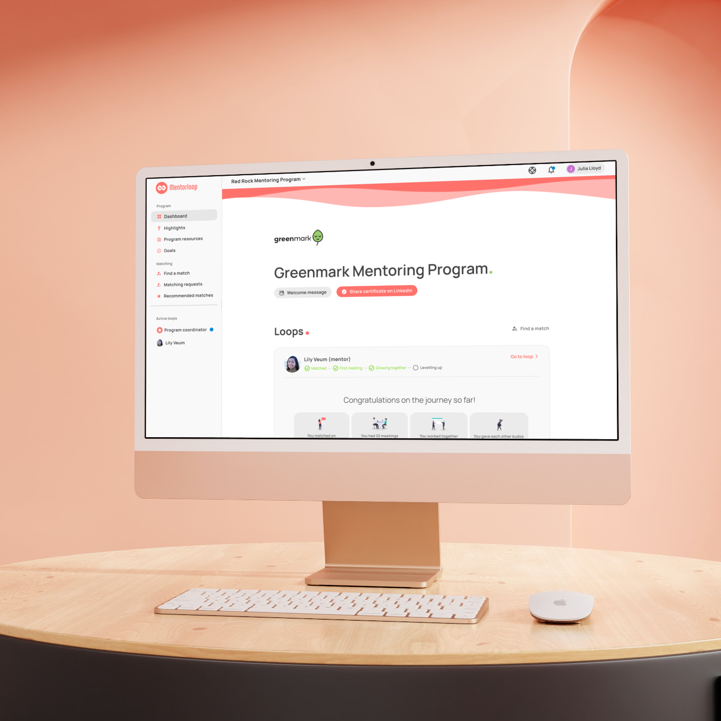
About
Mentorloop is our mentoring software - where the magic happens!
Mentorloop makes it easy to :
  manage and document
your mentoring relationship
  access resources and guidance
along your mentoring journey
Notes:
To streamline this process, we proudly introduce Mentorloop."
Narrator: "With Mentorloop, you're not just getting another tool; you're getting a comprehensive solution tailored for mentoring. Here's how Mentorloop can benefit you."
[Narrator: "First, Mentorloop empowers you to manage and meticulously document every aspect of your mentoring relationship. Track progress, set milestones, and record invaluable feedback – all in one place."
[Narrator: "And that's not all. Mentorloop is packed with resources and guidance tailored for your mentoring journey. Whether you're a mentor or a mentee, you'll find a wealth of information to guide and inspire you every step of the way."

Slide 13

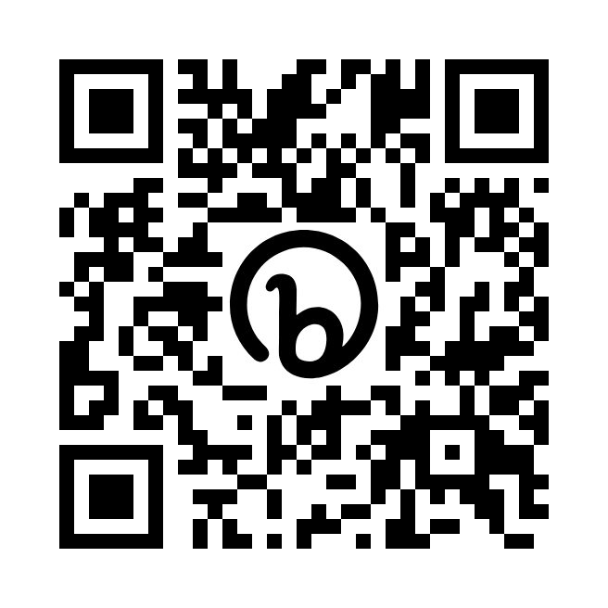
How to join
Step 1:
Go to https://nabcrmp.org/coachloop-mentoring
OR scan the QR code on this slide.
Step 2:
You'll be taken to a registration page where you'll be able to fill out your profile on Mentorloop.

Slide 14
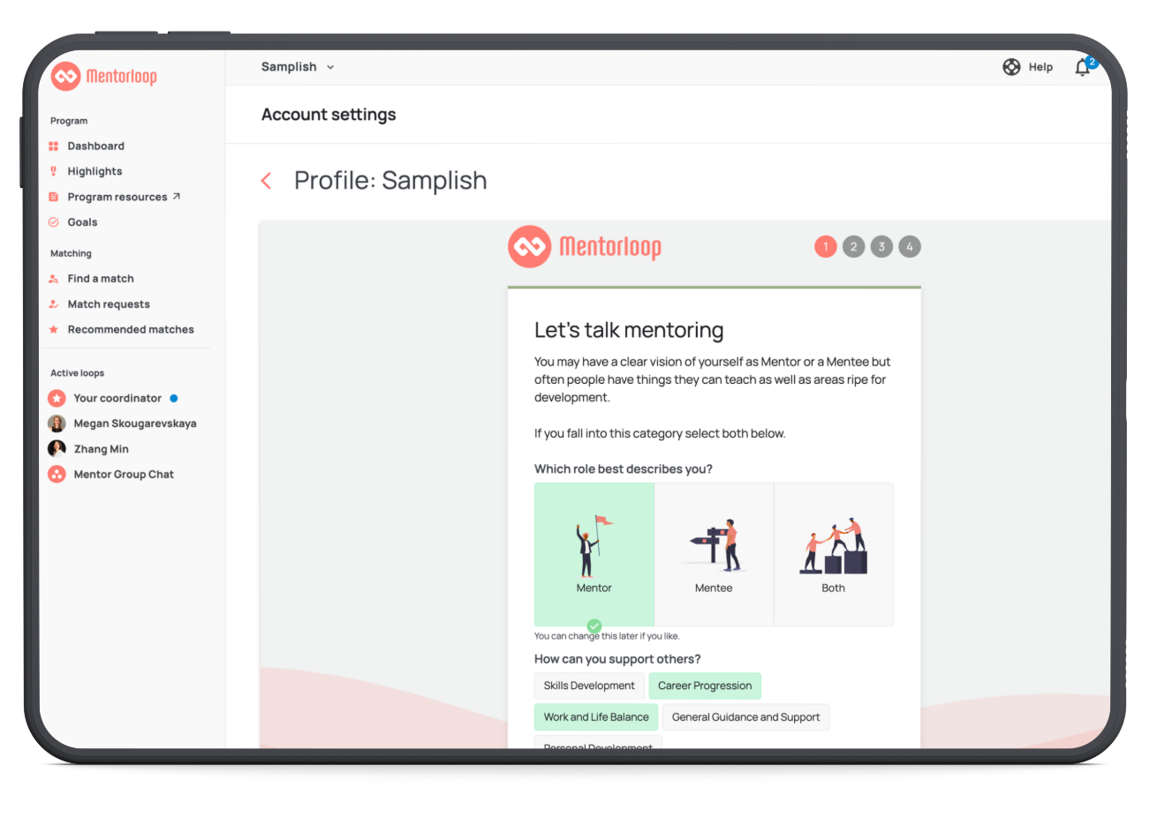
Building Your Profile
  Contact Info
  Role / Job Info
  Skills, Specialties, Goals
Tip: Fill out your profile as best you can as this information is very helpful when it comes to matching.
Notes:
Our matching methodology: Matching Based on Career Development or Professional Growth
We Identify specific career development or professional growth areas that drive the match criteria. For
example, if the development or growth area is focused on building leadership competencies, match
mentees having specific competency gaps with mentors who are strong in those competencies. Using
specific development and growth areas to define matching criteria helps avoid the unwanted: matches
based on personality traits and “similarity” alone – rather than on developmental goals.

Slide 15
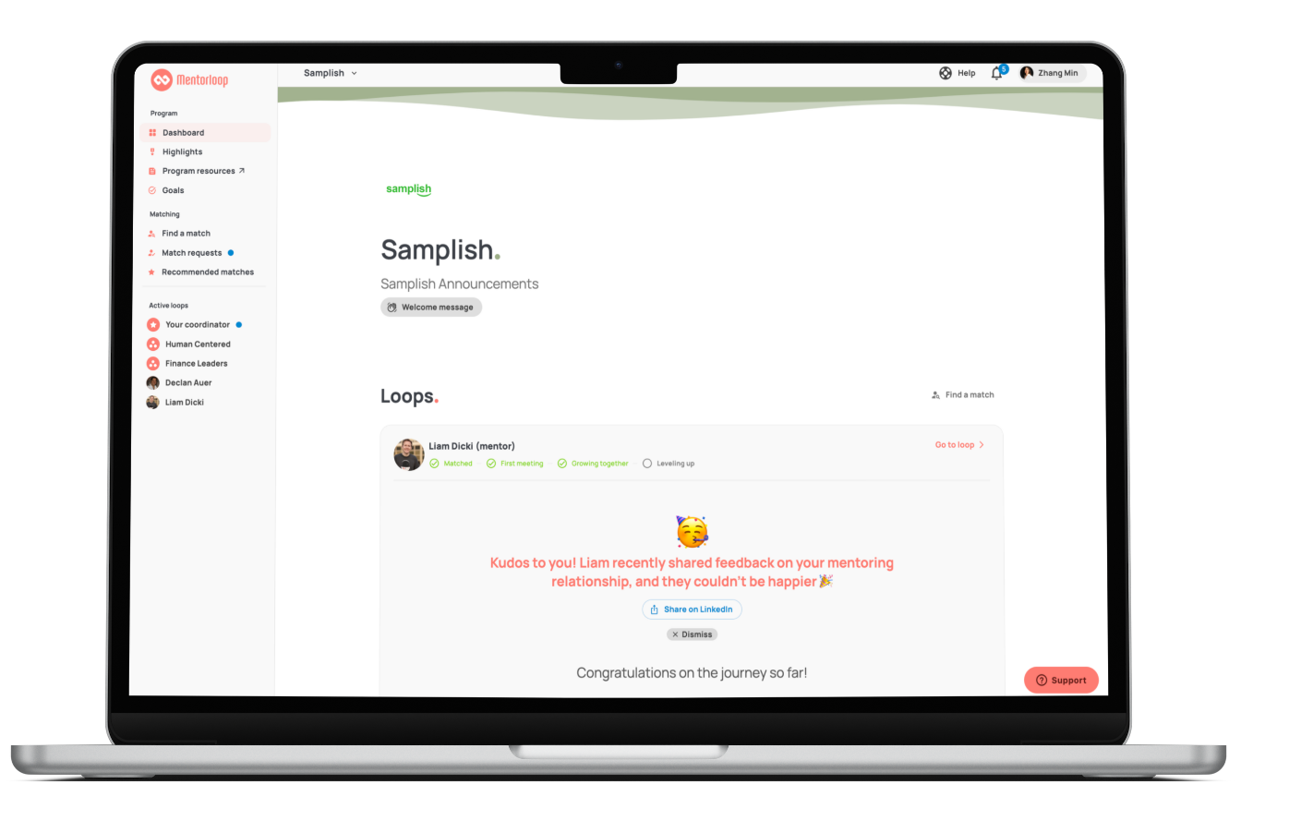

The Dashboard: Your Mentoring Home
Access to the mentoring blog
Chat with your program coordinator
Keep track of your mentoring milestones
Share your achievements on Linkedin
Notes:
At the launch of program, we’ll have a specific training with staff members from Mentorloop who will walk participants through the softward and program

Slide 16
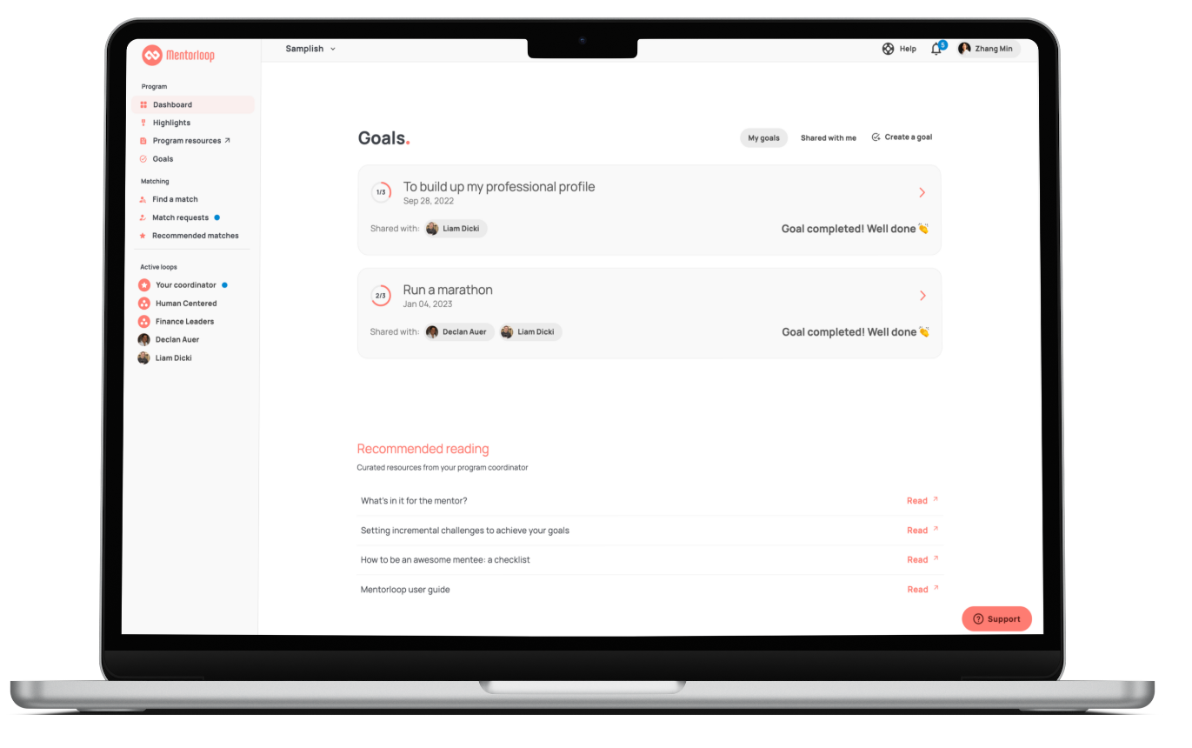
The Dashboard: Your Mentoring Home
Establish accountability for your goals
Recommended readings to help you get started

Slide 17
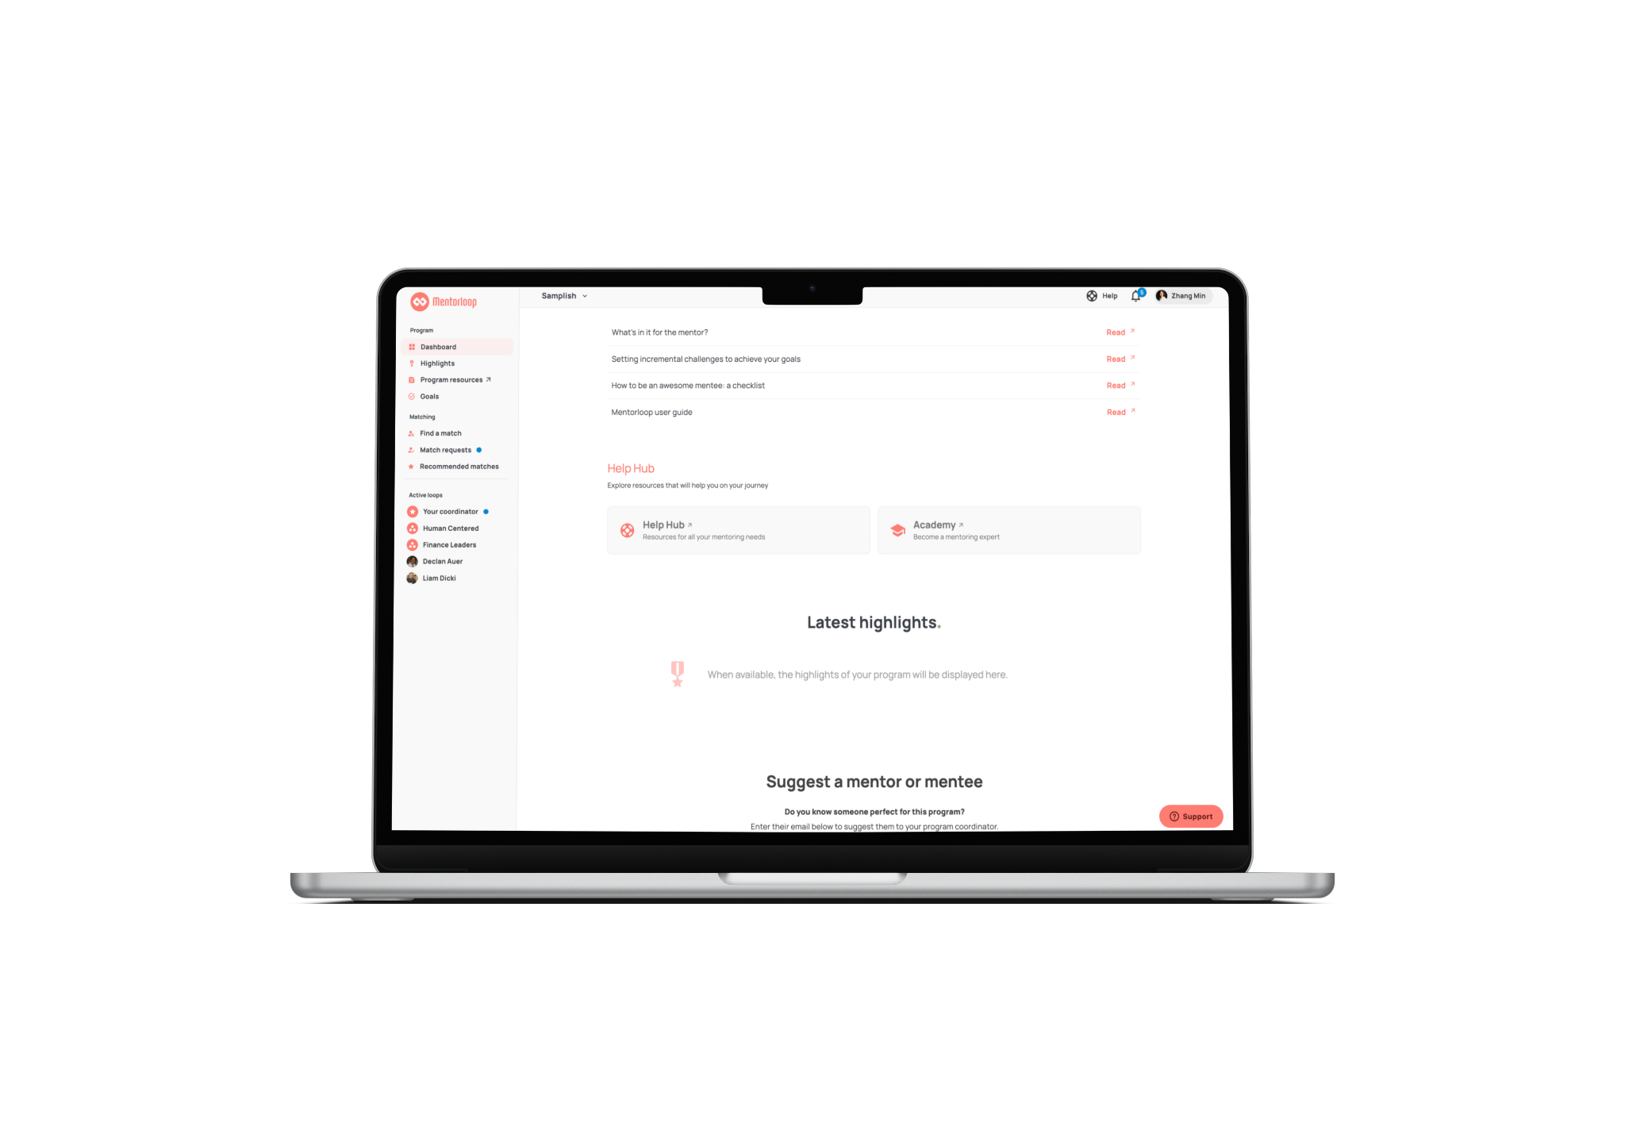
The Dashboard: Your Mentoring Home
Access a treasure trove of mentoring resources
Enhance your Mentoring experience
Feel motivated with other’s mentoring achievements
Having trouble?
Get help here

Slide 18
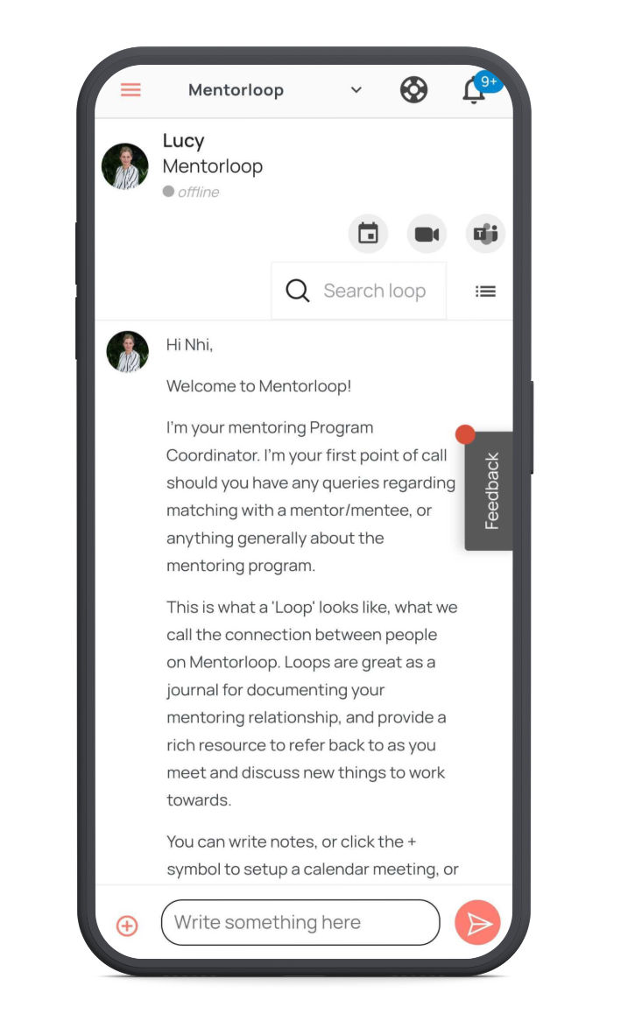
Your Loop Screen
More than a message board
Chat
Share resources and documents
Schedule meetings
Take and keep notes
Share goals and tasks
Notes:
Once you've been matched with someone, you will enter a loop with them. The purpose and power of loops go far beyond introductions. They provide a space for mentors and mentees to document their entire journeys together and keep track of their progress, throughout the entire relationship. A 1:1 loop is where you can record the happenings of your mentoring relationship with your mentor or mentee. Once you are matched with a mentor or mentee, you have access to a private 1:1 loop and have the ability to:
Communicate with one another and record your meeting minutes
Share files
Schedule and launch a meeting
Create and share your goals
Preview your match's profile by click on their icon or name at the top
The beauty of this is that overtime, the loop becomes your own personal online journal that gives you an overview of your mentoring experience to date.

Slide 19

The HelpHub
How to Use Mentorloop
Getting Started
Matching Guidance
First Meeting Tips
Growing Your Mentoring Relationship
and more!

Slide 20
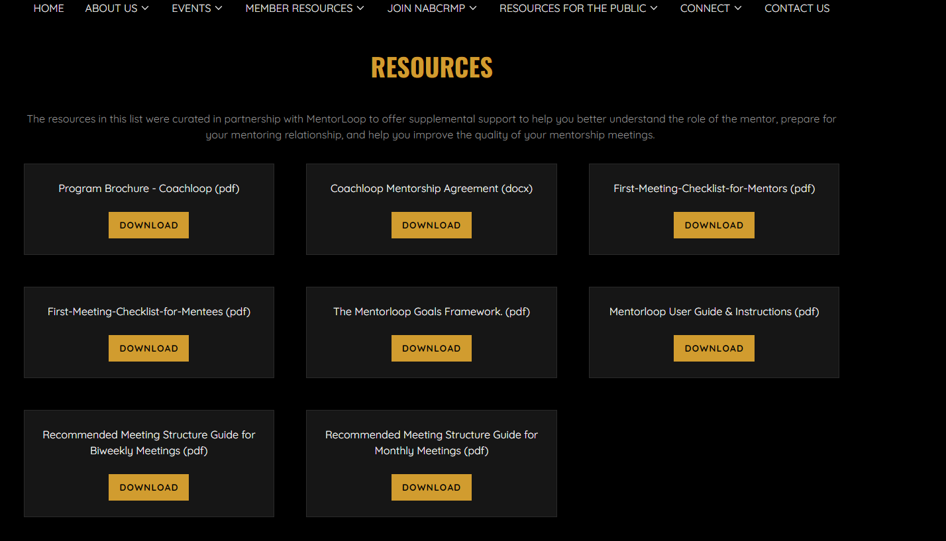

Slide 21

Key Dates for the 2024 Program
10/09/23 – Application Opens for 2024 Cohort
10/19/23 – Interested Mentee & Mentor Information Session
11/30/23 - Mentee / Mentor Applications Close
Week of 12/3/23 – Mentor/Mentee Pairs Released and Notified
1/11/24 – Kick-off Meeting for Mentors and Mentees (required) (via Zoom) (Networking, Ice breakers, review platform and program, Q&A, mentee/mentor schedule meeting frequency, expectations, first meeting date)
1/16/24 – Official start to 2024 Program
7/16/24 – Official end to 2024 Program
7/19/24 - Graduation / Closing Ceremony
Three Professional Workshops/Webinars – Bi-monthly
Mentor & Mentee Meeting Frequency - (no less than one meeting per month). Mentor-mentee pairs will establish their own call schedules.

Slide 22
Your Program Coordinators
Name : Jennifer Newton
Email: Jennifer@nabcrmp.org
Name: Athena Lynn
Email: alynn@nabcrmp.org
Or message me via our 1:1 Loop on Mentorloop!

Slide 23

Your Questions? How can we help?

