Slide 1

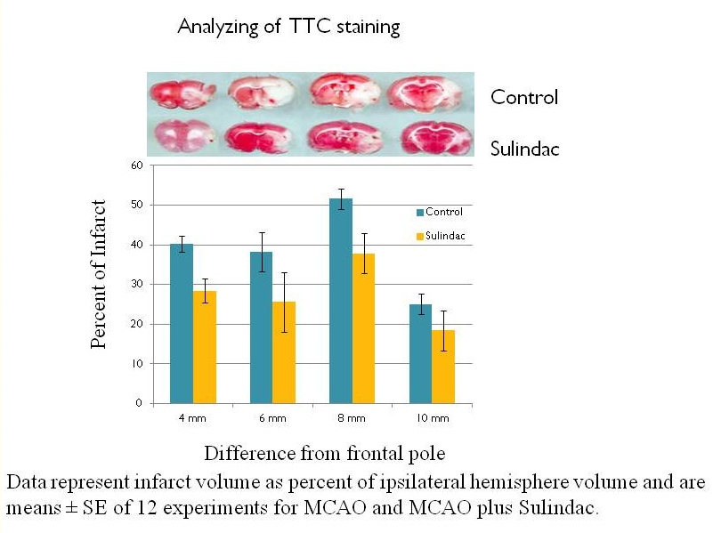
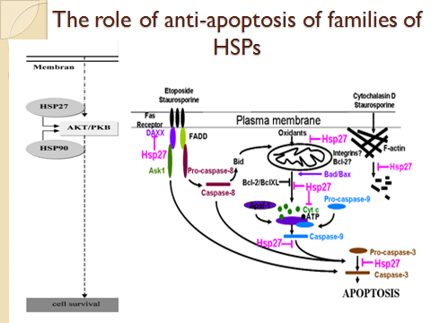
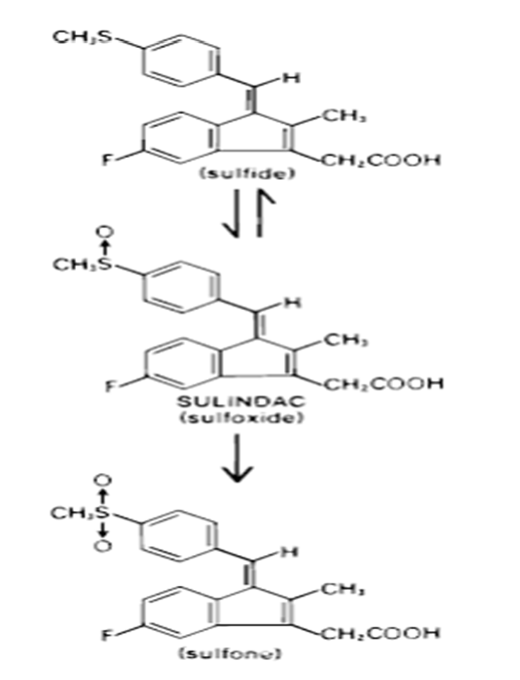
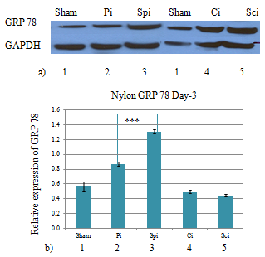
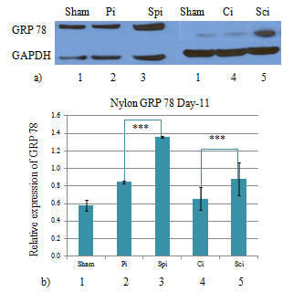
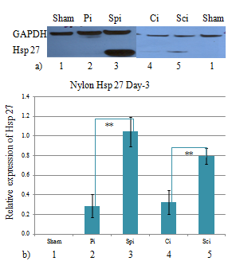
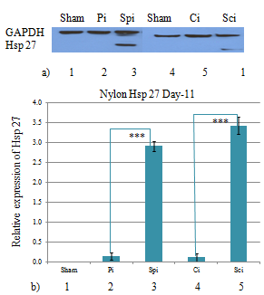
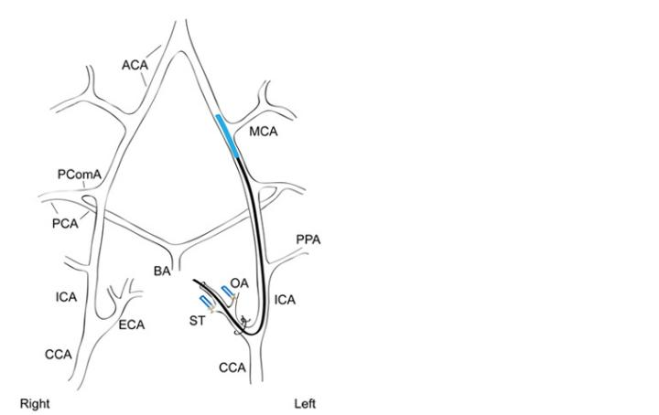
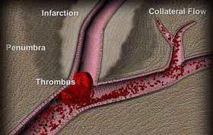
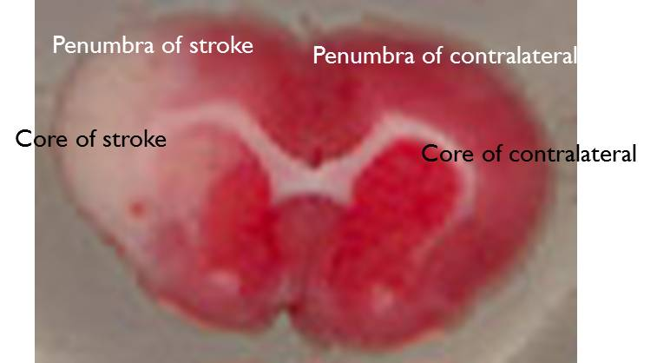
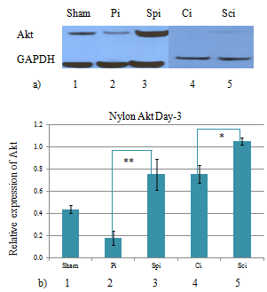
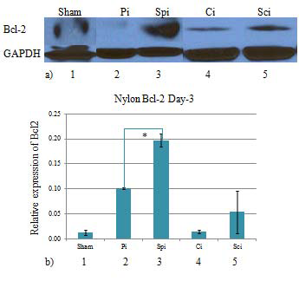
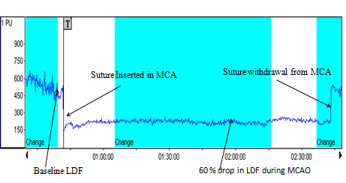
There is a major need for treatments of stroke and at present both experimental and clinical interventions for it have only met with modest success. Our study examined Sulindac treatment would prevent, attenuate or repair ischemia in brain injury and reverse functional impairment in animal model of stroke.
Protective Mechanism of Sulindac Against Animal Model of Ischemic Stroke.
Jigar Modi¹,³, Payam M. Gharibani¹, Zhiyuan Ma¹, Rui Tao¹, Janet Menzie², Howard Prentice¹,³ and Jang Yen Wu¹,³
¹ College of Medicine, FAU; ²Program in Integrative Biology, FAU; ³Centre of Complex Systems and Brain Sciences, FAU.
Background and Purpose –
There is a major need for effective treatments for stroke and at present both experimental and clinical interventions for this disease have only met with modest success. The present studied examined the hypothesis that Sulindac, an anti inflammatory drug (NSAID) treatment would prevent, attenuate or repair ischemia induced brain injury and reverse functional impairment in focal animal model of stroke.
.
Fig8.
Fig1. sulindac and its active metabolites
Fig5.
Materials & Methods
We established an animal model of stroke according to established procedures. Briefly, male Sprague-Dawley rats weighing 250 to 300 g were used in this study. Animals were anesthetized with intraperitoneal injection of Ketamine and Xylazine. In all experiments, body temperature was monitored and maintained at 36.8°C to 37.0°C using a thermometer coupled with an electric heating pad and rectal probe. Focal cerebral ischemia was induced by occlusion of the left middle cerebral artery by a 4-0 nylon monofilament for 2 hours (Fig 2). Cortical blood flow was continuously monitored by a laser-Doppler Flowmetry (LDF). Sulindac was administered subcutaneously (0.2 mg/kg) for 3 & 11 days with the first two injection occurring 2 days before surgery. 3 & 11 days after stroke onset, animals were sacrificed and infarct size in the left hemisphere was measured by 2, 3, 5-triphenyltetrazolium chloride (TTC) staining. Western Blotting on the core and the penumbra tissue of both hemispheres (Fig 2) was employed for analysis of the expression of key proteins involved in apoptosis (Bcl-2) two heat shock proteins (HSP27, HSP70), GRP78 and AKT.
Fig9.
Fig 2. MCAO, Stroke Core and Penumbra
Fig6.
Fig10.
Conclusion
Our data on the MCAO model indicate that administration of sulindac results in decreased infarct size and the analyses points to a role for the molecular chaperone Hsp27, the pro-survival kinase Akt and the anti-apoptotic component Bcl-2 in mediating these protective effects.
Fig7.
Results
TTC analysis of brain slices indicated a decrease in infarct size in sulindac treated animals at 4 mm, 6 mm and 8 mm from the anterior pole. The western results indicated that sulindac induced Hsp 27 protein expression in ischemic penumbra and core on Day 3 & 11. Hsp 27 is a marker of cell stress and plays an important role as a molecular chaperone. There were also significant increases in the protective molecules Akt and Bcl-2 in
ischemic penumbra and core.
Fig 3 A laser Doppler monitoring trace of relative cerebral blood flow during MCAO
ACKNOWLEDGEMENTS
This study was supported in part by James & Esther King Biomedical Research Grant # 09KW-11 and Florida Atlantic University Major Research Theme in Neuroscience Grant

