Slide 1
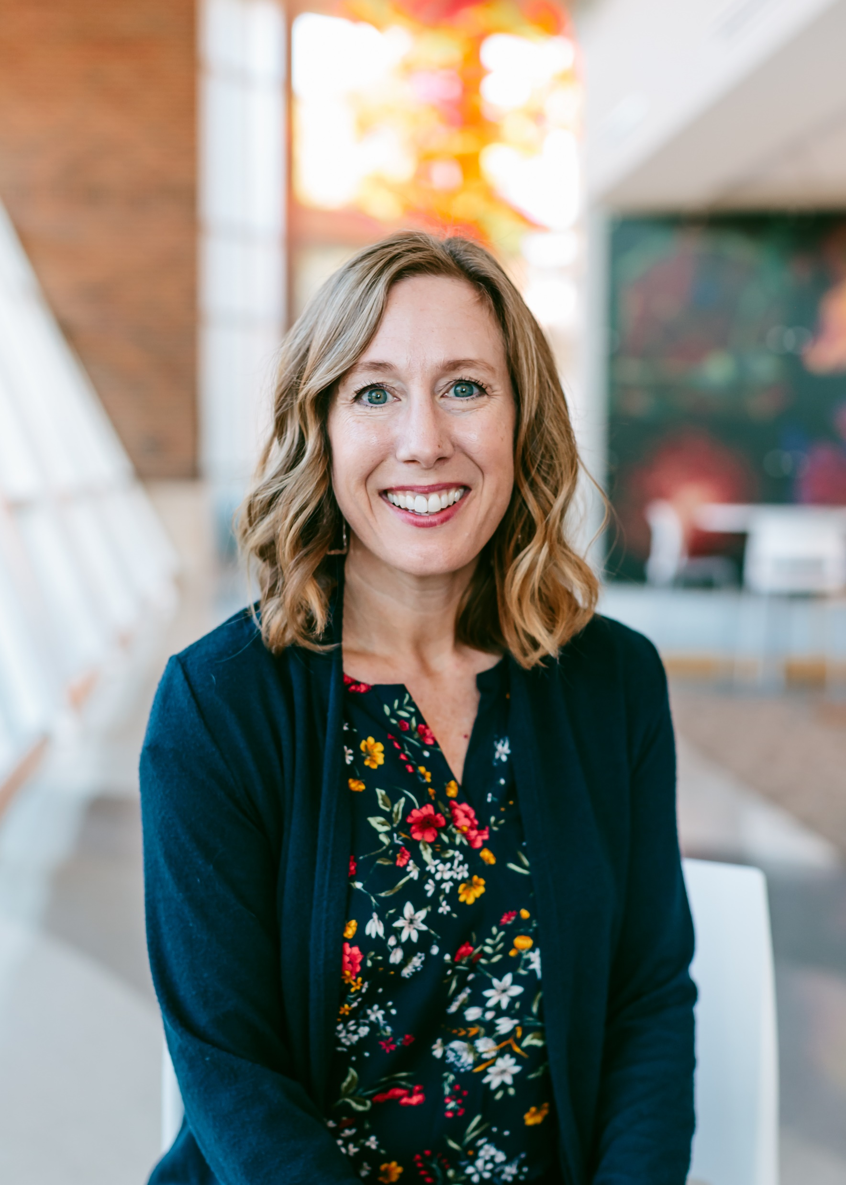
Communication in Supervisory Relationships
Holly Sapp, MA, LPC
she/her

Slide 2
About Me:
Graduated from SNU in 2011
Private Practice until 2016
Health and Wellness Coordinator at Deer Creek Public Schools 2016-2021
2021-present—Renew Counseling @ SNU Co-Director
Notes:
Also husband of almost 17 years and 2 kids (13 and 7☺)
Why do I love supervision? Keeps me in the know, I love consultation almost as much as I love actual counseling, I love the freedom of knowing that we don’t have to be alone as we make counseling decisions like treatment plans and crisis calls.
Why do I feel nervous without communication? **Probably my own anxiety☺.

Slide 3
Communication in Supervision
Almost 50 INTERNS!
6 Candidates for Licensure
What is the key to making internship/practicum and candidacy a success for both supervisor AND supervisee?....

Slide 4
COMMUNICATION!!
Notes:
There’s LOTs of communication, though, depending on….

Slide 5
Roles in Supervision
Administrative
Teacher/Coach
Consultant
Counselor (to a small degree)
Sounding Board
Evaluator
Recorder/Documenter
Empowerer
Advocate

Slide 6
Each of these roles require some level of communication, whether formal or informal.

Slide 7
Administrative
Between Supervisor and Supervisee
The Contract!
Weekly Supervision Log

Slide 8
Contract
Philosophy of Supervision: Supervision can and should be a process whereby clients are guarded from harm and a new the^{r}apist is encouraged through his/her own development in the profession of counseling. As your supervisor, I will be mentor, coach, consultant, administrator, and teache^{r}- You will gain more by investing more, and your role in our supervision will also ^{v}a^{rY} among student, consultant, and staff member. Supervision Process Because this is a crucial time of development for you as a therapist, your developmental process will have a central role in our supervision process. For instance, in your first individual sessions, I will be especially directive in our individual supervision sessions, in order to ensure that you are prepared. However, as our time continues, I should become less directive and our time will be much more collaborative. Our individual sessions will include talk about your own thoughts and feelings about your clients, how you are utilizing self-care, and ethical practices. you will meet with me weekly for individual supervision at a time determined jointly by you and me. There may also be times when you and other candidates for licensure meet with me for group supervision. This can be helpful for your growth as a therapist and these times are to be determined as we go throughout the process. Evaluations Evaluations will take place continually throughout your time as a supervisee, both formal and informal. Every six months, we will meet and intentionally review your growth. You will also have opportunity to evaluate me as a supervisor! You will be evaluated on your growth in the areas of: • professionalism (promptness, keeping up with notes, etc.) • records • development of theory/conceptualization • ethical practices

Slide 9
Contract
You will evaluate me in the areas of: • professionalism • ethical practice • knowledge of best practices ' helpfulness Confidentiality The same ethical and legal principles of confidentiality that apply to our clients apply to you as an intern or candidate. Your confidentiality and your clients’ confidentiality is a prioritY to our Health and Wellness Program. However, just like with clients, there are limits to our confidentiality in supervision. These are reasons I would share information about our sessions with someone else: • You sign a release for information to be exchanged with someone else' • You or your client is deemed to be at risk for harming self or others. • Reports/suspicion of child abuse or abuse of a vulnerable adult. • Records are required by law to be released. • it is necessary to defend myself against legal action or formal complaint thªt Yo^{u} or your client makes before a court or regulatory board. I keep a written record of our supervision sessions together, and the same stand^{ar}d^{s} apply for written notes as our face-to-face interactions. Please know that since this is a training time for you, it is helpful and ethical fo^{r} Y^{our} supervisor to consult with other professionals. If it seems beneficial to consult about something you and I have talked about in a supervision session, identifying information will not be released; we will only discuss case particulars. Crisis As your individual supervisor, I am available 24/7 for consultation purposes. My cell phone number is listed above, as well as my email. It may be beneficial to speak with your onsite supervisor first in the event of an immediate crisis, but please call me each time/ even if you have already spoken with someone else in order to confirm what actions have been taken. your Contribution As one half of the individual supervision process, your active participation is vital! My hope is for you to benefit from this supervisory relationship: your feedback is desired and welcomed on a regular basis! As your supervisor, I am available to you at any time for internship related concerns. Please make use of my email and phone! Due Process
.
Notes:
Finally, the thing everyone’s worried about—money! Let your supervisee know what to expect in terms of charges!

Slide 10
Supervision Log
SUPERVISION LOG
Supervisor:
Supervisee:
Date:
Meeting Room:
Time:
Methods Used:
☐ Self-Report
☐ Process Notes
☐ Casenotes
☐ Digital Recording
☐ Other:
Interventions Used:
☐ Cathartic (elicit affective reactions)
☐ Catalytic (encourage self-exploration or problem-solving)
☐ Supportive (validate the supervisee)
☐ Prescriptive (giving advice; making suggestions)
☐ Informative (providing information)
☐ Confronting (noticing discrepancies between/among supervisee feelings, attitudes, behaviors)
☐ Conceptual (helping supervisee link theory to practice)
☐ Other:
Themes/Major Topics:
Goals for Next Supervision Session:
Notes:
Just like an individual counseling session, I want to keep notes! I ask about who my supervisee is seeing (basic list of first names or initials—I don’t need full names or ID info), basic info—age, grade, presenting problem
Add main topics—specific case? Treatment planning? Plans for future? Hours logs?

Slide 11
Evaluating Case Notes
From Supervisor to Supervisee
What do I look for?
Succinctness of notes
Tips I can give—too much/too little?
What’s happening in session?
Have I missed anything in our supervision sessions?
Are we on the right track diagnostically?
Notes:
Even though it’s not technically required by the licensing board (it doesn’t ask if you’ve signed all notes on the 6 month evaluations), it’s really helpful to your supervisee!

Slide 12
Informal and As Needed Communication
From Supervisee to Superviser
Crisis
Contact Notes
General Updates
Notes:
If I’m a teacher/coach/mentor/admin, those are tough without knowing what’s going on in a supervisee’s life and practice. Even if it’s not immediate, like a text or email, they can put it in their notes.

Slide 13
Crisis Communication
Every. Time.
Immediately.
Includes:
DHS reports
Suicidality or hospitalization
Anything else that alerts your “Spidey senses”
Notes:
One of my favorites—HTB always called me. She would say, “Ms. Holly, my client disclosed abuse. I consulted here on site, then called DHS and I will put that full report in the file. Anything else?” Or she would say, “My client reported suicidal ideation. I consulted onsite, then used the CAMS assessment and called emergency contact and sent them to the hospital. I faxed a 3rd party statement as well. I put all of that in the note. Anything else I need to do?”

Slide 14
Contact Notes
Every. Time. Outside of a therapy session.
Phone calls
Messages left
Emails sent/received
In person consultations (with parents, others involved in client’s life for whom supervisee has a release to exchange information.
Notes:
I can’t tell you how many times, as an onsite supervisor or director, that a client has called and said, “I did a phone screen 3 months ago and never heard anything. Why hasn’t anyone called me?” And it’s so much more fun to answer that call if I can look at the client’s file and easily say, “oh, I see here 3 contact notes that the therapist called AND emailed you and left messages for scheduling.” When the therapist hasn’t left a contact note, I feel grumpy. And the therapist ends up looking like they have poor customer service (along with our center).

Slide 15
Encourager/Advocate Communication
What am I (and HOW am I) communicating to my supervisee?
Do we have a regularly scheduled meeting? Do I honor that time?
Does the supervisee have my full attention during this meeting?
How am I encouraging my supervisee?
Notes:
This facilitates good therapy for your supervisee! If I am doing these things as a supervisor, then supervision becomes a true consultation time. We can conceptualize a problem that a client is having; we can check in with our own feelings; we can get to the deeper stuff of therapy when the above is happening.

Slide 16
RED FLAGS
Notes:
Here are some times when I had difficulty with supervisees, and the red flags that went along with them. And how I handled it! (with consultation, of course!)

Slide 17
The one where they go their own way and do what they want to do
Notes:
Supervisee mentioning as a side note that they told their client’s parent to give the child MiraLAX for their encopresis….
Or finding out later from a client that the child’s former intern therapist went to one of their plays….
No notes on these contacts, no mention of it in supervision beforehand, no text to say, “hey, just want to check in about this…”

Slide 18
The one where they just don’t come in
Notes:
When my supervisee isn’t working during a week, it’s nice to know!

Slide 19
Communication makes a healthy supervisory relationship!

Slide 20
Questions?

