Slide 1
Building Your Website with WordPress.Com
Gary Vaughan PMP

Slide 2
Agenda
Why a Website for a Solopreneur?
General Website Planning Steps
Simple Social Media and Website Options
Moving up to a WordPress (WP) Website
WordPress.Com as a basic, supported WP Option
Format: half Slides, half live WP.COM Demo, and Q&A!

Slide 3
Gary Vaughan linkedin.com/in/garyvaughan/
Since 2007 an IT Contractor at State Dept (WordPress Support)
Past Project Manager in int’l development (USAID, Peace Corps)
MBA and PMP (Project Management Professional)
Volunteer Website coaching of non-profits since 2018
Project Management Day of Service (PMDOS),
Baltimore Techies for Good, and 40PlusDC
RestonUse

Slide 4
Quintin Lake’s Story…
A professional British photographer
His 5 year hike of 11,000 km along Britain’s coast
The Perimeter, a website travel chronicle until 2020
Let’s explore his WP.COM website’s common features…..

Slide 5
The Perimeter’s key features
Inform…..
Rules (his walk’s “scope”)
FAQ (trim text for Web)
Map (dramatic image)
Engage….
Put Me Up (His “Call to Action”)
Blog (Photos, Comments)
Contact (Form + Social Media)

Slide 6
But you have your own Story!
Your website can share your cause or venture
Reasons for a website
A digital “storefront” you control and “brand”
A “hub” for other social media
A broad and deep “container” for your content
Website as a safe space to gradually roll out, express and sharpen your “business plan” for your target market

Slide 7
A WP.COM Example: My WP Resources Site Simple Website: https://wp4evryone.wordpress.com/

Slide 8
One Caveat!...Website as just part of your Marketing Message…
Website*
Hub
Social Media
Real World Marketing
Business Plan
*Why Need a Website in 2021?: Credibility, Control, Searchability

Slide 9
Get Started with Social Media
Focus on 1 of top Platforms
LinkedIn, Twitter, Facebook, Instagram (dynamic!)
Draft profile, engage with community
Lay basis for future connection to website
Explore Freelancing sites
Examples: Fiverr, Upwork
One-off sales – competitive!
Use to Research your “value add” and website brand

Slide 10
Do you really need a website?
Is a site worth the “investment”?
More time than money to set up and maintain
Easier alternatives to a website:
Engage on 1 or more social media platforms
Use a rich LinkedIn profile & network as a starting point on Web
Set up a simple “personal landing page” – About.Me (free or $7/mo.)

Slide 11
Website Investment Curve
Site Maintenance

Slide 12
Website Planning Tips
Target Audience (demographics)
Website models (inspiration)
Navigation (your sketch or outline)
Content (text, images…)
Team (Admin and support)
Design (or redesign…migration?)
Draft a Project Plan*…Timeline
*Trello as free, simple, graphical Project software

Slide 13
Website Design Best Practices
Scanability: Clean and simple...good use of white space, limit 3 Fonts in 3 sizes, few colors...key message (call to action?)
Navigation: Easy-to-find info (Visual Hierarchy), leverage conventions, consistency, accessibility, menus 3 levels, Contact clear
Text: Well written, engaging, varied content for audience
Images: Optimize size, photos, copyright…Quality!
Engagement: Build for traffic on Web, “SEO”, check Google Tools
Testing: check browser/device compatibility

Slide 14
Getting Software to Build your Website
What is a “Website Builder”?
– software to build and host your site
Most offer variety of “templates” to get started
– by type business
But limited ability to customize your site
Most charge a small monthly fee, with limited free trial option
“Proprietary” – so decide on one (difficult to switch!)
PC Magazine Ranking of Websitebuilders for 2021
Examples: Wix, Weebly, Squarespace, GoDaddy, etc.

Slide 15
A Closer look at GoDaddy
A good all round site-builder by a well known name on Web
Pros: has a free version, 100 templates, good support
Cons: limited customization, ecommerce only at higher cost option
See my simple site example, note site-building tips
Also: check out BoomerWorks GoDaddy site
Video tutorials:
How-to guide videos (GoDaddy)
Youtube GoDaddy beginner video
(Mike O’Brien)

Slide 16
Moving Up to WordPress
WordPress a Leader on the Web
Open Source Software + Thousands of Themes, Plugins
42% of Web is on WordPress – Community Support!
WordPress.Org (advanced) vs. WordPress.Com (simplified)
Cost: small monthly charges typically for hosting and support

Slide 17
A WP.COM Solution: Key Features
A simplified, hosted WordPress service by Automattic
Free or small fee ($4-$25/month), depending on Plan
Most Plans have no Plugins, but yes some custom functionality
Theme (layout) options limited to about 200 (and some retire!)
Built-in Security, SEO (Search), Site Analytics (user traffic)
Great Support!: FAQ knowledge base, videos, classes, forums

Slide 18
WordPress.Com:
All-in-One Website Platform
Host Server
[Security]
Web Outreach
[Search + Social]
“Themes” Directory
[200+ Layouts]
Support
[FAQ, Forums]
Site Analytics [“Stats”]
Cost
[Free or $ Upgrade]
WP Core Software, Content!

Slide 19
A Simple, Solopreneur Site My “WordPress for Everyone” website coaching site (WP.COM)
Inform
Free Coaching (how-to graphic)
Getting Started (account setup)
Links (resources, examples)
Engage
Blog (my activities - feedback)
Events (interaction options)
Help Form (coaching request)

Slide 20
Basic WordPress Concepts
Dashboard vs Site View – internal controls vs external public site
Theme – a type, or style of layout
Media – place for images, photos, PDFs
Post – changing content, like a blog post
Page – more static content, like an About page
Menu – a place to organize and display your content on site
Block Editor – use modular blocks to build Pages and Posts

Slide 21
WP.COM Demo (30 min.)
Set up a basic website from scratch
Our case example: Executive Coach consulting to baby-boomers
Pick a Theme (“Hever”)for layout
Input basic website content (placeholders):
Recap Demo Site, and Note Pending work to complete
Title, About, Services, Testimonial, Blog, Contact Form

Slide 22
Work to Finish your Site: A draft To Do List
Learn the WP software (create a test site?)
Content: text, images, graphs, links
Design: layout, color, font...branding!
Social Media Connections: LinkedIn, Twitter, etc.
Tweak design and WP functionality
Add more content: sub-pages, survey, etc.
Segue to consulting: blog tips, white paper
Advanced features: Podcasting, YouTube clips
Check Terms of Use/Plan, Copyright, other legal
Tech Testing and User feedback
Optimize for Search (SEO)...Launch!

Slide 23
WP.COM Support Resources
Get WP Answers on Support (or “?” on your Dashboard, or Google it)
View two WP.COM Videos: Getting Started 101, and Quick Start: Blogging
Learn from WP.COM Community: experts, forums, conferences
Sign up for a free class on Getting Started with your Blog or Website.
See Annex 2 for more details and links on WP.COM support resources
Book: The Checklist Manifesto, how Checklists for your website service areas can ease and improve your consulting deliverables.

Slide 24
Getting More Website Help
Ask Family or Friend as backup Admin…site feedback!
WP.COM Design Help – from less than $500, on up…
Target any freelance help – for ex., Fiverr for logo design
Contract a WP Developer or Designer
Mostly for a complex WP.ORG site (not WP.COM)
Help with a site redesign or migration (see Tips in Annex 5)
Expensive – at least a few thousand $
Sources: Baltimore WP Meetup, WordCamps (free conferences)

Slide 25
Self-Help: Other Theme Suggestions in WP.COM
Shawburn
for a digital marketing firm – but adaptable to your business
Exford
a scrolling home page design, with various template areas to edit your content
Business
another small business Theme and template you can try
Hever
as Demo’d in this session
Or do a simple landing page in WP.COM
Plus… 200 other Themes on this Searchable Directory!

Slide 26
4 Sites for Added Inspiration
WordPress
Minding the Workplace, Blogger: Daniel Yamada, Boston academic, thought leadership (on WP.COM)
worksmart Coaching and Consulting, Dr. Cynthia Howard, Executive Coach/Performance Expert, Tampa FL, Good logo, clarity of coaching deliverables plus social media outreach (on WP.ORG)
Squarespace:
Rachael Hartley Nutrition, Registered Dietitian & Nutritionist, Columbia SC, Services/Pricing and Blog tips
Wix:
3LB Seed Capital, investment company, Italy, lean modern design and imaging
See also Annex 4 for sample U.S. Non-Profit Website links and best practices (Mostly WordPress.Org)

Slide 27
“Live” Edits of my WP.COM site [MINI-DEMO]
My WP.COM coaching site: WordPress for Everyone
Uses “Hemingway Rewritten” Theme
Do “live” editing of site with:
Update listing of BoomerWorks link on my site (a “Page”)
Draft a short Blog article on this just completed talk (a “Post”); and
Show this Post flowing to my Twitter feed.

Slide 28
Your Next Steps
Focus first on your Social Media profile and updates (√ other BW tips)
Plan out a website sketch or outline, consulting any Web models
Consider a simpler sitebuilder, based on 2021 PC Magazine rankings
If WP.COM, create an account and starter site (see my 10 Steps)
Sign up for an upcoming free WP.COM Blog or Website class
Finalize your design, content and social media links…and Launch!

Slide 29
My Conclusions
A website can express, sharpen & brand a Solopreneur business plan
A site as a “hub” for social media interaction with your Audience
WordPress dominates Web, and WP.COM is easier entrée than .ORG
WP.COM - more flexible and “moveable” Sitebuilder than others
…But it entails a lot of learning and work for setup and content
WP.COM offers a wealth of self-help resources and support
Check out WordPress.Com today!

Slide 30
Contact Me
Email: glvconsulting@hotmail.com
Phone: 703-899-9940
Website: https://wp4evryone.wordpress.com/
Happy to answer questions (just no coaching at this time)!

Slide 31
ANNEX SLIDES for reference only…
Annex 1 – Credits: Image Sources for Slides
Annex 2 – WP.ORG vs WP.COM: Two WP Hosting Choices
Annex 3 – Support: Theme Directory, FAQs, Community
Annex 4 – Design : Non-Profit Best Practice Site Examples
Annex 5 – Site Redesign and Migration: Checklists and Links

Slide 32
Annex 1 – Credits: Image Sources for Slides
The Perimeter: Photos by Quintin Lake Slides 4 & 5 - Isleornsay on Skye, Scotland)
Free Stock Photos · Pexels (a free photo library built into the WP.COM Dashboard), 13
WordPress.Com Demo images (esp. for Theme Directory and for sample bloggers)
Pixabay (Slide 12)
VistaPrint color drone logo from Adobe Stock on Slides 1, 19, 30, and on my business card – latter can be a useful mini-design!
Adobe Stock Images (Hermes logo – Slide 29)
WordPress.Org (WCUS 2019 site, Slide 43)
Microsoft SmartArt (graphics in Slides 8,18)
IconMonstr (for icons Slides 2, 6)
MockupEditor.Com (Annex 2, Slides 39-41)
FYI – Wikipedia and Creative Commons as other general good sources of mostly public domain images

Slide 33
Annex 2 – WP.ORG vs WP.COM Website Two different platform choices for WordPress software
WP.ORG (self-hosted…more tech, advanced)
PRO
More flexible, customizable, robust site
Wide variety of users, from bloggers to large organizations
Open Source, PhP scripting language, and MySQL data base
WP.ORG (not WP.COM) dominates community resources
CON
More expensive L/T, requires a hosting company on Web
Longer learning curve – for IT Developers, Designers, Site Admins
Detailed configuration and upkeep on web host important

Slide 34
WP.COM (a hosting service - a simplified entry into WP)
PRO
Easy, free setup, many templates
Mainly bloggers – but CMS, business capability…underrated!
Fully supported by Automattic, and can grow (various paid plans)
Shorter learning curve – a “one-stop-shop” – plus “Block Editor” power!
CON
Advertising with free site
3 Gig Size Limit on free site (up to 13 Gigs for Premium)
Limited customization – no Plugins, only 200 Themes
More bloggers than business users (“Reader” blog community)
See also WPBeginner.Com’s analysis of WP.ORG vs WP.COM for another perspective

Slide 35
Annex 3 – Support 1. Search Theme Directory on WP.COM (160+ Options – Browse Theme Dashboard/Search)
1.

Slide 36
Check out Info on “Exford” Theme

Slide 37
2. : Get Answers on WP.COM Support
How to Access this knowledge base
On your Dashboard (lower right “?”)
Or On Google – type Search term + “WordPress.Com”
Content: articles, screenshots, videos…
Subscribe to WP.COM Blog/Newsletter for tips: ex. Single Pg WebSite.
Example: "How to do a category" - per Google search: https://en.support.wordpress.com/posts/categories/#adding-categories
Also, WP.COM Learn site: for ex., Get Your Site Going: the Movie – 5 short video reviews of basic site actions

Slide 38
3. : Learn from the WP Community
WP.COM Forum
Online Live Chat (Premium accounts)
In person or Zoom help (interactive):
Attend Baltimore WordPress, or Baltimore Techies for Good Meetups
Check WordCampCentral - free conferences!
Tap online courses and news by WP.COM:
Blogging University or Free Live Webinars
Blogging for Beginners - $49 course for beginners
WordPress.Com Blog – news about new features

Slide 39
Annex 4 – Design : Non-Profit Website Best Practices Selected from Taproot and Compass Pro Bono Case Studies*
Reporting and Results
Manna Food Center (MD) – Impact and Budget
College Possible (US) – Our Model
Friends of Refugees (GA) – Annual Report (2 pp!)
MetroSquash/Outcomes (IL) – Testimonials/Stats/Photos
Effective Page Styles
Healthy Schools Campaign (IL) – Page Layout
Mighty Writers (PA) – Home page (scrolling)
Safe Spot (VA) – Home Page (scrolling)
Potomac Riverkeeper Network (DC, VA) – Home Page and Slider

Slide 40
More Non-profit Website Best practices*
Story-telling
Lab School (DC) – Video Gallery
Mighty Writers (PA) – Featured Blog Author
Safe Spot (VA) – Supporting Victims
Girls on the Run (US) – Your Story
Imagery and Icons
College Possible (US) - Lively Header Photo
Safe Spot (VA) – Supporting Victims
User Interaction
Building Families Together (IL) – Call to Action
Potomac Riverkeeper Network (DC, VA) – Pollution Reporting
Lakeview Pantry (IL) – Sponsor Opportunities
*Source: Sites (mostly WP.ORG) selected from Taproot Case Studies, and Compass Success Stories (Chi, Phila, DC & Current Clients), with my own judgment on website best practice.

Slide 41
Other “Best” Website Models
See other recent Web recommendations of “best” WordPress sites (mostly WP.ORG)
10 Sample WP Sites (ThemeIsle)
WP.ORG Site Showcase (WP.ORG),
Open Source and Non-Profit WP Sites (Kinsta)
While these designs are complex, 3 key features stand out across all sites
(1) Mission Clarity;
(2) Contemporary Design;
(3) Understandable Navigation
…Which should be achievable standards for any kind of website -- and doable in WP.COM!

Slide 42
Another Recommended WP.COM Theme ”Rowling”…Best for Blog Design – see info on Theme Directory

Slide 43
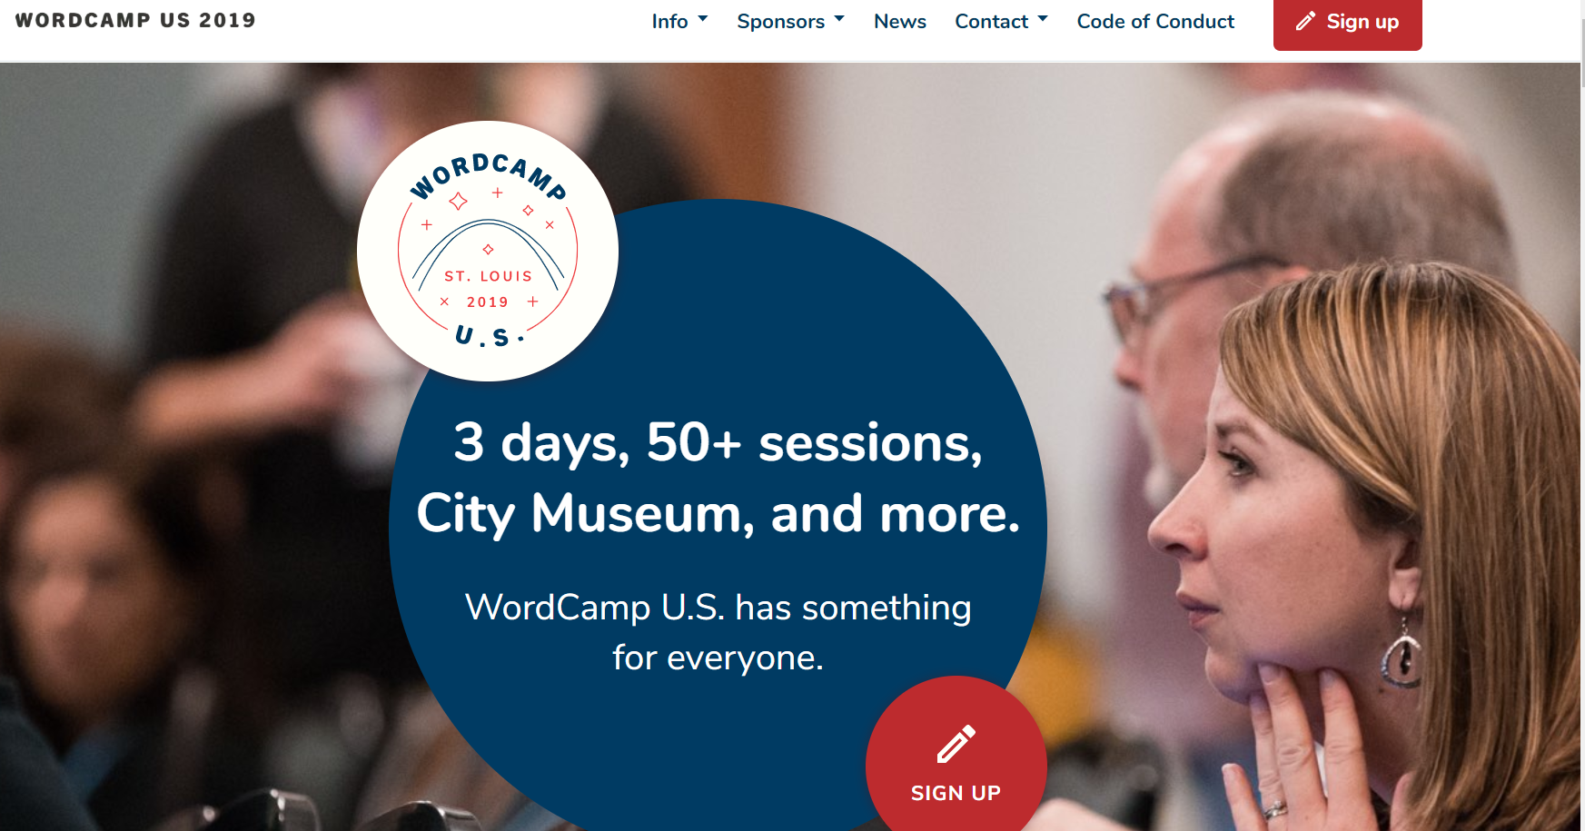
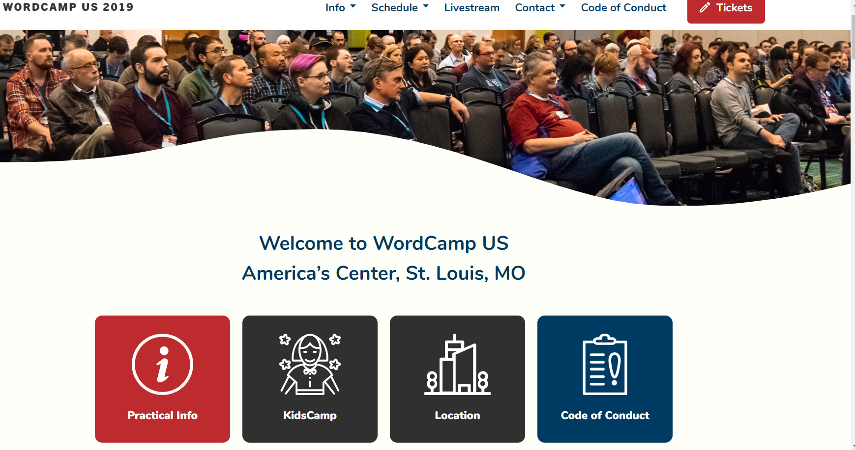
Evolving WCUS 2019 Conference Website Design…..
1
3
Pre…
Post…
2
https://2019.us.wordcamp.org/
During…

Slide 44
Annex 5: Site Redesign and Migration Tips
Three Possible Objectives:
Scenario A.: “Refresh” or Tweak site (relatively easy)
New Logo, update navigation, new Home Page or other content
Scenario B.: Redesign WP.COM existing site (a “heavier lift”)
A general overhaul of site, rebranding, significant new content/functionality
Scenario C: Migrate a site into WP.ORG or WP.COM (the “heaviest!”)
Same as B., + redirection from old site, move domain, conserve earned SEO

Slide 45
Redesign in Place - Checklist
Rationale: (fixing, branding…models on Web?)
Redesign Goals (general and specific - measurable)
User Feedback, Useability, Metrics
Site Audit: “as is, to be” (spreadsheet)
Rough Mockup (Wireframe?) for new design, Theme
Backup Existing Site
Implement new Theme, Navigation, Branding (“private” setting)
Test, Relaunch to Search, Monitor Success
Ref link: https://elementor.com/blog/website-redesign-guide

Slide 46
Migrate from Another Sitebuilder - Checklist
Assess old site vs new WP.COM (content, functionality)
Design New WP.COM site (Theme – set to “private”)
Backup old site
Export to XML, Import to WP.COM (migration tool?)
Conserve SEO, Redirection
Transfer your domain to new site
Enable Social Networks ("Publicize“ on WP.COM)
Test, Open Search, Relaunch - Monitor Success new site
Ref Links
https://www.wpexplorer.com/migrate-to-wordpress/
https://www.wpsupportspecialists.com/moving-your-website-to-wordpress-a-guide-to-migration/
https://wordpress.com/support/moving-from-self-hosted-wordpress-to-wordpress-com/

Slide 47
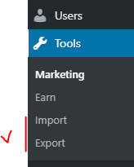
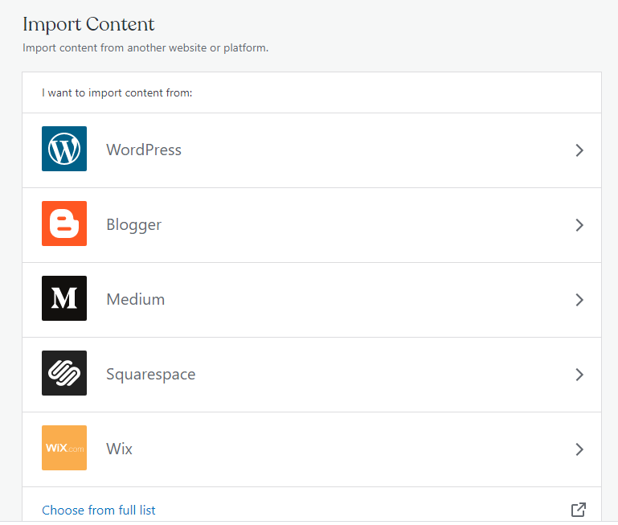
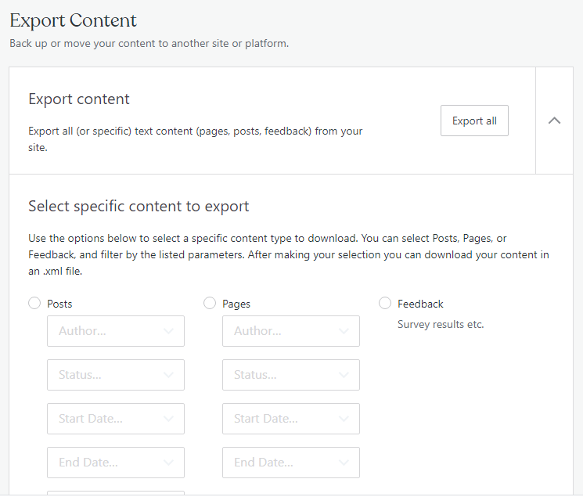
Migrating Content to/from WP.COM
“Import” Screen
“Export” Screen

Slide 48
How a Consultant can Help in “Heavy Lifts”
Help in Redesign
Site audit (old vs. new)
Logo and branding design
New navigation and site map
Update Social Media strategy
Project planning
Help in Migration
SEO conservation, redirection
Old site export/import process
Project planning

Slide 49
Thank You!

