Slide 1
The Difference Between Marketing and Sales

Slide 2
Purpose
To define both marketing and sales
To understand the difference in marketing and sales
To identify why we need both
To understand how both contribute to growth and positive results

Slide 3
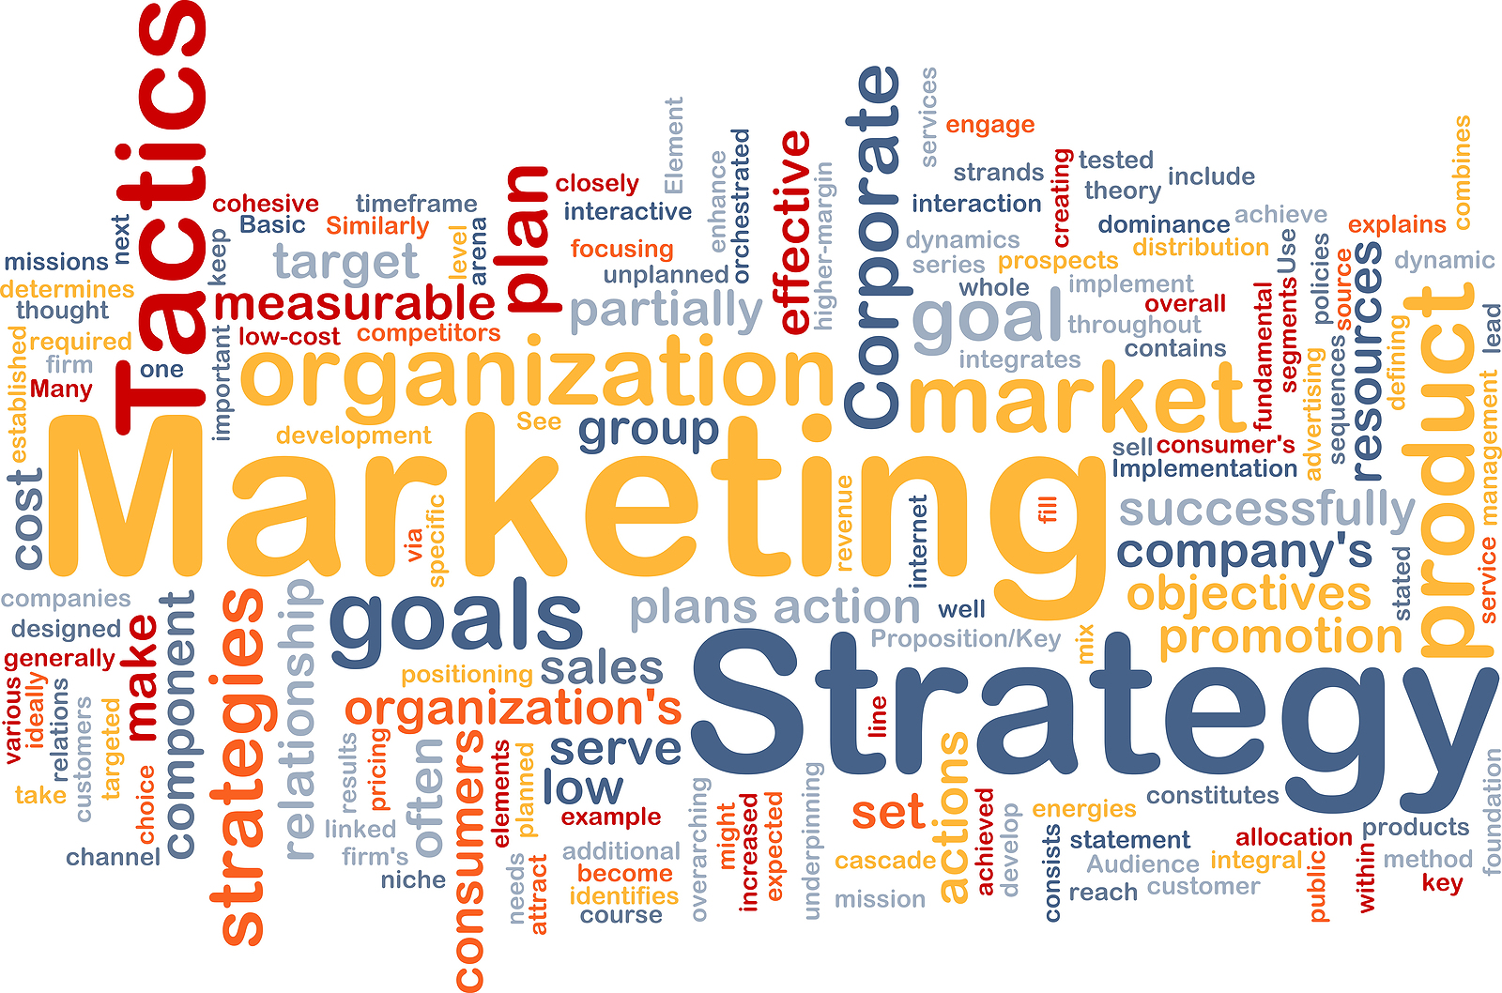
What Is Marketing?
The method of communicating the value of a product or service to customers for the purpose of selling that product or service
The goal of marketing is to positively impact sales

Slide 4
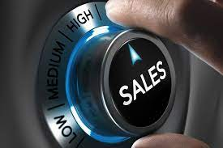
What Is Sales?
The providing of a product or service to fit a need
The goal of sales is to identify features and benefits that people or organizations will buy

Slide 5
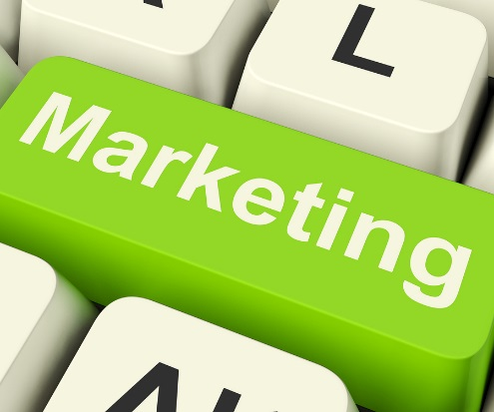
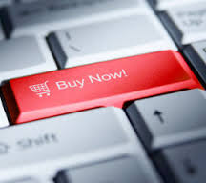
Marketing vs. Selling
What is marketing?
What is selling?
One-to-many education
Generating qualified leads
One-to-one education
Converting leads to customers

Slide 6
MARKETING

Slide 7
Marketing Definition
“The action of promoting a business, it’s products or services. It can include networking, advertising, and market research.”
*Oxford Dictionary

Slide 8
How Does Marketing Promote Growth?
New Customers
Acquiring new prospects or customers
Brand Awareness
Creating an awareness and recognizability of your brand
Relationships
Education
Competitive Edge
Leveraging the power of the relationships you have worked so hard to build
Educating customers on your company, products, and the services you provide
Standing out among the competition

Slide 9
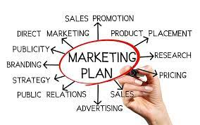
Components of a Marketing Plan
Clear strategy: What do you want to accomplish?
Vision/Mission with respect to marketing
Marketing budget
Specific activities and goals
Marketing Calendar of events and activities

Slide 10
Key Questions
Who is your client (Age/Gender/Income)?
Where is your client (Location/Geography)?
What do you want to communicate to your client (Message)?
How will you communicate to your client (Platform/Tools)?

Slide 11
Social Media Platforms
LinkedIn (Blogs/Newsletters/Videos)
Facebook (FB Groups/Videos/Ads)
Google (Ads/Online Reviews GMB)
Instagram (Stories/Videos/Ads)
TikTok (Videos/Reels/Ads/Stories)

Slide 12
Social Media Tools
Blogs/Posts
Newsletters
Videos (Instructional / Interviews / Reality)
Pictures/Graphics (Before-After / Examples)
Google and Facebook Ads

Slide 14
Social Media Tools
Monthly or Quarterly Plan of Events and Activities
Promotions & Advertising: Coupons/Bundling/LTO’s
6-12 Month Marketing Calendar
Sponsor events, activities, classes or organizations

Slide 15
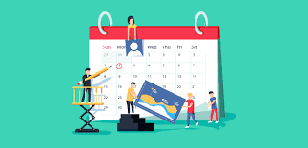
Marketing Calendar Example:
2022 Marketing Calendar
Events/Activities | Jan | Feb | Mar | Apr | May | Jun
BNI | Weekly | Weekly | Weekly | Weekly | Weekly | Weekly
Business Bagels & More | 8th | 12th | 11th | 8th | 13th | 10th
Business Growth Workshops | 27th | 16th | 29th | 20th | 18th | 22nd
Business Series Workshops |  | 9th | 22nd |  | 10th
CNEW | 19th
DART | 20th | 17th | 16th | 20th | 18th | 15th
Dulles Business Series | 15th | 5th | 4th | 1st | 6th | 3rd
Hot Pricing | Chamber $500 | Chamber $500 | Chamber $500 | Chamber $500 | Chamber $500 | Chamber $500
Leadshare | 12th, 26th | 9th, 23rd | 8th, 22nd | 12th,26th | 10th,24th | 14th,28th
Roundtable | 5th | 2nd | 1st | 5th | 3rd | 7th
Sales Training Workshops |  | 24th | 23rd | 19th | 17th | 21st
SBO Workshops | 22nd, 29th |  |  | 1st, 8th
Special Pricing | Group Rates | Group Rates | Group Rates | Group Rates | Group Rates | Group Rates
Webinars |  |  | 31st | 21st | 19th | 16th
Other:
Coupons
Frequency Cards

Slide 16
Sales and The selling Process

Slide 17
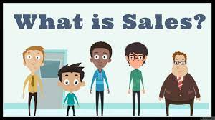
Sales Definition
“The exchange of a product or service for money. The action of selling something..”
*Oxford Dictionary

Slide 18
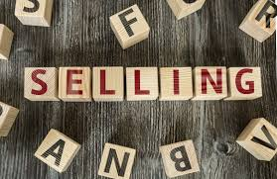
What Is Selling?
Providing a great product or service (Quality).
Fulfilling a need (Solve a problem).
Building a great relationship with clients (Know/Like/Trust).

Slide 19
Consultative Sales vs Transactional Selling
Build Relationships
Help People
Be Genuine
Be a Resource
Benefits: More and better relationships, Better client experiences, Better Reviews, More referrals, More business.

Slide 20
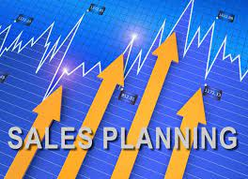
Sales Plan
Sales Vision – The What (Purpose)
Sales Mission – The How (How will you implement the vision?)
Sales Goals – (SMART: Short Term/Long Term)

Slide 21
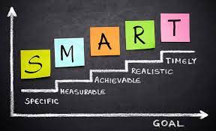
SMART SALES GOALS
Specific
Measurable
Acheiveable
Relevant
Time Bound
Short Term goals are 12 months or less.
Long Term goals are typically more than 12 months, typically 2 to 5 years.

Slide 22
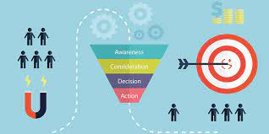
Sales Process
There Is A Process To Selling
Each Step Is Important
Must Understand Each Step/Key Components
The Better Each Step/The Easier The Close

Slide 23
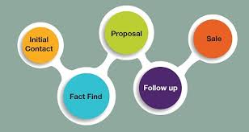
READ 4 Step Selling Process
The READ 4 Step Selling Process works with clients, customers, and also internally with presenting proposals, policies, and projects. The process usually takes multiple meetings and each step must be fully completed.
READ is an acronym:
Relate To The Client
Establish A Need
Advance A Tailored Solution
Develop A Commitment

Slide 24
Key Learnings
Sales Plan
Sales Process Steps
Key Sales Components
Sales Benefits/Purpose
Sales is about building relationships and solving problems with your products and services. It’s not about convincing clients to buy your products or services.

Slide 25
Marketing Summary
The purpose of Marketing is to get the name of your company and it’s products out to your potential clients (Part Branding/Part Educating)
There are many ways and many tools that can be used to market (Networking, Media, Print, Promotions, Giveaways, Sponsorships, Blogs).
Develop a Strategy that consists of a Marketing Plan, Marketing Goals, Marketing Calendar and a Marketing Budget.

Slide 26
Sales Summary
Sales should be consultative and not transactional.
You need a sales plan and process, which addresses how you will sell your products and services.
A sales plan consists of a vision/mission and SMART Goals.
READ is a four (4) step selling process that works.
Build relationships and solve problems. Great sales professionals do both.

Slide 27
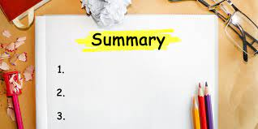
Overall Review
Marketing and sales are equally important to growing your business.
Understand the differences in both marketing and sales.
Leverage and use marketing and sales strategies in your business.
Develop a marketing plan and a sales plan to be successful.
Build relationships and solve problems. Great business professionals do both.
Utilize individuals, organizations, and resources around you to help you succeed.

Slide 28
Discussion Questions
Do you understand the difference between marketing and sales? What are some differences?
Which do you need the most in your business?
Which is harder to implement in your business?
What concerns do you have relative to marketing?
What concerns do you have relative to sales?
What other challenges are you currently facing within your business?
Knowing what you now know about marketing and sales what will you do next?

Slide 29
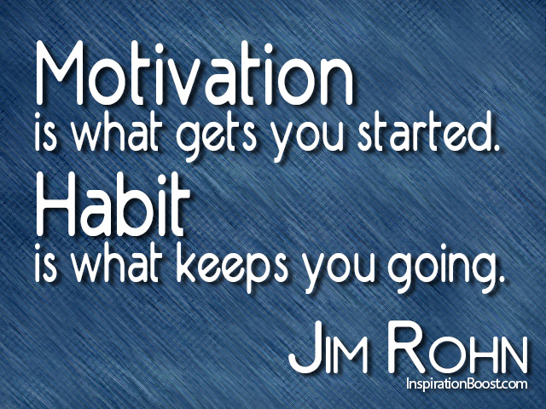
Next Steps…
Establish a Marketing Strategy/Plan
Establish a Sales Plan/Process
Focus on developing business relationships
Go Win

Slide 30
Thank You!
Mike Williams The Growth Coach of Northern VA www.thegrowthcoachofnorthernva.com email: mwilliams@thegrowthcoach.com

