Slide 1
Digital Content Marketing 201 Customer-Centric Content Marketing a.k.a. It’s Not About You
Notes:
Welcome
Today we’re going to dig deep into what makes content marketing really effective, and I’ll share some tips and tricks on using these concepts to help your business grow.
Questions at any point – put them in the chat

Slide 2
Jon DeNunzio, Presenter
Owner, Squarely Digital, squarelydigital.com
Marketing consultant and former journalist who helps clients get meaningful results online
Clients are small businesses and nonprofits.
jon@squarelydigital.com
Notes:
I’m Jon DeNunzio
I run Squarely Digital, where I do online marketing for small businesses and nonprofits
I’m a former journalist who worked for almost 18 years at the Washington Post, and I’ve taken the obsession with high-quality content I learned and honed there and applied them to help my clients over the past eight years.

Slide 3
Customer-Centric Content
The Prime Directive:
Put the customer first in your content.
When you do, you:
Reach the right people
Encourage repeat visits
Build expertise and trust
Improve online visibility …
Notes:
A few months ago, I gave a “Content Marketing 101” talk for BoomerWorks. In it, I explained the basics of content marketing — theory and the key steps in creating effective marketing content.
Today is sort of a 201 talk --- and I’m going to focus on the approach that makes it all work.
I know Star Wars Day was earlier this week, but in a shout-out to Star Trek fans, I call this “the Prime Directive” – put the customer first in your content.
When you do that, you:
- Reach the prospects you want to reach
- Encourage repeat visits to your website
Build expertise and trust
and
- Improve your business’s visibility online

Slide 4
It Gets Results and…
More leads
More customers
More revenue
Notes:
And that leads to
Your website generating more leads
More of them becoming customers
And
You getting more revenue
When content marketing is done right, in time, your website can become a lead-generation machine. That’s the goal.

Slide 5
Definition of Content Marketing (Refresher)
“Content marketing is a strategic marketing approach focused on creating and distributing valuable, relevant, and consistent content to attract and retain a clearly defined audience — and, ultimately, to drive profitable customer action.”
— Content Marketing Institute
Notes:
Before I get too far into this, let’s quickly go over what content marketing is, and the basic steps involved.
The Content Marketing Institute – a website with some great, free resources, by the way – defines content marketing like this:
“Content marketing is a strategic marketing approach focused on creating and distributing valuable, relevant, and consistent content to attract and retain a clearly defined audience — and, ultimately, to drive profitable customer action.”

Slide 6
Refresher: 5 Steps to Success
1. ID the Ideal
2. Idea Generation (benefits & results; buyer’s journey)
3. Copy that converts
4. Self-edit
5. Next steps
Notes:
I break the process of producing marketing content into five steps. They are:
1. Identify your ideal customers and their needs
2. Generate content ideas that:
a) Focus on benefits and results
b) Address each stage of the buyers’ journey
3. Write copy that converts
4. Perform a thorough self-edit
5. Anticipate and prepare for the next steps

Slide 7
Today’s Focus
Steps 1 and 2:
1. Identify your ideal customers and their needs
2. Generate content ideas that
a) focus on benefits and results
b) address each stage of the buyer’s journey
Notes:
We’re going to concentrate on steps 1 and 2.
This is when it pays the most to be customer-centric:
Again, those steps are
1. Identifying your ideal customers and their needs
2. Generating content ideas that
a) focus on benefits and results
b) address each stage of the buyer’s journey

Slide 8
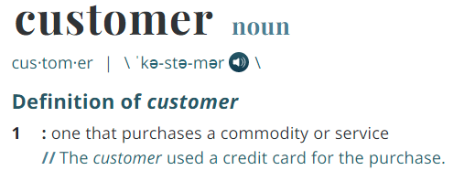
Defining Your Ideal Customers
Figure out:
Who they are
The urgent problem
Questions on their mind
Notes:
We’ll start with defining your ideal customer
To do that, you need to figure out
- Who they are
- What urgent problem you solve for them
- What questions are on their mind as they hunt for a solution

Slide 9
Who They Are
Time to Dream …
Good customers
Bad Customers, Too
Successful Sales
Recommendations
Notes:
You define your customers so you know who you’re writing for.
These are your “ideal” customers, so it’s okay to fantasize a little -- in an ideal world, this is who you’re doing business with.
Think about:
Who makes a good customer for you? Who doesn’t?
From your experience: who is most likely to buy from you?
What have you learned from current customers? (Think of the ones who make you say, “I need more customers like them!”)
Who recommends you? Who do they recommend you to?

Slide 10
Formalize It
CUSTOMER
“A semi-fictional representation of your ideal customer based on market research and real data about your existing customers.”
PERSONA
Demographics, behavior, motivations, goals
Get detailed … but not too detailed
Stick with what’s important
Notes:
Once you’ve done that, you can get more practical: Turn them into customer persona descriptions.
Hubspot defines a customer persona as:
“A semi-fictional representation of your ideal customer based on market research and real data about your existing customers.”
And Hubspot adds:
‘When creating your persona(s), consider including customer demographics, behavior patterns, motivations, and goals.”
This helps you create relevant content, write with a “voice” that’s appropriate for the context and decide where to promote your content.
But you can get hung up by getting too detailed, too. Concentrate on what’s important for your industry, your product or service, and your customers.
Age, job title, job responsibilities, college degree, favorite social media channel, music listening habits … these may be important. They may not be.

Slide 11
Customer Persona Example
Business: Cookie company Job Title: Business owner
Age Range: 35-55
Frustrations: Not enough supply, chips melt too easily
Desires: Consistent supply, better quality
Price Conscious? Not very – willing to pay for quality
Social Media Channels: Instagram
SAMPLE
PERSONA
Notes:
Here’s a persona example:
Say you sell chocolate chips to cookie companies. Here’s a persona for an ideal customer.
No cutesy name
Persona written to help understand:
their problems
what they say they need
what they use now
Price sensitivity
How to reach them with online content

Slide 12
The Urgent Problem You Solve
Why do customers ‘hire’ you?
“When we buy a product, we essentially ‘hire’ it to help us do a job. If it does the job well, we’ll hire it again.”
Source: “Know Your Customers’ ‘Jobs to Be Done,’ Harvard Business Review, Sept. 2016
Notes:
Once you know who you’re marketing to, you want to look for the ways your product or service aligns with them. Specifically, you need to know why customers ‘hire’ you?
The concept of “hiring” a product or service comes from the idea “jobs to be done.” In an influential article in the HBR in 2016, they wrote:
“When we buy a product, we essentially ‘hire’ it to help us do a job. If it does the job well, we’ll hire it again.”
Source: “Know Your Customers’ ‘Jobs to Be Done,’ Harvard Business Review, Sept. 2016

Slide 13
The Bottom Line
It’s why they’re buying.
Not why you’re selling.
Notes:
The reason we create customer personas and think about their jobs to be done is so we can zero in on your customers’ reasons for buying.
This is the guiding principal behind all the content you create – their reasons for buying, not your reasons for selling
An apartment management company might think: “We just renovated our gym and it looks great – we need to blog about that.”
But if they focus on what their potential renters want, they might discover most of them are thinking: “I just want to live close to the Metro.”
That’s what they should be marketing about.
When you have a firm grasp of why customers choose you, it changes how you market

Slide 14
Questions On Their Mind
What are they thinking:
as they shop?
as they decide?
Examples:
What’s the source of this problem?
How much does it cost to address?
What are my options?
Who’s the best?
Notes:
Once you’ve identified your ideal customers and the urgent problems you solve for them, it’s time to get more granular.
You want to know the questions they want answered as they’re shopping and deciding
Questions they could be asking include:
- What’s the source of this problem?
- How much does it cost to address?
What are my options?
Which company is best at solving my problem?
>> To find out, you need to do some research!

Slide 15
How To Find the Questions
1. Talk to existing customers
2. Review sales conversations
3. Do some research
4. Competitor reviews
Notes:
There are many different ways to uncover the questions that are on the minds of your potential customers.
One way is talking to the customers you already have: Why did they choose you? Why do they stick with you?
Another is to review sales conversations -- what do potential customers ask when they’re sizing you up?
A third way is to do your own research. For instance, you could create a survey.
Ask customers and non-customers in your niche about their frustrations and their needs.
Offer incentive to participate (it could be sending them survey results)
A 4th way is looking at competitor reviews: What do people rave about? What do they wish they were getting? I did this for my niche (digital marketing agency):
Positive: “They understand our business and our market.”
Negative: “They don’t meet their deadlines.”
Those reviews tell me what they’re looking for specifically

Slide 16
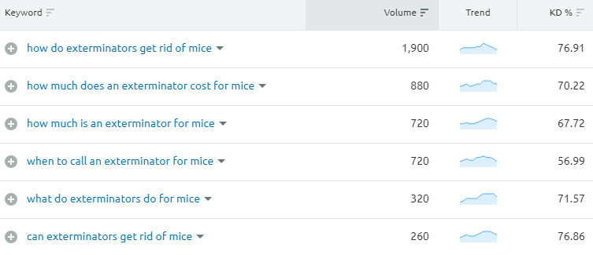
How To Find the Questions, cont’d
5. Keyword Research
Notes:
You can also dig into the data to find out what is on prospects’ minds
This is a screenshot from a paid SEO tool I use called SEMRush
These are the top questions people search on related to mice and exterminators. You can see the average monthly search volume and the keyword difficulty – the estimate for how hard it is to have a page rank for this question.
A paid tool is nice, but it’s not required …

Slide 17
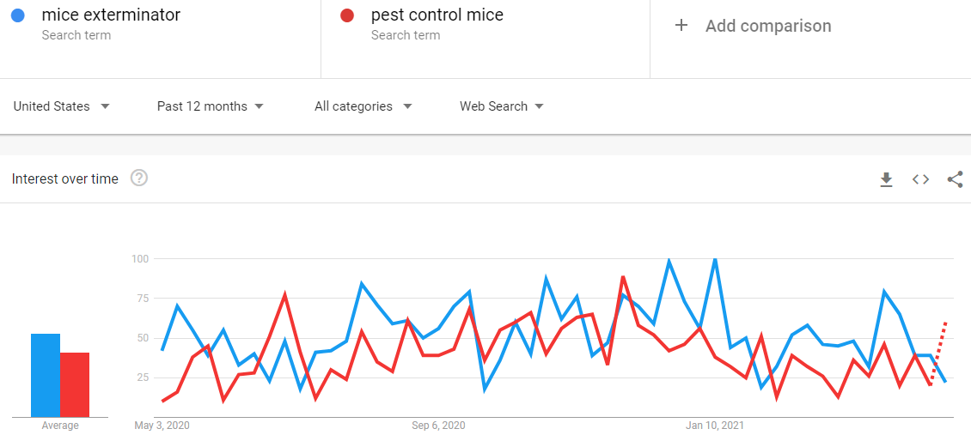
How To Find the Questions, cont’d
Google Trends
Notes:
Google offers a free tool – Google Trends – where you can look up the relative popularity of search terms. If I am an exterminator, for instance, and I’m not sure if more people search Google for “mice exterminator” or “pest control mice,” I can get an answer.

Slide 18
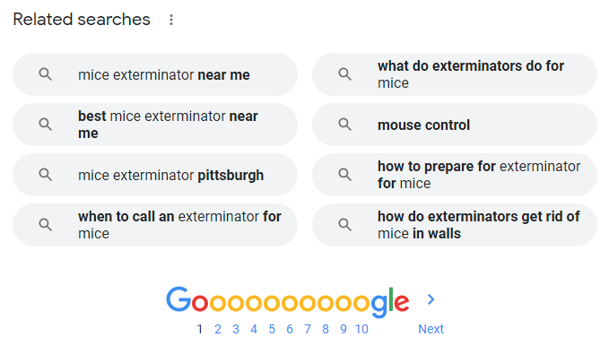
How To Find the Questions, cont’d
Google search: “mice exterminator”
Notes:
You can even get helpful information at the bottom of the search results page.
The related searches for “mice exterminator” offer some good ideas for content topics.
(Read examples)
All of these methods help you understand what your customer wants and needs – and that’s how you should focus your marketing.

Slide 19
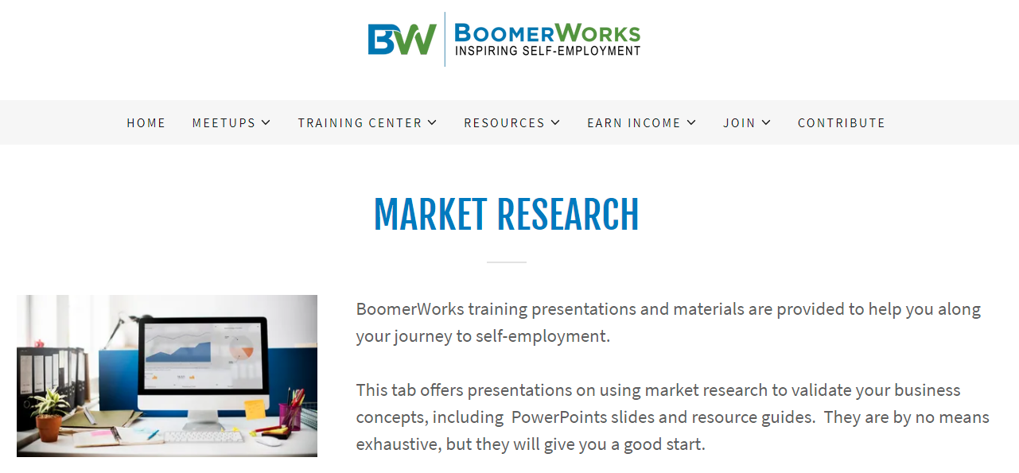
How To Find the Questions, cont’d
Market Research Resource: BoomerWorks
Notes:
Everything I’ve mentioned on the last few slides are forms of market research of course.
For more information on market research, BoomerWorks has a great training video on their site:
Visit bw.org, click the training center tab and drop down to “market research” to view videos

Slide 20
The Buyer’s Journey
Sort your research results by the stages of the buyers’ journey.
Awareness
Consideration
Decision
Notes:
Once you understand your customer, it’s time to start thinking about the buyer’s journey.
The buyer’s journey is a framework for understanding the steps a customer takes from the moment they start thinking about a purchase to actually completing the transaction.
It is typically divided into three stages: Awareness, Consideration and Decision
I suggest you sort your research results by these three stages
In other words, how do they view their problems, and what questions are on their mind in each stage?

Slide 21
Example: IT Services
Notes:
How do you do this? Let’s look at an example.
Imagine Ivan, who owns a small IT services business.
Ivan has started to find his accounting tasks to be overwhelming.
He’s thinking: “There must be a better way.”

Slide 22
Ivan’s ‘Buyer’s Journey’
 | Awareness | Consideration | Decision
Ivan’s Question | Why do some companies outsource accounting? | Can outsourced accounting offer me CFO services? | How has Accounting Outsourcers LLC helped other companies like mine?
Your Goal | Help reader understand the root of their problem and introduce solutions | Help reader zero in on the best *type* of solution for their problem. | Help reader see what exactly your solution does and why it’s best for them.
Content Example | “5 Reasons to Outsource Your Business’s Accounting” | “5 Benefits of Hiring an Outsourced CFO Service.” | “Success Story: How We Helped Company X Grow Its Revenue by 25%”
Notes:
At first, Ivan is in the awareness stage. He’s wondering things like “What are some reasons some companies like mine outsource their accounting?”
If you offer accounting svcs for small biz, In this stage, you want to write content that helps readers like Ivan understand the root of their problem and introduce solutions.
When Ivan moves into the consideration stage, he has questions like “Can outsourced accounting offer me CFO services?”
In this stage, you want to write content that helps the reader zero in on the best *type* of solution for their problem.
And when he’s in the decision stage, getting close to making a purchase, Ivan is wondering about a specific company he’s been researching. How have they helped other companies like his?
At this stage, you’re writing content that helps readers see exactly what your service does, and why it’s best for them. This content gets you across the finish line – the sake.

Slide 23
Awareness Stage Examples
Daily money manager: “How to help an aging parent with their finances”
Tutoring Service: “5 Best Ways To Get Your Kid to Do Their Homework”
Notes:
Let’s dig deeper into the types of content that work well in each stage.
Here are two more examples of awareness stage content.
(read them)
As you can see, the content in this stage is meant to get the reader thinking about how they will solve their problem. It helps them make more educated decisions and starts to build your reputation as an expert.
It is not very sales-heavy. Prospects in this stage are usually not ready to be sold to.

Slide 24
Consideration Stage Examples
WordPress web designer: “5 Problems With Using Wordpress for an E-Commerce Website”
Chiropractor: “The Comprehensive Guide to Treating Back Pain”
Notes:
In the consideration stage, the content is about types of solutions. Not specific solutions – it’s more general than that.
For instance, related to the first example, you can imagine content that is headlined “5 Reasons Acme Web Developers Are the Best Choice for E-Commerce Sites.”
That’s decision stage content. We’ll get to that next.
Instead, in this stage, the content example allows a potential client for Acme’s web development services to know what to look for – and what not to look for.
Of course, you’ll want some of this content to align with the advantages your product or service brings. But the goal here is to educate the prospect and have a segment of them recognize you offer this, and you could be a great fit for them.
And it’s worth noting that consideration stage content might contain cost information – how much do certain solutions, and your solution, cost? As the prospect figures out how to solve their problem, cost is a factor you can’t ignore.

Slide 25
Decision Stage Examples
Interior designer: “How We Turned a 1970s Kitchen into a Modern Culinary Hub”
Landscaping Company: “A Step-By-Step Guide to How We Care For Your Yard”
Notes:
In the decision stage, you want to close the deal. So you want the reader to see exactly what your product or solution does, and why it is right for them.
The interior designer example here is a classic case study – with a compelling story, photos and testimonials from the customer who had the work done, the reader is presented with a powerful argument for choosing this designer.
The landscaping company example tells the reader EXACTLY what they will get. Get into the weeds (no pun intended) to showcase your strong points and the inherent value of your offering.

Slide 26
But Wait …
Common Objections:
That doesn’t sound like it will lead to a sale.
I don’t want to mention the cost.
Why should I mention my competitors?
Notes:
When some people see these sorts of examples, they hesitate.
They have objections to putting this sort of information out publicly. Or they say things like:
- That’s an interesting blog post, but it doesn’t sound like it will lead to a sale
I don’t want to mention the cost! It will scare people away.
Are you really recommending I mention my competitors?
(Yes, sometimes I recommend that – lay it out there for prospects: We are good at X, but if you need Y, this company might be right for you.)

Slide 27
It Works
Responses to Objections:
Sales: Prospects aren’t always ready to be sold to.
Cost: Do you want prospects who can’t afford you?
Competitors: They will research them anyway.
Notes:
Here are my responses to those objections:
Not all content is sales-y because prospects aren’t always ready to be sold to – especially in early stages
Cost: It’s a good idea to mention how much you cost (even if it’s a ballpark figure), so you can weed out the prospects who can’t afford you
And you may as well mention competitors, because your prospects will research them anyway. An honest appraisal will build your credibility and allow you to frame the competition the way you want to.

Slide 28
Turn Your Ideas Into a Plan
Awareness Stage | Consideration Stage | Decision Stage
Idea 1 | Idea 1 | Idea 1
Idea 2 | Idea 2 | Idea 2
Idea 3 | Idea 3 | Idea 3
Notes:
For each customer persona you create, your goal is
Fill a grid with content ideas, several for each buyer’s journey stage
Create a content calendar and stick to it
The online environment rewards consistent production. Your first five pieces of content might not produce huge results, but when you get to 15, 20, 25, the benefits often are exponential.
(Why? Readers – and Google -- start to notice as readers come to your site for one piece and stay because they see other relevant, interesting content.)

Slide 29
Repurpose!
Video scripts → blog posts
Blog post series → white paper
Email w/links → 5 social media posts
Old post → updated new post
Notes:
This sounds like a lot of work. And it can be.
But I have good news, too: You can (and should) make repurposing content part of your strategy.
A video script can become a blog post
A series of blog posts can become a white paper
An email newsletter edition with links to other interesting content can be chopped up into social media posts
An old case study can be updated and refreshed

Slide 30
Is It Working?
1. Measure
2. Analyze
3. Adjust
Notes:
If you’re going to do all this, you need to track the results.
Use a tool like Google Analytics to track things like:
Page views
Engagement (time on page, length of visit)
Traffic patterns (where do they go next?)
Find out what works and keep doing it!

Slide 31
Breakout session
Generate one story idea for an ideal customer.
Address one specific problem or need
Can be any stage of the journey
Be specific!
Notes:
It’s time to go to our breakout sessions
In it, you will brainstorm with others to come up with one content idea you could create and publish next week
Steps:
- Say who your ideal customer is
What problem or need of theirs do you address?
Which stage of the journey is this content for?
Be specific – We want to head headlines when you come back, like “5 Common Questions People Ask Us About Installing an AC Unit.” (HVAC company, decision stage)
Questions?

Slide 32
Resources
Free resources from Squarely Digital:
Download the Guide to Creating Quality Content: squarelydigital.com/guide
Sign up for my email: squarelydigital.com/email-newsletter-signup/
Join my Content Tune-Up Workshop
(June 7, 12-1 pm): squarelydigital.com/tuneup
Contact me for a free consultation: jon@squarelydigital.com
Notes:
Some free resources from me:
There’s a downloadable Guide to Creating Quality Content on my website at squarelydigital.com/guide
I offer free, no-obligation content strategy consultations by Zoom/phone.
And I offer regular free Content Tune-Up Workshops – these are group Zoom sessions where participants – and I -- help everyone improve a content marketing piece submitted ahead of time. You can get more info and sign up at squarelydigital.com/tuneup

Slide 33
Thank You!
Notes:
Thanks so much for attending, and don’t hesitate to get in touch if you have questions. I am at jon@squarelydigital.com

