Slide 1
Crack the Code:
Leverage Your Personal Brand to Grow Your Business Brand
Notes:
Welcome and Introduction
Jen to kick off the panel
Let’s meet our panelists – Debbie Myers from Virtuarte and Manuella Hancock from MWH Copy

Slide 2
What is a personal brand?
Reputation
What makes you unique
How others see you

Slide 3
A brand has three jobs.
Choose
Confidence
Connection
Oprah
Nike
Elon Musk
Volvo

Slide 4
Let’s Go!

Slide 5
From Problem to Promise.

Slide 6
Example: BrandMirror
Amazing, talented people are unable to clearly define and understand their value = their talent goes unseen and their impact is not fully realized.
I can utilize my branding, marketing, and business acumen to help them define and message their value to increase their visibility and impact.
Crafted & vetted my business idea – audience, competitors, and opportunities using existing network.
Launched my business and tweaked it within the first few months, then adjust as needed.
@BrandMirror BrandMirror Copyright 2022. All Rights Reserved.
Notes:
Is professionalism dead?

Slide 7
Start with the Why.
Why
Purpose
Why
Change
Why
Niche
brand

Slide 8
Purpose is at the heart of your business.
Purpose is the ‘Why’ you exist: The higher order reason for being for a brand or business than just ‘making a profit’ or ‘driving shareholder value’. It adds value to your clients, sets you apart from competitors, and provides clarification on what matters - which shapes the culture you build.
Mission
Mission(s) are the ‘What’ of you should do to get there: These could be specific initiatives or tactics centered around product development, operational excellence, go-to-market strategies or brand communications.
Vision
Values
Values are the ‘How’ you would like to behave in order to get there: What is the organizational culture of a company or an organization? And what are the qualities or behaviors it prizes: for instance, curiosity, inclusivity, diversity of thought etc. Your values clarify the behaviors you expect from yourself & your team.
Vision is ‘Where’ of where you want to get to: This is a destination of what you want the brand or business to be in the future (e.g. ‘We want to be the world’s leading provider of X by 2020').

Slide 9
Our Purpose, Promises, Mission & Vision
Purpose As a Purpose Sherpa, to help everyone understand their passion & purpose and make their mark on the world. | Vision We believe if everyone knew their purpose and intentionally delivered on it the world would be a much better place.
Promises Every client feel as if they are our only client. To be responsive and proactive for our stakeholders. To create clarity through strategy and structure on our client’s passion and purpose. To move the needle on our client’s visibility and impact. | Mission We are dedicated to discovering the purpose and passion of individuals and companies while moving the needle on their visibility and impact.
Values Intentional Clarity Respect & Compassion Listen to Understand Noisebreaker | What Makes Us Unique Developed our own Noisebreaker Process One to One Coaching with Jen Focus on Client, Audience, Competitors to Craft a Message that Breaks Through the Noise Candid & Compassionate Guidance Women Owned & Certified Focus on CEOs, Executives, Entrepreneurs

Slide 10
Finding the Right Brand Balance
Growing Your Business
Start Your Own Practice
Growing Your Business
Low Personal Brand High
“Low Visibility” on Purpose
“Low Visibility”
New Business
Multi-Level Marketing
Franchise
Licensing
Low Company Brand High
@BrandMirror BrandMirror Copyright 2022. All Rights Reserved.
Notes:
Is professionalism dead?

Slide 11
Branding and marketing do overlap.
brand
marketing
Why
Long Term
Loyalty
Niche
Promise
Feeling
Reputation
Destination
Being
Expectation
Reason to Buy
How
Short Term
Response
Target
Tactic
Campaign
Sale
Stop
Doing
Tool
Thought to Buy
Name
Logo
Colors
Tagline
Font
Mark
Icons
Images

Slide 12
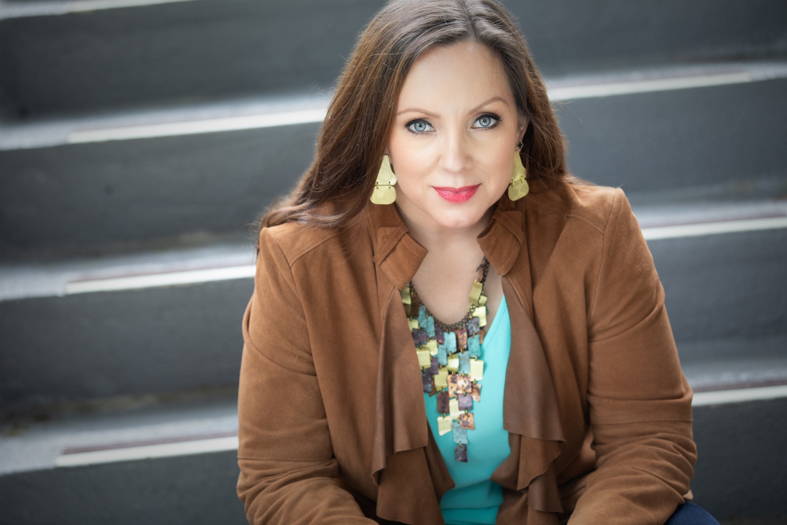
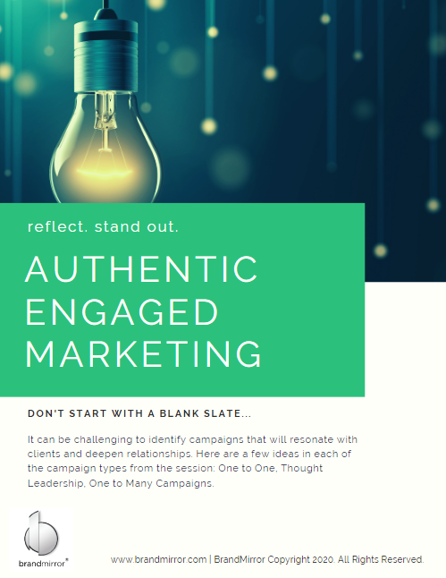
Define Your Brand (Or Others Will)
Personal Mission Statement
Build Intentional Reputation Strategies for People
I am a gutsy leader
committed to enabling leaders to live their purpose and passion
by moving the needle on their visibility and impact by leveraging these core skills:
strategy,
structure,
and clarity.
Leverage Structure to Move Forward Intentionally
Enable Clarity to Drive Visibility & Impact
reflect. stand out.

Slide 13
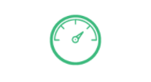
Brand: BrandMirror
Why: To help people know their purpose and passion and increase their visibility and impact.
Name | Logo | Tagline | Colors
brandmirror |  | reflect. stand out.
Font | Mark | Icons | Images
Raleway
reflect. stand out.

Slide 14
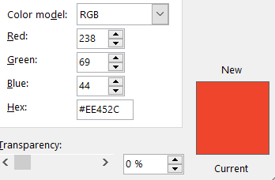
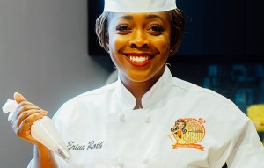
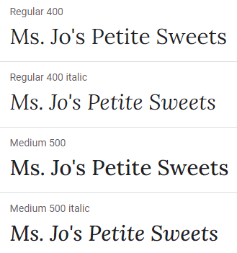
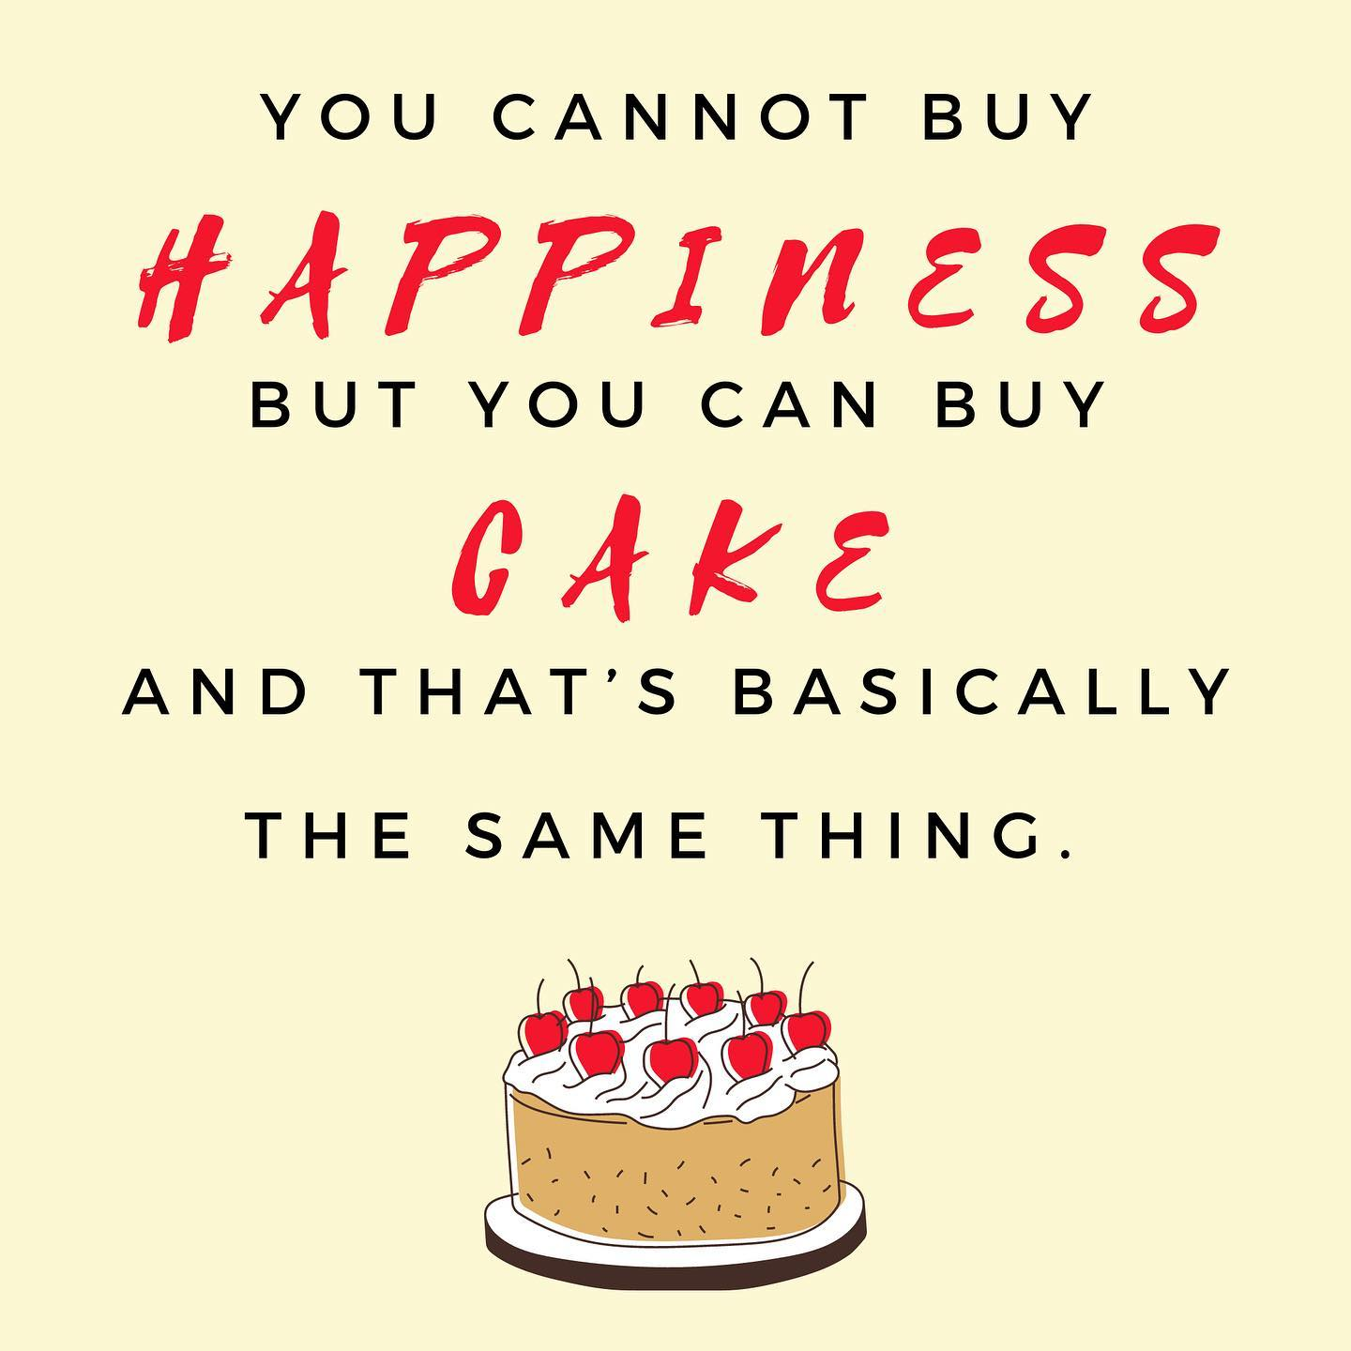
Brand: Ms. Jo Petite Sweets
Why: Ms. Jo’s is a tribute to Roth’s late mother who always encouraged the people around her to cherish each day and enjoy life’s sweetest moments.
Name | Logo | Tagline | Colors
Ms. Jo’s Petite Sweets |  | Life is Sweet, Have a Treat
Font | Mark | Icons | Images
Lora Arial

Slide 15
Elevate the brand message.
Customer Centric
Emotional:
Customers feel heard, celebrated, and wowed!
Black Forest Cake
Value Add:
Custom, Unique Desserts
Traditional + Innovation
Functional:
Catered dessert
Product/Service Centric

Slide 16
Which audiences need to see you differently?
Who is Your Audience? | Know | Feel | Do | Communication Ideas
Event Planner | Unique, Custom High-End Events | Exceptional Treats for their Clients | Book a Tasting | Visit Event Planner Offices / Call on Event Planners
Your Business?

Slide 17
Crafting Your Brand Positioning Statement
Example: AirBnB
Summarizes the value that your brand, products, and services bring to the target market.
Target market | Frame of Reference | Product Attribute | Benefit / Point of Difference
To adventurous and youthful minded travelers | Airbnb is the accomodation option | that allows you to experience new places | like a local.
To adventurous and youthful minded travelers, Airbnb is the accomodation option that allows you to experience new places like a local.
@BrandMirror BrandMirror Copyright 2022. All Rights Reserved.
Notes:
https://docs.google.com/document/d/1xflYXZYuKTlyFFQ51d0JDIwNa1TikMnUlDwc5zrXgYA/edit?usp=sharing
What you offer them
How you offer it
Why you do what you do
How this compares to what's already out there

Slide 18
Credibility is Key
Trust.
Like.
Know.

Slide 19
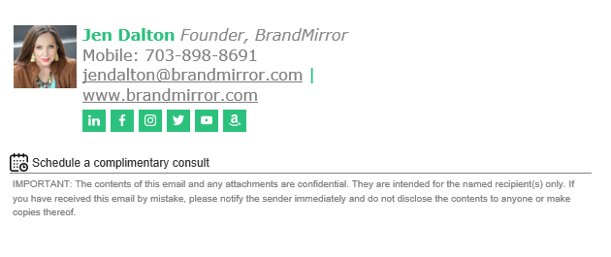
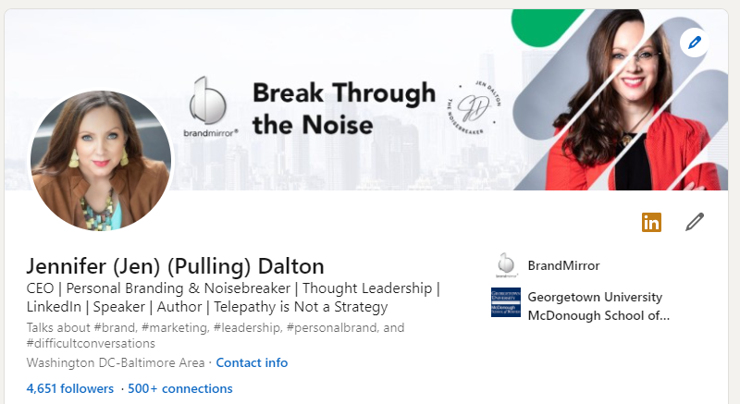
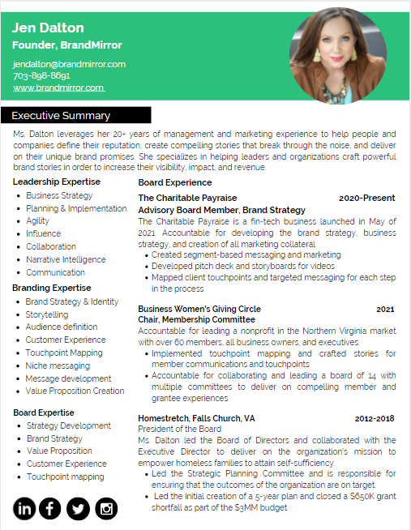
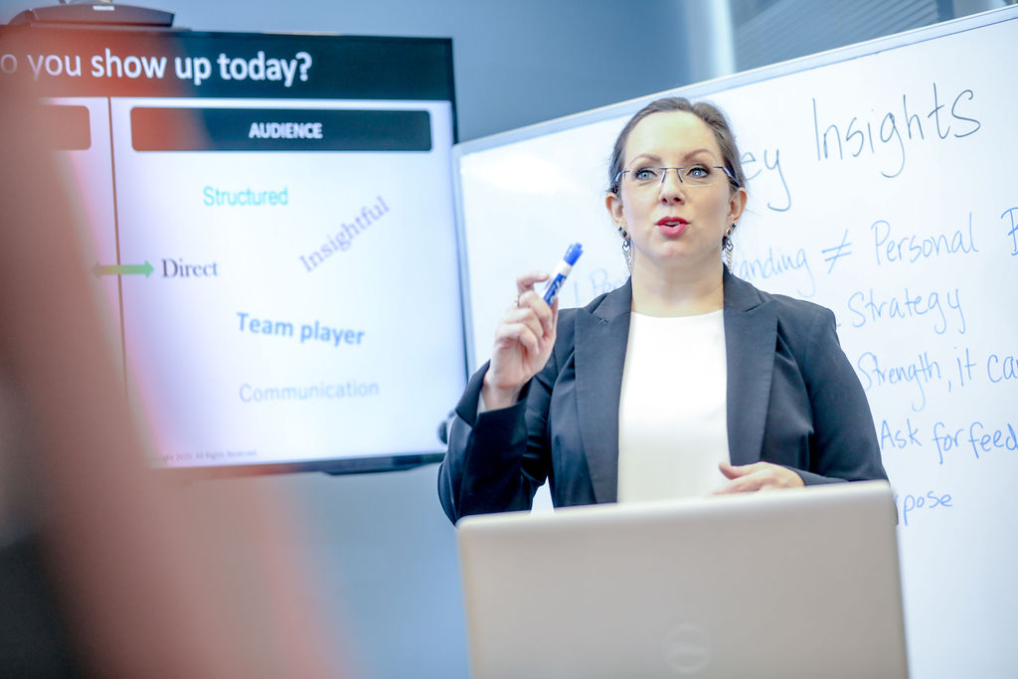
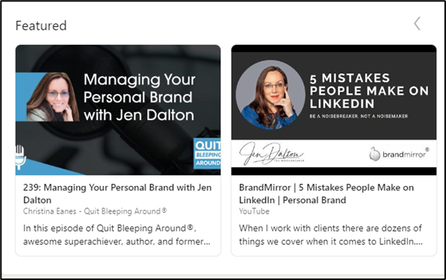
Elevate Your Evidence
In Person Digital

Slide 20
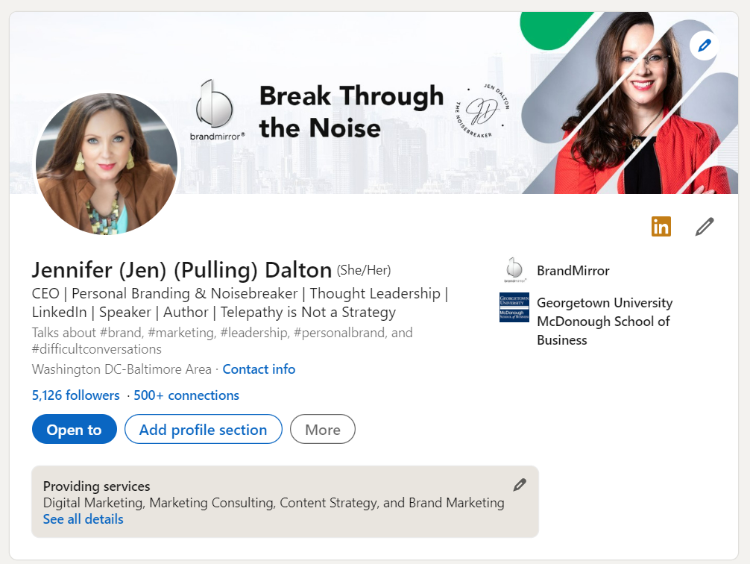
Where to Start
Create a LinkedIn Profile
Create a simple one-page website/landing page
Invest in understanding and defining your top 3-5 audiences
Define a clear and compelling value proposition
Develop your top services/solutions/products
Small, medium, large pricing

Slide 21
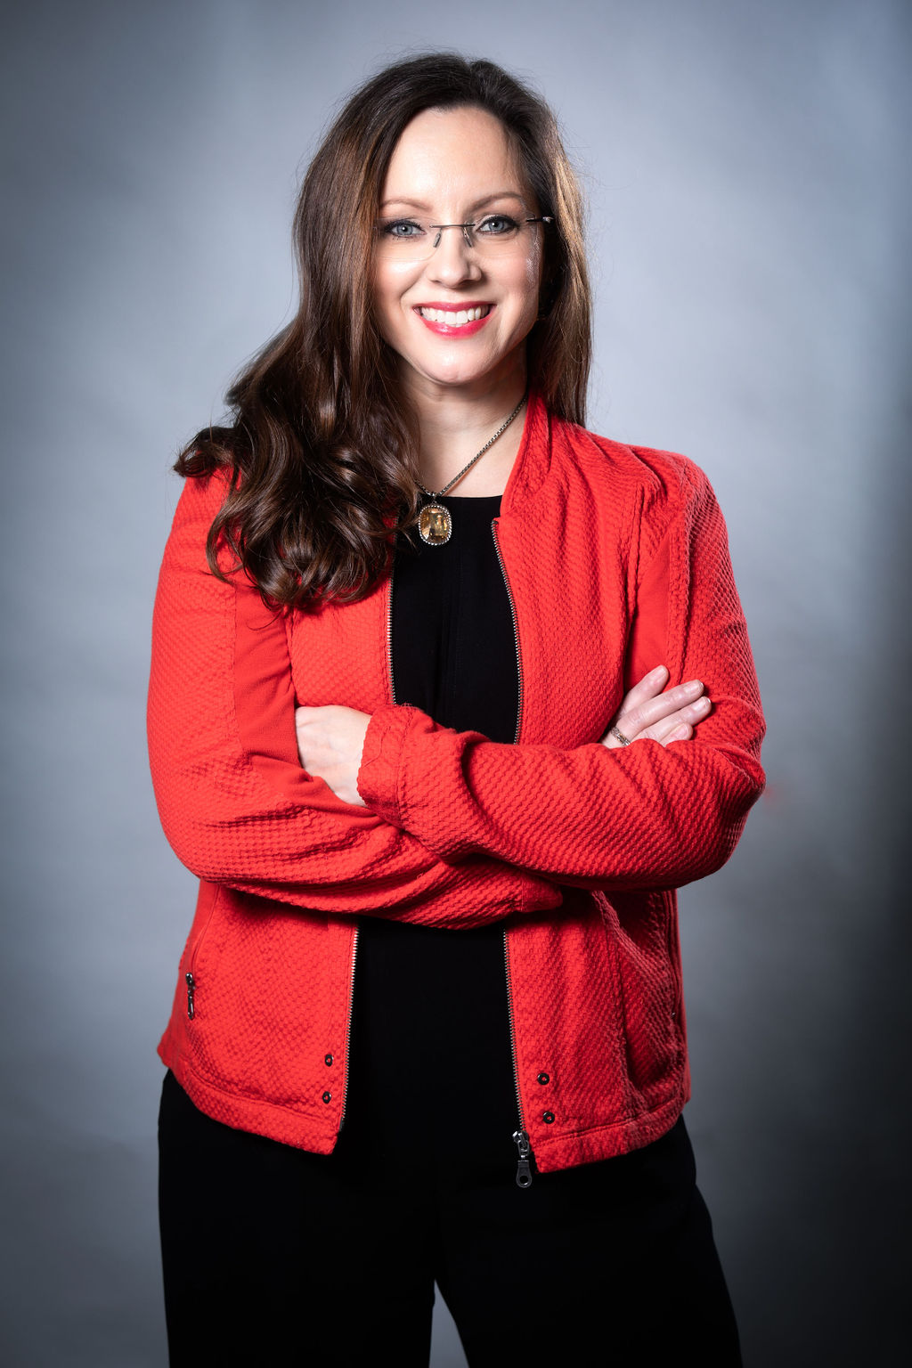
Stay in Touch
Visit www.brandmirror.com
Complimentary Consult
Free Resources to Help You
Please connect on LinkedIn
Join the conversation on Facebook, Instagram, Twitter, and LinkedIn
@BrandMirror BrandMirror Copyright 2022. All Rights Reserved.
21

