Slide 1
From Accidents to Allies: Your Hidden-in-Plain Sight Network

Slide 2
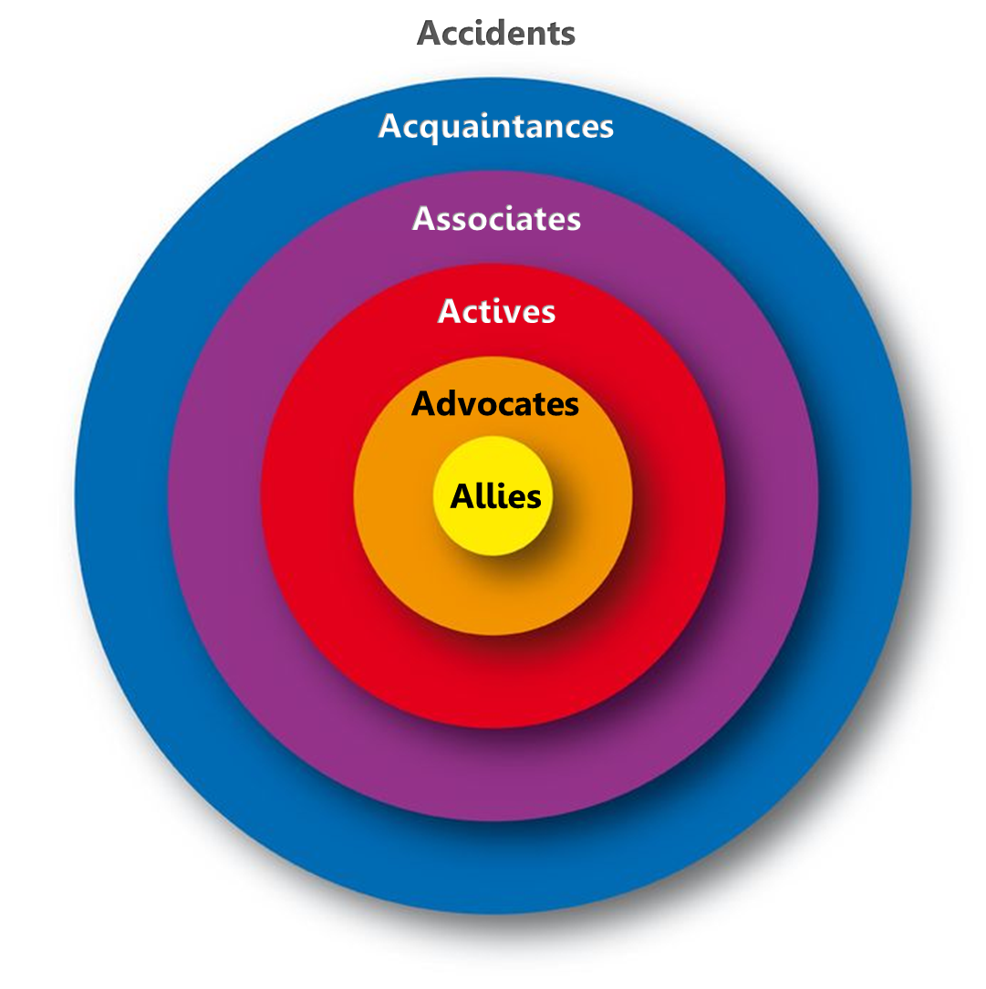
Develop Trusting Relationships: The 6 Stages
Accidents
…are random encounters – people you’ll never see again, unless
one of you reaches out.
Acquaintances
…and you have a contact in common. You can always find them again through that contact.
Associates
…are members of the same groups you are a member of (professional association, club, workplace, etc.).
Actives
…exchange information and resources with you.
Dormant
Advocates
…send opportunities your way, speak up for you, believe in your Character & Competence.
Allies
…are committed to your life-long business and personal success, know you in all parts of your life, give you constructive criticism, and celebrate with you.
© ContactsCount -2018 www.contactscount.com

Slide 3
WHO TO NETWORK WITH
Vern explains the 5A concentric circles (10 – 15 min??) to describe ANY conversation
Accidents
Acquaintances
Associates
Actives
Advocates
Allies
Vern shares the Rate Your Relationship exercise – pick someone who you consider your Advocate and complete the exercise – then Vern says, how many of you were surprised that they didn’t check all the boxes?
How to catalogue and build your network
Shira explain family network ( “siblings, first cousins, second cousins” ) for general networking
Shira explain types of alliance partnerships (family network) to leverage for business development
Vern and Shira explain how to *tailor* the pitch stories for each cohort. Eg. HR contacts don’t need explanation of “employee engagement” but association CEOs might. (10 min)
Person who gets you – more specific
Person who doesn’t – more generic
Participants have 2 minutes to list names of allies and advocates / twin and sibling (know you)
In breakout rooms, they discuss how they would tailor their pitch to different audiences. (30 min)
Return to the main room for spot coaching with a few folks (20 minutes)

