Slide 2
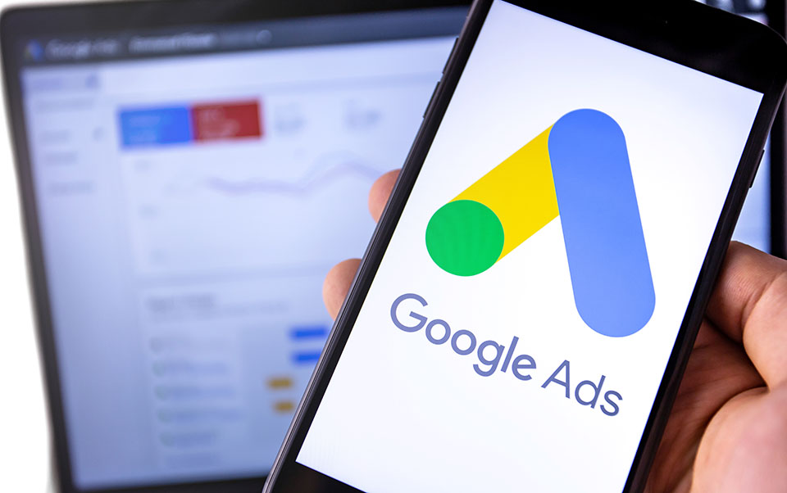
Using Google Ads To Grow Your Business

Slide 3
Jon DeNunzio, Presenter
Owner, Squarely Digital, squarelydigital.com
Marketing consultant and former journalist who helps clients get meaningful results online
Clients are small and medium-sized businesses and nonprofits
Email: jon@squarelydigital.com

Slide 4
What Are Google Search Ads?
Text Advertisements at Top
Pay-Per-Click
Self-Serve Platform

Slide 5
How Do Google Search Ads Work?
1. Keyword
2. Ad
3. Website

Slide 6
Are Google Search Ads Right for You?
This is a complicated question …

Slide 7
Questions You Should Ask …
1. Is There Enough Interest?
2. How’s Your Website?

Slide 8
Questions You Should Ask …
3. What’s Your Goal?
4. Can You Invest?

Slide 9
Questions You Should Ask …
5. Do You Have the Time?

Slide 10
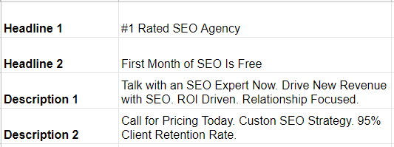
Why Some Businesses Love Them …
1. Simple to Create

Slide 11
Why Some Businesses Love Them …
2. Relevancy
3. Pay Only for Clicks

Slide 12
Why Some Businesses Love Them …
4. Leap Ahead to the Top
5. Quick Results

Slide 13
Why Some Businesses Love Them …
6. Measurable Results

Slide 14
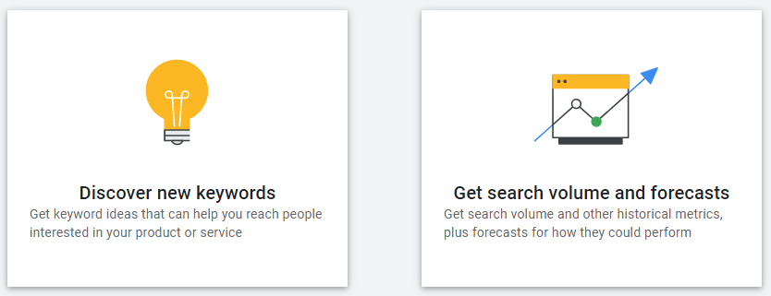
Where Do You Start?
Google Ads Keyword Planner

Slide 15
Additionally …
More Than One Ad
Negative Keywords
Extensions
Ad Schedule

Slide 16
Resources
#ppcchat on Twitter
www.wordstream.com – and its Industry Benchmarks (Search for “Google Ads Benchmarks for YOUR Industry”)
Paid Media Pros YouTube channel
Google Ads Certifications - Skillshop
Contact me: jon@squarelydigital.com

Slide 17
Any Questions?

Slide 18
Thank You!

