Slide 1


Using Productivity Tools Like a Pro:
Solve Your Small Business Productivity Challenges with Cool Tech Tools with Laura. M. Labovich

Slide 2
“The way to get started is to quit talking and start doing. - Walt Disney

Slide 3
CREATE A TECHNOLOGY STRATEGY THAT COINCIDES WITH YOUR GROWTH
PLAN
Consider where you are today, and where you want to be in one year....5 years.
Current Technology
Make a list of everything you have in place right now.
Assess how much are you using your current tech.
Does it make your life better?
Assess current challenges. Can they be solved with technology?
Future Technology
In an ideal world, what would your business look like?
What big growth ideas would you like to implement within 5 years?
Create a technology strategy that coincides with your 5-year plan.

Slide 4

Some of my Favorite Tech Tools and Concepts

Slide 5

CHALLENGE: It takes so much time to agree on a time to meet.
SOLUTION: IMPLEMENT A CALENDAR SYSTEM
Best thing I did for my business – got me “hooked” on productivity hacks! Frees up your time from going back-and-forth with clients for appointment scheduling. I use it for consultations, resume intake sessions, coaching calls, staff coaching calls, demos for my course, etc.
    Acuity Scheduling (www.acuityscheduling.com – great ease of use
      TimeTrade (www.timetrade.com)
      Calendly (www.calendly.com) - Interface is slick and my team can schedule their own appointments.
      vCita (www.vcita.com) - Chat now feature is convenient!
      Appointy (www.appointy.com)

Slide 6
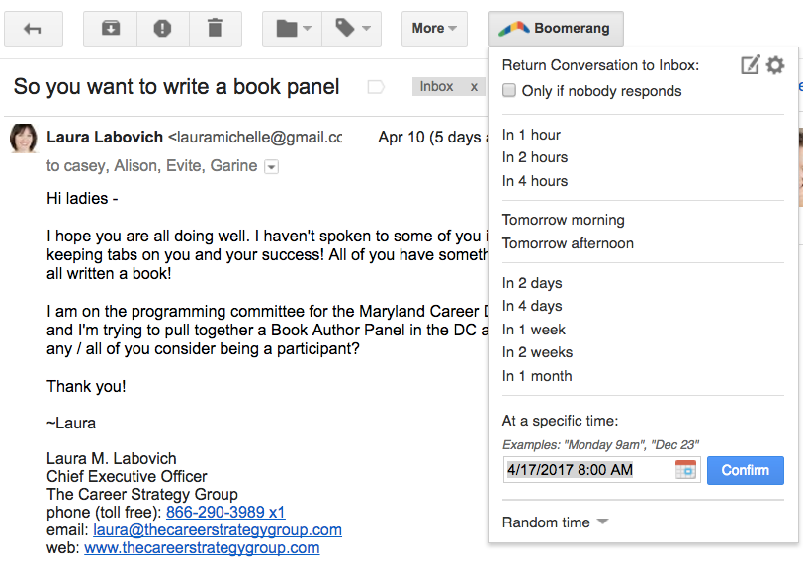
CHALLENGE:
Spending tons of time processing and keeping track of email to-dos.
SOLUTION: BOOMERANG

Slide 7

CHALLENGE: Heaps of paperwork and documents I need to print and scan.
SOLUTION:
PDF
FILLER
Do you cringe when someone asks you to sign and return a PDF? It is easy to share PDFs, but not so easy to edit them! There are few options, short of printing and filling it out by hand, and then scanning or faxing it is time-consuming. You can turn around multiple PDFs in 5-7 minutes!
Free and low-cost alternatives include:
FrameBench (www.framebench.com)
PDF Escape (www.pdfescape.com) - some suggest that truly confidential documents should not be uploaded here, but this is a no-software solution.

Slide 8

CHALLENGE:
I’m stuck under a mountain of emails and I can’t get out!
SOLUTION: UNROLL.ME
An inbox you’ll love.
Unroll.me email management is a game changer.
Instantly see a list of all of your subscription emails.
Unsubscribe easily to whatever you don’t want.
Free

Slide 9
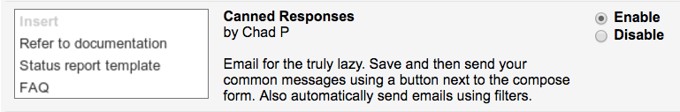
CHALLENGE: I am constantly spending time writing the same #&*! emails.
SOLUTION: CANNED RESPONSES FROM GMAIL (MY #1 TIMESAVER)
Canned Responses are part of Gmail Labs: Some Crazy Experimental Stuff
Copying and pasting the same email over and over again is a nightmare and recipe for lost time.
You can quickly save time using “canned responses” instead.
Easy to set up.
Easy to customize.

Slide 10


CHALLENGE:
It takes a long time to create proposals.
SOLUTION: PROPOSIFY:
PROPOSAL SOFTWARE

Slide 11

CHALLENGE:
I have so much to do and not enough time to do it!
SOLUTION:
HIRE A VIRTUAL ASSISTANT (VA)
What can my VA do for me??
Contact Database Management
Social Media Management
Online Web Research
Search Engine Optimization
Calendar Management
Database Entry & Data Collection
Graphic Design / Photoshop
Blog / Article Writing
Newsletters
Customer Care and/or Referral Program Launch
Focus Group Development

Slide 12
CHALLENGE:
I have so much to do and not enough time to do it!
SOLUTION:
HIRE A VIRTUAL ASSISTANT (VA)
  Where can I find a good VA?
  Ussist.ME
TaskRabbit
TaskBullet
Fancy Hands
Virtual Assist USA
Upwork
If you are having trouble finding a good VA, you can always consult the International Virtual Assistance Association (ivaa.org)

Slide 13
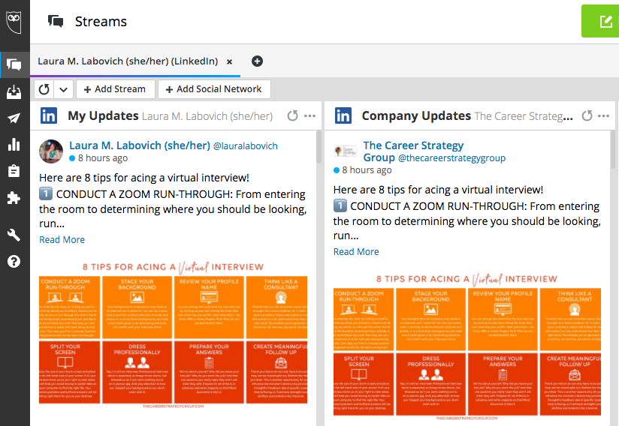
CHALLENGE:
Social Media Management takes so much time!
SOLUTION: HOOTSUITE (or TweetDeck)
Social media is an essential part of our lives and most businesses use social media platforms to gain more visibility, reach out to a larger clientele and grow. Hootsuite is one of the most trusted social media management and scheduling platforms which can help you manage all your social media portals and accounts from one unified tool.

Slide 14
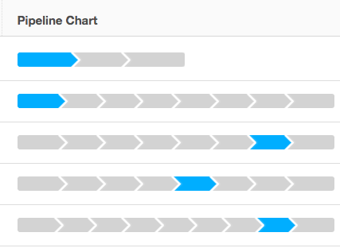
CHALLENGE:
I’d like a way to manage all of my customer relationships, from lead to sale to project completion
SOLUTION: CRMs
Looking for a better way to manage your business? No discussion would be complete without addressing CRMs. Customer relationship management (CRM) software is an all-in-one tool to manage customer info, add notes, send emails, customer satisfaction, and so much more. And, you can do it all without leaving the CRM software platform.
Vtiger for an all-in-one CRM
Zoho CRM for scaling your business
Freshsales for ease of use
HubSpot CRM for a free option
Insightly for project management >>>>
Creatio for automating sales processes
Bitrix24 for an inexpensive option
Agile CRM for marketing needs

Slide 15

CHALLENGE:
I have a zillion cool ideas in my head and I need to flush them all out.
SOLUTION: MIND-MAPPING SOFTWARE
Mind mapping helps you to visualize your thinking....
Use for problem solving, brainstorming, event preparation, project management/meeting planning, task lists
Collaborative
Integrated live chat
Add images, links and attachments
3 mind maps for free – add additional for fee

Slide 16
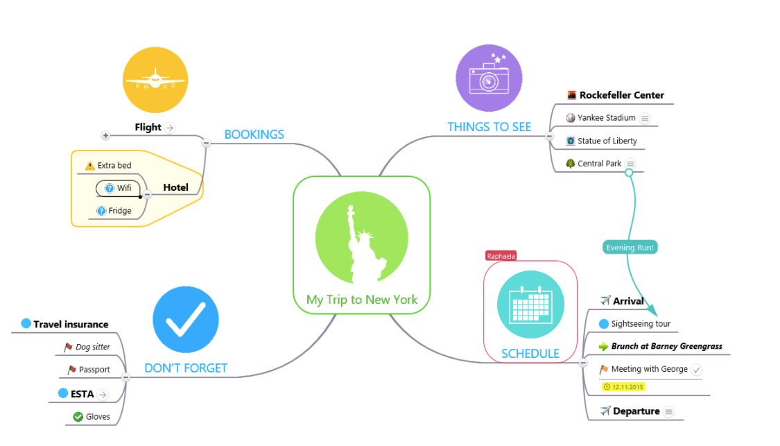
MIND-MAPPING SOFTWARE

Slide 17
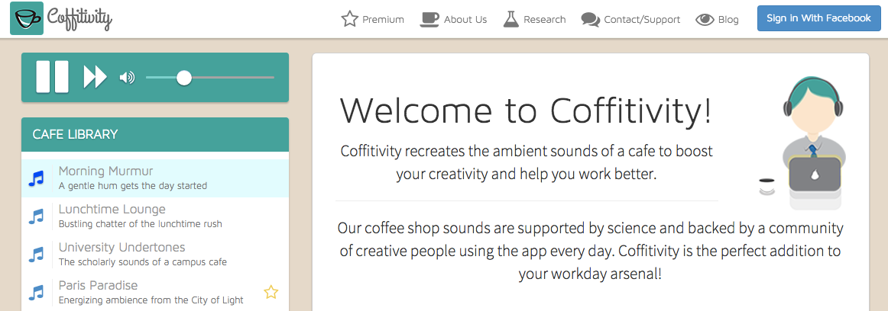
CHALLENGE:
I feel super lonely at working from home!
SOLUTION: COFFITIVITY!

Slide 18
CREATE FOCUS,
BUFFER,
AND
FREE DAYS
FOR OPTIMAL PRODUCTIVITY
FOCUS DAYS
These days are like gold to an entrepreneur. We must protect them. We cannot let meetings, phone calls, technical issues run interference into our schedule.
This schedule consists of long periods of uninterrupted time.
Long: You should be able to block out time to get “in the flow” – this time when things really start to happen, innovate, come to life.
Uninterrupted: No pings! No rings! Nothing. Just pure quiet. (Feel free to use Coffitivity, if it helps you be useful).
Periods: Pomorodoro method is perfect for allowing you to freely enter, and take breaks from, the zone.

Slide 19
CREATE FOCUS,
BUFFER,
AND
FREE DAYS
FOR OPTIMAL PRODUCTIVITY
BUFFER DAYS
The Manager’s schedule consists of meetings. On this day, you can delegate tasks, automate systems, create standard operating procedures, train staff, conduct staff meetings, run retreats, etc.
The key here is that you are “In the business” not working on the business.
Using a calendar system, such as Calendly, TimeTrade or Acuity, allows you to reduce the amount of time in the “back-and-forth,” allowing individuals to choose times that are best for them, thus optimizing convenience for both parties.

Slide 20
CREATE FOCUS,
BUFFER,
AND
FREE DAYS
FOR OPTIMAL PRODUCTIVITY
FREE DAYS
A apple a day keeps the doctor away....it’s true about work life as well. We all need down time to protect our work health.
When you schedule in a Free Day, you are not to work, check email, or make business calls from 12am to 12am the next day. Period.
To stay at the top of your entrepreneurial game, you must:
Schedule these in advance.
Do what YOU want to do. Make them meaningful, fun, relaxing and rejuvenating.

Slide 21
SOME TECH TOOL OPTIONS
Task Management & To-Do Tools
Evernote
Any.do
Toodledo
Carrot
Cloud Storage Tools
Dropbox
Google Drive
Apple’s iCloud
Microsoft OneDrive
Box
CRM
Salesforce
Act!
Nimble
Zoho
Insightly
Marketing Automation Tools
Infusionsoft
MailChimp
Constant Contact
Marketo
Emfluence
Aweber
Social Media / Content Tools
Hootsuite
TweetDeck
Sprout Social
Social Jukebox
Hearsay Social
Buffer App
Web Conferencing Tools
Zoom
Webinar Ninja
Webinar Jam
Instant Teleseminar 2.0
Go to Webinar
Teams

Slide 22
SOME TECH TOOL OPTIONS
Financial Tools
QuickBooks
PayPal
FreshBooks
FundBox
Square
Video Creation / Sharing Tools
Candidio
Periscope
WeVideo
Wistia
YouTube
Travel Tools
Tripit
Breather
Uber
United
Zillow
Collaboration Tools
Dropbox
Join Me
Zoom
FreeConferenceCall.com
Project Management Tools
Asana
Basecamp
Todoist
Trello
Insightly
Web Design Tools
Wordpress
Wix
LeadPages

Slide 23
THANK YOU!
Laura M. Labovich
The Career Strategy Group laura@thecareerstrategygroup.com

