Slide 1


Using SWOT to Grow Your Business

Slide 2
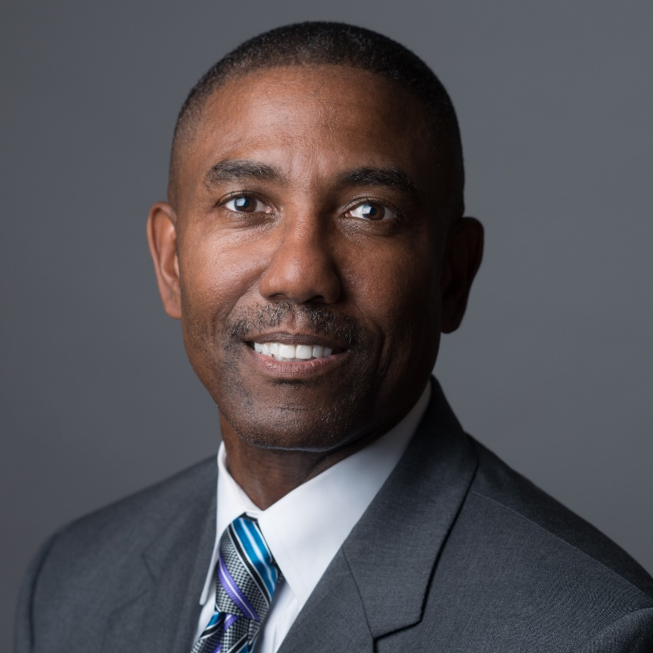
About Mike Williams………
Owner of Growth Coach of Northern VA
Born in Baltimore, MD
Morgan State University Graduate
6 yrs Army Officer
6 yrs Mobil Chemical Company
20 yrs Coca-Cola Company
Married 37yrs (2 Children: Aaron, Alexis)
Live in Fredericksburg, VA (23 yrs)

Slide 3

BUSINESS STRATBUSINESS STRATEGY SESSION
With A Focus on SWOT

Slide 4

Purpose
Review The Planning Process
Identify Strategic Planning vs Planning
Discuss The Benefits of The SWOT
Review How To Build And Use A SWOT
To Provide A Strategic Plan Outline

Slide 5
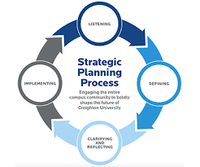
Planning Process Discussion
Why plan? What’s the purpose?
Strategic Planning/Business Planning: What’s the difference?
What does a good business plan look like?
If you have planned in the past, what has worked well? What has not?
What is a good format for a business plan?
Notes:
1.) What are your thoughts around planning? Is it important to plan and if so why?
2.) If I say Business Planning or Strategic Planning are they the same or is there a difference in your mind?
3.) Have you completed a business plan in the past, if so what did it look like? What are the components.
We are going to discuss a step by step planning template………..does not mean you need to change your document or template, but you may want to check to insure that you have all of the planning components and tools to be most successful. Any questions?

Slide 6
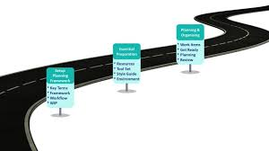
Planning Outline
I. Vision Statement
II. Mission Statement
III. SWOT Analysis (Primary Focus Today)
IV. Short Term Objectives (1 yr)
V. Long Term Objectives (5 yrs or beyond)

Slide 7
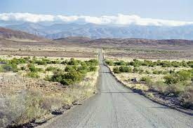
Step 1: Your Vision Statement
Definition: A vision statement for a company or organization focuses on the potential inherent in the company's future, or what they intend to be (Yourdictionary.com).
Should be a long term statement
Should be somewhat broad or all encompassing with respect to your business.
Notes:
This is the actual beginning of the process. It all starts with your vision for your business company or organization. The statement sets the tone for the organization and the plan both short term and long term. Should be broad and should be shared with the entire team. And by the way, if you are not a business owner you can still develop a palnning document for yourself in your organization (You will want it to fit into the total over plan for the business). How can you insure that it is a good fit?
1

Slide 8

Step 2: Your Mission Statement
Definition: A mission statement is a statement which is used as a way of communicating the purpose of the organization (Wikipedia.org).
Should be a little more specific
Your strategy and objectives should support your mission statement (and vision statement).
Notes:
-Defines the purpose of your organization. – Mission statement should not change from year to year. – Vision/Mission statements should be shared with your team. – Even if you are a solopreneur or sole proprietor your team (CPA/Banker/Others) should know and understand your vison/mission and overall plan.

Slide 9
Mission Statement: Examples
The Growth Coach of Northern VA Mission Statement:
To provide successful business solutions through proven processes,
and a clear roadmap for growth.
The Growth Coach (Corp.) Mission Statement:
To significantly transform lives and businesses around the world ... ONE community at a time.
Notes:
Two statements.- One more broad than the other. -Both good statements. – What are your thoughts around these statements? – Do any of you have a mission statement for your organization? Okay let’s do a quick exercise………….

Slide 10
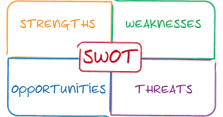
SWOT
SWOT is an Acronym
Strengths, Weaknesses , Opportunities , Threats
It’s a worksheet (Not customer/client facing)
Uses include projects, programs, processes, goals, objectives

Slide 11
Step 3: SWOT Analysis
Strengths (Internal)
Great experience in sales and business management Local presence and availability in market.. Proven processes and programs (Money back guarantee). Tailored program support.
Weaknesses (Internal)
Impatience with process. Must be more deliberate and patient with steps. Too many gratis programs. More paid events/activities. Electronic Marketing (Newsletters/Social Media). SEO Tools: Google Place, Linked In, Facebook.
Opportunities (External)
More exposure: Chamber, BNI, Special Events. Client Focus: Segments (Restuarants, Real Estate, Medical Groups, CPA’s), Referral Partners. Referral Database – Follow up. DISC, Team Building, Business Accountability, Long Term Goal Setting
Threats (External)
Uncertain Economy Owner mindset – “I don’t need coaching” Competition: Action Coach, Vistage, Local Coaches. Owners not focused on a long term winning strategy for their business.
Notes:
Analysis of your Strengths, Weaknesses, Opportunities, and Threats. For this tool to really heal you, you need to be as honest as you can with yourself in completing the analysis. If you are not honest, it won’t help you in writing your goals and objectives..

Slide 12
Exercise: SWOT Analysis
Strengths (Internal)
Weaknesses (Internal)
Opportunities (External)
Threats (External)
Notes:
Analysis of your Strengths, Weaknesses, Opportunities, and Threats. For this tool to really heal you, you need to be as honest as you can with yourself in completing the analysis. If you are not honest, it won’t help you in writing your goals and objectives..

Slide 13

Step 4: 2022/2023 Objectives or Goals
3-5 goals that align with your mission and plan for this year.
Should be SMART: Specific , Measurable, Achievable, Relevant, Time bound.
Use Key Business Indicators such as: Revenue, Sales, New Business, Marketing Tools, Operations Tools, Budget.
Notes:
Increase your self-knowledge: how you respond to conflict, what motivates you, what causes you stress and how you solve problems
Facilitate better teamwork and minimize team conflict
Develop stronger sales skills by identifying and responding to customer styles
Manage more effectively by understanding the dispositions and priorities of employees and team members
Become more self-knowledgeable, well-rounded and effective leaders

Slide 14
2022/2023 SMART Objectives Example
To grow incremental revenue by $500K by 12/31.
Develop a Marketing Calendar to identify activities and investments by 2/15.
Initiate or activate at least one Business Growth Workshop, Webinar, or sponsored business growth activity on a monthly basis starting January 2018 (12 minimum for the year).
Leverage social media resources through training and education. Activate SEO tools such as Google Places by 3/15.

Slide 15

Step 5: Long Term Objectives
1-2 goals or objectives
Timeline should be three years or beyond (3-5yrs)
SMART Objectives.
Notes:
Will or can these objectives change? Certainly. – Why are these objectives important? – Is this part of the potential or purpose of my business?

Slide 16
Long Term Objectives Example
Three year total revenue of $6MM by 12-31-2025.
20 Average annual incremental clients per year by 12-31-2026.
Quarterly paid speaking engagements by 12-31-2026.
Published book by 12-31-2025.

Slide 17

Next Exercise
Discuss Strategic Plan/SWOT
Review Key Learnings/Challenges
What Do You Need To Do Next?
Do you need any other support or information?

Slide 18
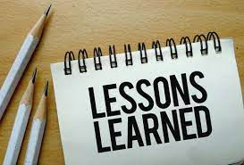
Key Learnings
Process Steps
Key Components
Benefits/Purpose

Slide 19

Planning Summary
Starts with Vision and Mission Statements.
Five Step process
Helpful Tools: SWOT, Marketing Calendar, Budget, KBI’s, 30-60-90 day plan.
Breathing Document – Review constantly, update as needed, benchmark progress.

Slide 20

Planning Outline Review
I. Vision Statement
II. Mission Statement
III. SWOT Analysis
IV. Short Term Objectives (1 yr)
V. Long Term Objectives (5 yrs or beyond)

Slide 21
Growth Coach Programs & Activities
Business Planning Workshops –Strategic Planning/Business Development
Strategic Business Owner Workshops
Strategic Business Manager Workshops
Sales Training Workshops - Sales Process
Sales Mastery Workshops – Process/Objections/DiSC/Mastermind
Team Building/Team Training - High Performance/Time Management/Marketing Networking/DiSC/Other Team Sessions

Slide 22

Questions?

