Slide 1
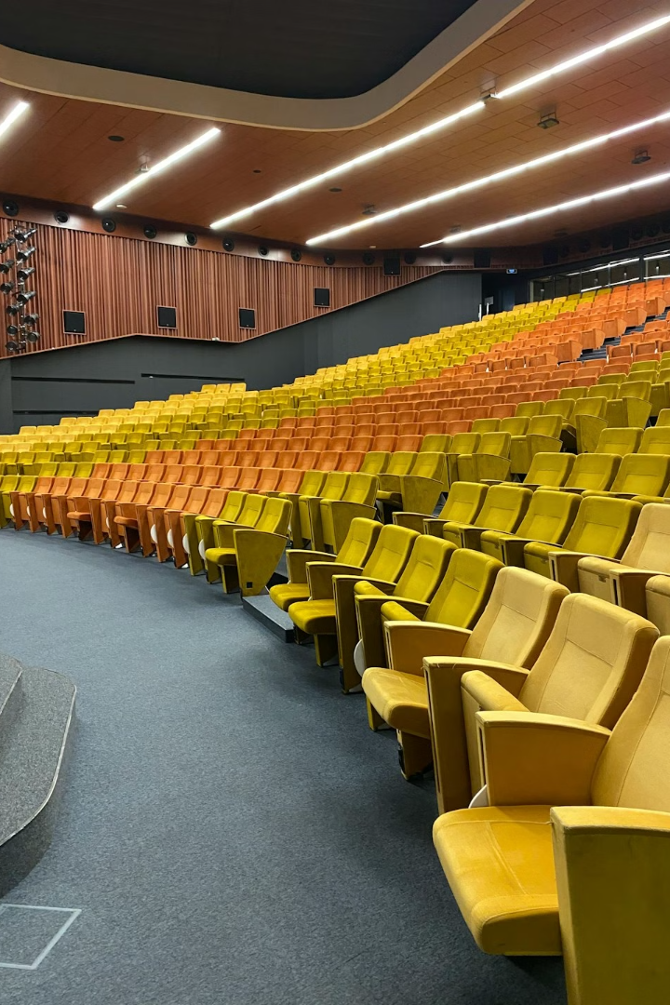
Transform Your Seminar Hall
Cutting-Edge Technology and Safety. Created by Nexus Technologies.
by Anupam das

Slide 2
Optimized Setup for Maximum Impact
Display Placement
Microphone Accessibility
Audio Optimization
Internet Coverage
Centralize the 98-inch 4K UHD display for unparalleled visibility and engagement.
Use the Logitech Group Extended Microphone to enhance sound clarity during video calls.
Install the WiFi router in a central, unobstructed area to guarantee seamless connectivity.
Strategically position podium microphones for presenters and ensure handheld mics are ready for audience interaction.

Slide 3
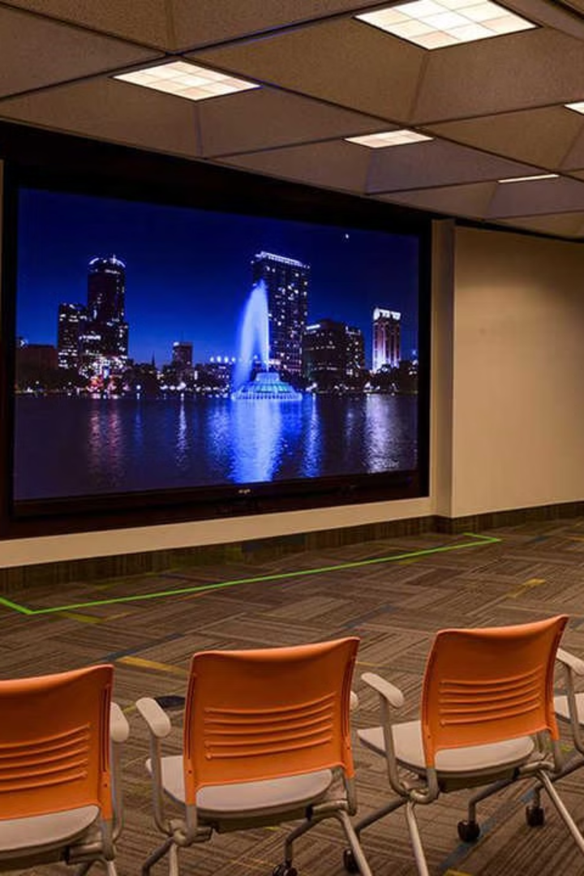
🎥 State-of-the-Art Display System
1
98-inch 4K UHD Display
2
Immersive Experience
Crystal-clear visuals for presentations, local meetings, and software-based video conferencing.
Captivates your audience with a high-resolution, impactful display.

Slide 4
🎙️ Premium Audio System for Seamless Communication
Podium Microphone
Wireless Handheld Microphone
Perfect for presenters to deliver clear, impactful speeches.
Allows freedom of movement for dynamic and engaging presentations.
Logitech Group Extended Microphone
Designed for flawless audio capture during software-based video conferencing.

Slide 5
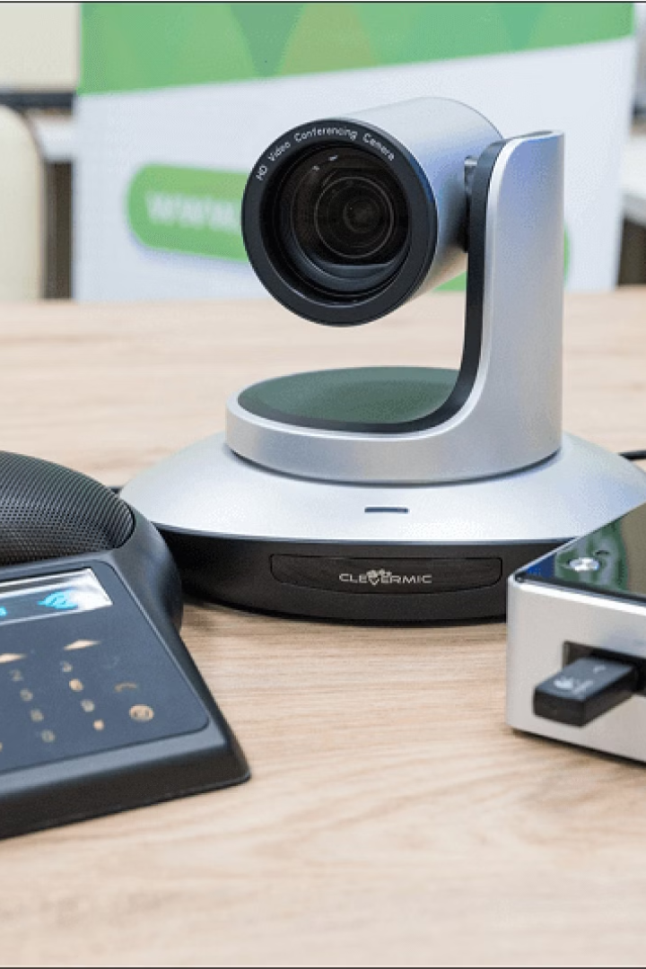
🌐 Streamlined Video Conferencing Tools
Logitech Group
WiFi Router
The ultimate solution for professional-grade video and audio integration.
Provides high-speed, reliable internet connectivity.

Slide 6
🔒 Safety Comes First
1
Modular Clean Agent Fire Extinguisher
2
HFC 236fa - 5 KG
3
Eco-friendly & Compliant

Slide 7
💡 Why Choose This Setup?
1
Enhanced Collaboration
Foster seamless communication for local and remote participants.
2
Immersive Experience
High-quality audio and visuals create a professional environment.
3
Interactivity
Empower presenters and participants with mobility and cutting-edge tools.
4
Safety Assurance
Comply with safety standards while ensuring a worry-free environment.

Slide 8
A Diverse Group Of Clients Have Placed Their Trust In Us

Slide 9
For More Details
Mail us at anupam.d@nexus-technologies.in, WhatsApp / Call us on 9831939190 visit at www.nexus-technologies.in

