Slide 1
Transforming Education with Smart Classrooms
This presentation will explore how integrating the Hikvision DS-D5B75RB/EL 75-inch 4K Interactive Flat Panel Display can enhance teaching and learning in your school.

Slide 2
What is a Smart Classroom?
Technology Integration
Interactive Experiences
Engaging Learning
Smart classrooms leverage technology to create a dynamic and interactive learning environment.
Interactive displays, internet connectivity, and software combine for a seamless experience.
Smart classrooms promote collaboration, engagement, and personalized learning.

Slide 3
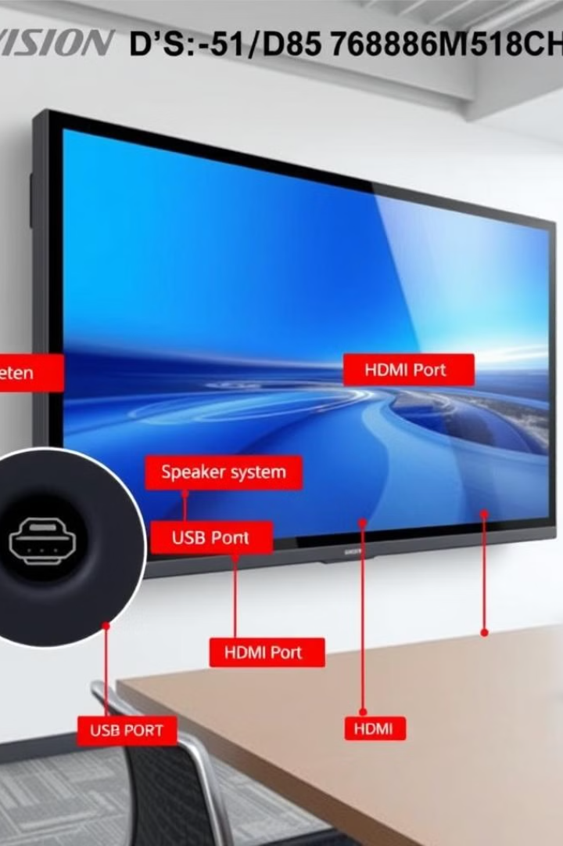
Hikvision DS-D5B75RB/EL Overview
1
4K Resolution
2
Multi-Touch
75-inch display delivers crystal-clear visuals for optimal learning.
Supports up to 20 points of touch, allowing for collaborative interaction.
3
Android System
4
Anti-Glare
Built-in Android system provides access to a range of educational apps.
Reduces eye strain and improves visibility in any lighting conditions.

Slide 4
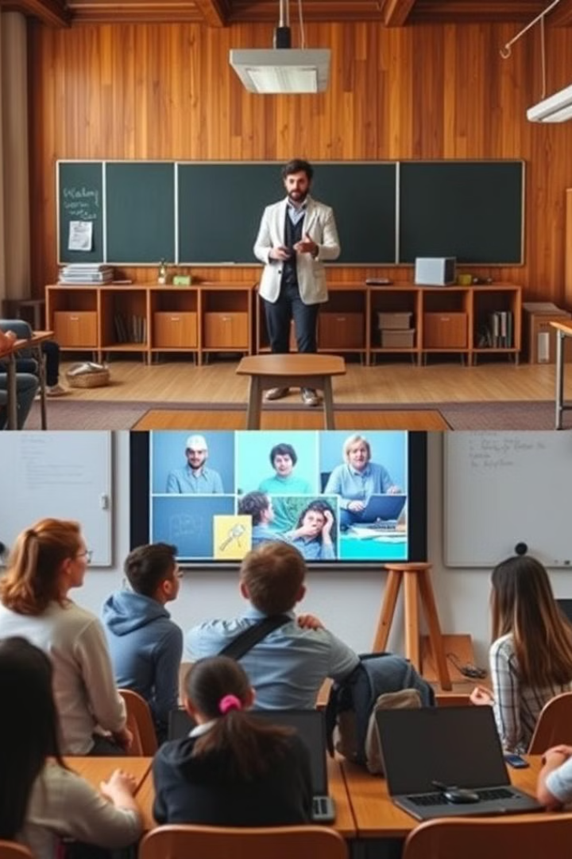
Enhancing the Learning Experience
Interactive Lessons
Software Integration
Multi-touch capabilities transform passive lectures into engaging experiences.
Seamless integration with educational software enhances curriculum delivery.
Wireless Sharing
Accessibility
Wireless screen sharing fosters collaboration and real-time interaction.
Provides accessibility features to accommodate diverse learning needs.

Slide 5
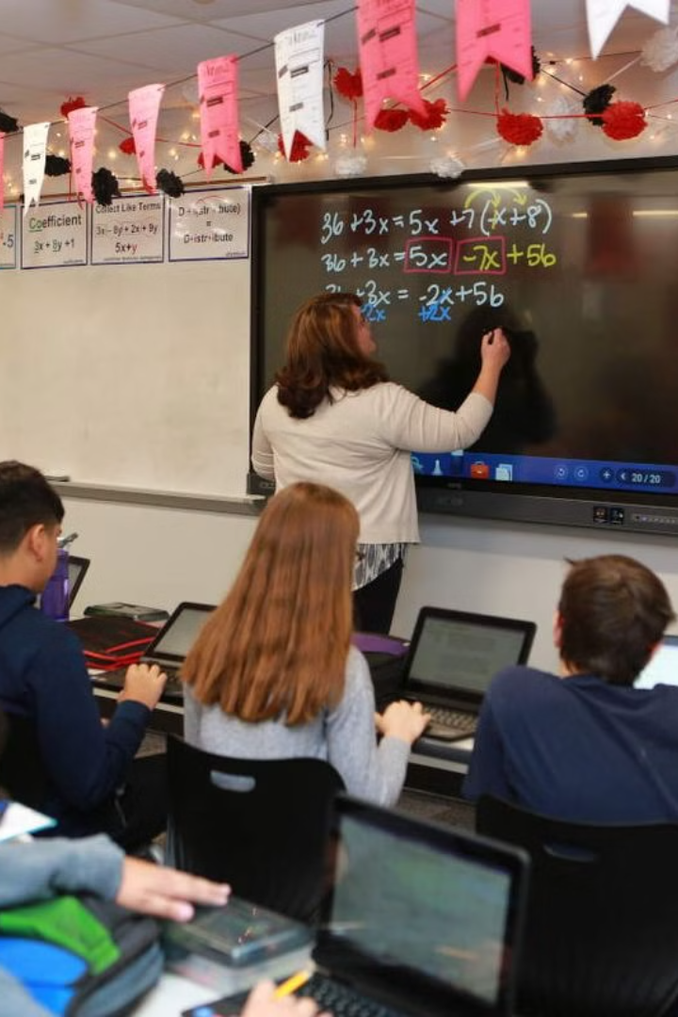
Real-World Applications
Virtual Labs
Interactive Quizzes
Conduct immersive and interactive virtual labs and experiments.
Engaging quizzes and games reinforce learning through active participation.
Real-Time Collaboration
Digital Whiteboarding
Facilitate brainstorming sessions and group projects with ease.
Dynamic lessons with intuitive digital whiteboarding tools.

Slide 6
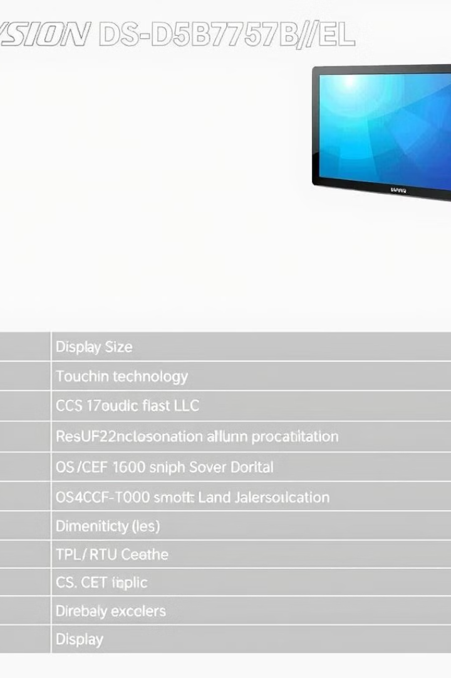
Key Specifications
Display
75-inch, 3840 x 2160 resolution (4K)
Touch
Infrared touch technology with 20 touch points
OS
Built-in Android and compatibility with external Windows systems
Connectivity
HDMI, USB, LAN, and wireless screen sharing
Dimensions
\[Add dimensions, for example: 69.1" x 40.3" x 2.6"\]
Power Consumption
\[Add details, for example: 200 watts, 100-240V, 50/60Hz\]

Slide 7
The Hikvision Advantage
Trusted Brand
1
Hikvision is a global leader in innovative security and smart technology solutions.
Durable & Reliable
2
Durable construction ensures long-term use and investment protection.
Exceptional Support
3
Hikvision provides comprehensive customer support and warranty services.
Future-Proof
4
Advanced technology adapts to evolving educational needs for years to come.

Slide 8
Steps to Integrate the Hikvision Display
Needs Assessment
1
Evaluate classroom needs and existing infrastructure to ensure seamless integration.
2
Procurement & Installation
Procure the Hikvision DS-D5B75RB/EL and ensure proper installation.
Educator Training
3
Provide comprehensive training on using the display and best practices.
4
Lesson Plan Development
Collaborate with educators to develop interactive and engaging lesson plans.
Monitoring & Evaluation
5
Continuously monitor the effectiveness of the Hikvision display and make adjustments as needed.

Slide 9
Success Stories
School A
1
Reported increased student engagement and active participation in learning.
School B
2
Experienced simplified teaching processes with enhanced lesson delivery.
School C
3
Observed improved learning outcomes, particularly in STEM subjects.

Slide 10
Transforming Education
Embrace the future of education with the Hikvision DS-D5B75RB/EL. Enhance engagement, collaboration, and learning outcomes. Invest in technology for a smarter, brighter tomorrow. Visit \[Website/Contact Info\] for more information or schedule a demo today!

