Slide 1
AI Based Surveillance System Architecture
Overview of Components and Workflow
CREATED BY
NEXUS TECHNOLOGIES

Slide 2
System Overview
This system integrates cameras, a processing server, and dashboards to provide real-time monitoring and analytics. It supports both local and cloud-based operations.
COPYRIGHT © 2024 NEXUS TECHNOLOGIES - ALL RIGHTS RESERVED.

Slide 3
Input Devices
IP Camera: Captures video and streams it over the network.
Direct Connection Camera: Sends data directly to the server via LAN.
External Storage (e.g., Pen Drive, Hard Disk): Used for data storage and transfer.
COPYRIGHT © 2024 NEXUS TECHNOLOGIES - ALL RIGHTS RESERVED.

Slide 4
Image Processing and Data Server
- Processes data from cameras and storage devices.
- Performs tasks like motion detection, facial recognition, and data compression.
- Prepares data for storage or transmission to dashboards.
COPYRIGHT © 2024 NEXUS TECHNOLOGIES - ALL RIGHTS RESERVED.

Slide 5
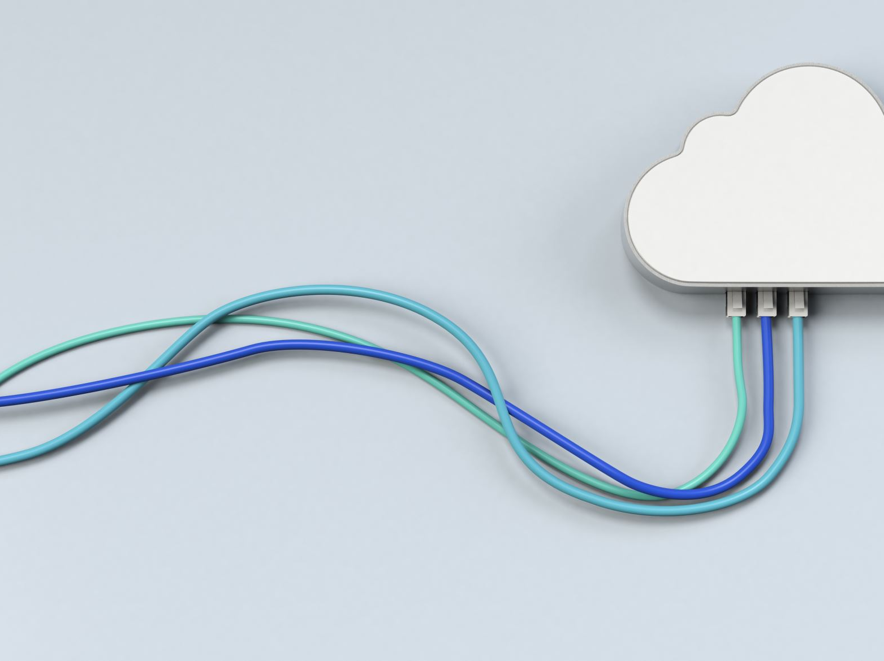
Dashboard Options
Local Dashboard: Hosted within the same network for secure, offline monitoring.
Cloud Dashboard: Accessible globally via the internet, allowing multi-location monitoring.
COPYRIGHT © 2024 NEXUS TECHNOLOGIES - ALL RIGHTS RESERVED.

Slide 6
Data Flow
Video and data captured by cameras/storage devices.
Sent to the processing server for analysis.
Processed data is stored or sent to dashboards for monitoring and decision-making.
COPYRIGHT © 2024 NEXUS TECHNOLOGIES - ALL RIGHTS RESERVED.

Slide 7
For More Details Mail us at anupam.d@nexus-technologies.in, WhatsApp / Call us on 9831939190 visit at www.nexus-technologies.in
COPYRIGHT © 2024 NEXUS TECHNOLOGIES - ALL RIGHTS RESERVED.

