Slide 1

Board Annual Report
DRAFT Board Meeting
October 24, 2024

Slide 2
Hardin Community School
Governing Board
2023-2024
John Hohn, Chairman
Mark Bishop
Dennis Burns
Melissa Humble
Kirk Shepherd
Chad Thrush
Jodi Tudor

Slide 3
Purpose – Mission / Vision
Purpose
Hardin Community School is a drop-out recovery conversion school of Hardin County pursuant to Section 3314.03 of the Ohio Revised Code. HCS is a school designed especially for credit deficient "at-risk" students in grades 6-12, with the majority of students ages 16-21 as permitted under the Ohio Revised Code 3314-06.
Vision
Hardin Community School will lead, shape, educate and transform youth into self-motivated, engaged, and successful citizens of the Hardin County community.
Mission
Hardin Community School exists to value, educate, empower, and transform the lives of our students and their families.

Slide 4
2023 – 2024 Enrollment

Slide 5
Current Enrollment
Monday, October 21
30 Students

Slide 6
Finances
FY24 – FY25

Slide 8
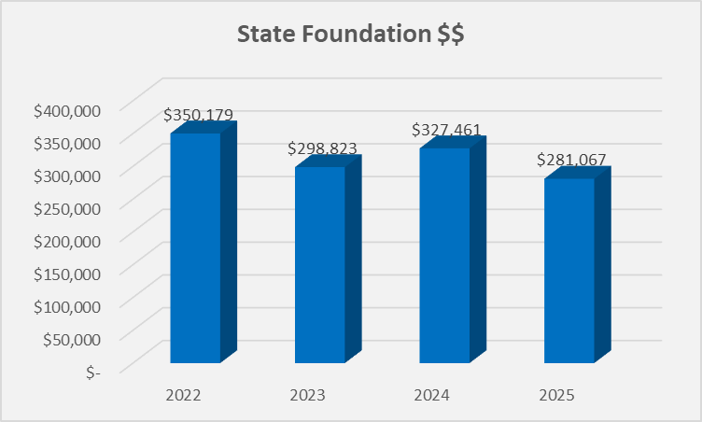
Decreased Revenue

Slide 9
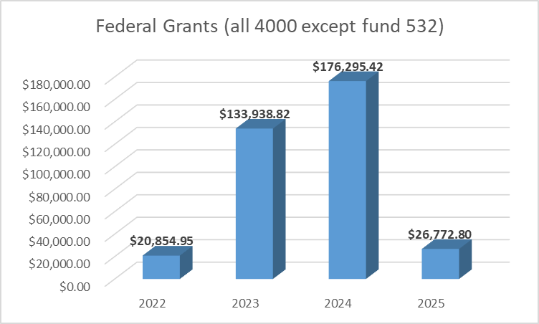
Decreased Revenue

Slide 10
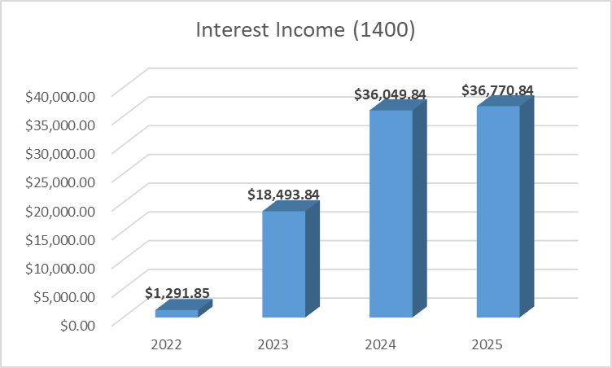
Increase Revenue – future..?

Slide 11
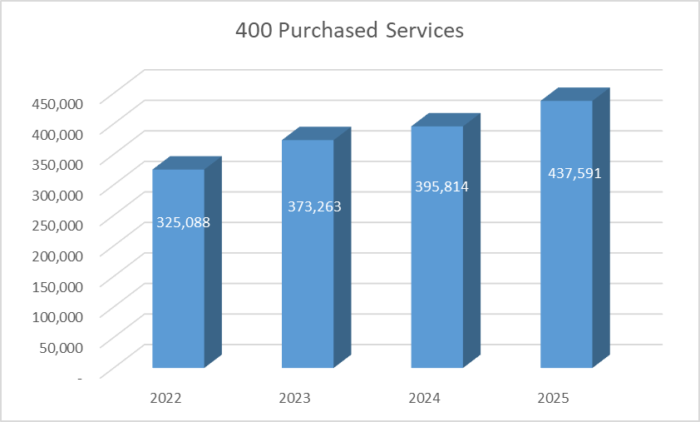
Increased Costs

Slide 12
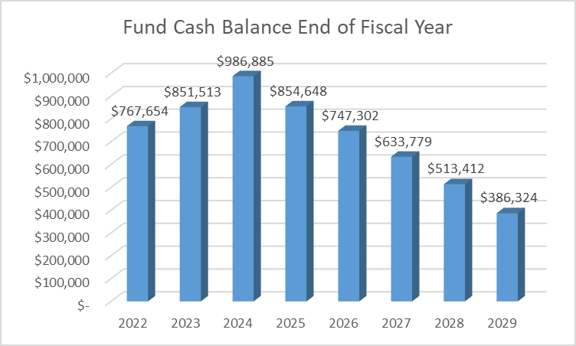

Slide 13
Solutions / Recommendations
Partner with the Court – Share Expenses
Partner with County Schools / ESC (e.g. Behavioral School – share expenses
Expand the School – additional students
Transition out of Business of Education

