Slide 1

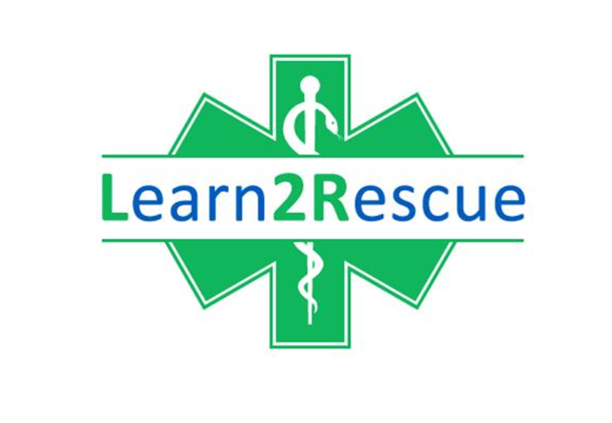
EFAW Quiz
Learn2Rescue EFAW Assessment and
Knowledge Check

Slide 2
How do you know if someone who does not respond to your voice, is unresponsive?
    Keep talking to them and wait for them to reply
    Gently open their eyes and see if their eyes are moving around
    Listen to their breathing and heart is beating
    Push a pressure point or pinch them to check for pain
      Go!

Slide 3
How deep do you push down when doing adult chest compressions?
  As far as you possibly can
  Around 5 to 6cm
  Around 10 - 15cm
  1 cm
    Go!

Slide 4
How many times per minute does a resting 70 year old female breathe approximately?
  100 - 130 breaths per minute
  10 breaths per minute
  Between 12 and 20 breaths per minute
  Between 40 and 60 breaths per minute
    Go!

Slide 5
Which of the following should not be found in a first aid kit?
  Plasters
  Aspirin
  Saline solution (slightly salty water)
  Compression bandages
    Go!

Slide 6
How many hours learning, does the Health and Safety Executive recommend a first aider studies, for a low-risk office with 30 employees in attendance?
  6 hour one day course
  12 hour two day course
  18 hour three day course
  As long as the risk assessment deem it necessary
    Go!

Slide 7
In the workplace, on what occasions do you report incidents to the Health and Safety Executive?
  Every time a first aider is required to attend
  When there is a need to report an injury, disease or a dangerous occurrence
  Only when an ambulance has been called
  If a first aider is fed up of the not being listened to
    Go!

Slide 8
How long do you check for breathing from an unconscious male?
Just a few seconds
12 seconds
You do not need to, if you can see they are not breathing
10 seconds
  Go!

Slide 9
At what point would you shout for help for a non-responsive adult, if you are alone?
  When they do not respond to a pain or pressure test
  As soon as you see they are not moving on the floor
  As soon as they do not answer you asking if they are ‘ok’
  When you establish they are not breathing
    Go!

Slide 10
If a casualty is lying on their front with head turned facing the side, do you need to turn them onto their back to see if they are breathing?
  No, check them as you find them
  No, use a feather next to their nose and see if it moves
  Yes, they have to be on their back for CPR anyway
  Yes, as it is impossible to check them in that position
    Go!

Slide 11
An 18 year old teenager feels unwell. Which question would you not ask?
  Are you on any medication?
  Have you got any pain anywhere?
  Do you have a headache?
  Have you had breakfast today?
    Go!

Slide 12
Why do we check for danger before approaching an injured, bleeding casualty?
  So we need to know what kind of emergency service to call
  So we do not injure ourselves too
  To complete the necessary paperwork after the incident
  To prevent getting our clothes dirty
    Go!

Slide 13
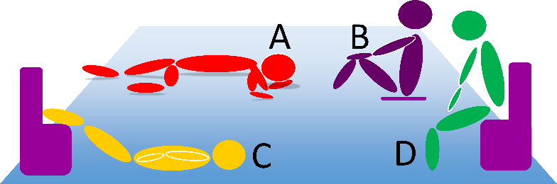
Which position would you put someone in that has lost a lot of blood and feels faint?
  Go!

Slide 14
A restaurant guest starts to cough ineffectively while eating grapes, do you…
  Watch and wait for them to clear the obstruction for up to 5 minutes
  Reach under their arms from behind, and squeeze their chest
  Offer glass a water and small pieces of bread
  Perform 5 hard back blows between the shoulder blades
    Go!

Slide 15
A cyclist falls on a road and grazes their knees, do you…
  Wash with water, cover and tell her to try to keep it dry for 10 days
  Apply over-the-counter antiseptic cream, and give them a plaster
  Remove all little stones with tweezers, clean and cover
  Leave the area to dry in the air with no treatment
    Go!

Slide 16
Why do we leave a finger or thumb visible when bandaging up an entire hand
  So people can still use at least one finger to text
  So the hand skin and wound can breathe
  So we know which finger is not injured
  So we can check circulation in the hand
    GO!

Slide 17
Why is it important to complete an accident form?
HSE need to prove their importance, so we do what they say
In case we forget the accident happened
The accident form is kept to show details of the incident for legal reasons
Because every government organisation requires bureaucracy
  Go!

Slide 18
When would you stop CPR?
After 10 minutes of trying
If the ambulance or AED are definitely going to be more than 8 minutes
When you are told to by a medical professional, (MEDS)
After 30 minutes of trying, and no improvement seen.
  GO!

Slide 19
In the AVPU check for response, we check for pain / pressure…
…by pinching them hard on the nose
…to see if they respond and there is brain activity
…before we check for a voice response
…because it can shock start revival in someone who has stopped breathing
  Go!

Slide 20
First Aid…
… is the immediate assistance given
… provides assistance until a more qualified person arrives
… aims to try to prevent further deterioration
… all of the above
  Go!

Slide 21
Which of the following is correct, for an adult not breathing, WHEN ALONE?
We go and get help as soon we know they are not breathing, without any resuscitation attempts
We start with 5 rescue breaths, then 30 compressions, followed by 2 breathes. After one minute, we go and get help.
Start with 30 compressions and then 2 breaths for one minute, then get help
Perform 5 rescue breaths, get help, return five more rescue breaths then 30 compressions and 2 breaths
Go!

Slide 22
Thank YOu

