Slide 1
Education Outreach: Why and How?
Notes:
Opening presentation
Introduction and career history

Slide 2
Objectives
Understand the need for STEM related education outreach.
Feel confident in engaging local students/parents/teachers. Leverage lessons learned to develop an outreach event.
Notes:
CMSC Education Outreach
Presentations
The Education Zone will be having three Presentations during the conference.
Education Zone Topic III: What we as Professionals can do to reach out for S T E M.

Slide 3
Notes:
My History
Georgia Harris and Elizabeth Gentry persuaded me to become a metrology ambassador.
This committee provides support, training and often assist with educational equipment loans and providing metrology related promotional materials. The committee also offers informational sessions on reaching out to the local school education system. A valuable tool when engaging an education system that can have some political pitfalls.

Slide 4
Extinction – “…the process of eliminating or reducing a conditioned response by not reinforcing it”
Merriam-Webster.com
Notes:
Why education outreach is necessary in Metrology and STEM

Slide 5
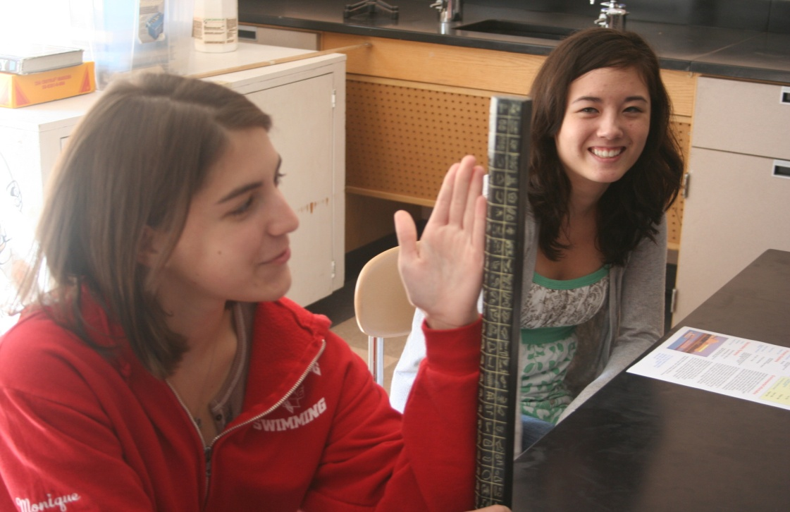
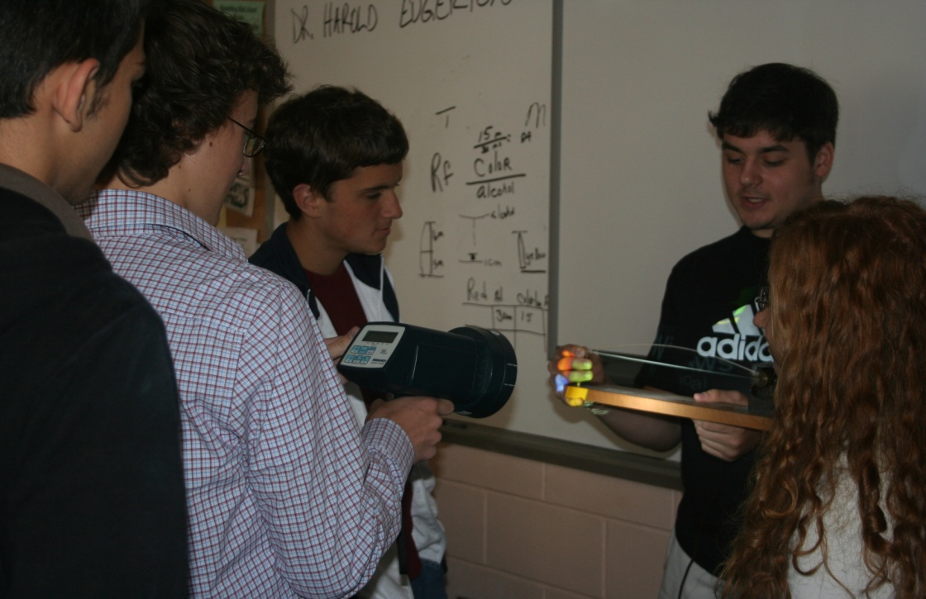
Notes:
NextEra Energy’s Seabrook Station identified surplus M&TE that was no longer needed for plant support and it was deemed prudent to donate them to a local school rather than the recycle bin. The Spaulding High School in Rochester, NH received several items including a new hydrometer for their honors Physics/Chemistry department.
I returned the following week with several items of measuring and test equipment from our lab along with a replica of a cubit for some historical linkage to metrology. The students were introduced to the science of metrology, traceability and how metrology impacts their lives every day. They inspected calipers, pressure gauges, an atmospheric combustible gas monitor and a strobe tach that the students realized could be used to observe one of their physics demonstrators using stop-motion.

Slide 6
PETAC
Governor
Grants and Funding
STATE DOE
SCHOOL ADMIN
Pacing Charts
Student Assessments
Federal Mandate
Federal
Aid
NGSS
STD.
Testing
TEACHERS
Society (Ethics)
PARENTS
FUTURE GOALS ?!
STUDENTS
FRIENDS
Social Media
Notes:
It was at this point in my outreach career that I learned how isolated the schools were from local technology and how isolated the tech sector was from local education. The State of New Hampshire, Department of Education soon began referring to me as the New Hampshire Statewide Metrology Ambassador following the first metrology workshop presented during the 2015 Girls Technology Day events sponsored by the New Hampshire Department of Education. When asked why this distinction, they stated that “nobody else is doing it.”
Flow Chart – Standardized testing typically 3 times per year to determine level of student education. PACE, MAP, Smarter Balance, Dibels (reading in K-6)
PETAC - Pre-Engineering Technology | Bureau of Career Development | NH Tech into middle and high schools. PETAC's role is to advise the Department of Education in the implementation and expansion of the pre-engineering technology curriculum, to assist the Department of Education in the implementation, evaluation, and expansion of the pre-engineering technology curriculum, and to assist the Department of Education in pursuing public and private funds in order to ensure statewide access to pre-engineering technology curriculum coursework for public school students in grades 6 through 12. (188-E:15)

Slide 7
“Tell me and I forget, teach me and I may remember, involve me and I learn”
- Ben Franklin
Notes:
Lessons Learned – Involvement and student contact with technology

Slide 8
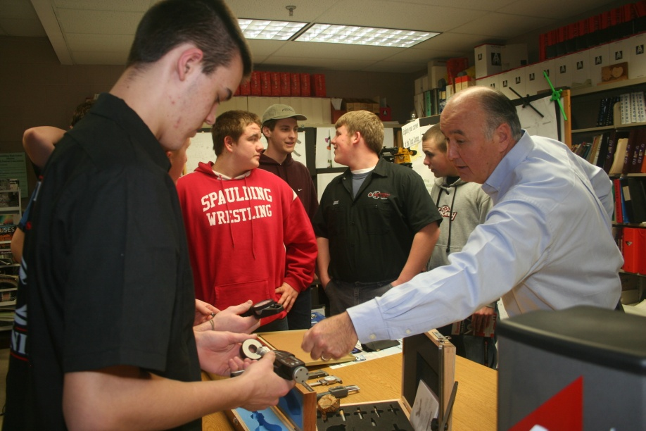
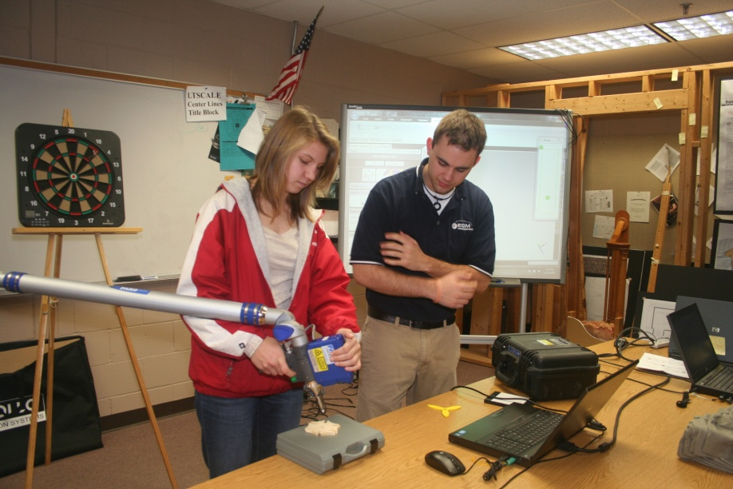
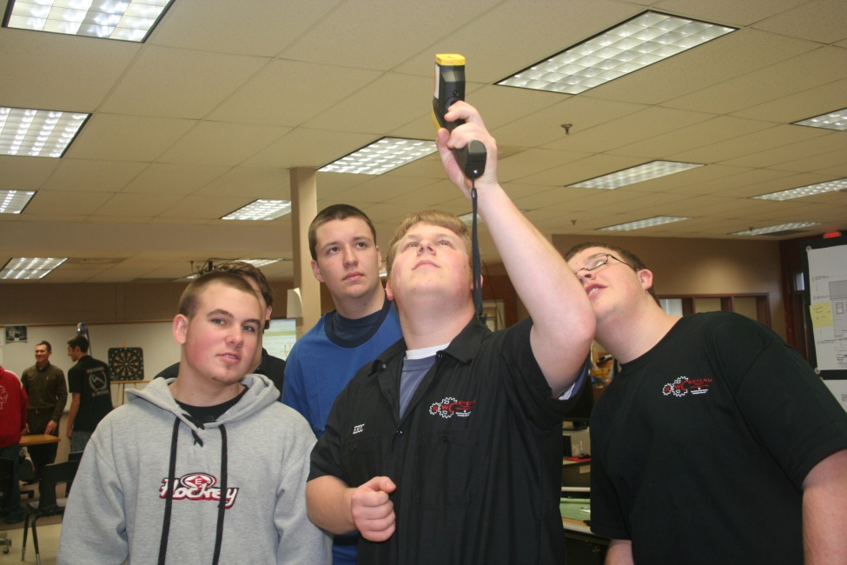
Notes:
First large scale event with multiple presenters – Georgia Harris, Tim Osmer, Gary Confalone, Rob Melanson
Students from Tech Center, Honors science and physics
Several teachers and guidance counselors
Student attention drifts after 20-minutes – move to contact and discovery time.

Slide 9
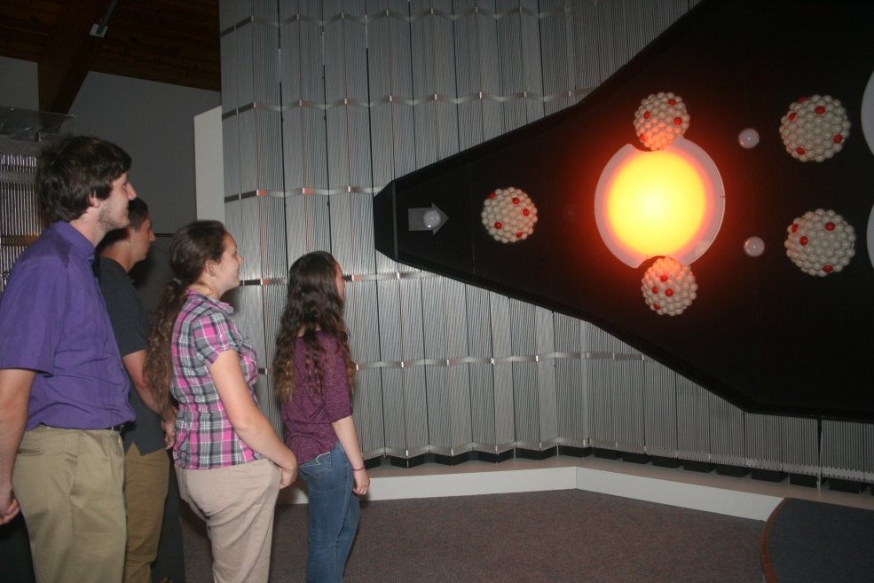
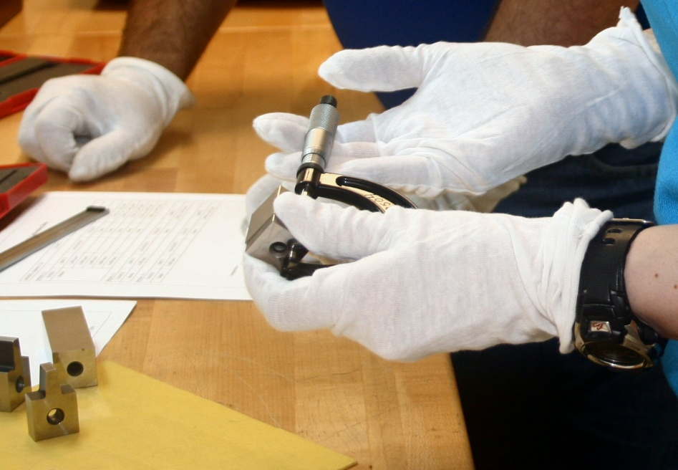
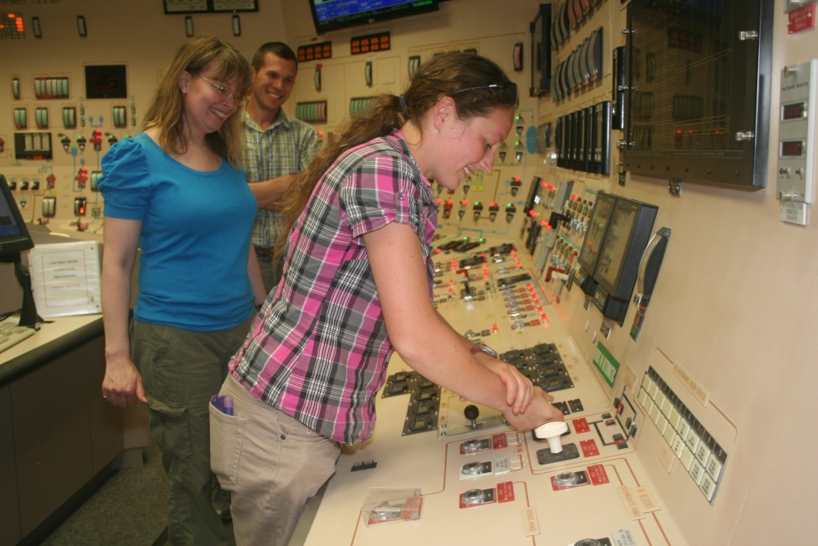
Notes:
Seabrook Metrology Visit

Slide 10
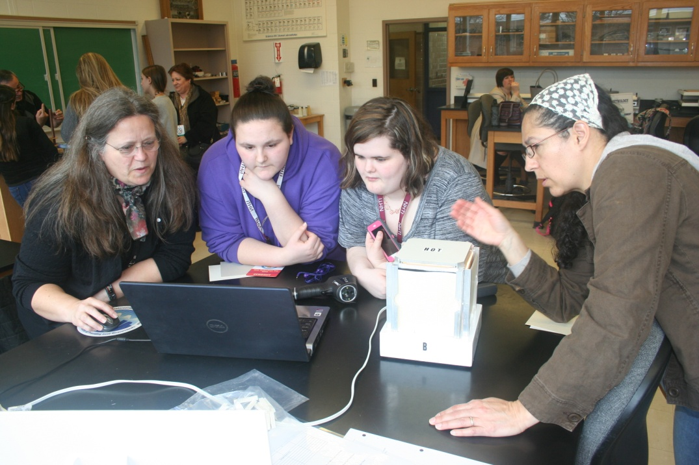
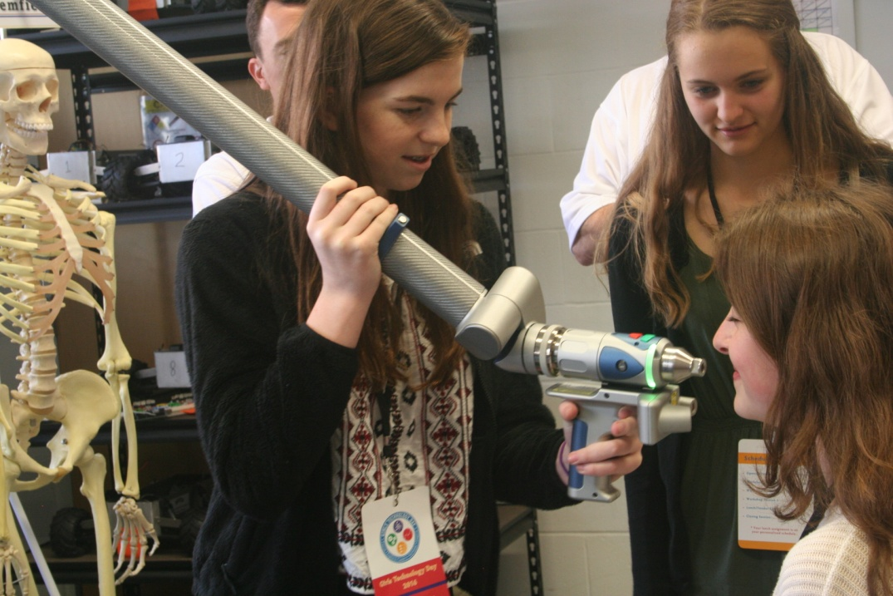
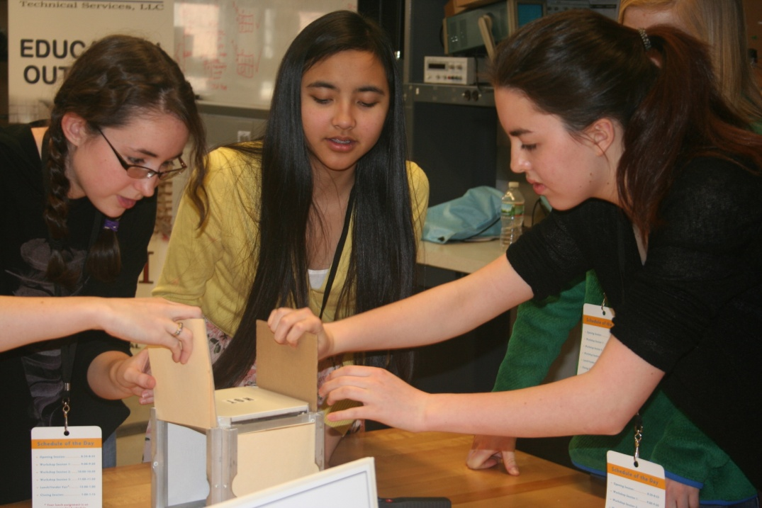
Notes:
STEM Taskforce 2014 by executive order. Office of STEM education through Governors High-Tech Council, Tech Women-Tech Girls and CCSNH fostered Girls Technology Day through DOE.
Girls/Women are under represented. 48% of workforce but less than 24% of STEM related workforce (Source: https://en.wikipedia.org/wiki/Women_in_STEM_fields)
Metrology Ambassador efforts in GTD

Slide 11
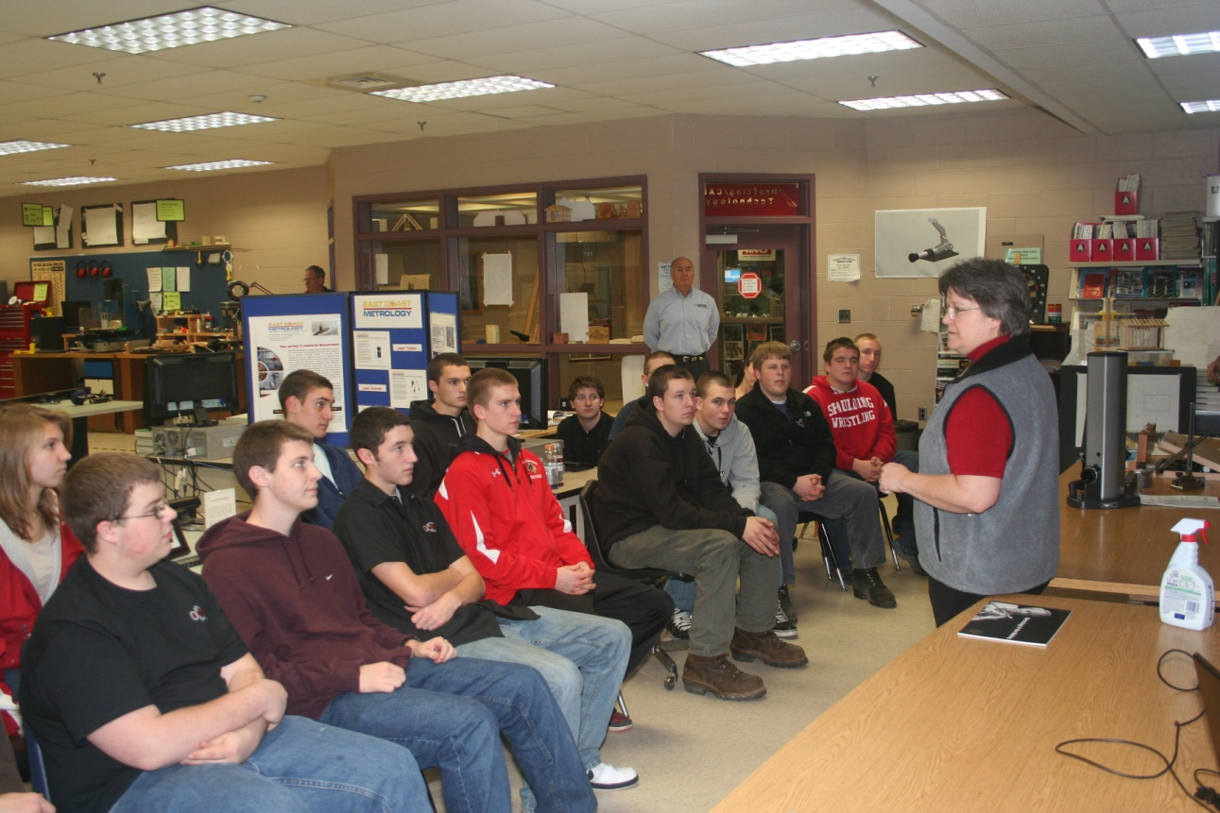
Metrology and
STEM Careers
?
Notes:
High School students decide to go into STEM careers and Metrology?
Most already guided by parents, teachers and guidance staff toward 4-year schools. OLD THINKING!
We need to start sooner.

Slide 12
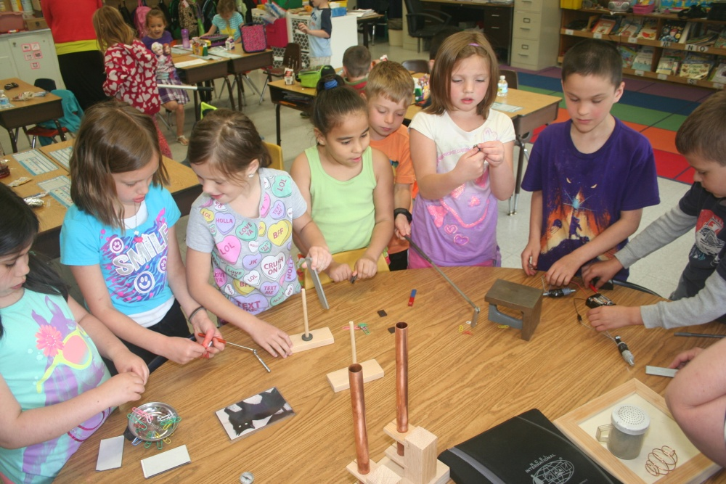
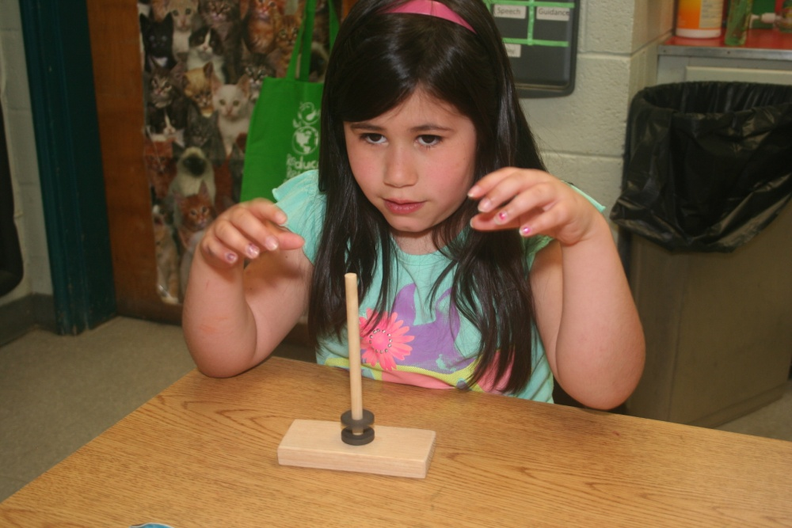
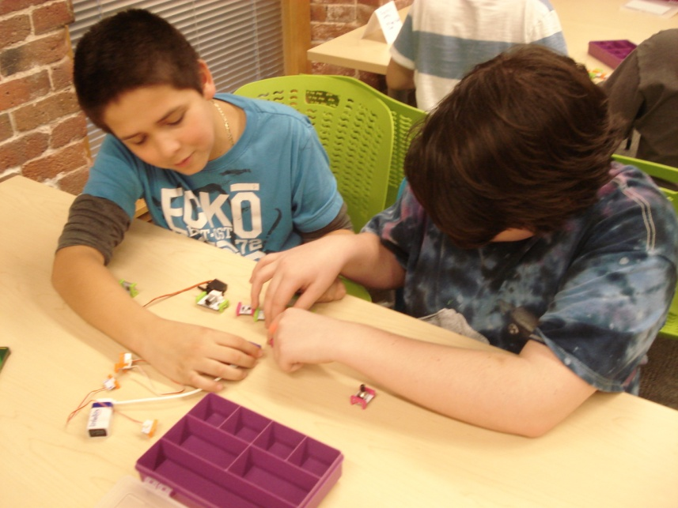
Notes:
Reaching down to elementary and up to CCSNH 14 plus the teachers. NHSTA.

Slide 13
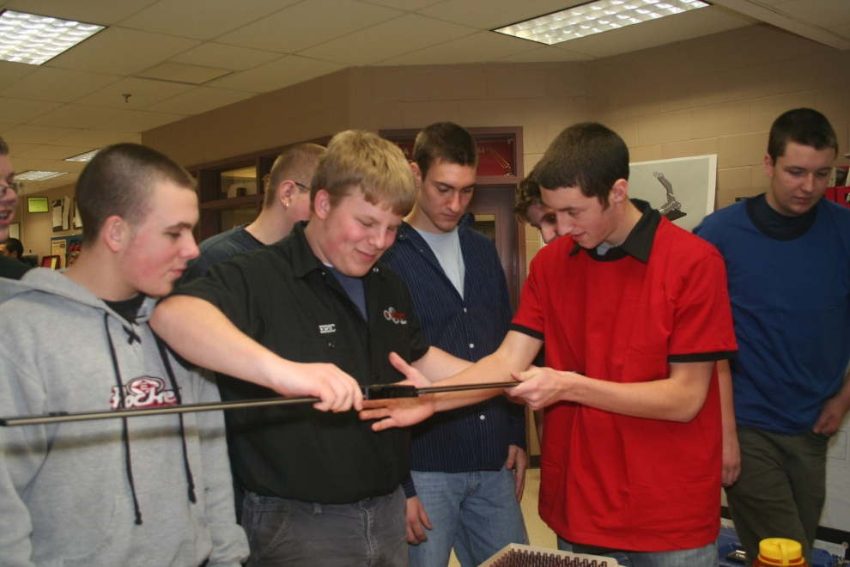
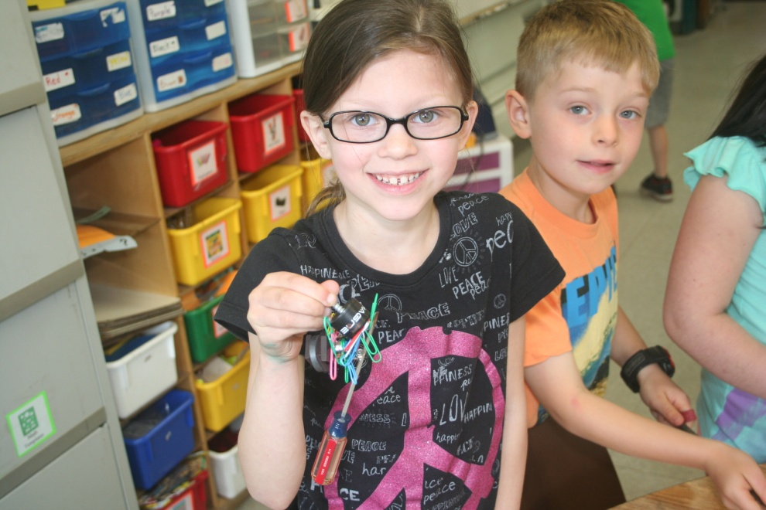
Notes:
Video of Spaulding and McClelland are available.

Slide 14
Objectives
Understand the need for STEM related education outreach.
Feel confident in engaging local students/parents/teachers. Leverage lessons learned to develop an outreach event.
Notes:
Objectives

Slide 15
“Involve me and I learn”

Slide 16
QUESTIONS?
Notes:
It is very clear that we need more STEM educated people to keep pace with the workforce demands from technology based industries. Metrology is currently part of that demand on STEM skills. We understand the need for this training and education outreach can be a part of the success path but not by putting students and teachers, in the seats and simply talking at them. They all benefit from engagement and interaction with local industry partners as well as the traditional education community. Like Ben Franklin said, “Involve me and I learn.”
Questions?

Slide 17
wdhinton@gmail.com
603-335-9315
Notes:
Thank You

