Slide 1
WHY BUILD A SMALL SIDED SOCCER CENTER? ALAN GEORGESON PRESIDENT, SMALL SIDED SOCCER ASSOCIATION AND CONSTRUCTIVE 4 GROUP CONSULTING 2023

Slide 2
INTRODUCTION
15 million+ soccer players in the USA
Small Sided soccer is fastest growing variant
IT’s for everyone
Fits in tight spaces
Soccer clubs and US Soccer are IN
Small Sided Soccer Centers are profitable

Slide 3
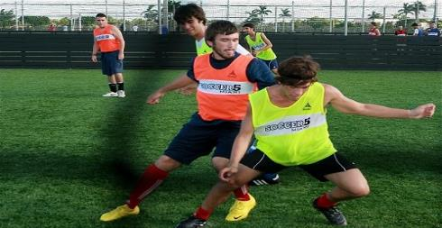
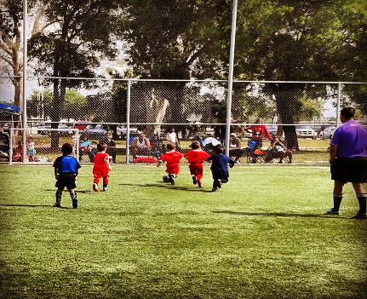
SMALL SIDED SOCCER WHAT DOES IT MEAN?
Small size fields – 8+ small fields can fit in 1 big field
Small sided games – 3v3 to 8v8
More touches on the ball= more fun=more learning
Played from age 3 through all ages
Social soccer

Slide 4
HISTORY OF SMALL SIDED SOCCER CENTERS
UK in the 1970’s
12 field project on 2 acre city site
Kids and Adults
Europe now has 50,000+ custom small sided soccer pitches
More play small sided soccer than 11 v 11 in Europe
US will be the same within next 5 years

Slide 5
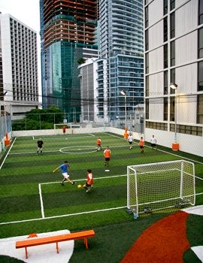
IF I BUILD IT WILL THEY COME?
Location, location, location
CRE Professional
Capital cost
Do the planning
Do the math
Stand back
Go

Slide 6
THE PLANNING PROCESS
Site size
How do we finance?
Planning phases
Making a profit
Hire the right consultant!

Slide 7
CONSULTING, DESIGN AND CONSTRUCTION PHASES
The Consulting Plan
Center Design
Permitting
Hiring the right General Contractor!
Ensuring Specifications are in place which are proven
Warranties/VFM analysis

Slide 8
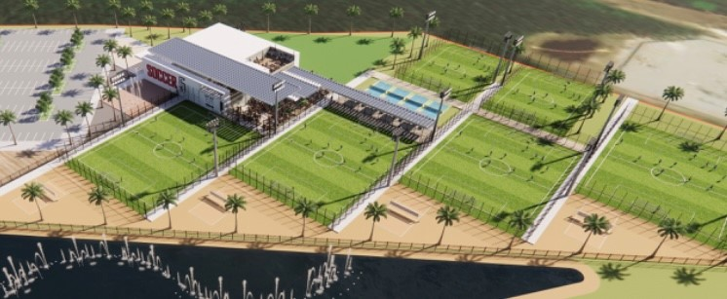
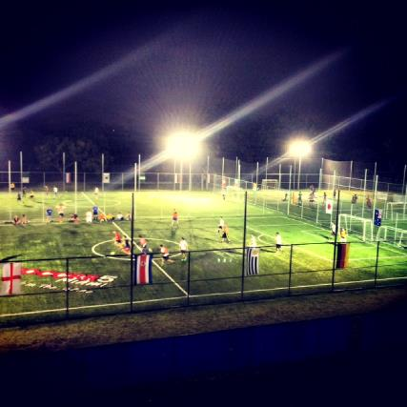

Slide 9
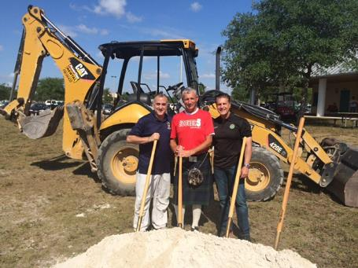
MARKETING AND OPERATIONS
Staffing
Facilities
Operations Manual
Benchmarking
On the case
Strong cashflows

Slide 10
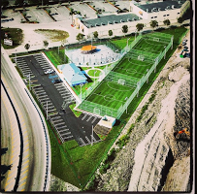
FACILITIES
Design
Maintenance
Security
Warranties
Staffing

Slide 11
CASE STUDY
Miami Dade County Florida
P3 Projects
Soccer 5
Design. Build. Team
Visuals

Slide 12
QUESTIONS
www.smallsidedsoccerassociation.com
Constructive 4 Group
Sports and Leisure experience – 100+ soccer projects
www.constructive4.com

