Slide 1



THE ART OF
EVALUATION
Date of presentation

Slide 2

NOTES FOR TEACHING
Please adapt/alter this PowerPoint in as many sections as you wish.
In this PowerPoint we will look at how students can present evidence/research to support an argument that they may be using in extended writing. This will include looking at:
What is evaluation
How to evaluate well
Top tips for extended writing
The best way to signpost an evaluation point
Activities to help your students evaluate
Application of knowledge for extended writing
Extended writing in research methods
2

Slide 3
WHAT DOES EVALUATION MEAN?
THE ABILITY TO ASSESS
THE SIGNIFICANCE, WORTH
OR QUALITY OF SOMETHING.
3

Slide 4
EVALUATION
Psychology qualifications require evaluation as one of the ‘assessment objectives’.
Students are assed on their ability to:
Analyse
Apply
Assess
Analyse and evaluate scientific knowledge and processes.
Apply scientific knowledge and processes to unfamiliar situations, including those related to issues.
Assess the validity, reliability and credibility of scientific information in terms of its implications to the theory/study.
4

Slide 5
HOW TO EVALUATE WELL
EVALUATING A THEORY
Where relevant refer to:
Strengths and weaknesses of the theory.
Use evidence to support or criticise the theory.
Discuss issues relating to culture, gender,
nature/nurture, free will, determinism/reductionism.
Application of the theory.
5

Slide 6
HOW TO EVALUATE WELL
When evaluating research or a theory, it is very important that students use research evidence, not anecdotal evidence
(they need to show they have been studying psychology!).
Good exam answers use examples of relevant research to support a point or as a counterargument.
It is not enough to just say ‘I believe that…’
6

Slide 7
HOW TO EVALUATE WELL
GIVE ENOUGH INFORMATION:
An answer can only gain high marks if there is enough information in that answer. Check how many marks are being awarded for the question and use this as a guide to how many points should be made in your answer.
FOR EXAMPLE:
A question of 16 marks requires more evaluation points than an 8 mark question. Also, remember that evaluation can include strengths as well as weaknesses of a theory/research study.
7

Slide 8
HOW TO EVALUATE WELL
EVALUATING A STUDY
It is good to consider the following methodological points when evaluating a study but ONLY if relevant to the question.
Sample
Controls (such as demand characteristics) Bias
Research design
Reliability and Validity e.g. inter-rater reliability or internal/external validity and or ecological validity
Ethics
Data analysis
8

Slide 9
HOW TO EVALUATE WELL
CONSIDER SEVERAL POINTS OF EVALUATION
High-scoring answers evaluate a theory/research study by considering several points such as:
Ethical issues
The methodology used
Validity
Reliability
Usefulness
Effectiveness, etc.
FOR EXAMPLE:
An evaluation of a therapy for mental disorders could consider any research evidence about:
The therapy’s appropriateness and effectiveness.
Ethical issues, whether it can be used for many disorders.
How it compares to other therapies (making it clear in what way the therapy is better/worse.
9

Slide 10
EXTENDED WRITING IN
RESEARCH METHODS
WRITTEN
DESIGNED
RESEARCHED
Some awarding bodies will require the student to write about a research study but each board will have their own specific requirements that are assessed as evaluation.
Some awarding bodies may require the student to design a research study.
Others may require the students to carry out a specific piece of research that the students will be required to write about.
KEY ADVICE: Know your awarding bodies’ requirements and how they will be assessing this type of work.
10

Slide 11
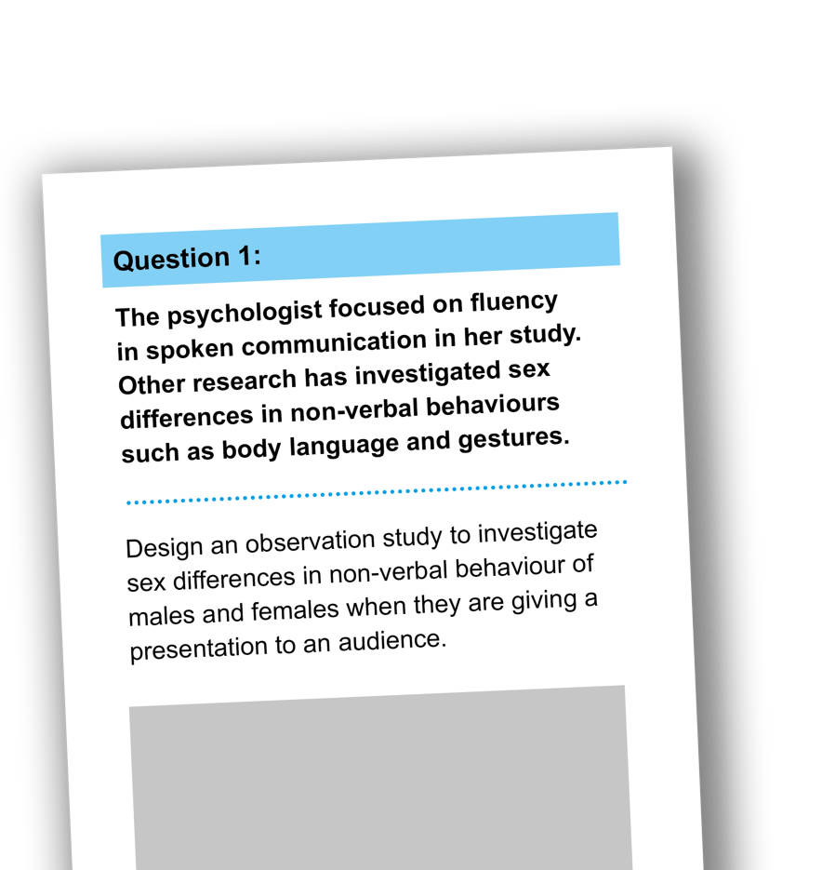
EXTENDED WRITING IN
RESEARCH METHODS: EXAMPLE
In the answer the students should provide detail of:
The task for the participants
The behavioural categories to be used and how the data will be recorded
How reliability of the data collection might be established
Ethical issues to be considered.
(12 marks)
11
Notes:
AQA

Slide 12
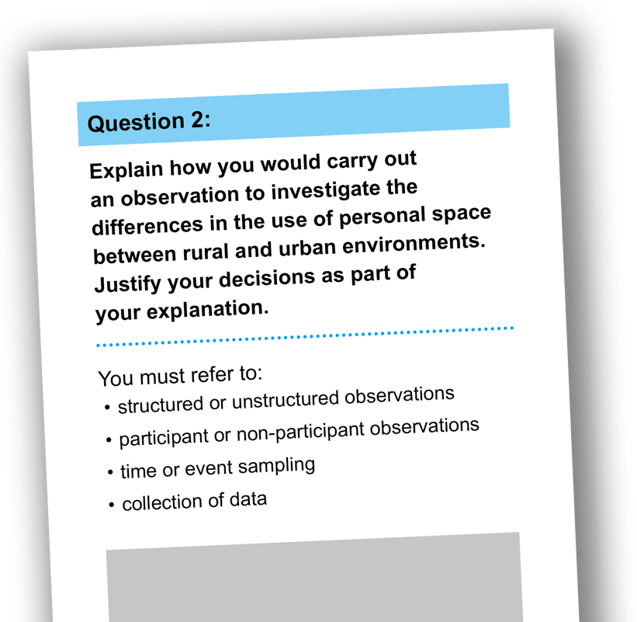
EXTENDED WRITING IN
RESEARCH METHODS: EXAMPLE
Students should use their own experience of carrying out an observation to inform their response. (15 marks)
12
Notes:
OCR

Slide 13
HOW TO EVALUATE WELL
KEEP IT RELEVANT:
Good answers relate the evaluation directly to the theory/research study in the question. They use the findings of other evidence which may support or conflict with the theory/research.
Good answers do not wander off the point into a description of other research or theories without showing how they relate/link
to the theory/research in the question.
13

Slide 14


HOW TO EVALUATE WELL
USE TERMS EFFECTIVELY:
Using psychological terminology correctly and explaining how it relates to the research/theory will gain marks. For example:
‘A weakness of the study is that it is conducted in a laboratory which means that it has low ecological validity.’
‘A problem with the study is that it is conducted in laboratory which is an artificial setting. The participants may behave differently in the laboratory than they would in real-life situations. The study has low ecological validity which means that it is not representative of naturally-occurring behaviour and the findings may not generalise to other settings.’
14

Slide 15

TOP TIPS FOR EXTENDED WRITING
15

Slide 16
TOP TIPS FOR EXTENDED WRITING
In examination conditions students should jump straight to the point of an essay; there is no time for a nice introduction.
Remember to show knowledge and understanding often referred to as descriptive writing
Evaluation is best demonstrated by:
Using evidence to support or criticise a point being made
Strengths and weaknesses of the theory/study
Consider the implications of Methodology issues to the theory in question or study is a studies-based question
Keep focused on the question… refer to it frequently
Remember, a good answer will also:
Have effective use of knowledge
Have no anecdotal evidence
Answer the question set
Show depth and breadth
Be organised
16

Slide 17
TOP TIPS FOR EXTENDED WRITING
Evaluation may include the following:
Offering support for your point (using evidence such as other studies) which must be explicitly flagged as a support or criticism
Strengths/weaknesses
Commentary which challenges the findings
Beware of ‘shopping list’
Beware of anecdotal information
Answer the question set
Organise the answer
Balance between depth and breadth
Dates and names: you do not need to know the names and dates of researchers but if you can it helps
17

Slide 18
TOP TIPS FOR EXTENDED WRITING
Consider the implication of a methodological issues to the theory if the question is a theory based question.
After each point, try to conclude and link back to the original point or question. This will help to keep the essay focused.
Use key phrases to demonstrate the skills that are about to be used.
18

Slide 19
KEY PHRASES
This means…
This approach to this topic…
This account is about…
S/he used this method…
S/he is a…
S/he believes in…
His/her data was collected by…
His/her hypothesis is…
This theory argues that…
The definition of…
The findings of this study are…
From this perspective…
The methods are…
The method used…
The main issues were…
S/he argues…
S/he sought to explain…
This study shows…
KNOWLEDGE AND UNDERSTANDING
Psychological ideas, debates theories, concepts, research findings. Explain in your own words the meaning of…
19

Slide 20
An example of this is…
In this context it may mean…
… suggests that…
Studies that support this view include…
According to studies by…
…also agrees with this study/theory
Demonstrates, shows illustrates, examines
This is relevant because…
This doesn’t apply because…
Explain the relevance in terms of…
An interpretation of this…
An application of this…
This theory/perspective can be applied…
This is typical of…
This coincides with…
In support of…
The reason for this…
This identifies…
The significance of…
KEY PHRASES
INTERPRETATION AND APPLICATION
Ability to select and use relevant psychological material in order to explain psychological problems and answer particular questions. Ability to identify the psychological significance of data presented in different forms.
20

Slide 21
KEY PHRASES
Validity of which
Adequately explain
It is arguable that…
In summary…
By analysing
In conclusion
From another perspective
These studies conflict because
Contrast with
They differ because
My reassessment of…
The extent to which
The accuracy of
Similarities between
In my opinion
Validity/reliability/representativeness
The adequacy of the explanation
EVALUATION
Ability to assess evident and argument in order to reach a reasoned conclusion and judgement.
The strengths/weaknesses of this analysis are…
This argument fails to explain…
On the other hand…
This proves/disproves…
A small degree of research failed to operationalise/consider…
21

Slide 22
TOP TIPS FOR EXTENDED WRITING
Different awarding bodies have a very slightly different approach to assessing extended writing.
Know what the assessment criteria are for the qualification you are studying, know how the marks
will be allocated, according to description, evaluation
and application.
Know if the conclusion is a key element for your qualification and always try to give a balanced argument.
22

Slide 23
STUDENT ACTIVITIES

Slide 24
STUDENT ACTIVITIES
Students find evaluation hard; the solution is to get students to evaluate without realising it!
Task:
In pairs, give students a box of mini cereals from a variety pack.
Ask each of the pairs to discuss the strengths and weaknesses of their pack, what is good about it, what is bad about it, they could consider the design of the pack, ingredients, taste, health benefits etc.
Each pair then has to compare and contrast their pack with another group. Which is best and why?
You don’t have to use cereals. You could use things like bands, cars, football teams, whatever will engage your class.
24

Slide 25
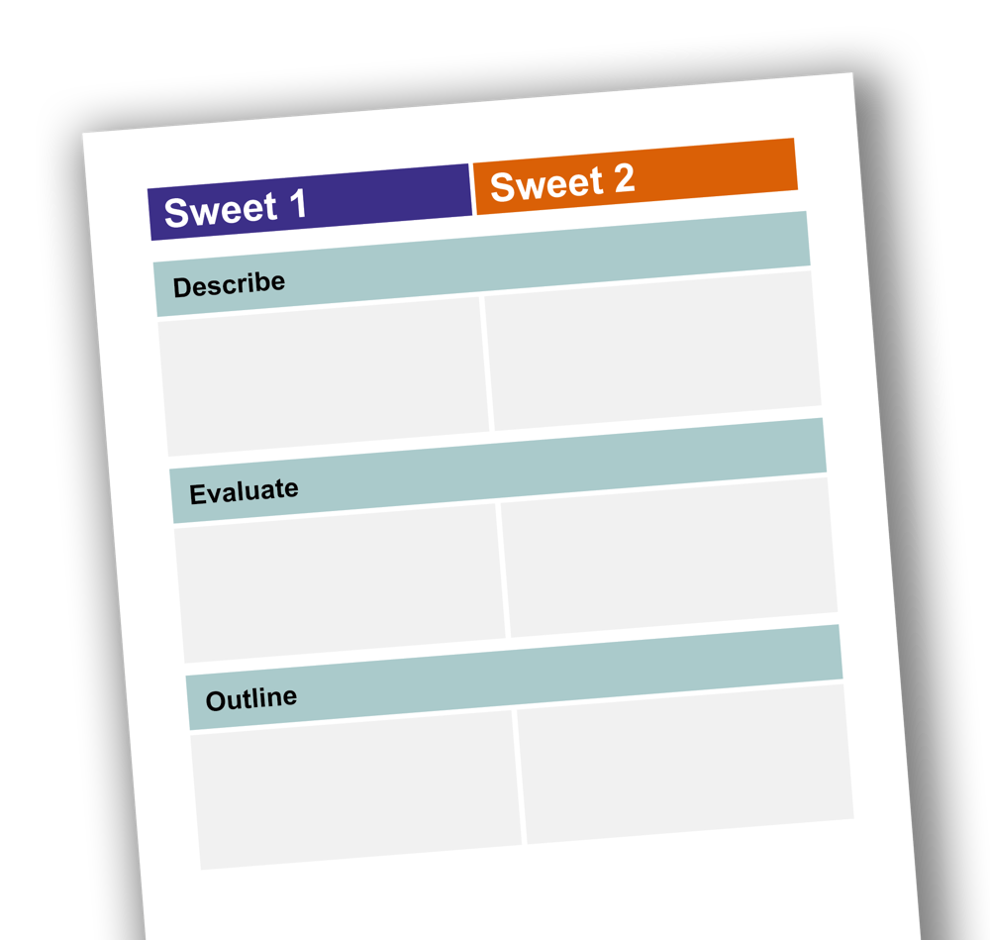
STUDENT ACTIVITIES
Task:
Give all students a sweet from a box of different types of chocolates or sweets. Also give them an official list of command words.
Their task is to complete the activities on the sheet e.g. Outline your sweet, describe your sweet, evaluate your sweet etc.

Slide 26
STUDENT ACTIVITIES
Remember PEEL: Point. Example. Explain. Link.
Outline and evaluate research into the effects of leading questions on EWT.
POINT
EXAMPLE/EVIDENCE
EXPLAIN
LINK
A weakness of Loftus’ research is that it lacks ecological validity.
Watching a video of a car crash is very different to experiencing one in real life.
Participants were told to watch the video carefully. In real life we don’t get a warning that an event is about to take place. Also there is no emotion involve in watching a video. In real life we may be anxious or scared.
Which could affect our memory.
26

Slide 27
STUDENT ACTIVITIES
Put students into groups of four. Each group gets a POINT
(evaluation point for an essay question your are going to plan together)
Task: PEEL your point
After 5 minutes swap points until all groups have seen all points.
Feedback to class.
You can use this activity with the following mnemonics as well or vary the task.
27

Slide 28
OTHER USEFUL MNEMONICS
An alternative to PEEL is PEC.
PEC
Make you POINT.
Explain how and why this point is relevant.
Discuss the consequences and/or implications to the theory or study.

Slide 29
OTHER USEFUL MNEMONICS
GRAVE
Generalisability
Reliability
Application
Validity
Ethics
BUT, beware generic, drop in evaluation – must be relevant to the question.

Slide 30
OTHER USEFUL MNEMONICS
SCODA
Supporting Studies
Criticism of supporting studies
Opposing studies
Different theories
Application to real life
Again, beware generic, drop in evaluation – must be relevant to the question.

Slide 31
OTHER USEFUL MNEMONICS
GRENADE
Gender Bias
Reductionism vs Holism
Ethical issues and Socially Sensitive research
Nature vs Nurture
Approach
Determinism vs Free Will
Ethnocentric (Cultural Bias)
Beware generic, drop in evaluation – must be relevant to the question.

Slide 32
ACTIVITIES TO HELP STUDENTS
EVALUATE
Peer Assessment
Give students an evaluation paragraph to assess
Individually get them to decide if it is:
Basic (Level 1, Level 2)
Reasonable (Level 3) or
Effective (Level 4)
Once they can confidentially recognise basic, reasonable and effective, students can then work in small groups or pairs to improve a basic or reasonable answer to an effective one.

Slide 33
EVALUATION LEVELS

Slide 34
EVALUATION LEVELS
Basic (Level 1/Level 2)
The cognitive interview technique is much more time consuming than a standard police interview. This makes it more expensive.
Reasonable (Level 3)
The cognitive interview technique is much more time consuming than a standard police interview. This makes it more expensive. Many police officers are not in favour of the cognitive interview technique as not only does the process take longer, but there is more evidence to process which may or may not be useful.

Slide 35
EVALUATION LEVELS
Effective (Level 4)
The cognitive interview technique is much more time consuming than a standard police interview. This makes it more expensive. Many police officers are not in favour of the cognitive interview technique as not only does the process take longer, but there is more evidence to process which may or may not be useful. Also, because the cognitive interview technique is much more complex than the standard police interview, it takes a long time to train officers to deliver the technique effectively. This may be a barrier to its implementation as all police forces are under financial and time constraints.

Slide 36
MODEL ANSWERS
Model answers can really help to boost student’s confidence and show
them exactly what is required.
Either write your own or use exemplars from students.
BUT, how do you ensure students read them?
Get active:
To ensure students read the exemplars. Cut words out and get students to work out which word goes where.
E.g Describe and evaluate the working memory model of memory (12 marks)
Extension activity: What mark would you give this answer and why?

Slide 37
MODEL ANSWERS ACTIVITY
Deconstruct an essay:
It is helpful for students to understand the requirements of an extended writing
question, for example:
Describe and evaluate monotropy as an explanation of attachment (12 marks)
Highlight descriptive element in one colour
Highlight evaluation in another colour
Underline key terms
Using a marking grid, decide in pairs what mark it would get
Or ask students to turn the essay into a plan by bullet pointing the main points

Slide 38
APPLICATION
Apply your knowledge to a scenario such as:
Martin is studying for his modern language exams. He revises French followed by Spanish on the same night and then gets confused between the two.
For example, he remembers the French word for ‘chair’ instead of the Spanish word for ‘chair’. Sometimes his mum helps to test Martin’s vocabulary. When he is unable to remember a word, his mum tells him the first letter, then he can often recall it correctly.
Students must refer to the stem in their answer and use quotes from the stem.

Slide 39
APPLICATION EXAMPLE
Discuss two explanations of forgetting:
Refer to Martin’s experiences in your answer.
A). One explanation for forgetting is interference.
Martin is showing proactive interference as old information is interfering with new information. He revises French first and then Spanish, so the French information is corrupting the Spanish information he is trying to learn, because French and Spanish are similar.

Slide 40
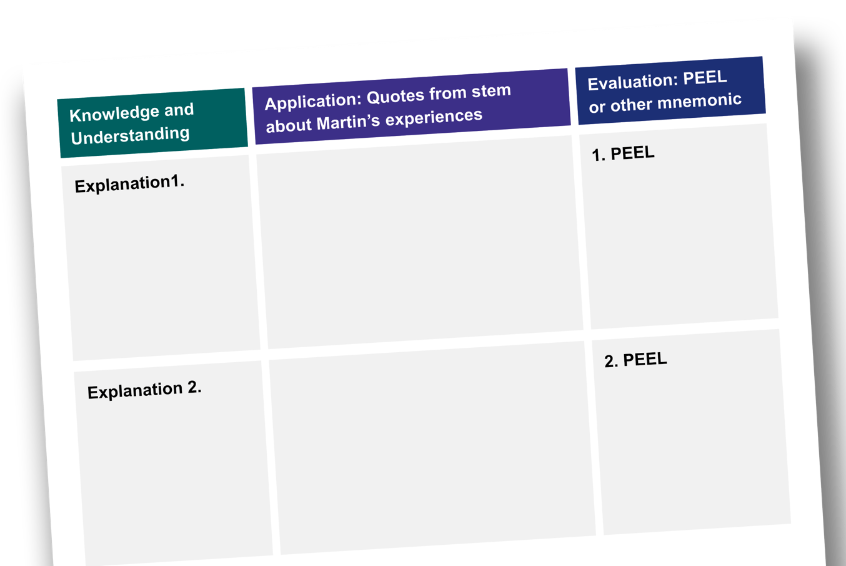
ESSAY PLANNING ACTIVTY
Discuss two explanations
of forgetting:
Refer to Martin’s experiences in your answer.
(Print grid onto A3 paper, students work in groups.)

Slide 41
EXTENDED WRITING IN
RESEARCH METHODS: EXAMPLE
In the answer the students should provide detail of:
The task for the participants
The behavioural categories to be used and how the data will be recorded
How reliability of the data collection might be established
Ethical issues to be considered.
(12 marks)

Slide 42


PLANNING A RESEARCH ANSWER
Details are essential:
The study must show it can be fully replicable.
As well as the details asked for in the question, it is important to remember to think about:

Slide 43


FOUR ELEMENTS OF DESIGN
TO BE CREDITED
The task for the participants
Detail of what the men and women in the study will have to do.
This must go beyond ‘give a presentation to an audience’.
43

Slide 44


FOUR ELEMENTS OF DESIGN
TO BE CREDITED
The behavioural categories
The behavioural categories to be used and how the data will be recorded – detail of specific and observable behaviours to be recorded.
This must go beyond the idea of global constructs such as ‘body language’ or gesture. Also detail of recording method to be used, e.g. record sheet.
44

Slide 45


FOUR ELEMENTS OF DESIGN
TO BE CREDITED
Reliability
How reliability of the data collection might be established, e.g. using two observers/raters and comparing separate recordings; statistical comparison of data from both observers/raters.
45

Slide 46


FOUR ELEMENTS OF DESIGN
TO BE CREDITED
Ethical issues
Specific or more general ethical considerations such as informed consent, debrief etc.
46

Slide 47


REMEMBER

