Slide 1



Pacific Air Switch Corporation

Slide 2

30 Years of leadership in manufacturing Air disconnect
Switch gear

Slide 3
Founded in 1988
Founded when Siemens closed the Tigard, Oregon switch facility and moved it to Jackson, Mississippi
In 1996 PASCOR was purchased by Travis Garske, owner of Travis Pattern, a non-ferrous foundry in Spokane, Washington

Slide 4
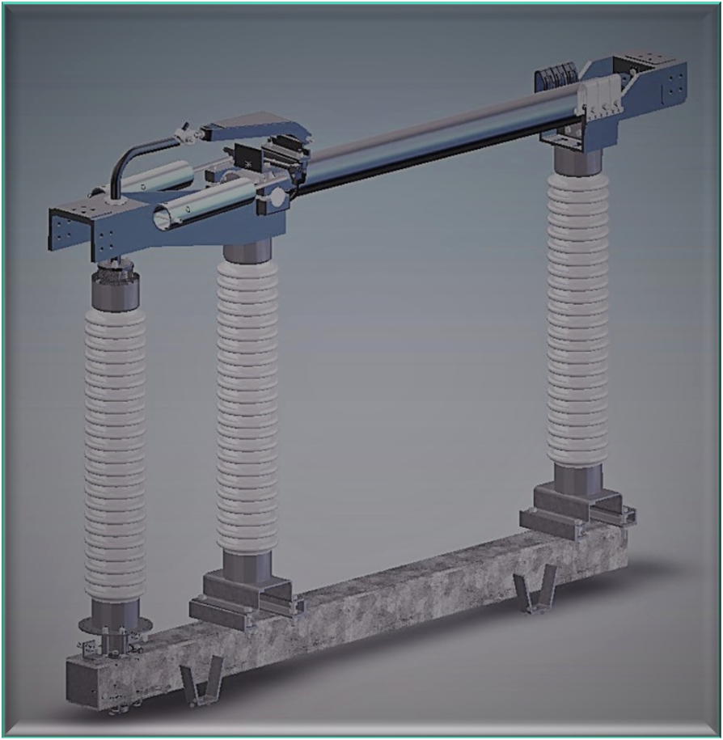
At PASCOR we have three core values that shape our organization and help drive the decisions we make.
Build a Quality Product
Provide Dependable Service
Ensure Customer Satisfaction

Slide 5
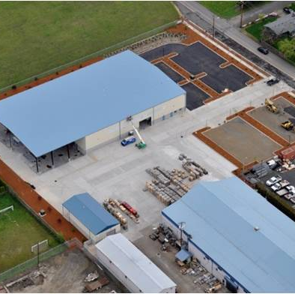
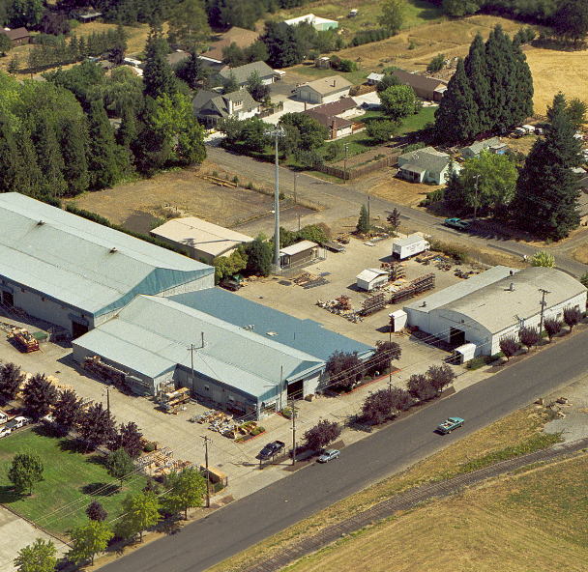
Located in forest grove, OR
(25 min. from Portland)
Over 56,000 Sqft of
Manufacturing Space
& 17,000 Sqft Office

Slide 6
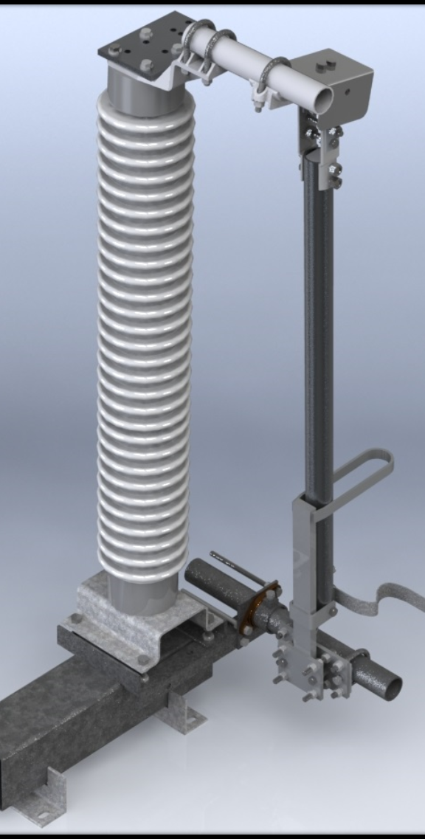
Marketing & Sales
Customer Focus
Technical knowledge
Problem Solving
Collaboration w/ customers

Slide 7
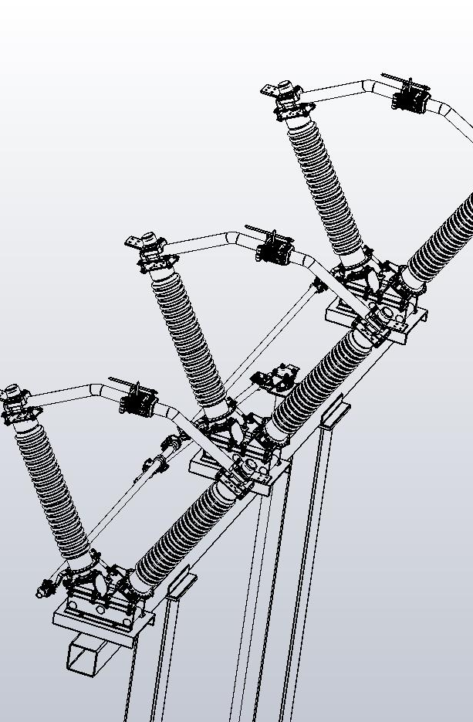
Engineering
Custom design
  CAD & SolidWorks
Problem Solving
Collaboration
IEEE Standards

Slide 8

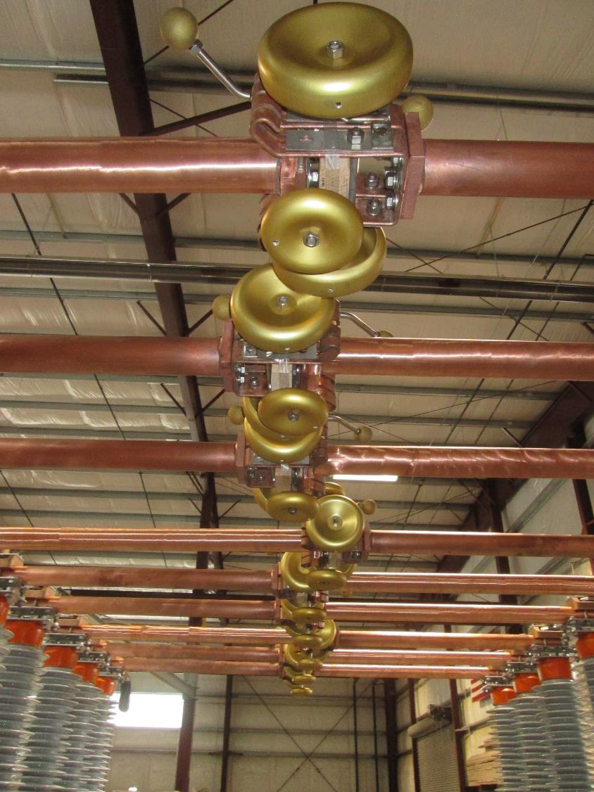
Fabrication & Machining
    Iron Workers
    Hem Saw
    Punch Press
    Lathes
    Drill Press
    MIG & TIG Welding
    Burning & Brazing

Slide 9
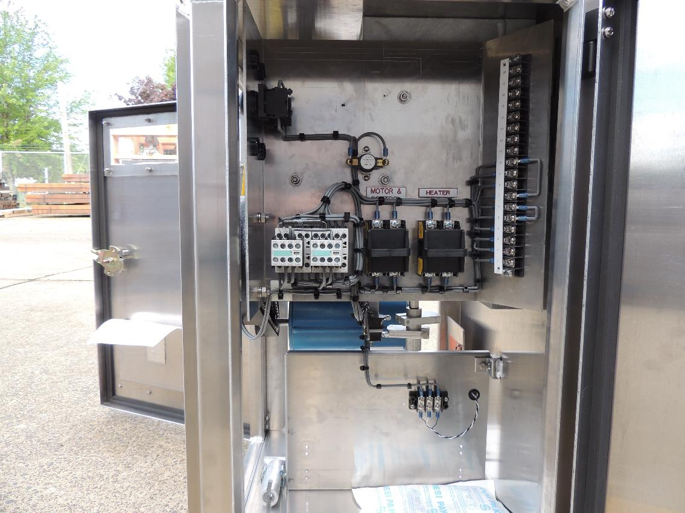
Motor Gear Operator
(MGO)
Custom Designs
NEMA 4

Slide 10
PASCOR Switch Gear
Vertical Break Switches
Center Break Switches
Side Break Switches
Ground Switches
Operators & Accessories

Slide 11
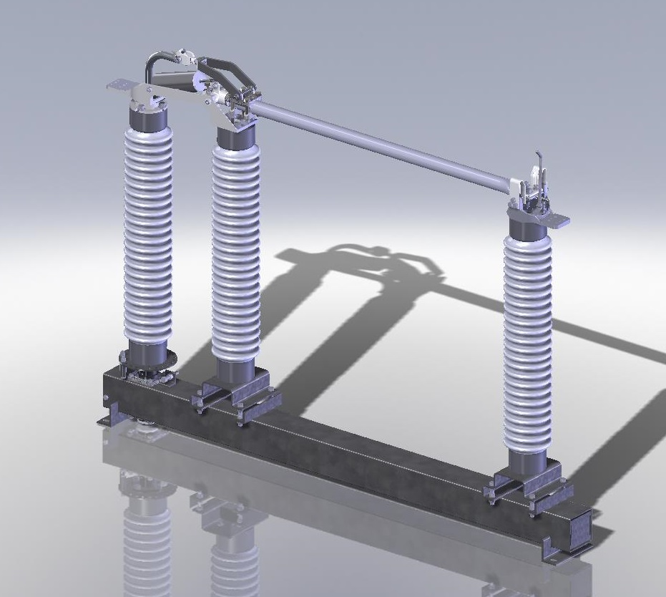

Vertical Break Switches
Aluminum & Copper
15 – 345 kV
1200 – 4000 Amp

Slide 12
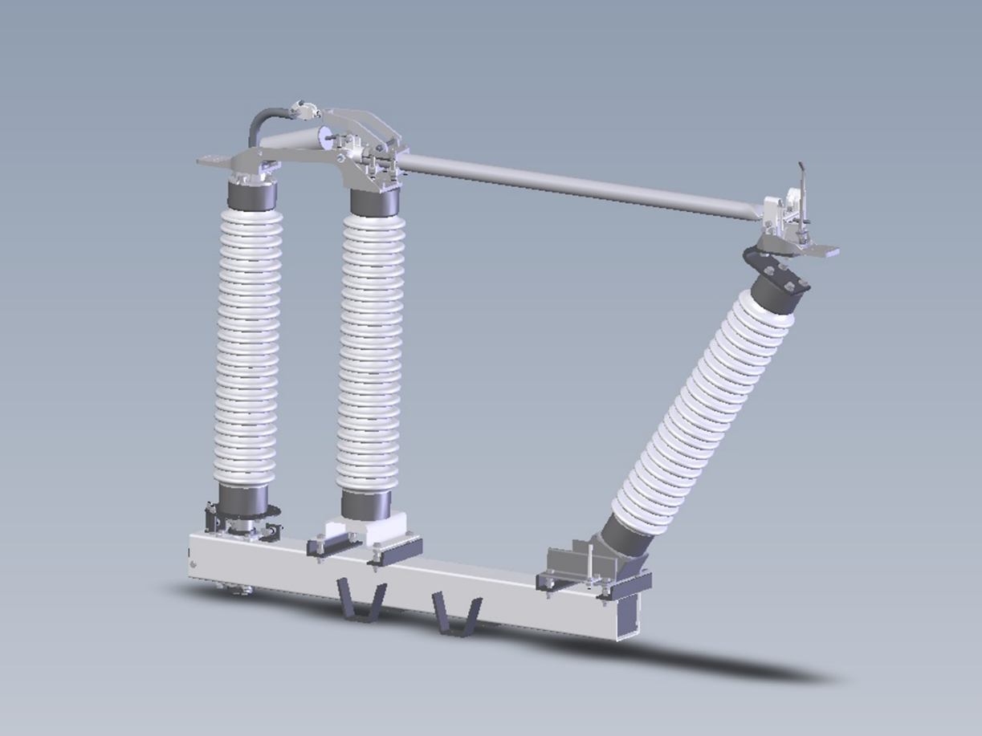

Vertical Break Slant Switches
Aluminum & Copper
69 – 230 kV
1200 – 2000 Amp

Slide 13
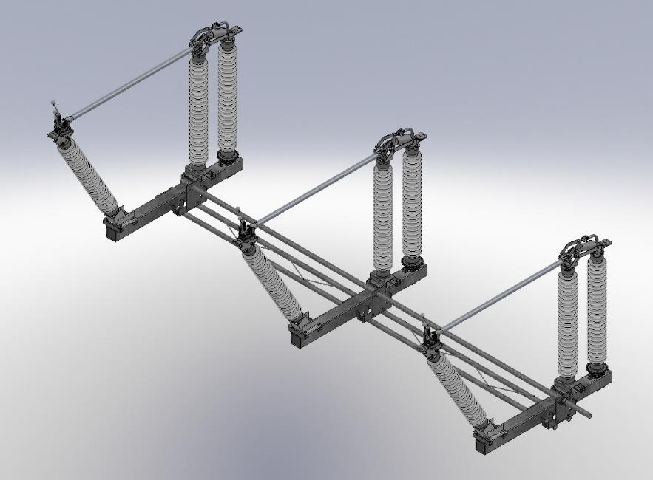
VBSA Unitized Switch
Single Crane Installation
3 Hours Total Install Time

Slide 14
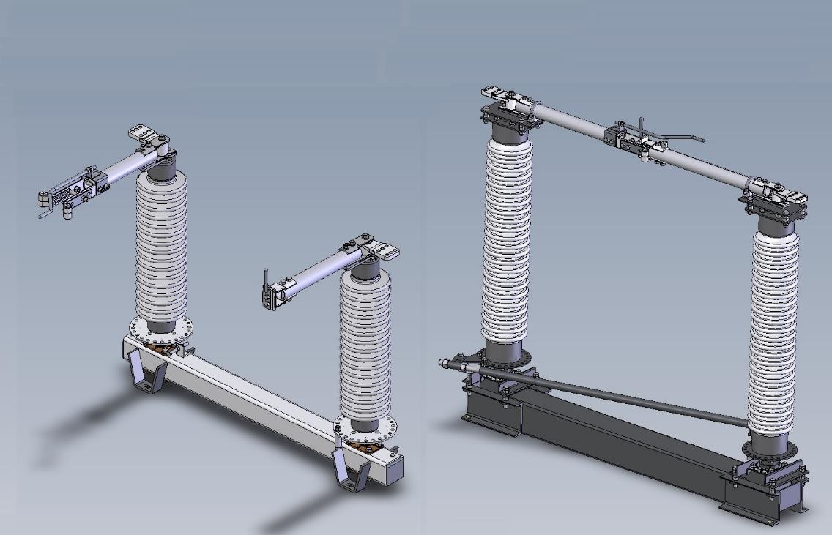
Center Break Switches
Aluminum & Copper
15 – 230 kV
1200 – 3000 Amp

Slide 15
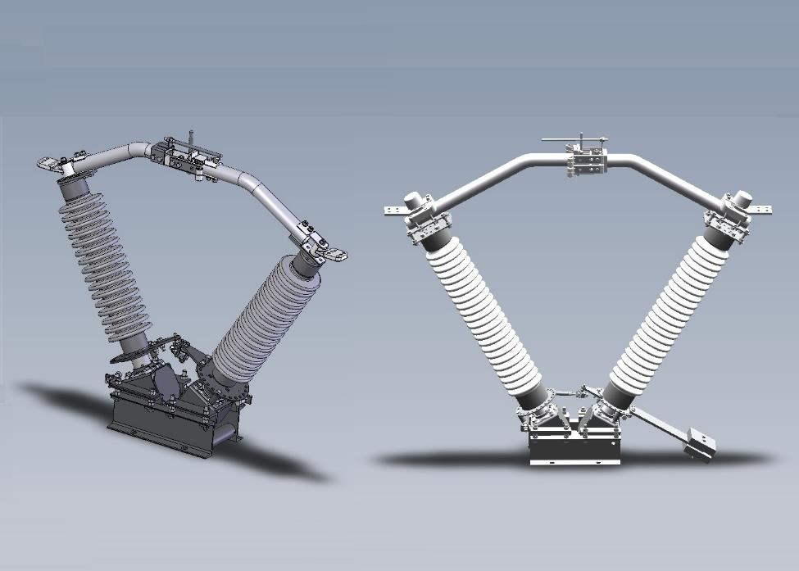
Center Break VEE Switches
Aluminum & Copper
15 – 230 kV
1200 – 3000 Amp

Slide 16
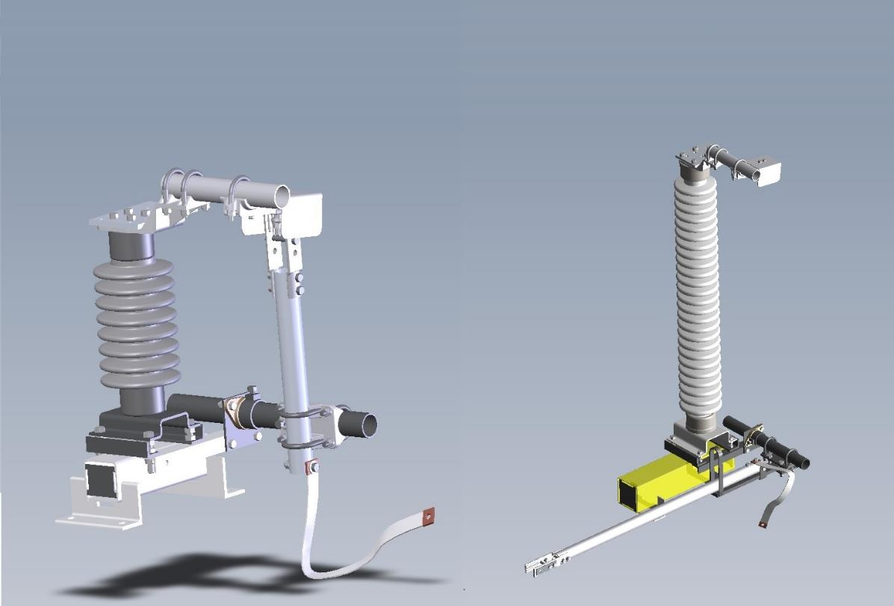
Ground Switches
Aluminum & Copper
61kA Momentary
70kA Momentary
120kA Momentary

Slide 17
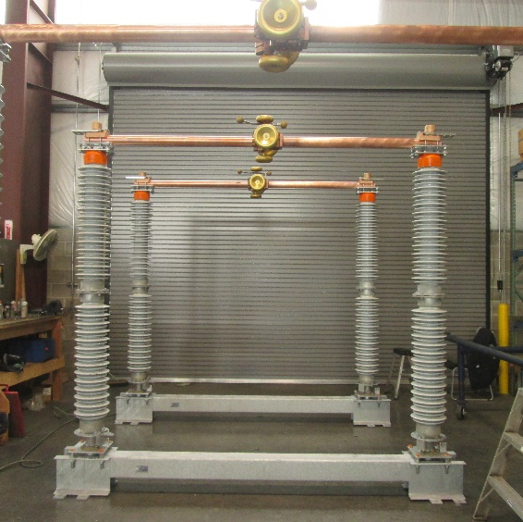
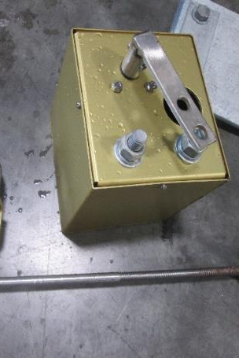
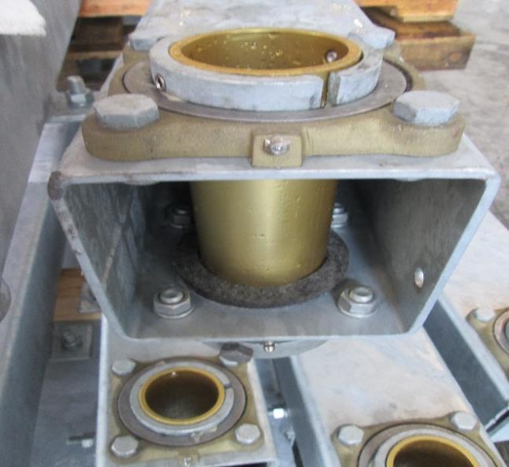
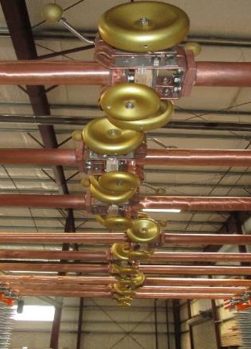
Special Application Packages Available
Refinery
Coastal

Slide 18
Operators & Accessories
Swing Handle Operator
Worm Gear Operator
Motor Gear Operator
Auxiliary Switches
Position Indicators
SR-500 Resistors
Custom Operator Platforms
Custom Mounting
Custom Wire Guides
Custom Standoff Insulator Outriggers

Slide 19
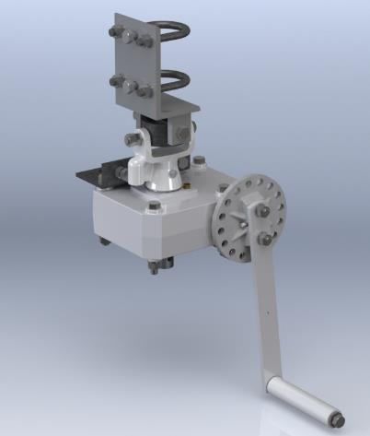
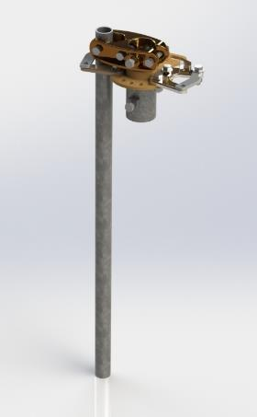
Worm Gear Operator
&
Swing Handle Operator
Worm Gear Options
12.5:1
25:1
50:1
Newly Developed Anti Back Drive Feature

Slide 20
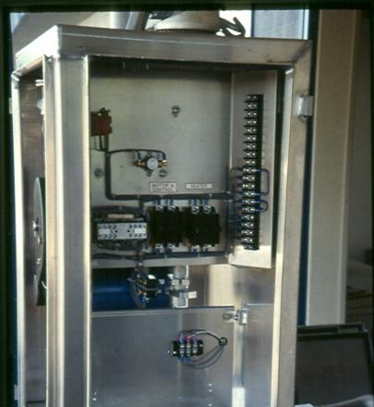
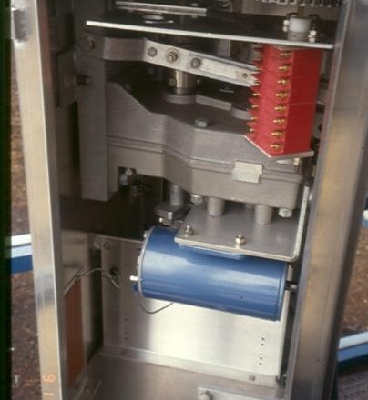
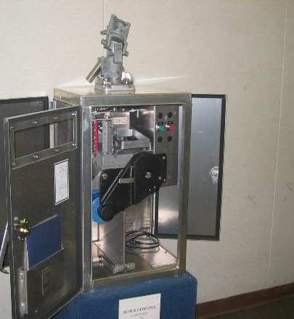
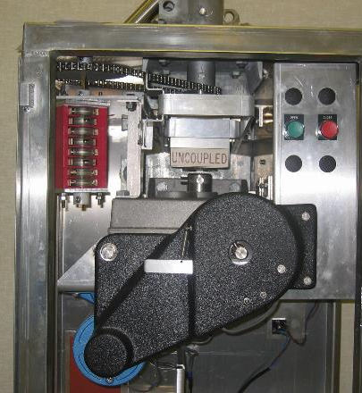

MGO- Motor GEAR Operator
Internal Decoupler
Access from 3 sides
32” High Cabinet
Aux Switches Inside
follow switch, motor,
or both.
Internal Aux Switch
Added Space for Customer Uses
Customer Wiring Space
Location for Terminal Blocks for Aux Switch Wiring

Slide 21
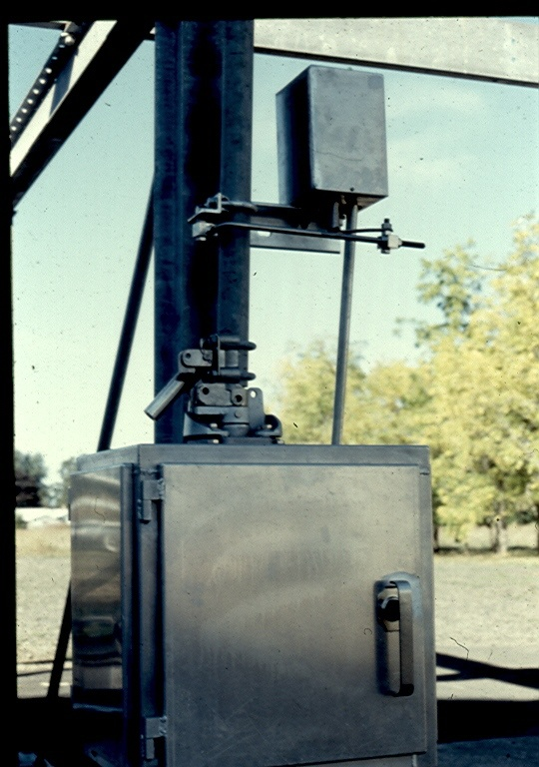
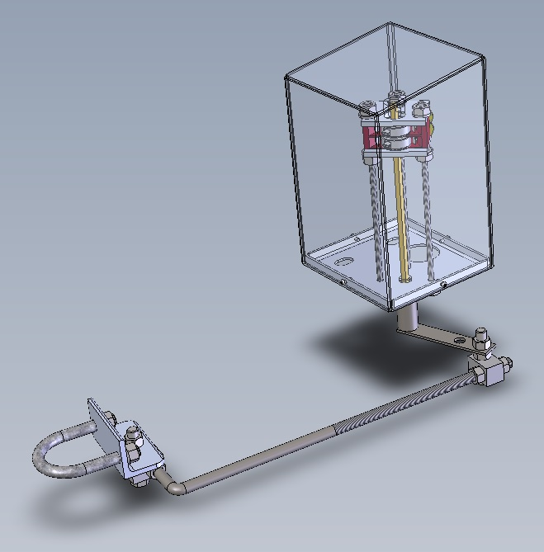
External
Auxiliary Switches

Slide 22

Position Indicartors

Slide 23
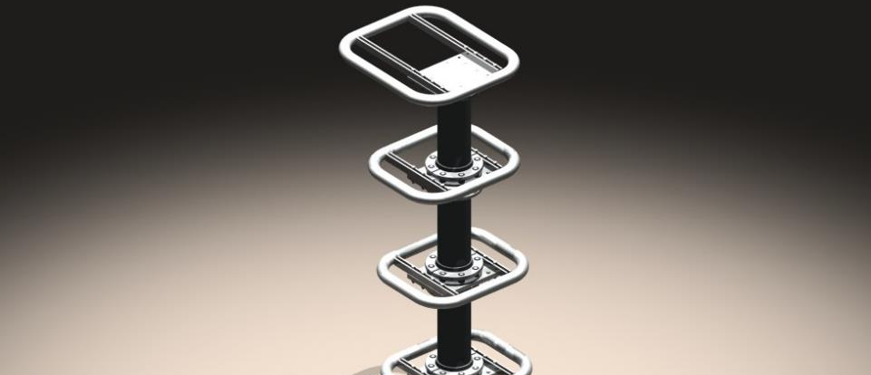
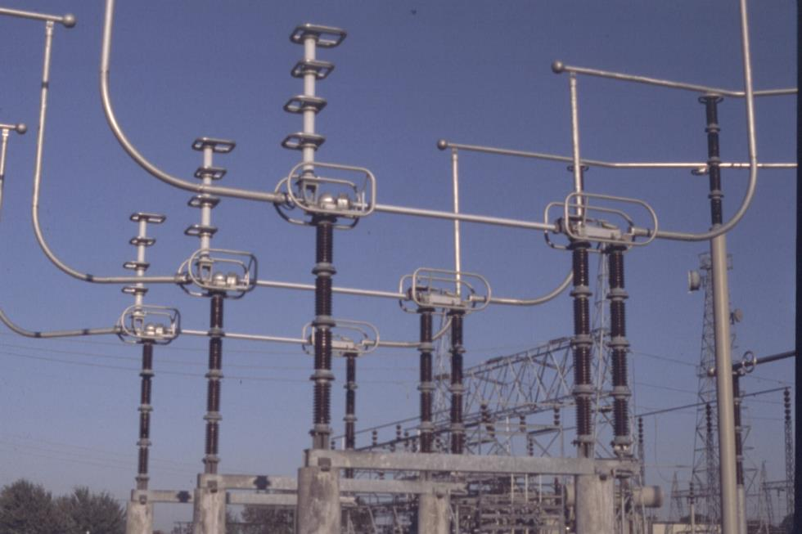
SR 500 Resistor Module
Available 115 kV through 500 kV

Slide 24
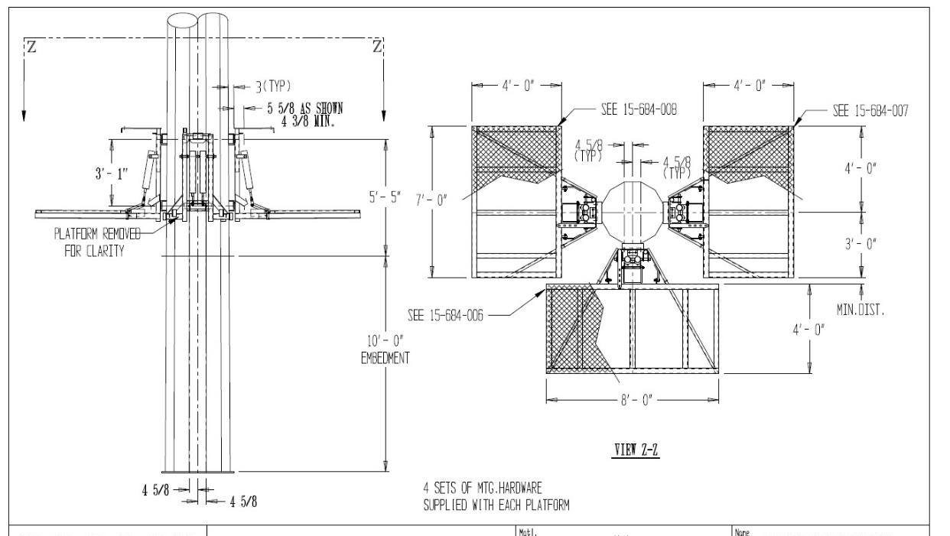
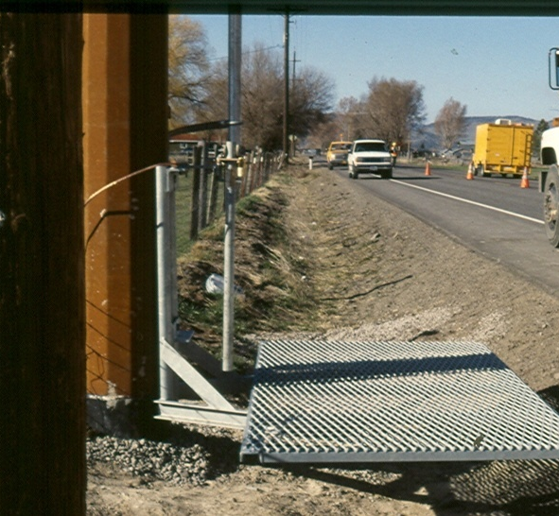
Custom Operator Platforms

Slide 25

Static and Hinged Options

Slide 26
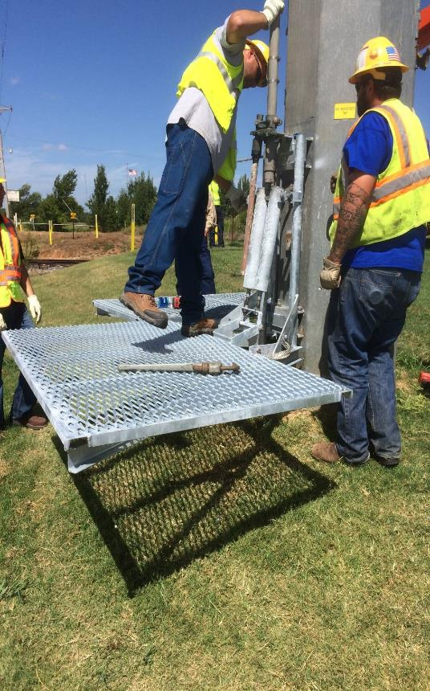
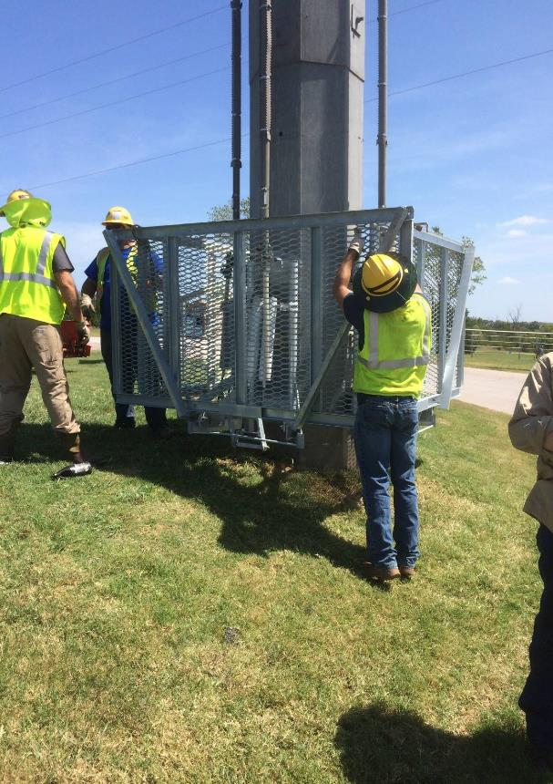

Slide 27
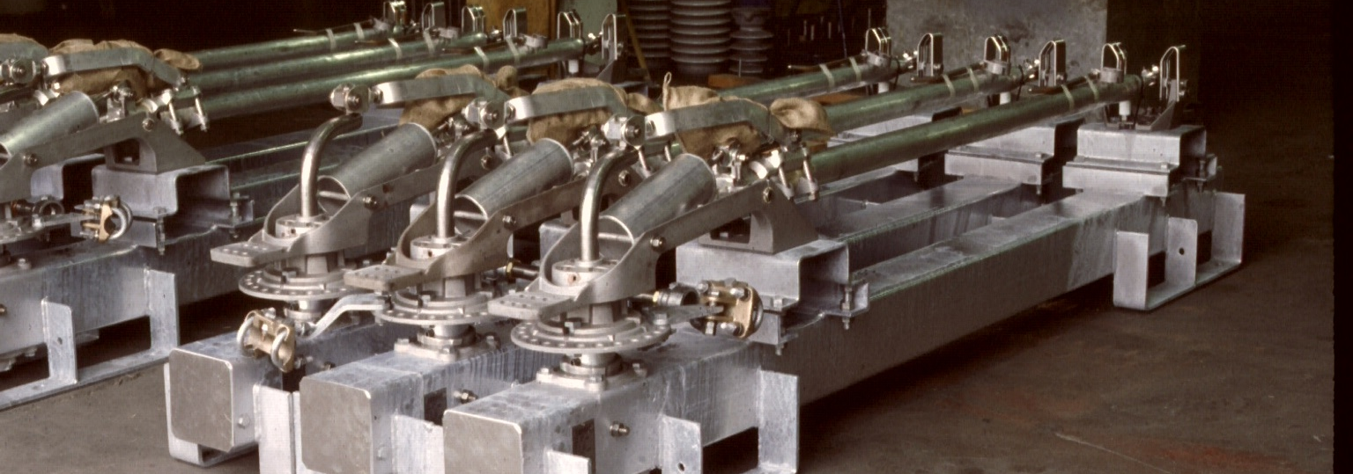
Custom Mounting

Slide 28
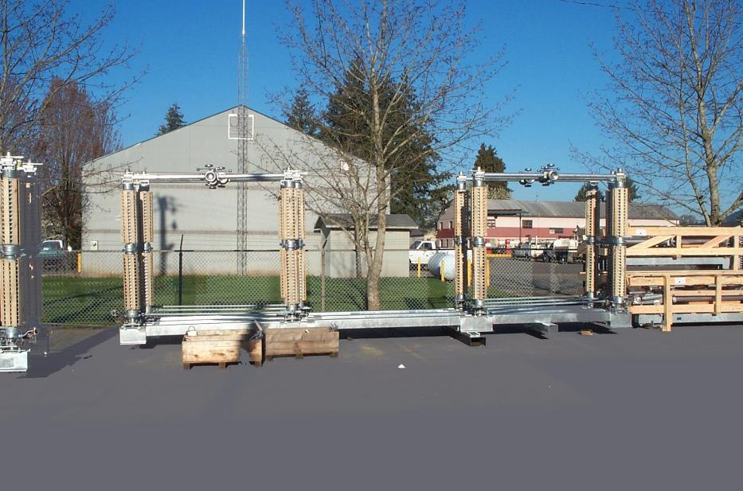


CBPA
230 kV Center Break Tandem

Slide 29
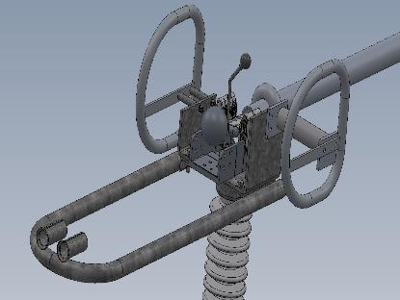
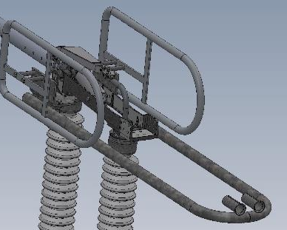
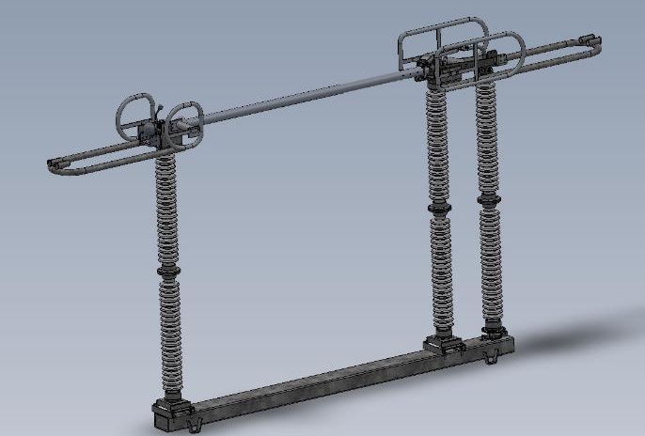

wire guides
Single Barrel
Double Barrel
Trench

Slide 30
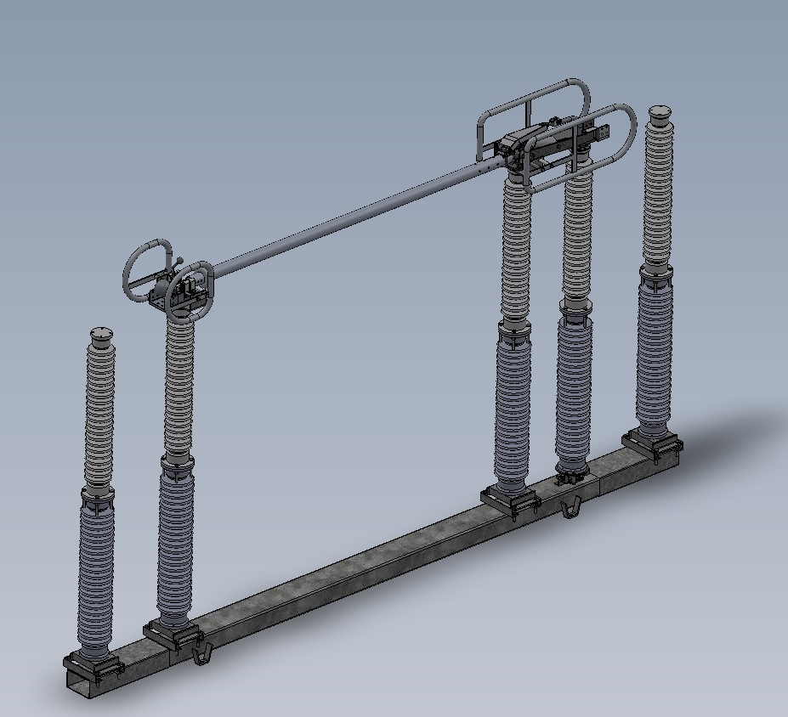
Standoff Insulator Outriggers

Slide 31

Testing for
Switch Gear
High Voltage Testing
High Current Testing
Temperature Rise Testing
Ice Testing
Mechanical Operations Testing
Seismic Testing

Slide 32
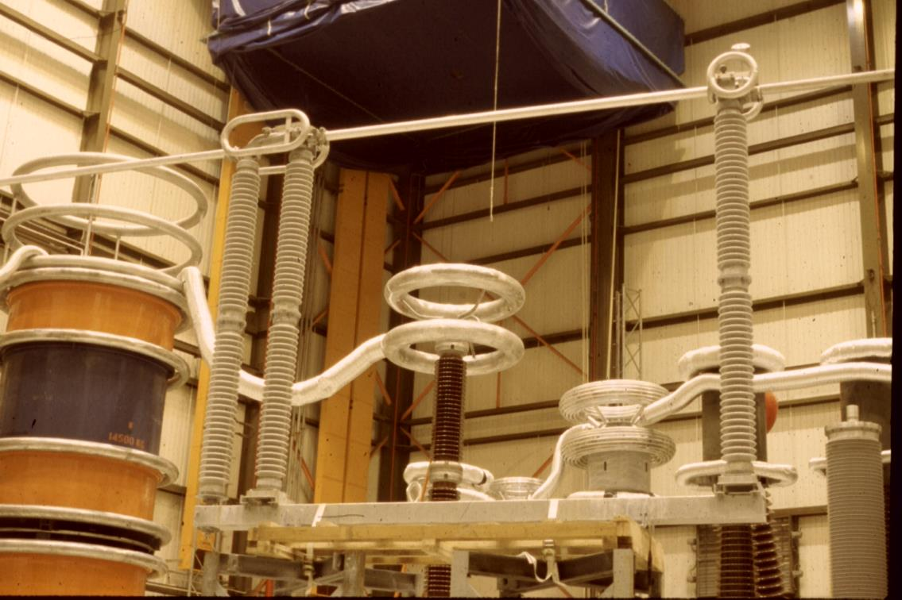
High Voltage Testing

Slide 33
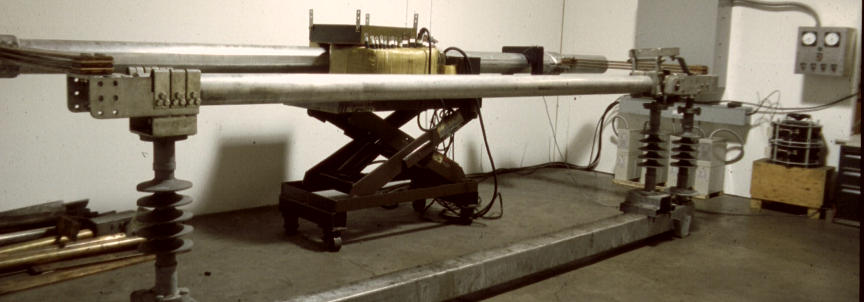
Temperature Rise Testing

Slide 34
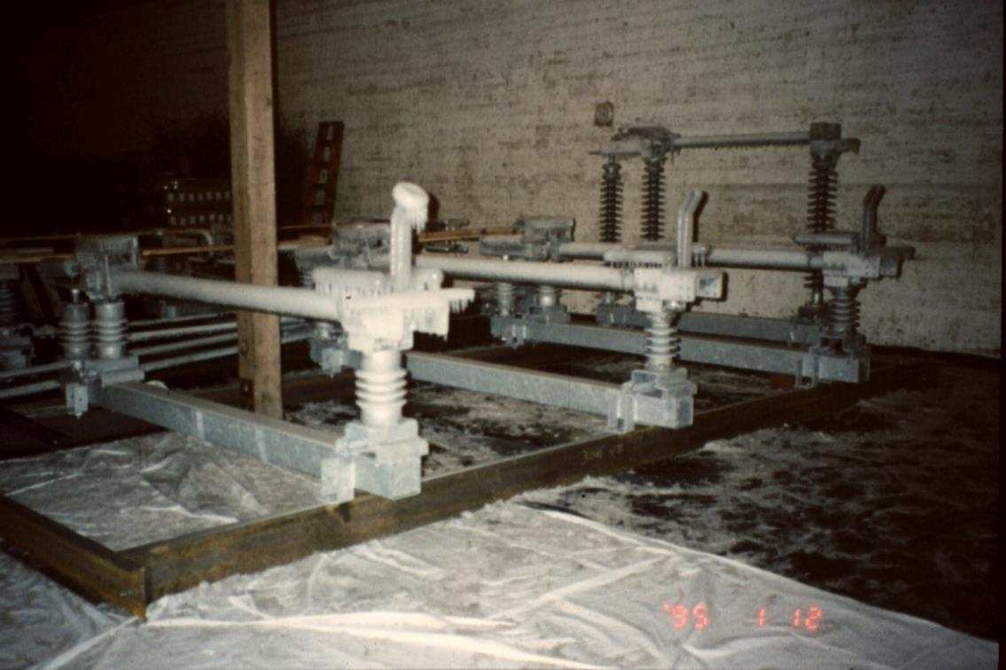
Ice Testing

Slide 35
Seismic Qualification Testing
High Seismic Level Qualification per IEEE 693

Slide 36
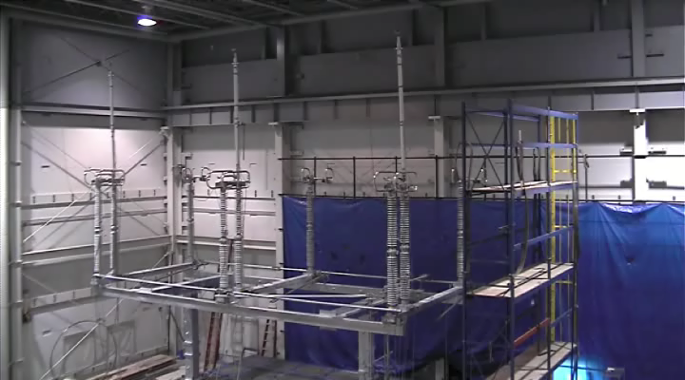

Slide 37

Switch Parameters
No zinc dichromate steel parts
No plastic bearings
No plastic parts in the bearings

Slide 38
Switch Parameters
All hardware in the live parts is series 300 Stainless Steel
Minimum hardware size is ½”
Only two wrench sizes needed for installation and adjustment

Slide 39
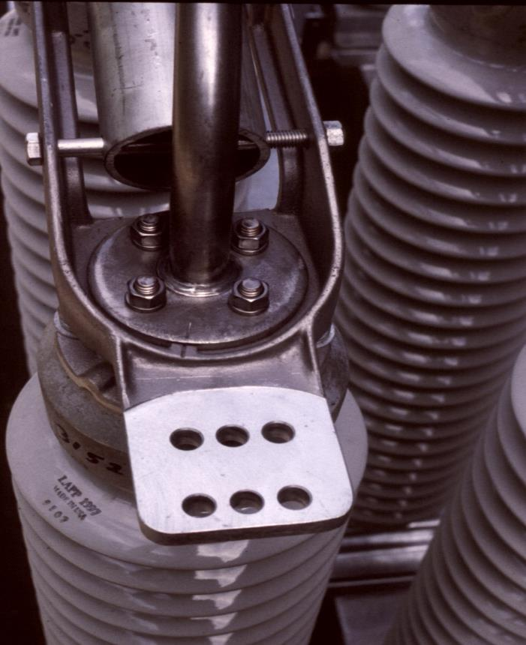
Hinge Assembly
1 ¼” Solid Stainless Steel Gooseneck
Match mark for ease of field assembly

Slide 40

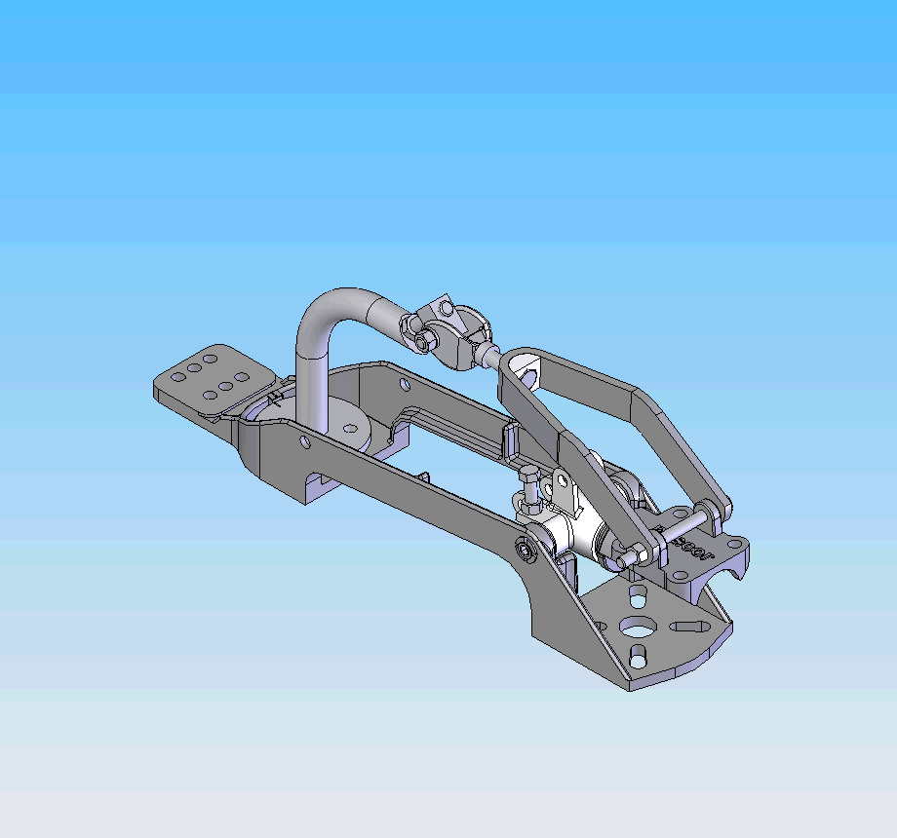

Slide 41

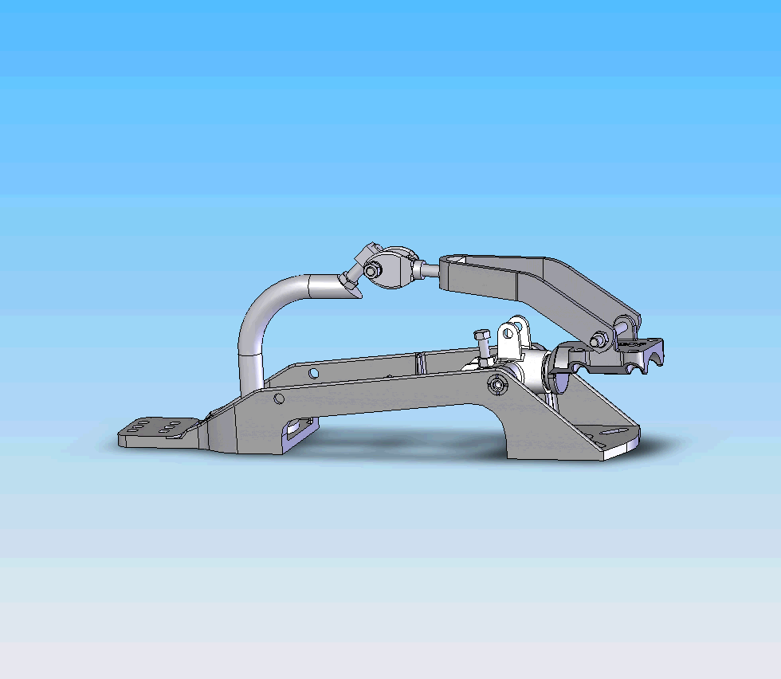

Slide 42
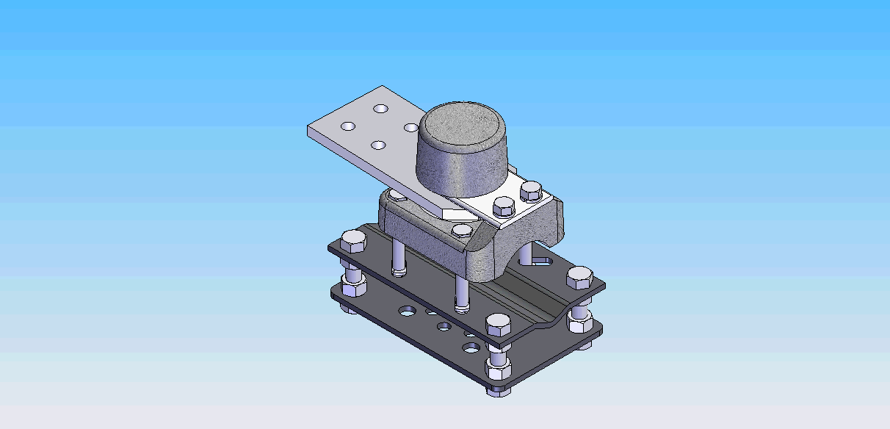

Slide 43
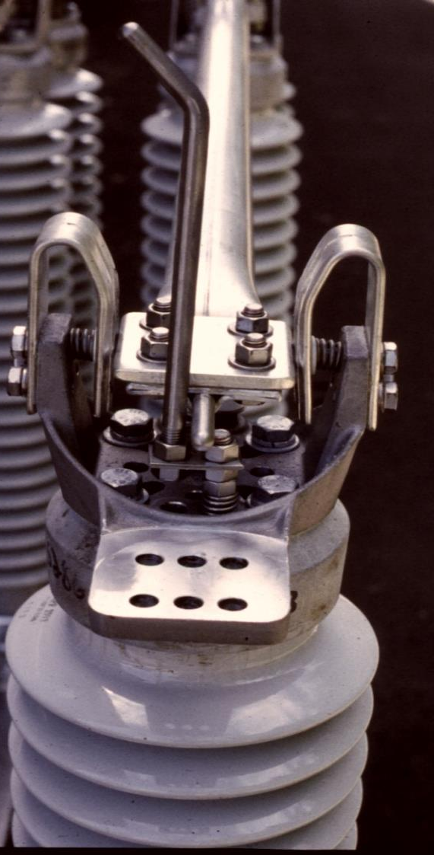
Contact Assembly
10 mil silver to silver contacts
Field replaceable contacts
Reverse loop shoes
½” stainless steel arcing horn

Slide 44
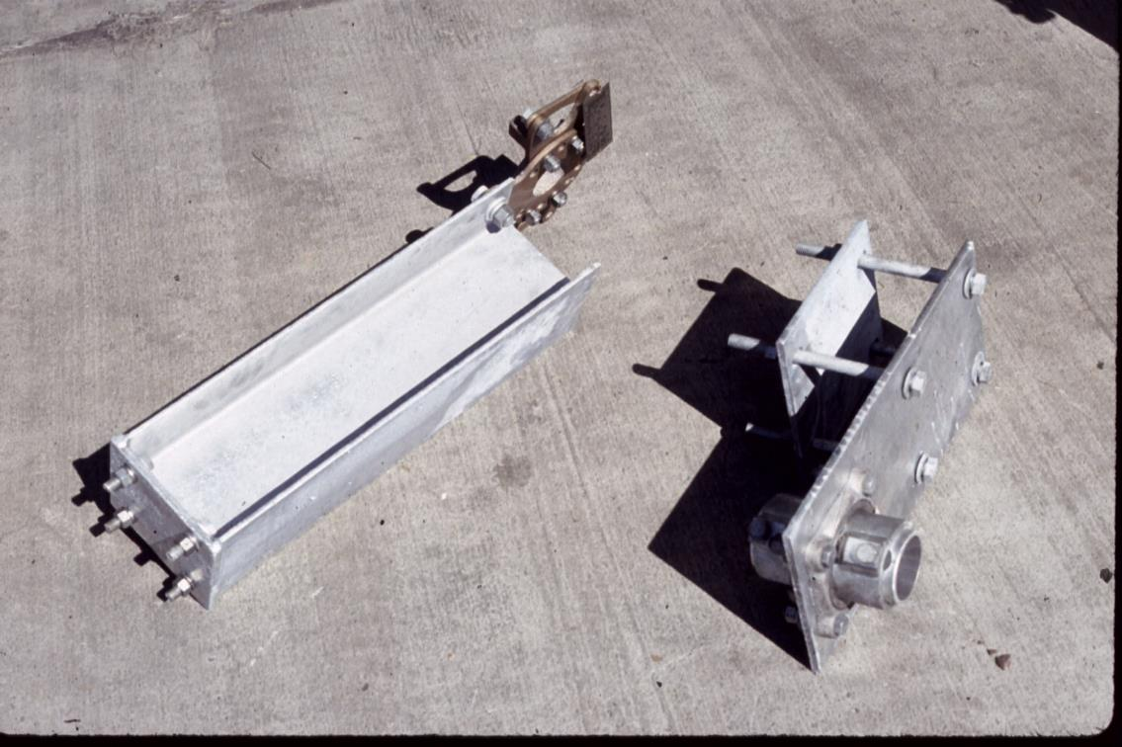
Ease of Installation

Slide 45

At PASCOR we have three core values that shape our organization and help drive the decisions we make.
Build a Quality Product
Provide Dependable Service
Ensure Customer Satisfaction

Slide 46

Pacific Air Switch Corporation
A Switch To Quality & Safety

