Slide 1
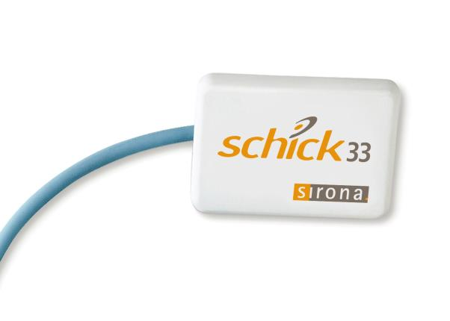
Enhanced Image Quality and Features of the
*This PowerPoint contains audio; please be sure your volume is on.

Slide 2
Agenda
Image Customization
Exposure Settings for X-Ray Unit
Field Replaceable Cable Technology

Slide 3
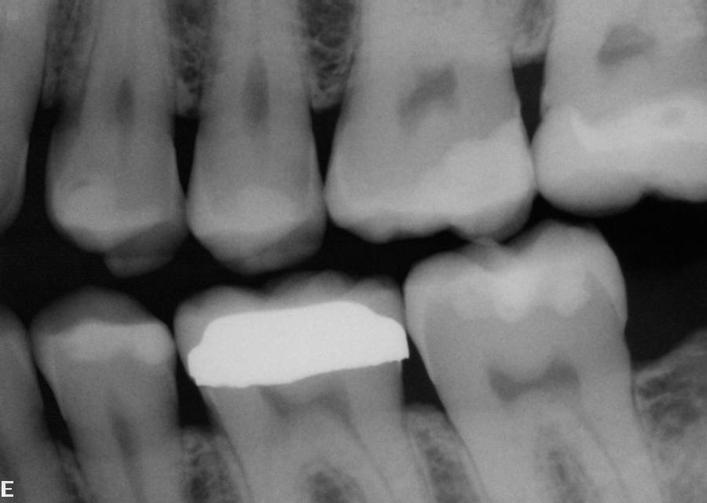
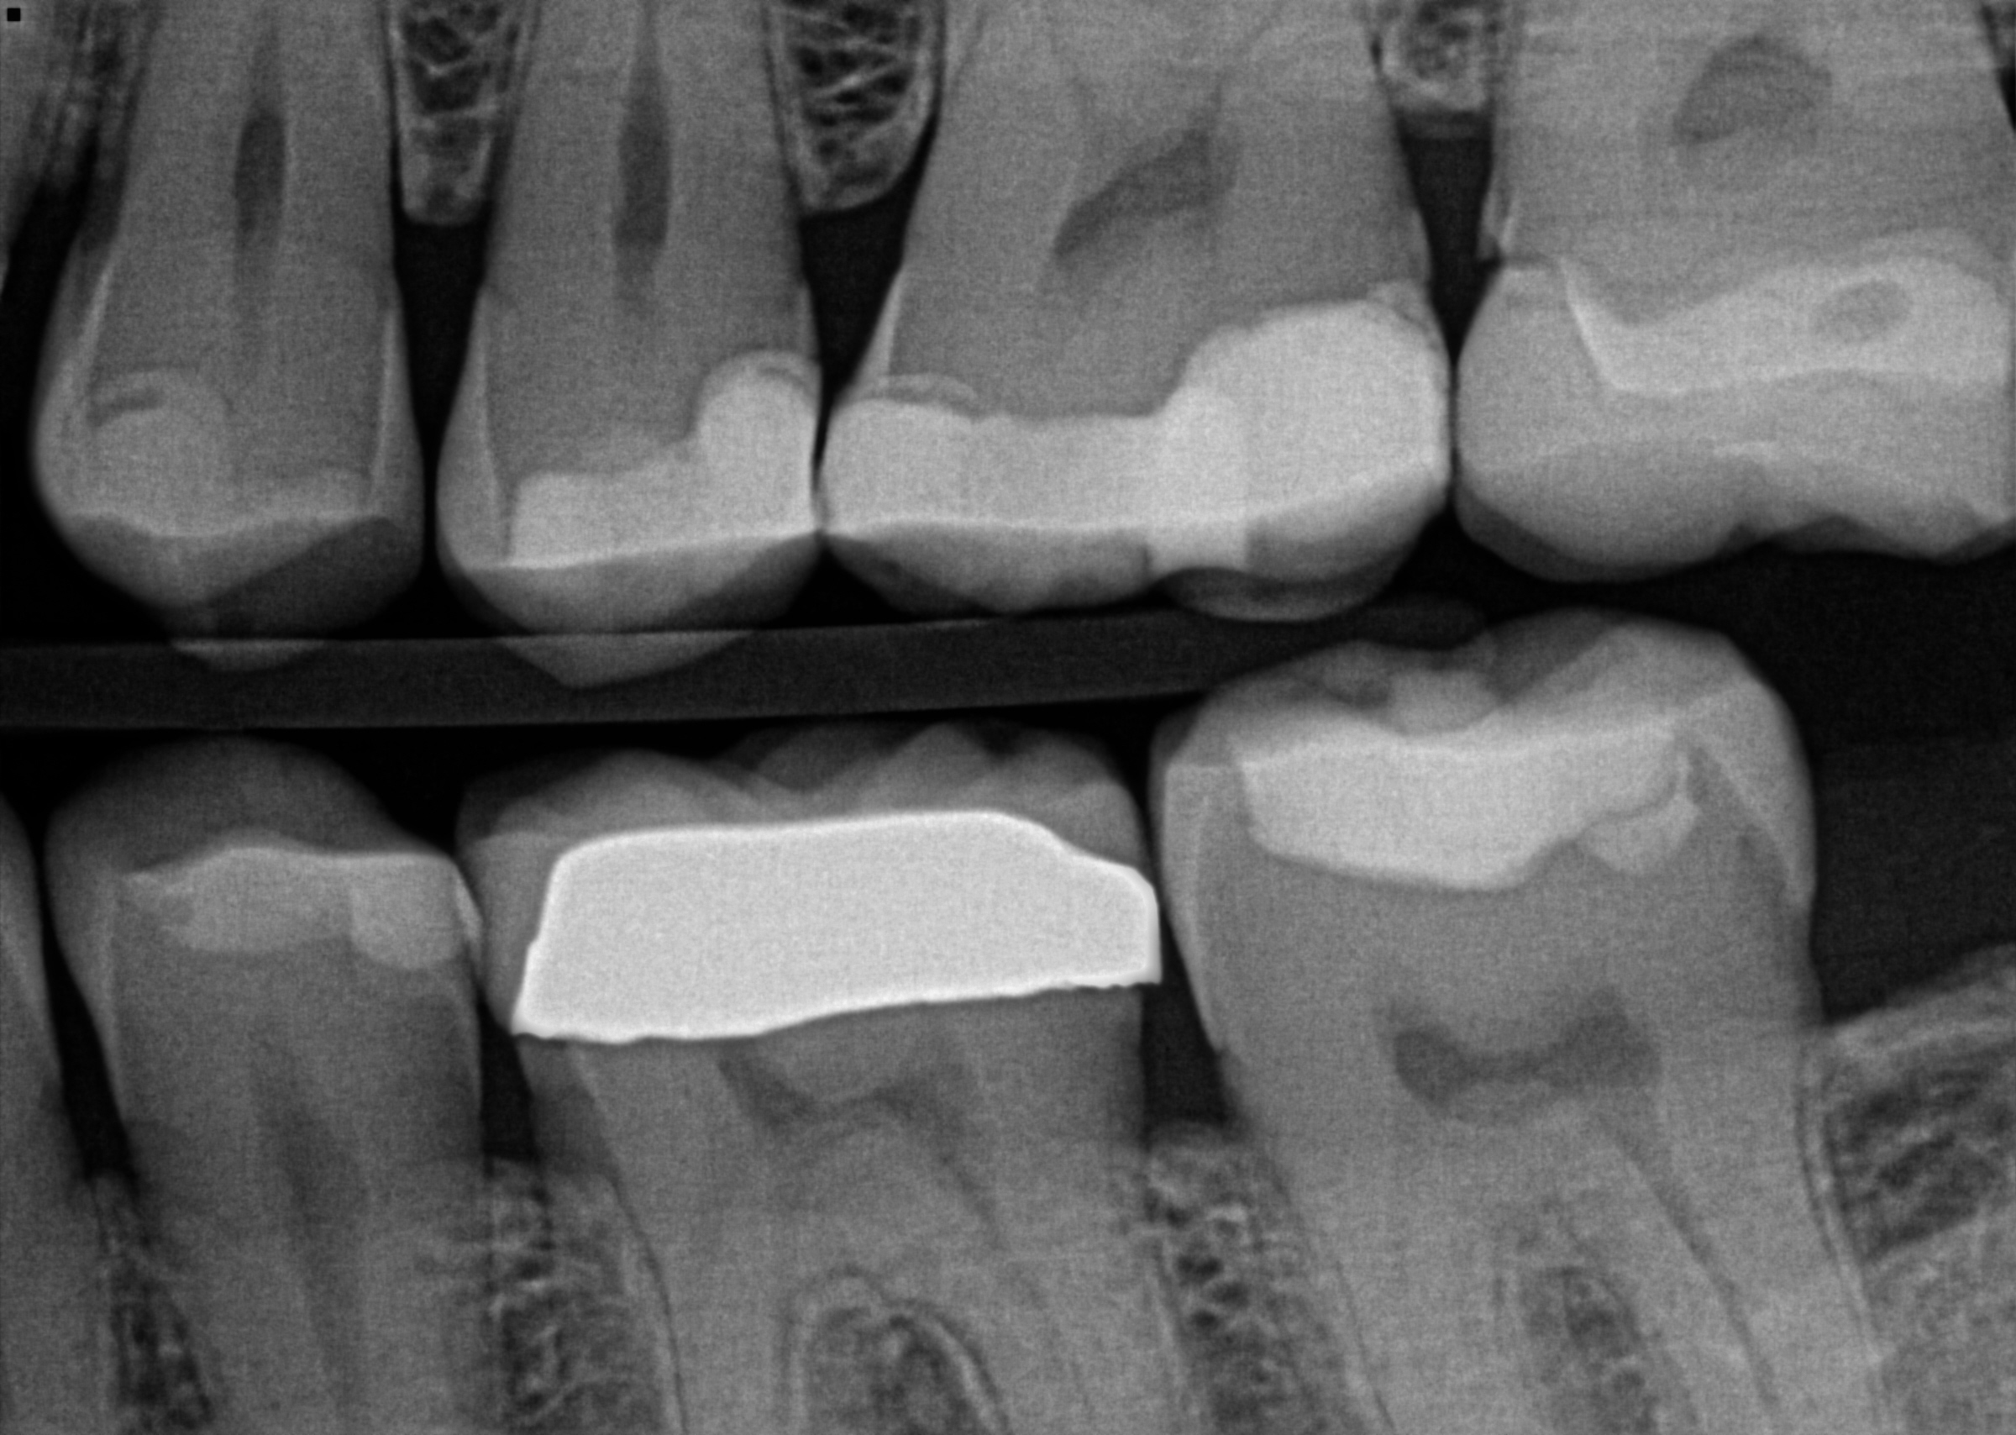
1. Image Customization
CDR

Slide 4
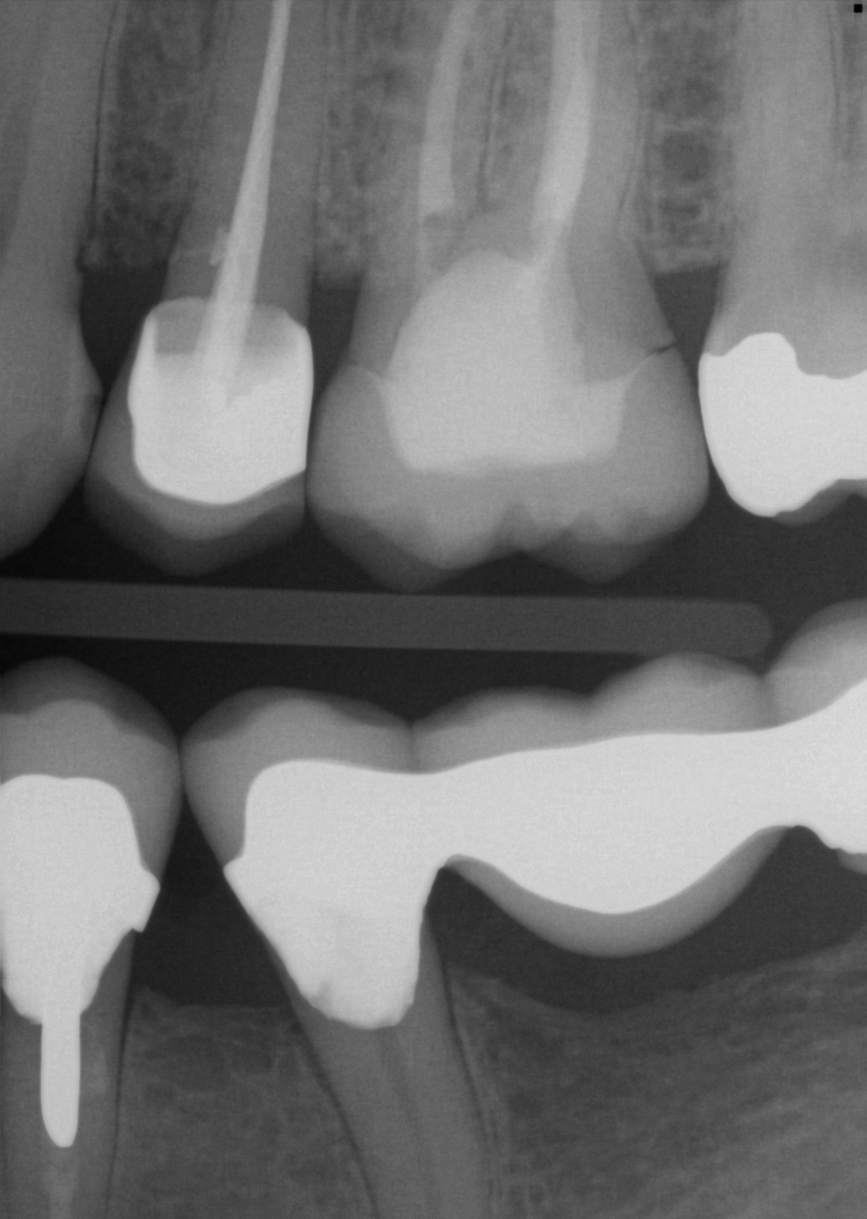
1. Image Customization
Dynamic Imaging feature allows for the customization of the image to the desired resolution.

Slide 5
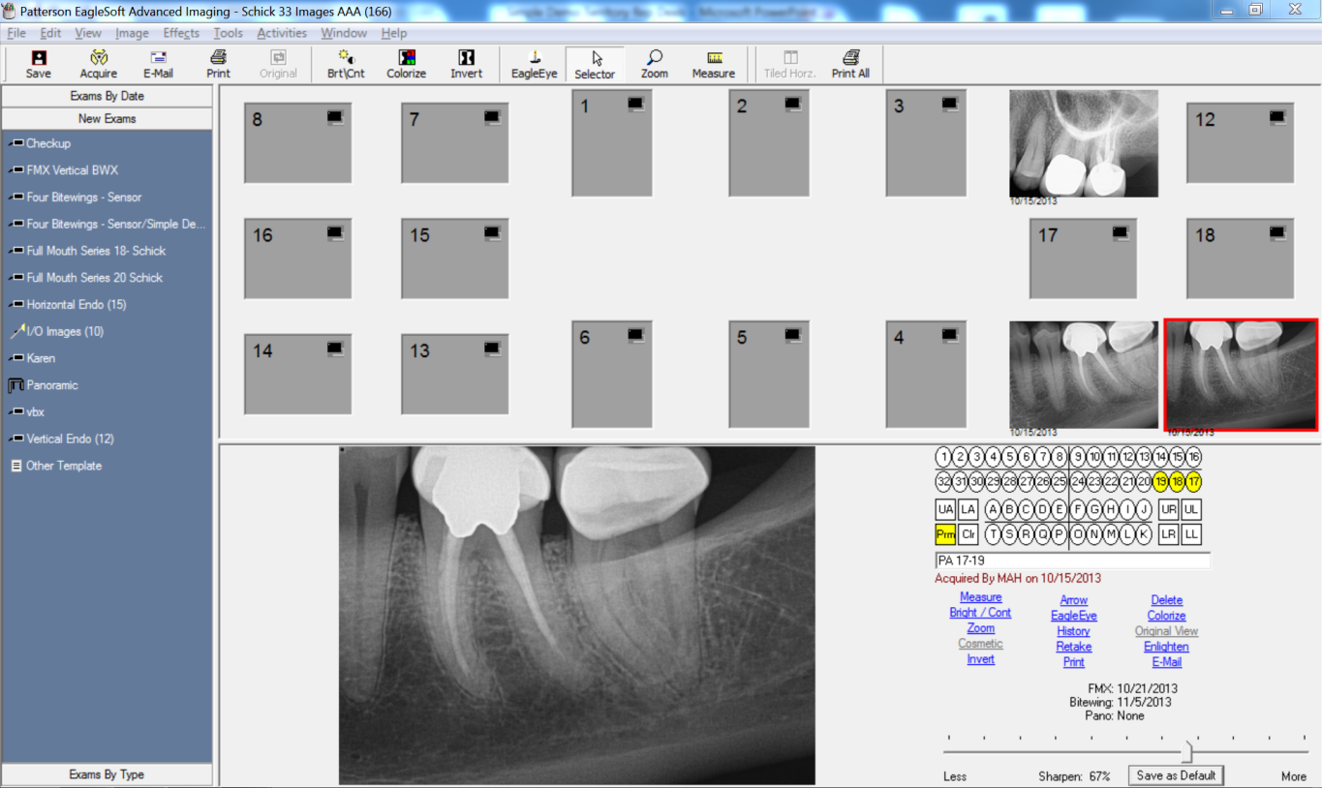
1. Image Customization
Dynamic Imaging feature allows for the customization of the image to the desired resolution.

Slide 6
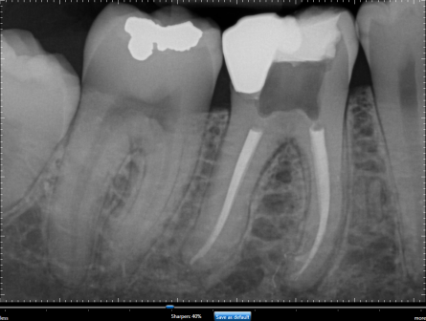
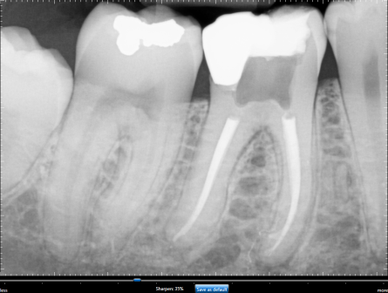
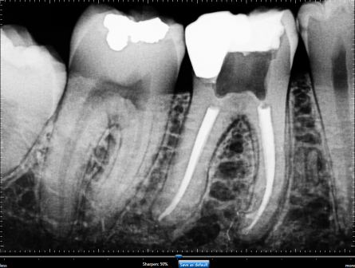
1. Image Customization
General Dentistry
Endodontic
Periodontic
Restorative

Slide 7
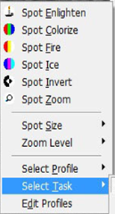
1. Image Customization

Slide 8
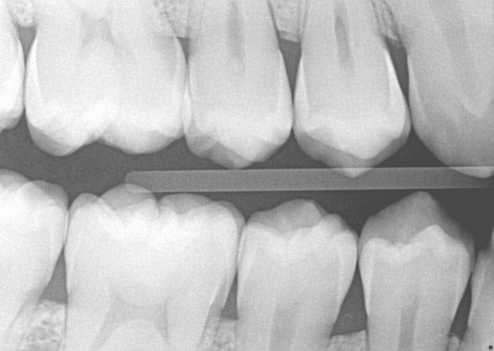
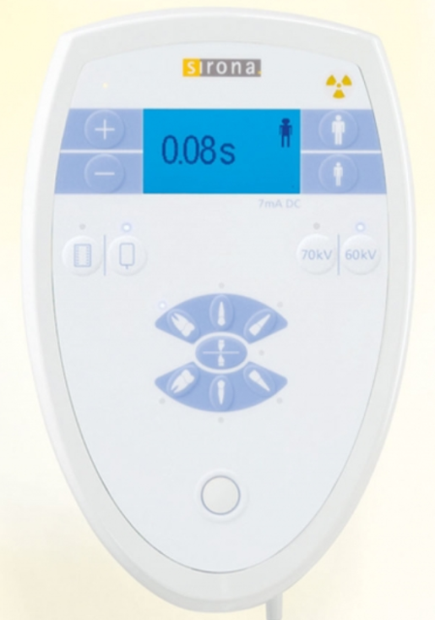
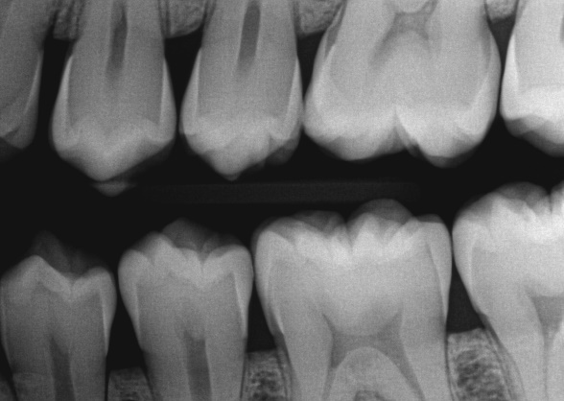
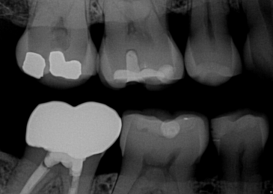
2. Exposure Settings for X-Ray Unit
Under-Exposed
0.08s
0.10s
0.06s
Correct Exposure
Over-Exposed

Slide 9
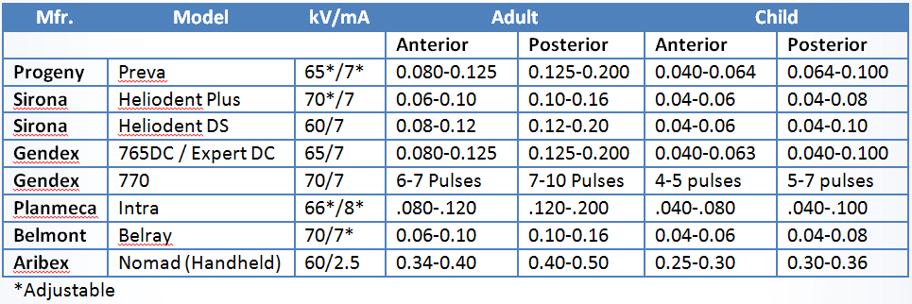
2. Exposure Settings for X-Ray Unit
http://www.youtube.com/watch?v=EppZLei7OVk&list=UUv3afAz_wVQpzs-fwlAobiw&index=19

Slide 10
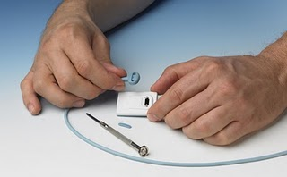
3. Field Replaceable Cable Technology
Each Schick 33 sensor comes with an extra sensor cable that can be replaced in the office if damage occurs to a cable.
Simple process and it takes less than 5 minutes.
Remember where you place the extra sensor cable.
Please click link below for access to sensor care video tutorial
https://www.youtube.com/watch?v=PinZo3ZdDGc&t=78s

Slide 11
http://www.youtube.com/playlist?list=UUv3afAz_wVQpzs-fwlAobiw
Please call the Patterson Technology Center with any
questions at (800) 475-5036 or contact your local Patterson branch.

Slide 12
Thank You

