Slide 1

&
Innovation
Craftmanship
since 1980
Notes:
Let’s have a quick start at Keller where we all stand for Innovation and Craftmanship.

Slide 2
2
CAD
Architect manual
since 1980
Notes:
Let’s have a quick start at Keller where we all stand for Innovation and Craftmanship.

Slide 3

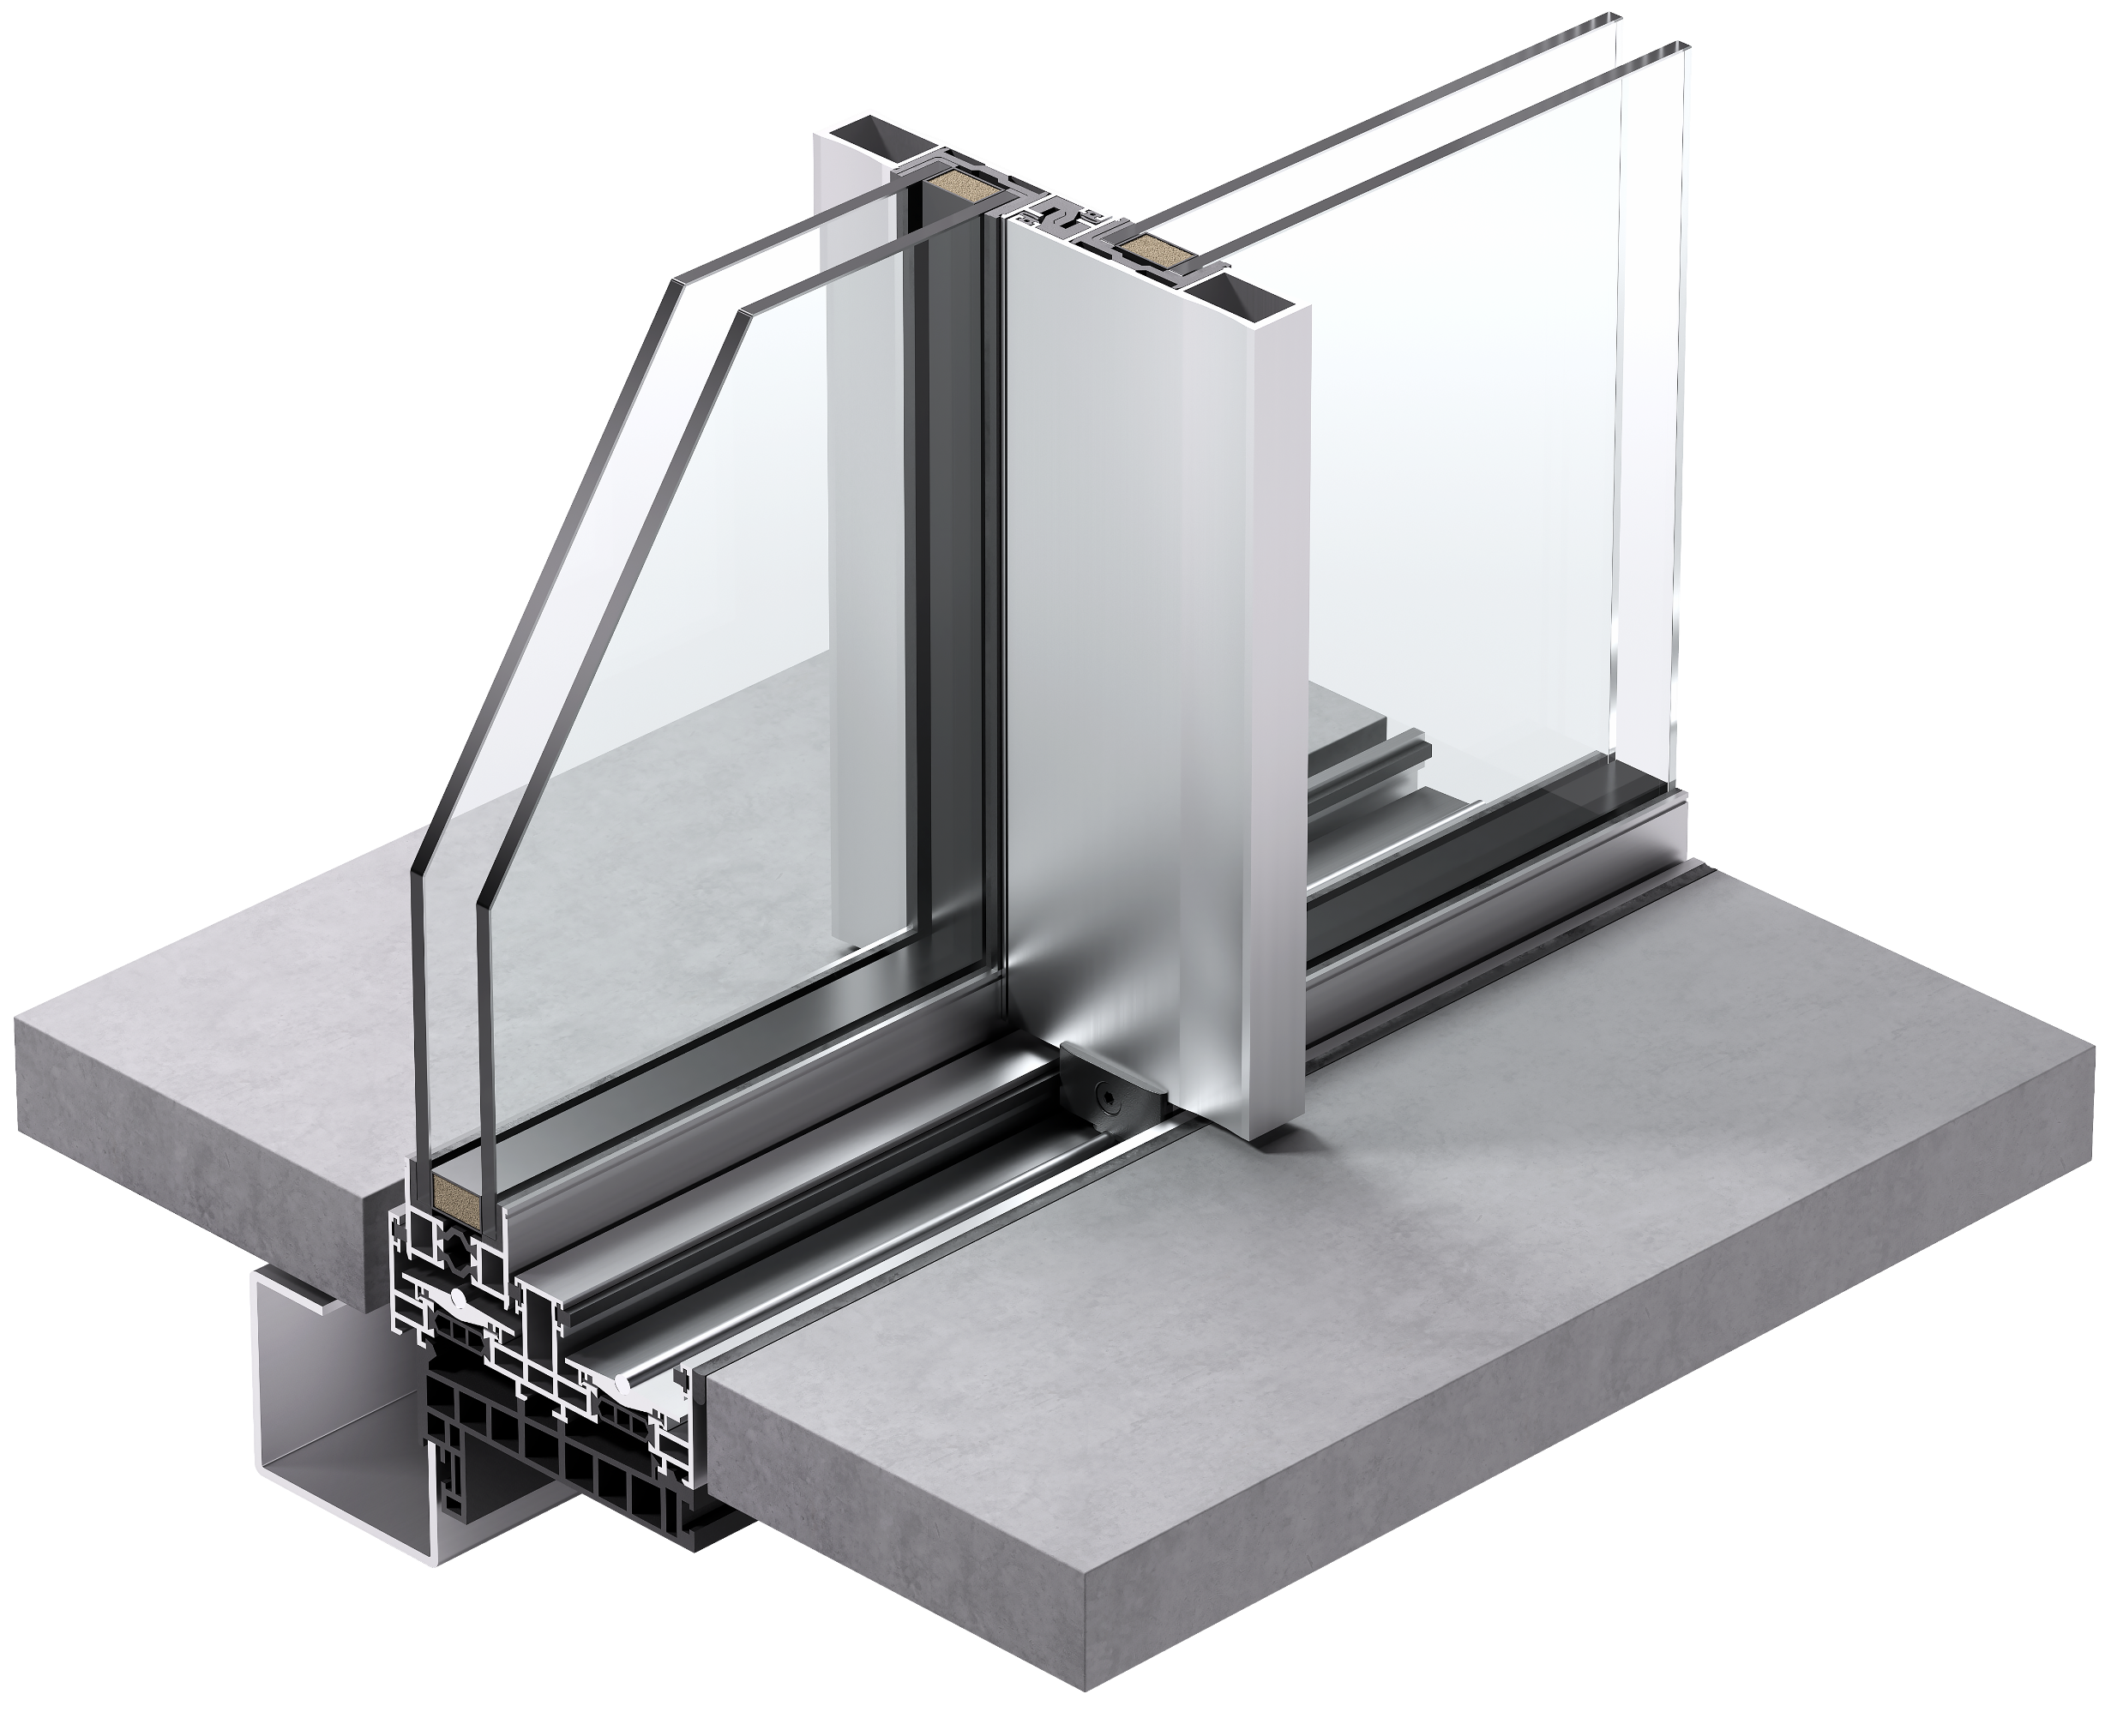
since 1980
Notes:
Let’s have a quick start at Keller where we all stand for Innovation and Craftmanship.

Slide 4
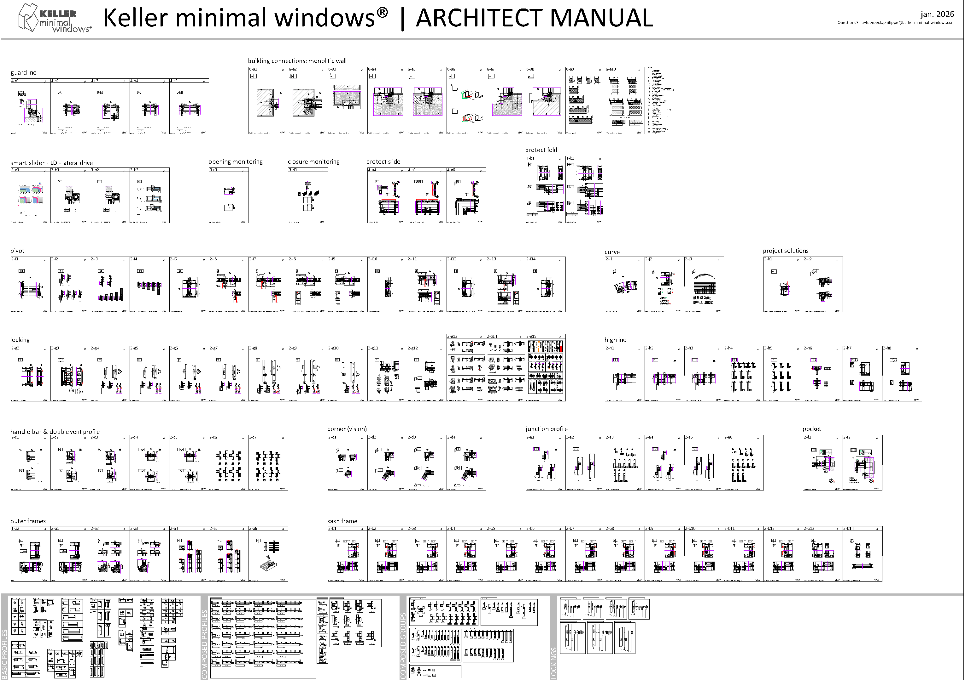

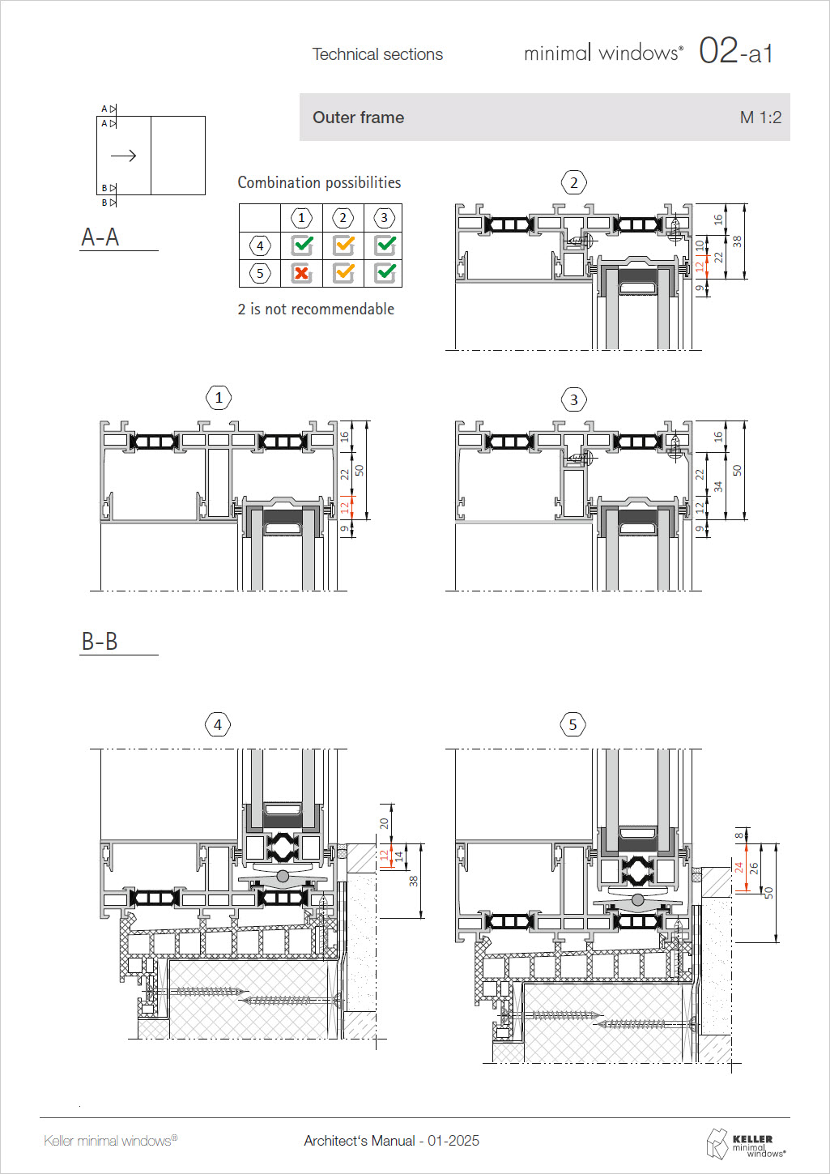
CAD 2 ARCHITECT MANUAL
guardline & building connections
smart slider & protect slide - fold
pivot & curve & project solutions
locking & highline
handle bar / double vent & corner (vision) & pocket
outer frames & sash frames
profile overview

Slide 5
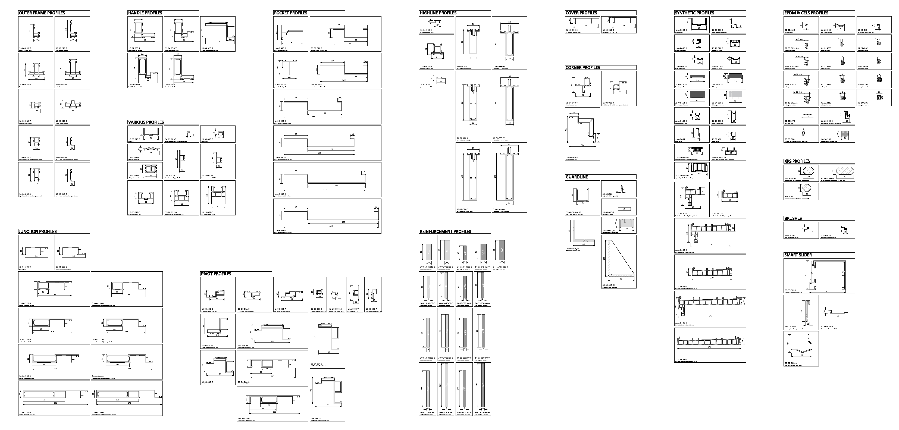
profile overview – basic profiles

Slide 6
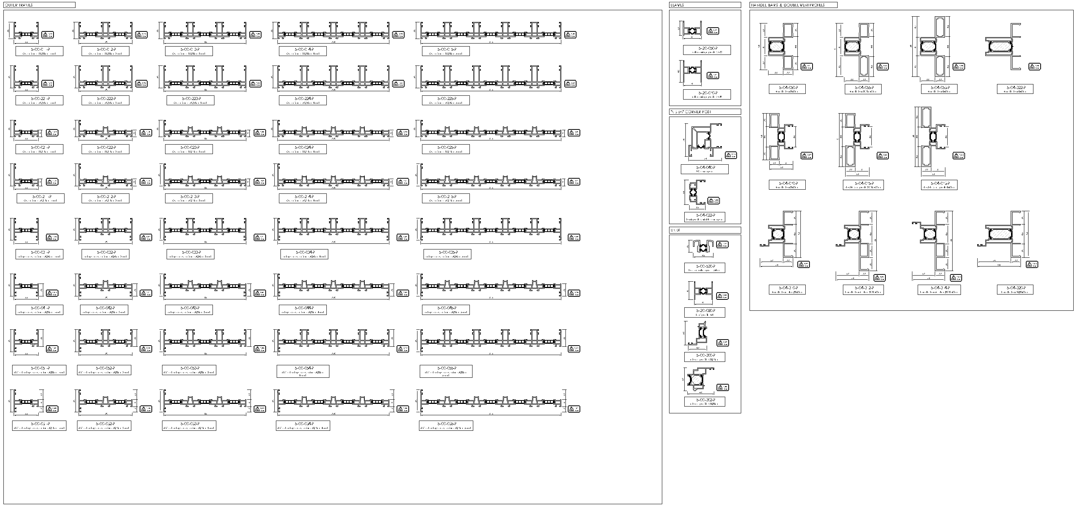
profile overview – composed profiles

Slide 7
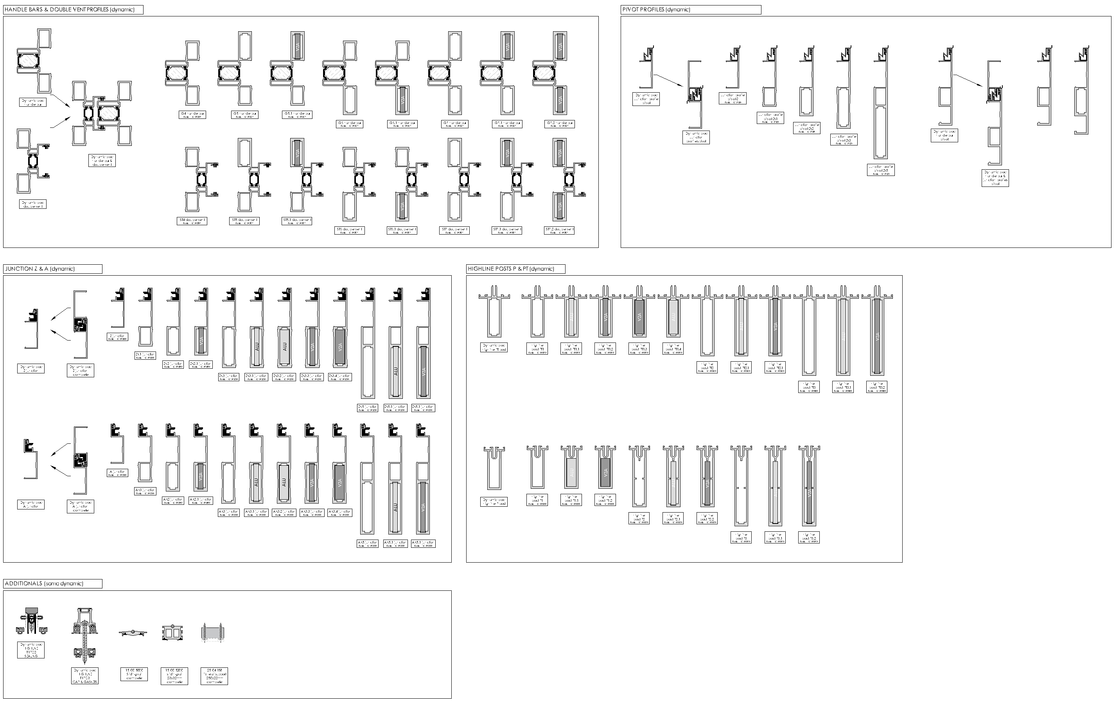
profile overview – composed groups (some dynamic functions)

Slide 8
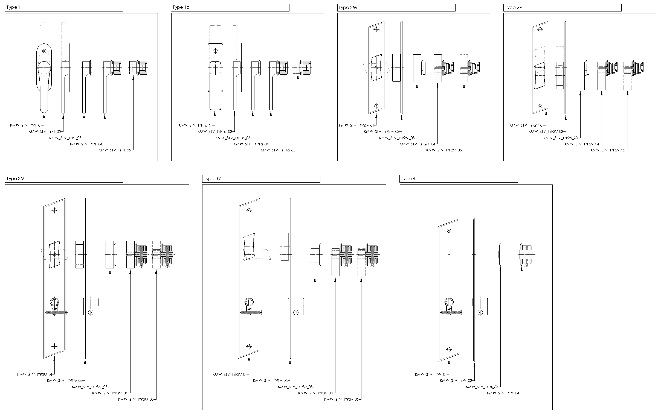
profile overview – lockings

Slide 9
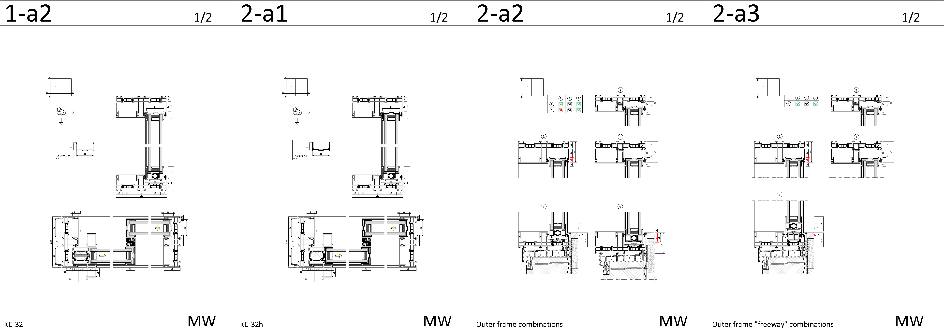
outer frames

Slide 10
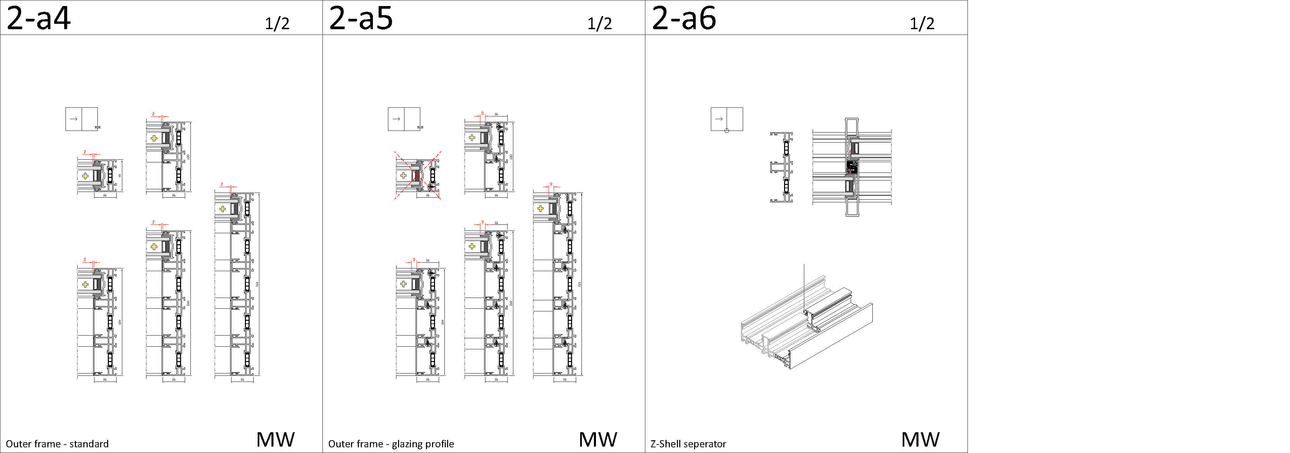
outer frames

Slide 11
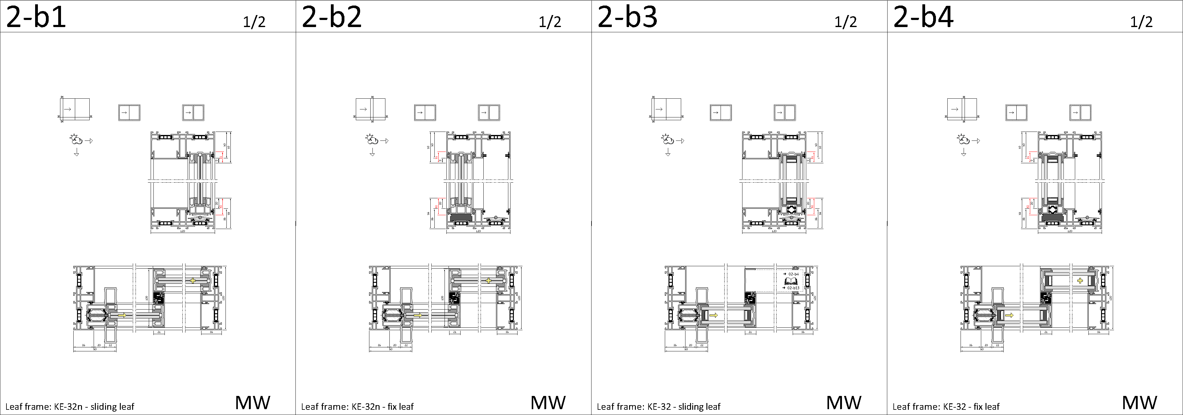
sasch frames

Slide 12
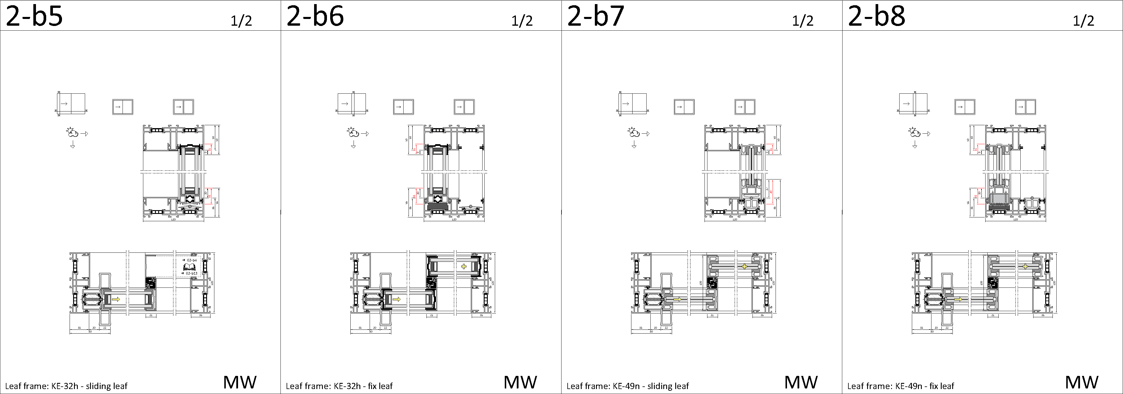
sasch frames

Slide 13
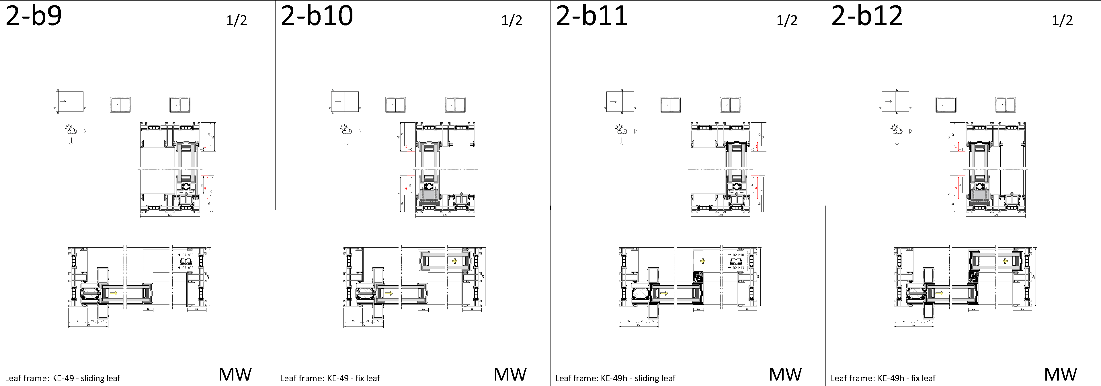
sasch frames

Slide 14
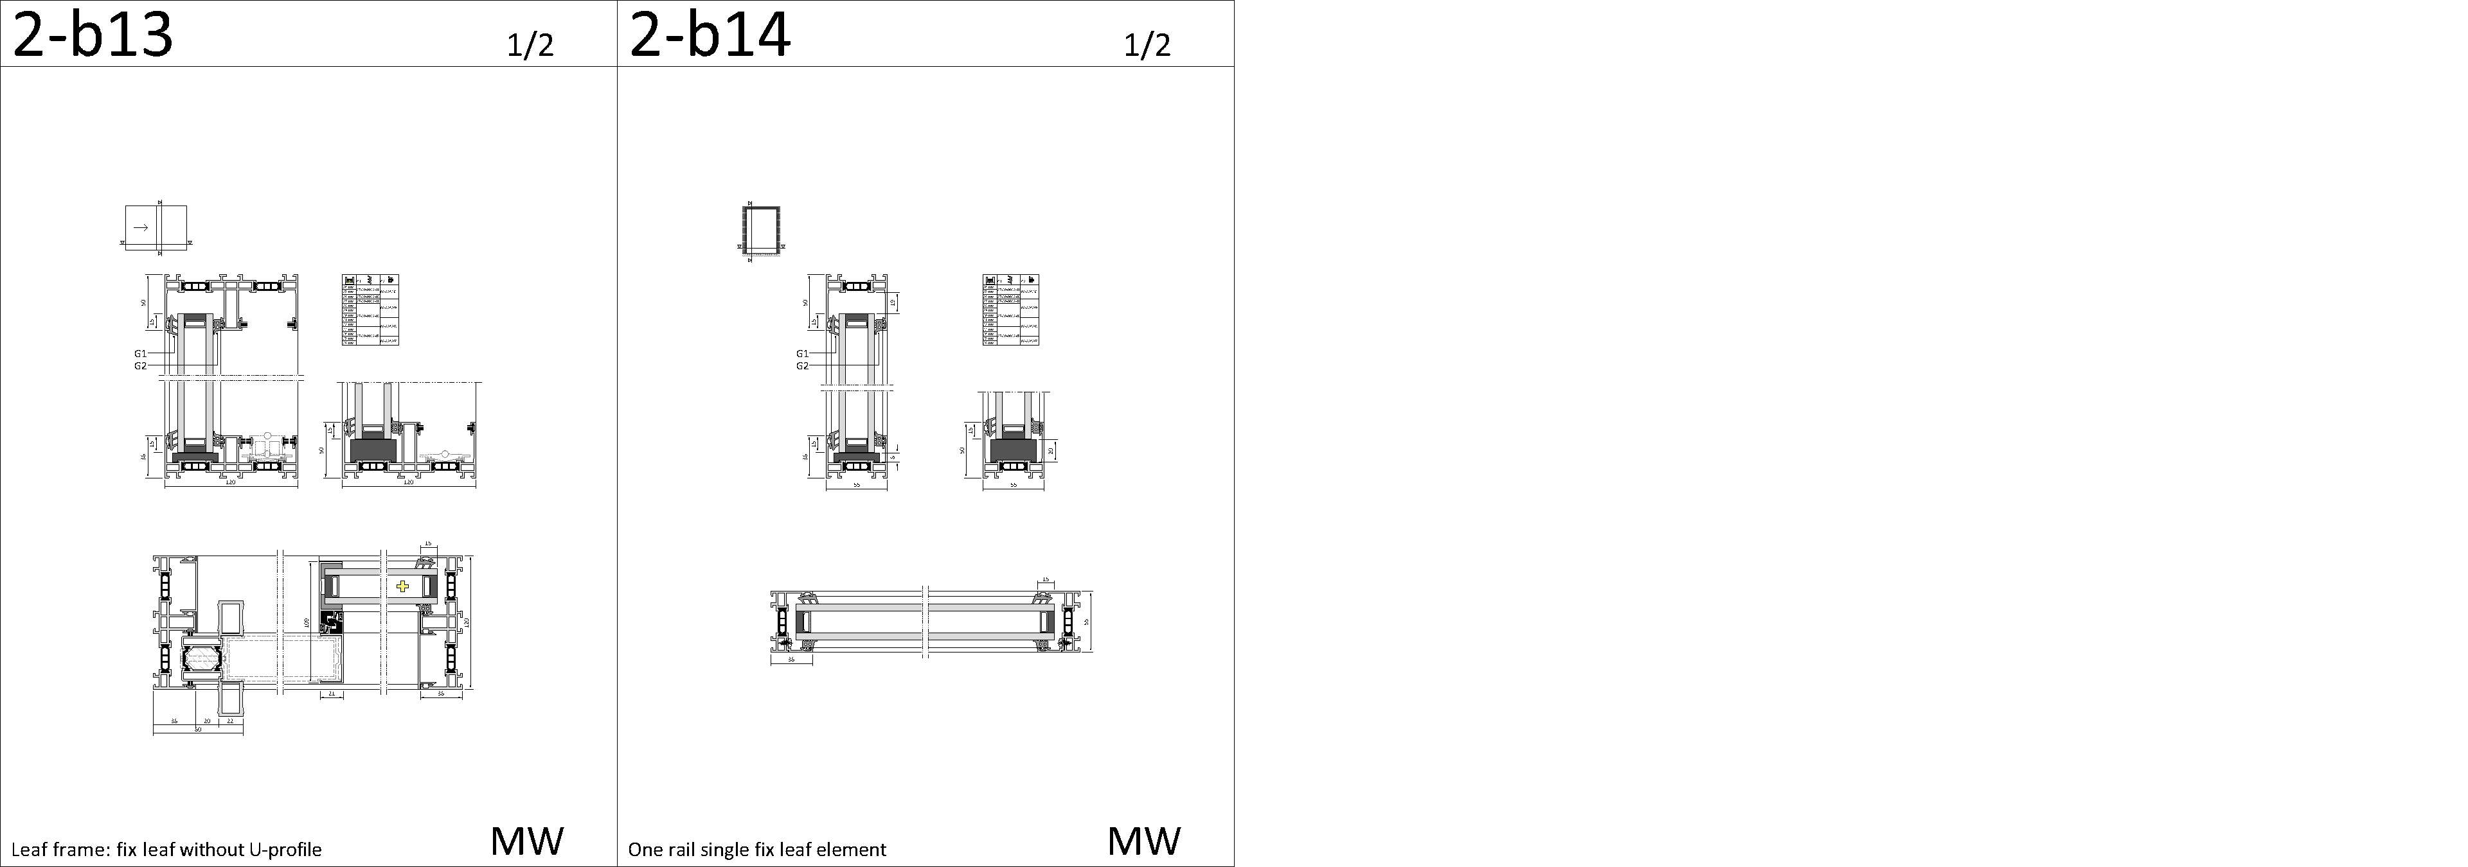
sasch frames

Slide 15
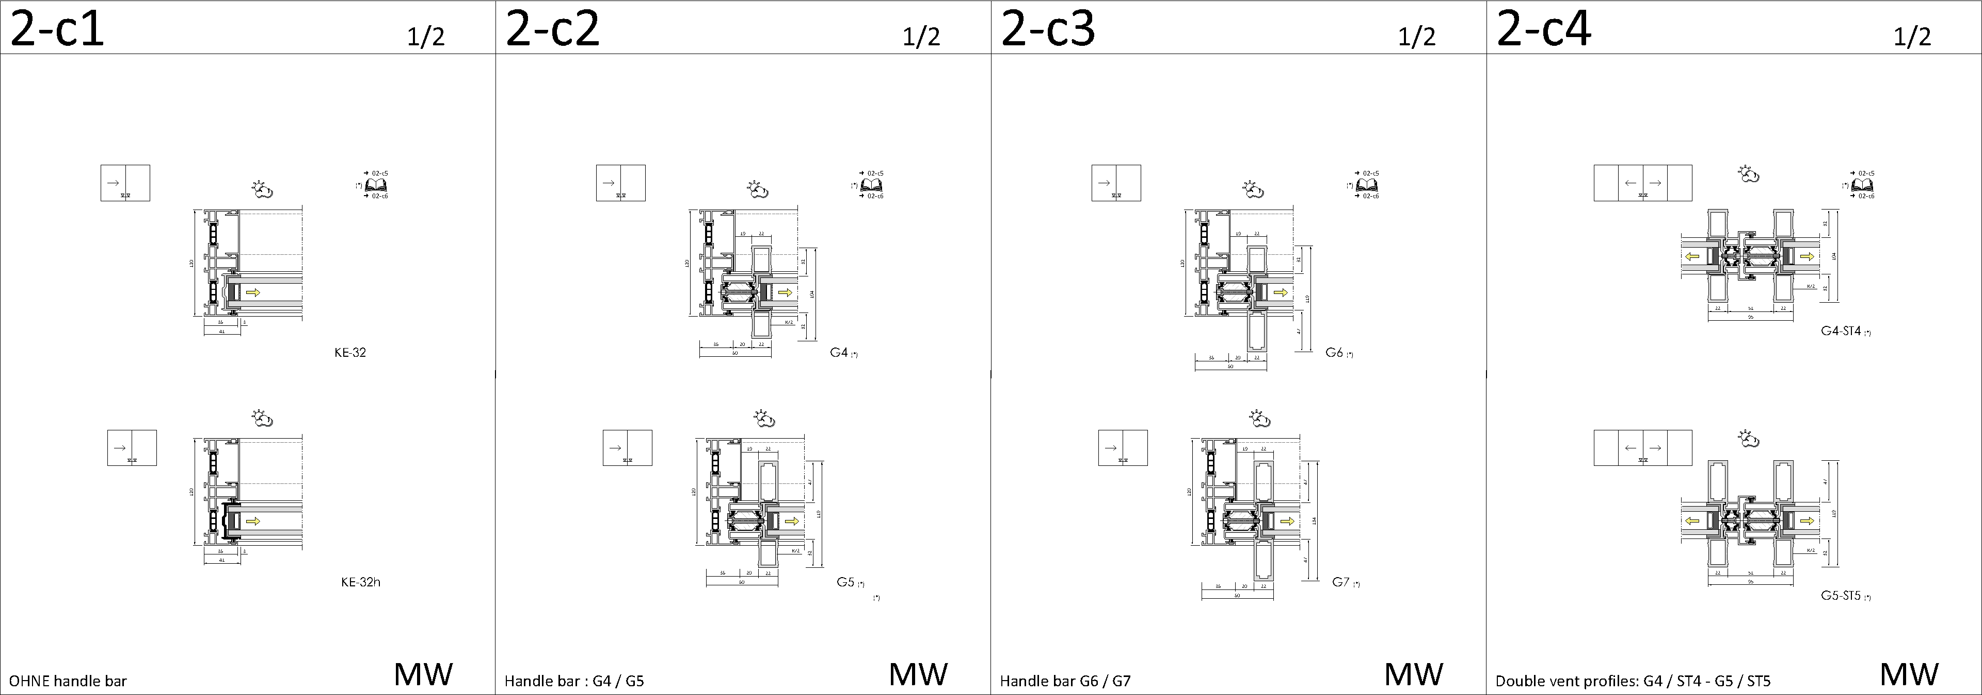
handle bars & double vent profiles

Slide 16
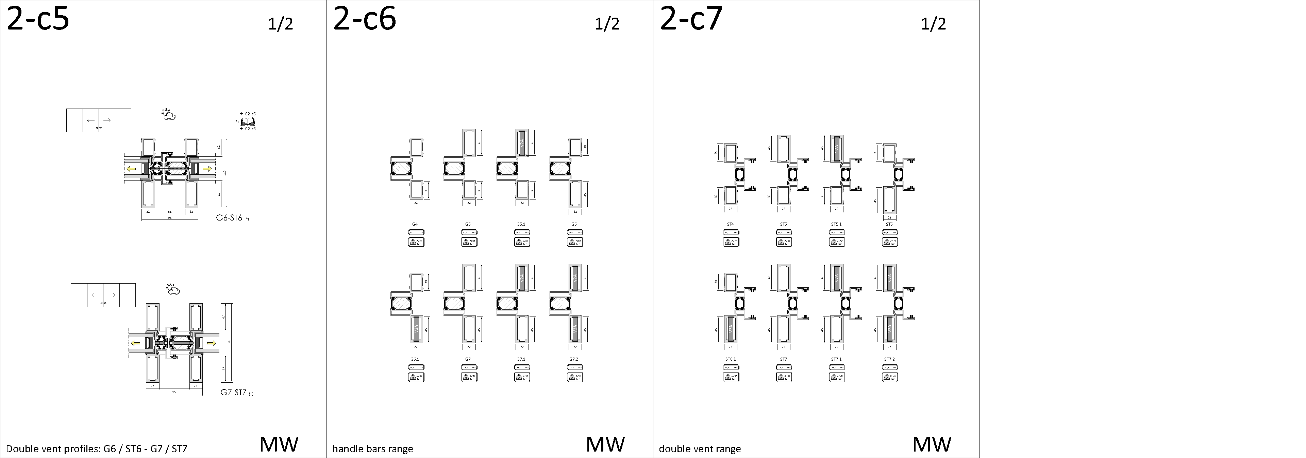
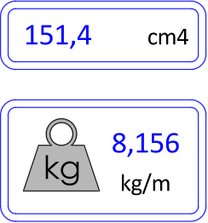
handle bars & double vent profiles - Static
Indication of
weight & static value

Slide 17
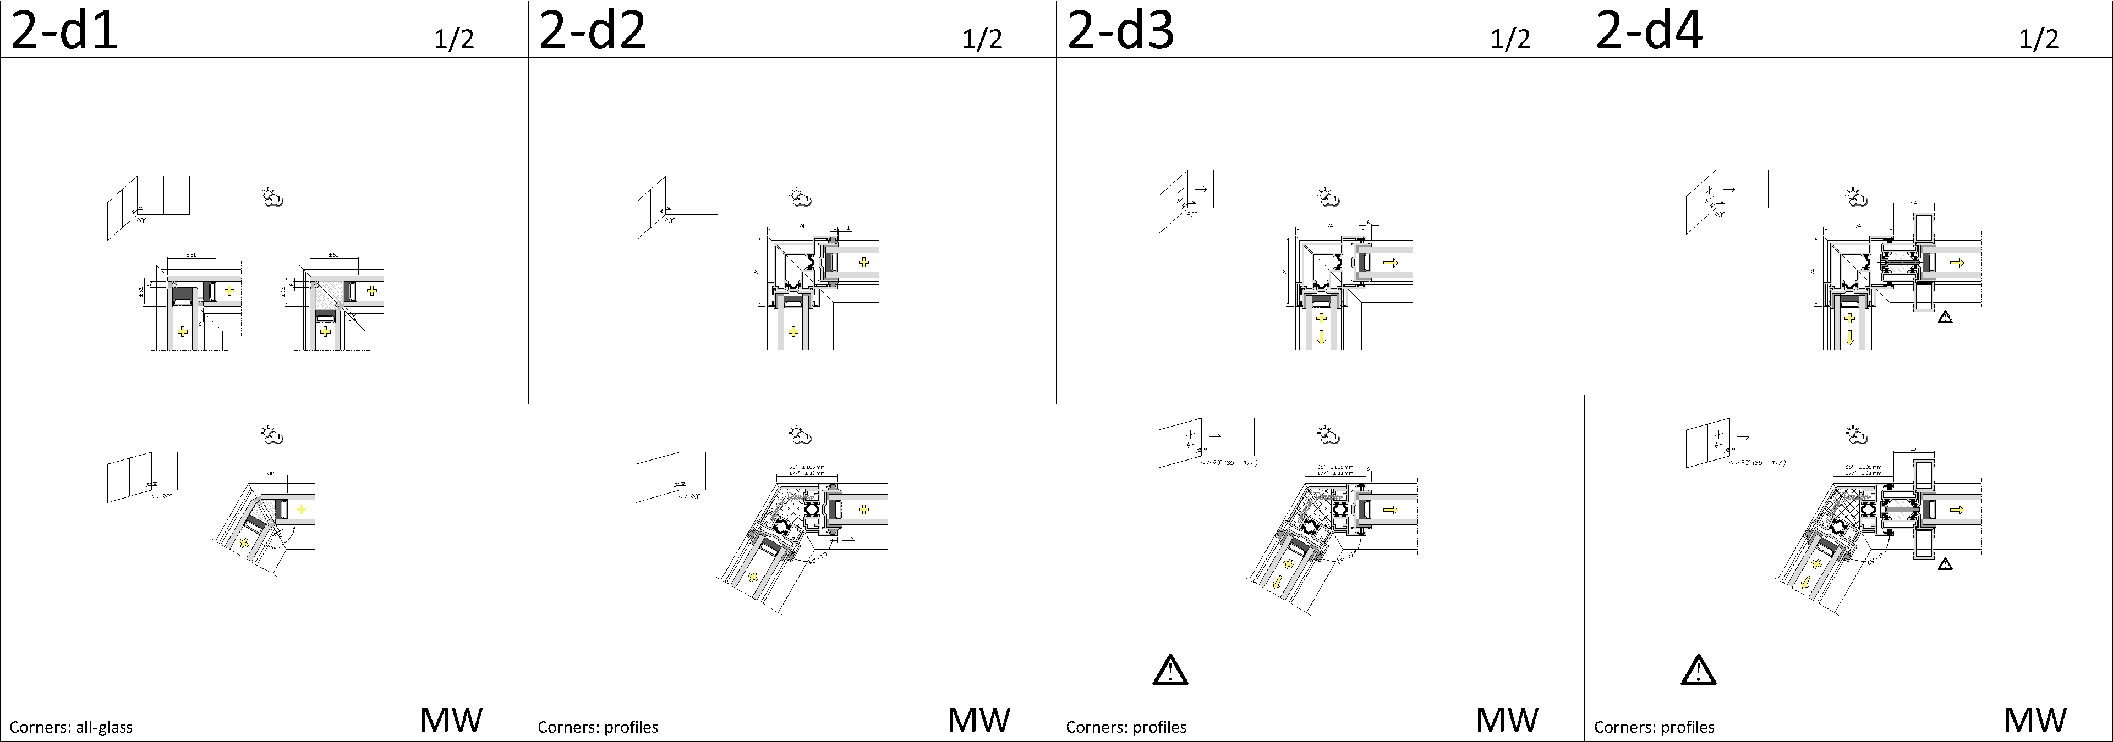
vision (corner)

Slide 18
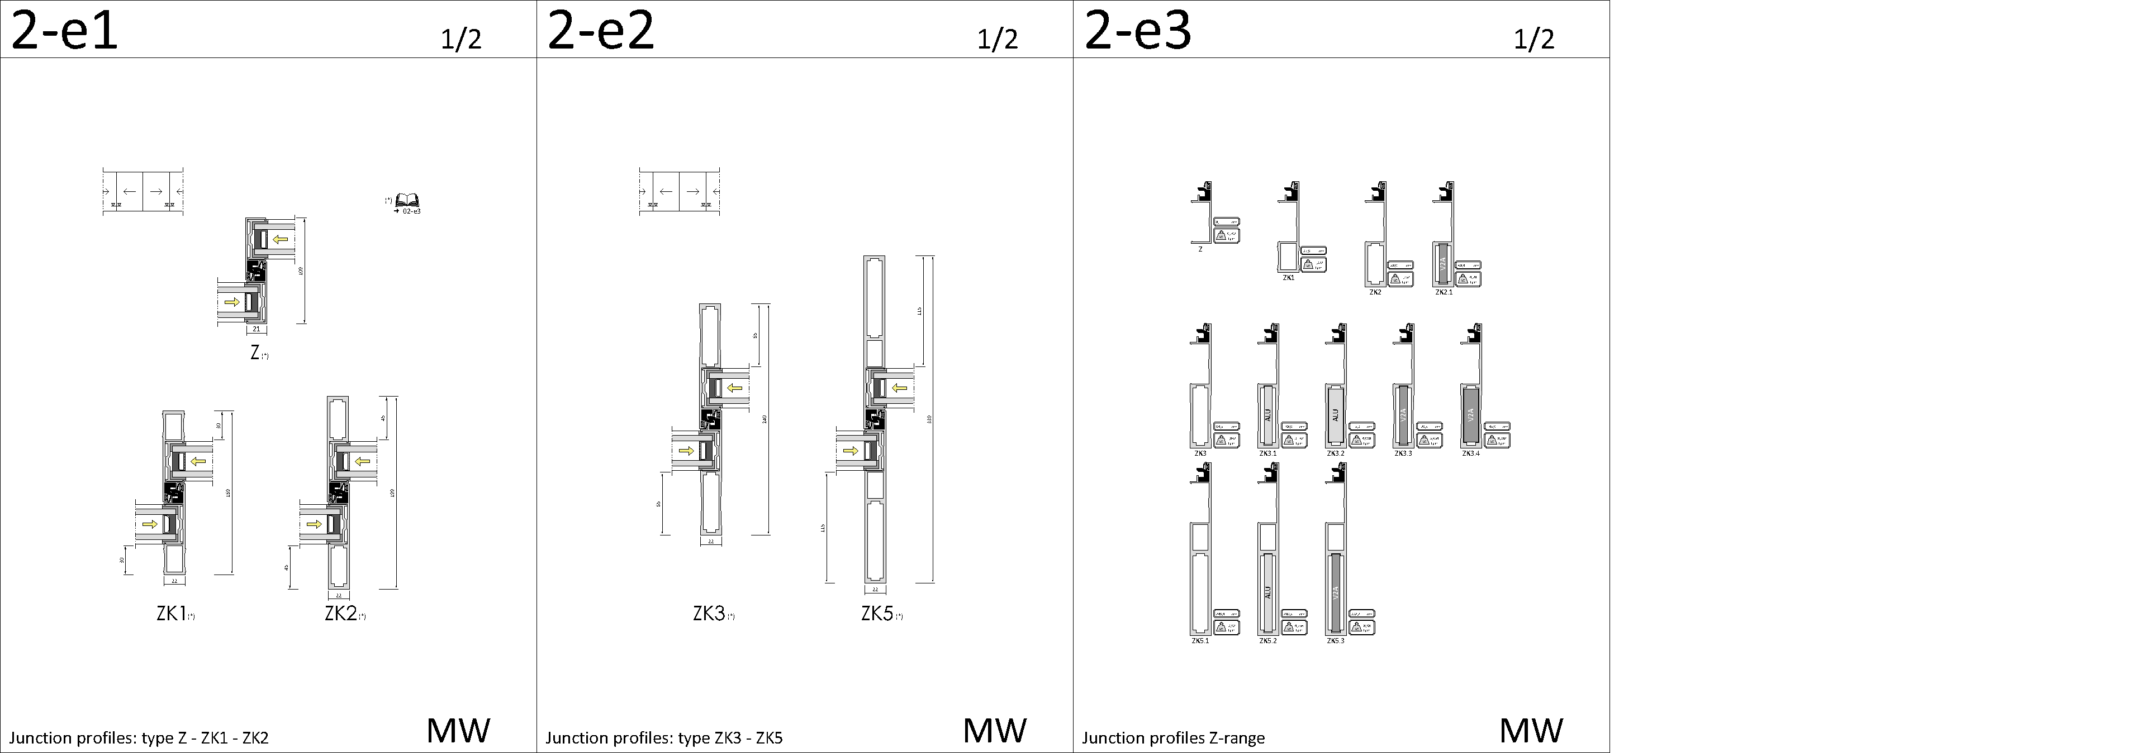
junction profiles – type Z

Slide 19

junction profiles – type A

Slide 20
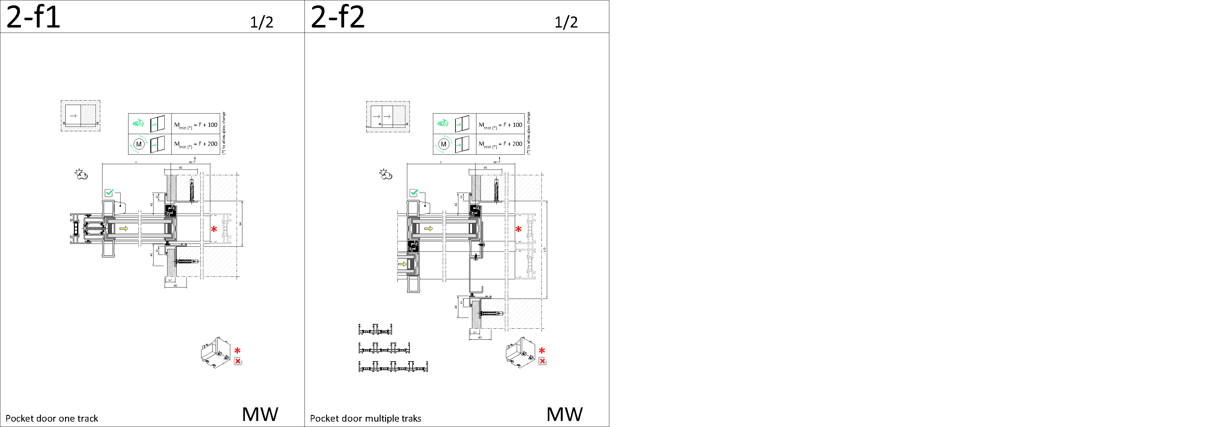
pocket

Slide 21
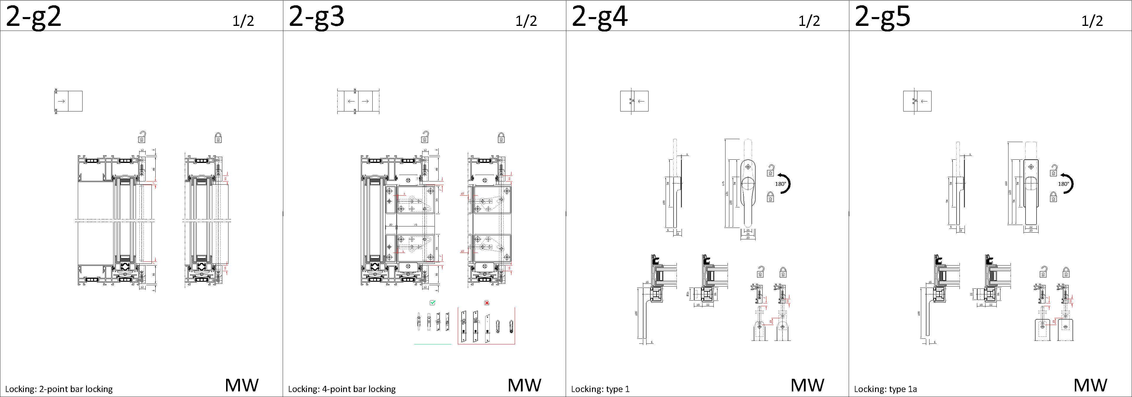
lockings

Slide 22
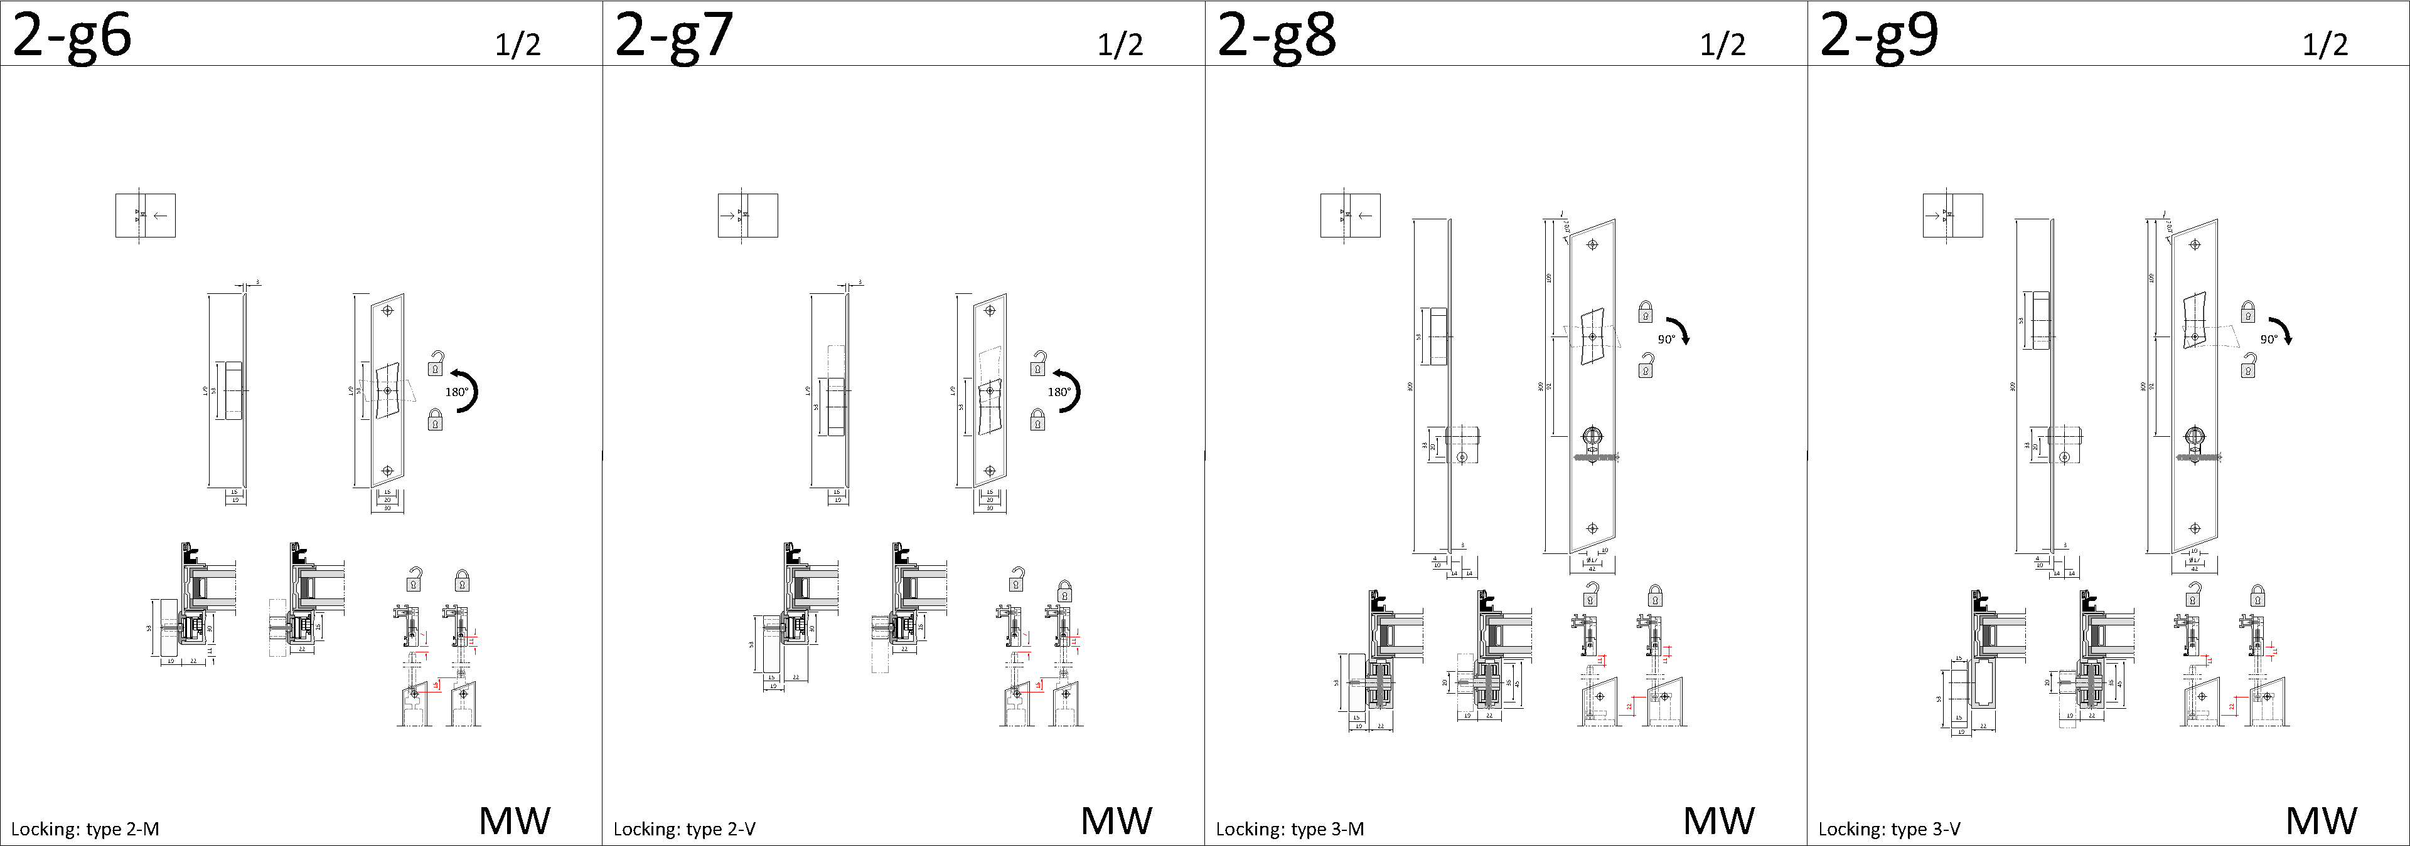
lockings

Slide 23
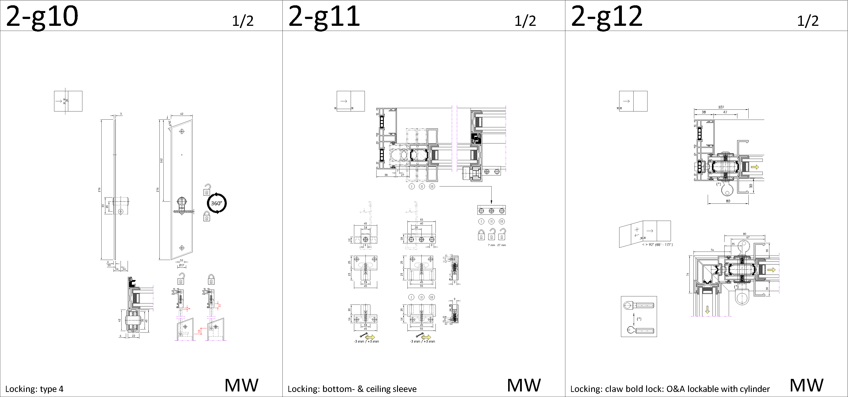
lockings

Slide 24
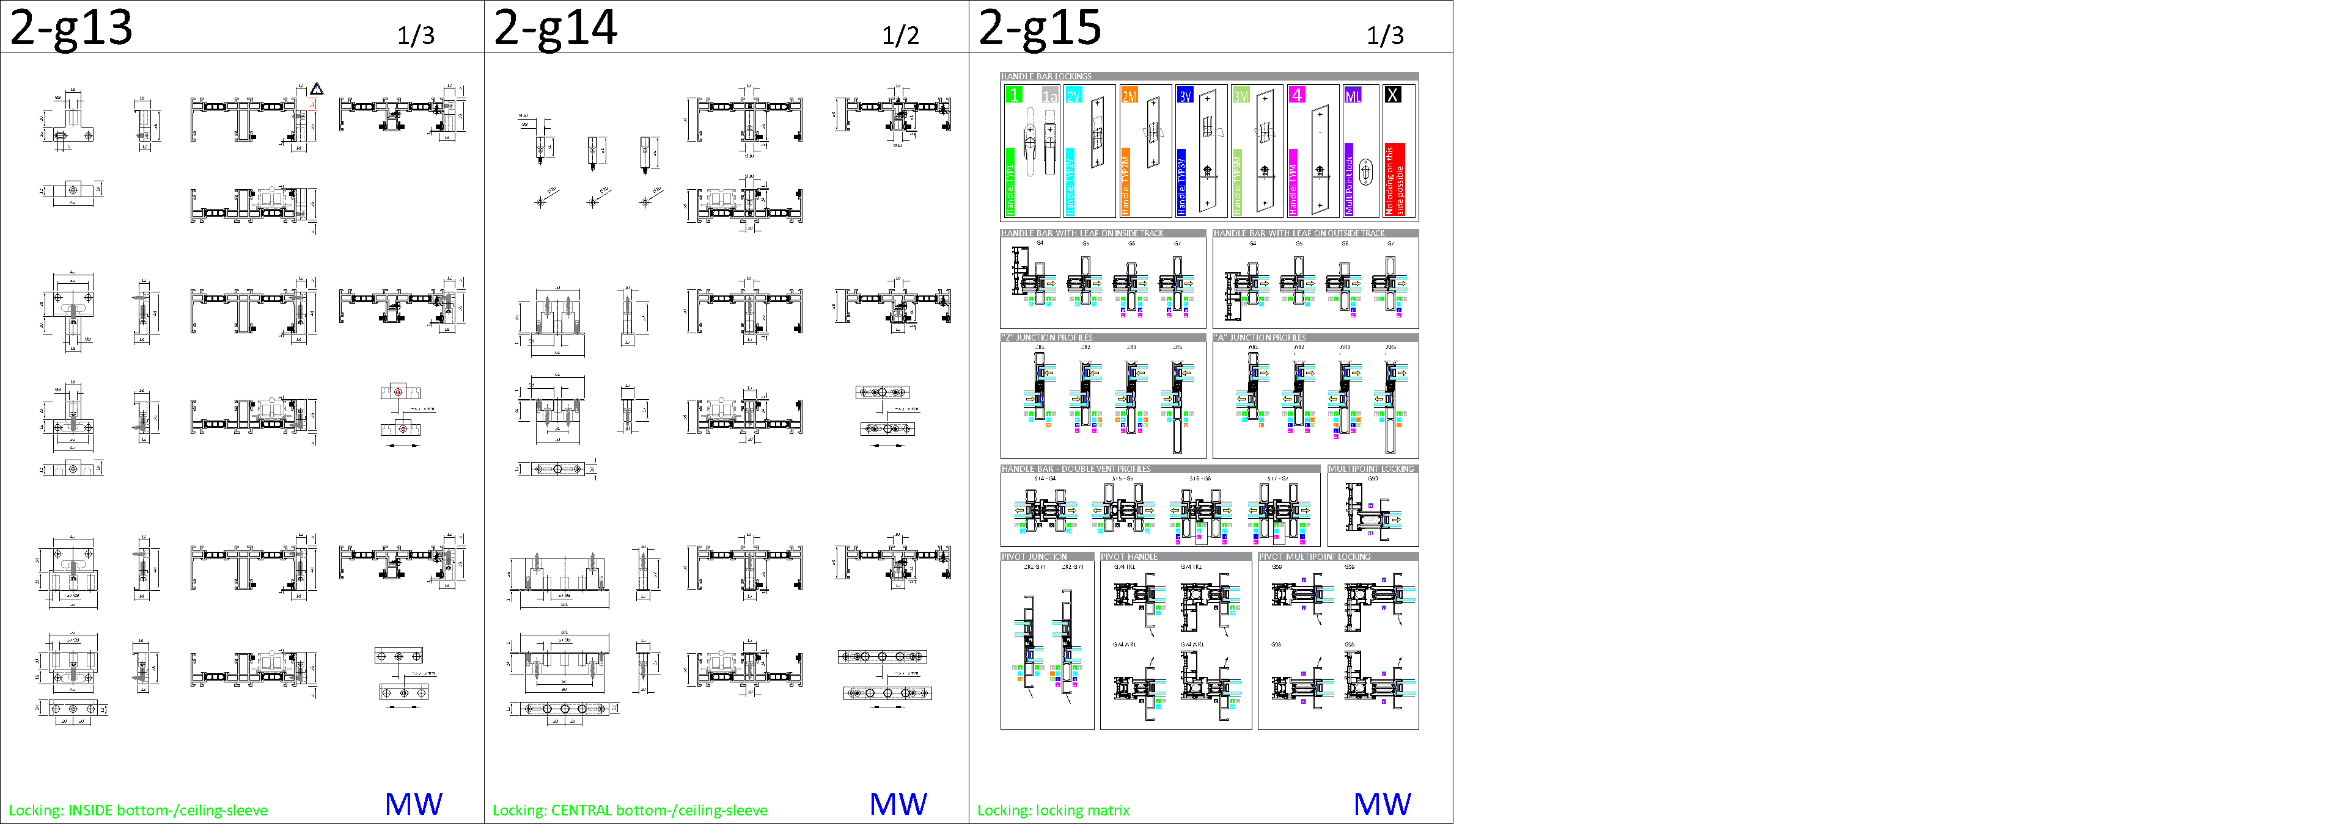
lockings

Slide 25
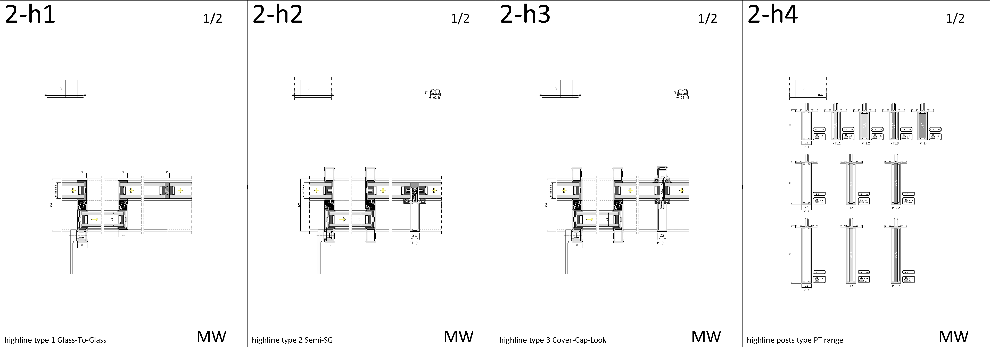
highline

Slide 26
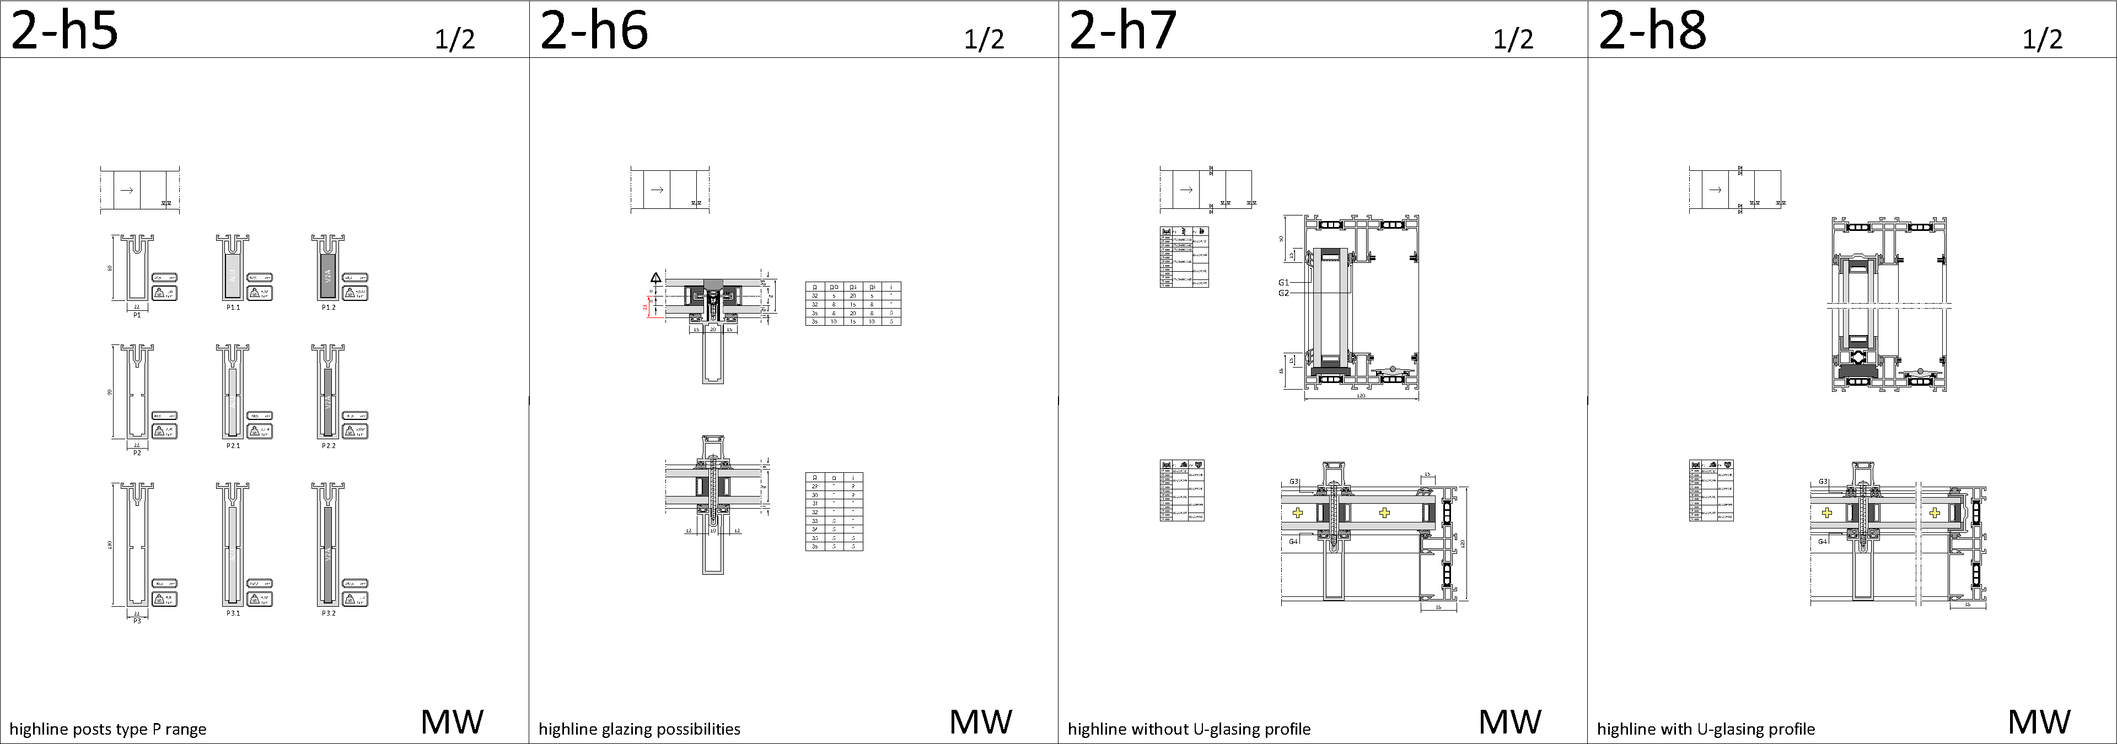
highline

Slide 27
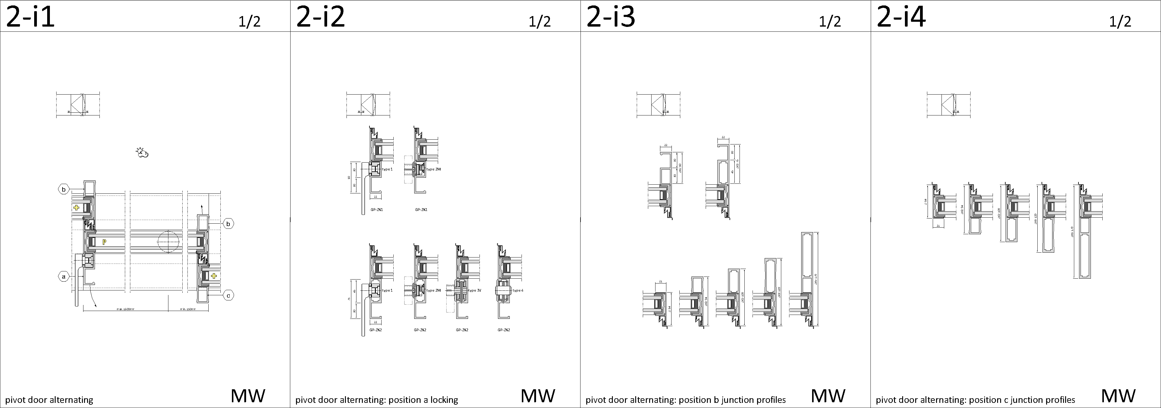
pivot

Slide 28
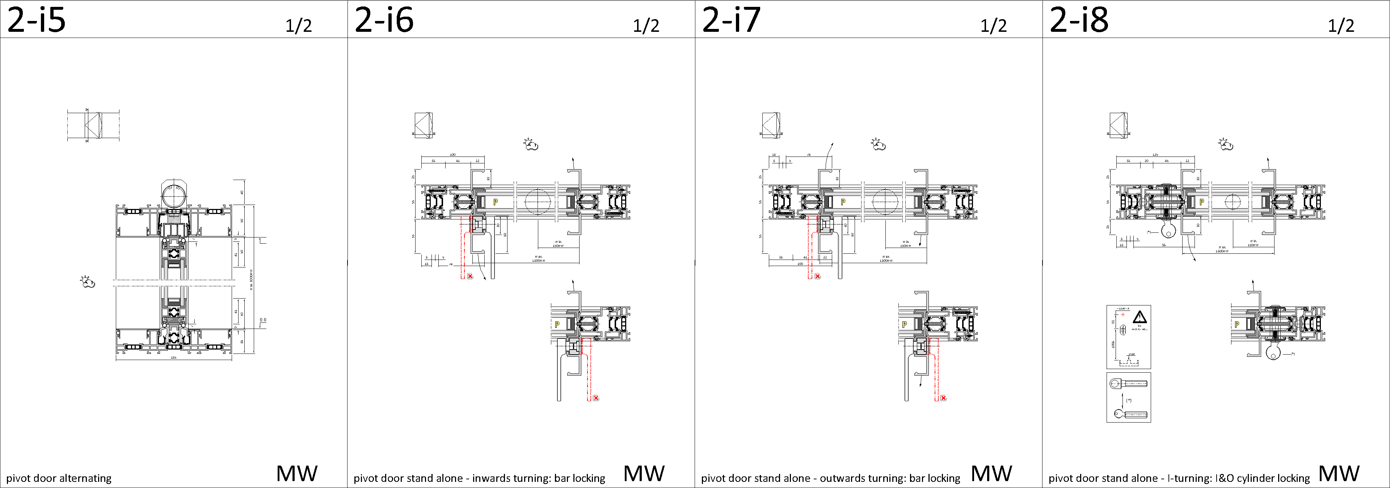
pivot

Slide 29
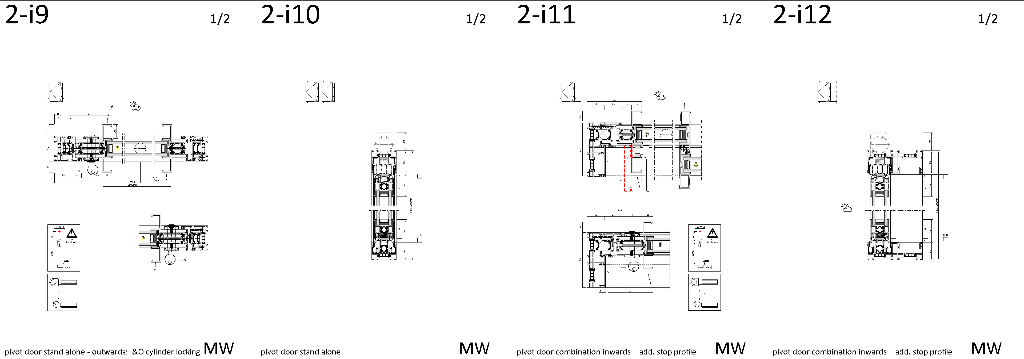
pivot

Slide 30
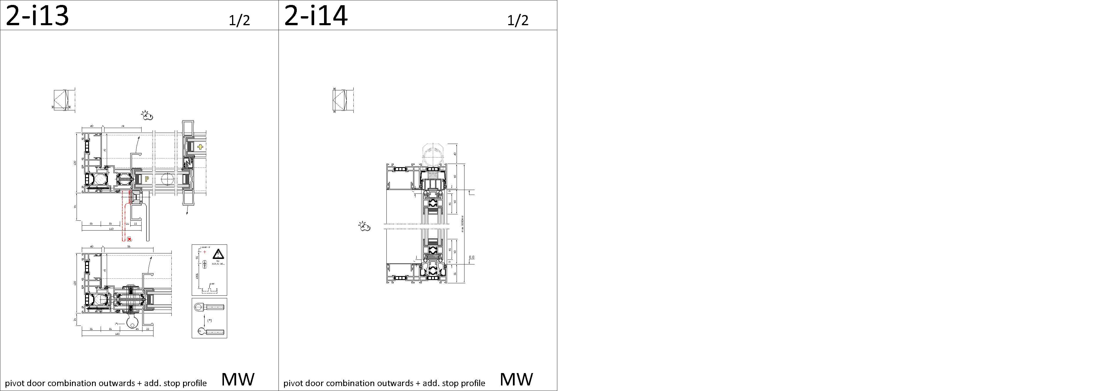
pivot

Slide 31
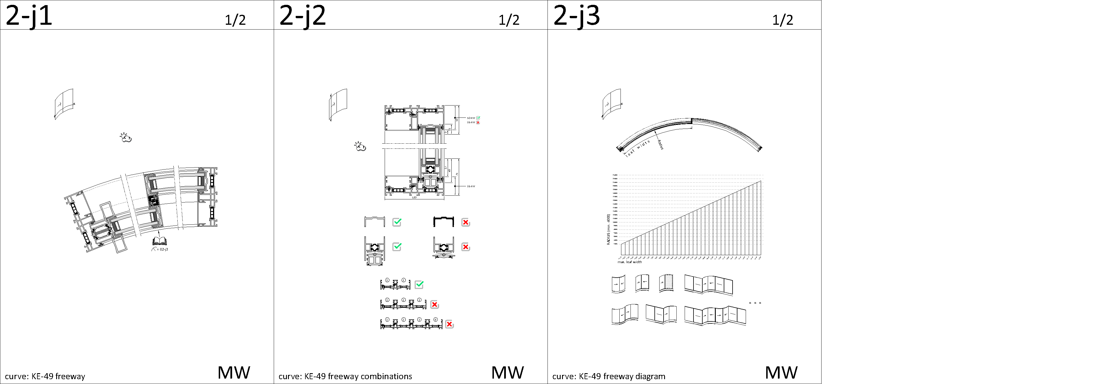
curve

Slide 32
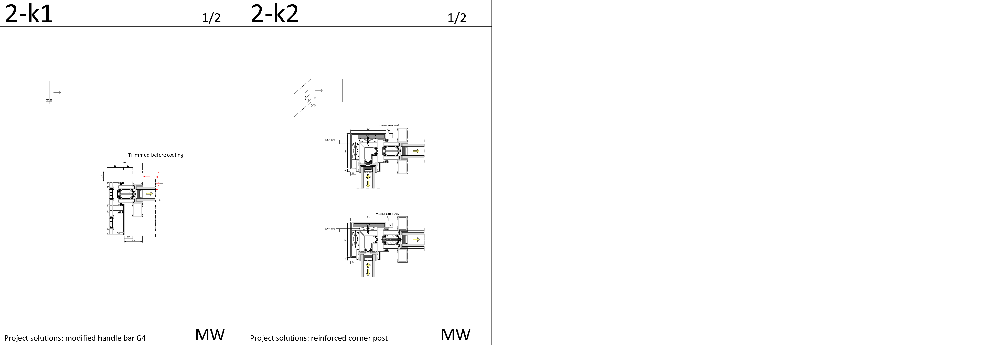
special project solutions

Slide 33
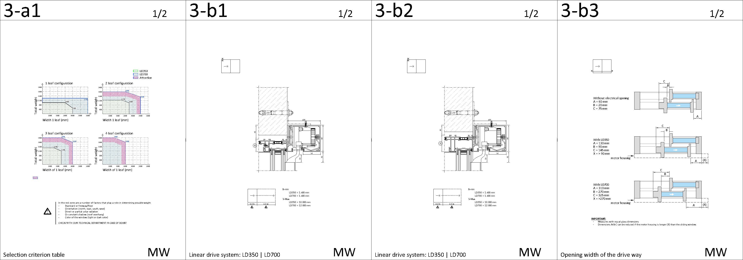
smart slider LD (lateral drive)

Slide 34
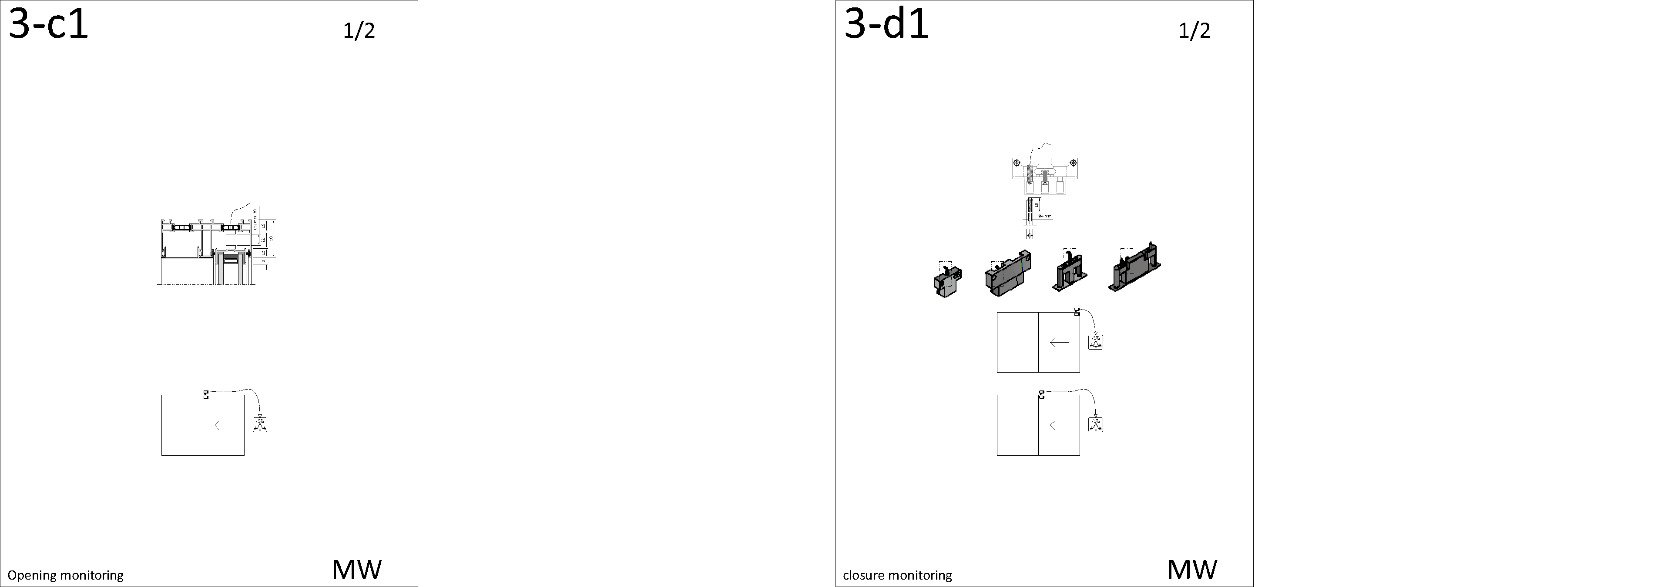
monitoring – opening & closing detection

Slide 35
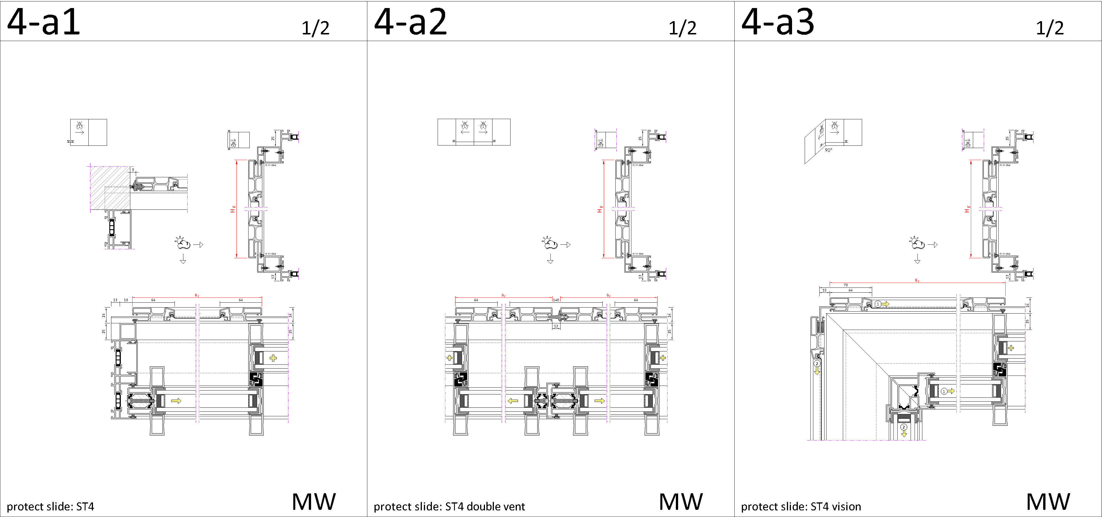
protect slide

Slide 36
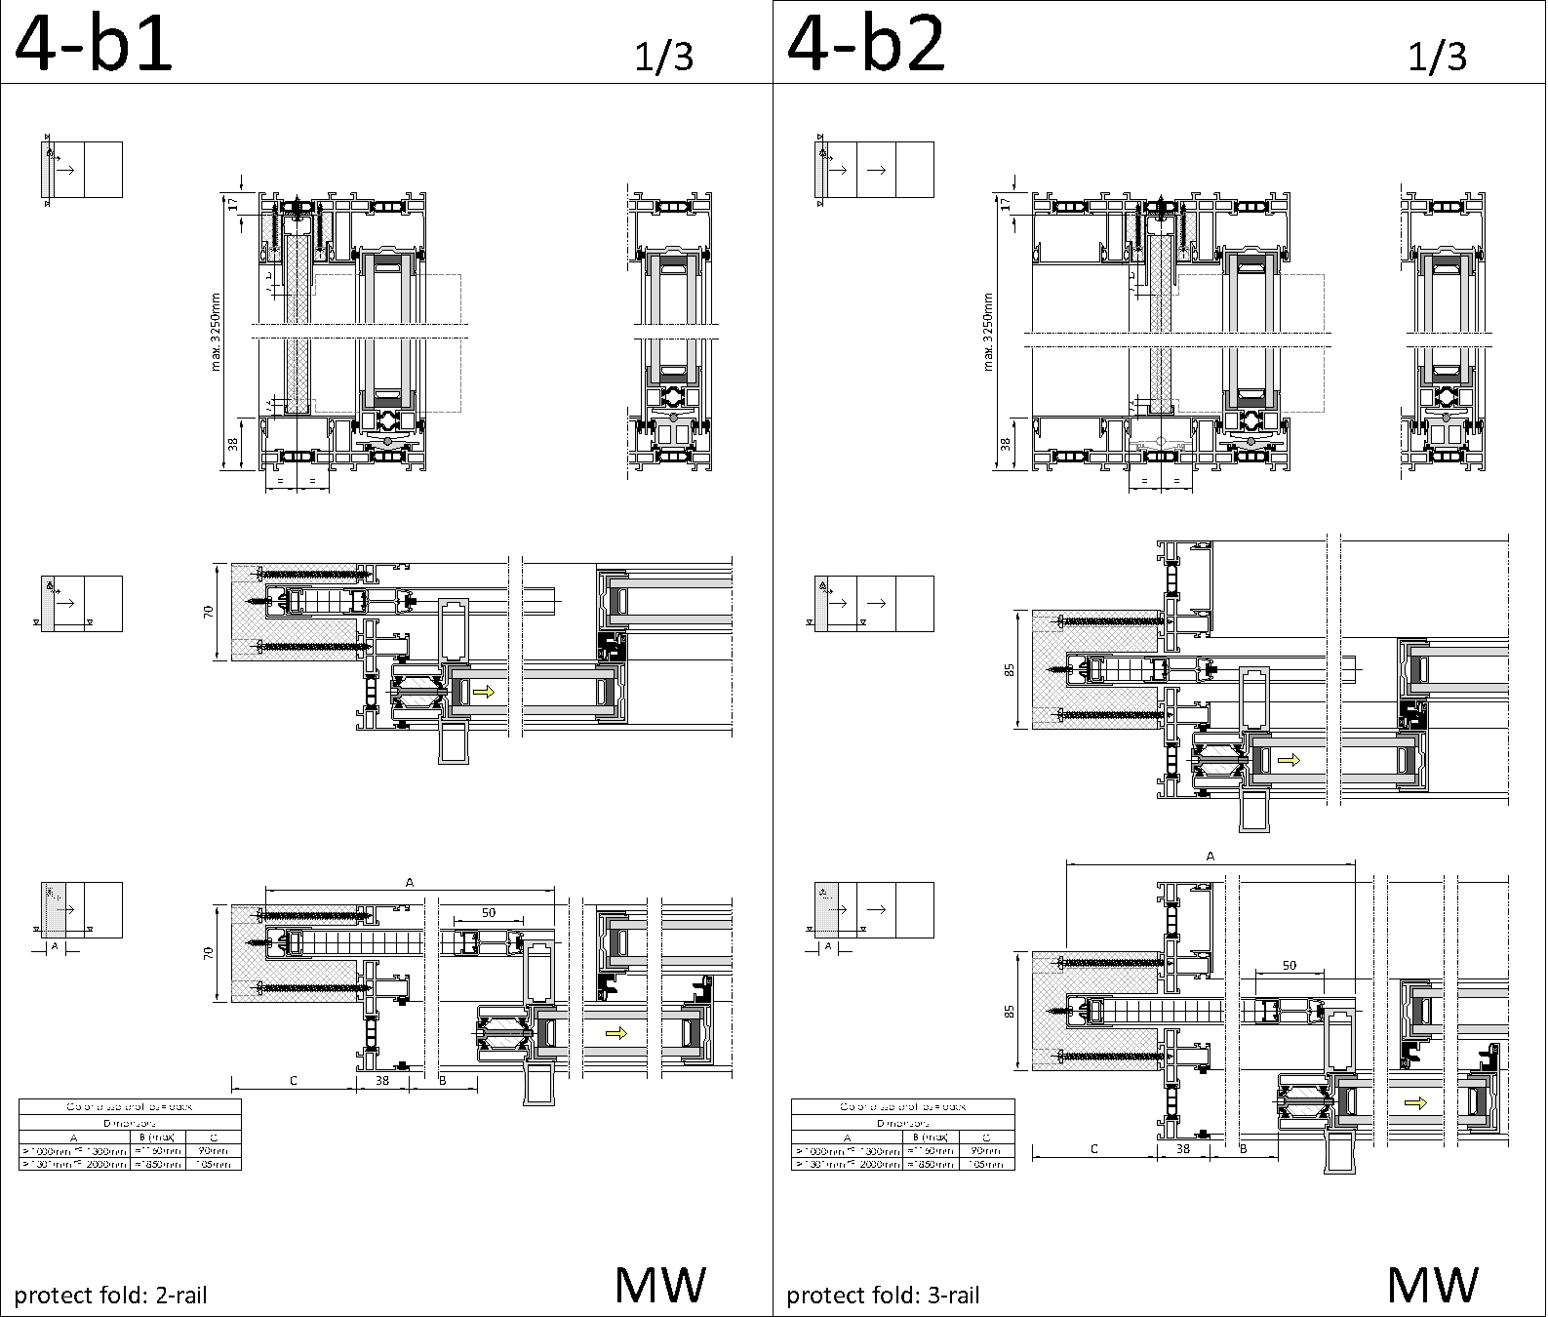
protect - fold

Slide 37
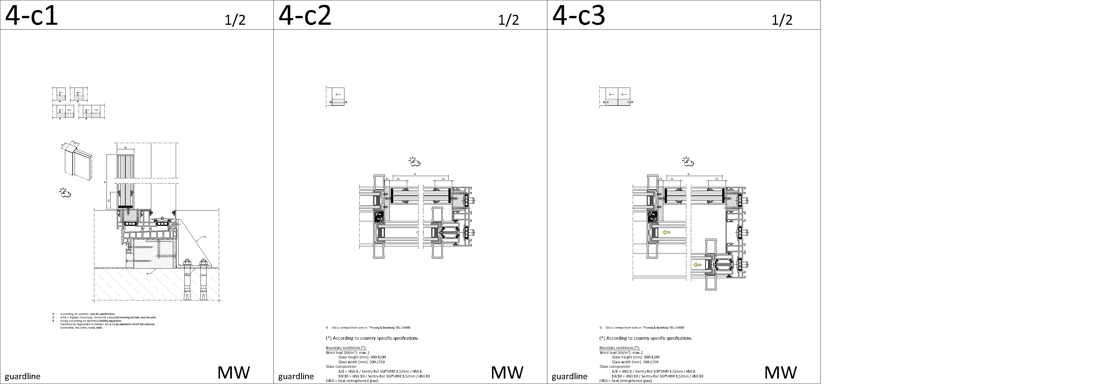
guardline

Slide 38
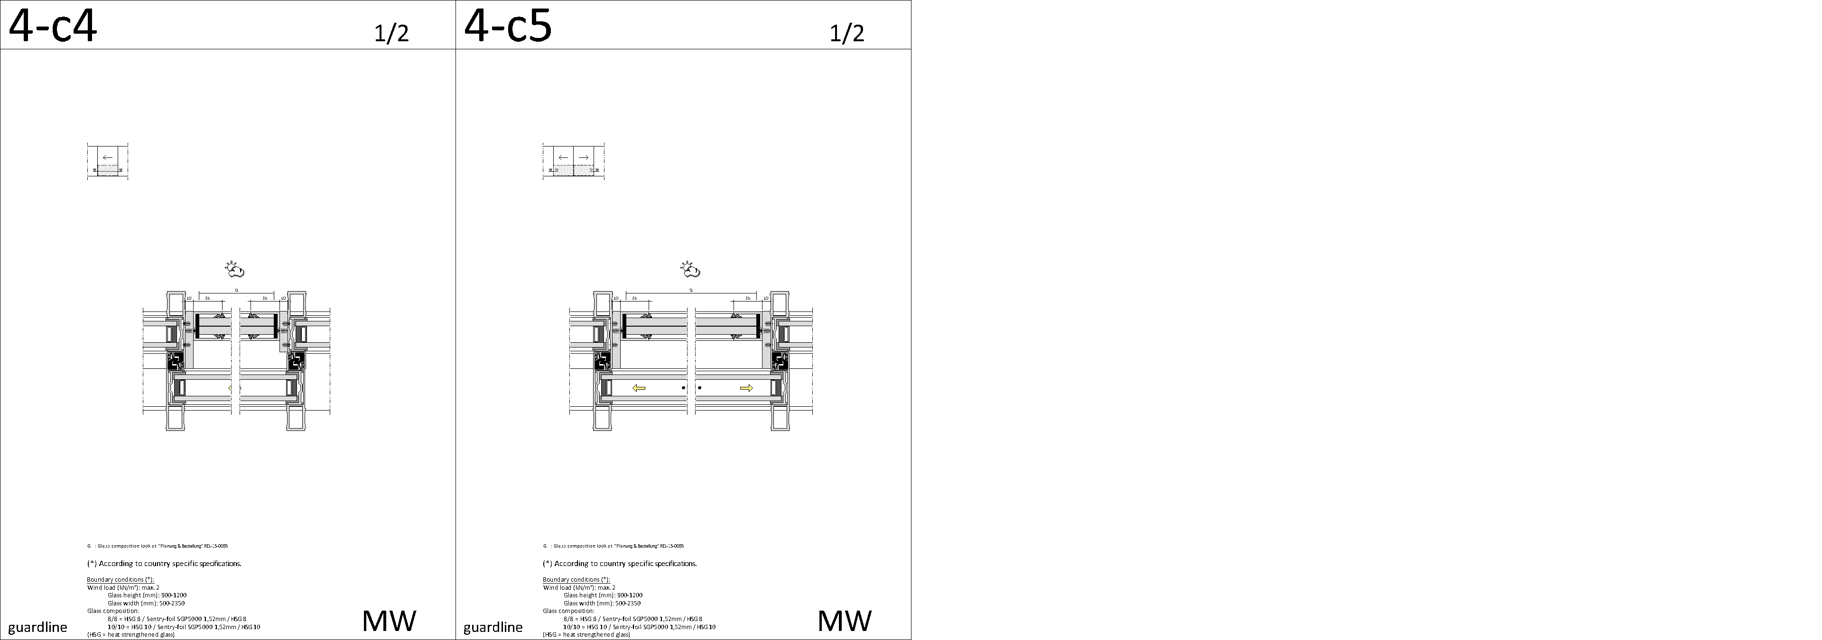
guardline

Slide 39
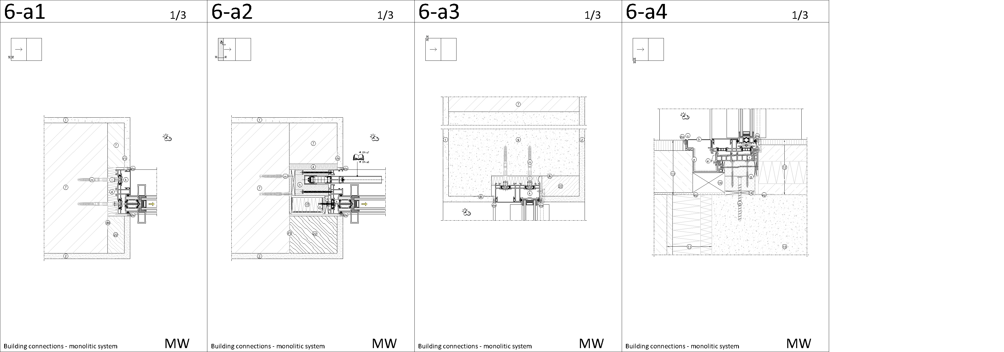
building connections – monolitic wallsystem

Slide 40
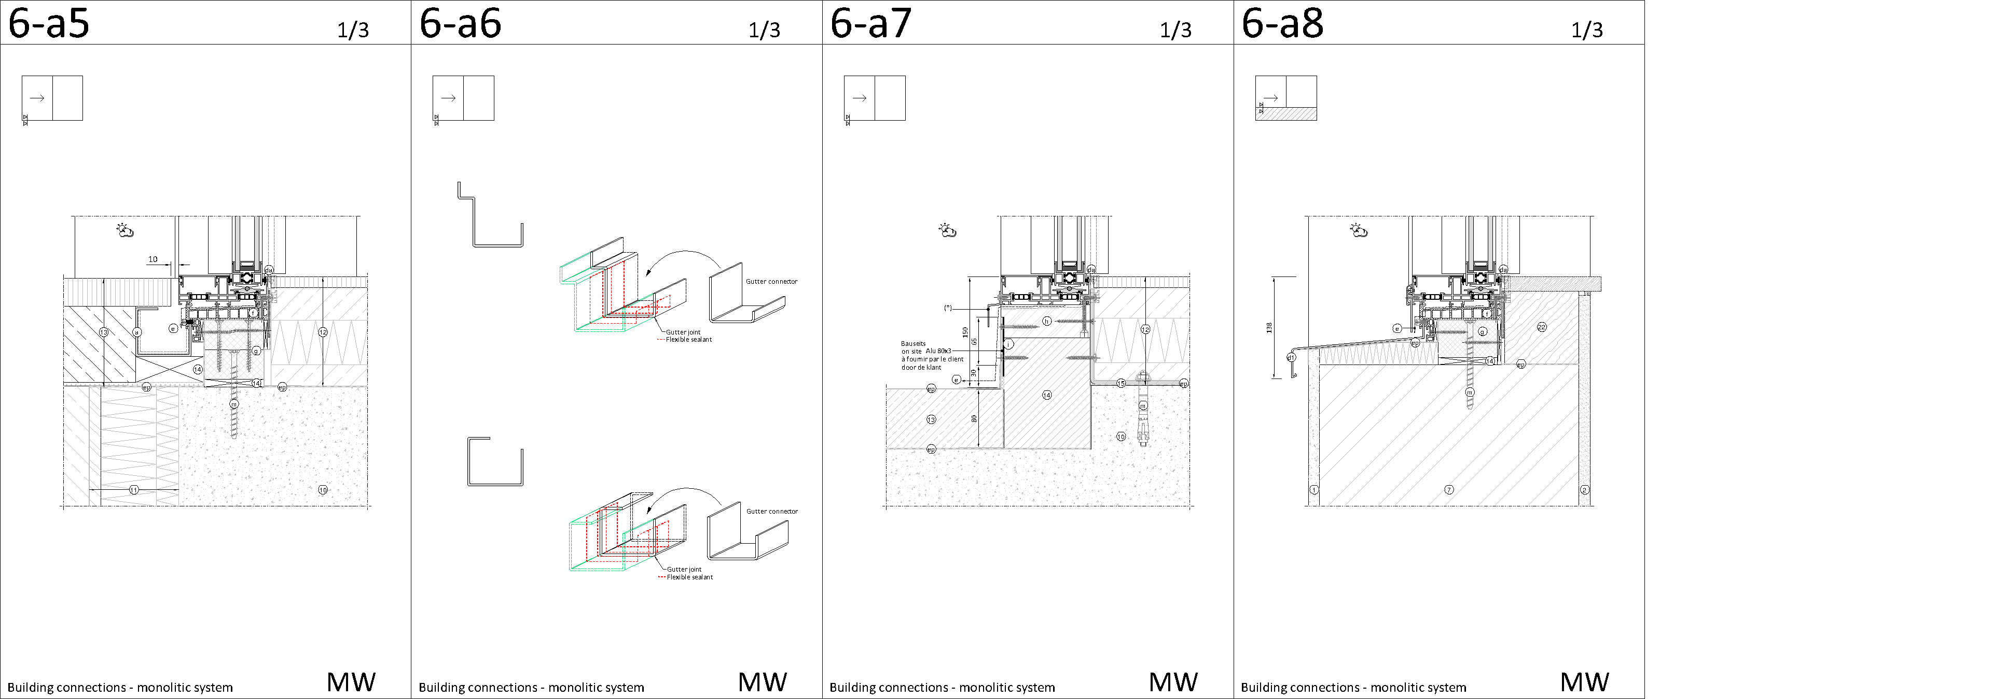
building connections – monolitic wallsystem

Slide 41
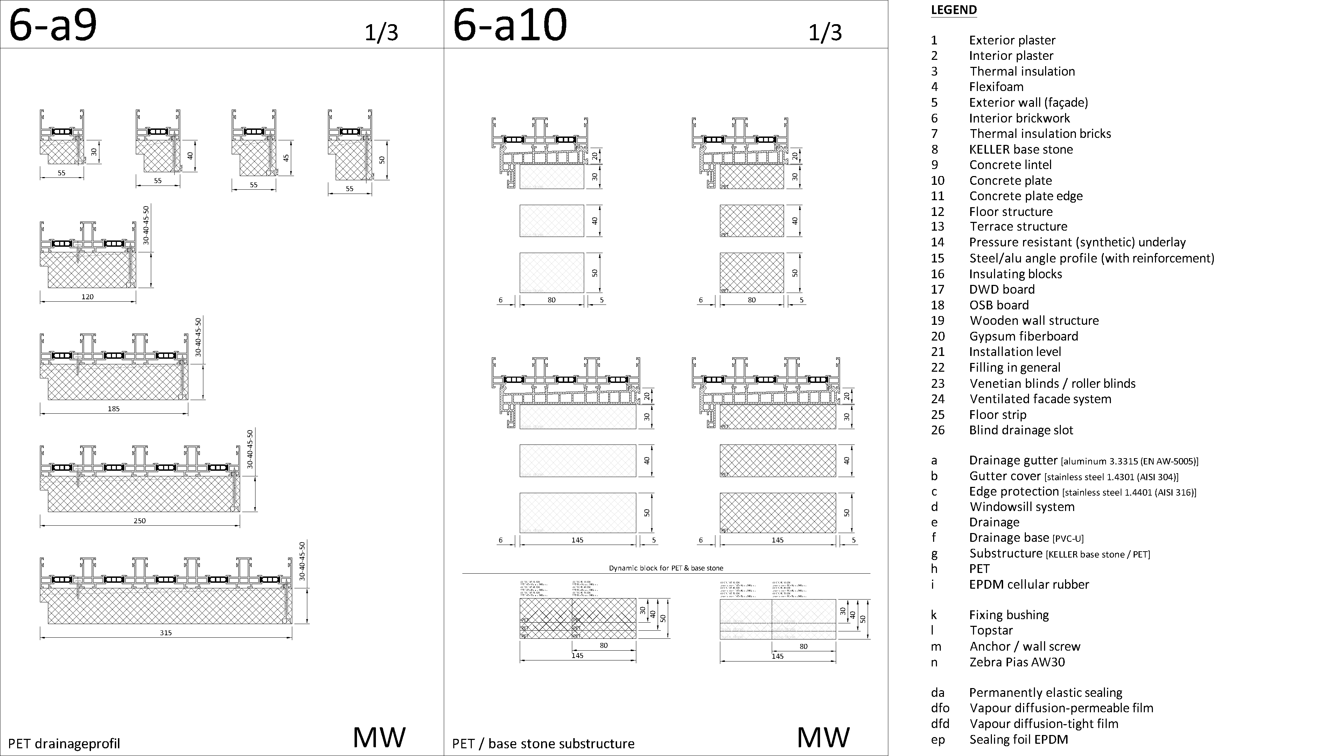
building connections – monolitic wallsystem

Slide 42
