Slide 1

&
Innovation
Craftmanship
since 1980
Notes:
Let’s have a quick start at Keller where we all stand for Innovation and Craftmanship.

Slide 2
2
CAD
Architect manual
since 1980
Notes:
Let’s have a quick start at Keller where we all stand for Innovation and Craftmanship.

Slide 3
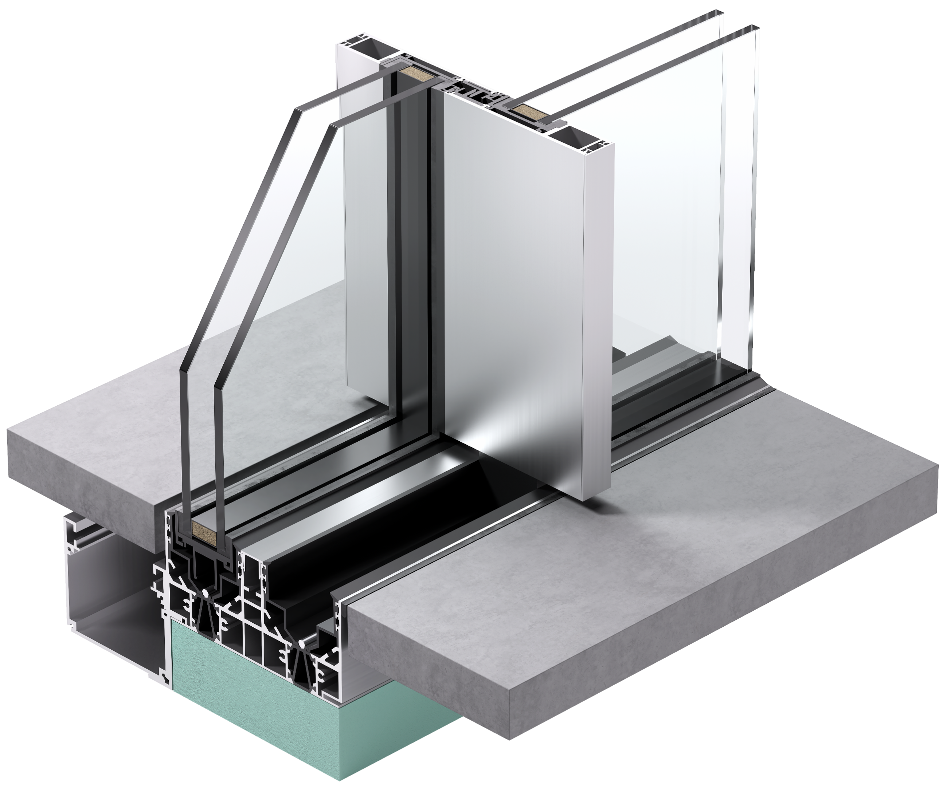
since 1980
Notes:
Let’s have a quick start at Keller where we all stand for Innovation and Craftmanship.

Slide 4
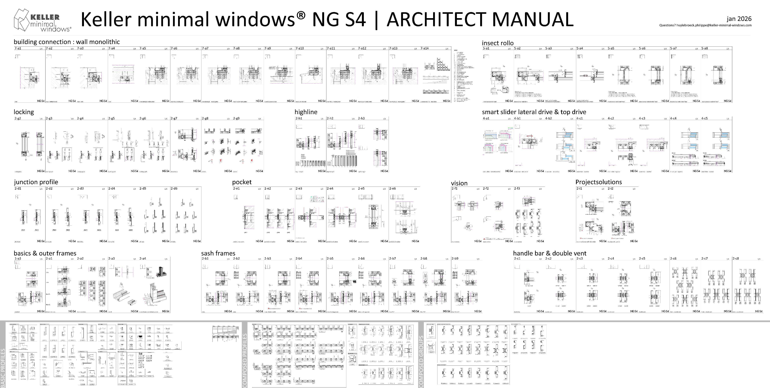
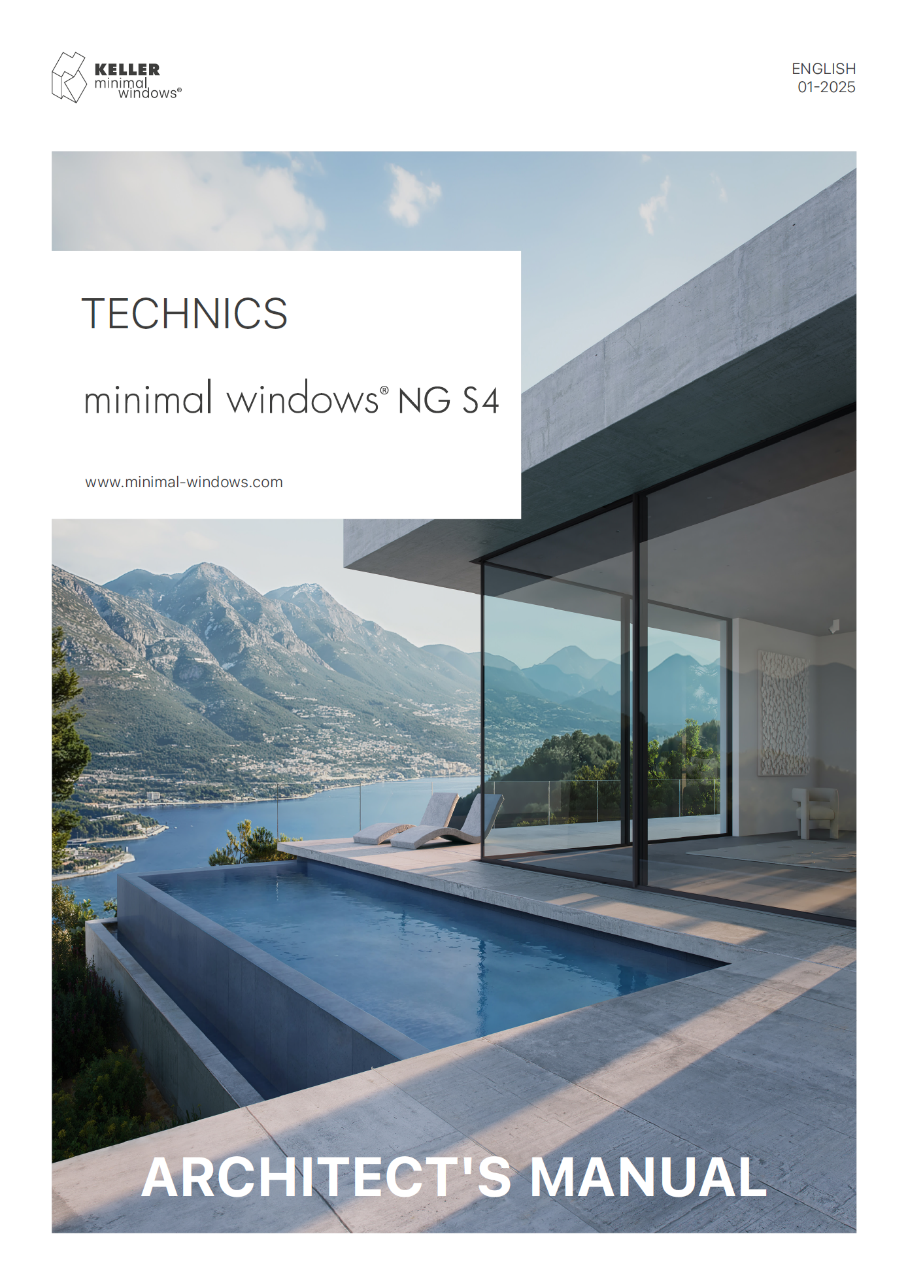
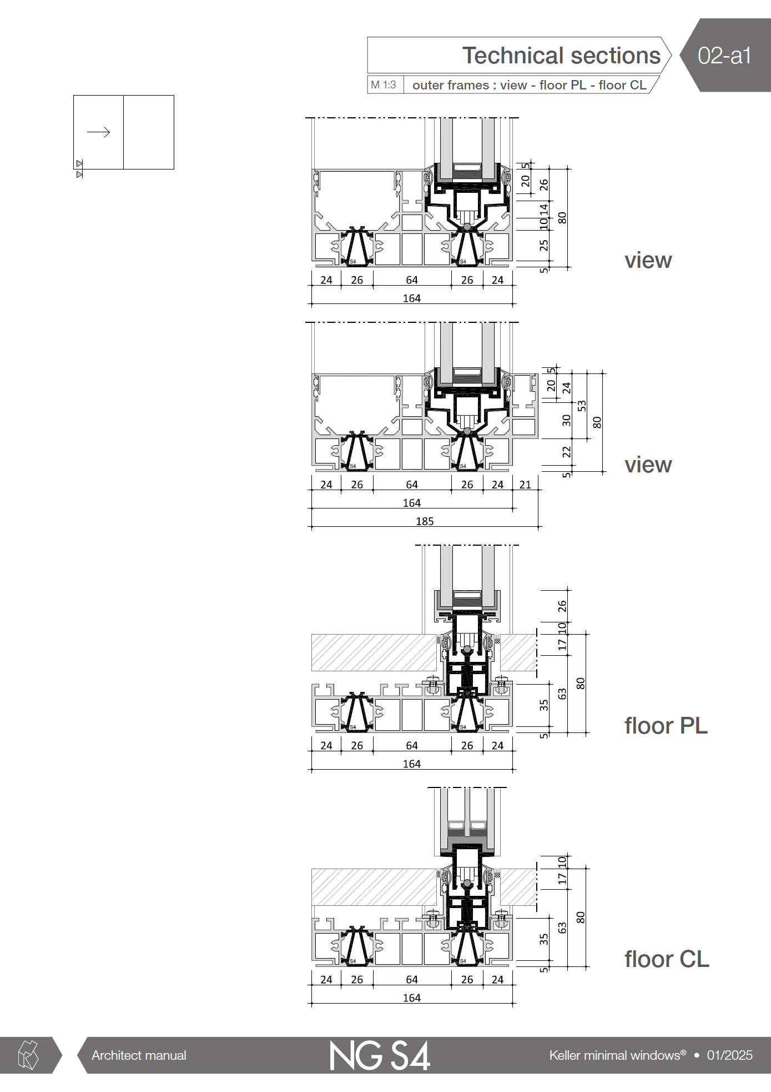
CAD 2 ARCHITECT MANUAL

Slide 5
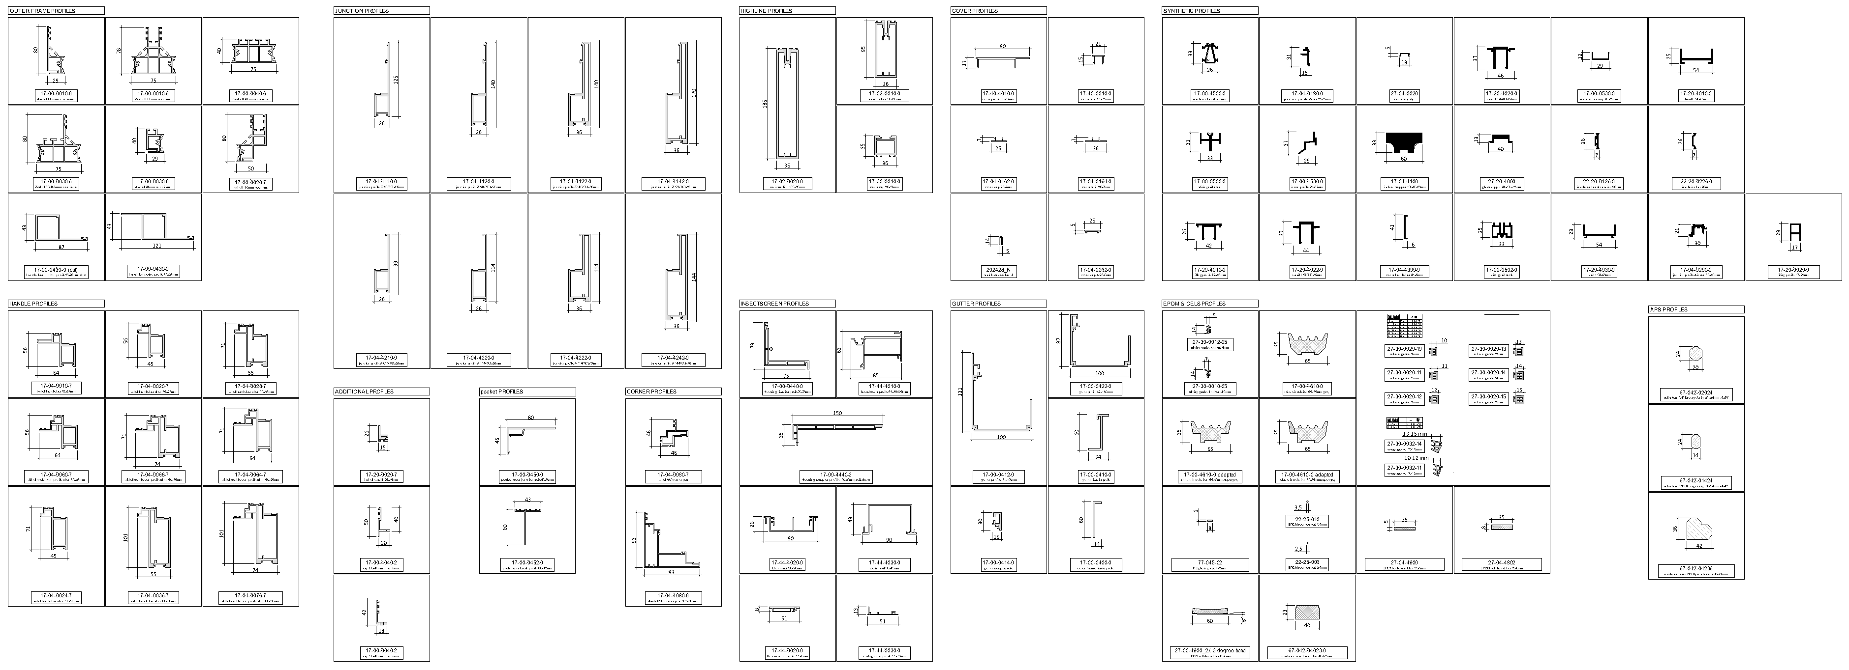
profile overview – basic profiles

Slide 6
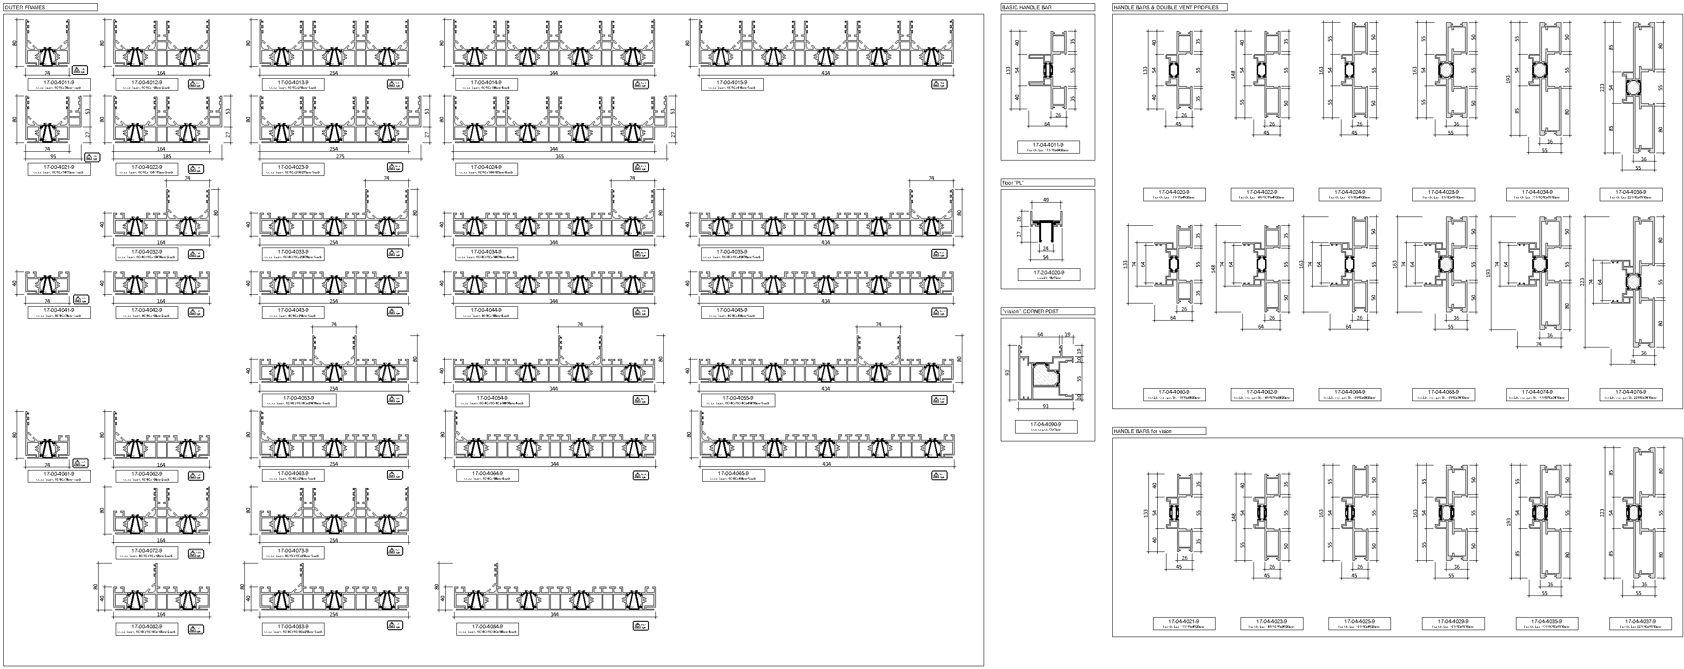
profile overview – composed profiles

Slide 7
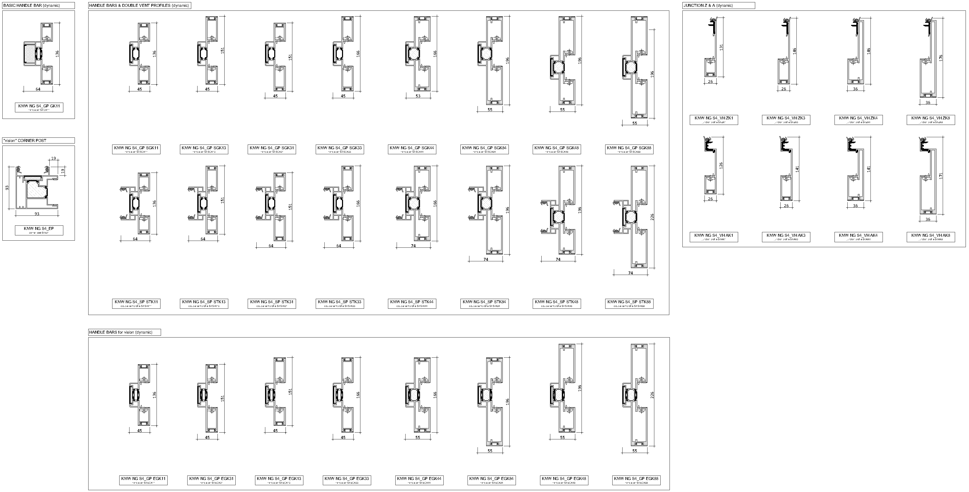
profile overview – composed groups (some dynamic functions)

Slide 8
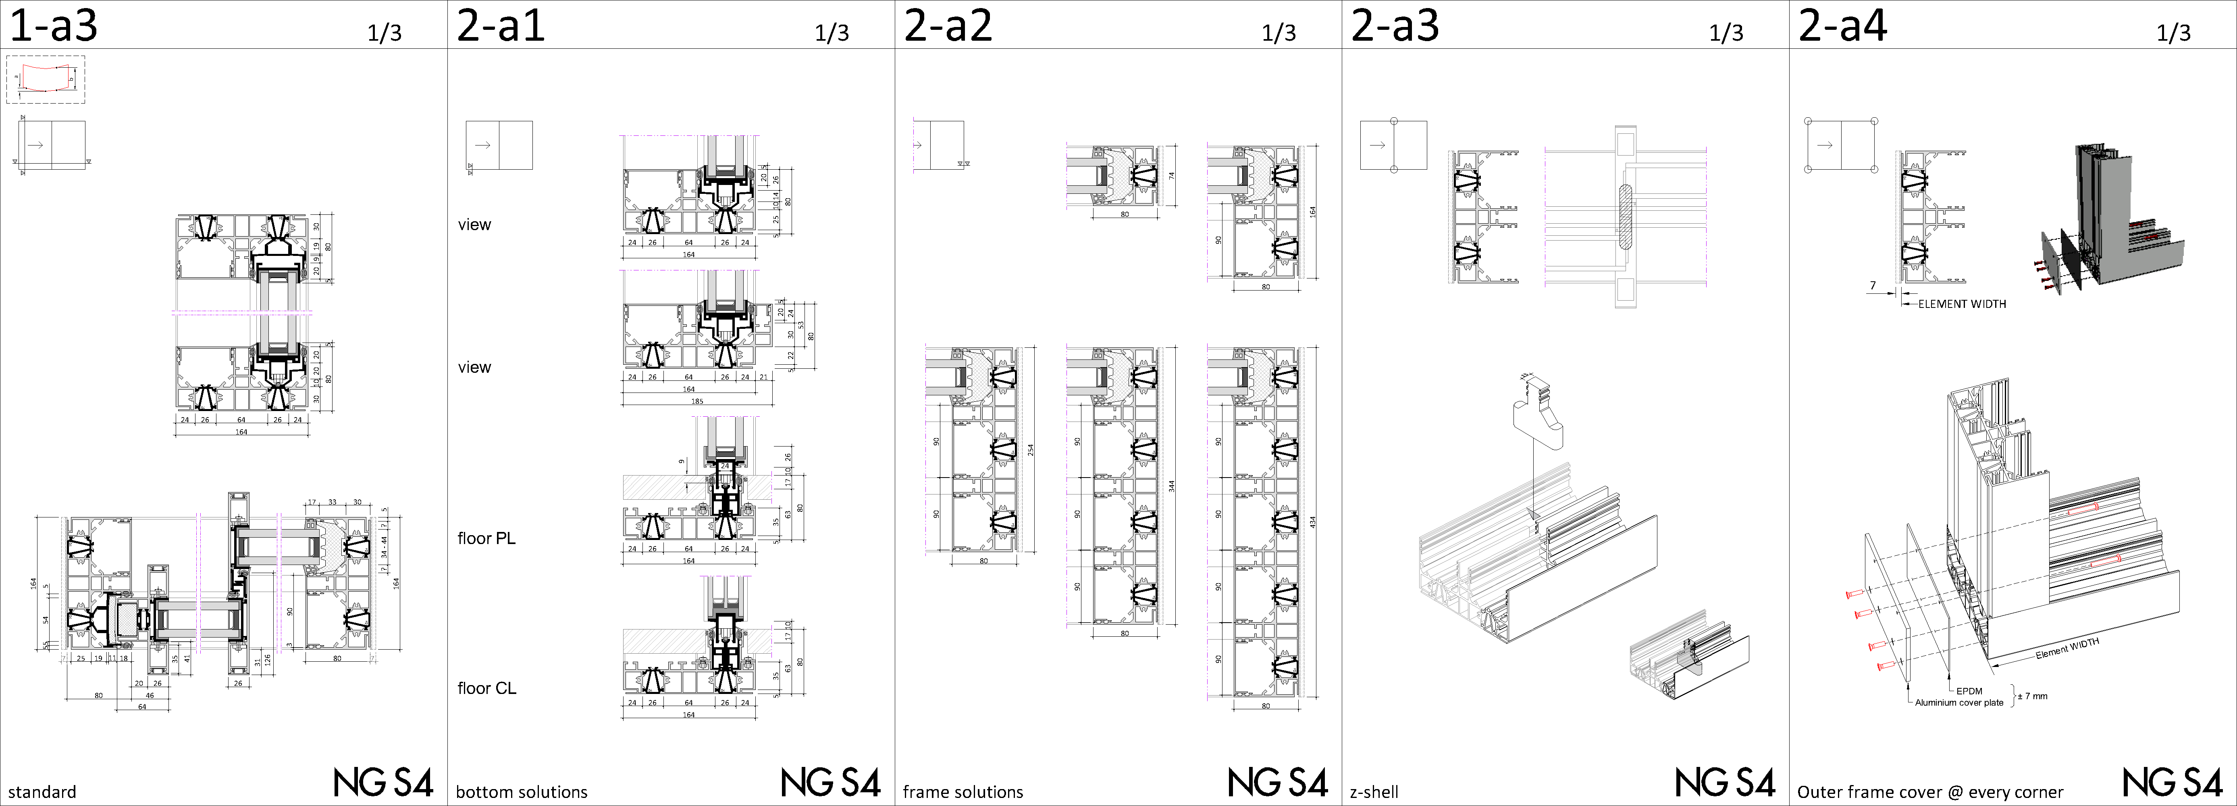
outer frames

Slide 9
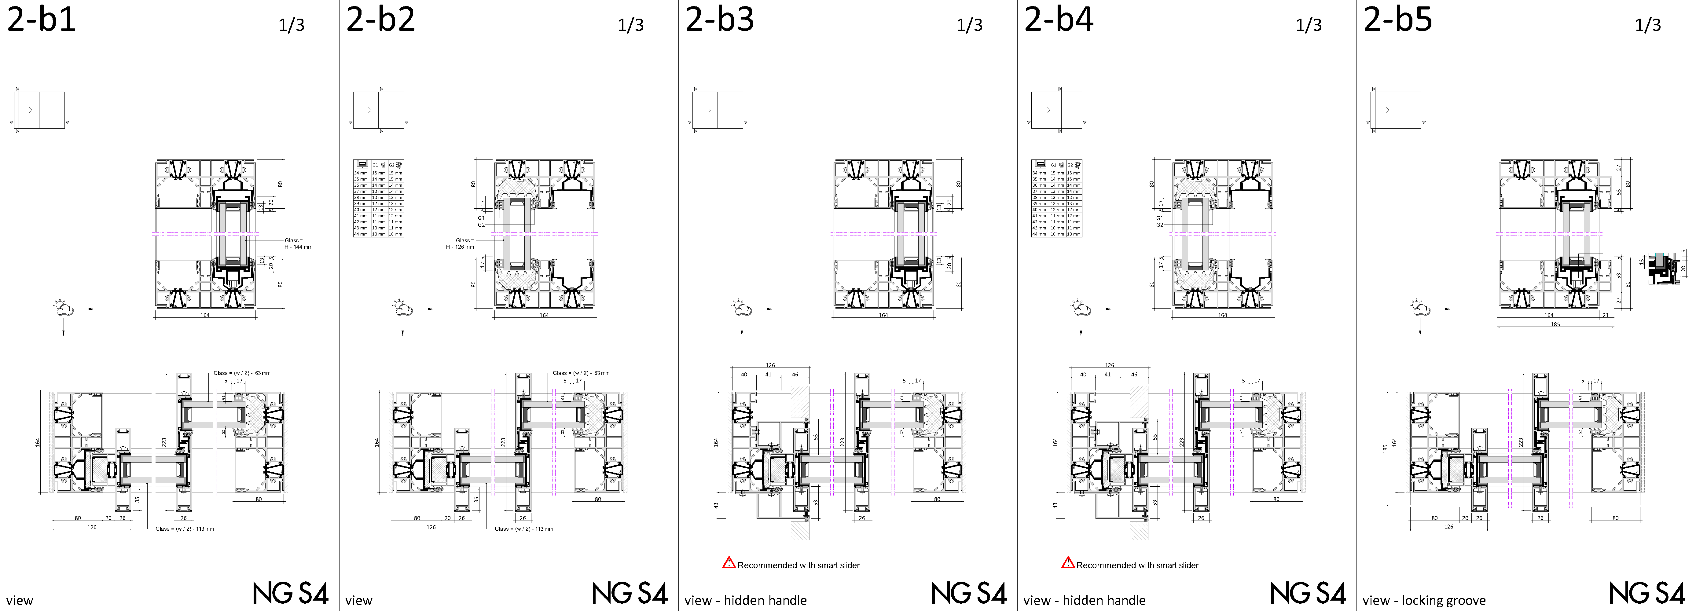
sasch frames

Slide 10
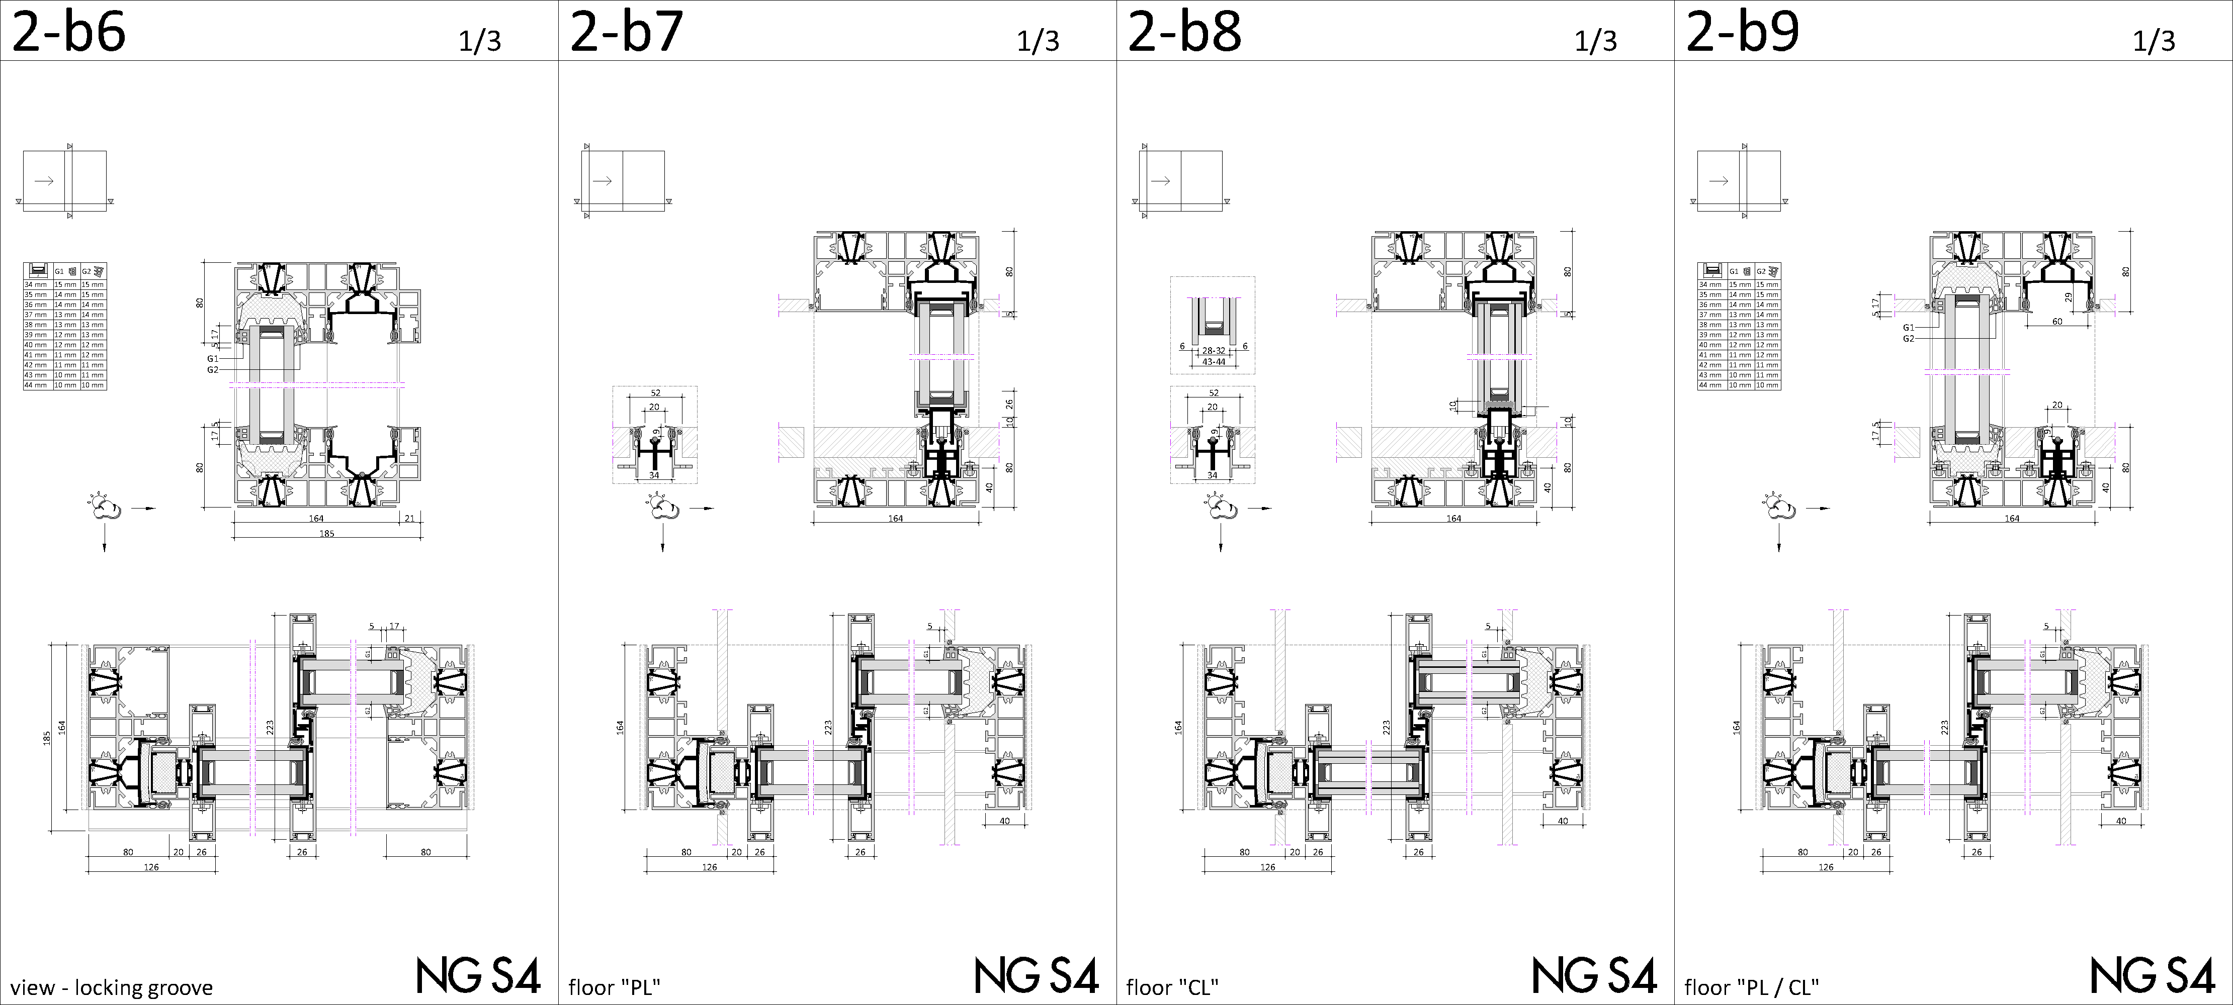
sasch frames

Slide 11
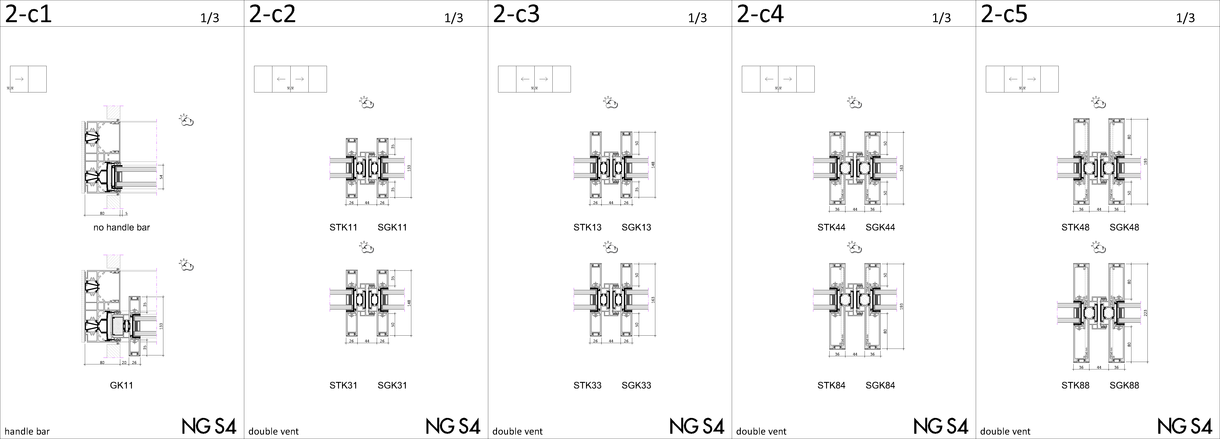
handle bars & double vent profiles

Slide 12
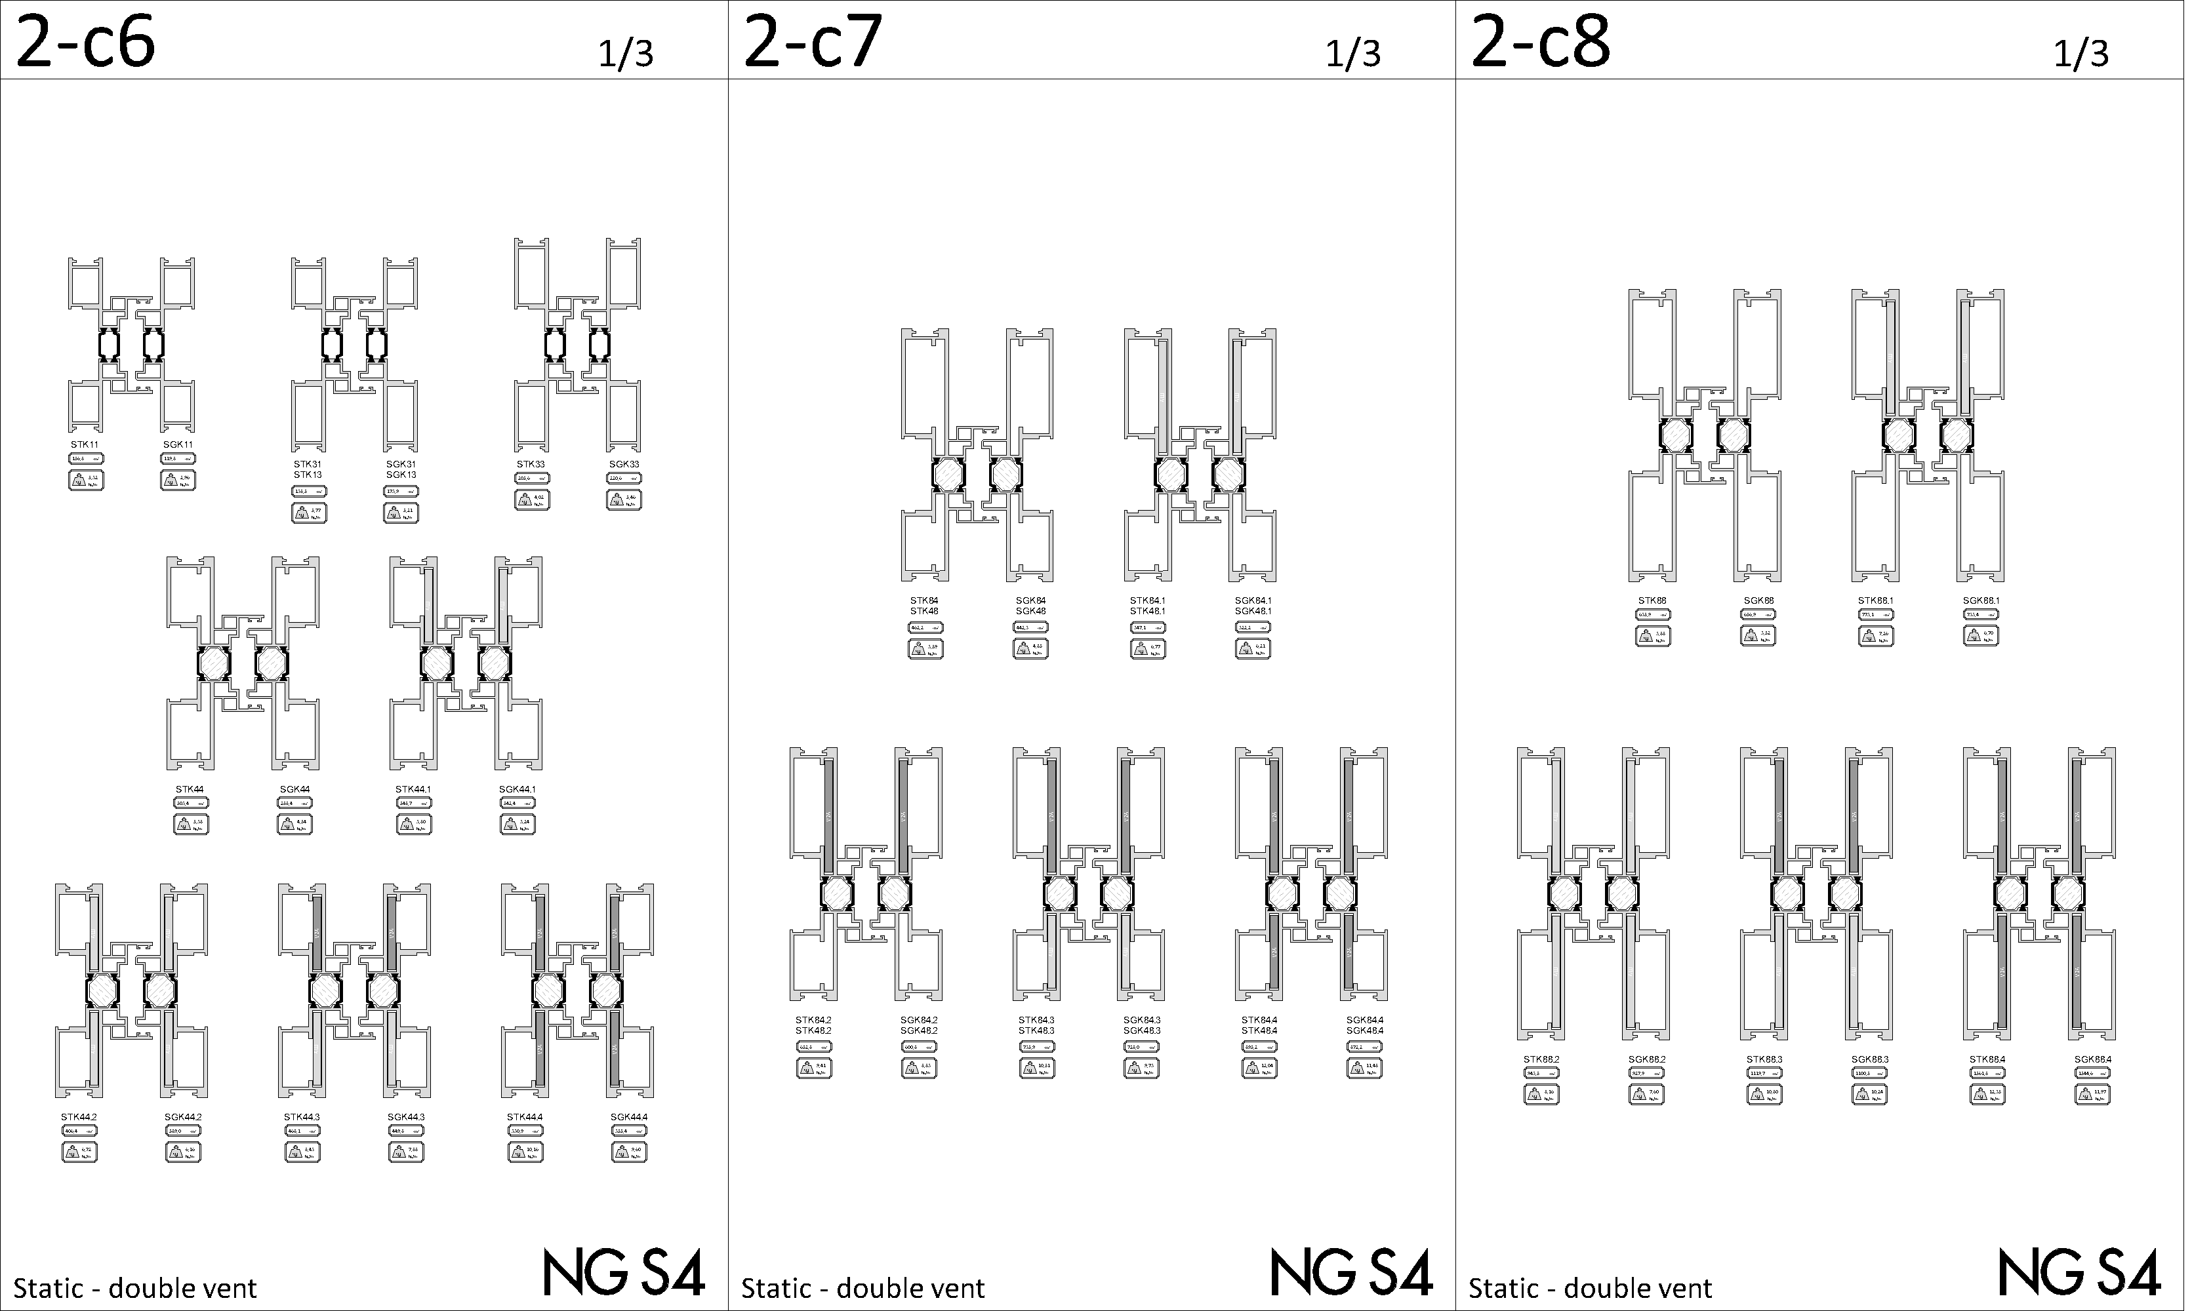
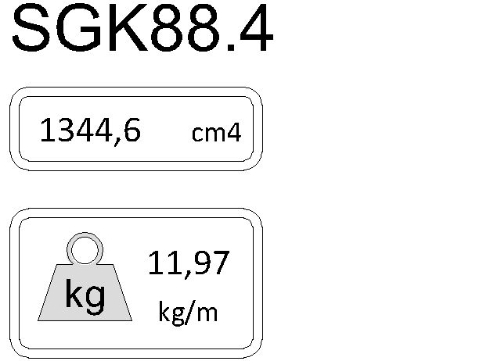
handle bars & double vent profiles - Static
Indication of
weight & static value

Slide 13
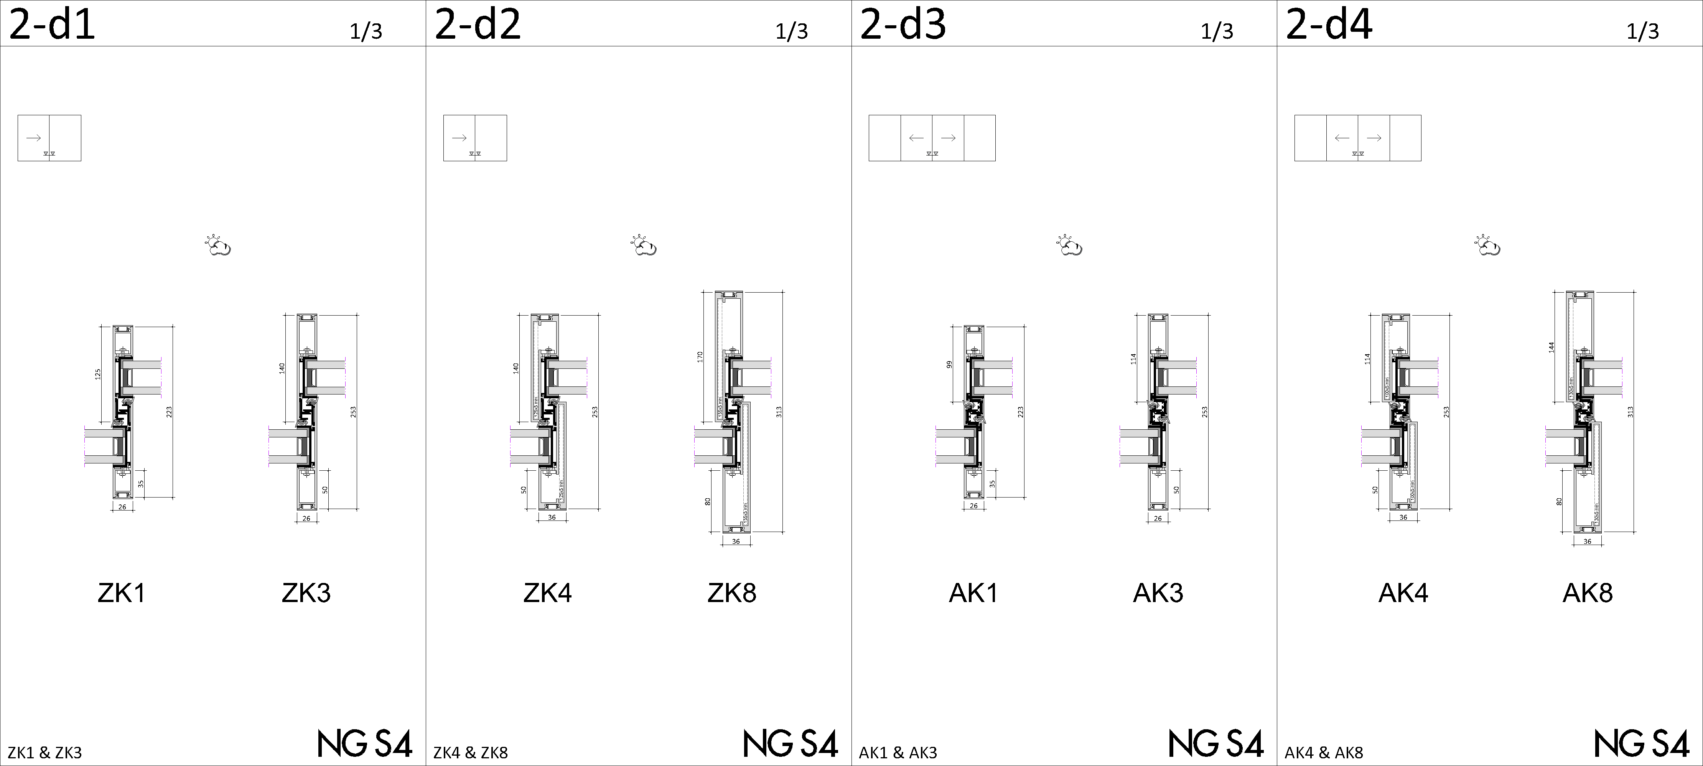
junction profiles – type Z & A

Slide 14
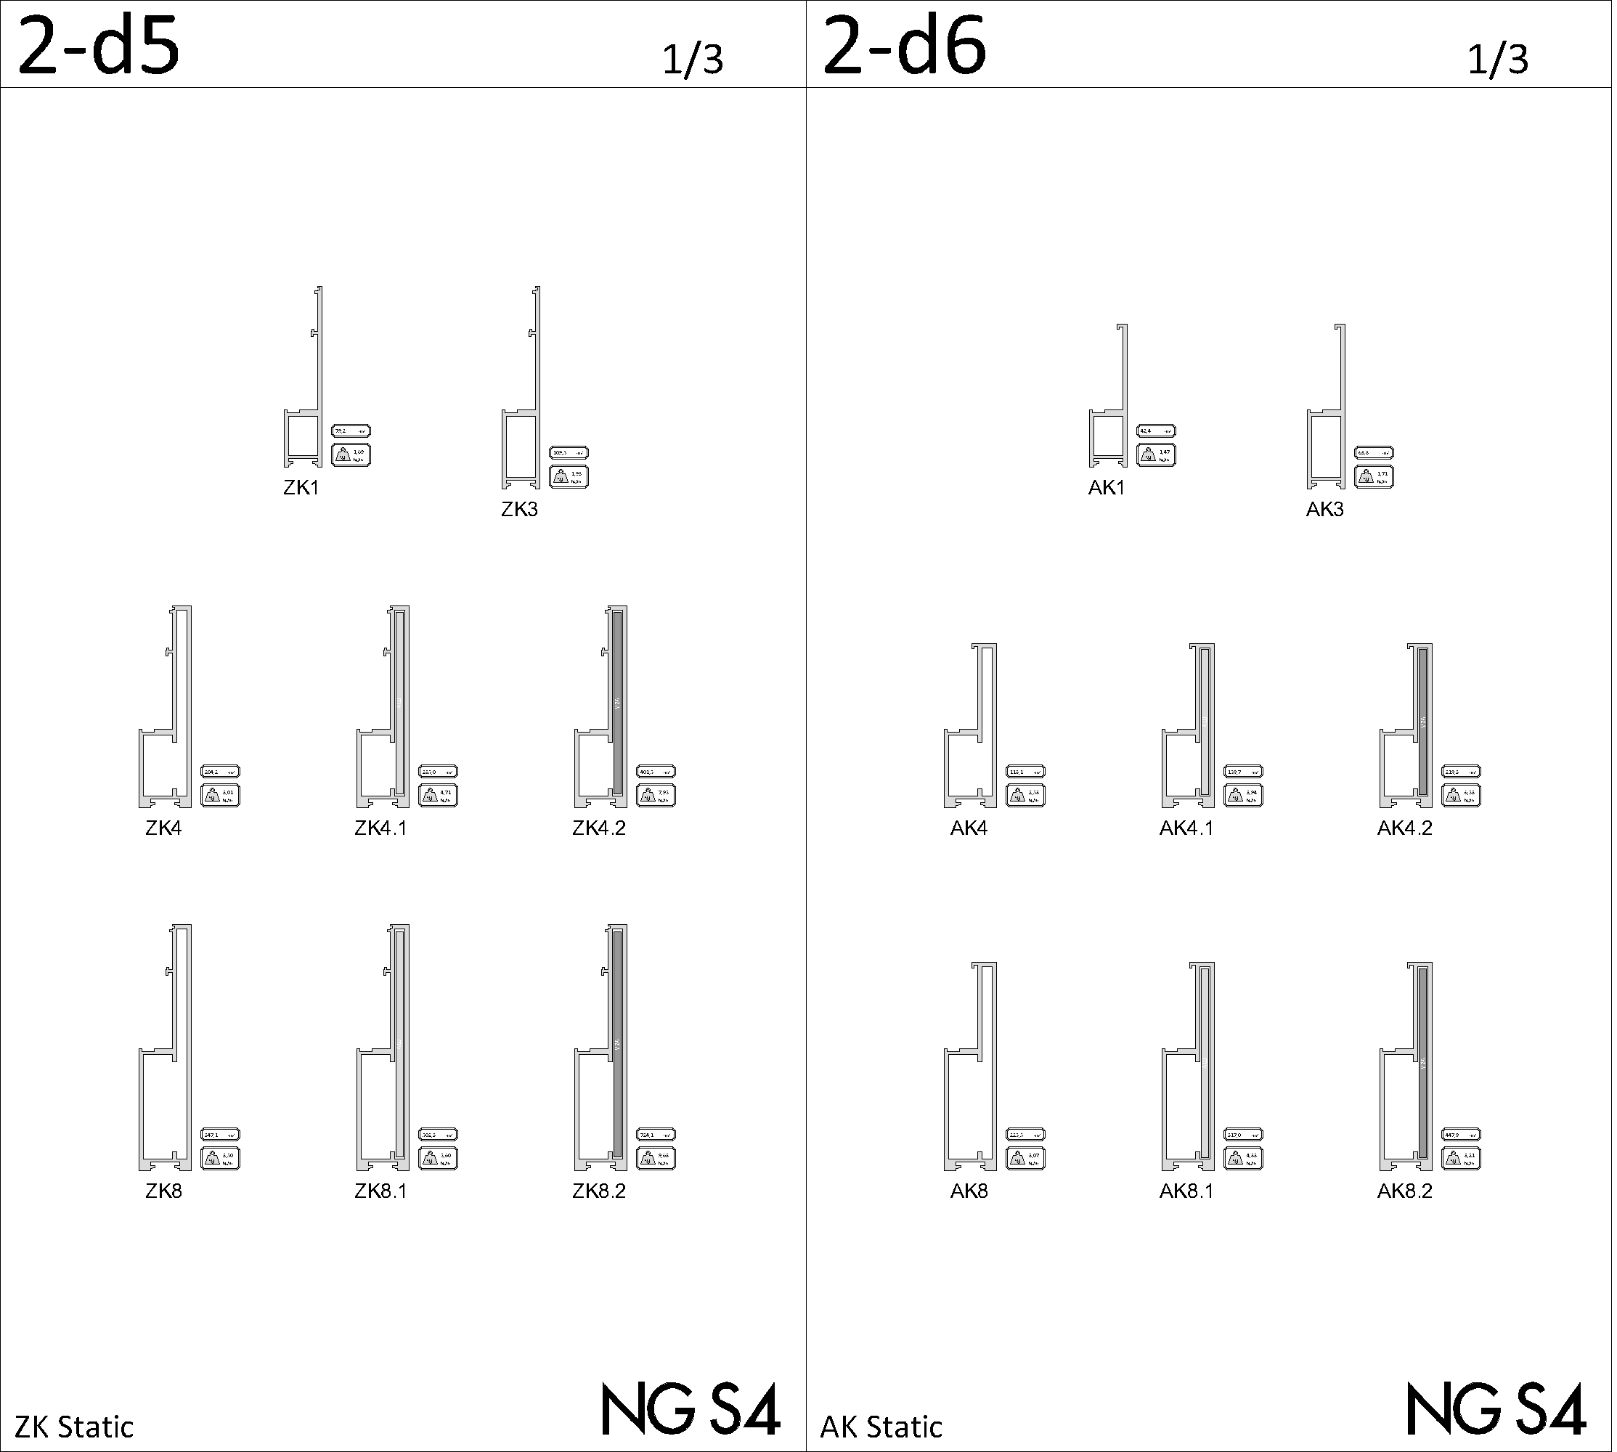
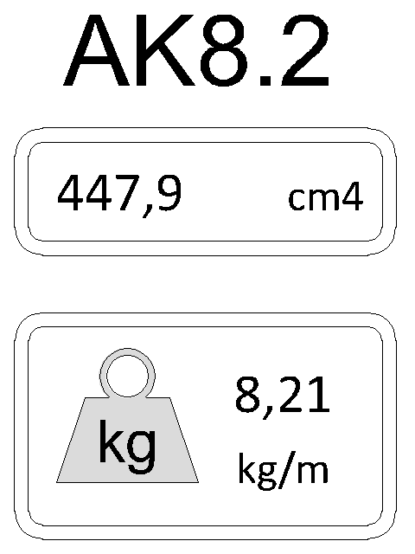
junction profiles – type Z & A - static
Indication of
weight & static value

Slide 15
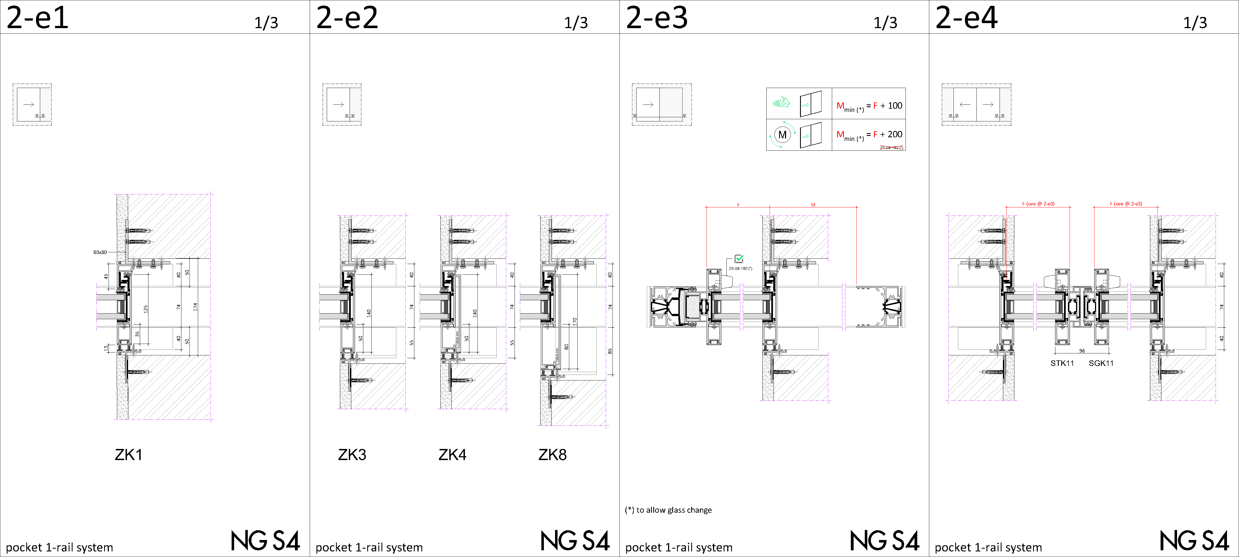
pocket

Slide 16
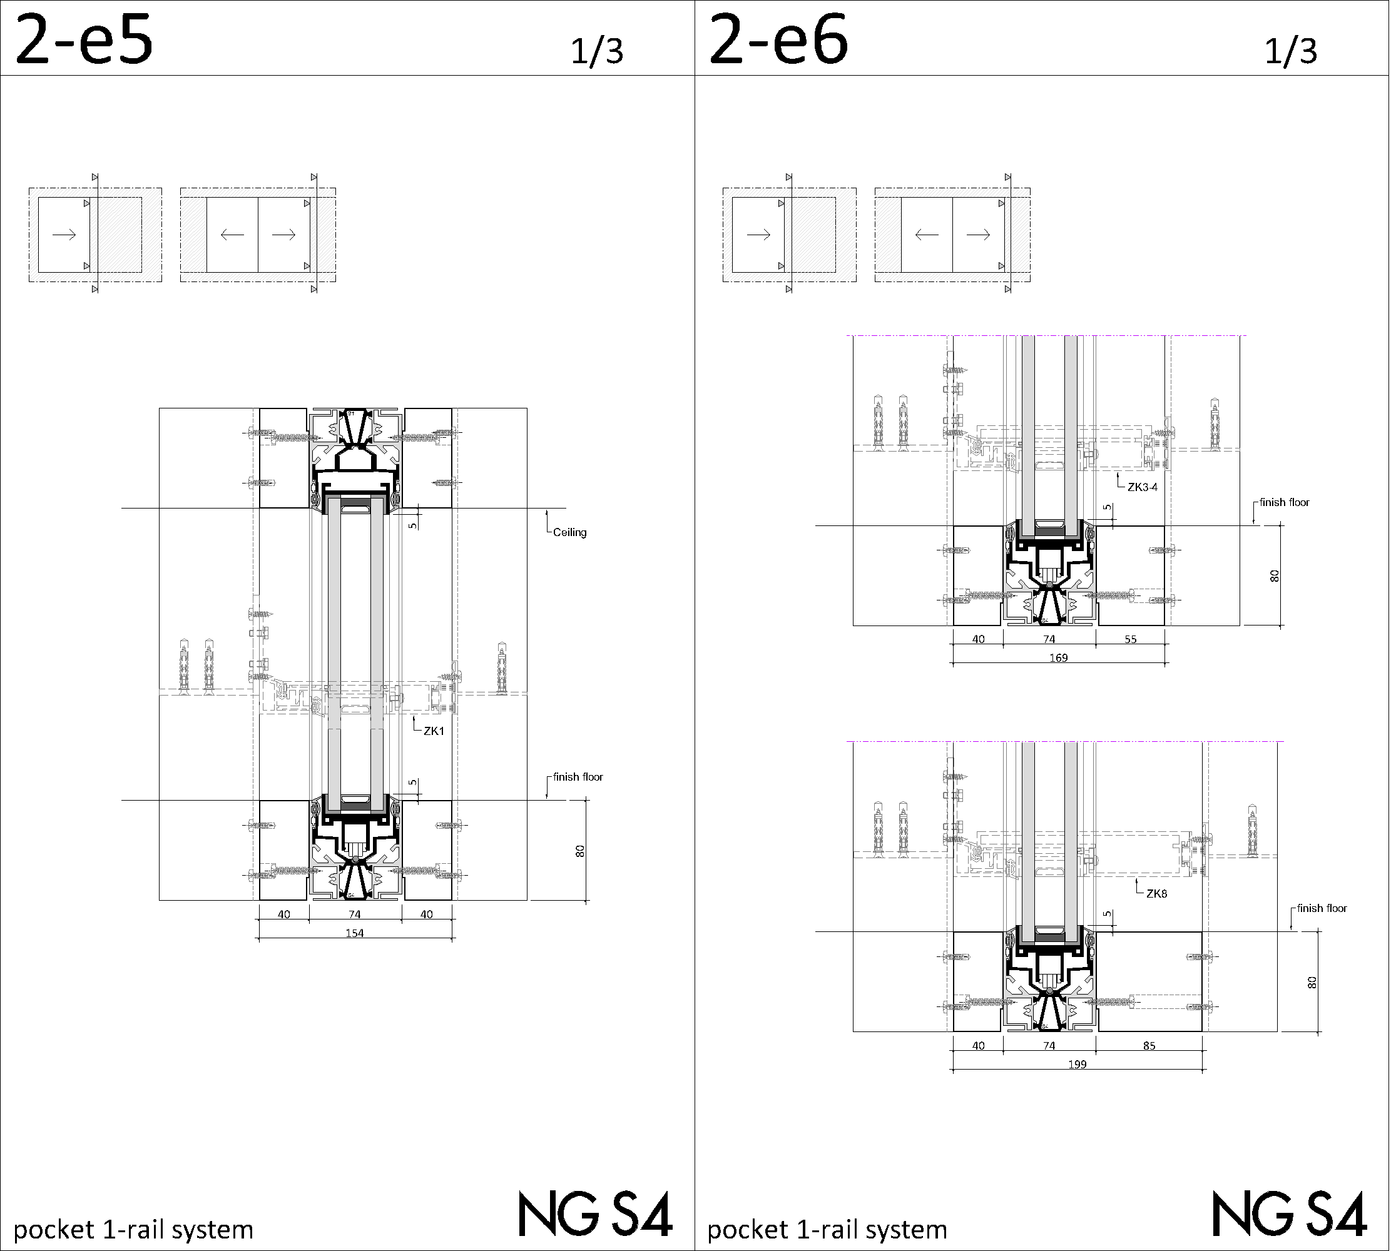
pocket

Slide 17
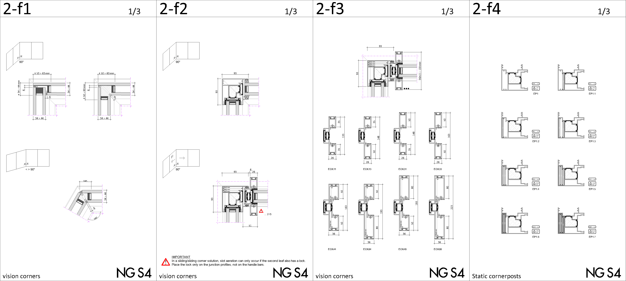
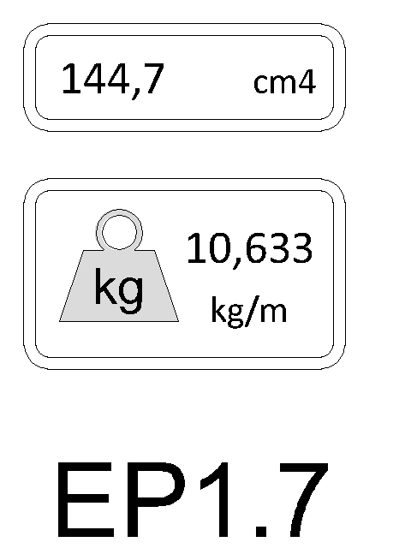
vision - corners
Indication of
weight & static value

Slide 18
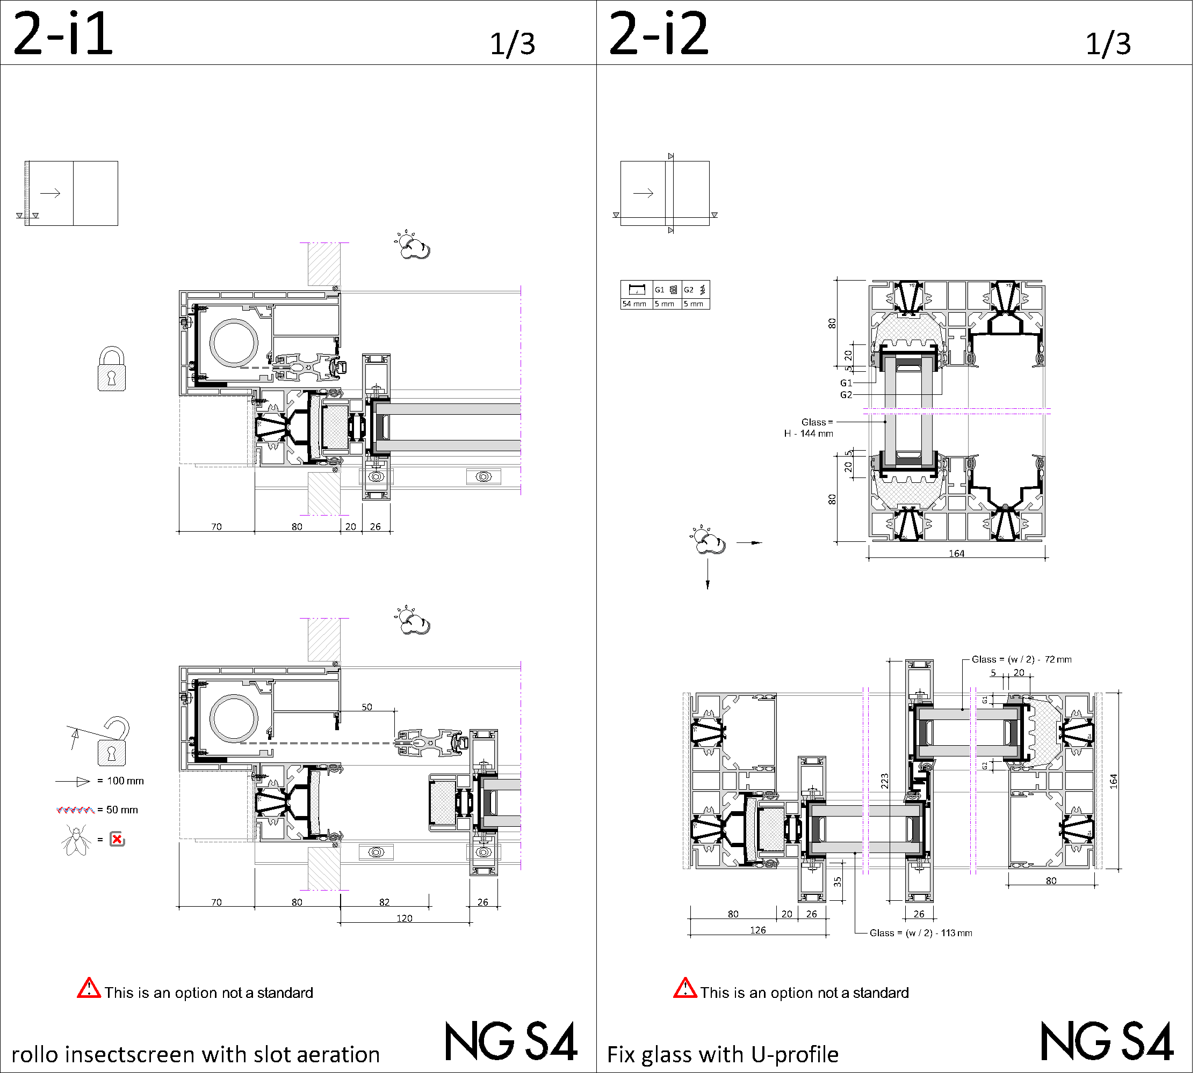
projectsolutions

Slide 19
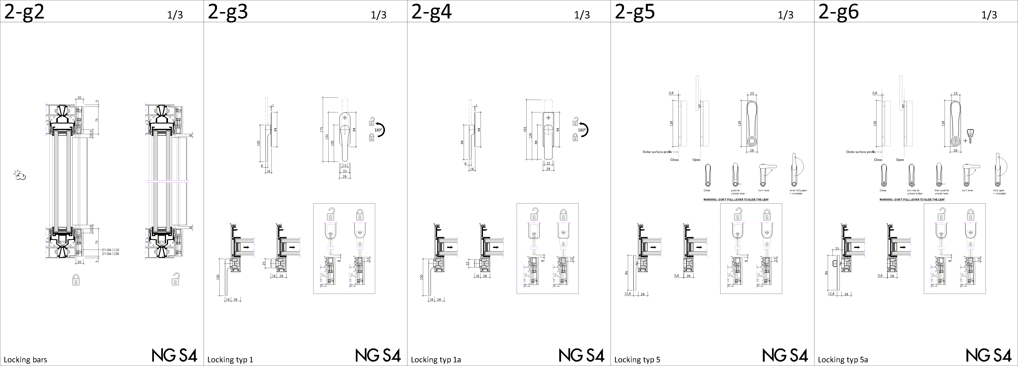
lockings

Slide 20
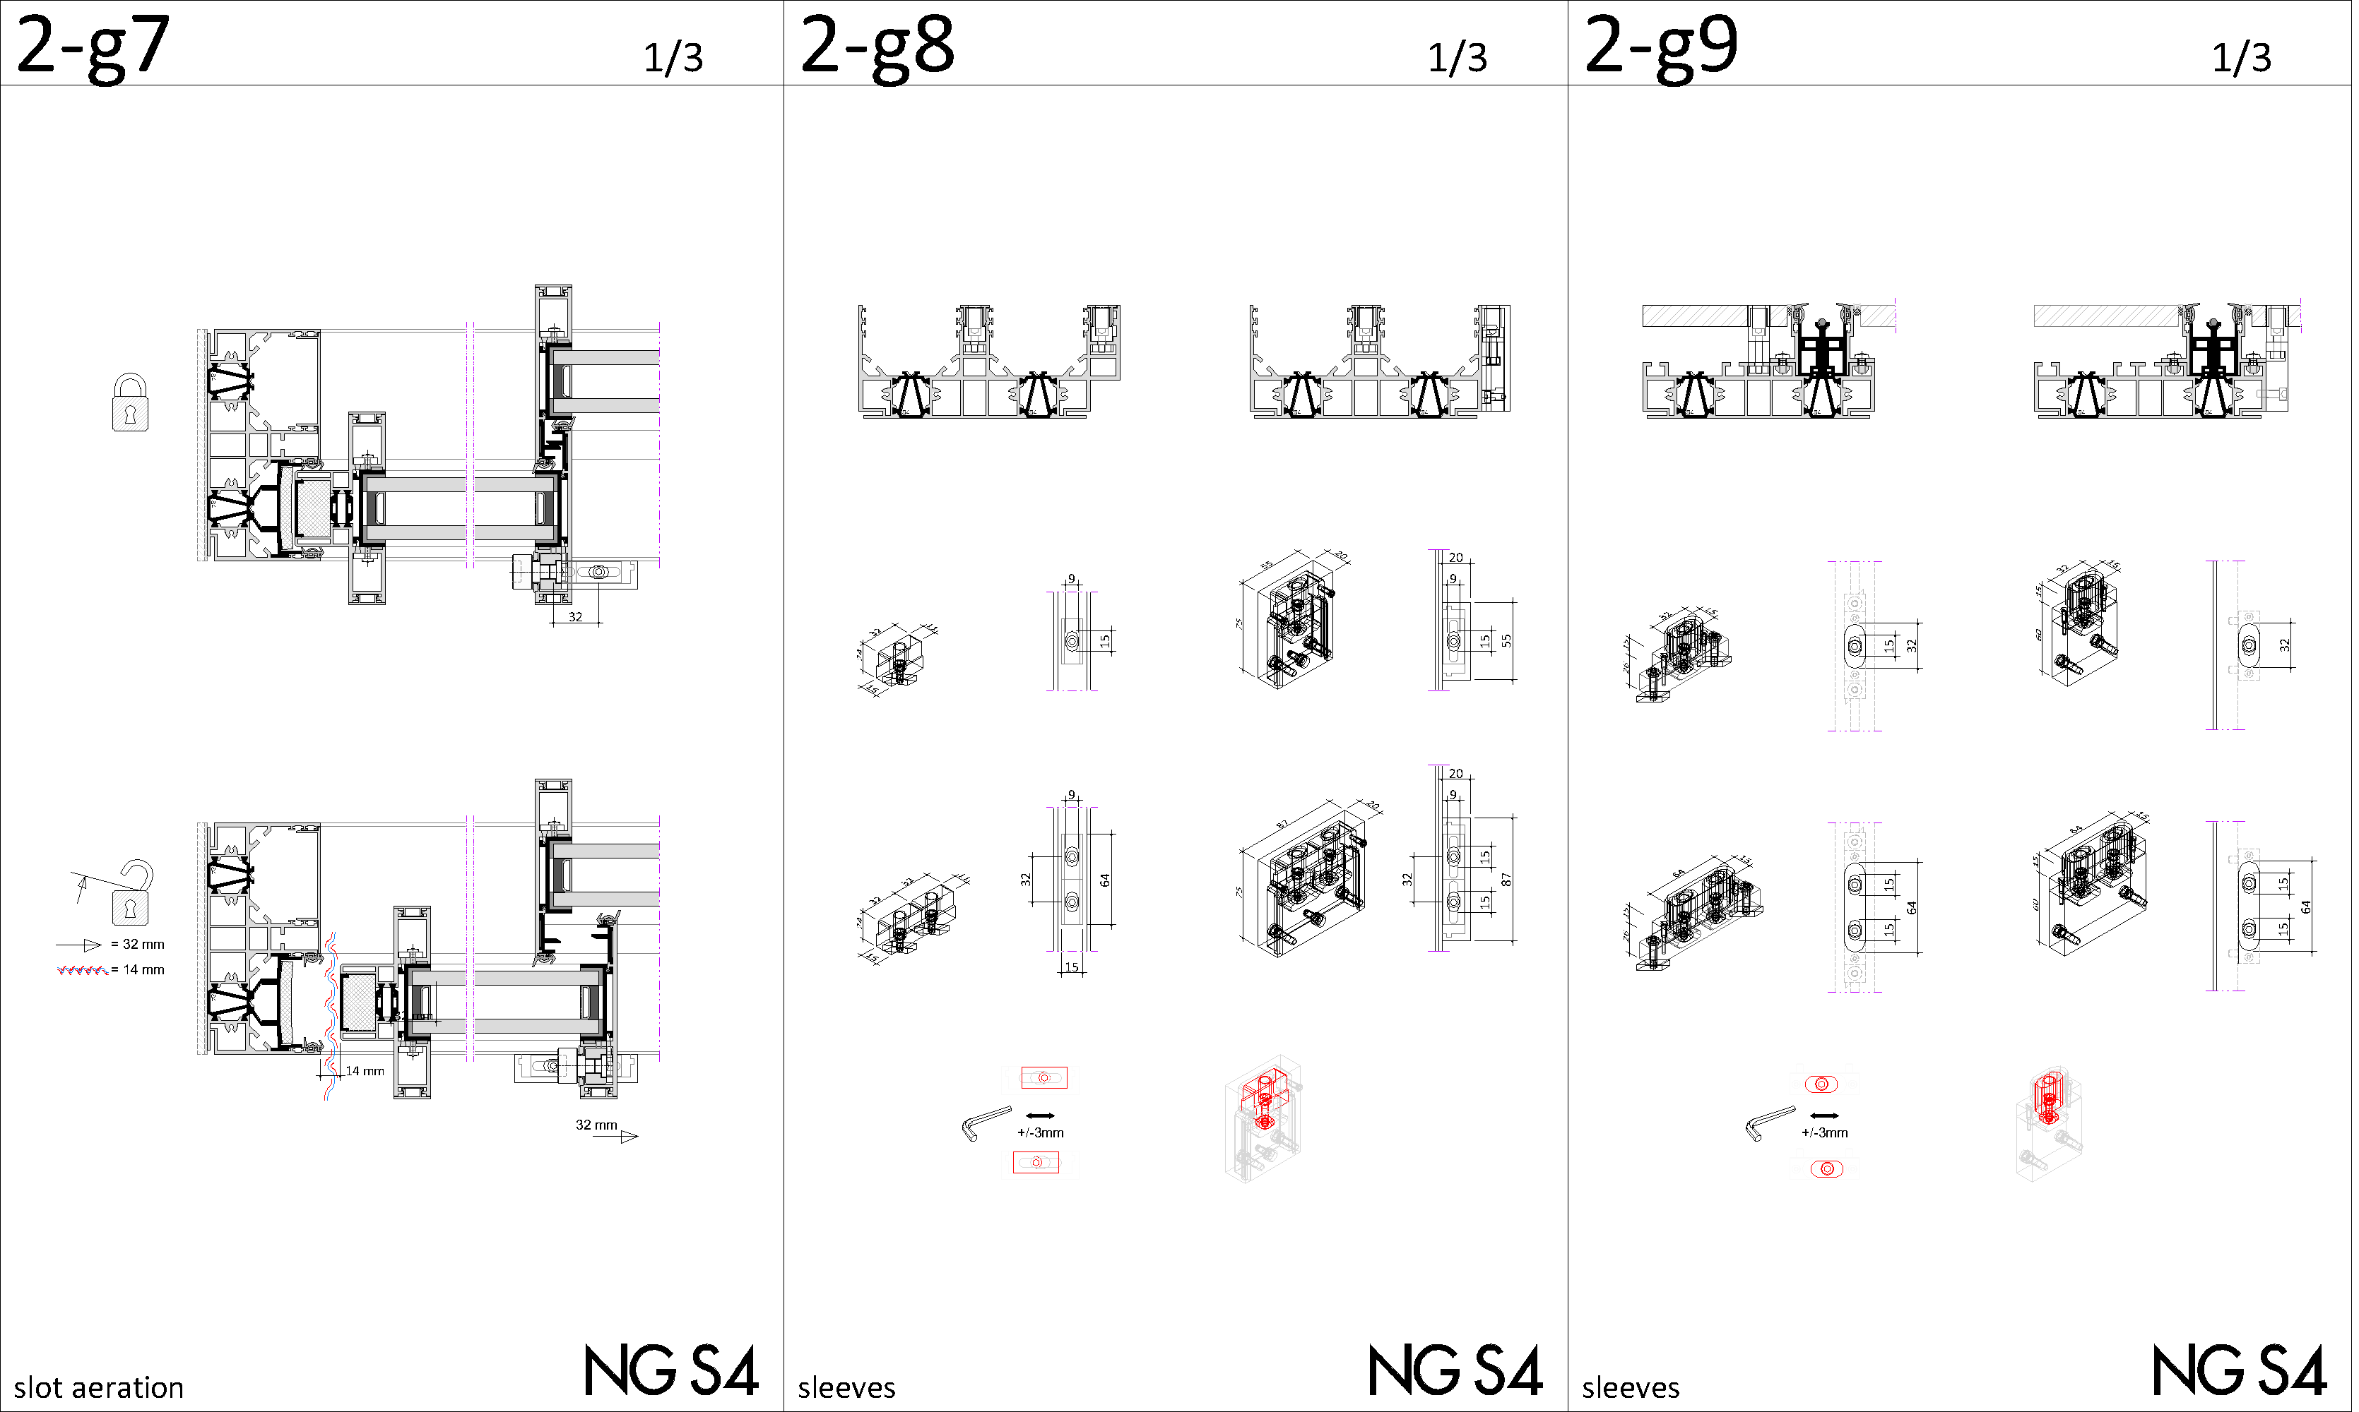
lockings

Slide 21
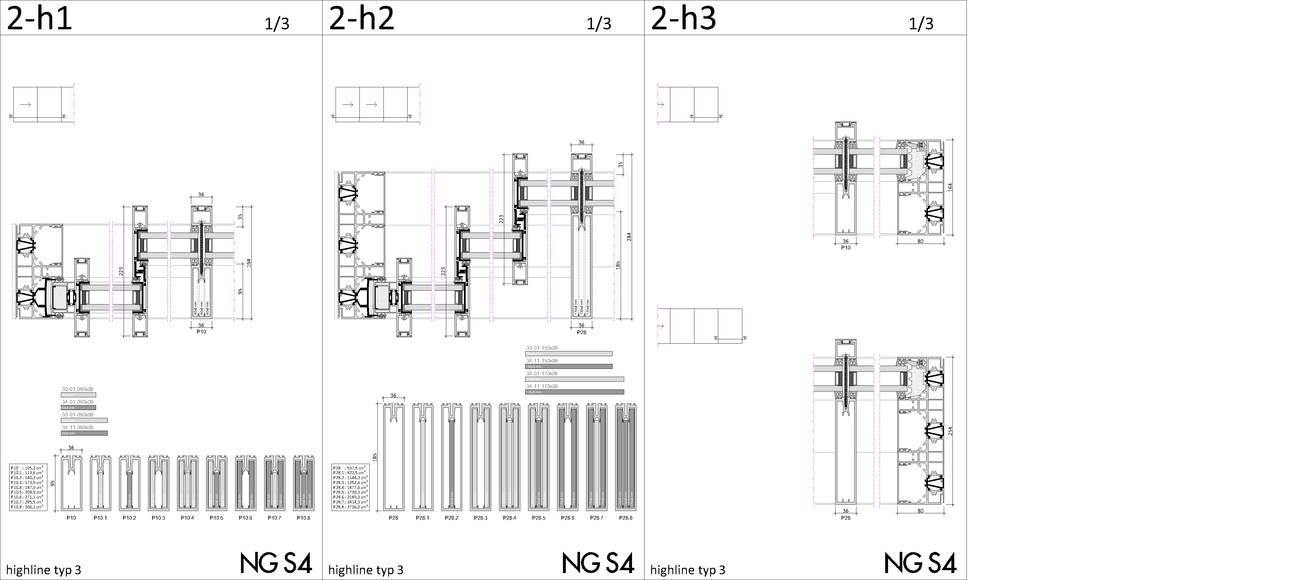
highline

Slide 22
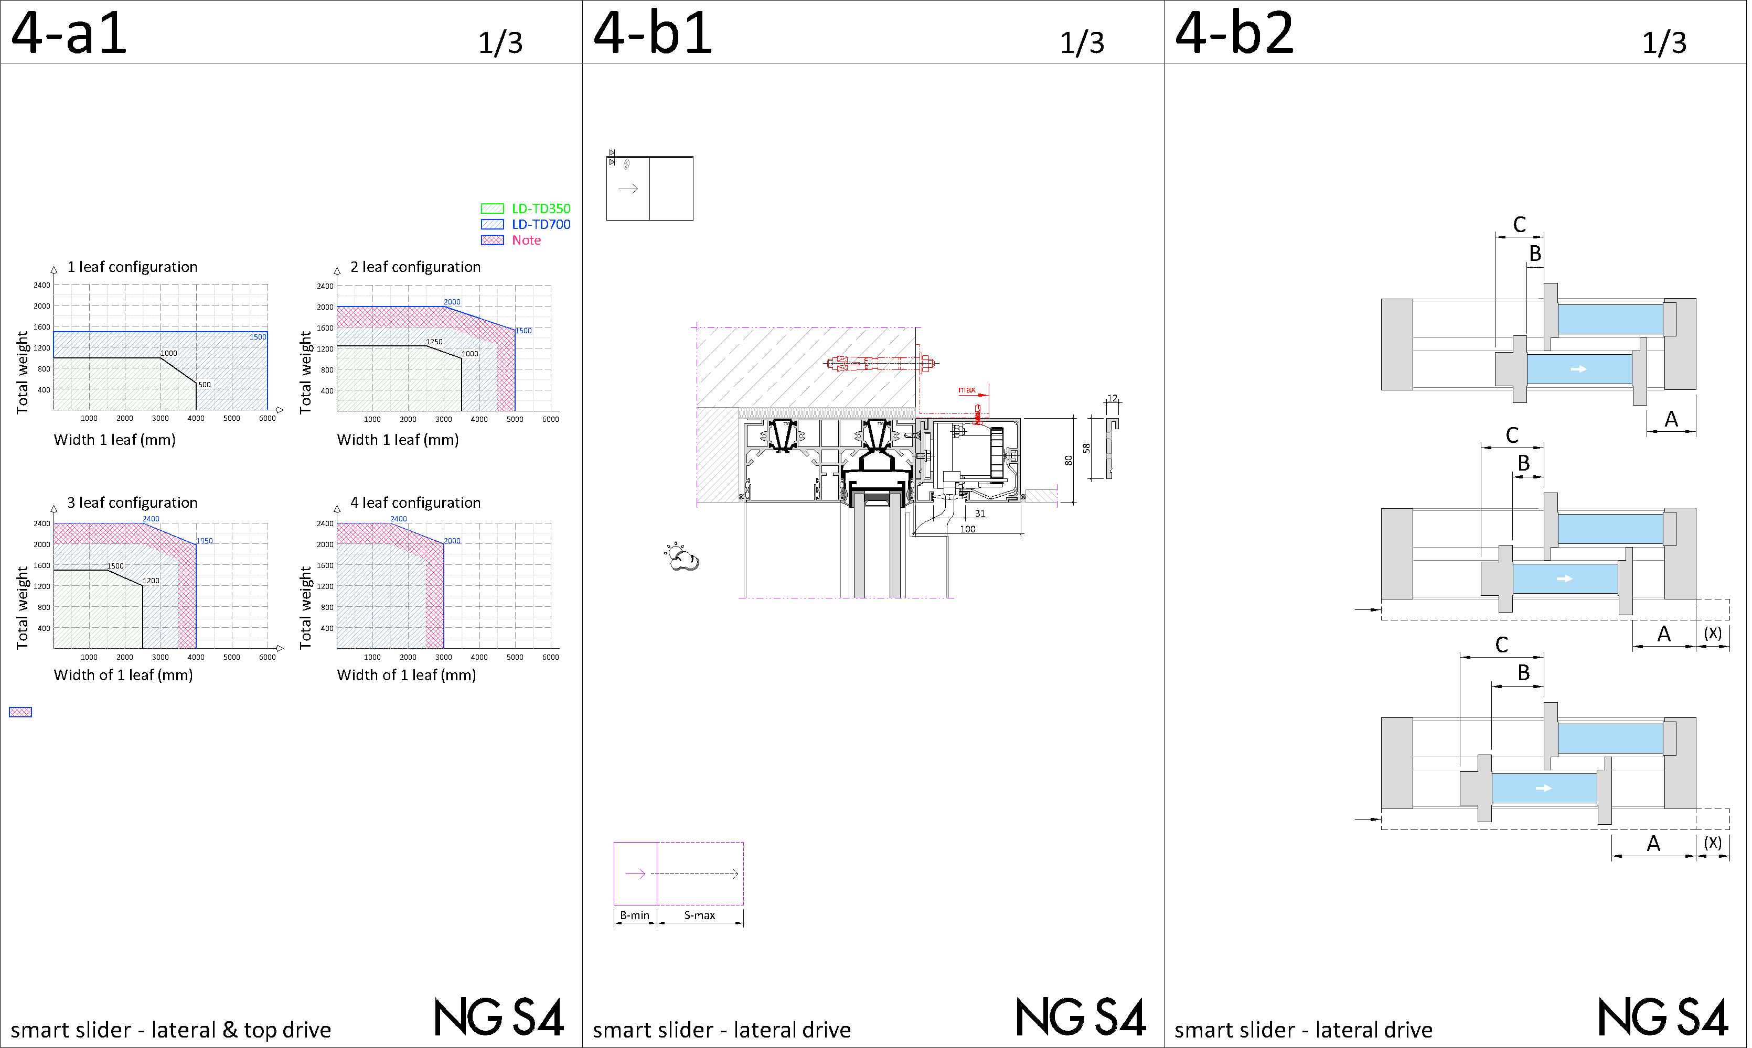
smart slider LD (lateral drive)

Slide 23
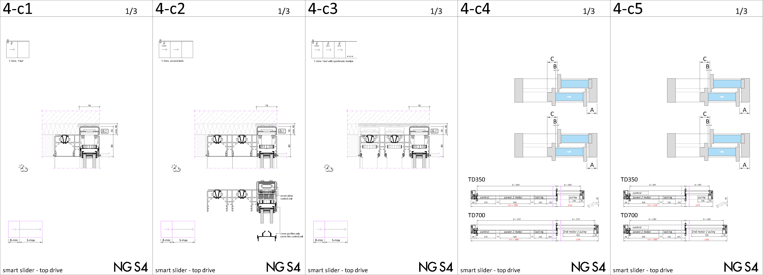
smart slider TD (top drive)

Slide 24
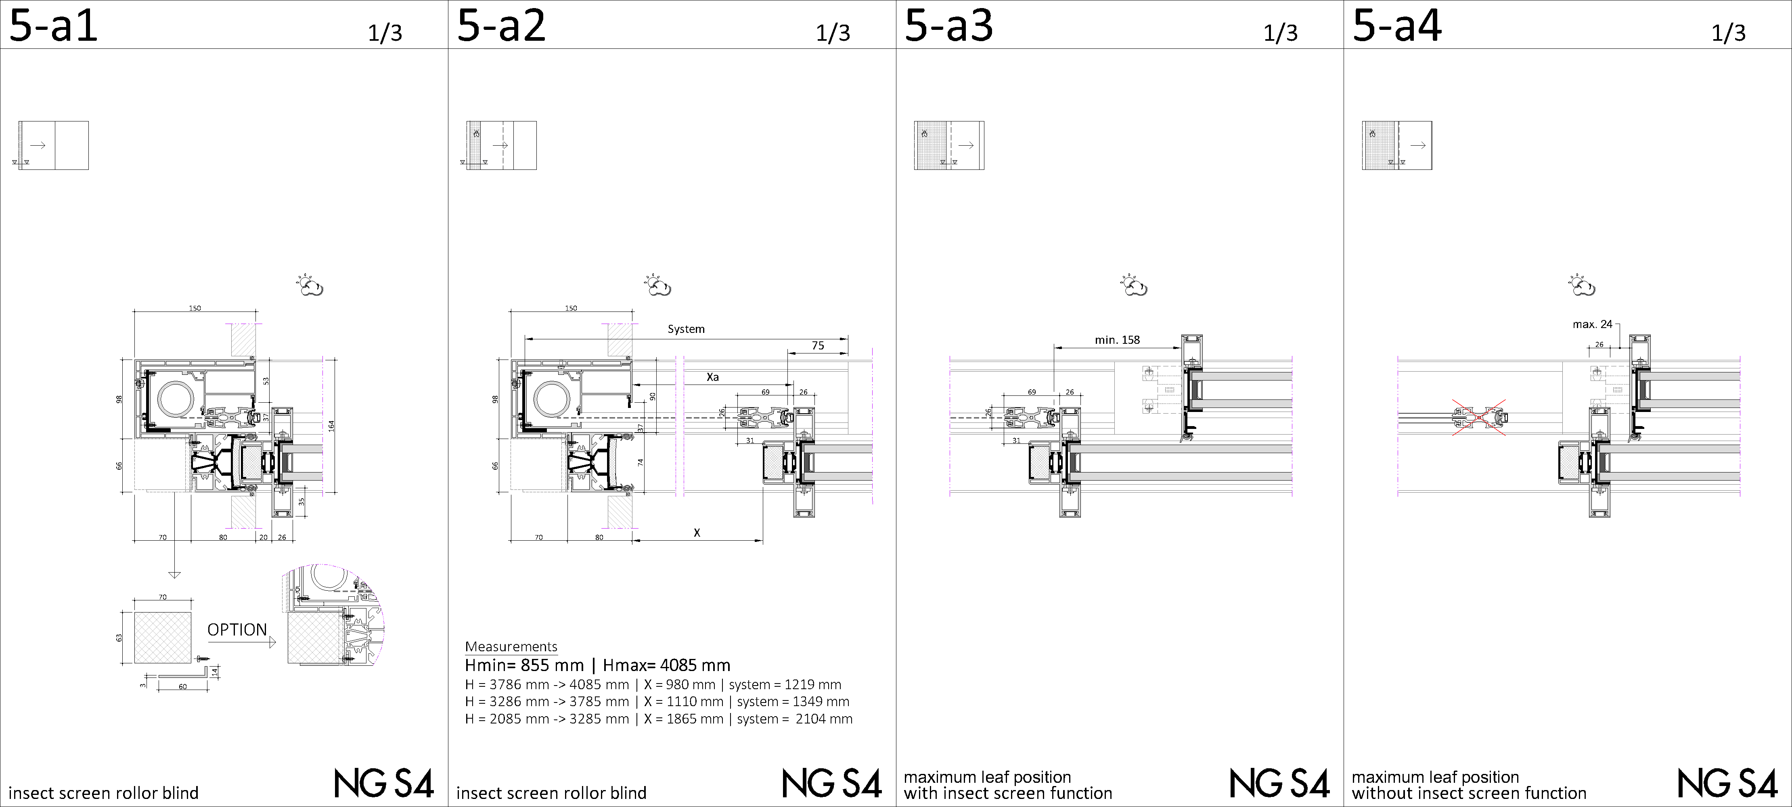
protect roll

Slide 25
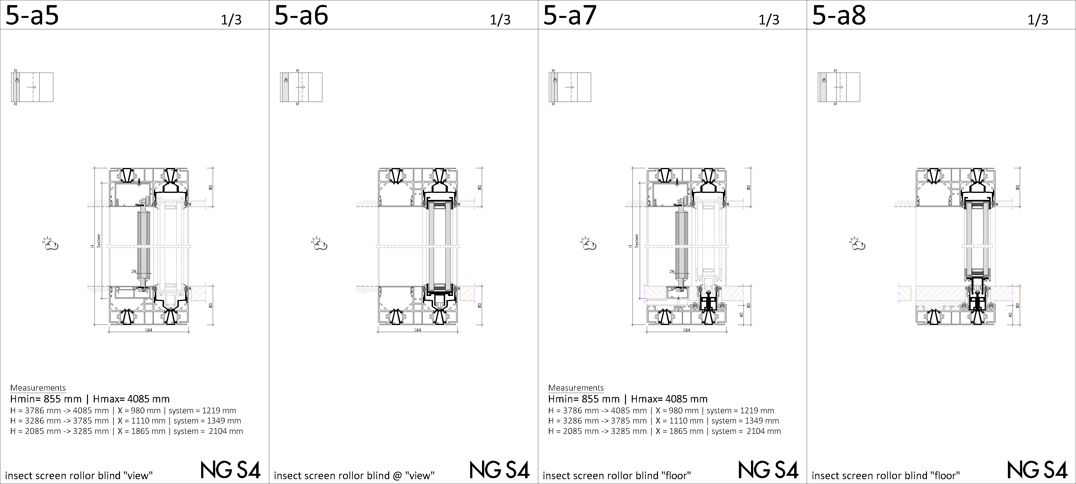
protect roll

Slide 26
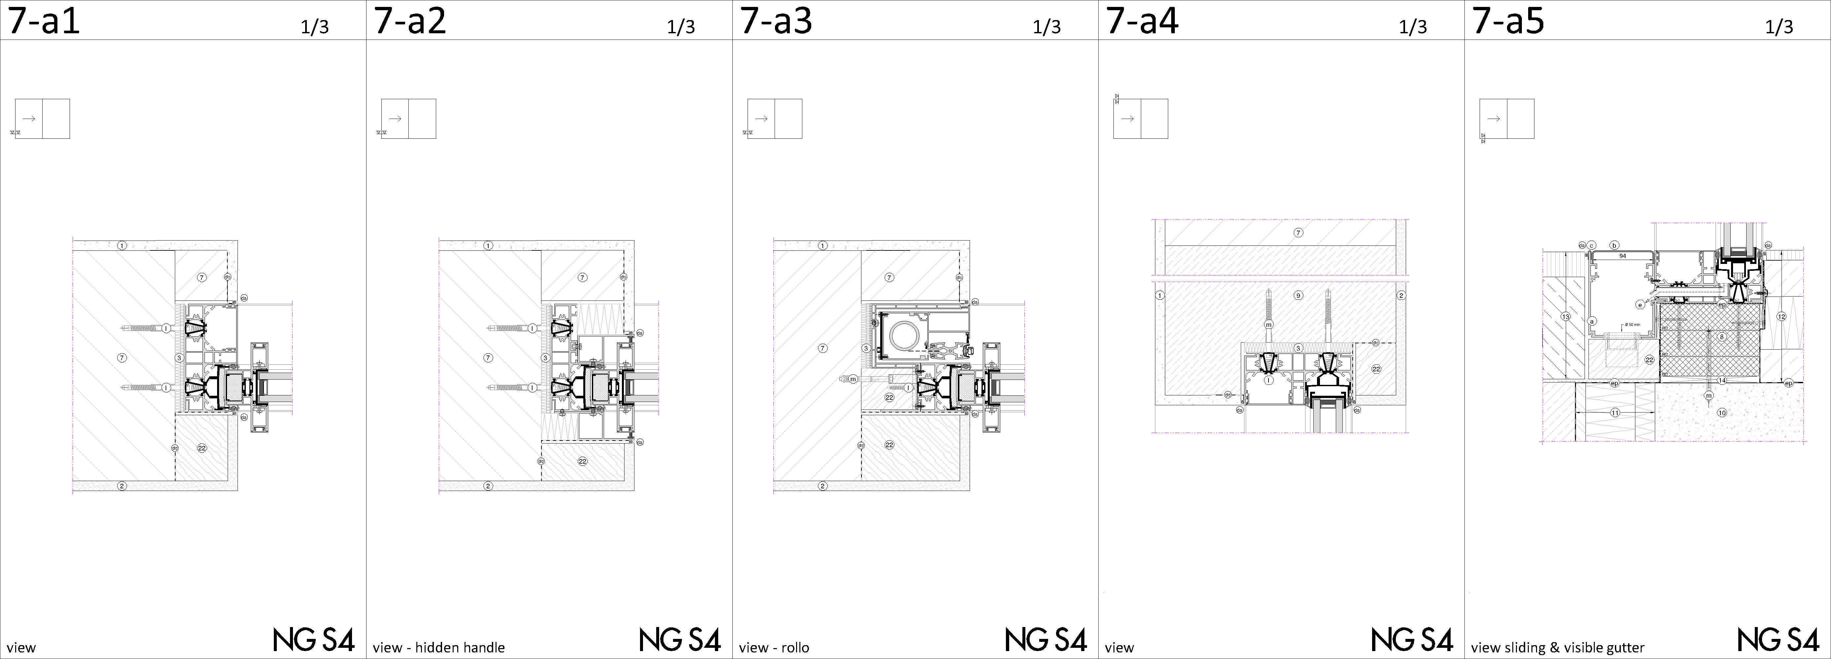
building connections – monolitic wallsystem

Slide 27
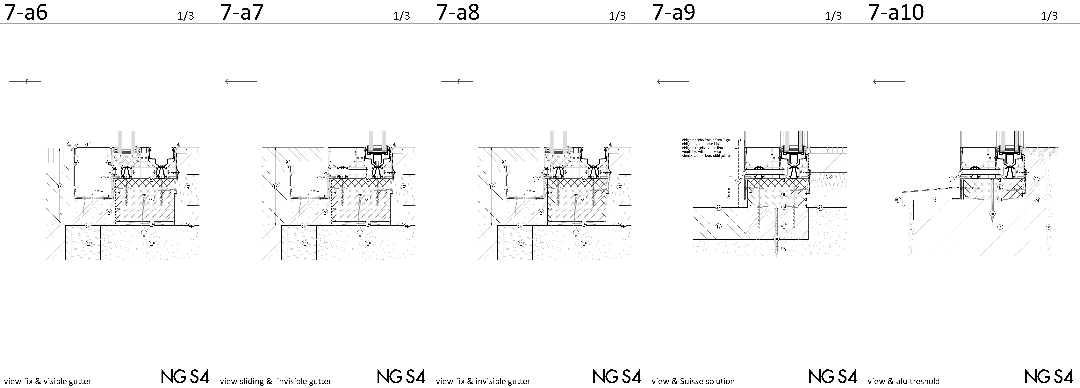
building connections – monolitic wallsystem

Slide 28
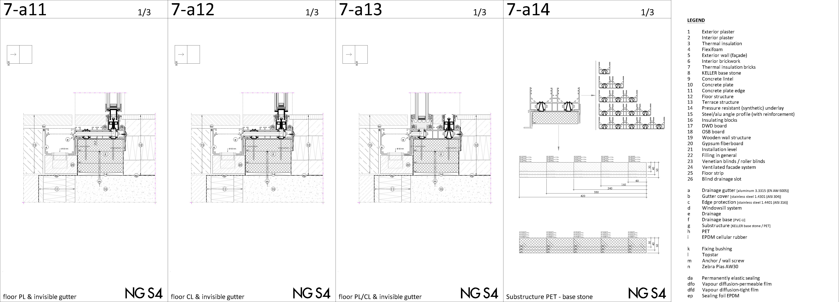
building connections – monolitic wallsystem

Slide 29






