Slide 1

Keller Minimal Windows SA
&
Innovation
Craftmanship
since 1980
Notes:
Let’s have a quick start at Keller where we all stand for Innovation and Craftmanship.

Slide 2
Keller Minimal Windows SA
Samples cases
2026-27
since 1980
Notes:
Let’s have a quick start at Keller where we all stand for Innovation and Craftmanship.

Slide 3
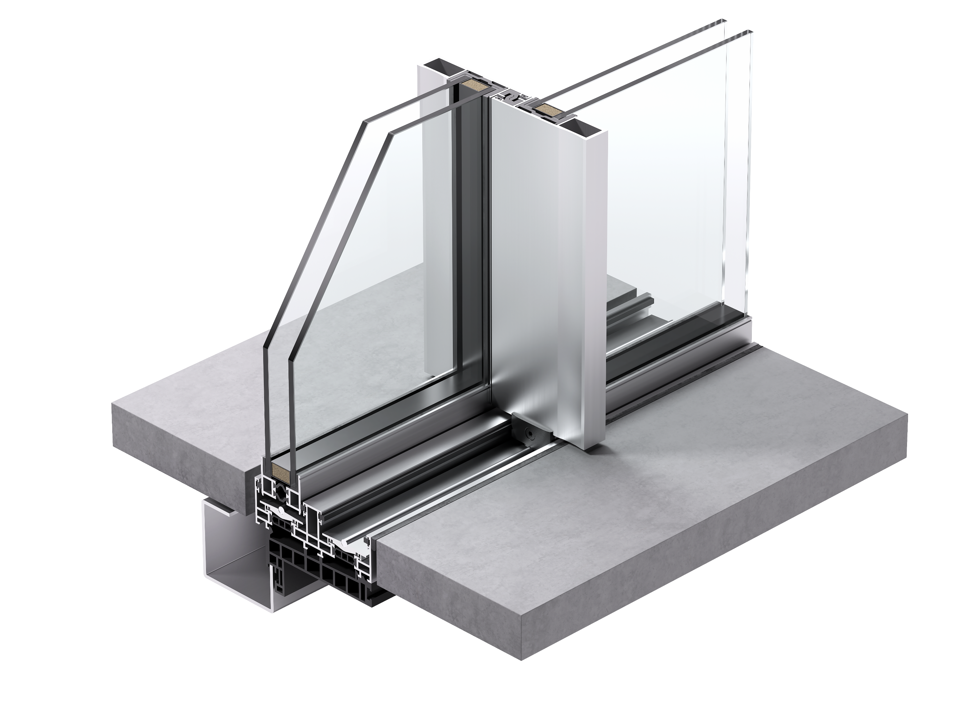
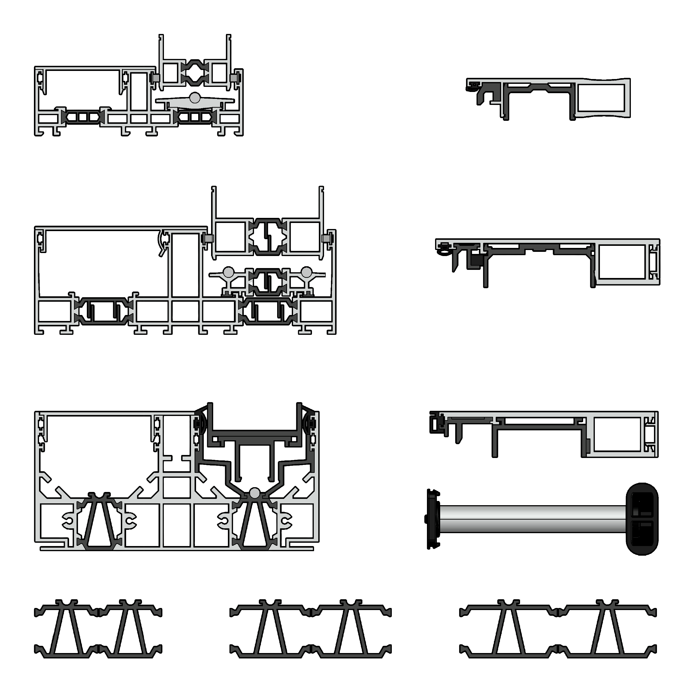
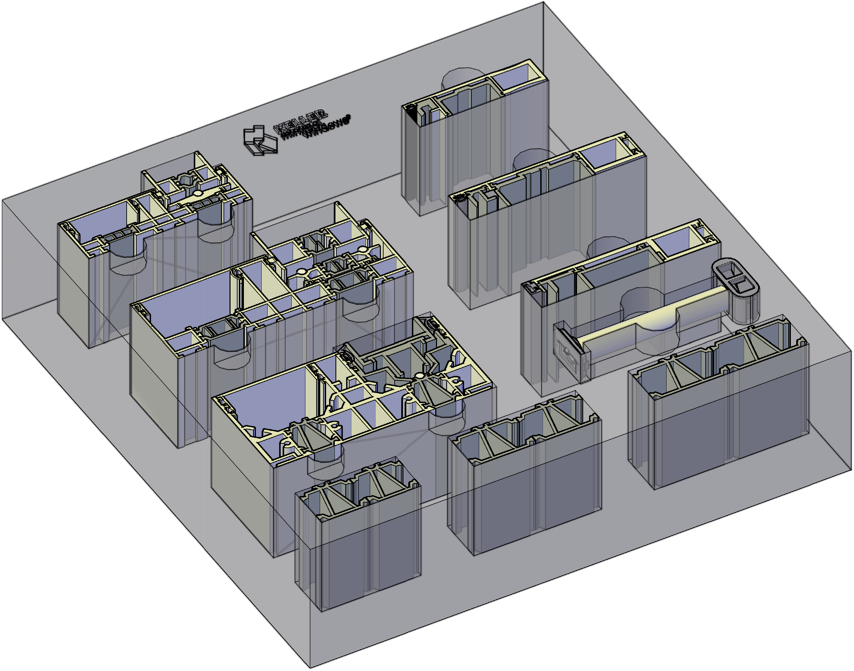
minimal windows® overview

Slide 4
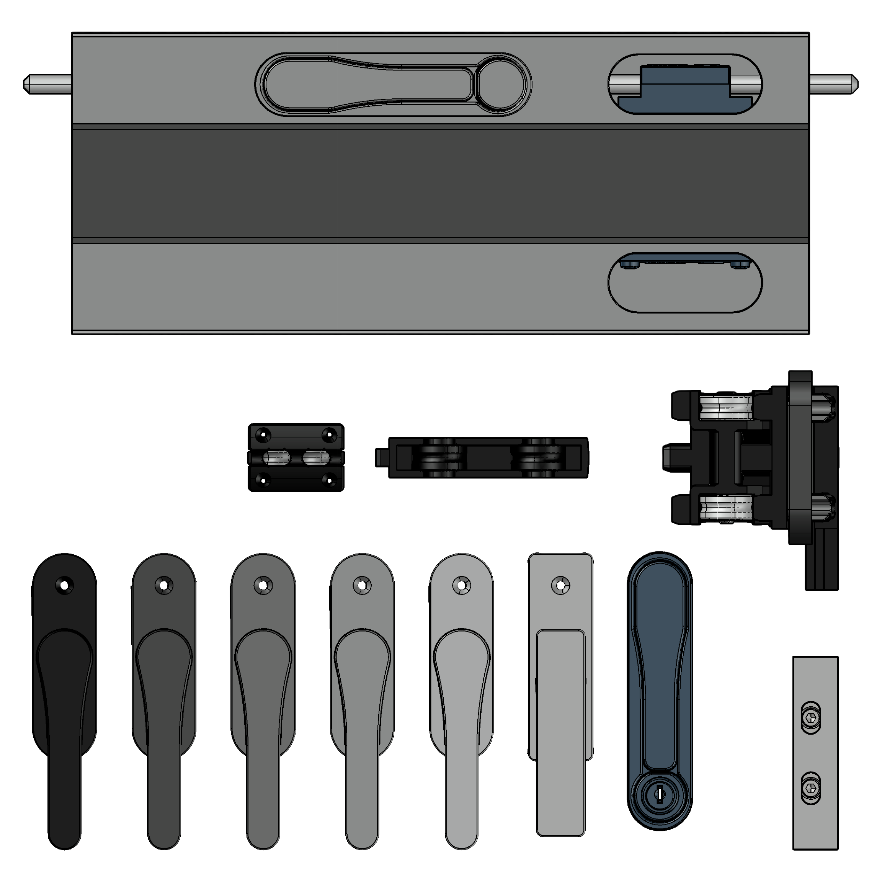
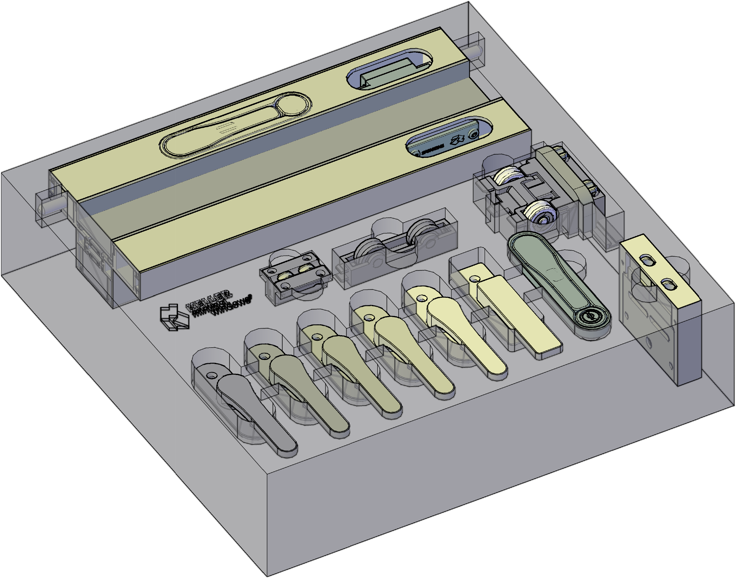
minimal windows® locking

Slide 5
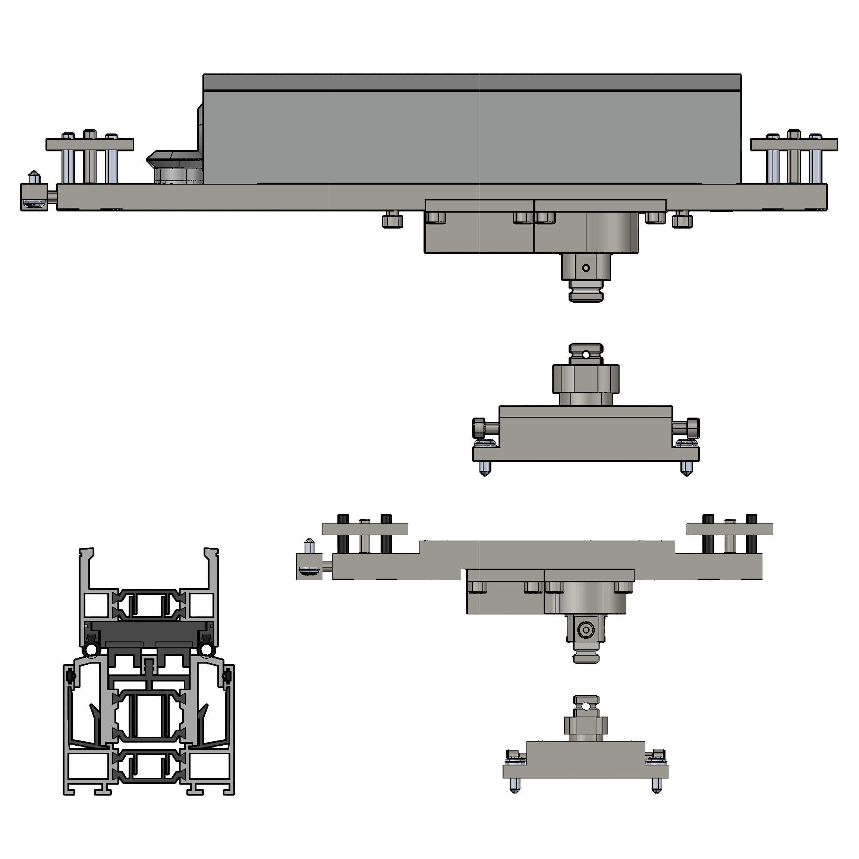
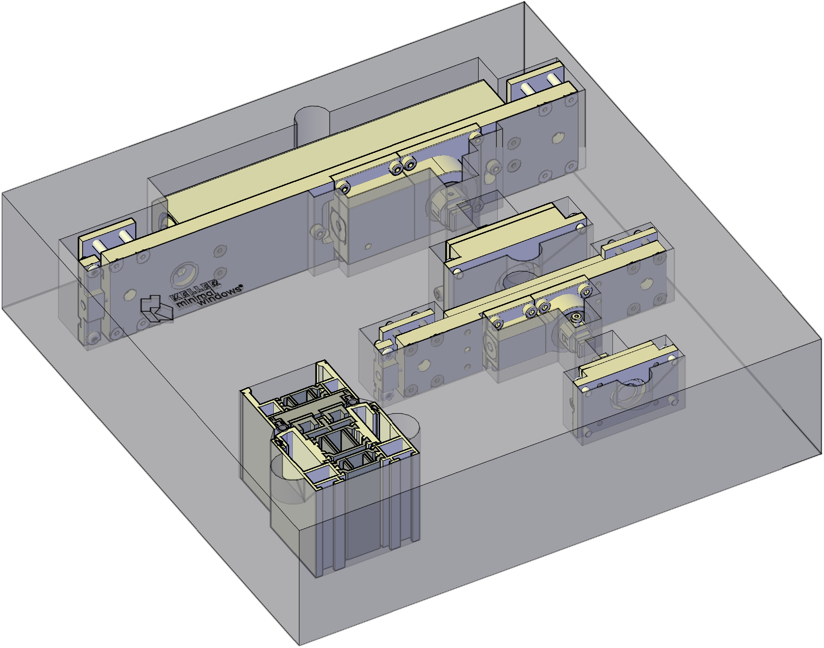
minimal windows® pivot

Slide 6
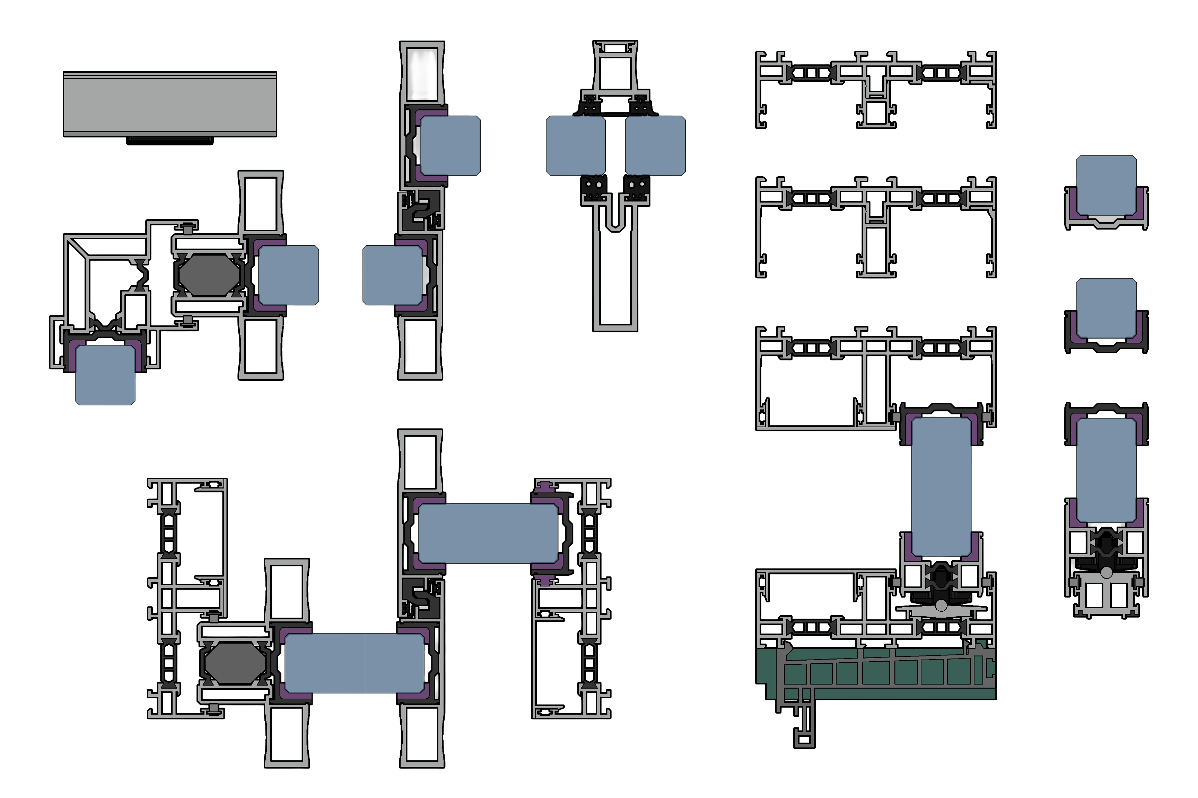
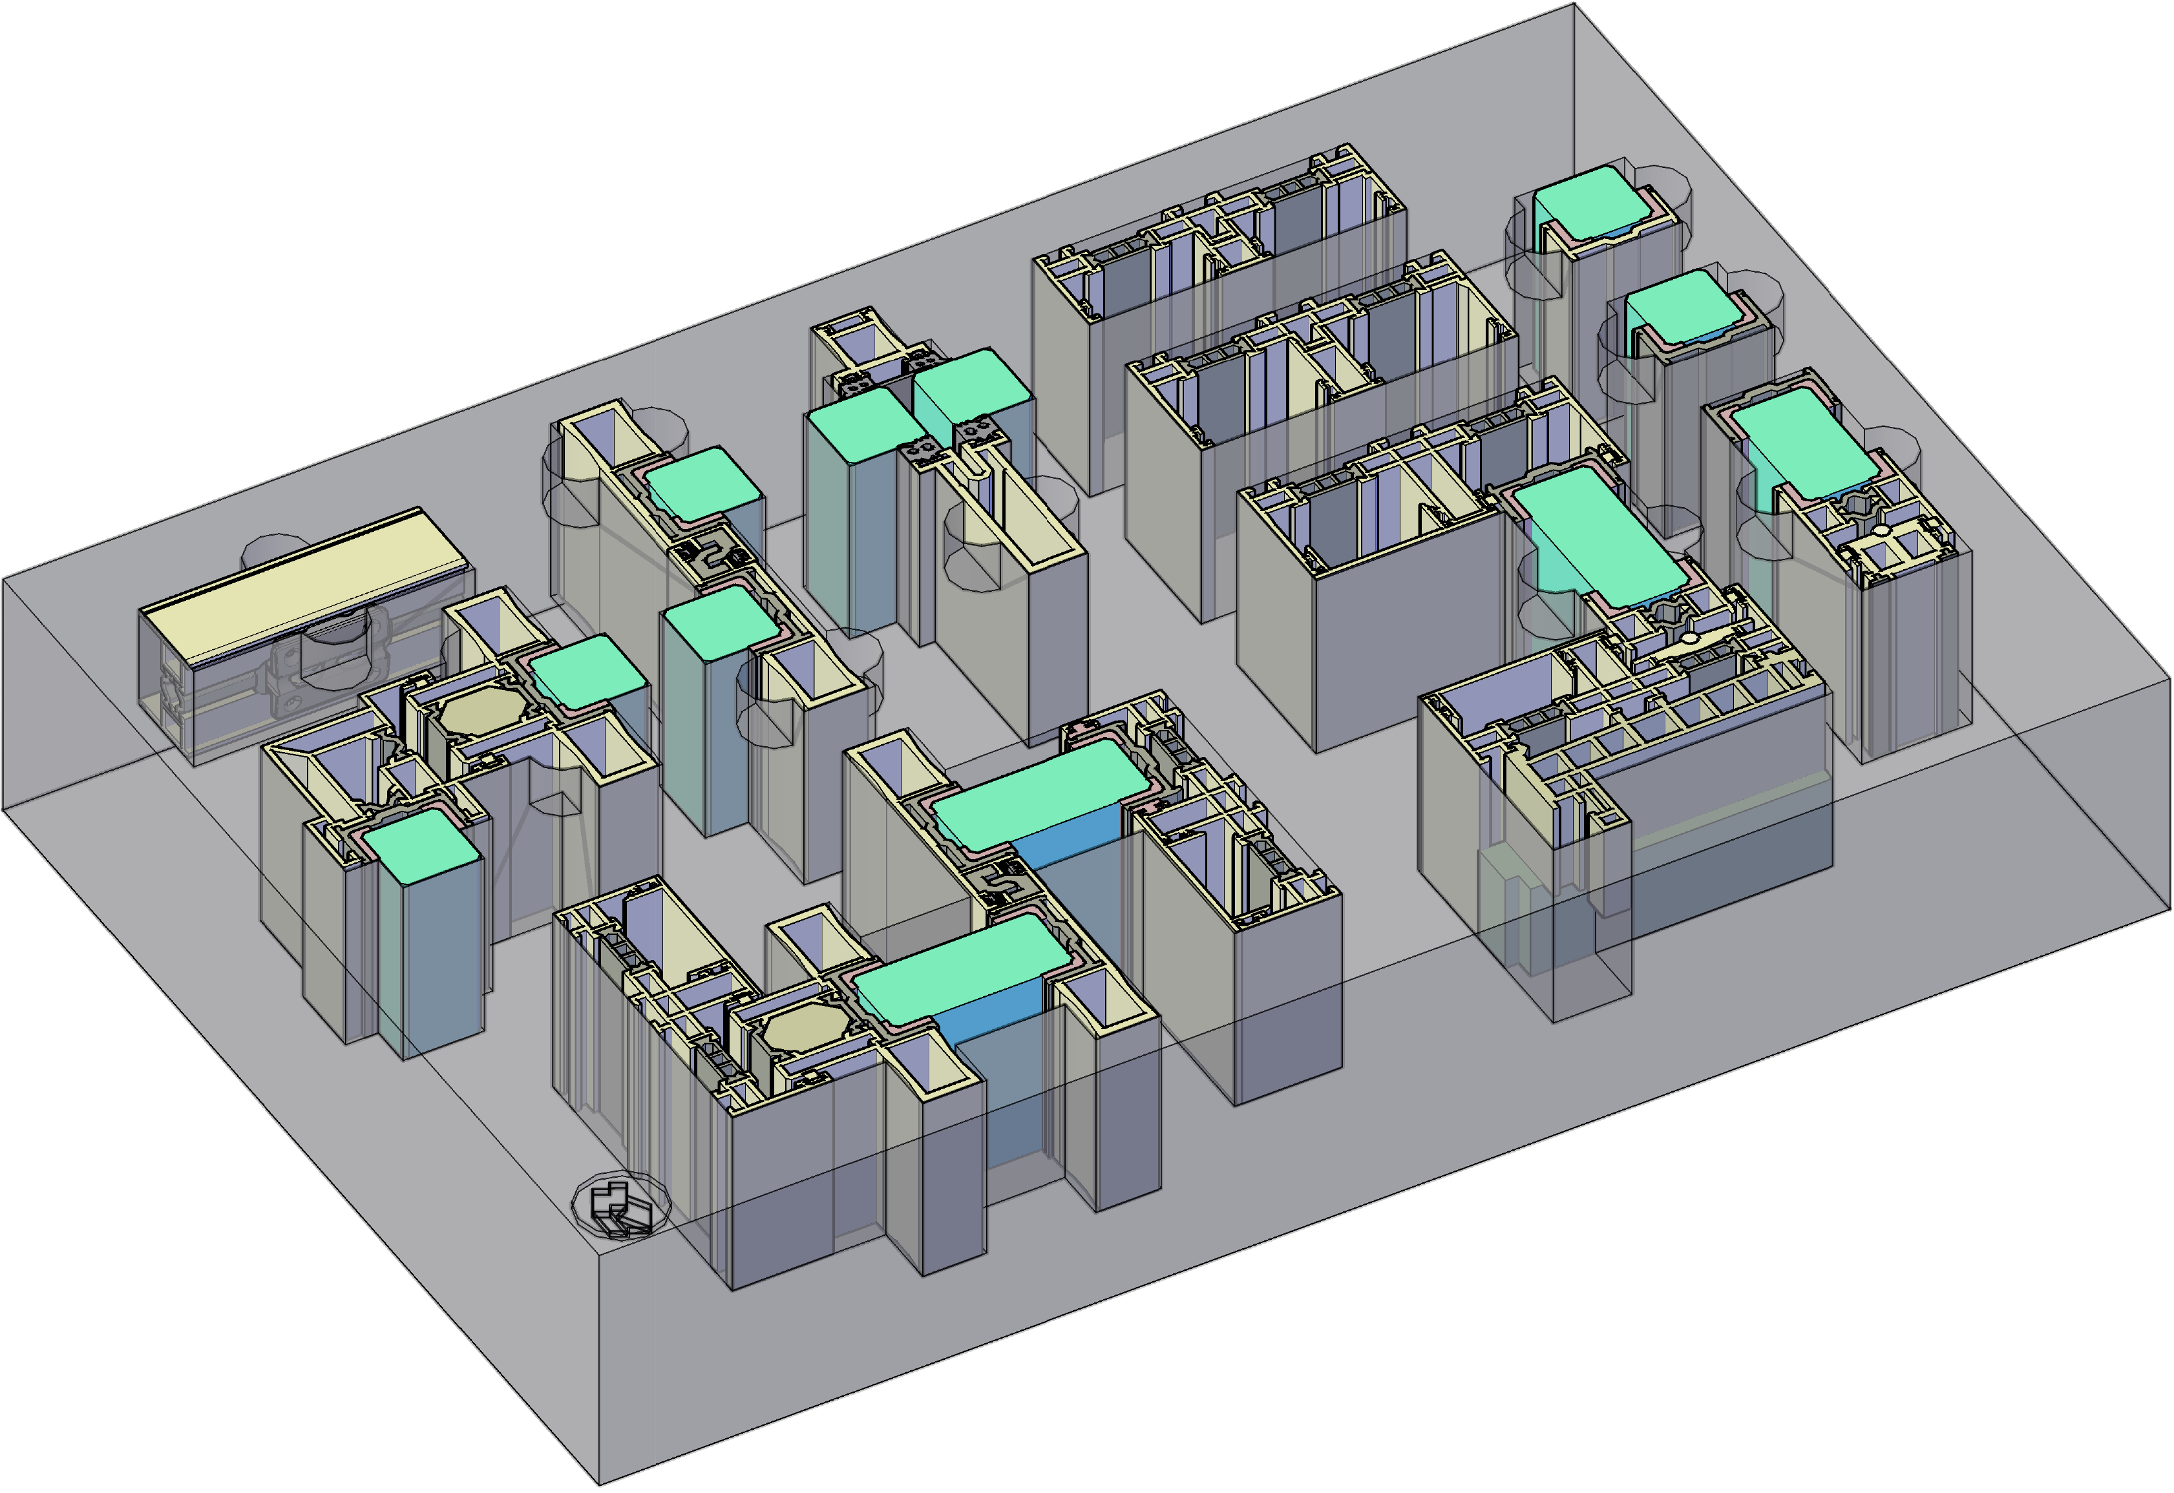
minimal windows®

Slide 7
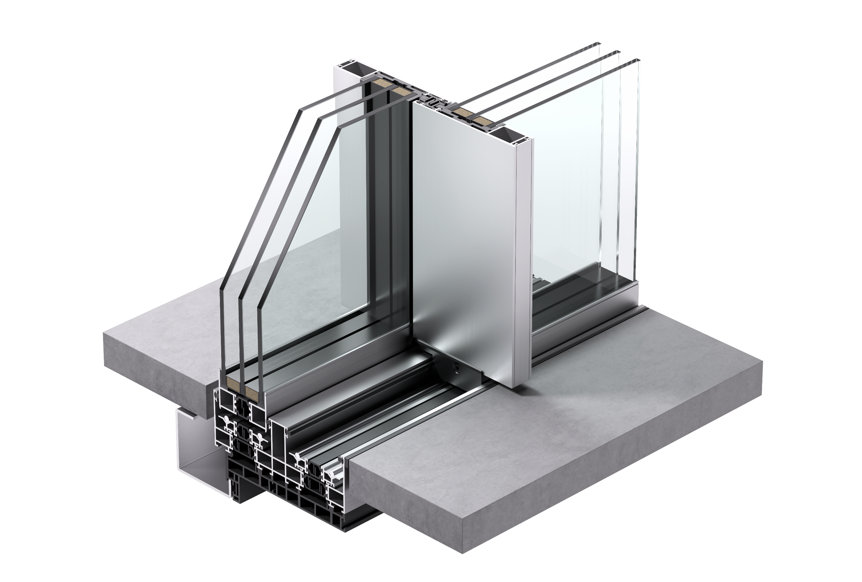
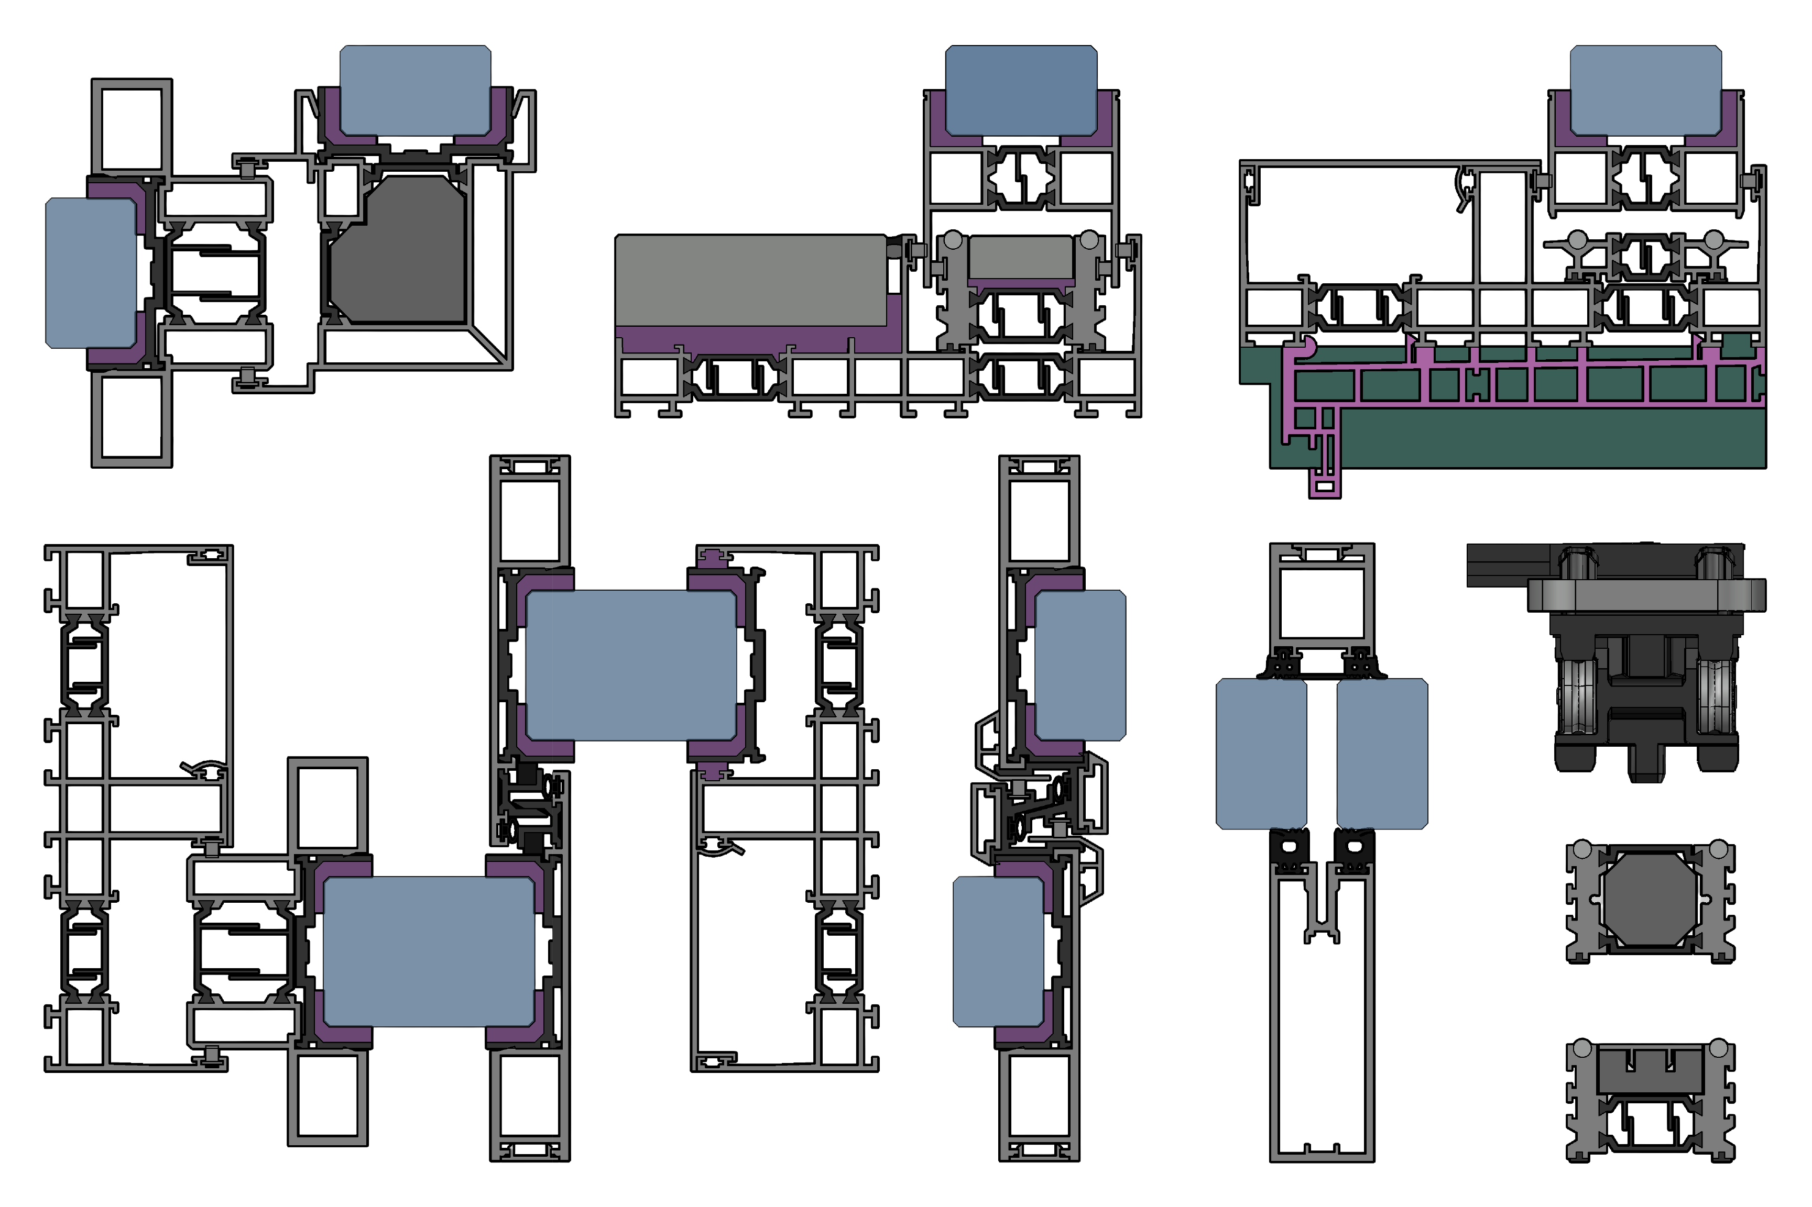
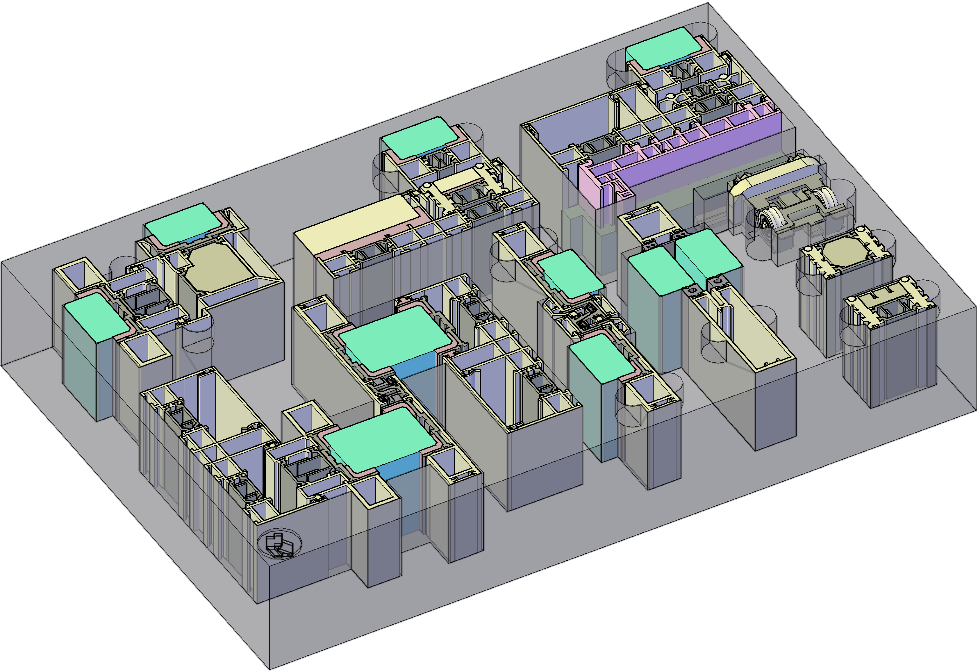
minimal windows®4+

Slide 8
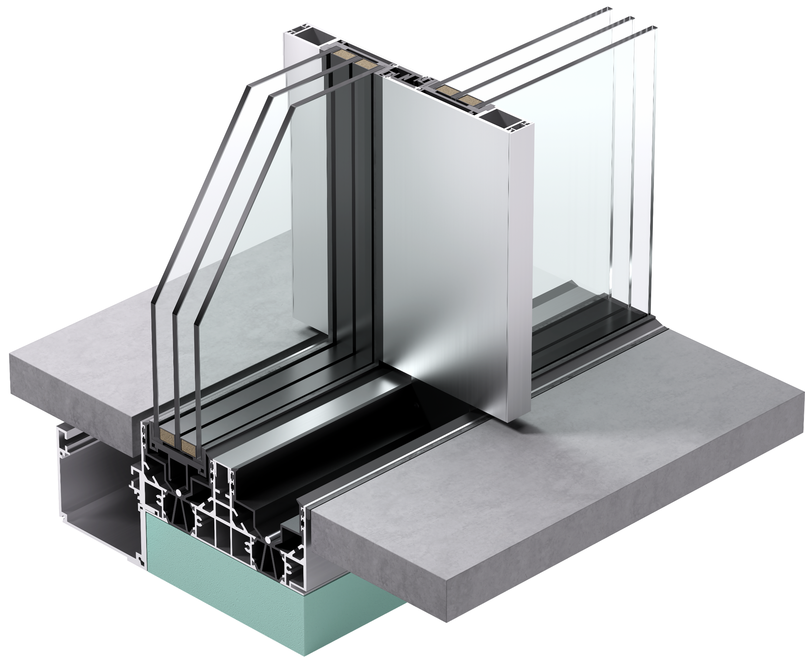
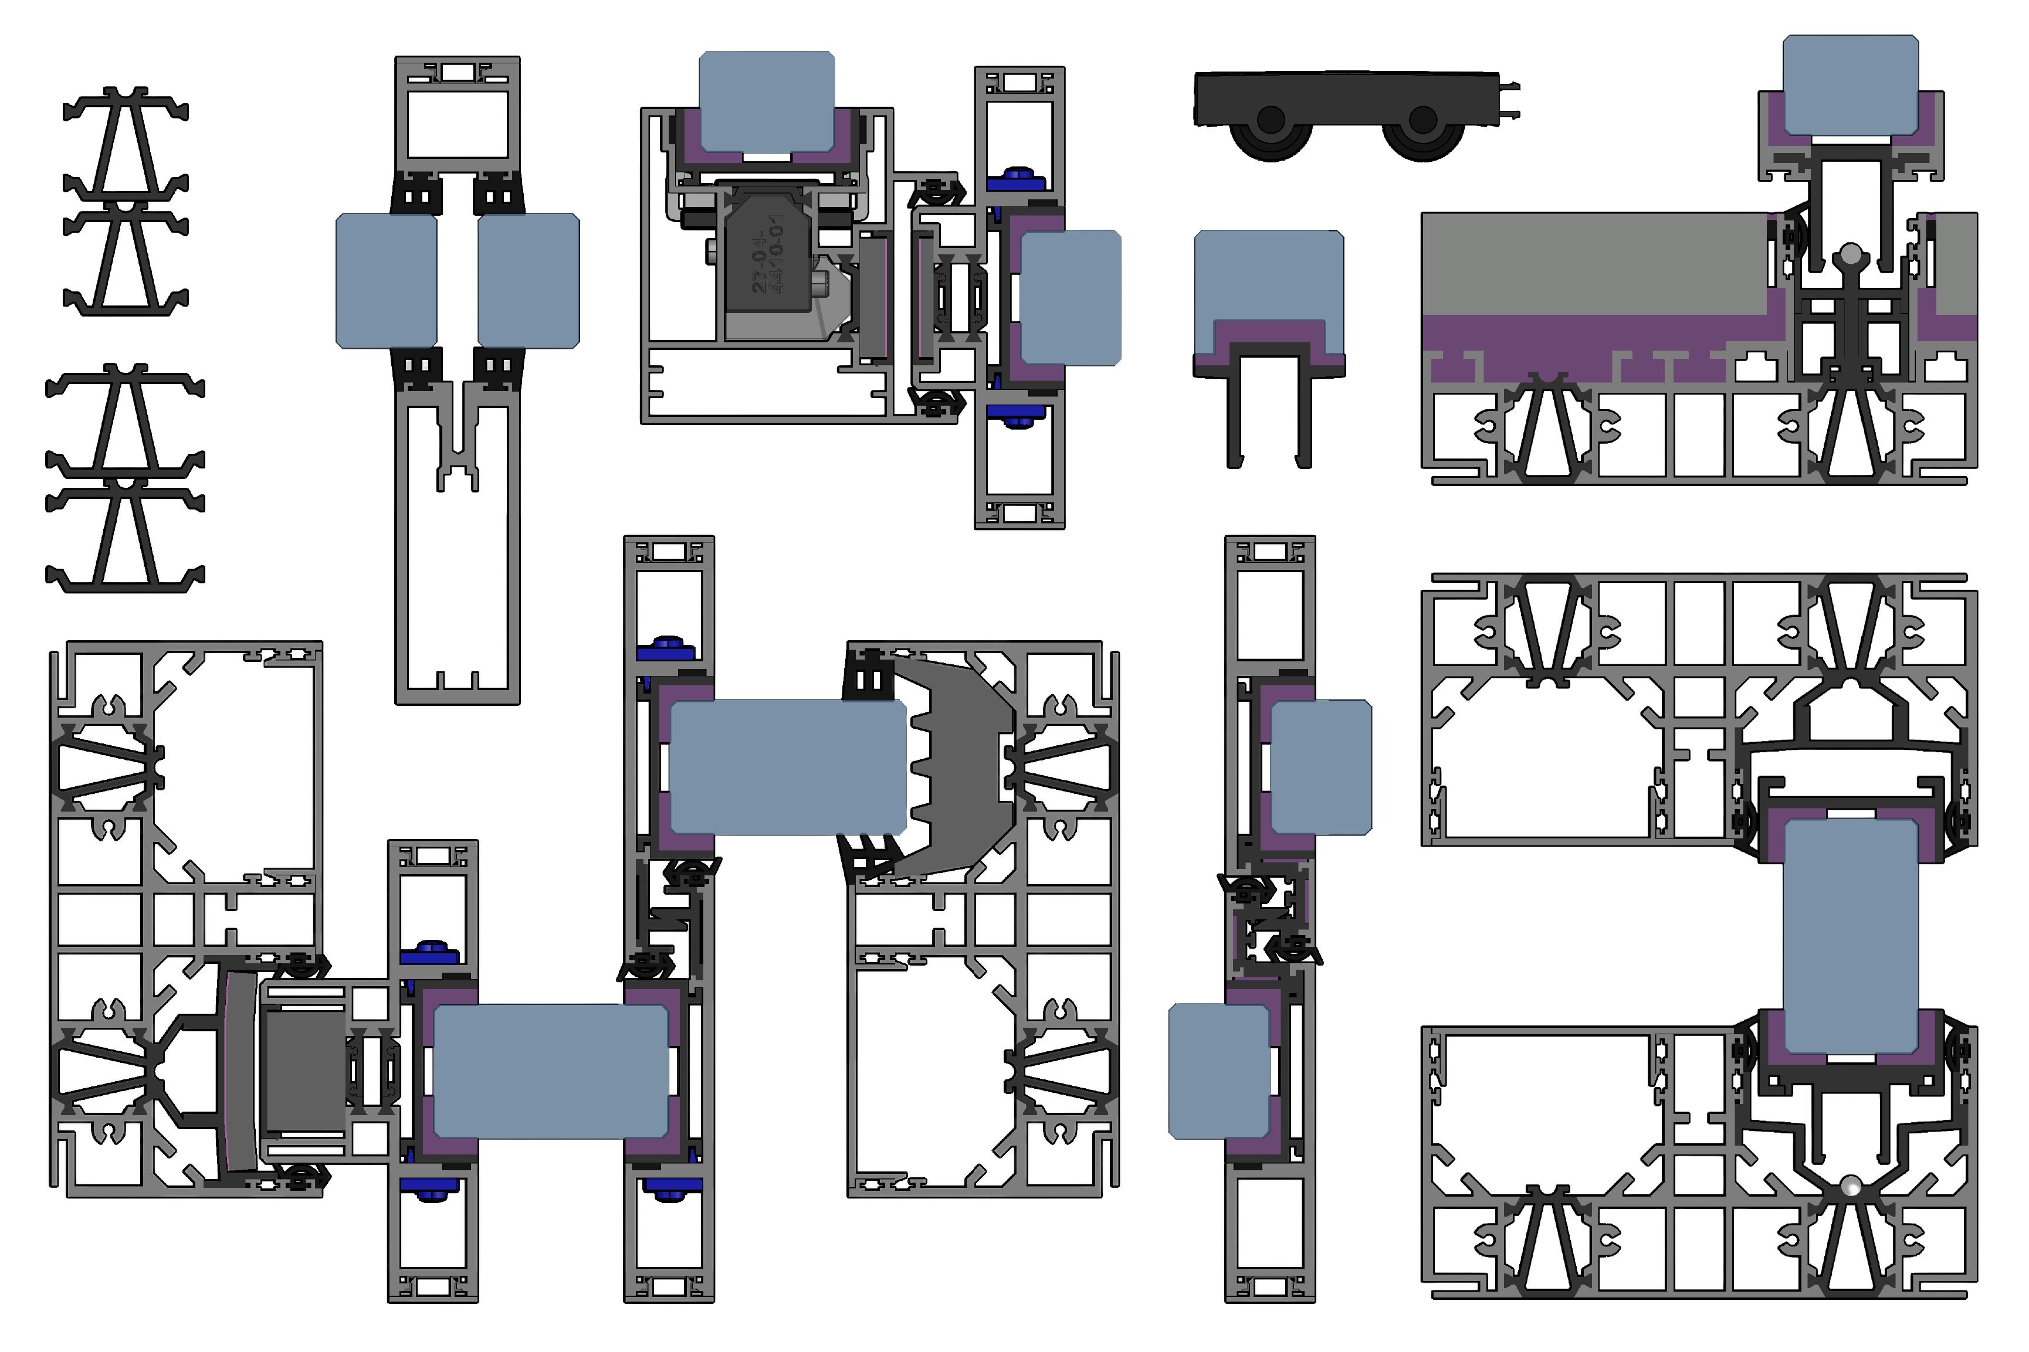
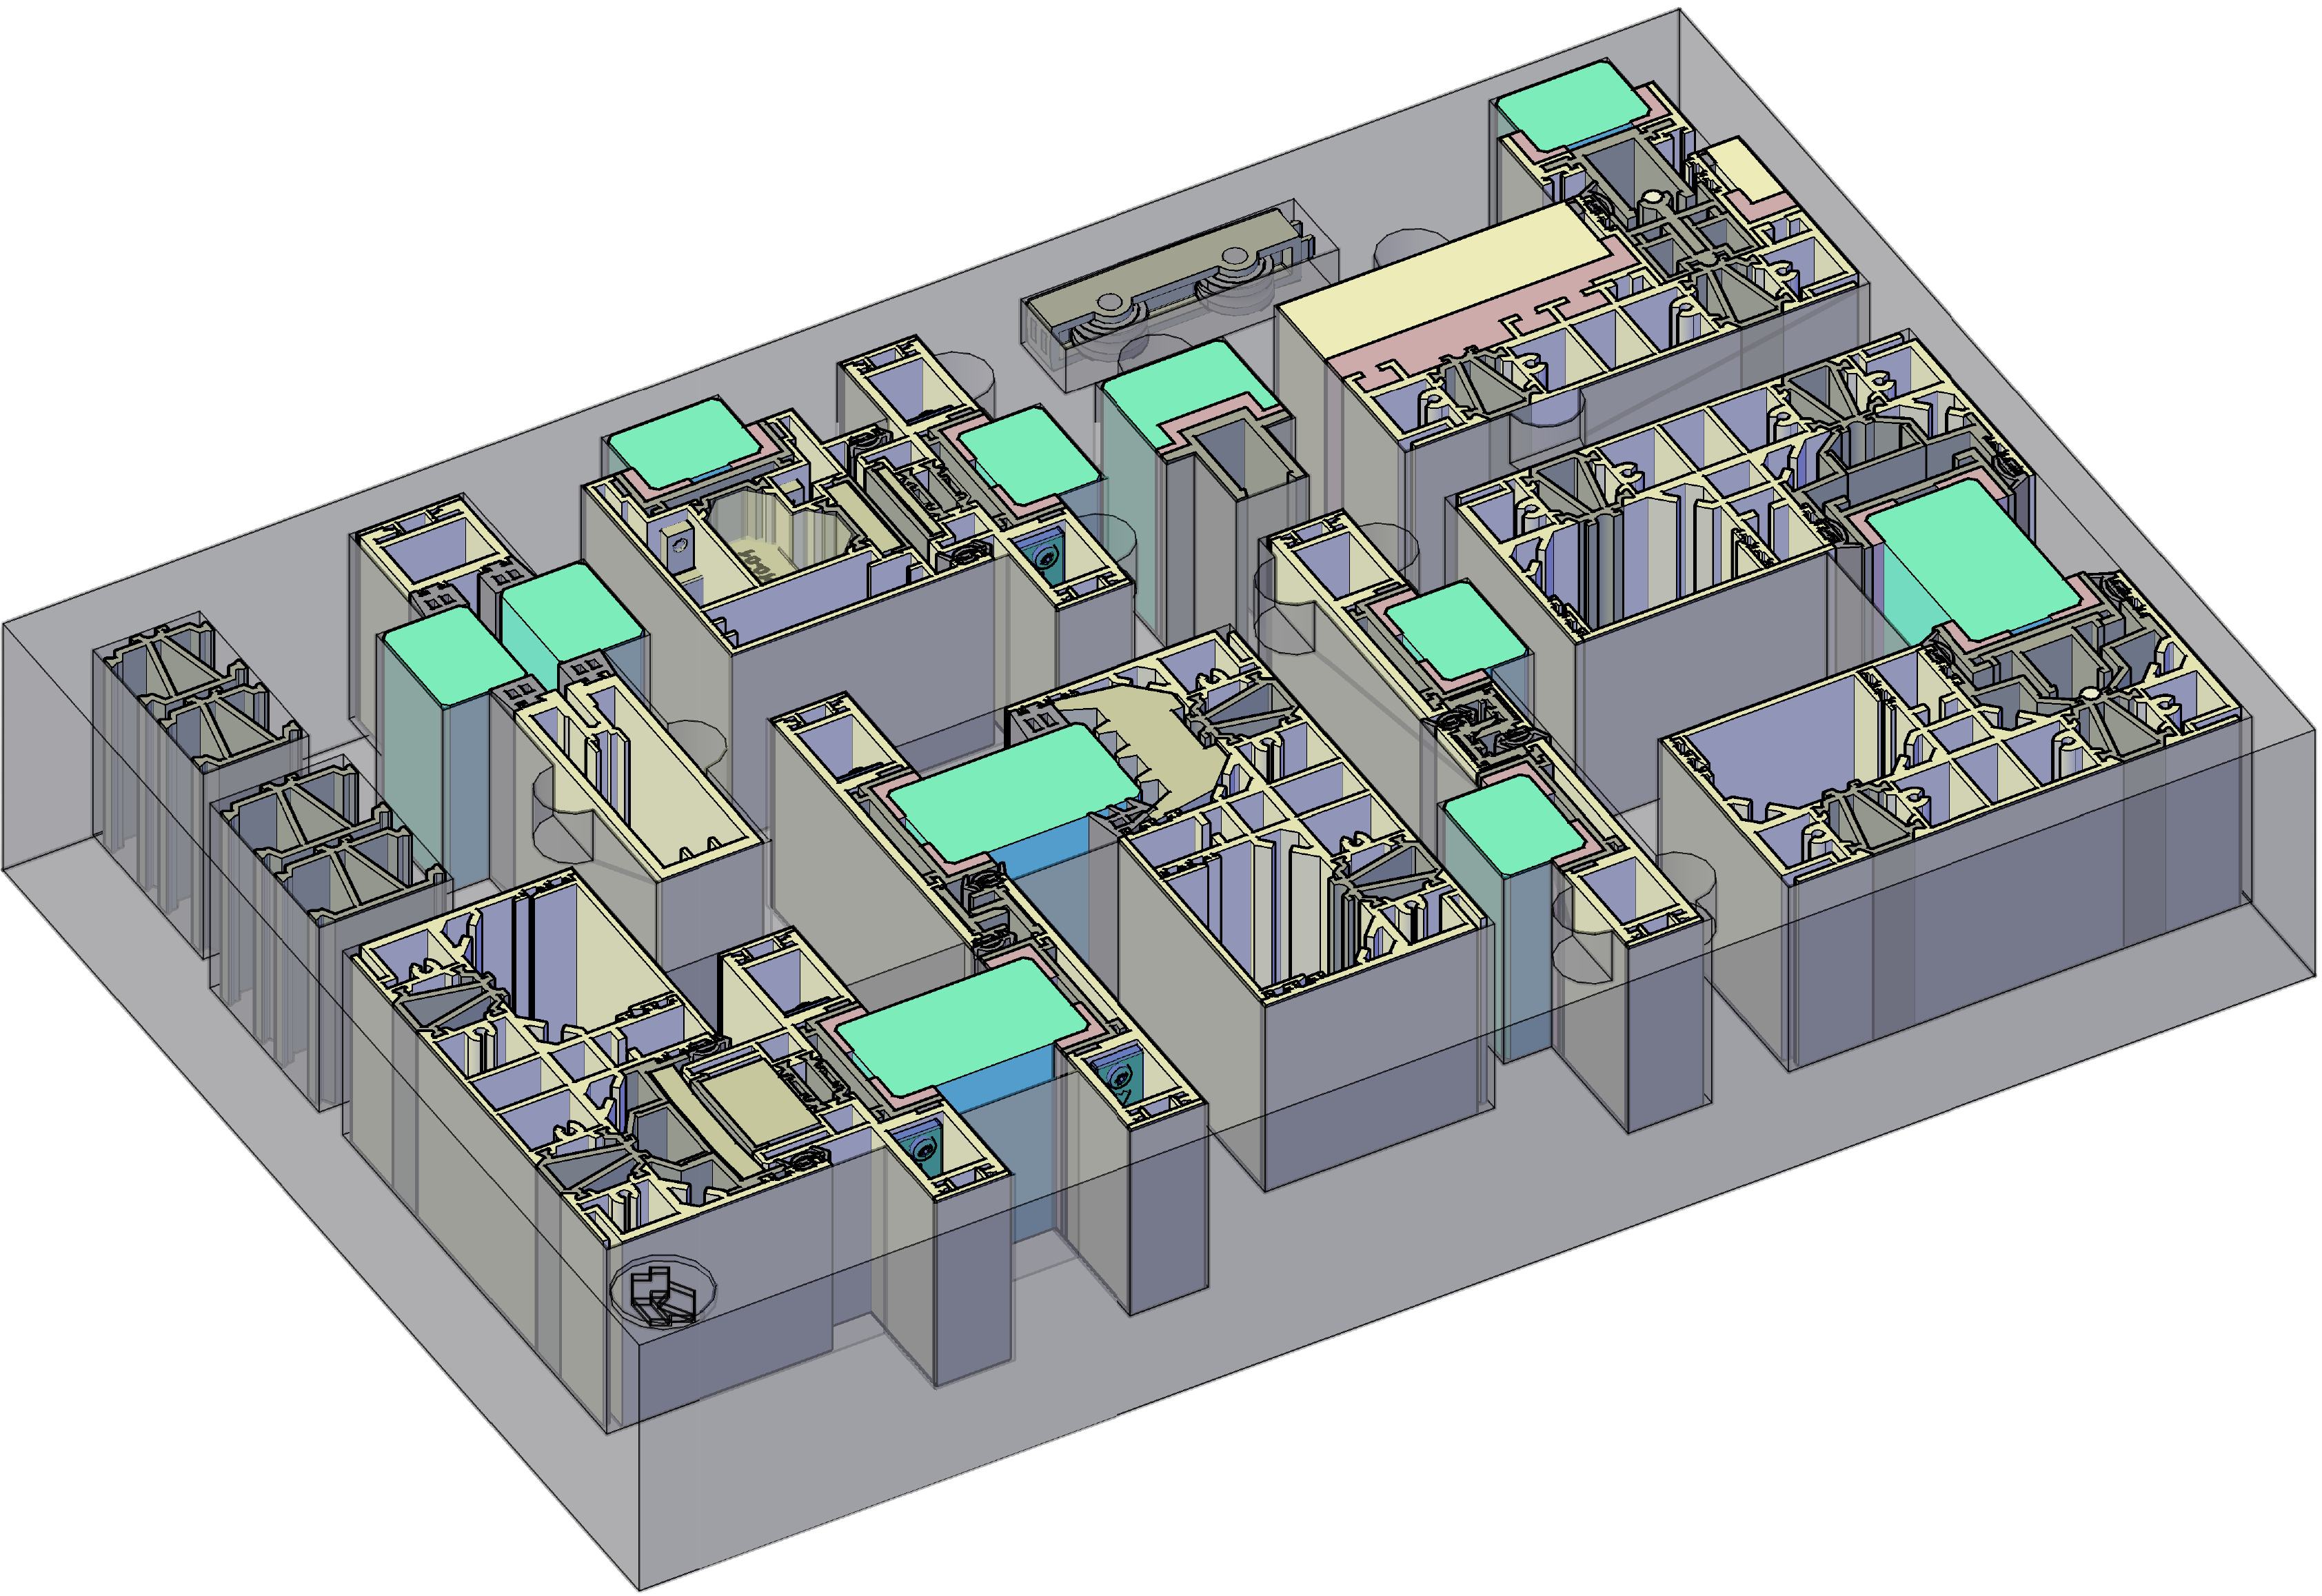
minimal windows®NGS

