Slide 1
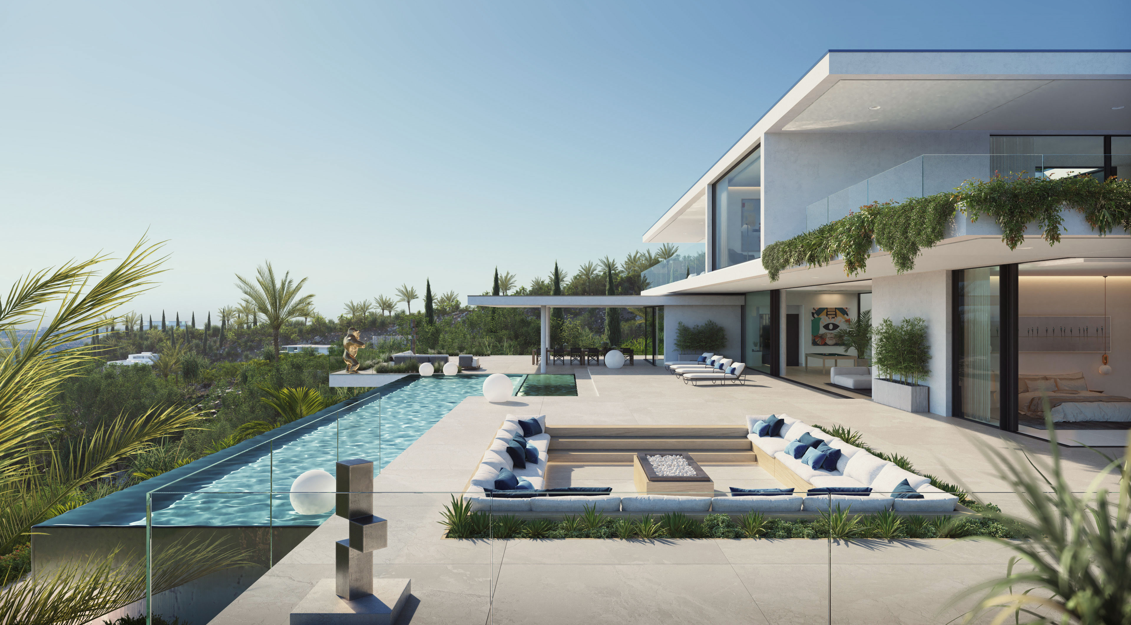
Titel der Präsentation Untertitel mit einer weiteren Beschreibung
Surface Finishes Presenter: Marvin Plumm + Werner Jager

Slide 2


Surface Finishes Presenter: Marvin Plumm + Werner Jager
#Qualification and Qualities requested
 | Product Examples | Test Weathering Duration
Class 1 | Standard Polyester | 1 year Florida ~ 3 years MEK
Class 2 | Super-Durable Polyester | 3 years Florida ~ 10 years MEK
Class 3 | Fluorpolymere PVDF / PFC | 10 years Florida ~ 30 years MEK
 | Product Examples | Test Weathering Duration
Standard | Standard Polyester | 1 year Florida ~ 3 years MEK
Master | Super-Durable Polyester | 3 years Florida ~ 10 years MEK
Premium | Fluorpolymere PVDF / PFC | 5 years Florida ~ 20 years MEK

Slide 3
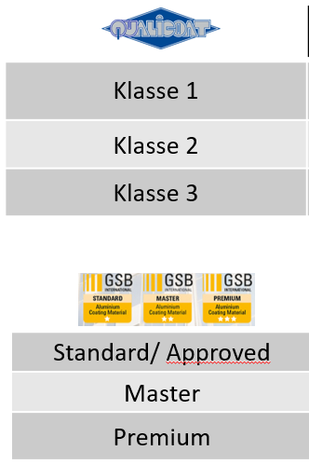
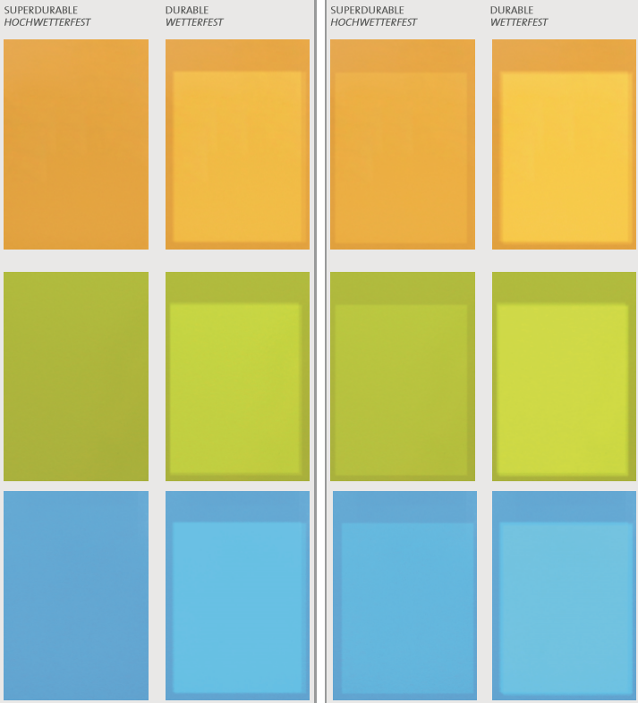
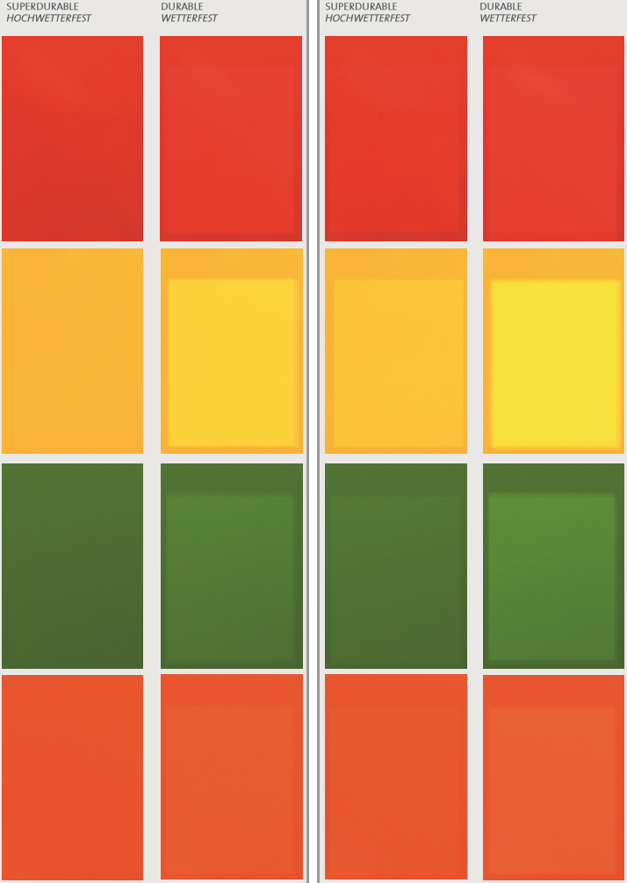
Surface Finishes Presenter: Marvin Plumm + Werner Jager
#Coating Classes and longtime Impact of UV Radiation
700 h UVB radiation - influence on color stability
Durable
Super Durable

Slide 4
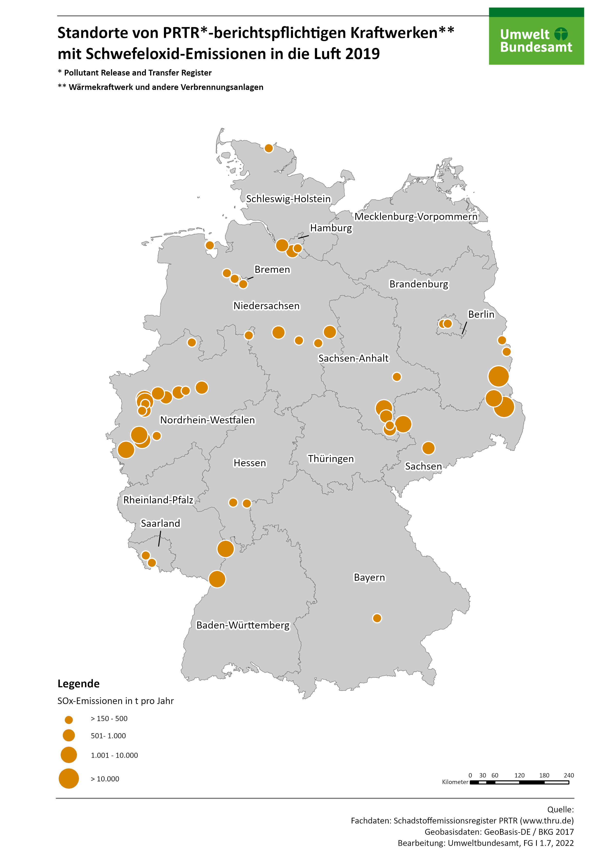
Surface Finishes Presenter: Marvin Plumm + Werner Jager
#Environmental Impact and Examples
Cx
Corrosion Category | Corrosion Impact | Examples
C1 | Very low | Inside: heated rooms e.g. schools, offices
C2 | Low | Inside: unheated rooms e.g. storage rooms, sports halls Outside: rural areas
C3 | Middle | Indoor: food processing, breweries, laundries Outside: lightly polluted urban areas
C4 | High | Inside: swimming pools, industrial plants Outside: heavily polluted urban areas, industrial areas, coastal areas without salt water spray, de-icing salt exposure
C5 | Very High | Inside: mine, processing with aggressive media Outside: industrial areas, coastal areas with salt water spray
Cx | Extreme | Extremely highly corrosive atmosphere, such as industrial plants in sub and tropical climates
Cx
C5
C4
C4
C4
C4
C3/C4

Slide 5

Surface Finishes Presenter: Marvin Plumm + Werner Jager
#Environmental Impact and Cleaning Intervalls
Environment | Corrosion Class | Cleaning Intervall
Indoor: food processing, breweries, laundries Outside: lightly polluted urban areas | until C3 | 1 x in 12 months
Inside: swimming pools, industrial plants Outside: heavily polluted urban areas, industrial areas, coastal areas without saltwater spray, de-icing salt exposure | C4 | 1 x in 6 months
Inside: mine, processing with aggressive media Outside: industrial areas, coastal areas with saltwater spray | C5 | 1 x in 3 months
Extremely highly corrosive atmosphere, such as industrial plants in sub and tropical climates | C5 to Cx | monthly
Cx
Cx
C5
C4
C4
C4
C4
C3/C4
Recommendation AXALTA

Slide 6
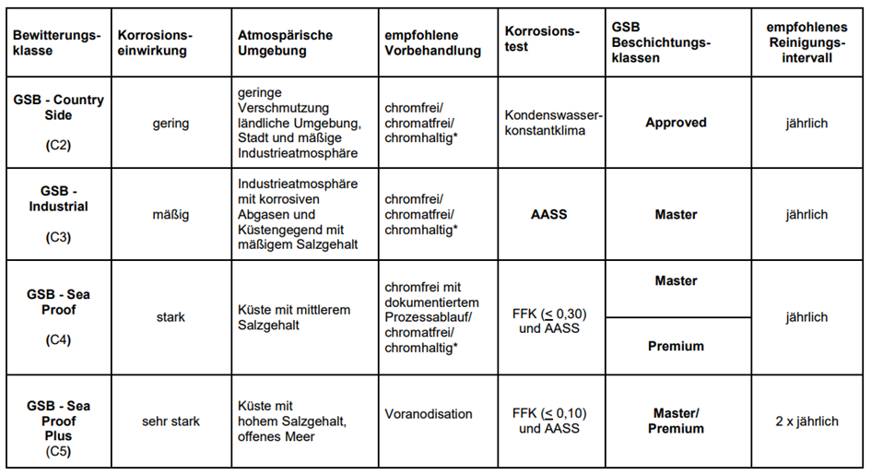
Surface Finishes Presenter: Marvin Plumm + Werner Jager
#Environmental Impact and Cleaning Intervalls
Source: GSB AL 631 Richtlinie Tabelle 2- 12.2017

Slide 7
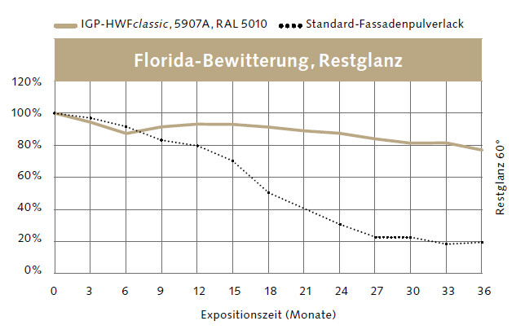
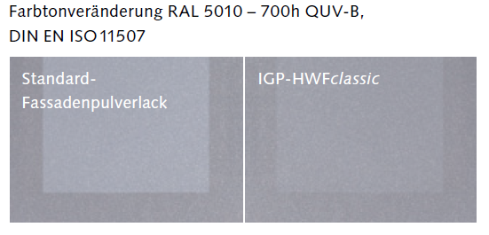
Surface Finishes Presenter: Marvin Plumm + Werner Jager
#Coating Classes and longtime Impact of UV Radiation
Source: IGP
Source: IGP
Guarantees if, among other things, annual cleaning/maintenance is carried out by a specialist company:
Class 1 – 3- 5 years
Class 2 – 10 years

Slide 8
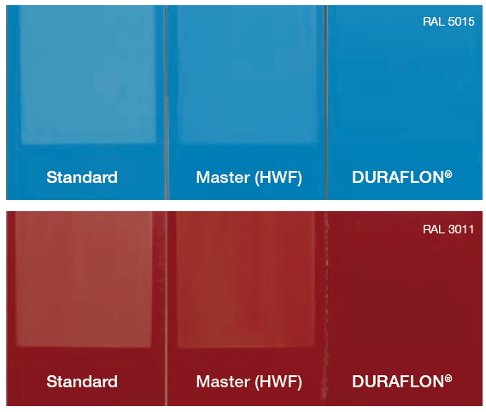
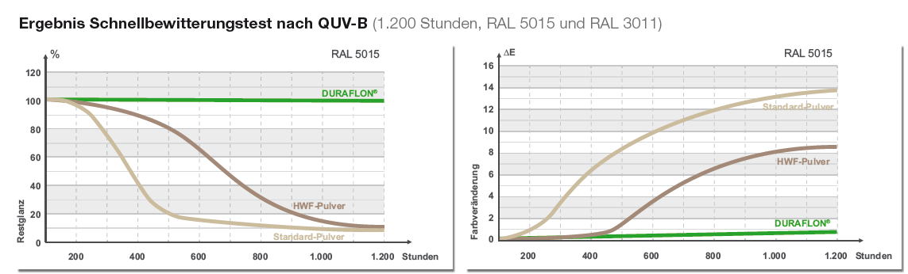
Surface Finishes Presenter: Marvin Plumm + Werner Jager
#DURAFLON Premium/ Class 3 Coatings (AAMA 2605):
"UV-resistant The durability of the surface essentially results from the UV resistance of the coating material.
Chemically resistant DURAFLON® shows its superior resistance even with so-called aggressive media, e.g., near industrial plants or in the medical sector, with frequent use of disinfectants.
Cleaning Dirt-repellent properties extend the usual cleaning intervals.
“easy(ier)-to-clean" technology Thanks to "easy-to-clean", any necessary cleaning is quick and easy."

Slide 9
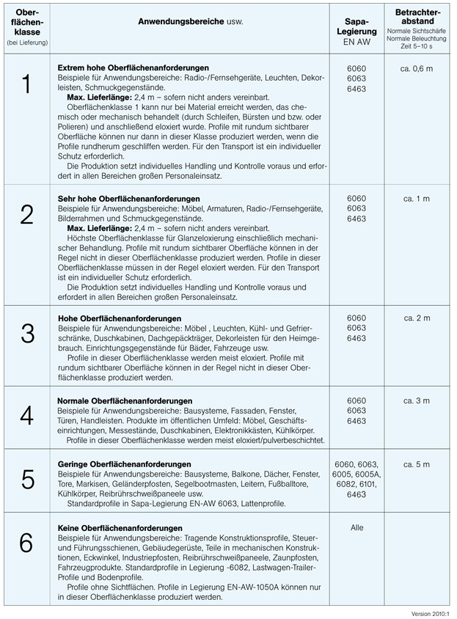
Surface Finishes Presenter: Marvin Plumm + Werner Jager
#Quality Assessment VFF AL.02: 2016-08 and VFF AL.03: 2016-08
The data sheets and guidelines are usually used to assess the surfaces quality:
VFF AL.02: 2016-08 Visual assessment of organically coated surfaces on aluminium
VFF AL.03: 2016-08 Visual assessment of anodised surfaces on aluminium

Slide 10
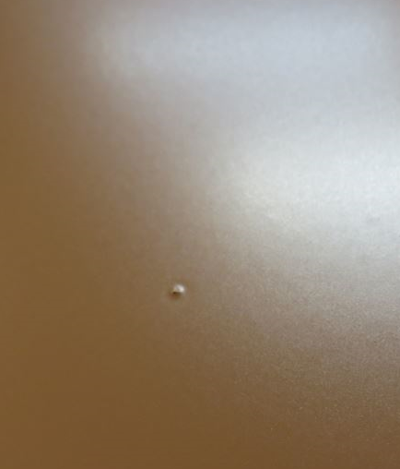
Surface Finishes Presenter: Marvin Plumm + Werner Jager
#Quality Assessment VFF AL.02: 2016-08
Testing of powder-coated surfaces:
Visual plan view, perpendicular to the surface
Max. 10 seconds
Outside surfaces at a distance of 5 meters
Inner surfaces spaced 3 meters apart
Prior marking of the characteristics is not permitted
Exterior surfaces with diffuse daylight, interior surfaces with diffuse illumination
Features are not permitted if they are recognized under the stated conditions.

Slide 11
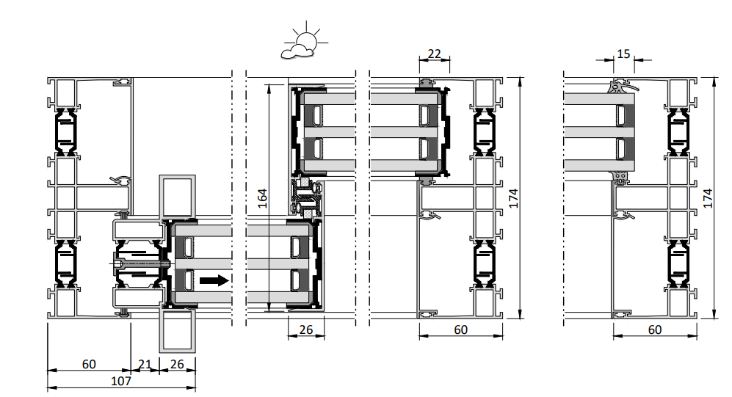
Surface Finishes Presenter: Marvin Plumm + Werner Jager
#Quality Assessment VFF AL.02: 2016-08
Testing of powder-coated surfaces:
Main visible surfaces with high quality requirements
Secondary visible surface with low quality requirements
All surfaces must be covered with a coat
Accumulation of paint in functional zones, e.g. compound and clip zones
Main Visible Surfaces – High requirement surface
Secondary visible areas – area with low requirements

Slide 12
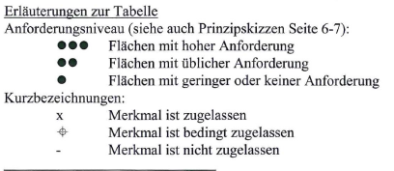
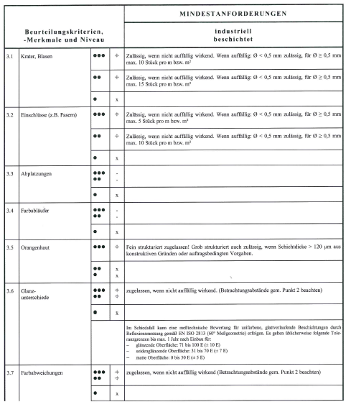
Surface Finishes Presenter: Marvin Plumm + Werner Jager
#Quality Assessment VFF AL.02: 2016-08
Testing of powder-coated surfaces:
Main Visible Surfaces – High requirement surface
Secondary visible areas – area with low requirements

Slide 13
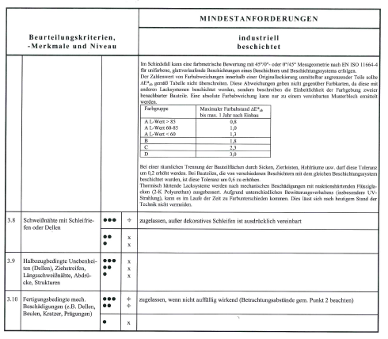
Surface Finishes Presenter: Marvin Plumm + Werner Jager
#Quality Assessment VFF AL.02: 2016-08
Testing of powder-coated surfaces:
Main Visible Surfaces – High requirement surface
Secondary visible areas – area with low requirements

Slide 14
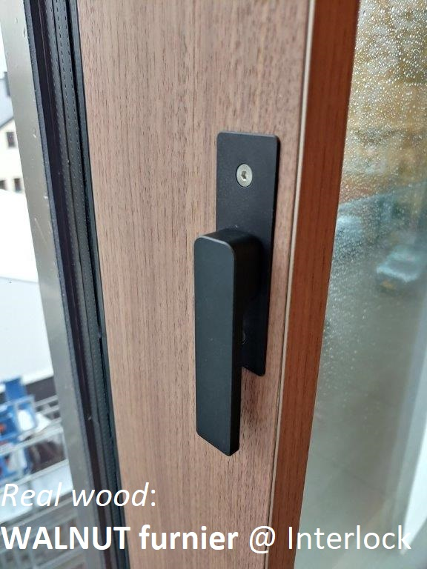
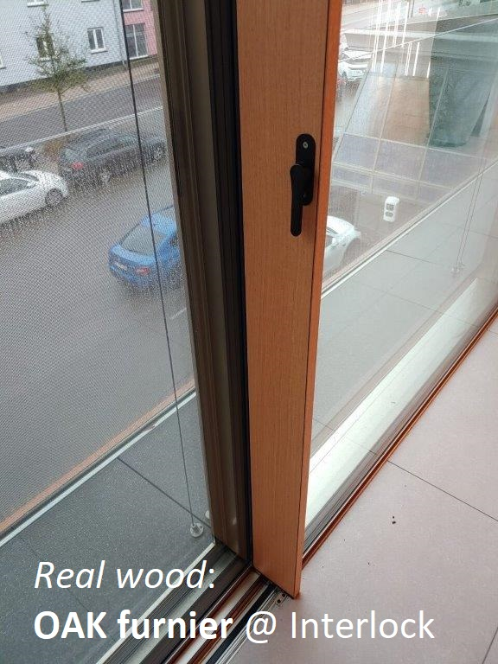
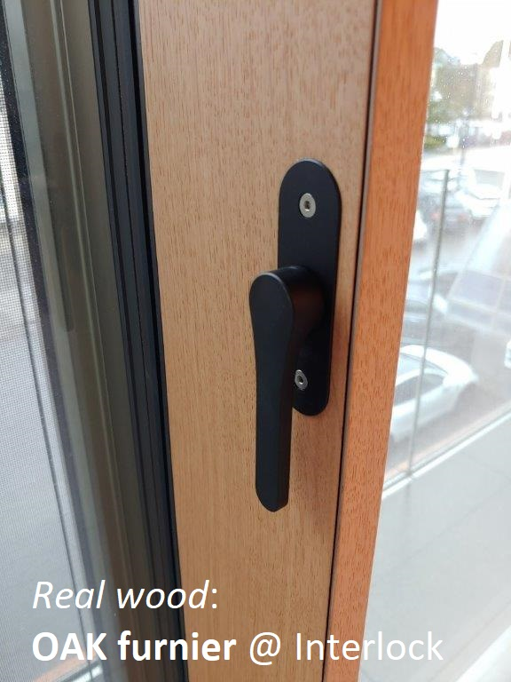
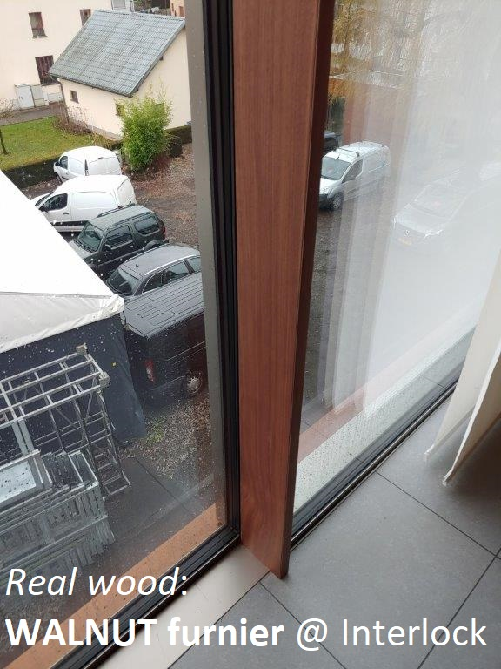
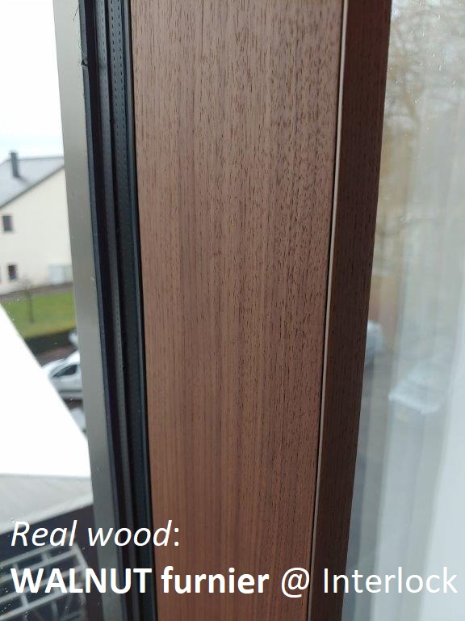
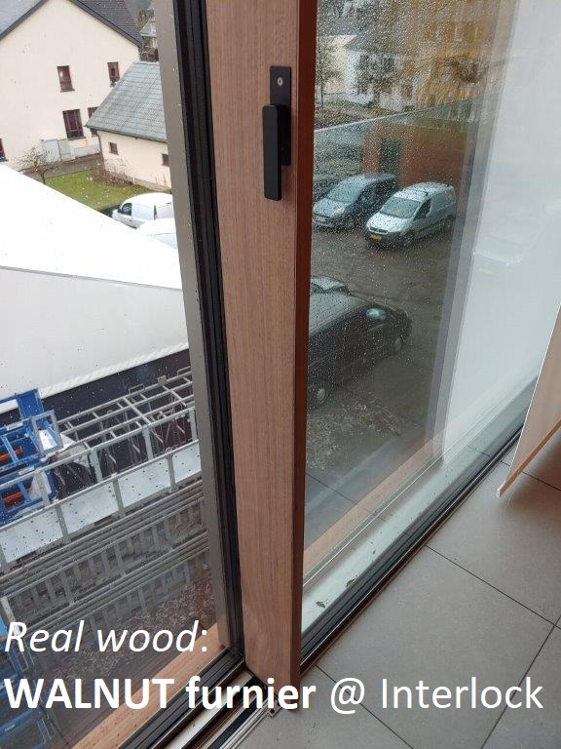
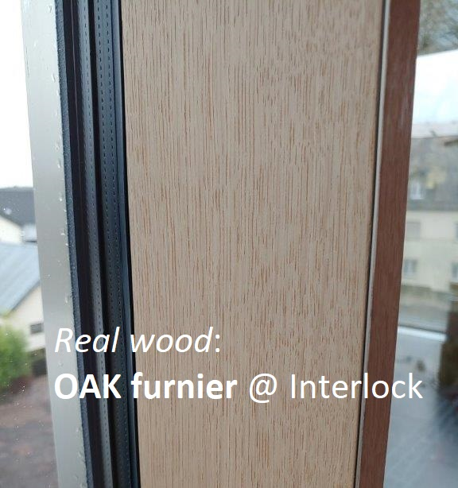
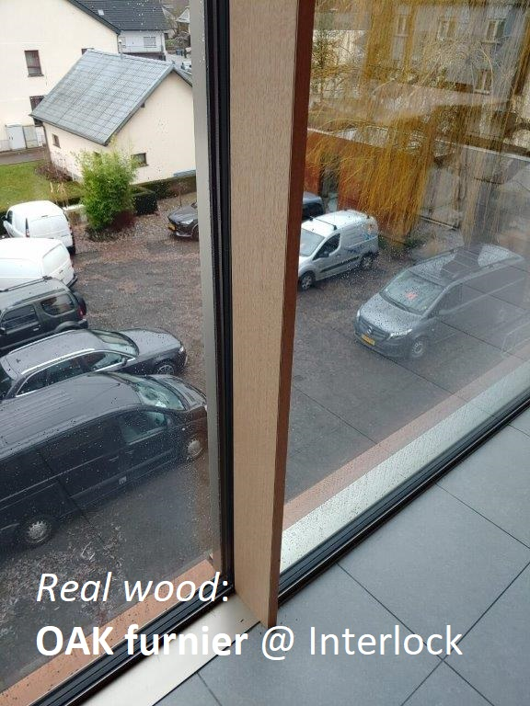
Surface Finishes Presenter: Marvin Plumm + Werner Jager

Slide 15
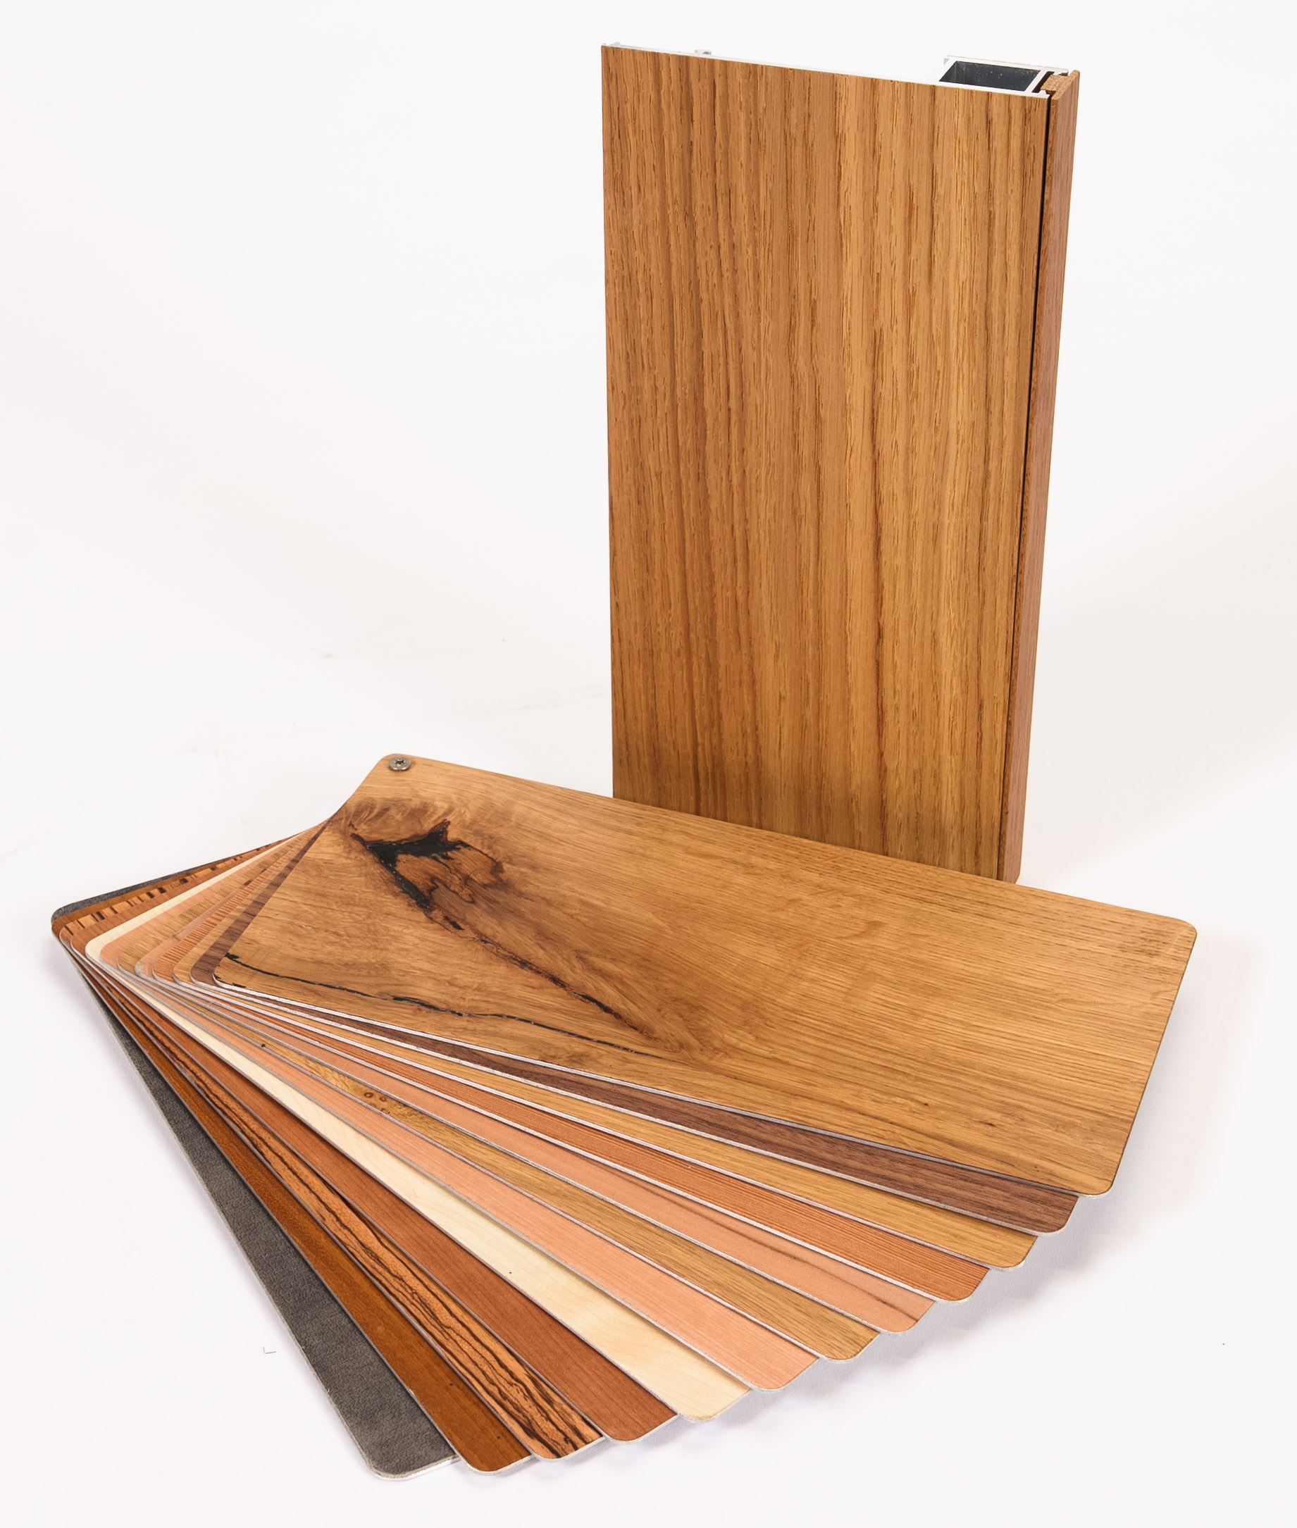
Surface Finishes Presenter: Marvin Plumm + Werner Jager
Risseiche
Nussbaum
Eiche schlicht
Lärche
Satin Walnut
Asteiche
Spitzahorn
Ahorn
Kirschbaum
Zebrano
Teak
Cracked Oak
Walnut
Plain oak
Larch
Satin Walnut
BranchOak
Norway Maple
Maple
Cherry Tree
Zebrano
Teak

Slide 16
Surface Finishes Presenter: Marvin Plumm + Werner Jager
General
Interior application only
Room climate
Interior Temperature > +19°C
Interior relative humidity 40% - 60%
No wet room application e.g., bathroom, sauna, swimming pool
On junction and mullion profiles only Alternative inner surfaces on request depending e.g., on indoor climate situation

Slide 17
Surface Finishes Presenter: Marvin Plumm + Werner Jager
Cleaning
For everyday care, it is sufficient to wipe the veneer dry with a soft, lint-free cloth.
If the veneer has also been clear coat varnished, you should avoid using microfiber cloths as this might lead to micro scratches on the surface finish.
Wipe off heavier dirt with a damp cloth. The cloth should not be too wet to prevent moisture from penetrating the veneer and preventing it from swelling or coming loose.
More stubborn dirt or fingerprints can be removed by adding a little detergent to the cleaning water.
Avoid harsh and aggressive cleaning agents
Acidic cleaners such as vinegar cleaners are also not suitable for cleaning wood veneer.
Avoid standing water or liquid accumulation on the veneer. This causes the veneer to swell and detach from the carrier board.
Do not use furniture polish. Since the veneer is very thin, it cannot absorb the polish and your veneer will get a “greasy” haze that you will have to laboriously clean off after a while.
Damaged areas that are not too extensive can be repaired with hard furniture wax in the right color of your veneer.
In any case before cleaning bigger areas tests must be caried out upfront - at a smaller surface areas and in less visible areas

Slide 18
Surface Finishes Presenter: Marvin Plumm + Werner Jager
Wood as natural material
Wood is a living material and changes under the influence of light or UV radiation. What's behind it: Lignin, one of the main ingredients in wood, protects the cells from UV light. Once a tree is felled, the wood no longer produces lignin - as a result, sunlight changes the color of the wood. Anyone who chooses a natural veneer finish should therefore consider how the color develops over the years.
As a rough rule of thumb:
light woods, such as maple or beech, usually become darker over time,
while dark woods, such as oak or pear, tend to become lighter.
Some veneers, such as maple and ash, change to a "yellowed" look over the years –
The surface is ageing over the period of use and develop a kind of vintage styles and veneer with patina what can be in demand in furnishing and living.

Slide 19
Surface Finishes Presenter: Marvin Plumm + Werner Jager
Wood as natural material
Wood is a natural product that continues to develop its natural color as a wooden furniture. This emphasizes the character of a veneer made of real wood. What to avoid: Uneven color change.
Here is the color development of some veneers at a glance:
Ash: darkens with a slight yellow tinge
Beech: darkens with a slight red tinge
Maple: darkens with a noticeable yellow tinge
Norway Maple: Color becomes golden
Oak: subtle darkening
Cherry tree: the red tone becomes more pronounced
Walnut: the golden-brown color becomes more pronounced
Increased humidity (> 70% relative humidity) in the direct area of the veneer might lead to
irreversible stains until mold
deformation of the veneer
The delamination of the veneer from the aluminium profile surface.
To minimize that risk ensure
proper ventilation of the room with air with less humidity (< 50% rel. Humidity)
That warm heating air is reacheing the area e.g., by floor heating convectors, no curtains that cut-off the connection of the veneer area from the heated room.

Slide 20
Surface Finishes Presenter: Marvin Plumm + Werner Jager
General
Max. 6 m length Max. 300 mm depth / width
Finish
Oil finish
Clear coat varnish
Add-on price starts at € 250,- per run. meter [m] excl. junction and mullion profiles, visible surfaces only.
Real wood cover clip profile – price on request

Slide 21

&
Innovation
craftmanship
23.04.2024
Partner Days 23-24
21

