Slide 1
Mediating publicness: An analysis of Pacific audiences & media in Aotearoa/New Zealand
Tara Ross
University of Canterbury
tara.ross@canterbury.ac.nz

Slide 2
Percentage of Pacific ethnic group able to speak their Pacific language
Pacific group | 2013 Census % of speakers | 2013 Census % of speakers born in NZ
Tuvalu | 63.2 | 43.7
Samoa | 55.6 | 36.1
Tonga | 53.2 | 34.9
Tokelau | 31.9 | 18.7
Fiji | 27.7 | 6.8
Niue | 18.7 | 7.5
Cook Islands Māori | 12.8 | 3.6
Notes:
Source: Statistics New Zealand n.d 2013 census

Slide 3
NZ on Air funding for Pacific special interest TV programming 2016
 | Annual NZ on Air funding | No. of shows | Funding per show
Sunpix: Tagata Pasifika | $1,696,165 | 53 | $32,003
Tikilounge Productions: Fresh | $1,843,571 | 40 | $46,089

Slide 5
www.niufm.com, June 19

Slide 6
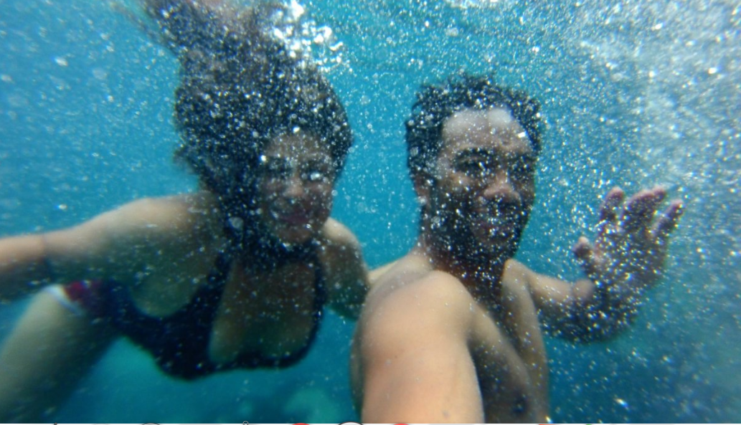
The site seeks to reconnect Pacific youth with their culture through music and video as well as blogs, and interactive and informative content. _NZ on Air

Slide 8
NZ On Air Funding Strategy
“Our strategy is founded on core public media principles. These include enriching the New Zealand cultural experience, improving diversity of media content in many forms, ensuring content is accessible, strengthening community life, and promoting informed debate. Our publicly-funded content may entertain but it will add cultural value.”
Notes:
http://www.nzonair.govt.nz/document-library/nz-on-air-funding-strategy-2017/

