Slide 1
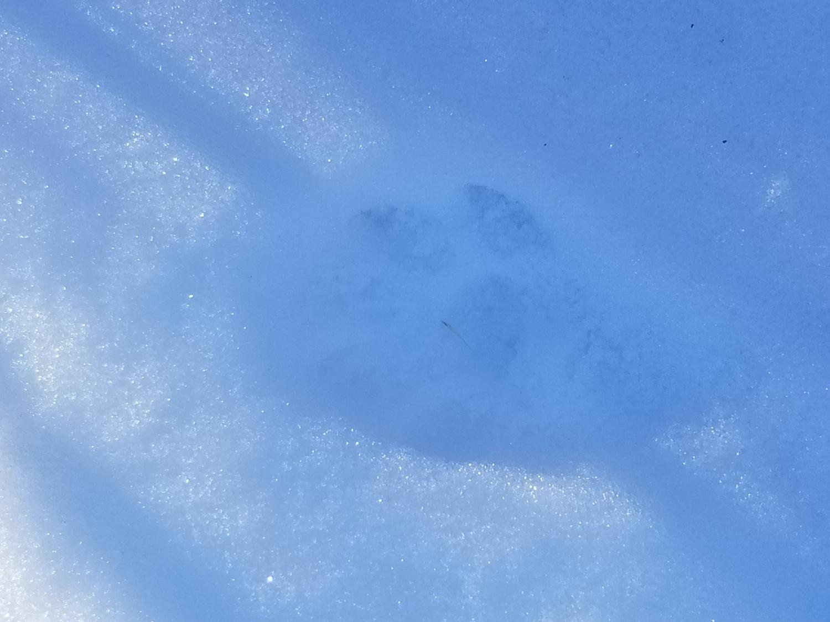
Some training slides
To help identify beaver activity

Slide 2
Fresh Cuts

Slide 3
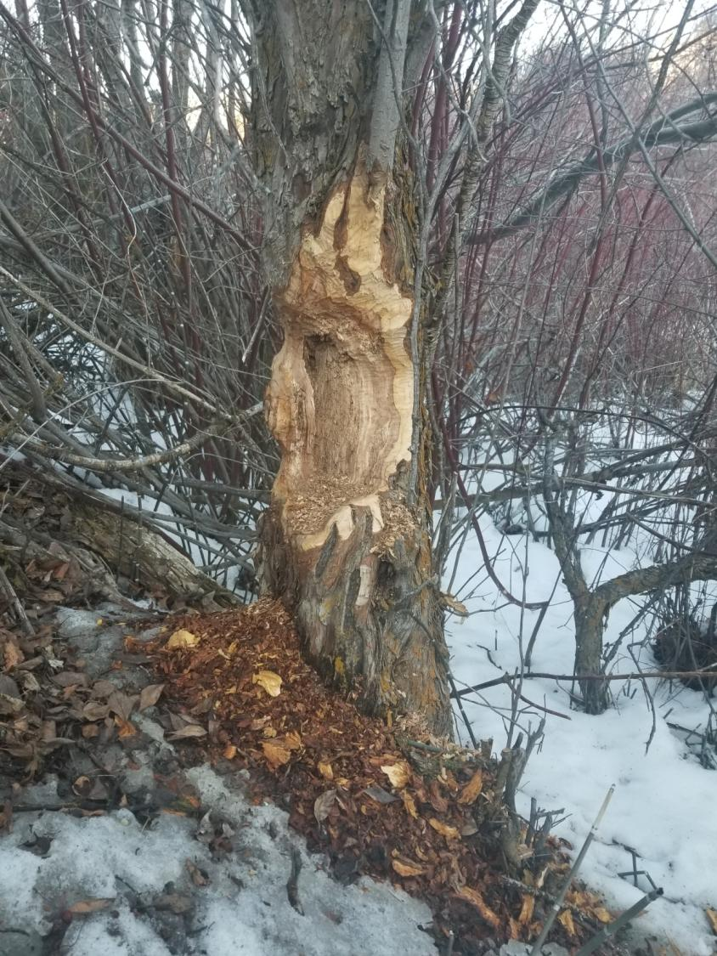
This tree has cuts that are still colored and not grey. These are FRESH CUTS and to be marked. If the chips are grey, but the cut on the tree is not, mark it as FRESH CUT

Slide 4
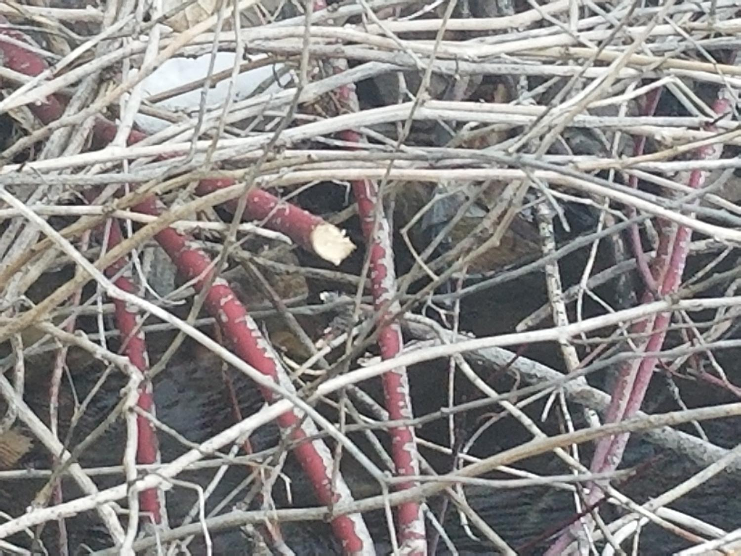
Notes:
Dogwood: Not a food, but a construction material.

Slide 5
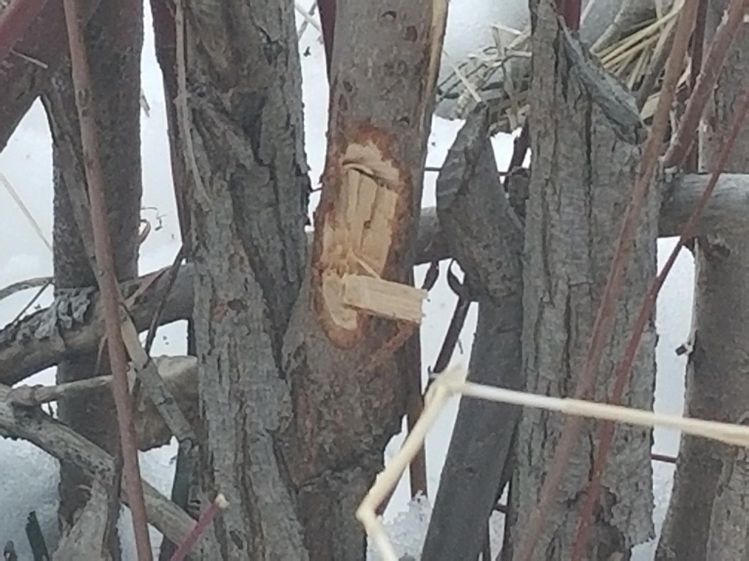
Fresh Cut
NOT Fresh Cut

Slide 6
Hatchet Cut? We do not count hatchet cuts as fresh cuts. But, as you can see from the color, this cut is recent

Slide 7
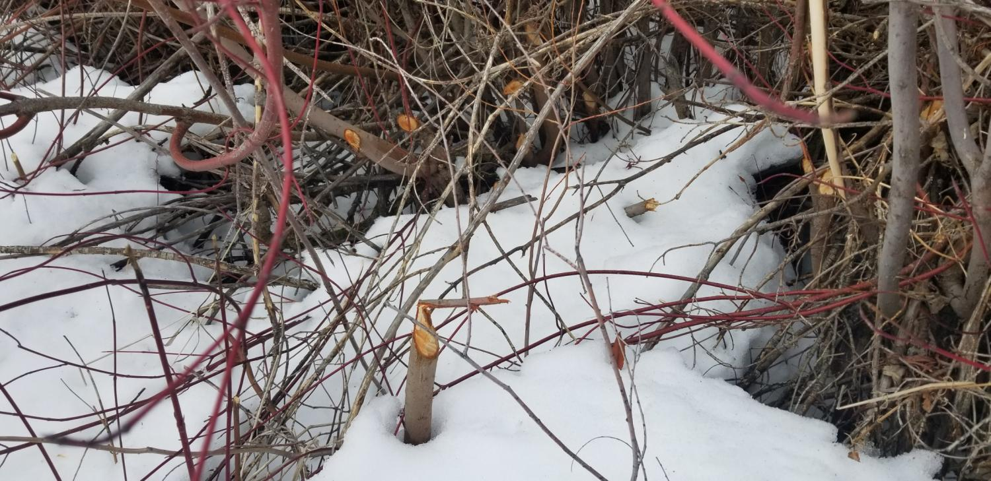
Fresh cuts-Willow. Note that Beaver typically do not eat the red twig dogwood

Slide 8
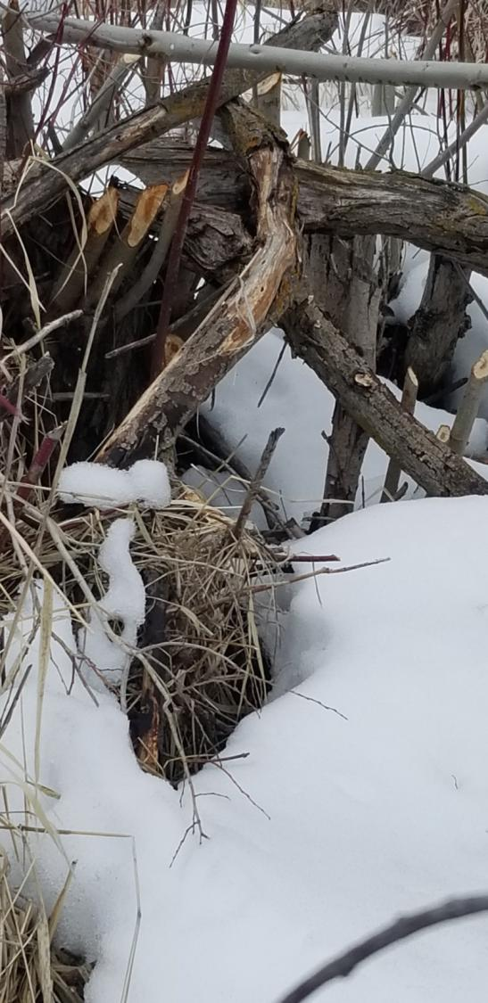
Not overly fresh cuts, but still FRESH CUTS
Notes:
Fresh and Old Cuts, willow

Slide 9
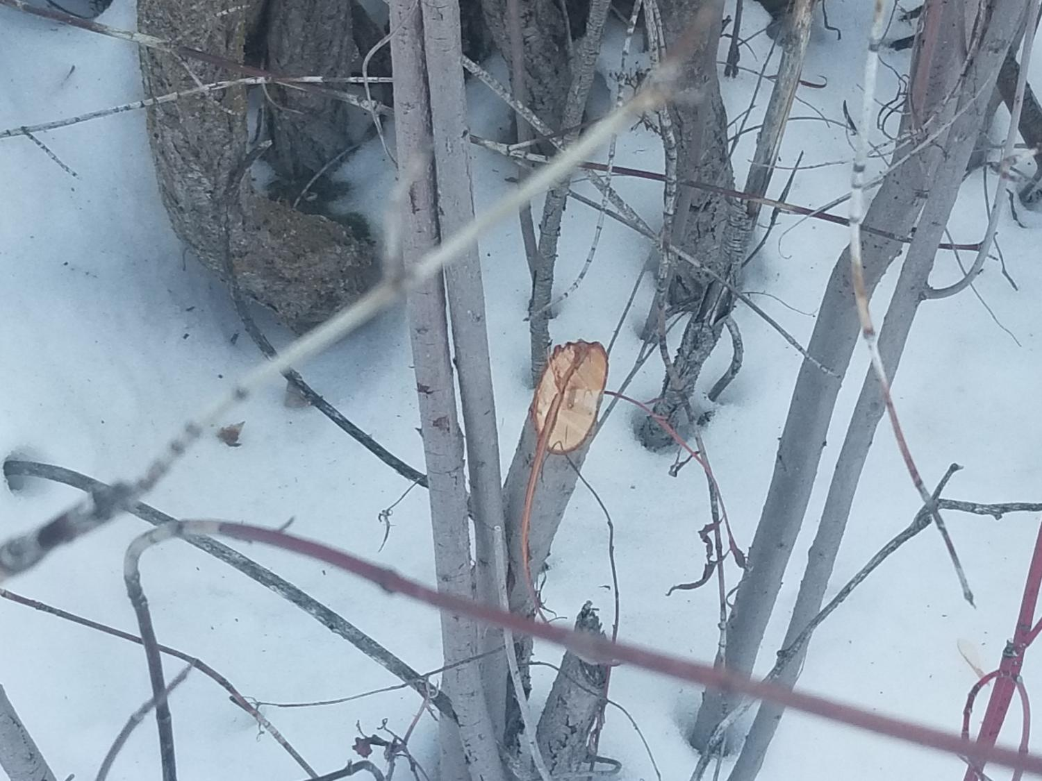
Cut Willow
Notes:
Note the red ring. This disappears 3-6 weeks depending upon the conditions

Slide 10
FRESH CUTS
Notes:
No checking. Less than a week old, mountain ash

Slide 11
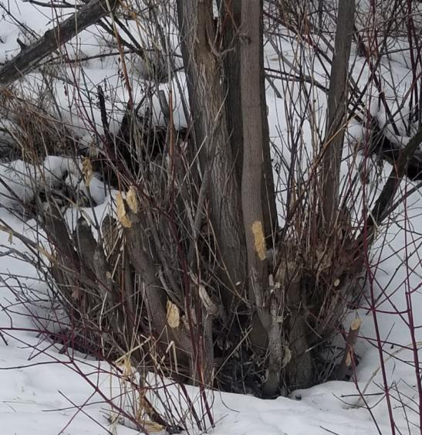
Fresh cuts: Willow
Notes:
Fresh and Old Cuts, Coyote Willow

Slide 12
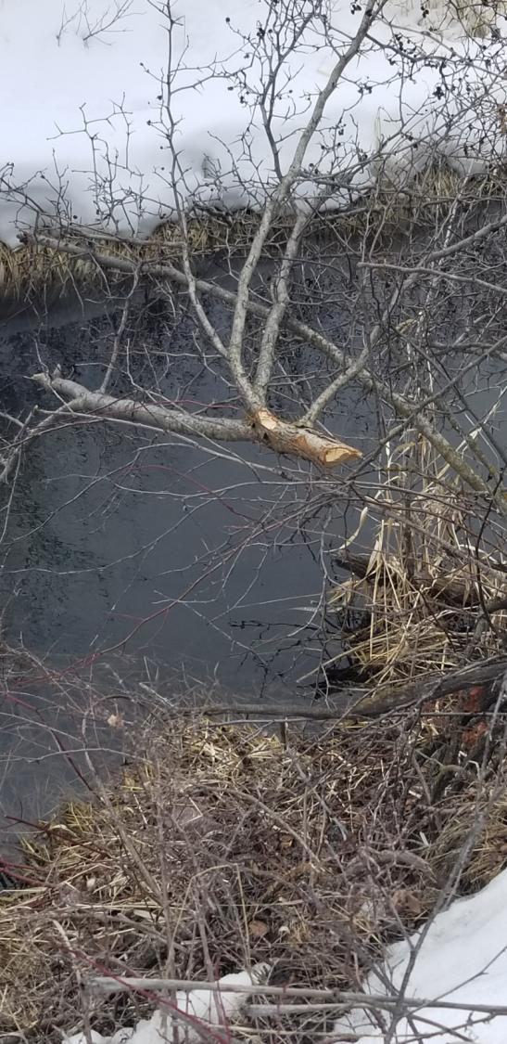
FRESH CUTS Hawthorne. Notice teeth marks

Slide 13
FRESH CUT mountain ash. Same hardness as baseball bats

Slide 14
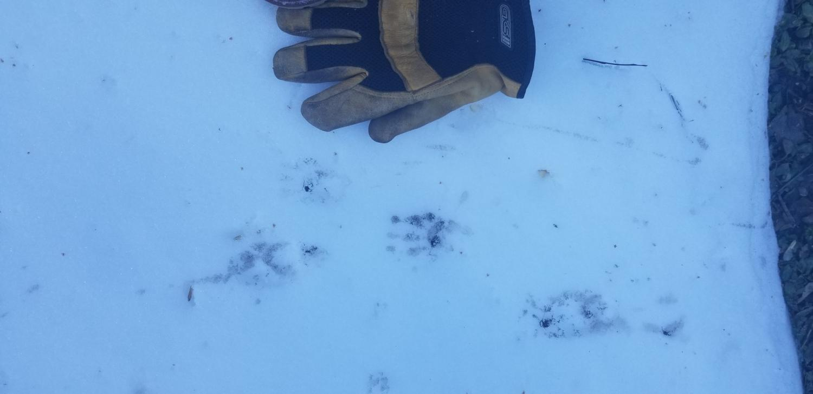
Tracks
7 inches

Slide 15
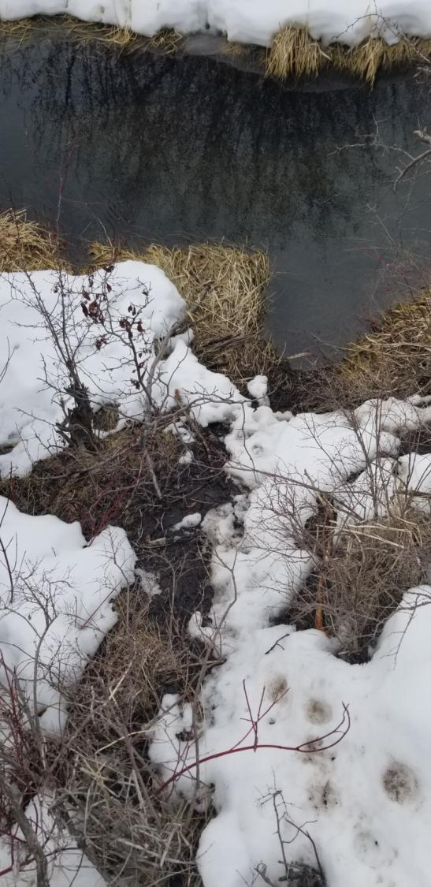
Tracks and slide

Slide 16
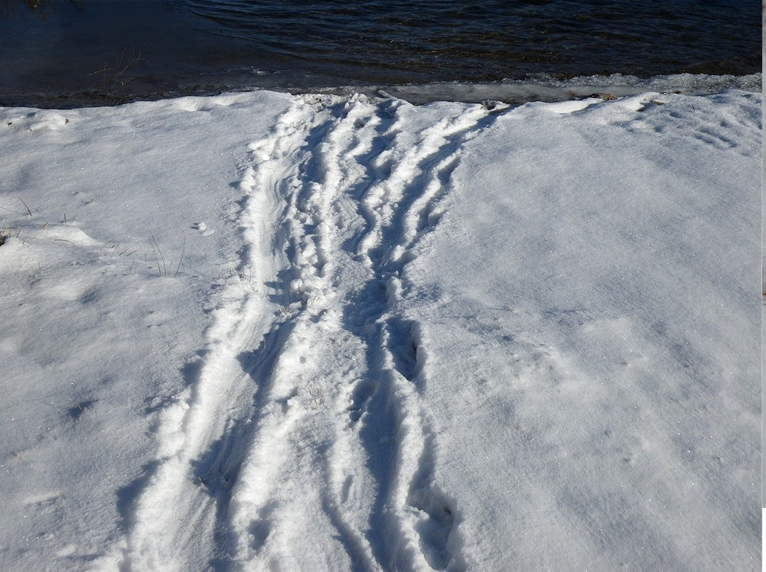
TRACKS AND SLIDE showing twigs being dragged to the water.

Slide 17
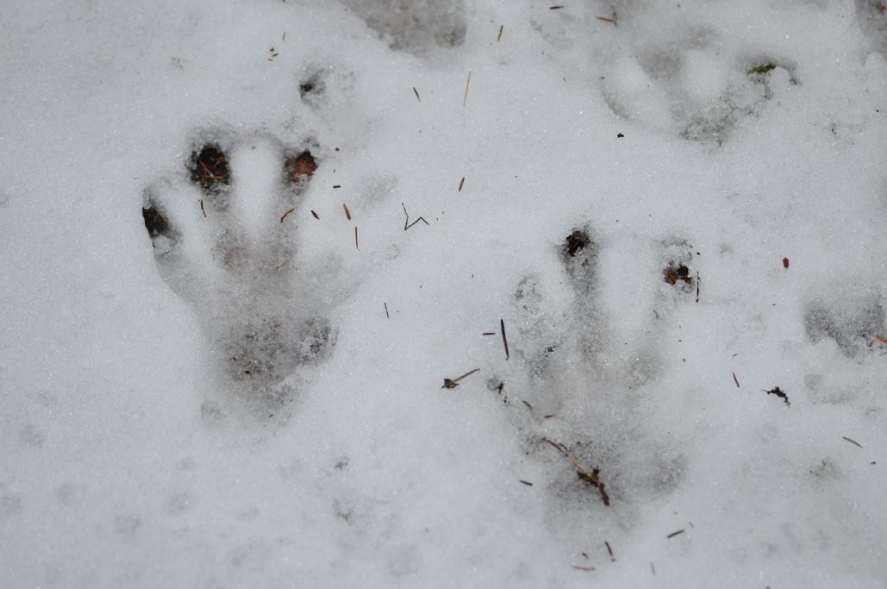
Tracks look much like a webbed human hand print
Tracks. Note thumb and webbed fingers

Slide 18
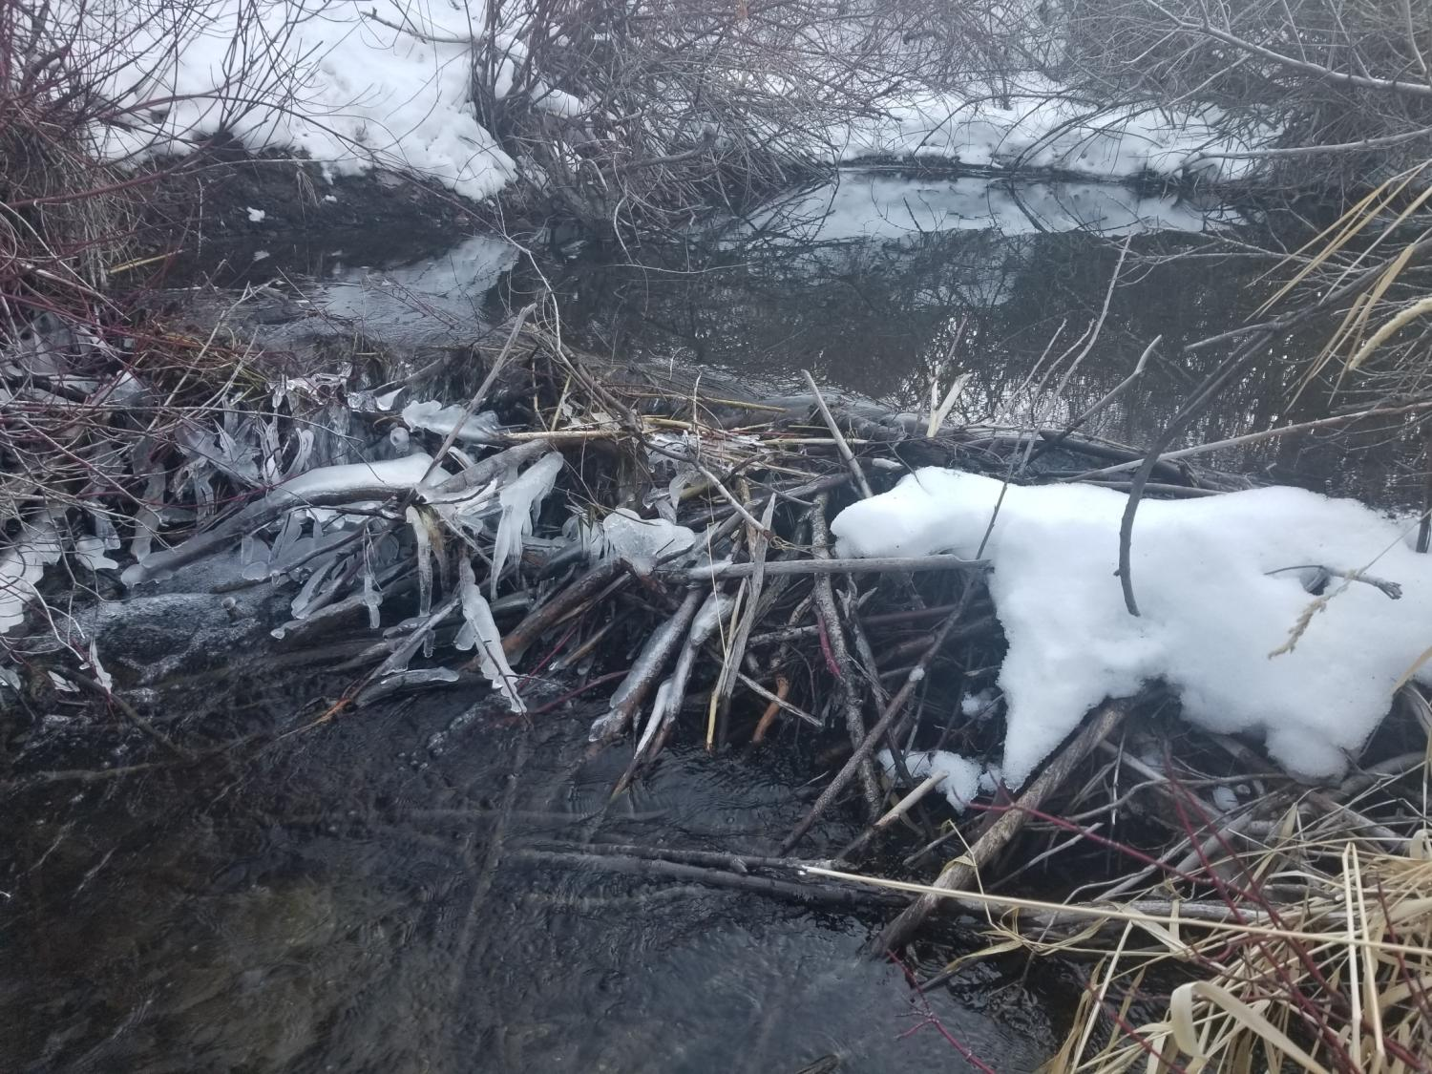
Note: Elevation difference in water level is a clue, but not necessarily an active dam
Notes:
Dam and pond with fresh mud

Slide 19
Pond and Dams
If the pond has ripples (not caused by wind) that are closer to the dam than the width of the dam, do NOT mark it as a “POND”

Slide 20
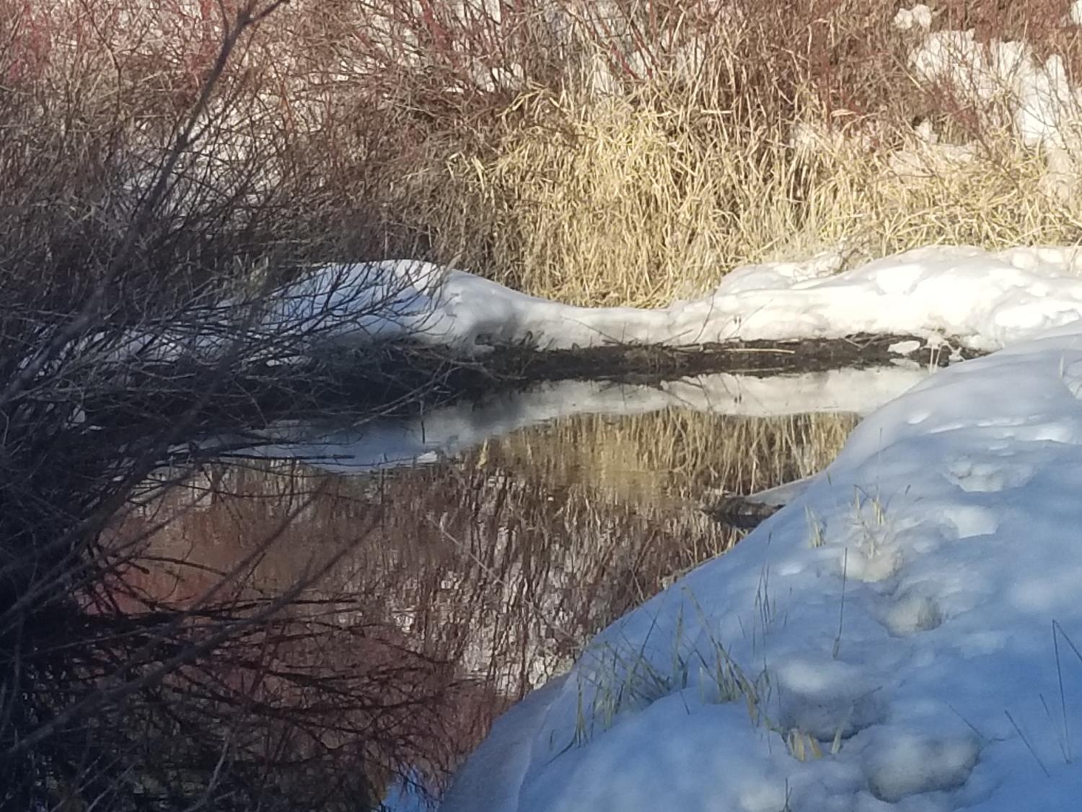
Dam
Pond

Slide 21
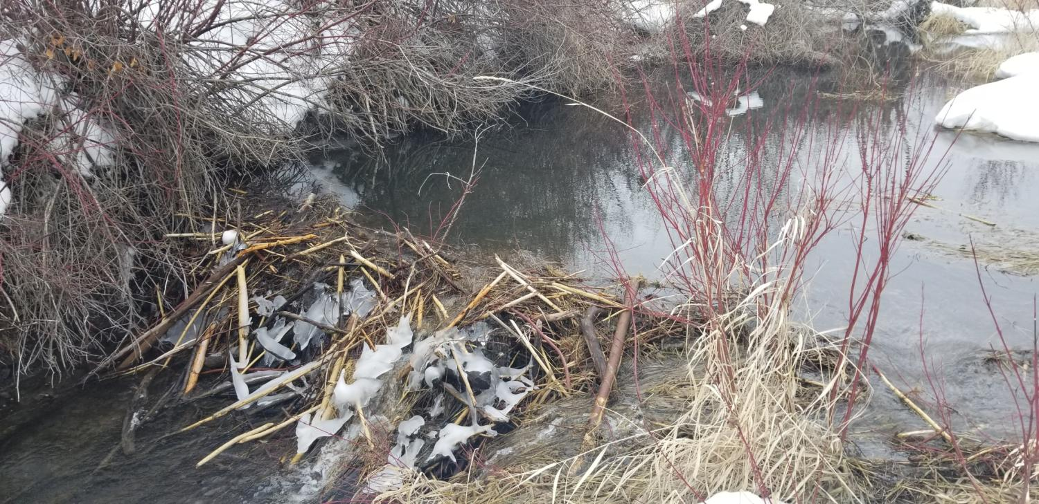
Fresh cut sticks in the dam, mid-channel breach-ACTIVE
Pond: Has no ripples over the majority of the surface
Notes:
New and Active Dam

Slide 22
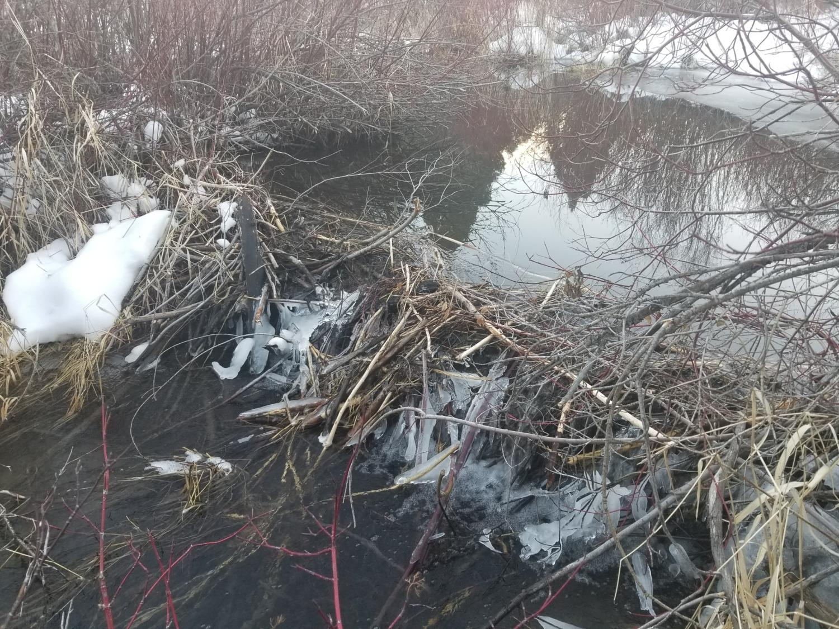
Mid Channel Breach, fresh cut wood: ACTIVE

Slide 23
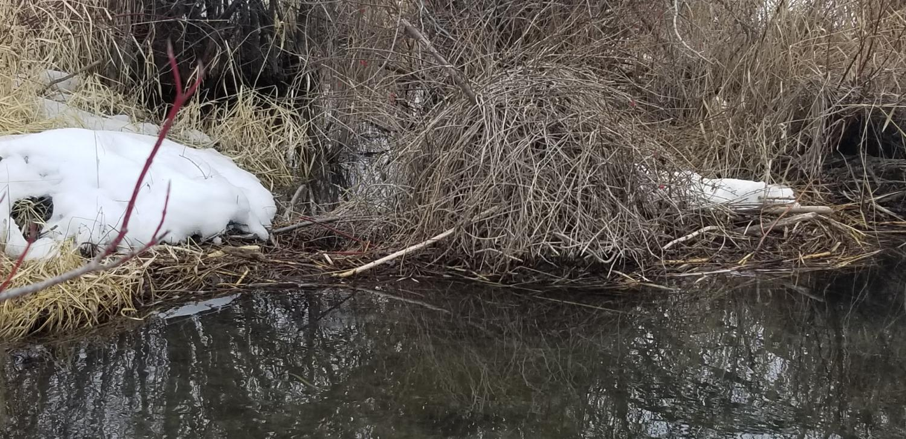
Dam is level across the top…..ACTIVE!
NOT a lodge

Slide 24
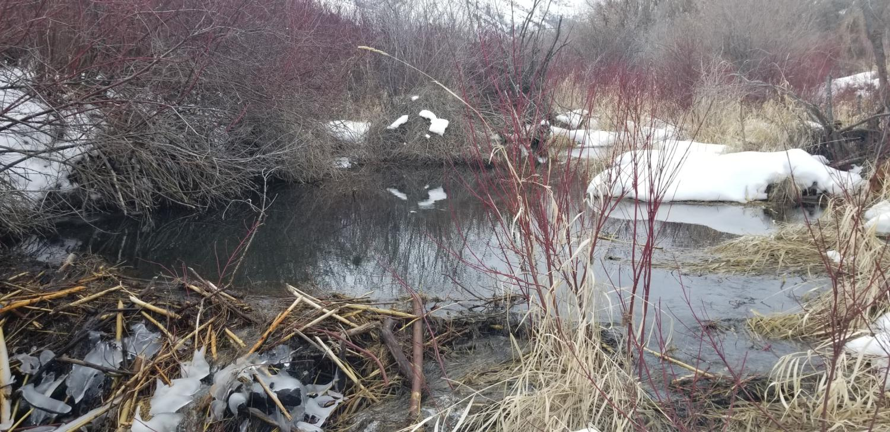
Fresh cut sticks on the dam, Mid-Channel breach (arrow): ACTIVE DAM
Notes:
Pond, fresh cuts and active dam

Slide 25
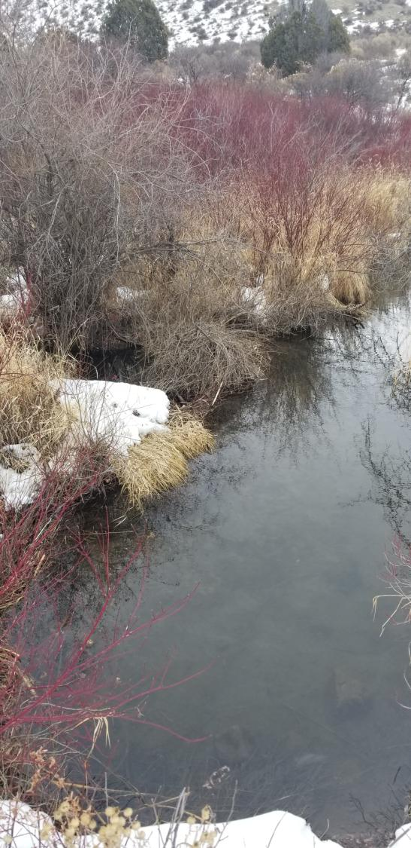
Quiet POND near the dam. ACTIVE DAM…no ripples.
Notes:
Not at bank full

Slide 26
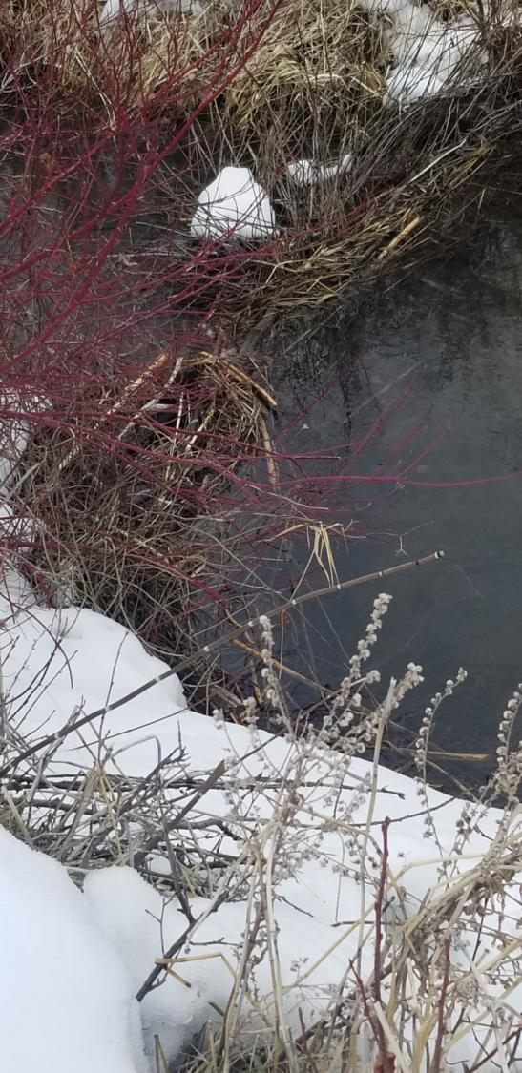
Mid channel Breach---indicates ACTIVE dam
Notes:
Mid-Channel breach

Slide 27
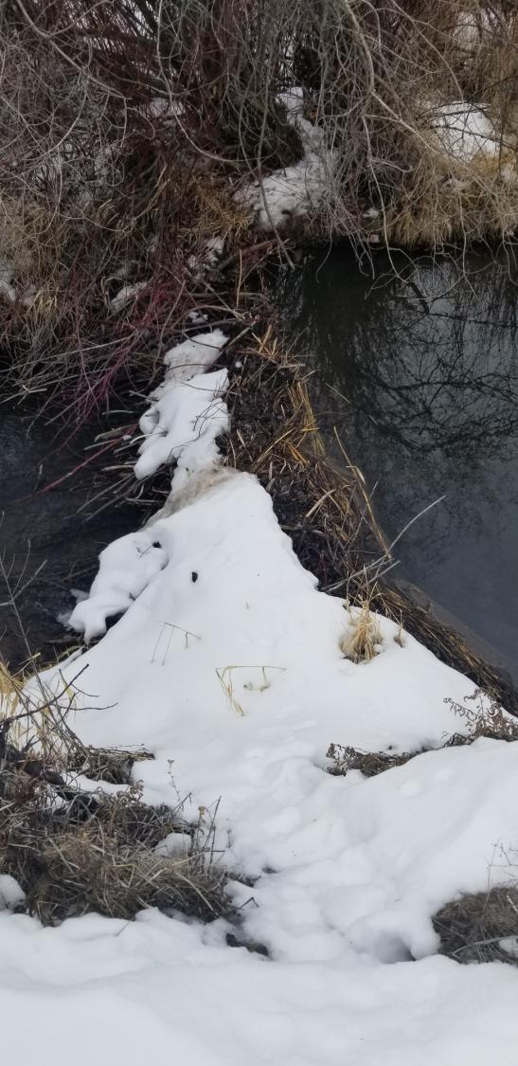
Dam is level across the top and the pond surface is quiet (not rippled)
ACTIVE
Notes:
Level

Slide 28
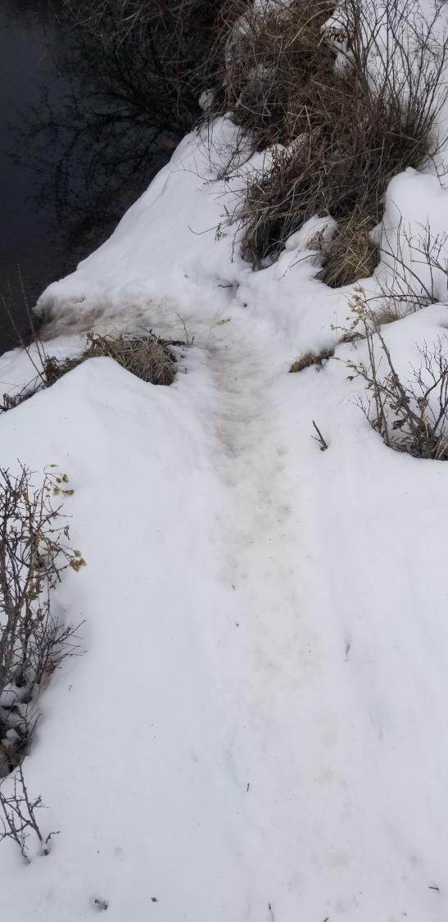
Beaver slide: A dished out depression leading from the water to the snow. Some mud. ACTIVE
Notes:
Classic Slide, dished, brown water coming out

Slide 29
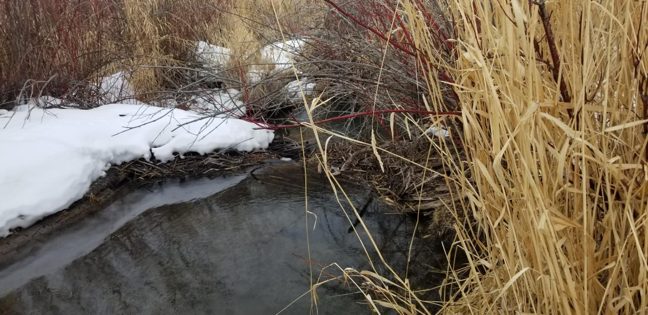
INACTIVE POND
NOTE RIPPLES NEAR THE DAM
Notes:
Not bank full, inactive

Slide 30
3 x separation distance between groups of dams as individual dams: (Rule of thumb)
Log 1
x
On your data sheet, notice that each line has a numbered “log”. This log represents the data for a group of dams
3x
Log 2
Notes:
Logs are Clusters of activity

Slide 31
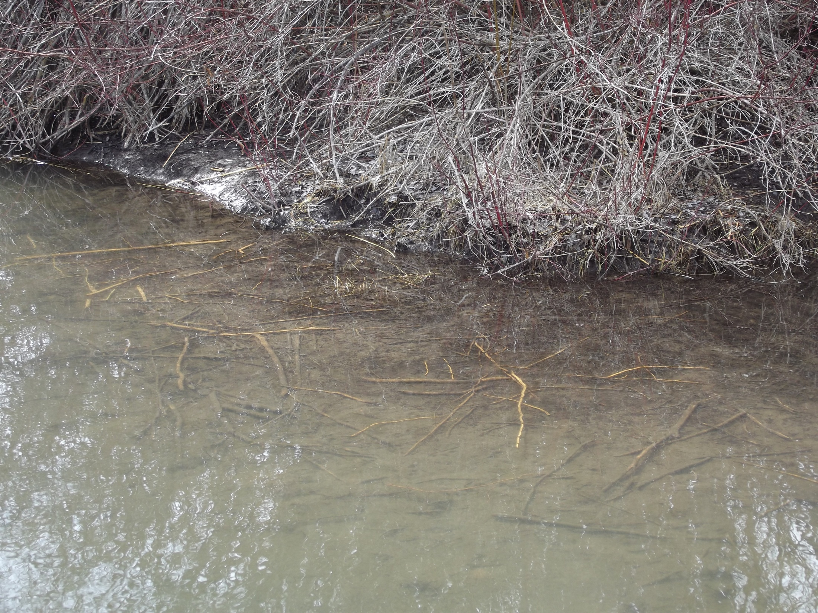
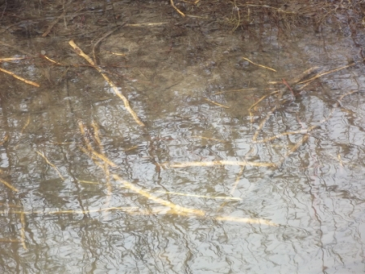
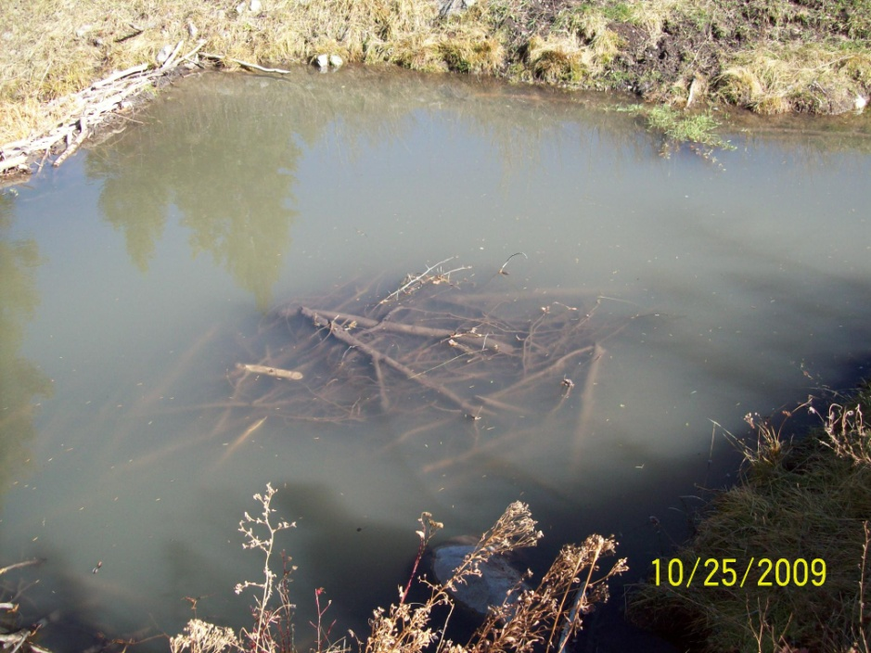
Old (inactive) Cache
Notes:
Some things to note: When the cache is peeled and develops a scum across the surface of the cache, it could be three years old or older. This does not mean that the system is active.

Slide 32
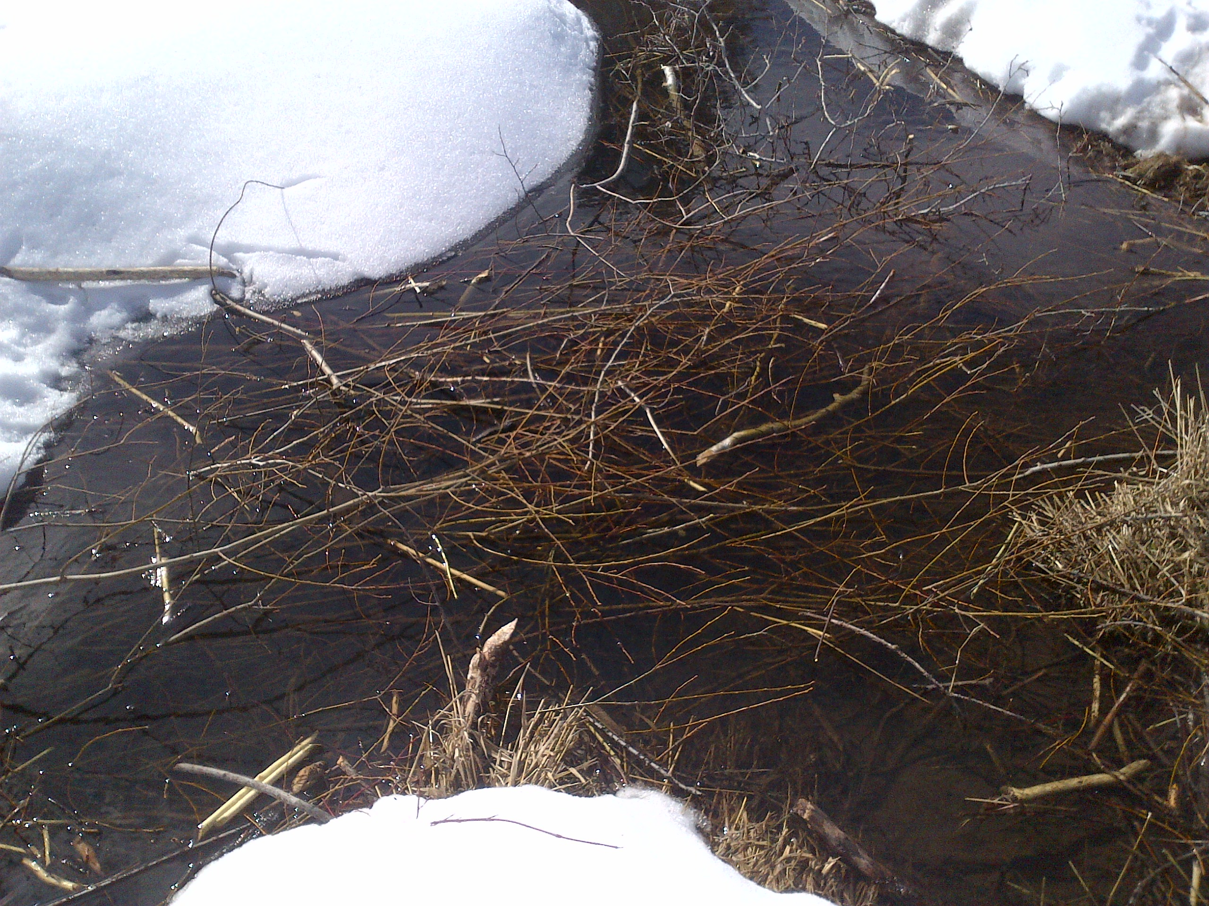
Fresh Cache: Winter food storage
Note that the bark is un-peeled

Slide 33
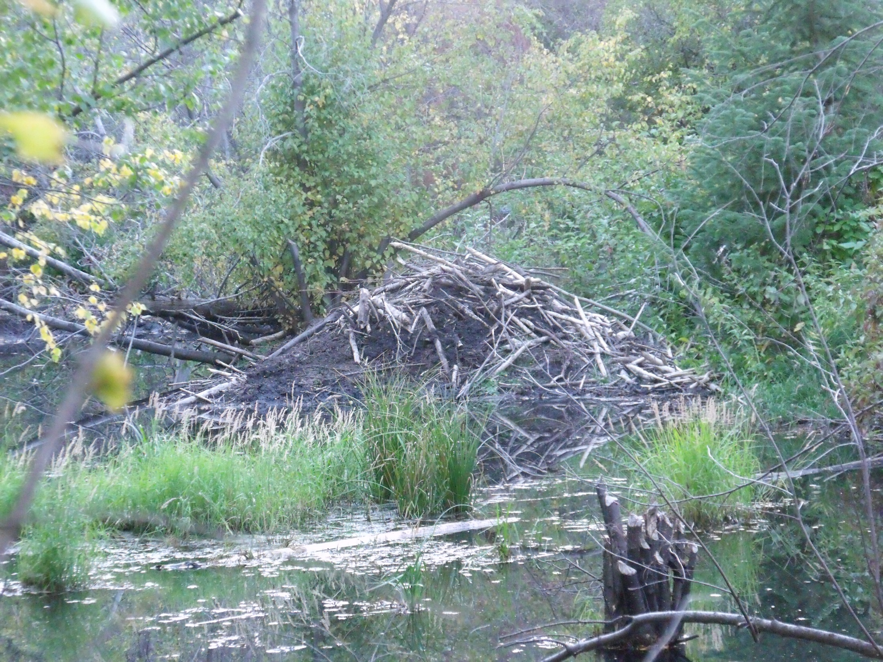
Lodge. If active:
The entrance will be submerged under water
There will be fresh cuts on top
You may see tracks leading to the lodge

Slide 34
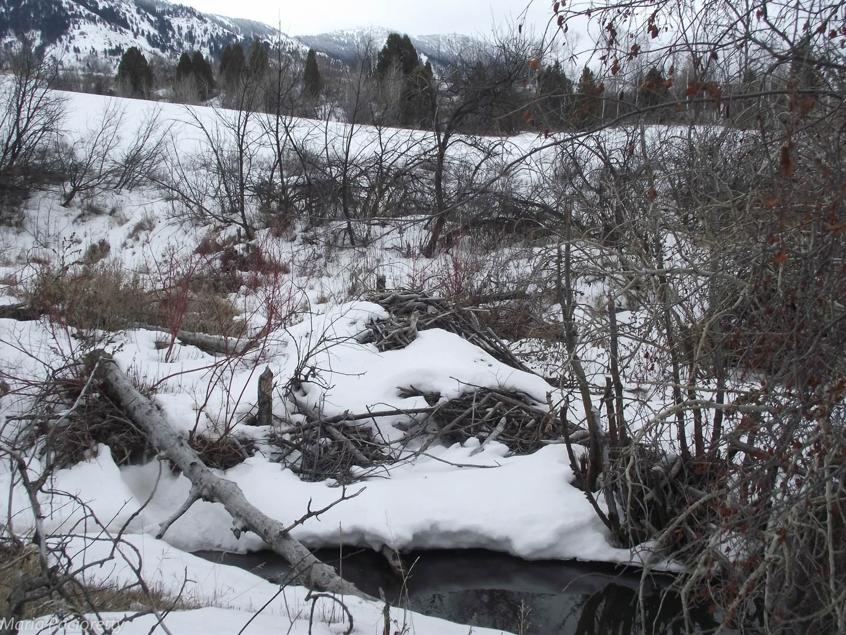
If entrance is above water level, this lodge is INACTIVE

Slide 35
Quiz
(T/F) If the entrance to a lodge is exposed or above water, the lodge is inactive.
Shavings from a cut
Will turn grey when old
Will spread out evenly away from the tree
Will melt through fresh snow
Will be eaten later by beaver
A common feature observed in an active dam is
Dam tilting towards one side
Sticks pointing up vertically
Fishy smell
A cut or breach in the middle of the dam

Slide 36
Quiz
(T/F) Slides are never seen in the middle of a dam.
(T/F). Beaver slides are always near the water.
Bank lodges are most likely created by:
Wandering muskrats
Large Families of beaver
Un-paired adults
Hobo spiders
What other animal creates large woody lodges?
Muskrats
Wolverines
Otters
Skunks

Slide 37
Quiz
Beaver tracks can be readily identified by
Long claw marks
Three toes
Webbing between the “fingers”
Zig-zagging trail
Beaver caches are piles of submerged wood. What distinguishes old from new or recent piles of wood?
Fresh cuts on new wood
Scummy film on the older wood
Peeled bark on the older wood
All of the above
Relative to the distance between dams, how many more times space is required before starting a new log entry on the data sheet?
3
2
9
5

Slide 38
Quiz
To be counted as a “pond”, the water in front of the dam upstream must not have
Wedge-shaped wood
Fresh cuts
Ripples
Level dam
(T/F) A dam with old wood but beaver prints on the upstream face is considered ACTIVE.
Which of the following is NOT a sign of an active lodge?
Submerged entrances
Beaver cache (old or new)
Fresh cuts nearby
Tracks leading to and from the lodge
It is important to keep the location of the lodge unknown because:
The Fish and Game doesn’t need to know
Trappers home in on the lodge in order to trap the entire colony
The information is useless
Lodges tend to move around anyway.

Slide 39
Quiz
Beaver eat many types of wood. Which type of woody plant do beaver not typically eat?
Dogwood
Hawthorne
Aspen
Coyote Willow
(T/F) A fresh cut, even if created by a hatchet, is still logged as a fresh cut.

