Slide 1
By Mike Settell
Watershed Guardians

Slide 2
Background
  Current research on measuring populations
  Existing agency metrics
    Voluntary-by trappers
      No action tied to results
      By County (Bannock County has
  Management
    Closed areas
    Surveys
      Discontinued (exception: Mink Creek 2013)
      Last aerial, statewide 1961

Slide 3
Many publications reference current U.S. beaver population estimates to be in the range of 40-70 million. The source of this often cited is from Naiman (1977) and is itself a reference to even older estimates. Prior to state budget cutbacks, the state wildlife agency overflew the state and counted active colonies by counting caches. The most recent statewide aerial survey in Idaho was completed in 1961. Currently, the agency estimates beaver populations using voluntary trapping reports. Data from the reports is converted into to a "effort" index used to estimate population trends. Some of these methods suffer from shortfalls including location error, un-reported kills, disease and other mortality factors. Other factors may confound or under report populations. We'll compare other states methods, suggest impacts on current research, and identify opportunities for improving beaver population estimates. We'll summarize the current status of beaver populations in Idaho.

Slide 4
  Management (cont’d)
    Closed areas
    Surveys
      Discontinued (exception: Mink Creek 2013)
      Last aerial, statewide 1961
  Idaho, SE Idaho, Portneuf, Mink Creek
    Nearly trapped out in 1980
    Re-intro in 1985
    My study area
    Rapid decline observed
The Count
Results
Conclusions

Slide 5
The Count
Results
Conclusions

Slide 6
WS trapping, US

Slide 7
Trapping reports

Slide 8
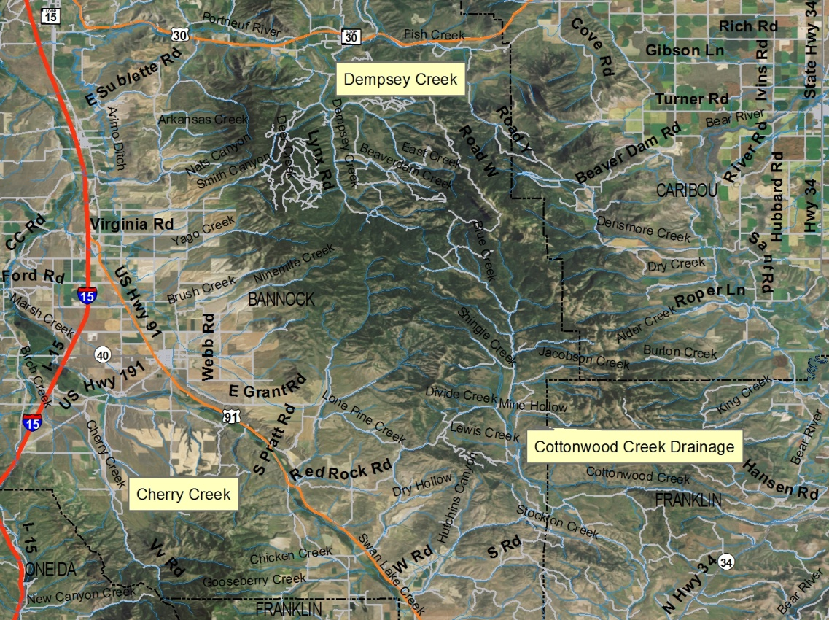
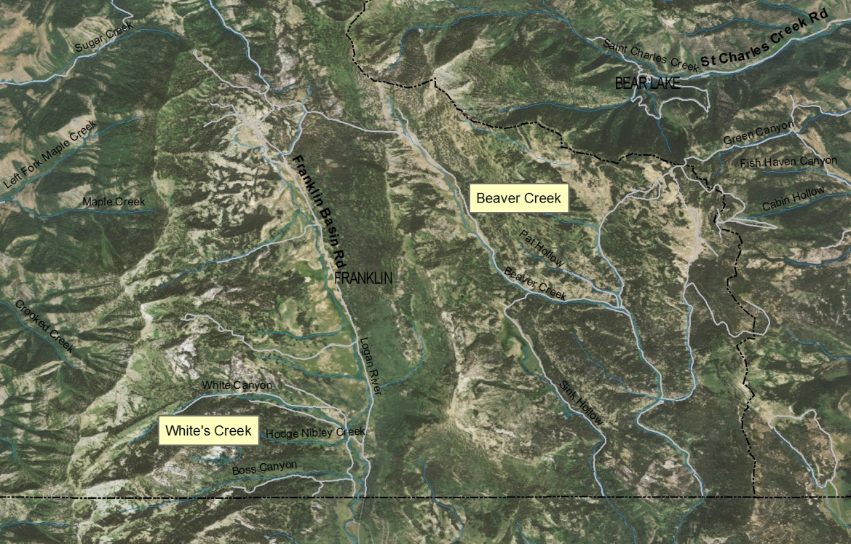
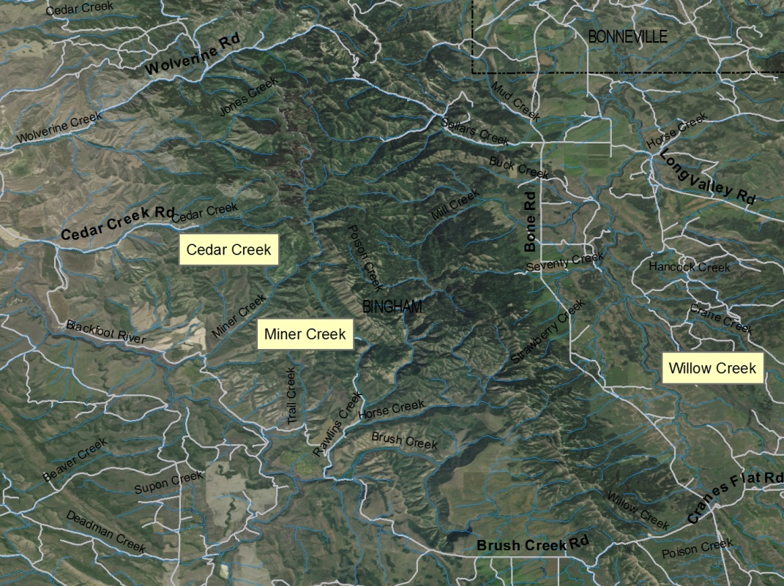
Closed to trapping

Slide 9
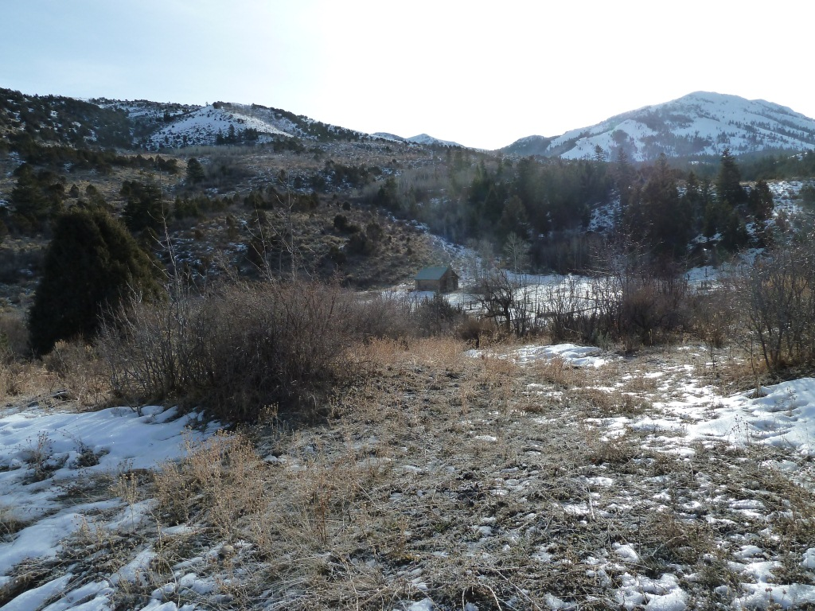
Landscape
Vegetation mix:
Conifer
  Douglas Fir
  Big Juniper
  Ponderosa Pine
Aspen
Willow (Salix spp.)
Dogwood
Black Hawthorn
Hydrology
  15-20” annual precip
  Gradient: 80: <3%
Notes:
Narrow canyons open into wider valleys with gradients of 1-2%. The majestic Scout Mountain watches over the valleys.

Slide 10
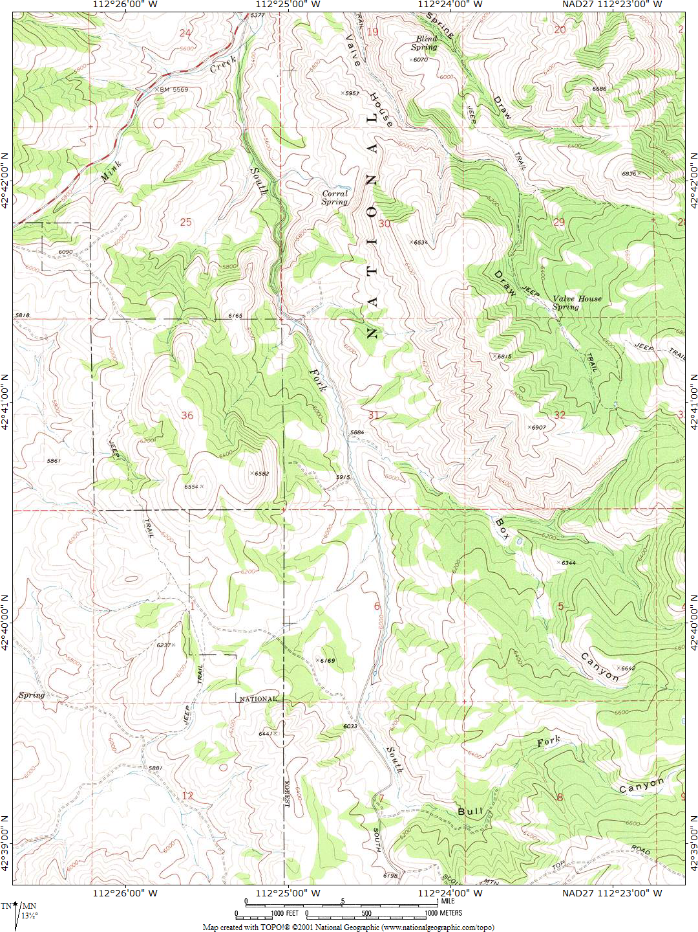

Survey Zones
^{Zone VI}
^{Zone VIII}
^{Zone VII}
^{Zone IX}
^{Zone X}

Slide 11
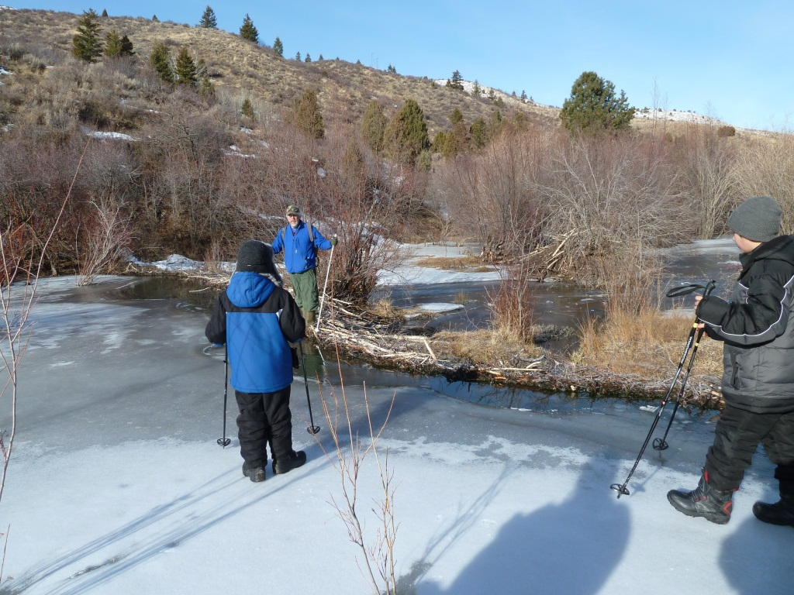
Training

Slide 12
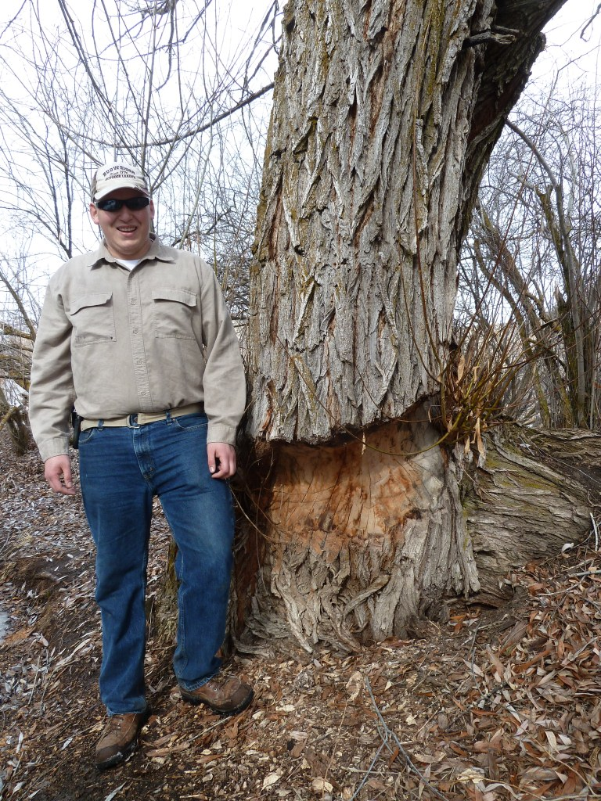
Fresh cuts

Slide 13
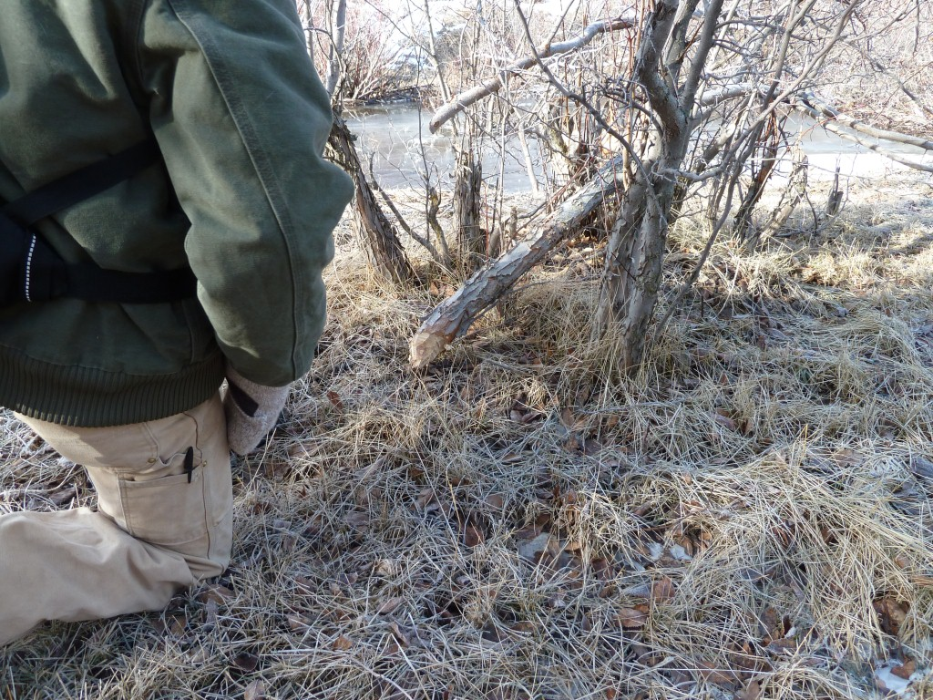
Training Cont’d.
Notes:
Invite our trainees to get a closer look

Slide 14
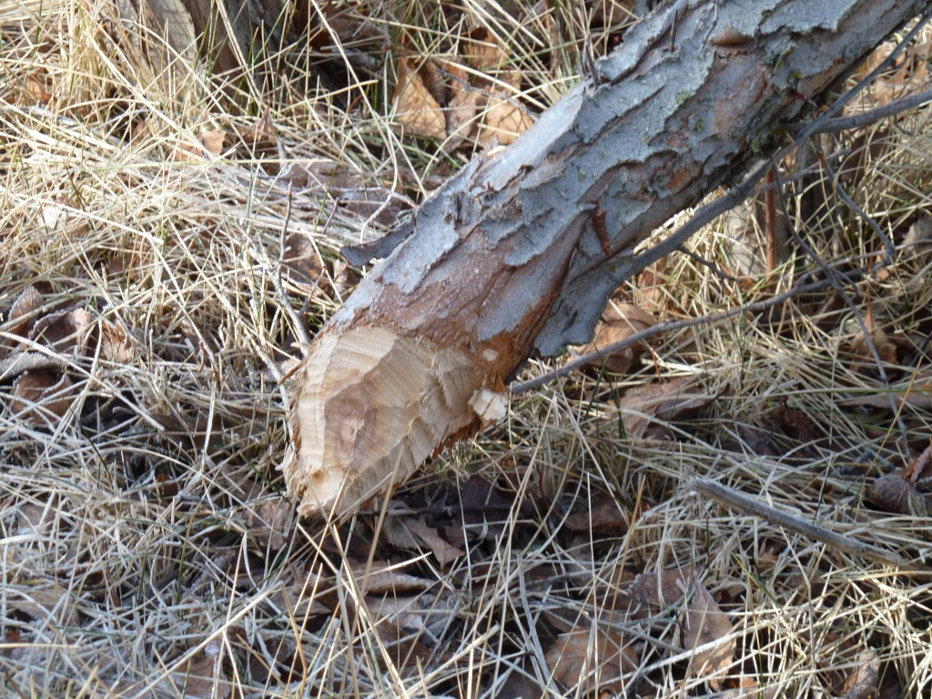
Fresh cuts
Notes:
Hawthorne

Slide 15
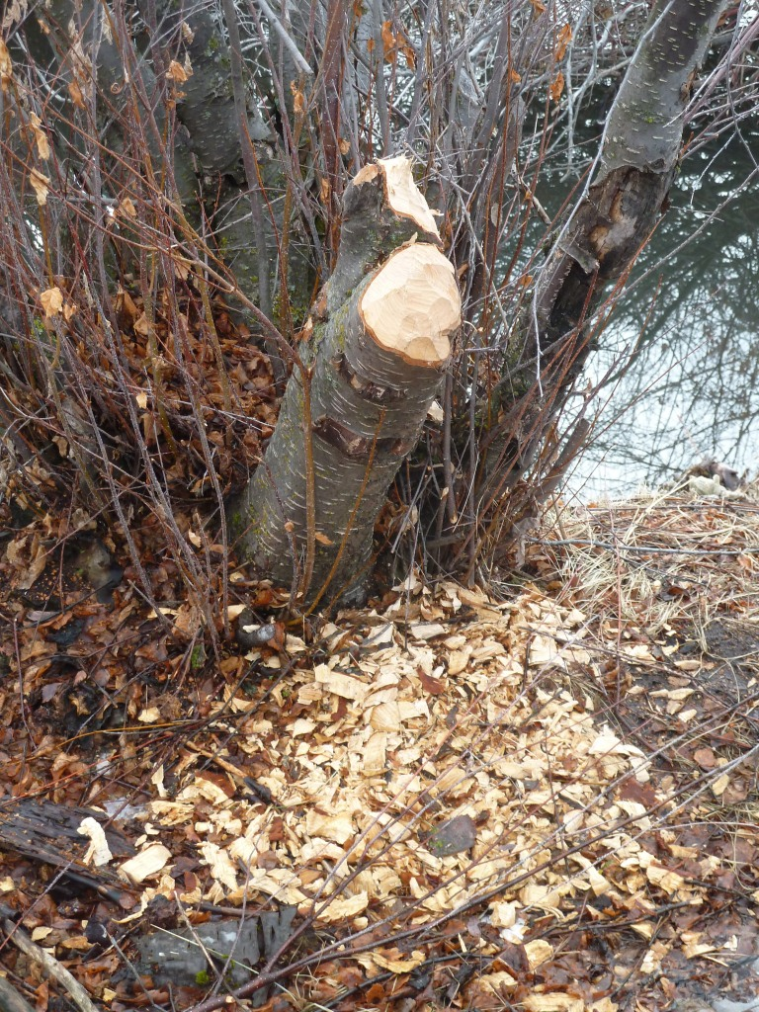
Fresh Cuts
How fresh is “fresh”?
Fading or graying color
Chips uncovered by dirt or snow
No cracking
Time frame <6 weeks

Slide 16
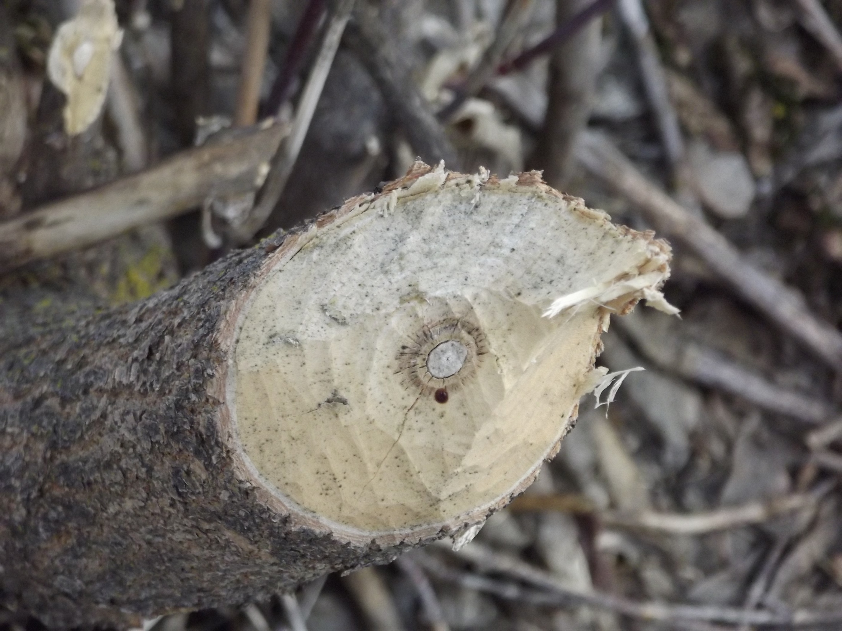
Beaver cut aged 6 weeks, Ash

Slide 17
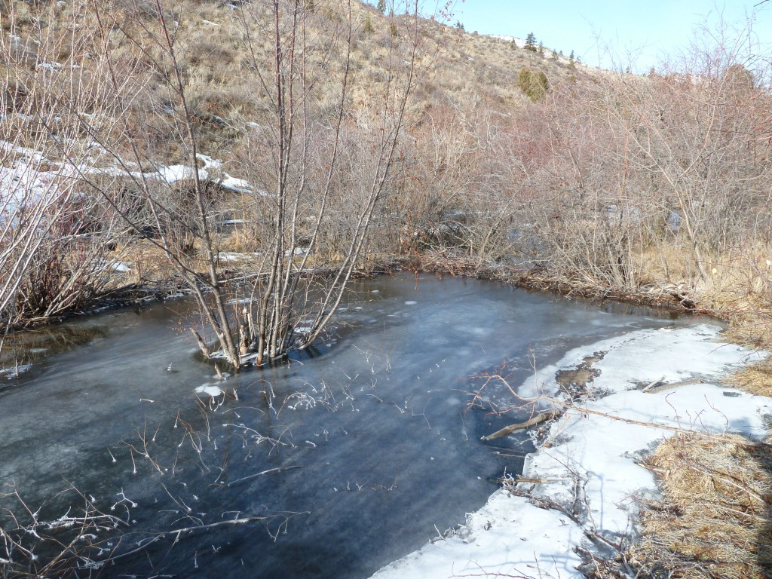
Dams/Ice
Notes:
Frozen pond makes access easier

Slide 18
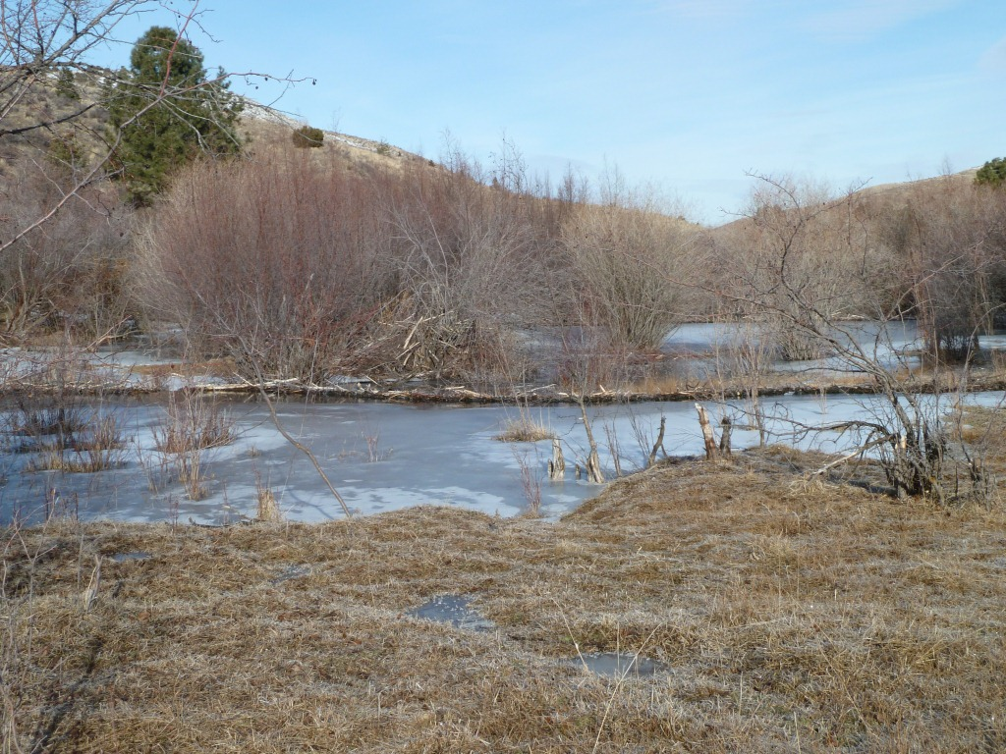
Dams: Level and Maintained (Active)
Notes:
Ice water level

Slide 19
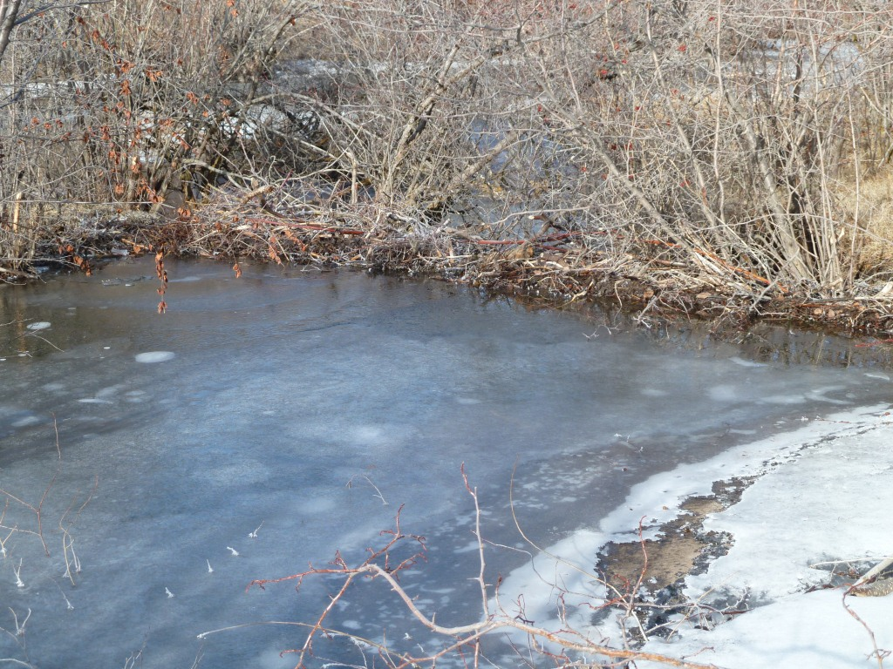
Dams/Level and Maintained/Active
Notes:
Maintained dam

Slide 20
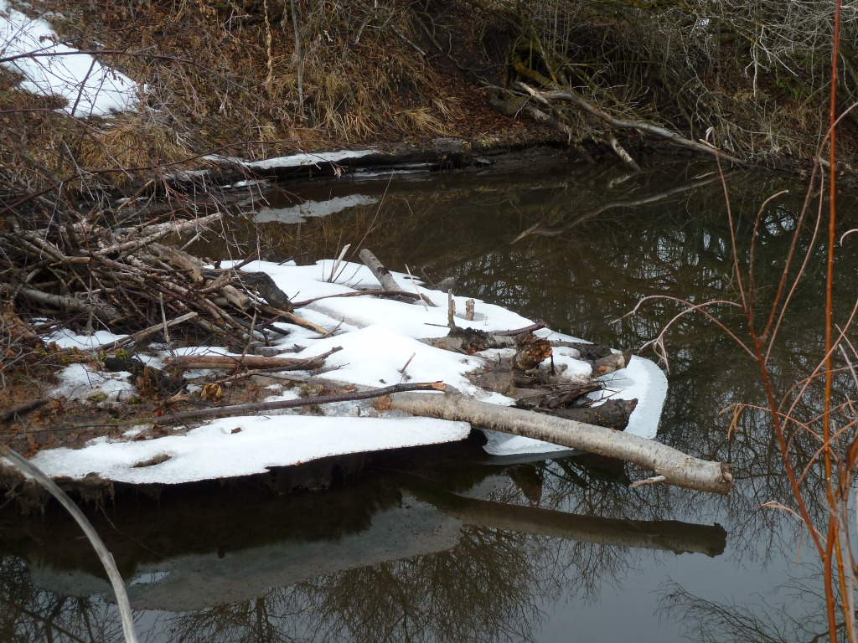
Inactive
Receding water levels
Notes:
Weighting factors

Slide 21
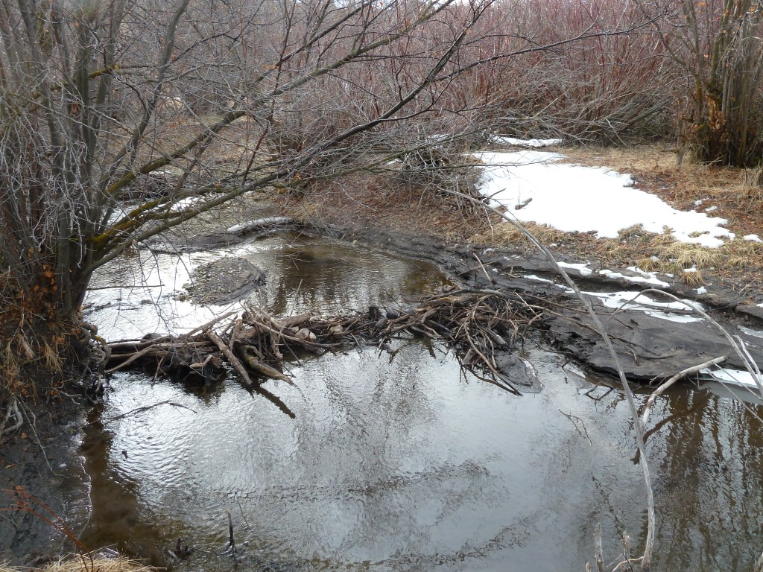
Inactive: Wing Scour
Inactive Dam: Wing scour

Slide 22
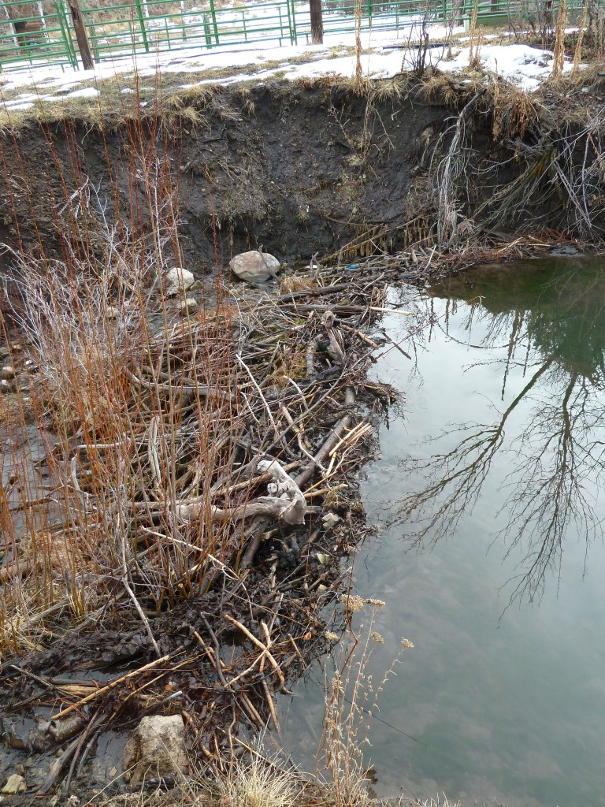
Quiz:
Active or Inactive?

Slide 23
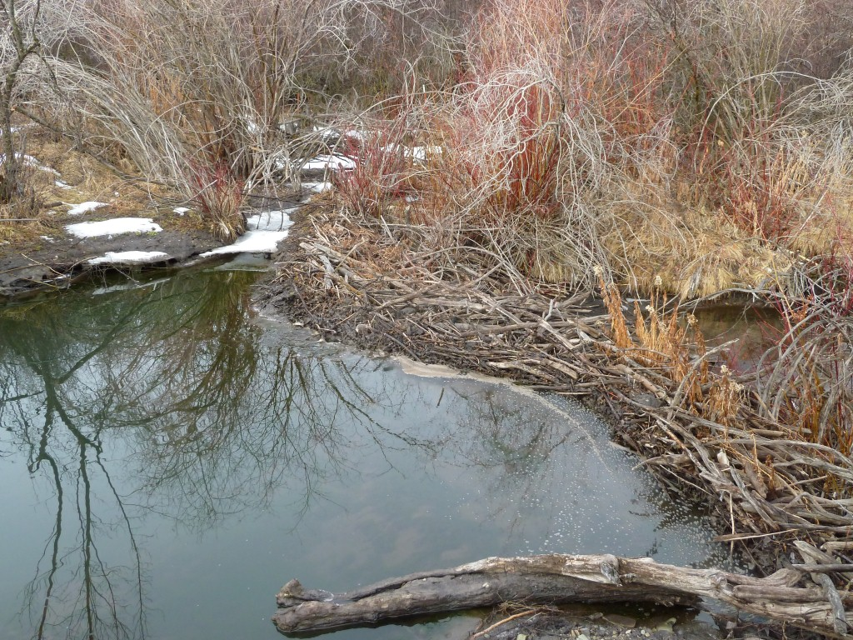
Quiz:
Active or Inactive?
Notes:
Inactive

Slide 24
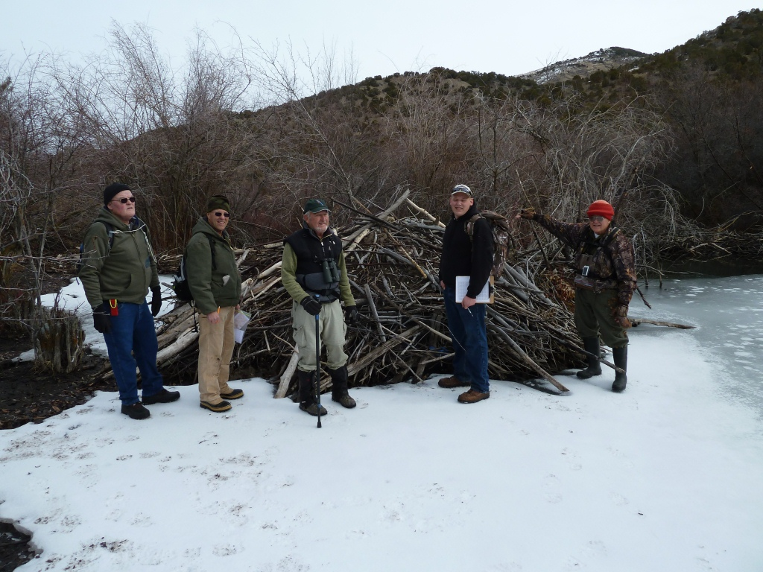
Lodges

Slide 25
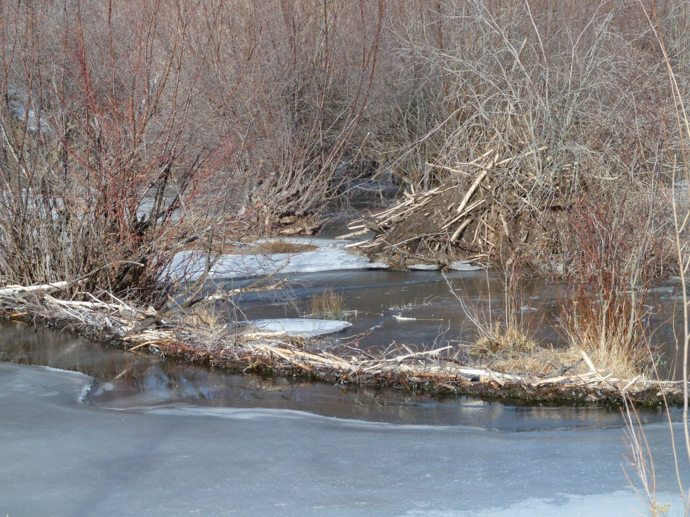
Active Lodge
Notes:
Active lodge, active dam. What makes an active lodge?

Slide 26
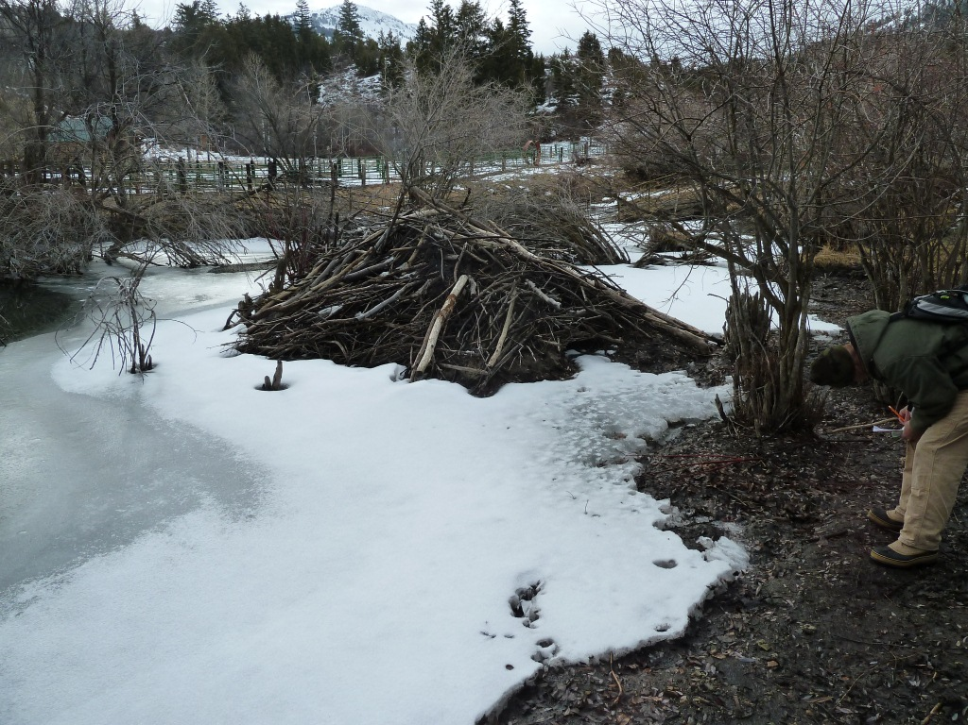
Inactive Lodge
Inactive Lodge
Notes:
What do you think? Here we have receding levels, old cuts and entrance exposed. Could possibly be rehabilitated for future use, but at this point, it appears abandoned: No beaver tracks, but other small animals appear to be using the lodge, possibly mink or weasel.

Slide 27
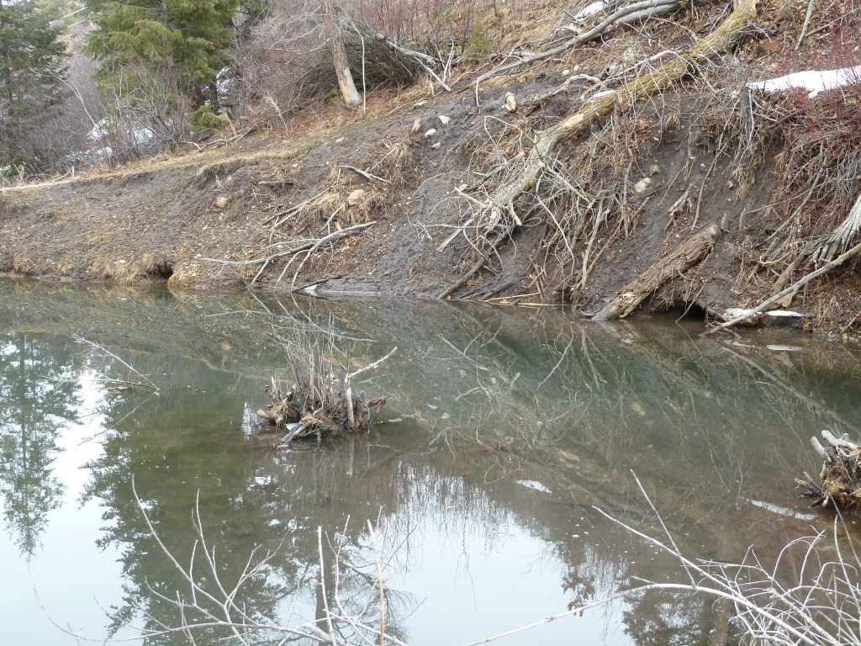
Bank Lodge
Found in same pond as dome lodge

Slide 28
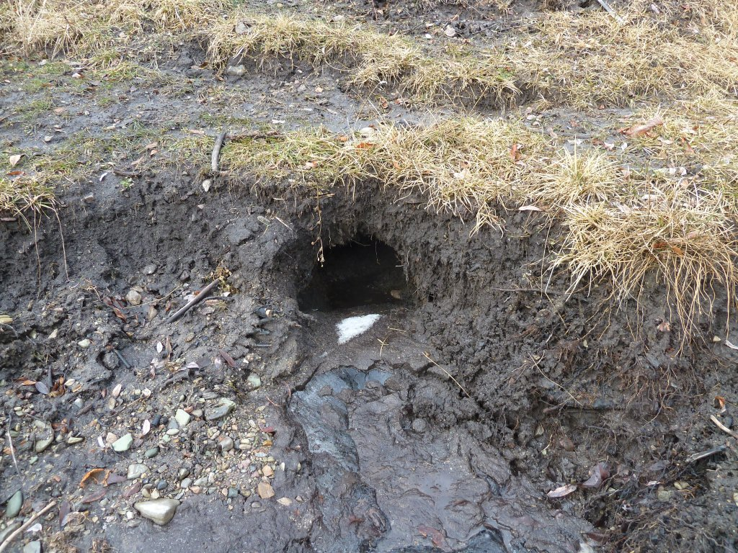
Bank Den
Bank Lodge
Notes:
Inactive bank lodge/den

Slide 29
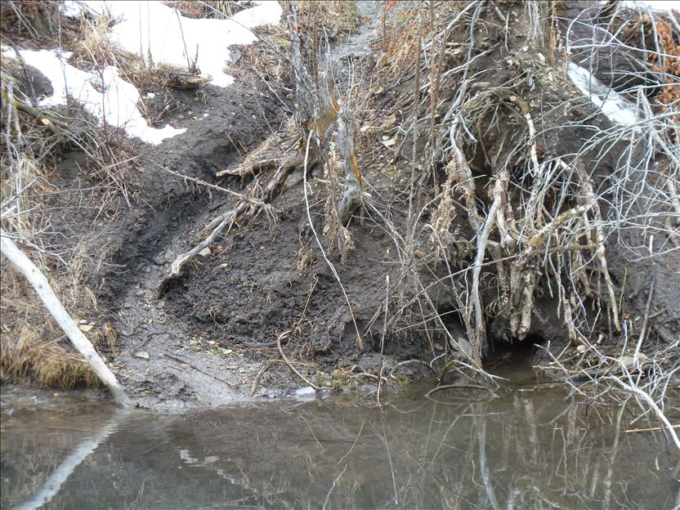

Slide 30
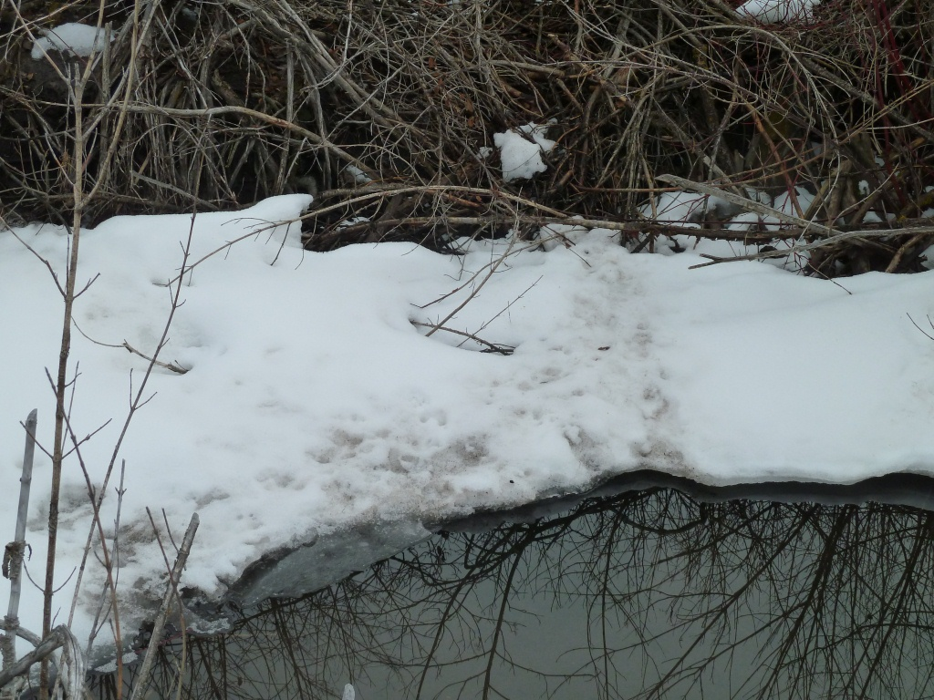
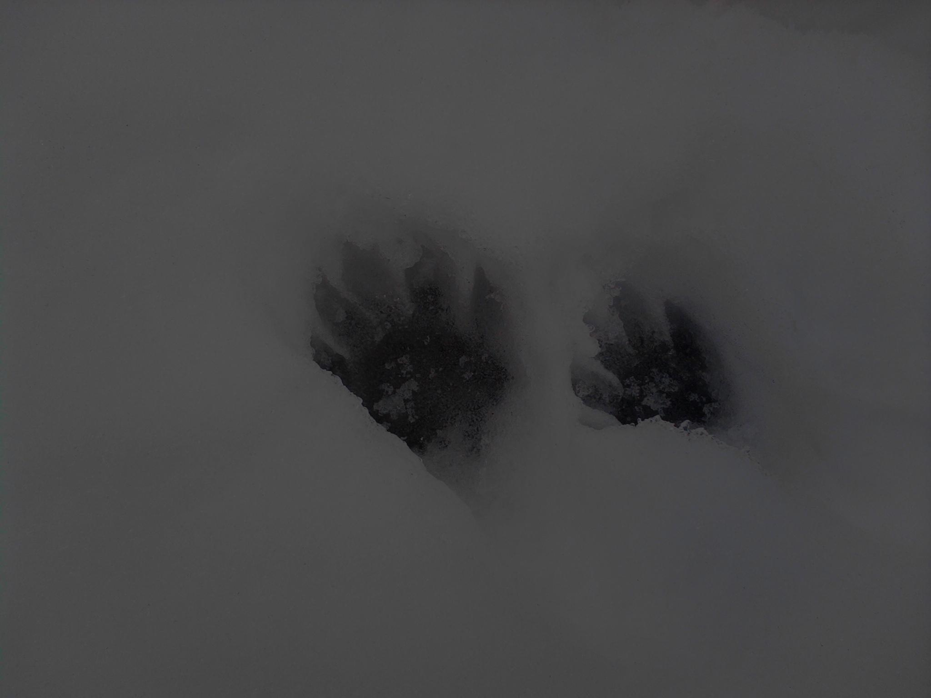
Tracks
Tracks

Slide 31
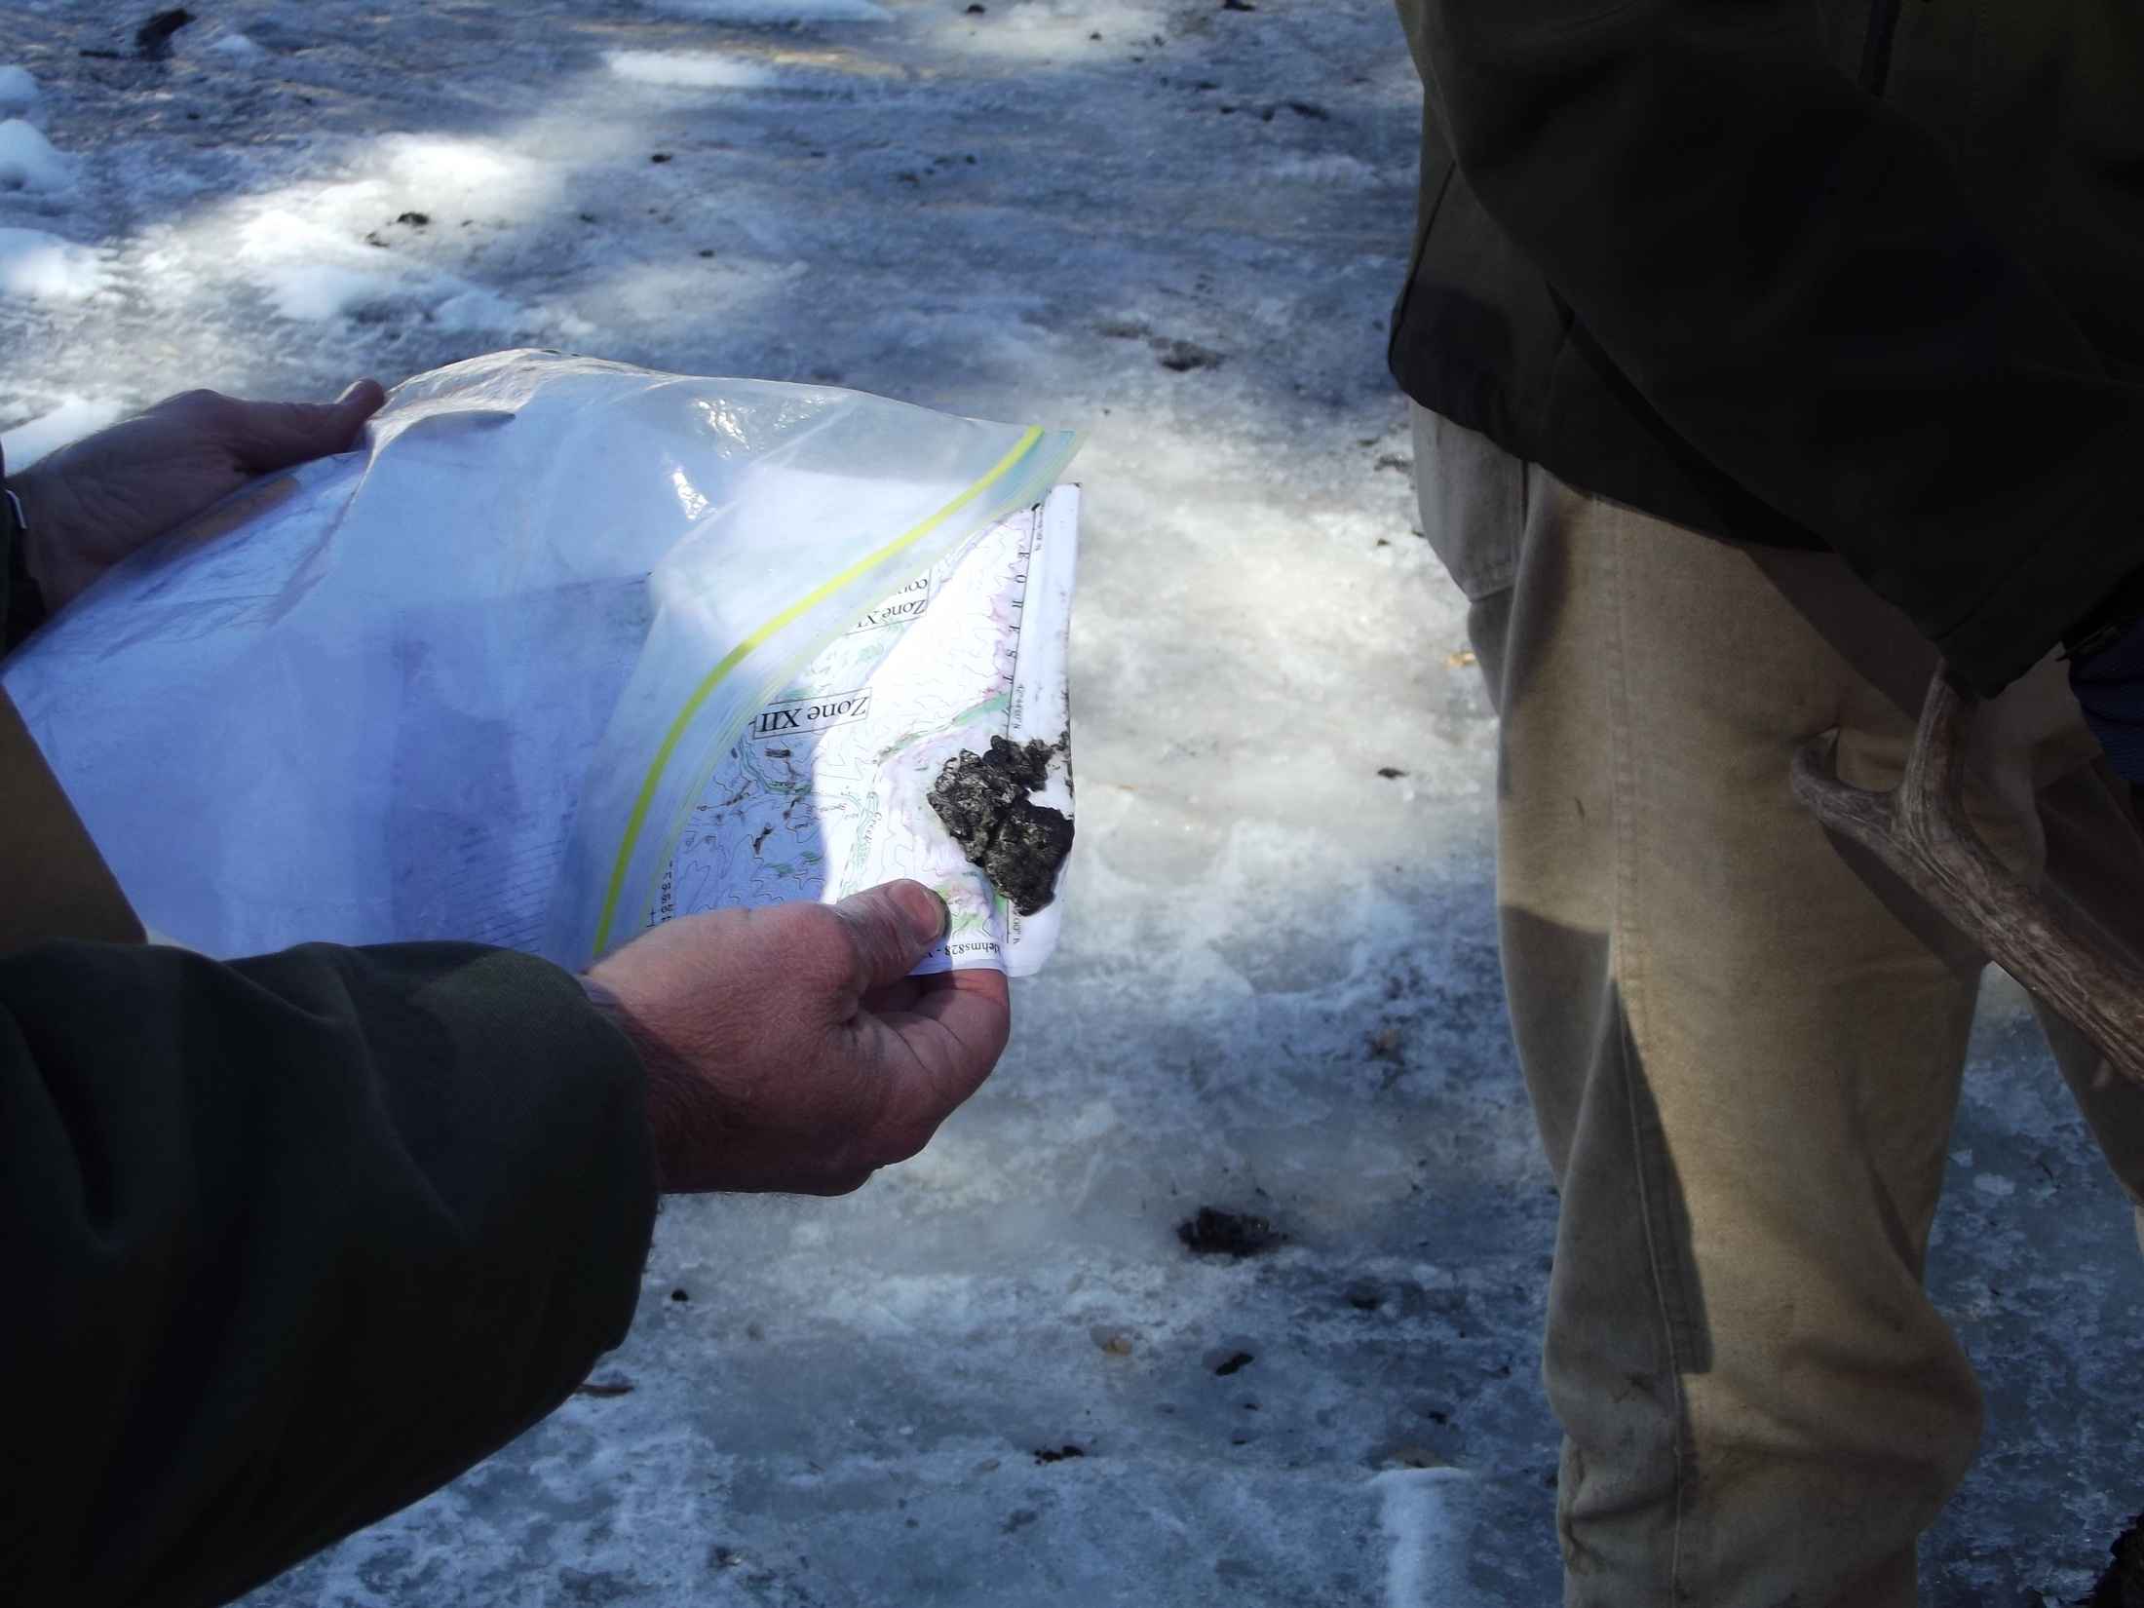

Slide 32
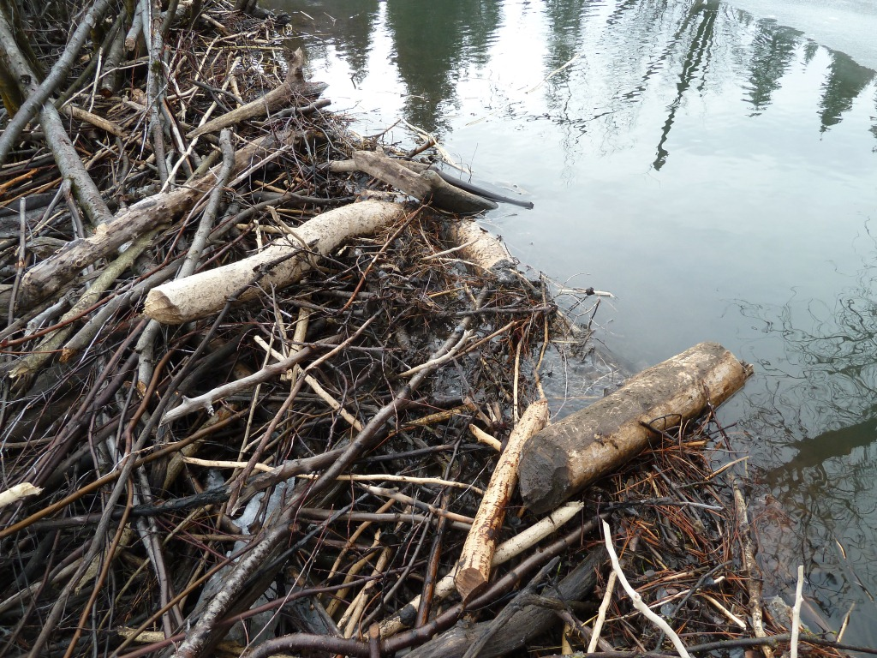
Fresh cuts, mud

Slide 33
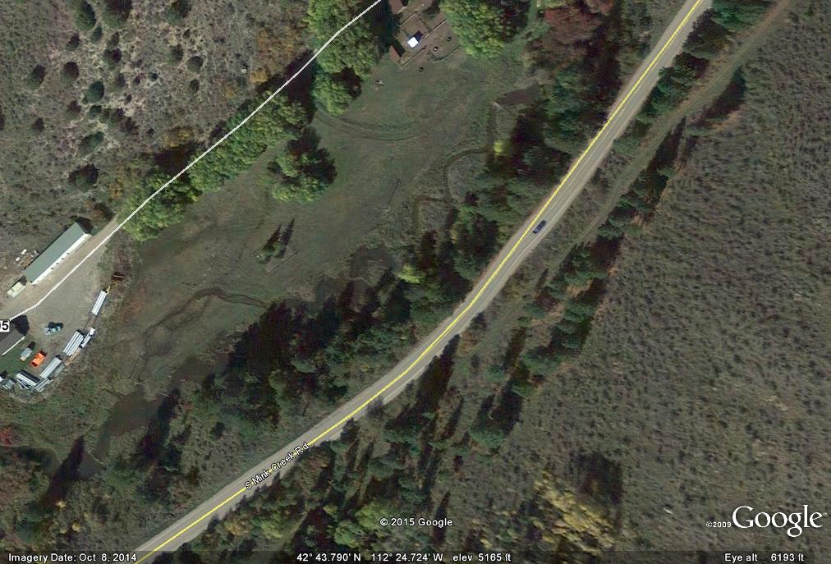

Slide 34
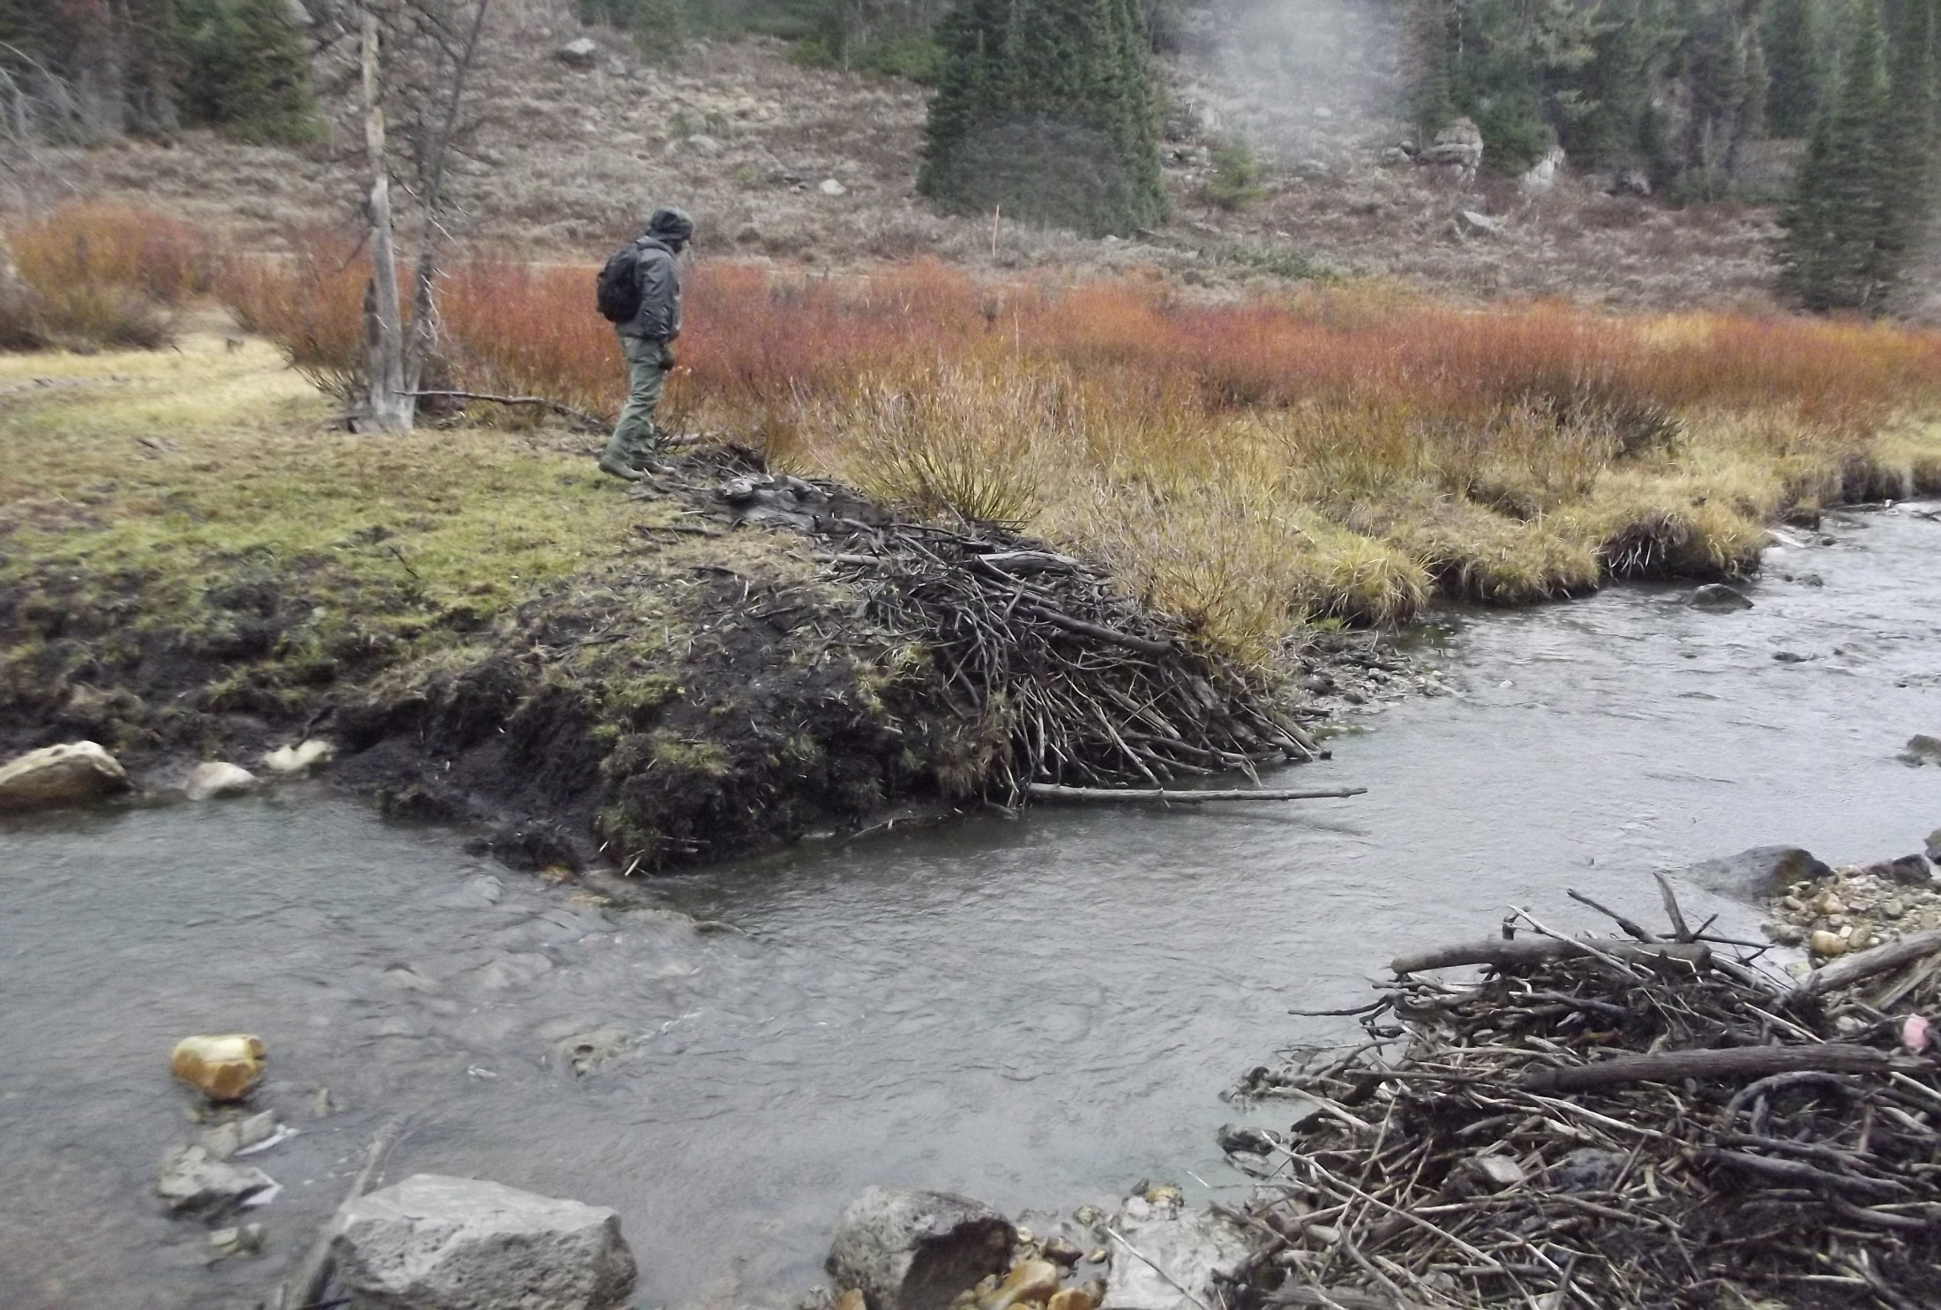
Active vs. Inactive Dams

Slide 35
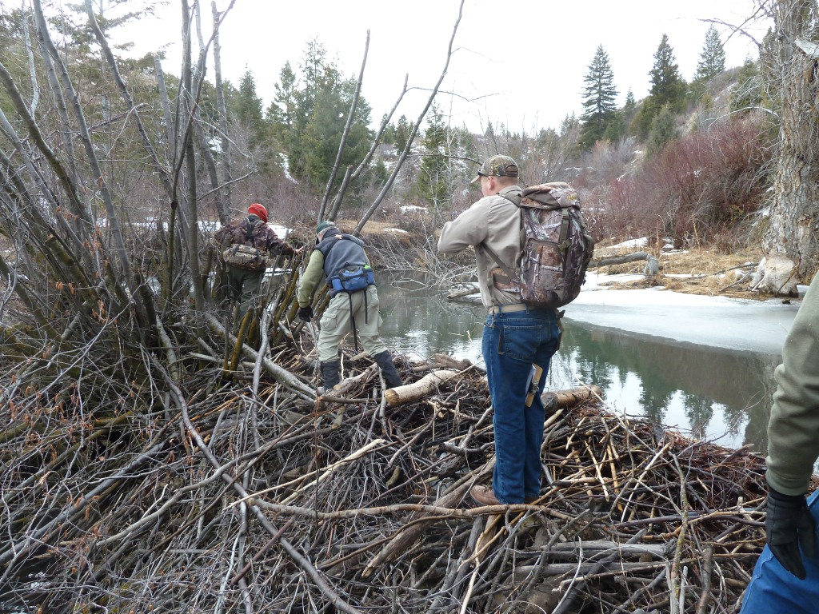
Active Dam

Slide 36
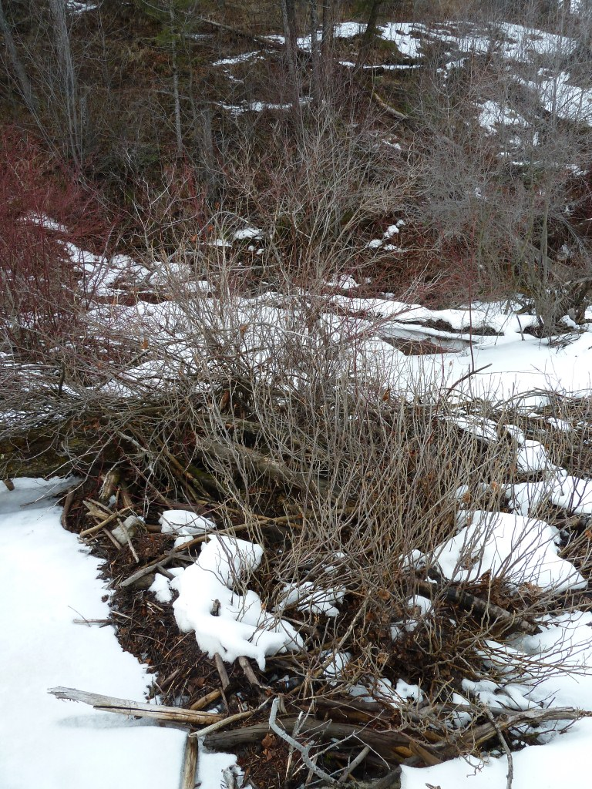
Inactive Dams
Inactive dams can persist for many years owing to lack of flood flows, vegetative revetment, and size.
Notes:
Inactive Dam

Slide 37
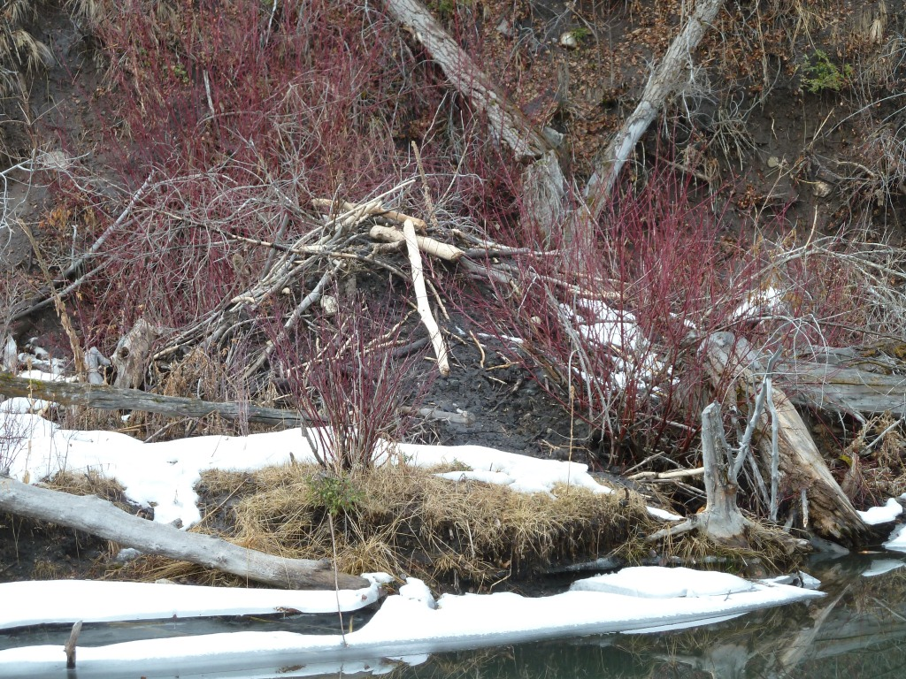
Quiz: Active Lodge
Notes:
Quiz.

Slide 38
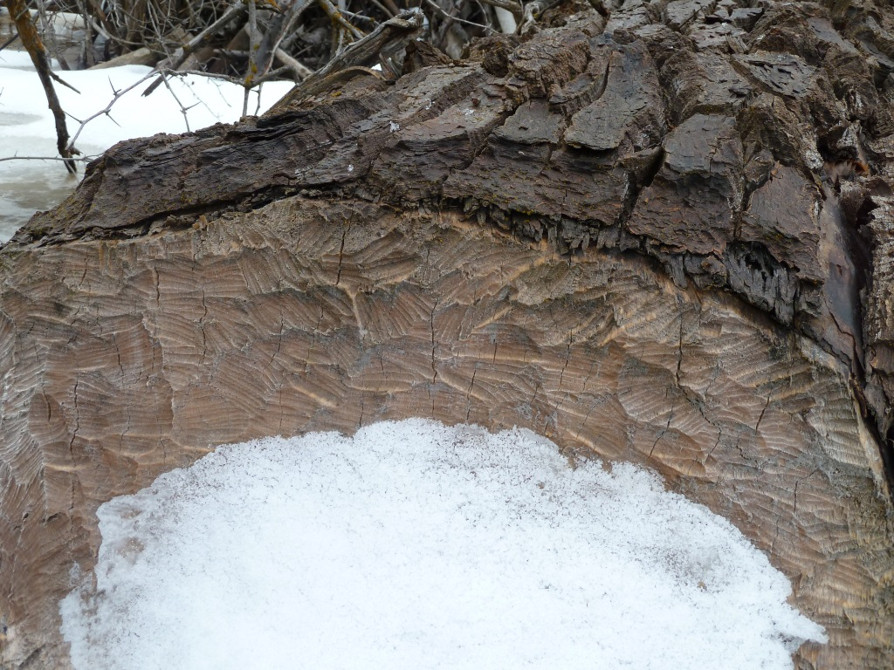

Slide 39
Decline
Colonies trapped due to other closures

Slide 40
Decline:
Closed to trapping this season

Slide 41
? Active and Inactive increasing?
Definite undercounting in 2012, bias.

Slide 42
Quality Control 2015-Inactive Dams

Slide 44
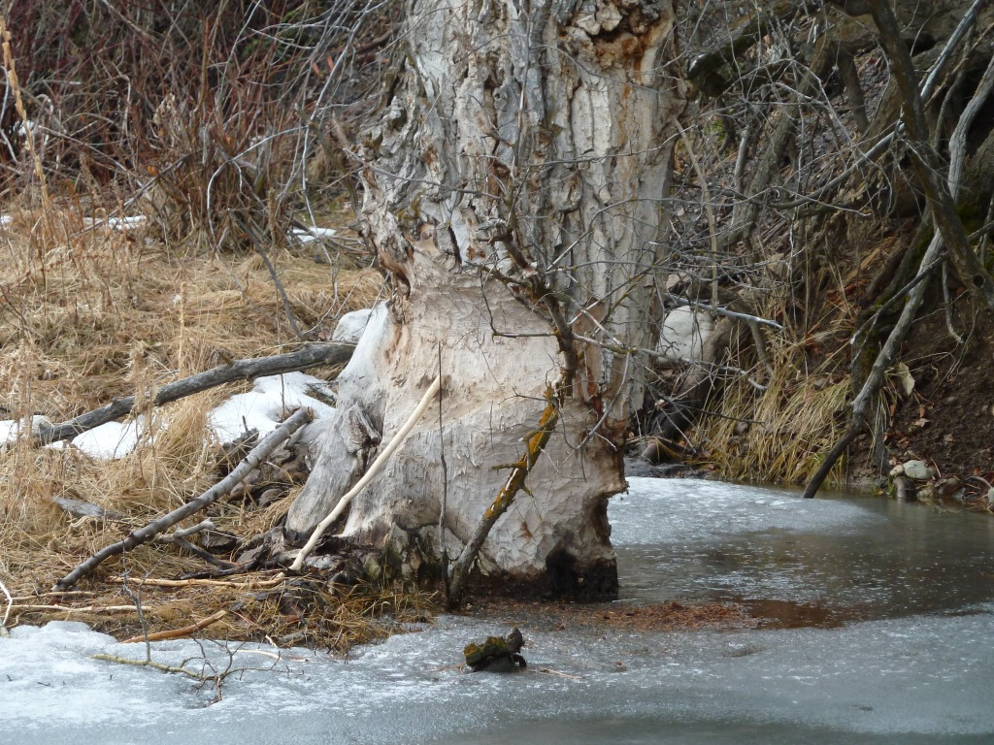

Slide 46
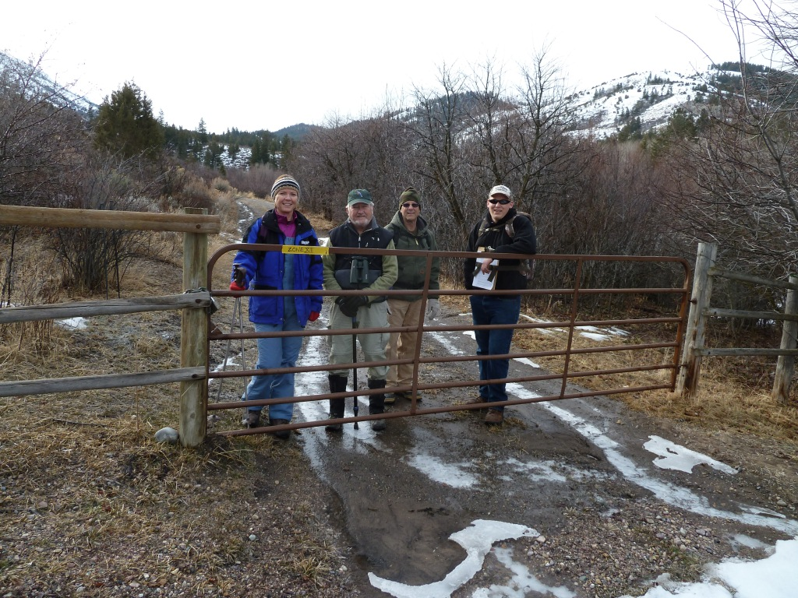
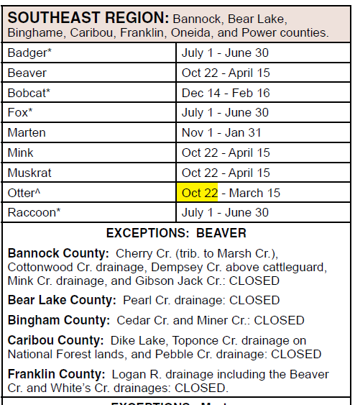
Beaver Count, and so do you!

