Slide 1
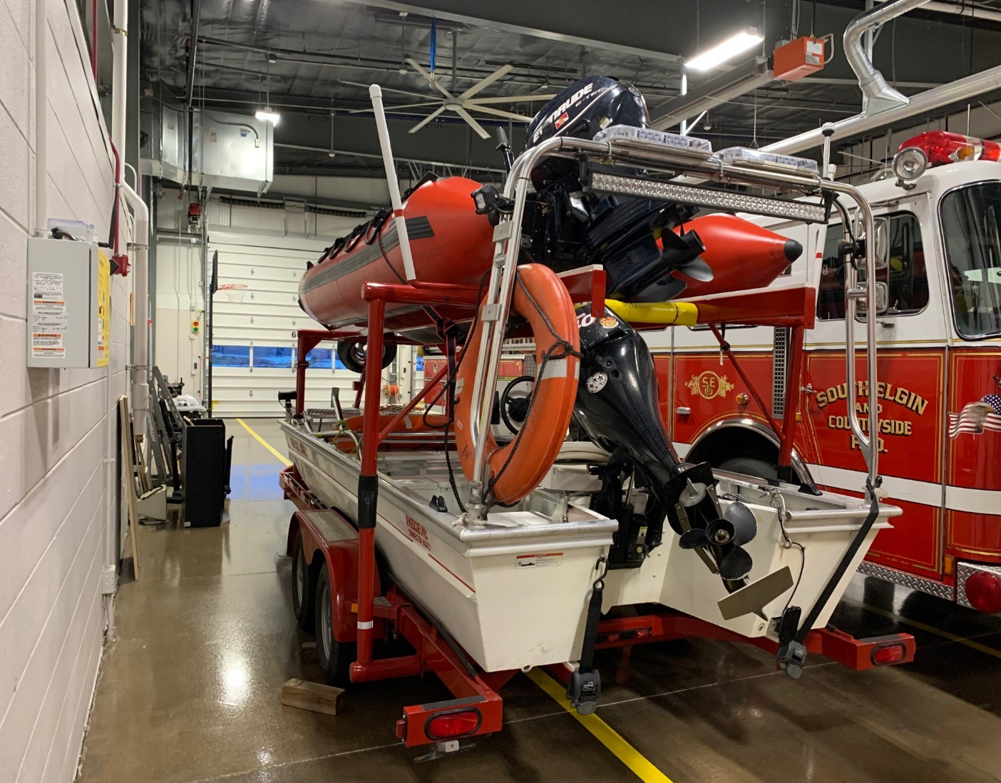
MABAS Division 2 Water Assets
MABAS Double Decker Boat Equipment Trailer
(Acquired in 2019 from MABAS)
2007 Rescue One Connector Boat
MABAS Owned Priority 2
Replacement: 15yrs
Cost: $12,000

Slide 2
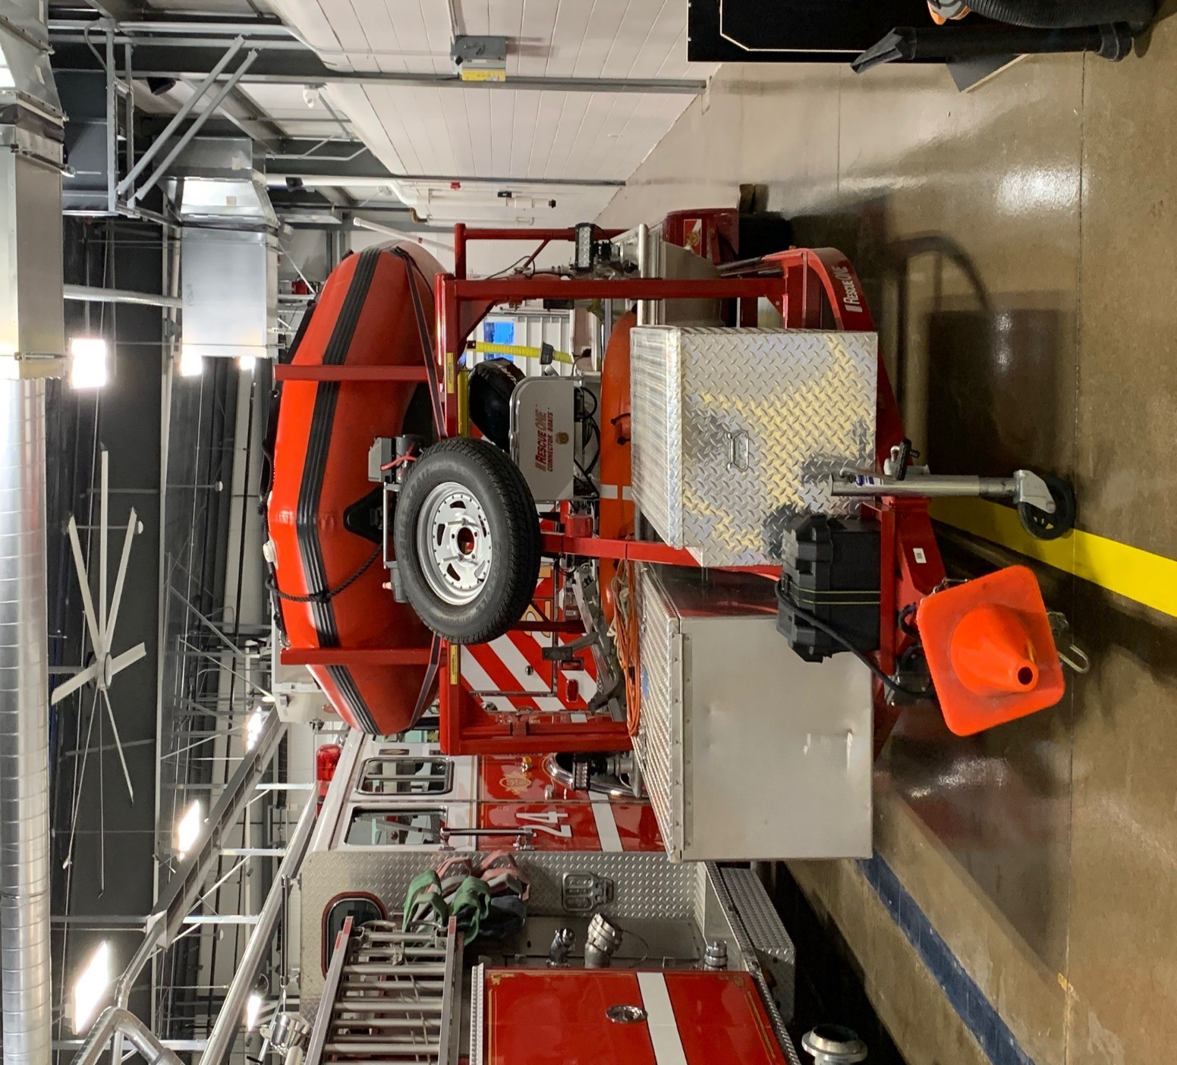
MABAS Division 2 Water Assets
2017 16ft Zodiac Inflatable boat
MABAS Owned Priority 2
Replacement: 15yrs
Cost: $15,000

Slide 3
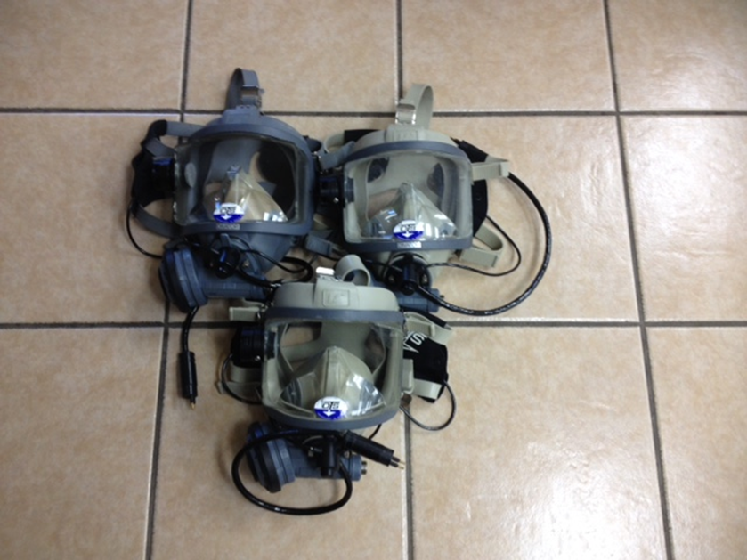
MABAS Division 2 Water Assets
2007 (3) AGA Masks / ABV valve / Ear & Microphone
Division 2 Owner
Replacement: 15yrs
Cost Masks: $3,500
Cost Ear/Microphones: $3,900
Currently Housed: West Dundee (2)
East Dundee (1)

Slide 4
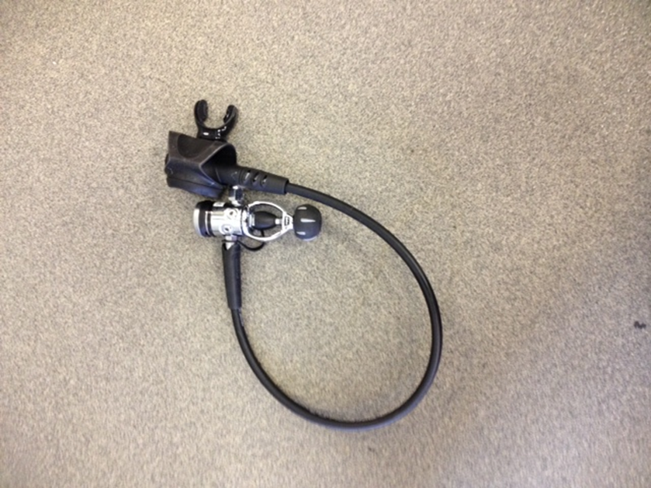
MABAS Division 2 Water Assets
2011 (30) Mars Rover Pony bottle regulators
Division 2 Owner
Replacement 15yrs
Cost: $5,500 (updated 2019)
South Elgin (9) East Dundee (5)
West Dundee (5) Rutland (2)
2018 Sold (9) Regulators to D.J. Scuba for (4) RS4 regulators
Total as of 2019 (21)

Slide 5
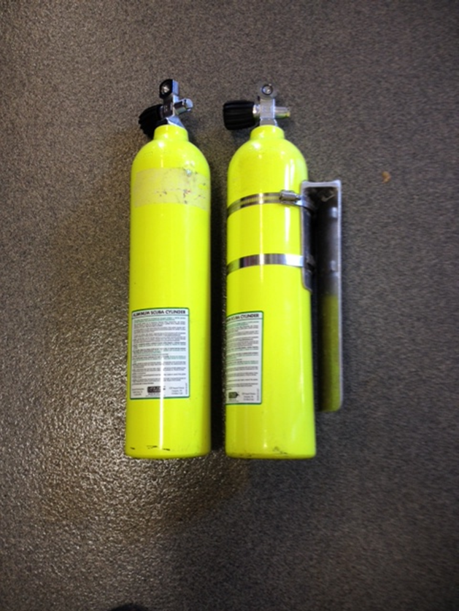
MABAS Division 2 Water Assets
2011 (30) SCUBA 19cuft Pony bottles with valve.
Division 2 Owner
Replacement: 20yrs
Cost: $2,800 (updated 2019)
2018 Sold (9) bottles back to D.J. Scuba for (4) RS4 Regulators
Total as of 2019 (21) bottles

Slide 6
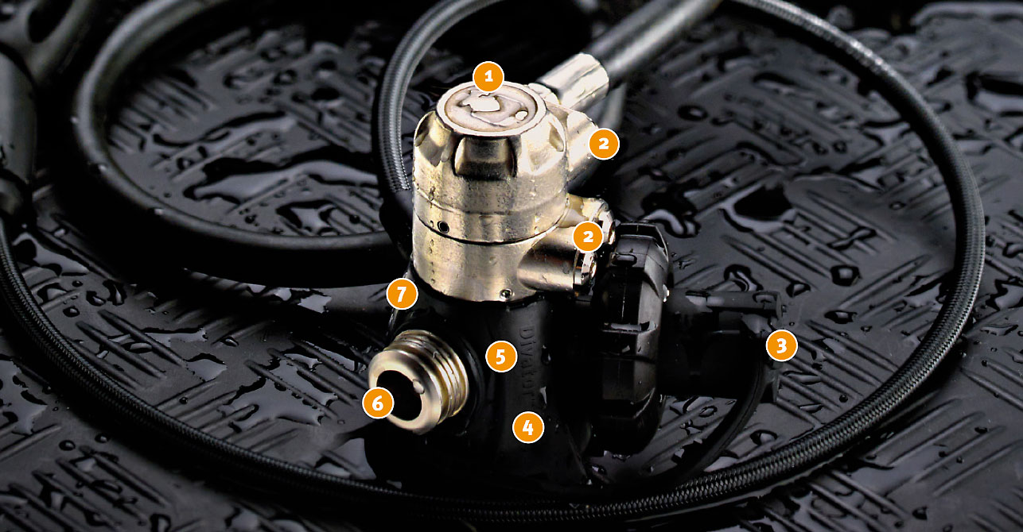
MABAS Division 2 Water Assets
2018 (4) RS4 Regulators
(Adaptable to Surface air supply systems)
East Dundee (3)
South Elgin (1)
$2,925.00

Slide 7
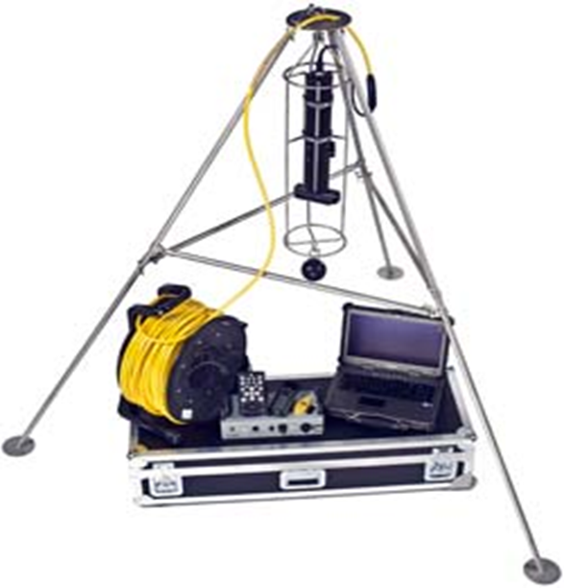
MABAS Division 2 Water Assets
2010 MABAS Kongsberg Sector Scan
MABAS Owned
2022 MABAS Water
Replaced Sonar Head
Replacement: 15yrs
Cost: $50,000

