Slide 1
Rethinking Energy 2020-2030
Think Hour November 2020

Slide 2
Reference
Reference
Adam Dorr and Tony Seba, “Rethinking Energy 2020-2030, 100% Solar, Wind, and Batteries is Just the Beginning”
A RethinkX Sector Disruption Report
Published October 2020
Available at https://static1.squarespace.com/static/585c3439be65942f022bbf9b/t/5f96dc32289db279491b5687/1603722339961/Rethinking+Energy+2020-2030.pdf
Utility Dive article at https://www.utilitydive.com/news/100-solar-wind-and-batteries-is-just-the-start-the-super-power-they-p/588412/

Slide 3
Part 1: Executive summary
Part 1: Executive summary
We are on the cusp of the fastest, deepest, most profound disruption of the energy sector
In the ’20s, solar PV will get cheaper by 72%, lithium-ion batteries by 80%, wind power by 43%
100% SWB (Solar, Wind, Battery) is physically possible, economically affordable and inevitable by 2030 – the cost across the U.S. is $2T or less, much less than previously imagined
Coal, gas and nuclear will become stranded assets in this decade and no new investment is rational at this point
The new system will include a super-abundance of clean energy (“super energy”) at near-zero marginal cost that will create new economic opportunities and allow us to decarbonize 50% economy-wide by 2030
What happened in the world of bits will happen in the world of electrons
This is a wake-up call for Utopus Insights and Vestas

Slide 4
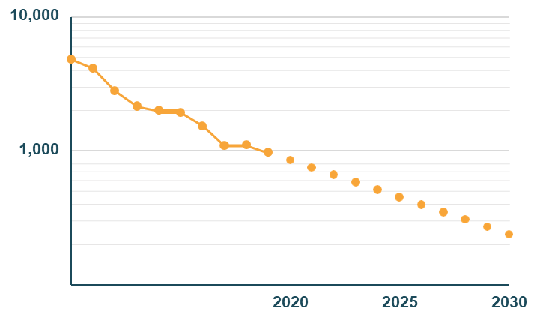
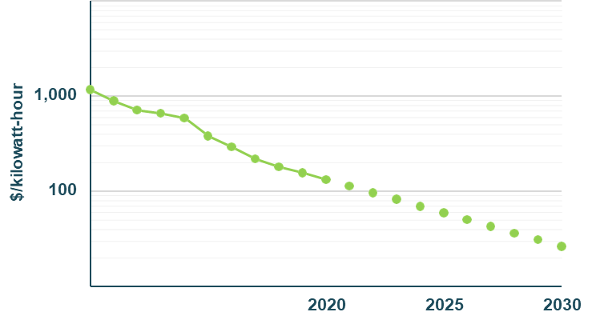
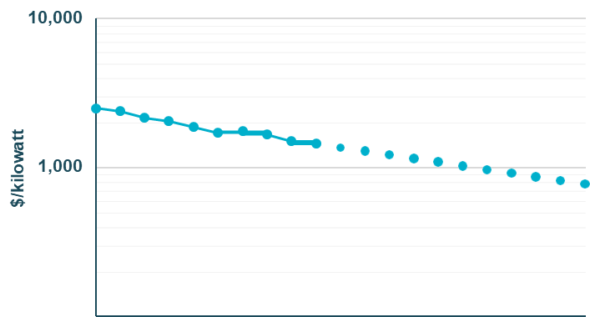
Part 2: Cost curves
U.S. Stationary Lithium-Ion Battery Energy Storage Capacity Cost (pack level) (logarithmic plot)
Part 2: Cost curves
U.S. Solar PV Capital Cost (logarithmic plot)
-82%
-87%
$/kilowatt
-72%
-80%
100
2010 2015
Source: NREL, 2018.¹ RethinkX projections 2019-2030.
U.S. Onshore Wind Power Capacity Cost (logarithmic plot)
Disruption X-Curve
New System
-46%
-43%
Old System
Source: RethinkX

Slide 5
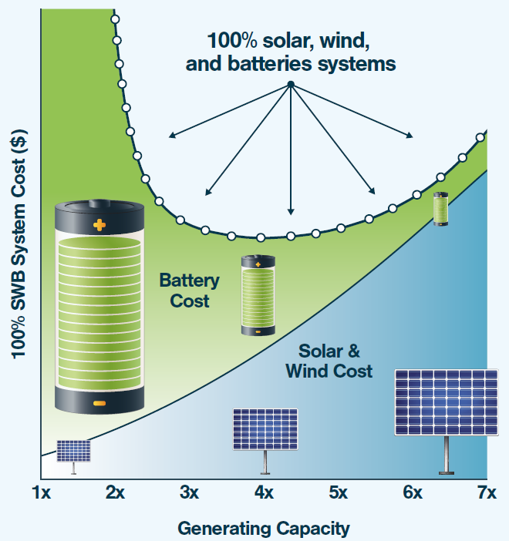
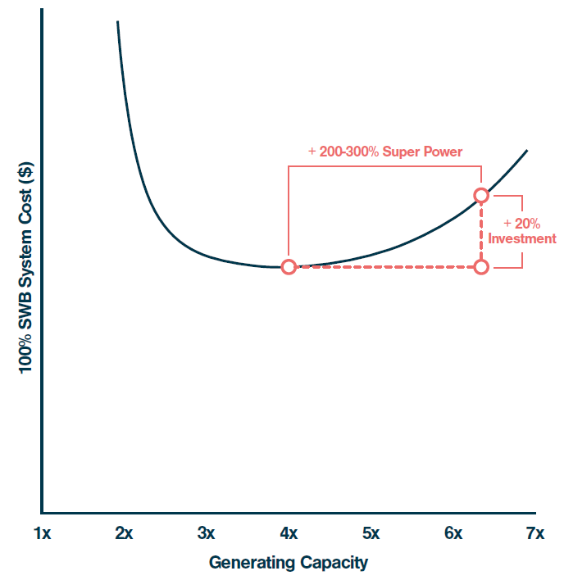
Part 3: Clean energy U-curve
Part 3: Clean energy U-curve
Disproportionate super power returns on additional system capex investment
Lowest cost SWB system

Slide 6
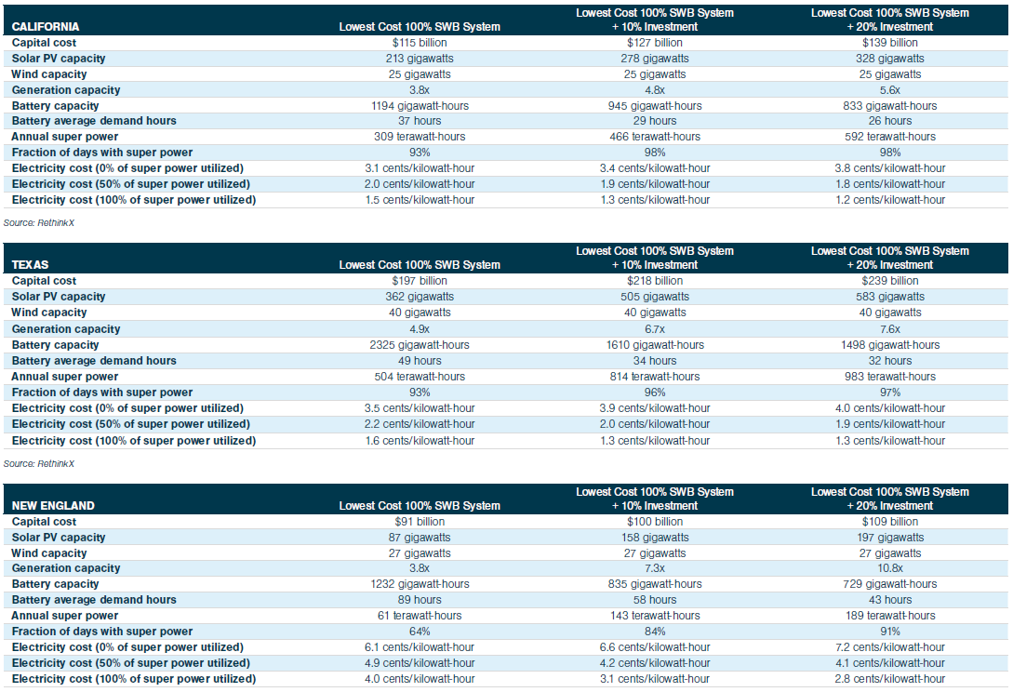
Part 4: Findings in CAL-ISO, ERCOT, ISO-NE
Part 4: Findings in CAL-ISO, ERCOT, ISO-NE
Today
28 gigawatts 6 gigawatts
4.6 gigawatts 29.4 gigawatts
1.5 gigawatts 1.5 gigawatts

Slide 7
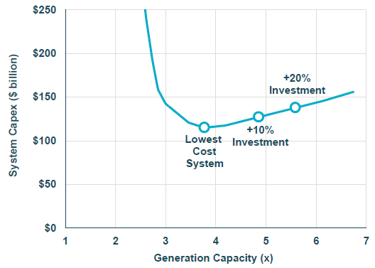
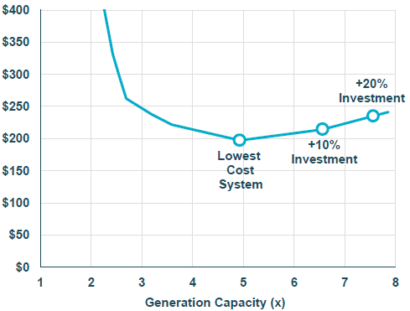
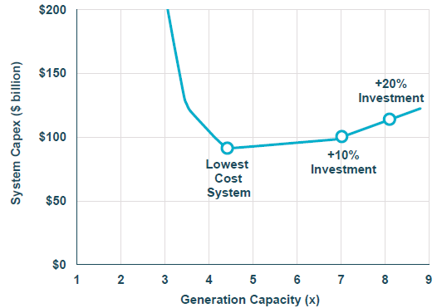
Clean energy U-curves
California
Part 4: Findings in CAL-ISO, ERCOT, ISO-NE
Texas
New England

Slide 8
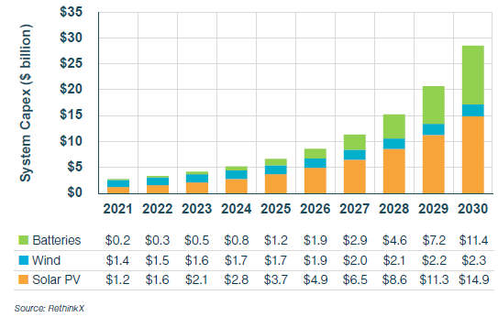
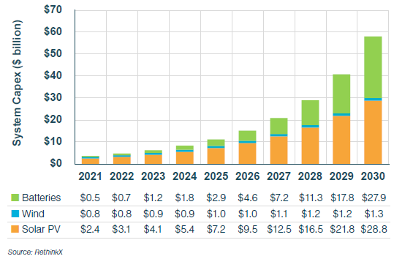
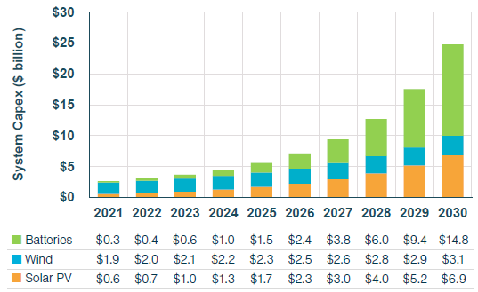
California
Texas
Part 4: Findings in CAL-ISO, ERCOT, ISO-NE
New England
System CapEx

Slide 9
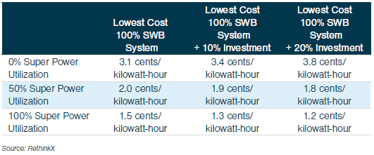
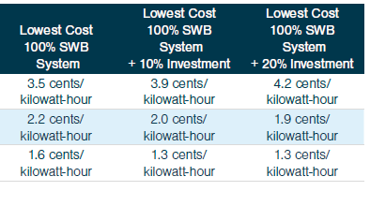
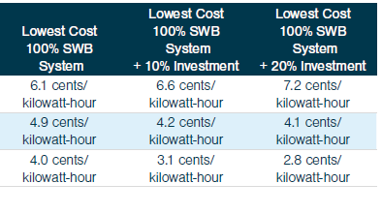
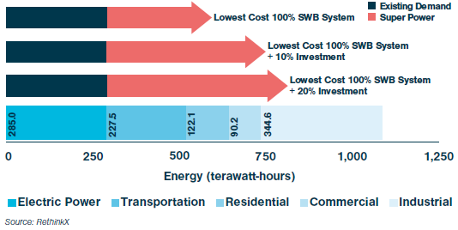
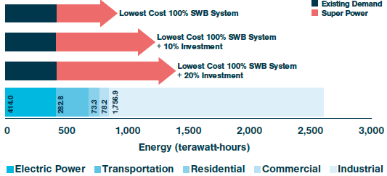
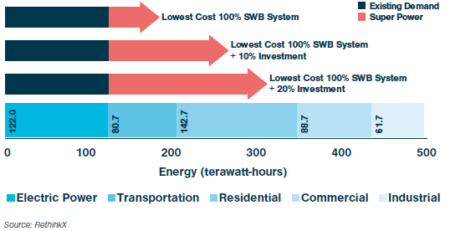
Electricity cost and super power use
Part 4: Findings in CAL-ISO, ERCOT, ISO-NE
California
Texas
New England

Slide 10
Part 5: Implications
Part 5: Implications
100% SWB system is possible, affordable, inevitable
Not dependent on subsidies or carbon taxes
Amount of battery storage is much less than widely believed (43 to 89 hours of storage)
100% SWB system will be the cheapest option for electricity
Economic benefits
Build-out will create millions of jobs
Super power will lead to new businesses and opportunities
Can eliminate 50% of greenhouse gases by 2030
Super power is a solution, not a problem
Can accelerate the decarbonization of heating, transportation, industy
Conventional thinking to limit to 90% {solar + wind + batteries} is wrong-headed

Slide 11
Part 6: Wake-up call
Part 6: Wake-up call
Utopus Insights
Wake up and smell the coffee: the big growth is in solar and batteries!
Congestion considerations argue for storage co-located with generation, i.e., hybrid power plants
Vestas
Wind turbines are getting commoditized (dwindling margins)
The big growth is in solar and batteries
Huge opportunity to be a system provider
Turnkey installation and service of hybrid plants along with financial vehicles to manage risk
Report weaknesses
Does not address congestion issues (or more generally, grid issues); with capacity = 3x average demand or higher, transmission will be heavily congested
Does not address how to develop demand for super power, but of course, this is a good problem to have

