Slide 1

Opportunities in Ohio’s Budget to Strengthen Children Services
& Give Voice to Children in Foster Care
May 17, 2021

Slide 2

Welcome!
Opening comments from our caucus co-chair and vice co-chair,
Senator Stephanie Kunze & Representive Allison Russo

Slide 3

Scott Britton,
Assistant Director,
Public Children Services Association of Ohio (PCSAO)

Slide 4


Budget Advocacy
Overview
May 2021

Slide 5

ODJFS –
Line 523, Family & Children Services
MAINTAINED:
State Child Protection Allocation $110.04M / year
Multi-System Youth $25.0M / year
Ohio START $4M / year
OhioKAN $8.5M / year
30 Days to Family $400K / year
Bridges $8.7M / year
EDMS (all programs) $11.8M / year
ESSA & Chafee Match $3.2M / year
Kinship Permanency Incentive $1M / year
Copyright © 2021, Public Children Services Association of Ohio. All rights reserved.
Notes:
There are other programs within this line like social service operating, foster parent training – those all have been maintained as well.
Note MSY -- $5M remains at state level; $20M allocated to counties – rules may be amended so unclear on the required transfer to FCFC for example

Slide 6
ODJFS –
Line 523, Family & Children Services
New Investments:
Kinship Support Program (state) $34.5M / $30.0M
Chafee Young Adults $800K / year
Ohio Youth Advisory Board $65K / year
Investment Changes:
Foster Parent Recruitment $5.0M / year
Best Practices $5.0M / year
*No longer tied to the State Child Protection Allocation formula
**Rules will be amended to define how the funds will be used
Copyright © 2021, Public Children Services Association of Ohio. All rights reserved.
Notes:
The KSP investment is why there is a 14% increase in Line 523. Covers the state’s share of the program.

Slide 7
ODJFS –
Line 450, Program Operations
New investments with some defined policy changes:
Ombudsman Program $500K / year
WWK Expansion $5.2M / year
Kinship Guardianship Assistance $2.5M / year
Prevention Services $5.0M / year
OCST Recommendations $5.0M / $6.7M
Regional Work $3.0M / year
Copyright © 2021, Public Children Services Association of Ohio. All rights reserved.
Notes:
There are new investments for targeted transformation efforts. Some of these investments have policy changes in the budget bill which we will review after going through the funding changes.
Ombudsman – no decision on where this will be housed, but will be at state level, to be independent and neutral from ODJFS/PCSAs, will be to investigate and resolve complaints made by or on behalf of families involved with children services
WWK – expanding it statewide with this investment
KGAP – hold as we will review with policy changes – the funding here is GRF
OCST recommendations to include – peer parent partner work, TA/training unit, parent finding tool, and other sundry list of items
Regional Work – per the OFC touchpoint meeting – possibly to use to create regional hubs to maximize training, TA, coaching, evaluations screening decisions

Slide 8
MAINTAINED:
Independent Living Initiative $2M / year
Children’s Trust Fund $1M / year
Fatherhood Commission $2.2M / year
PARTIALLY RESTORED BY HOUSE:
Kinship Caregiver Program (TANF) $10M / year
ODJFS –
TANF Children Services
Copyright © 2021, Public Children Services Association of Ohio. All rights reserved.

Slide 9


ODJFS –
Children Services Funding Summary
 | SFY 21 | SFY 22 | SFY 23 | Change (SFY21/23)
County GRF Allocations | $148.2M | $138.2M | $138.2M | -$10M
TANF earmark for Kinship Caregiver Prgm | $15.0M | $10M | $10M | -$5M
Statewide Programming | $31.7M | $95.2 | $90.7M | $59.0M
Initiatives | $4.7M | $18.8M | $20.5M | $15.8M
Copyright © 2021, Public Children Services Association of Ohio. All rights reserved.
Notes:
In summary, the budget for children services efforts is quite positive. However, all the new investments are at the state level or for statewide programming and special initiatives. Counties will experience a $10M reduction in allocations with the removal of the FP recruitment and BP funds moving out of the SCPA formula and another $5M loss with the reduction of the TANF Kinship Caregiver Program.
State level programming will increase by an additional $59M when comparing SFY23 to SFY21 – this includes the $30M KSP, WWK expansion, KGAP, FP recruitment, BP, state level prevention services, and Ombudsman program.
State level initiatives will increase by an additional $15.8M which includes OYAB and OCST implementation (peer parent partners, TA/training work, parent finding tool) and regional work.

Slide 10
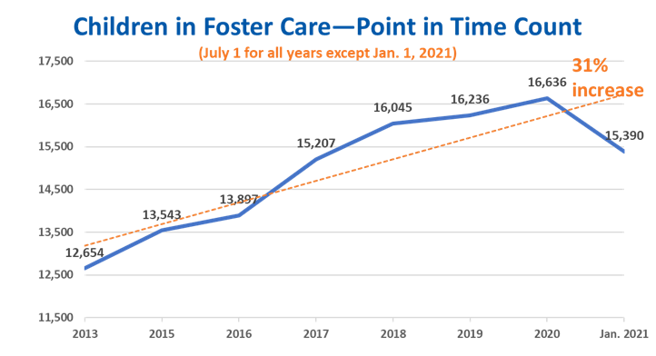
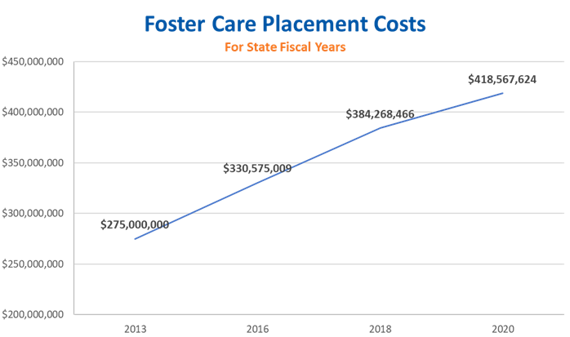
Next Steps
Copyright © 2021, Public Children Services Association of Ohio. All rights reserved.
Notes:
This comes at a time when:
caseloads are up,
placement costs are up and
state investments represent only 16% of the overall $1.2 billion spend in children services.

Slide 11
PCSAO Budget Request
In concert with CCAO, PCSAO is requesting $50 million in new State Child Protection Allocation funds
  To meet current need
  To support kinship caregivers
  To lay the groundwork for transforming the system
Next Steps
Copyright © 2021, Public Children Services Association of Ohio. All rights reserved.

Slide 12


Officers
Contact Us
Scott Britton
scott@pcsao.org
614-224-5802
Copyright © 2021, Public Children Services Association of Ohio. All rights reserved.

Slide 13

Kim Eckhart,
KIDS COUNT Project Manager,
Children’s Defense Fund-Ohio

Slide 14

Youth Ombudsman Office and
Foster Youth Bill of Rights
A review of current legislation and amendments
Kim Eckhart, M.S.
Project Manager
CDF-Ohio

Slide 15
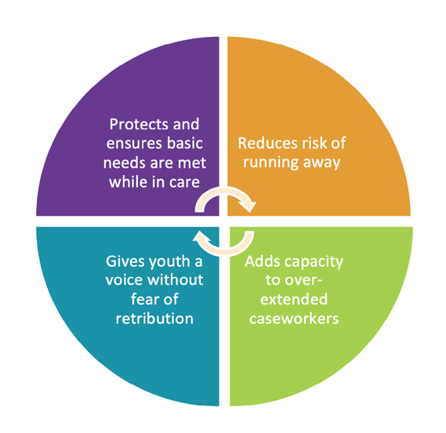
Creating a Youth Ombudsman Office and Bill of Rights will protect children and teens by empowering them to self-report abuse and rights violations and have an independent investigation in situations when the system is broken.

Slide 16
Key Components of a Robust and Youth-centered Ombudsman Office
The U.S. Ombudsman Association has defined independence as an essential characteristic to avoid conflicts of interest
Independent and autonomous
Separate from any office serving foster caregivers or professionals to avoid conflicts and focus on youth-specific practices
1
Those with lived experiences should be involved with the implementation at every stage to ensure practices will be effective.
Dedicated to youth
Designed by current and former foster youth
2
3

Slide 17
Executive Budget
We applaud Governor DeWine’s commitment of $1 million to create an ombudsman office and establish a Foster Youth Bill of Rights
Senate Amendments
Include appropriation outside JFS Program Operations (SC3398)
Create an autonomous commission to oversee a Youth Ombudsman Office and establish the bill of rights (SC3167)
Am Sub HB4
We applaud Rep. Manchester’s efforts to amend HB4 to address this issue. We testified to include even more robust language on independence and youth-focus.

Slide 18

Protecting and empowering youth through an Ombudsman Office
Charmion Janaé
ACTION Ohio

Slide 19
Questions & Answers
Moderated by our caucus vice co-chair, Senator Vernon Sykes
For legislators and legislative staff, please feel free to
unmute yourselves to ask questions or share feedback.
For all other participants, please use the chat feature.

Slide 20

Thank you for joining today’s webinar!
For more information on upcoming Ohio Legislative Children’s Caucus webinars and meetings,
please contact Alison Paxson at apaxson@childrensdefense.org

