Slide 1
A very warm welcome to the
CYCALL (Inclusive Cycling)
Annual General Meeting (2024)
Tuesday 15th April, 2025
11am
The Rooms, Guildbourne Centre

Slide 2
…….but if you would like a copy of any documents from the AGM sent by email please just ask.
#thinkbeforeyouprint

Slide 3
Housekeeping
Please ensure that mobile phone are on silent (where possible).
Thank you.

Slide 4
Agenda
Apologies for absence
Chair’s Report - Highlights of the season & reflections
Financial Report (including Annual Accounts)
Open Questions
Any Other Business
Close of Meeting
Please ask if you would like to receive a PDF copy of the Independently Examined Full Accounts & Trustee’s Annual Report. Alternatively these can be found published on the CYCALL website and on the Charity Commission website. (Reg Ch No 1189056)

Slide 5
Structure
Registered Charity (1189056)
Charitable Incorporated Organisation (CIO)
No voting as structure does not have members.
Definition: A CIO is a corporate form of business designed for charitable organizations in England and Wales.
Purpose: It provides a legal structure for charities, offering some of the benefits of being a company without some of the burdens.
Key Features:
CIOs are registered with the Charity Commission, not Companies House.
Trustees have limited or no liability for CIO debts or liabilities.
CIOs can enter into contracts in their own right.

Slide 6
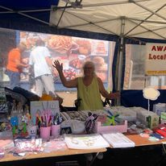
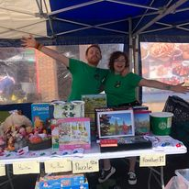
Highlights & Achievements
Workforce
4 session workers
Makaton Training
D of E Student-Sam
Inclusion Training
Mencap-LD in Sport (Holly)
Targets
Replace bikes
Increase volunteers
Increase in customers
Fundraising
Mayors’ Charity of the Year
Laura-Lands End-John O’Groats
Lancing Village Market

Slide 7
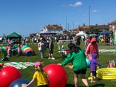
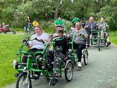
Highlights
HOIST CHUB
Worthing Carnival
Community Fun Day hosted by Mayor of Worthing
Dr Bike session/Sussex Police Bike Marking
Health & Wellbeing Network-Community Works
Mencap Sports Day
Palatine Fun Day
Lancing Beach Dreams
Ferring Festival
Worthing Carnival
CIL Assessment Panel & WCCH (Fred)
Active Sussex-Disability Sports Conf
My Active Community-Mencap

Slide 8
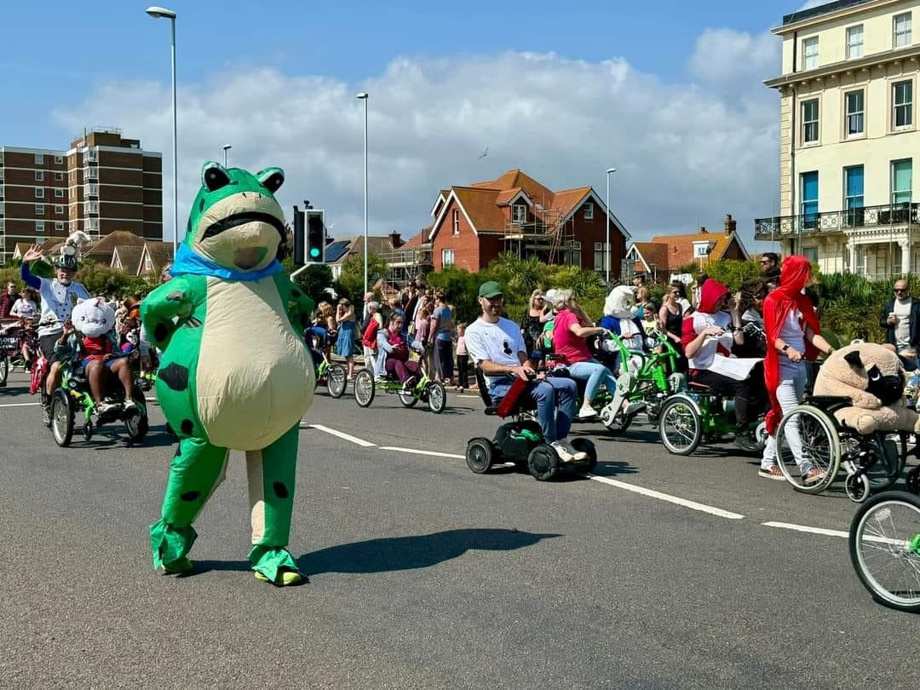
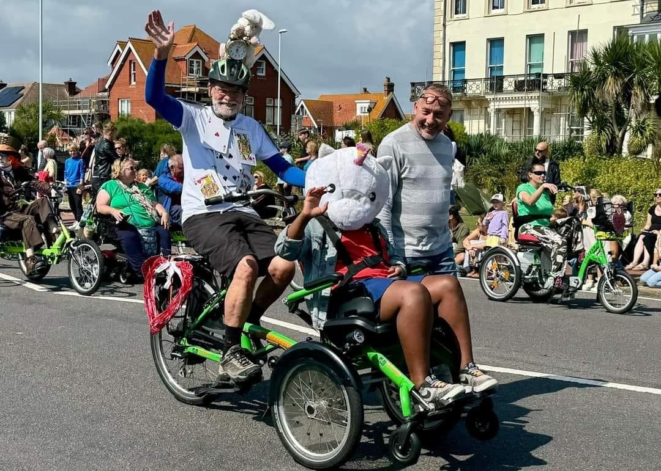
2024 Highlights-Worthing Carnival

Slide 9
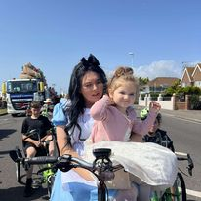
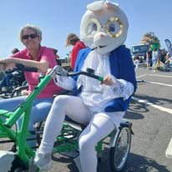
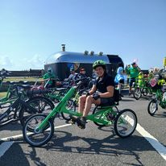
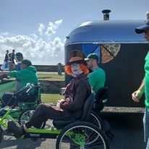
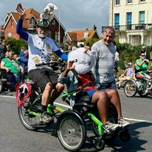
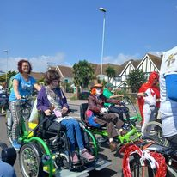
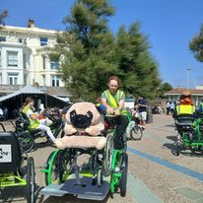
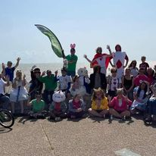
2024 Highlights-Worthing Carnival

Slide 10
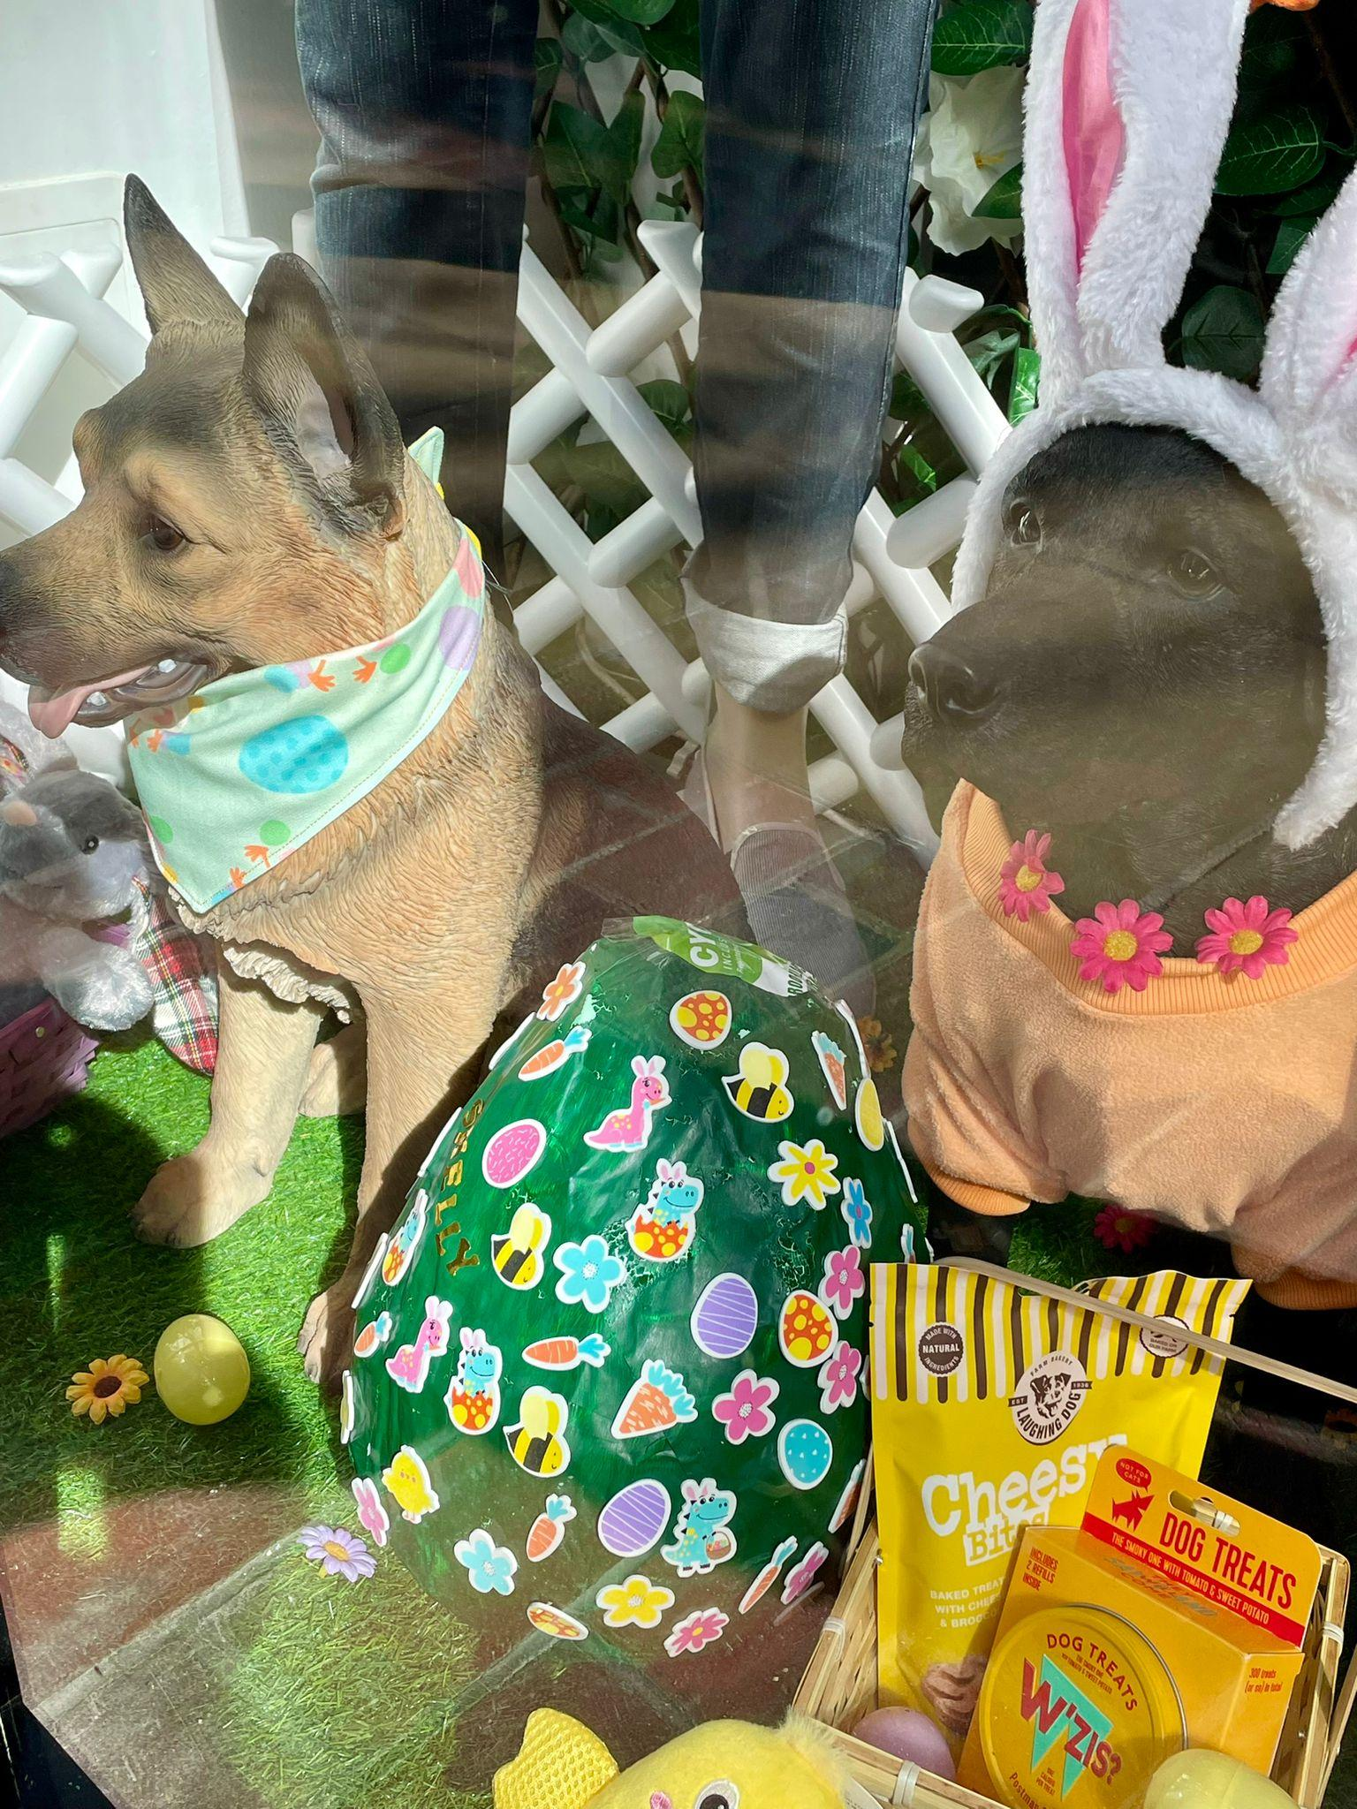
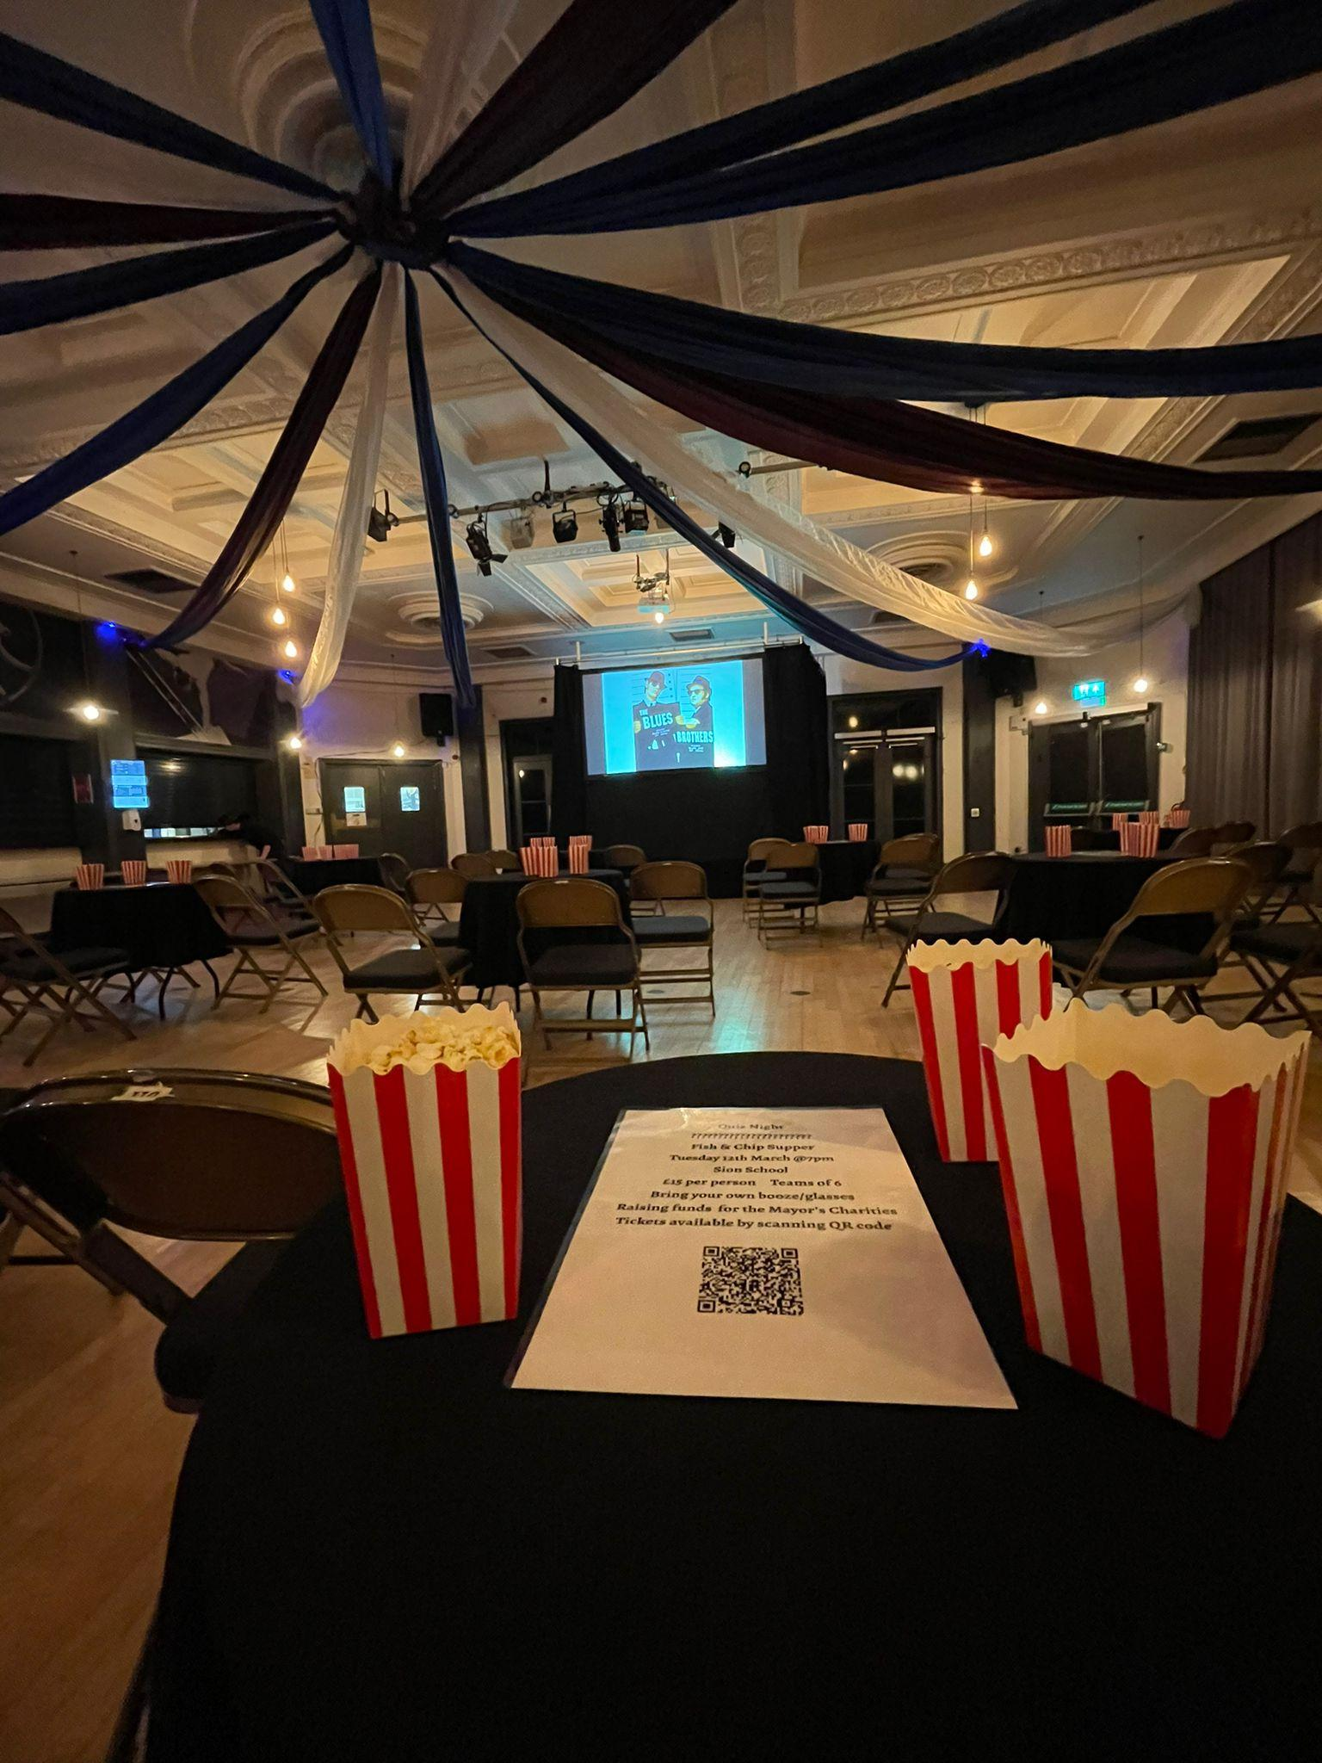
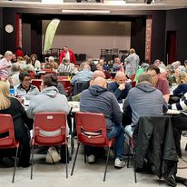
2024 Highlights
Mayor’s Charities-Quiz Night
Mayor’s Charities -Film Night
Worthing Easter Egg Trail

Slide 11
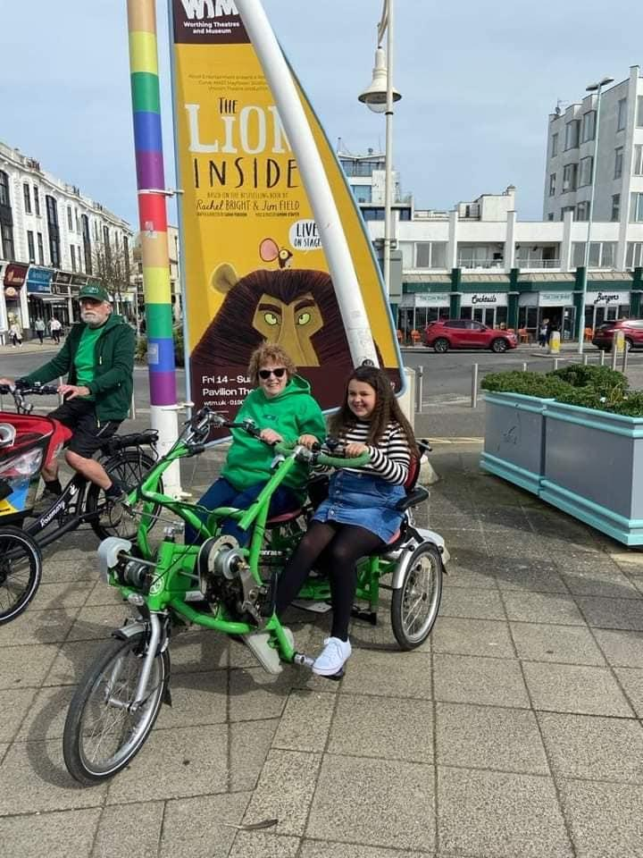
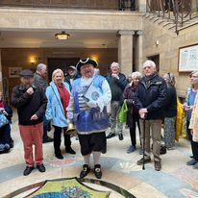
2024 Highlights
Mayor’s Charities-History Walk & Afternoon Tea
Sponsored Walk-Parkinsons UK
Friends of Brooklands
Easter event

Slide 12
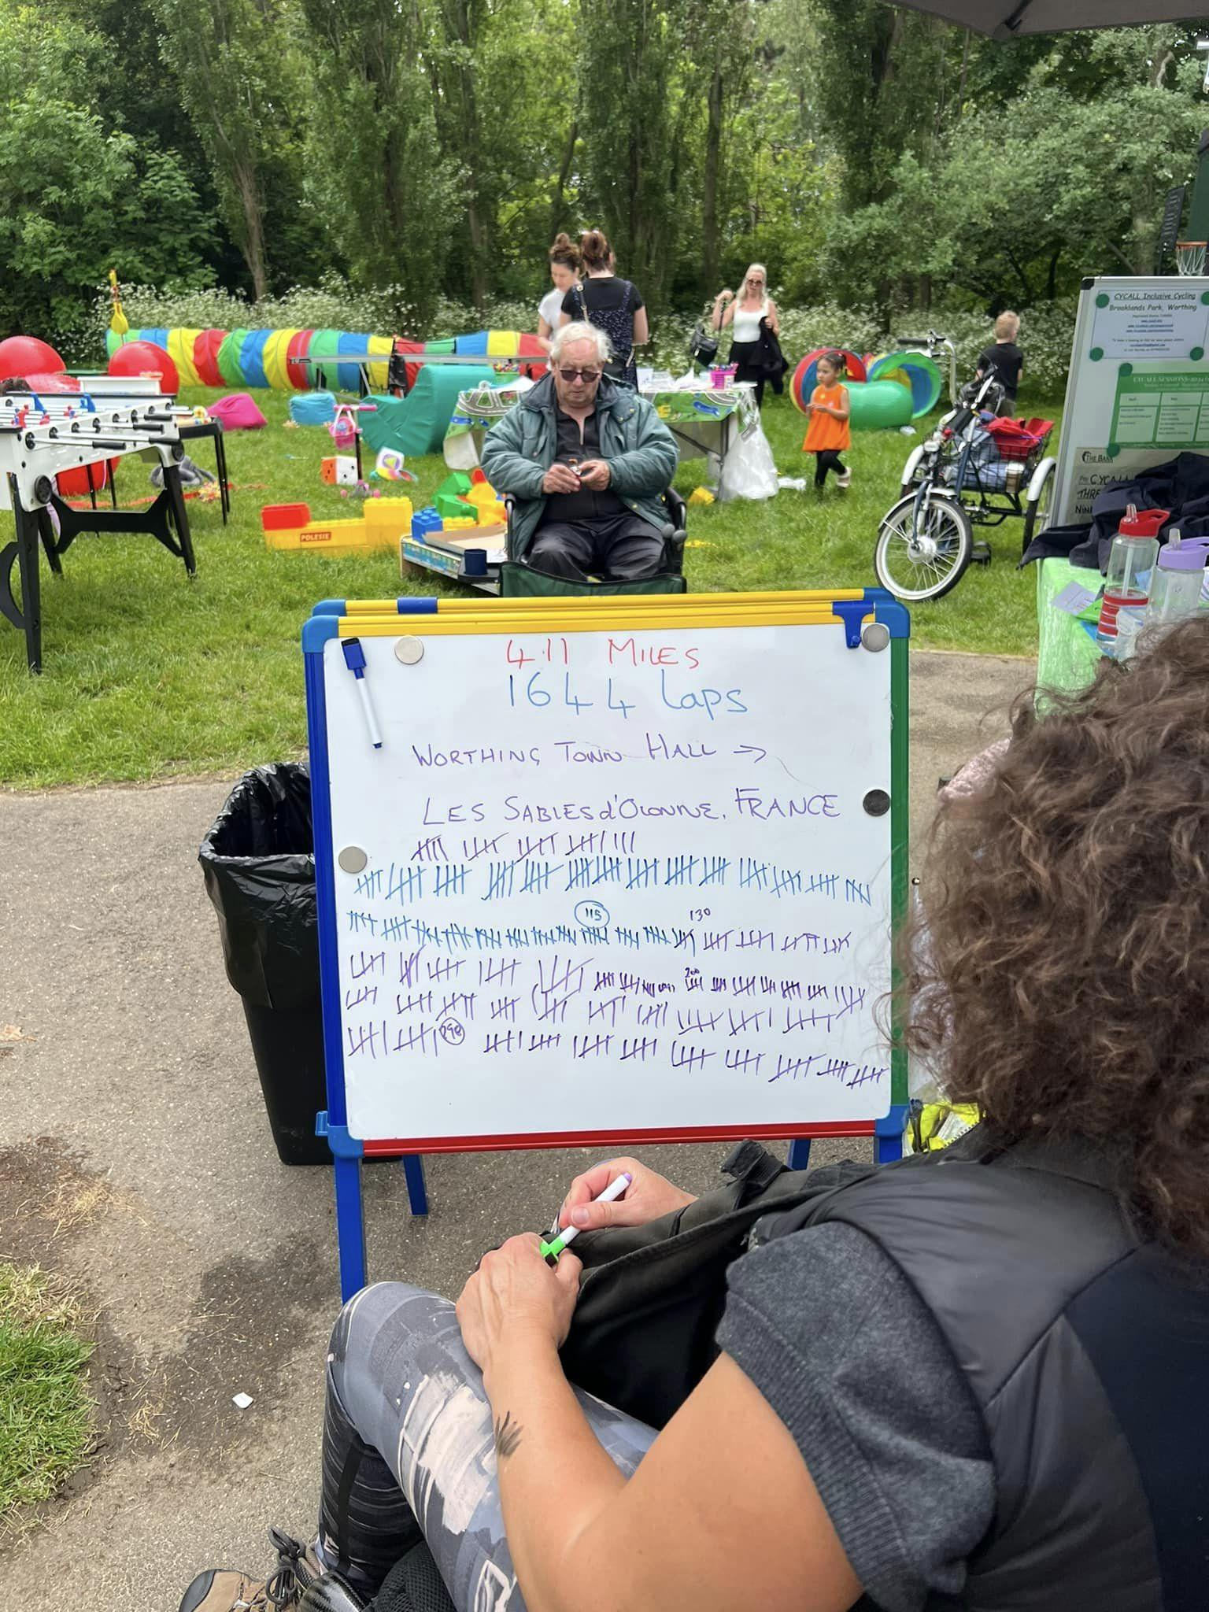
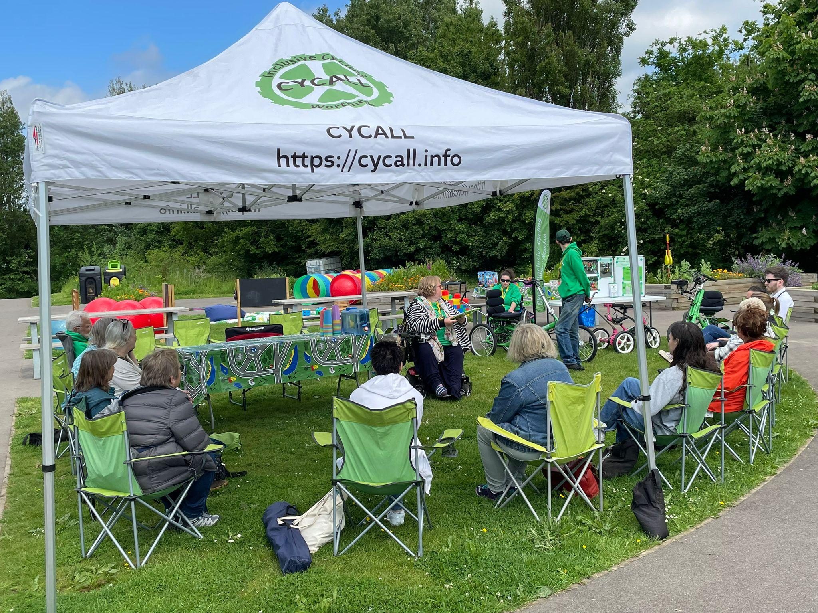
2024 Highlights
Health & Wellbeing Network Meeting-Community Works
Mayor's Charities-80’s Night
CYCALL Community Funday

Slide 13
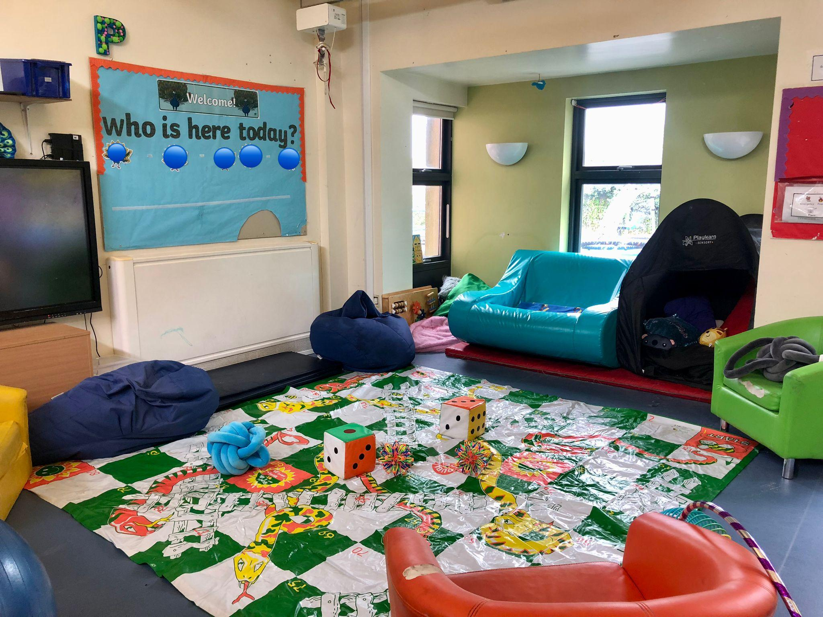
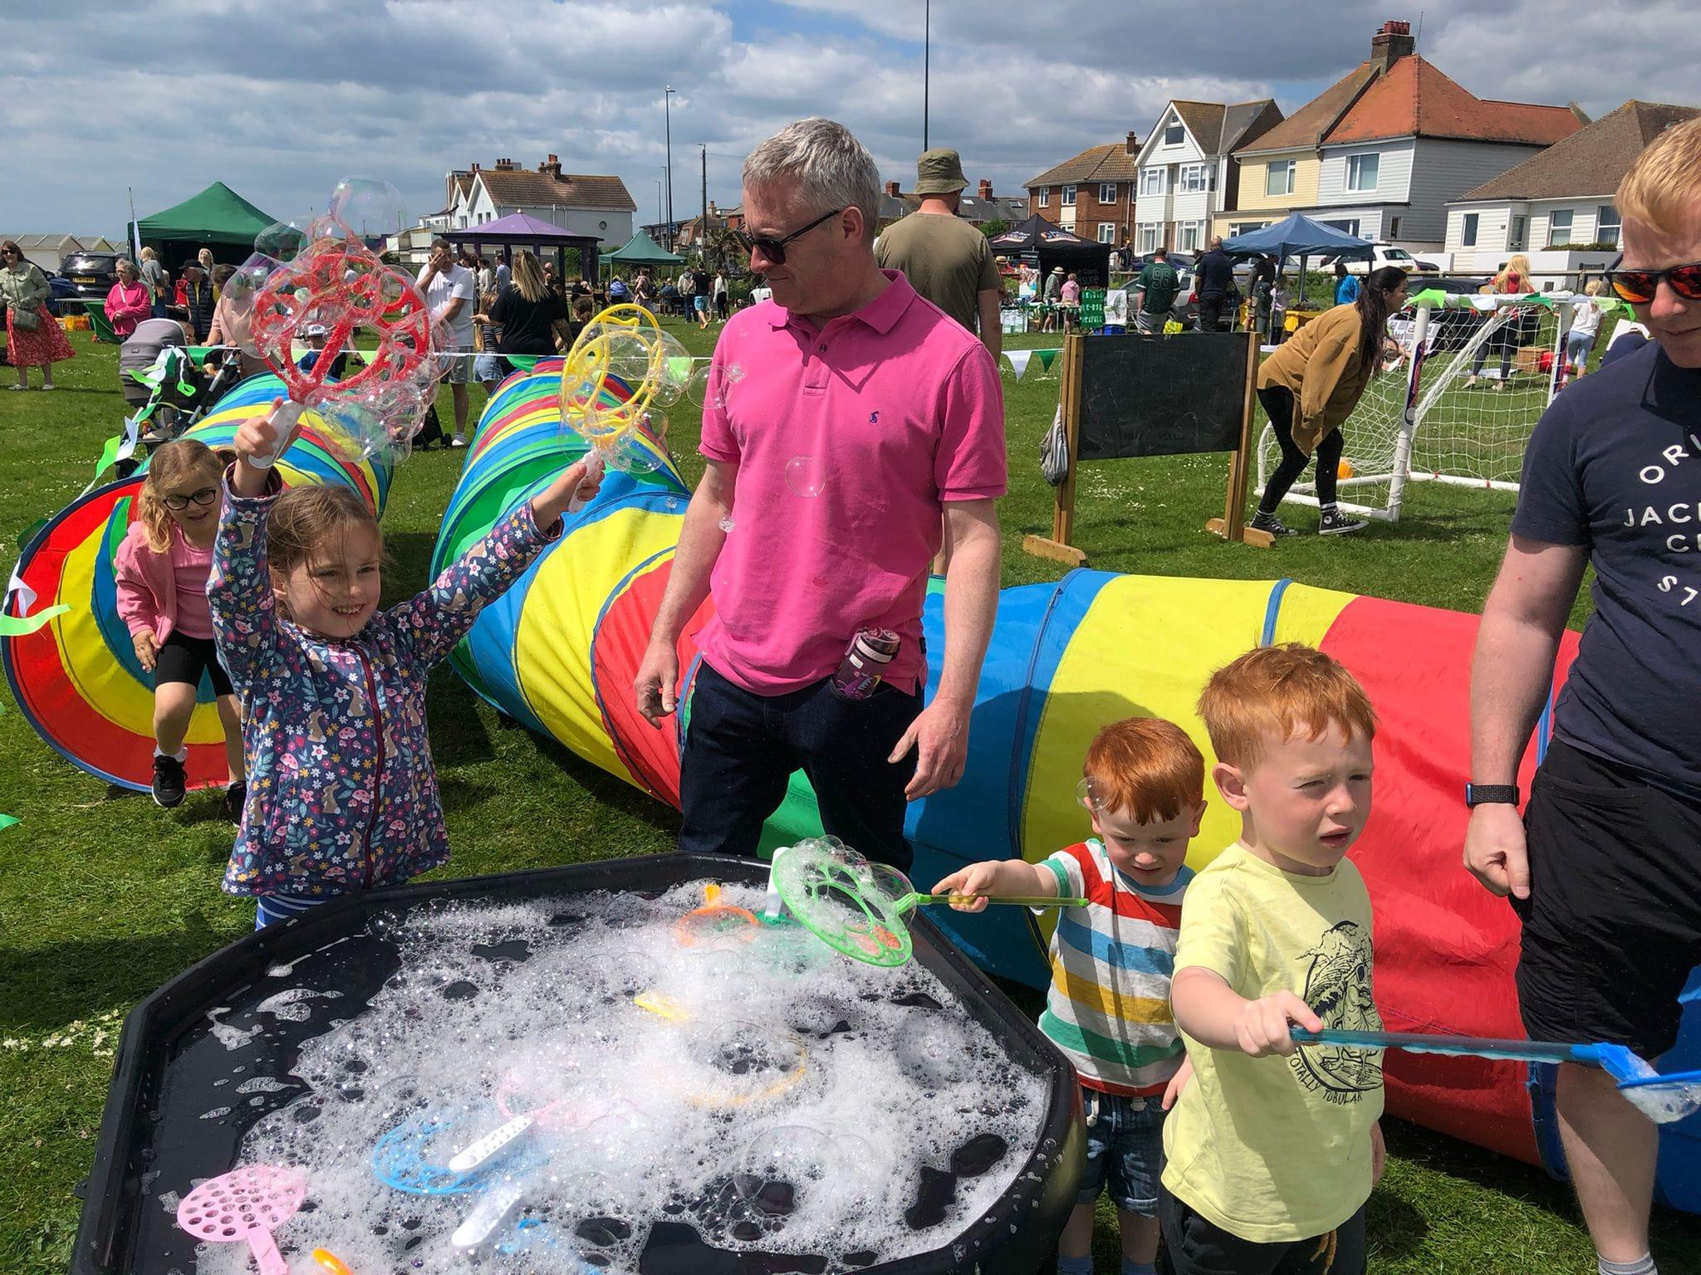
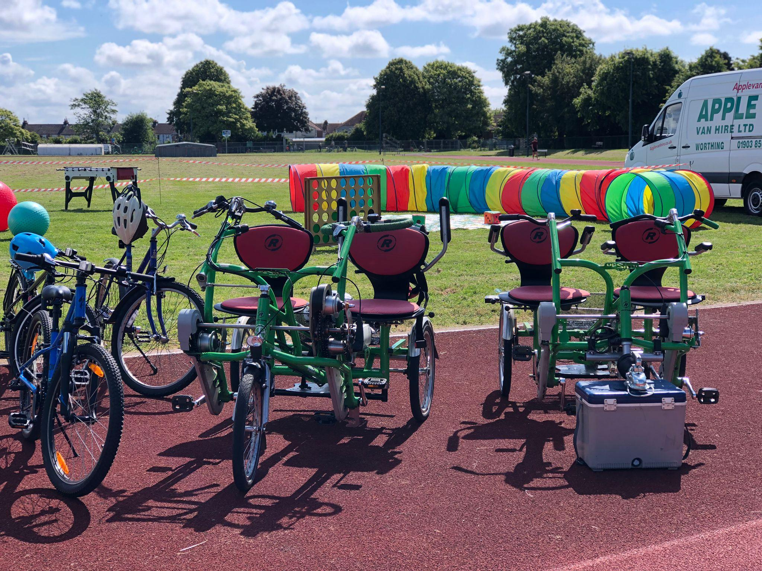
2024 Highlights
Lancing Green Dreams
Mencap Sports Day
Palatine Funday

Slide 14
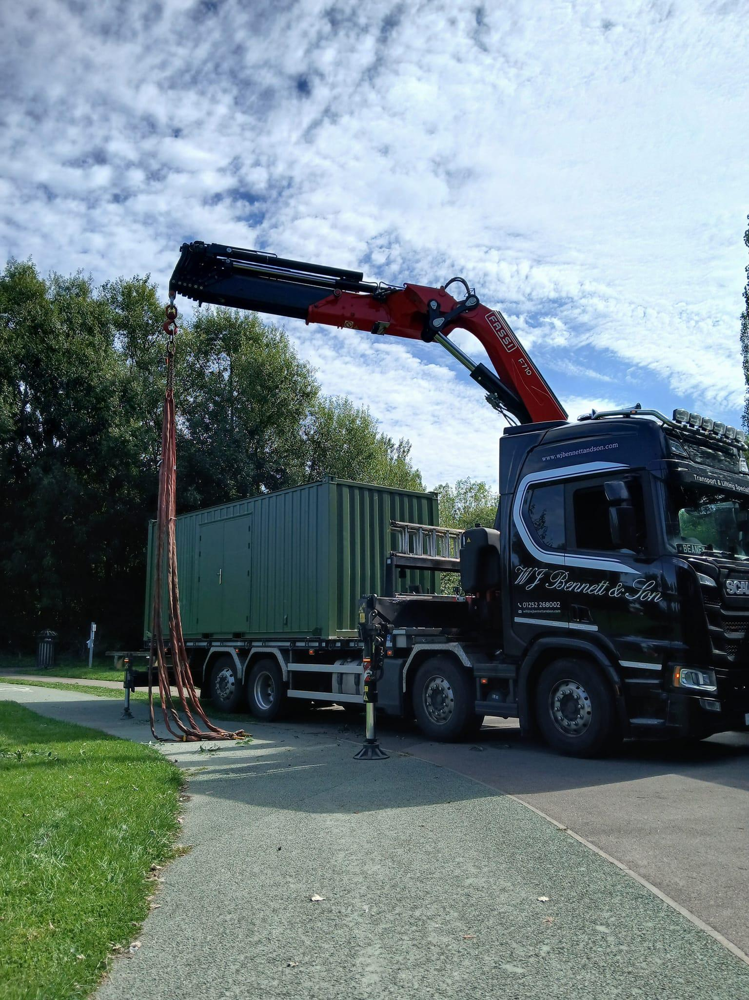
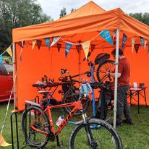
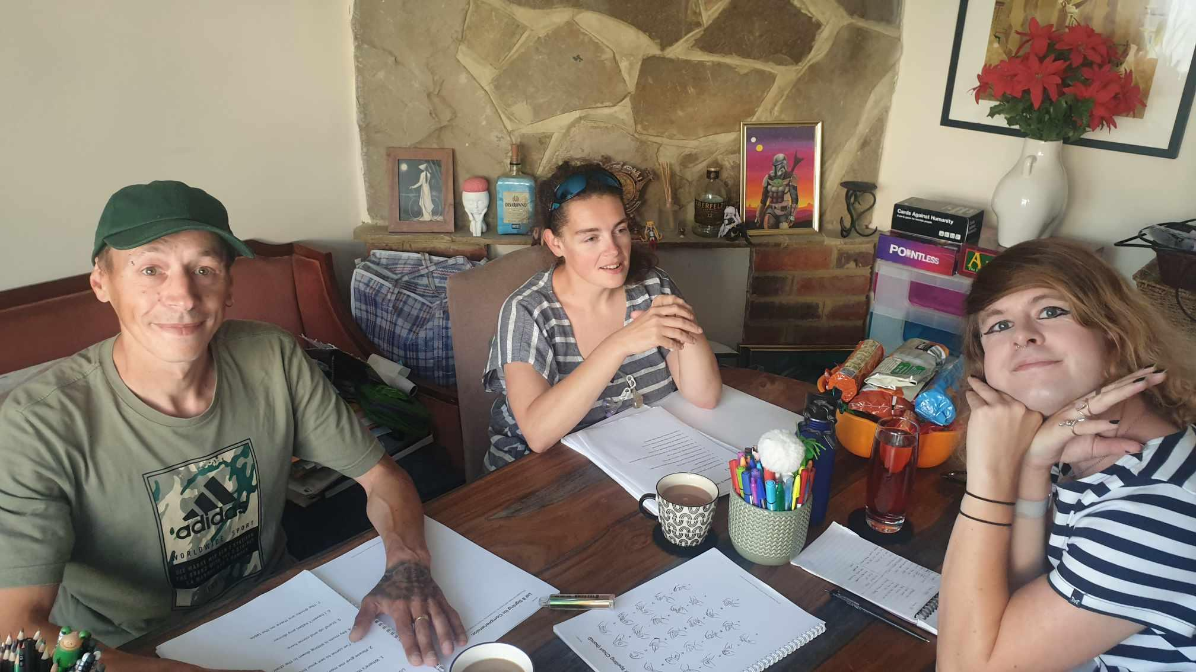
2024 Highlights
Makaton Training
CHUB delivery
Dr Bike Session-Cyclo Analysis & Sussex Police Bike Marking

Slide 15
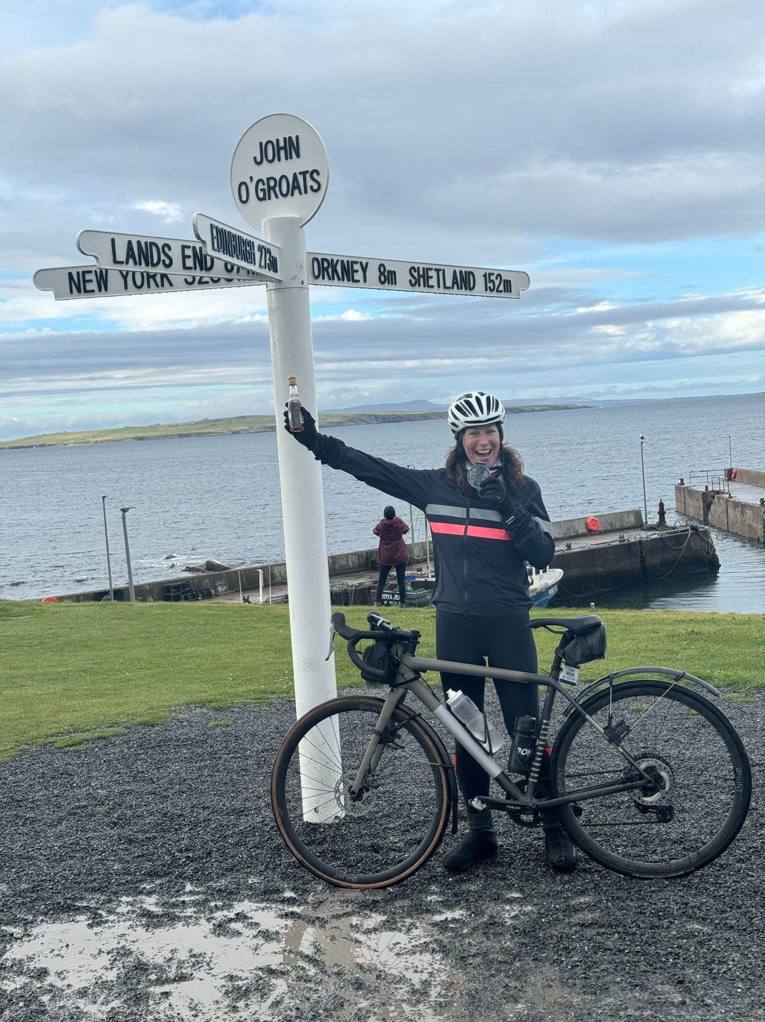
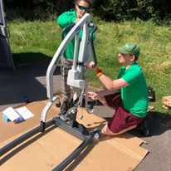
2024 Highlights
Laura
‘LEJOG’ fundraising challenge
Ferring Festival
Lancing Market
Hoist delivery

Slide 16
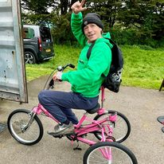
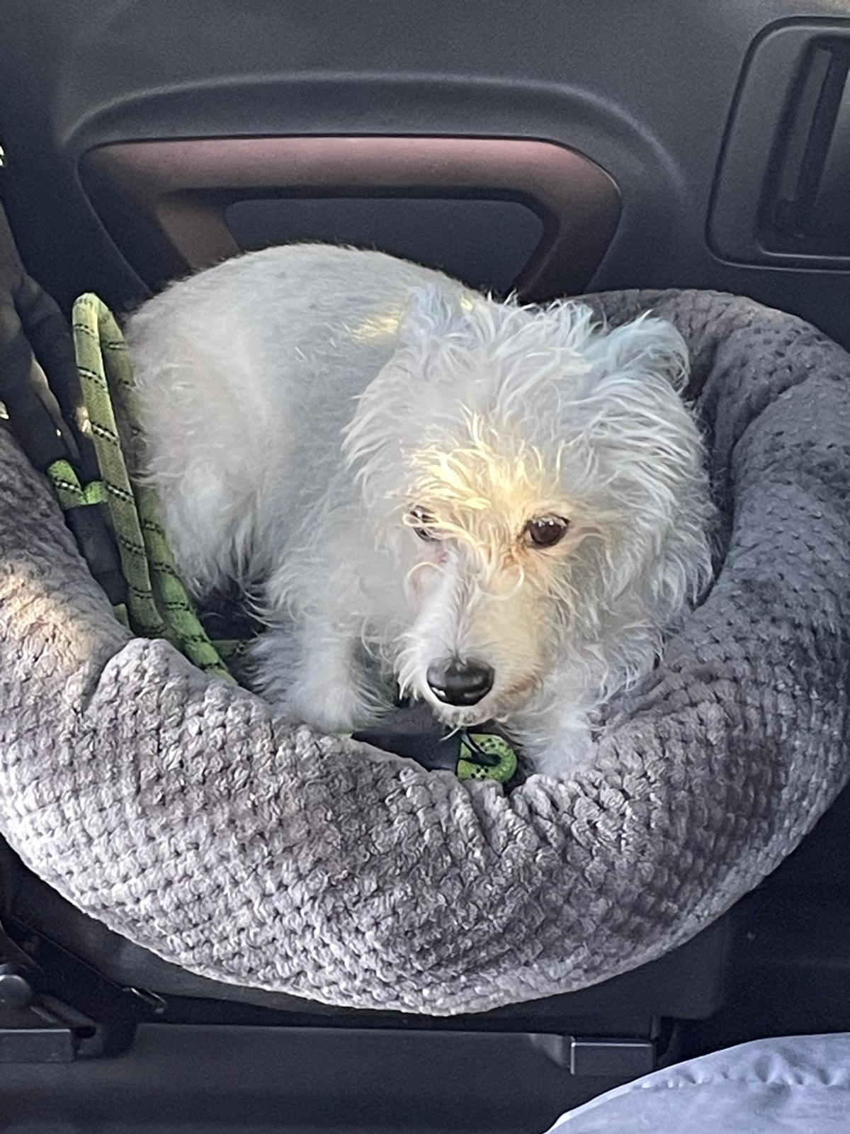
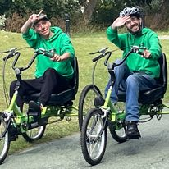
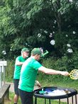
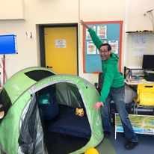
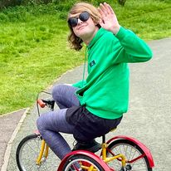
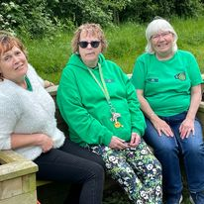
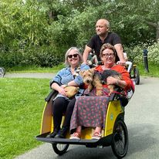
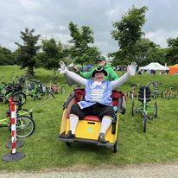
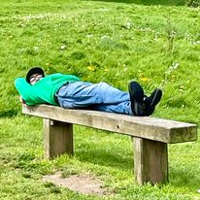
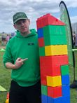
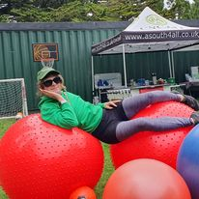
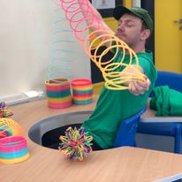
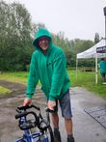
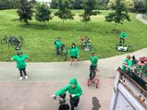
Having Fun!- CYCALL Sessions
2024

Slide 17
2818 volunteer
hours
34 CYCALL
sessions
1931
visitors
2024 In Numbers
29 local SEN schools & organisations attended
1 billion cups of tea..mostly Mart!!
1048 Facebook
posts

Slide 18
73% of customers regularly attend a CYCALL session
96% of participants said that they felt a sense of achievement after a CYCALL session
Outcomes
100% 0f participants reported an improved mood after a CYCALL session
All participants said that they particularly enjoyed making new friends
*Data collected by Google Forms Survey

Slide 19
Focus demographic-
Learning Disability (Mencap)*
CHUB
Sensory Space
Looking Forward 2025
Volunteer Recruitment
Succession planning
*Reflected in SDP-Beneficiaries/Volunteer targets

Slide 21
Our Active Community. Mencap’s ‘Our Active Community’ is designed to support people with a learning disability to access and engage in physical activity within their communities. The initiative is taking place in nine communities across England. ‘Mencap Active Community’; a nationwide network developed and facilitated by Mencap, provides national reach and supports wider stakeholders.

Slide 22
Challenges
Rise in costs …of everything. E.g. Repairs & maintenance costs
Small management team
Increased demand for CYCALL sessions/attendance at events
Looking Ahead-Plans for 2025
Increase Trustees
Succession planning-change of leadership
Explore partnership working

Slide 23
Customer Feedback
“**** said he cannot believe he can ride a bike. After years of trying you had the answer (and the patience)”
“I have watched the paralympics…that’s me”.

Slide 24
Financial Statement - Year End 31st May
 | 2022-2023 | 2023-2024
Total Incoming Resources | £51505 | £56932
Total Outgoing Resources | £42247 | £62537
Reserves | £5000 | £5000
*Grants paid in advance *Full accounts available on request and on Charity Commission website

Slide 25
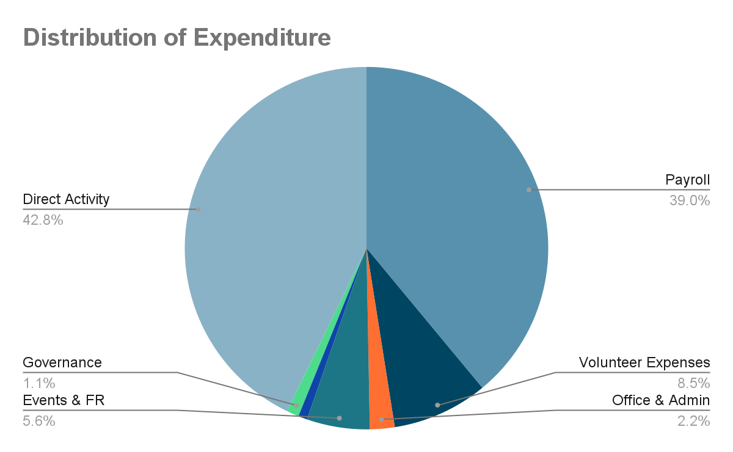

Slide 26
Notes to Accounts
CYCALL Reserves Policy is set at £5000 (Risk Register)
Grants account for most income
Accounts independently examined by Masters Fullers Chartered Certified Accountants (no matters of concern)
Payroll has increased
To prevent financial exclusion CYCALL sessions continue to be donation based
Groups & organisations continue to make appropriate donations

Slide 27
A Massive Thank You to you all for supporting CYCALL
“We are not a team because we work together. We are a team because we respect, trust and care for each other”

