Slide 1
Dementia Training
Dr. Christina Parker, Brazoria County Gathering Place Interfaith Ministries, Inc.

Slide 2
What is Dementia?
Dementia is not a single disease. It's an overall term to describe a collection of symptoms that one may experience if they are living with a variety of diseases, including Alzheimer's disease. Diseases grouped under the general term "dementia" are caused by abnormal brain changes. Dementia symptoms trigger a decline in thinking skills, also known as cognitive abilities, severe enough to impair daily life and independent function. They also affect behavior, feelings and relationships.
In Their Eyes

Slide 3
Alzheimer's disease accounts for 60%-80% of cases. Vascular dementia, which occurs because of microscopic bleeding and blood vessel blockage in the brain, is the second most common cause of dementia. Those who experience the brain changes of multiple types of dementia simultaneously have mixed dementia. There are many other conditions that can cause symptoms of cognitive impairment but that aren't dementia, including some that are reversible, such as thyroid problems and vitamin deficiencies. Dementia is often incorrectly referred to as "senility" or "senile dementia," which reflects the formerly widespread but incorrect belief that serious mental decline is a normal part of aging.

Slide 4
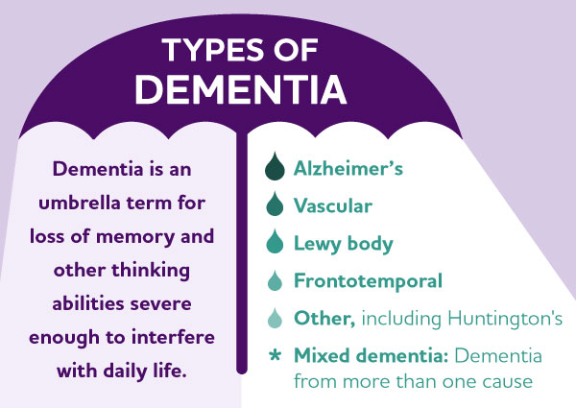

Slide 5
Signs and Symptoms of Dementia
Signs of dementia can vary greatly. Examples include problems with:
Short-term memory.
Keeping track of a purse or wallet.
Paying bills.
Planning and preparing meals.
Remembering appointments.
Traveling out of the neighborhood.

Slide 6
Causes
Dementia is caused by a variety of diseases that cause damage to brain cells. This damage interferes with the ability of brain cells to communicate with each other. When brain cells cannot communicate normally, thinking, behavior and feelings can be affected.
The brain has many distinct regions, each of which is responsible for different functions (for example, memory, judgment and movement). When cells in a particular region are damaged, that region cannot carry out its functions normally.

Slide 7
Different types of dementia are associated with particular types of brain cell damage in particular regions of the brain. For example, in Alzheimer's disease, high levels of certain proteins inside and outside brain cells make it hard for brain cells to stay healthy and to communicate with each other. The brain region called the hippocampus is the center of learning and memory in the brain, and the brain cells in this region are often the first to be damaged. That's why memory loss is often one of the earliest symptoms of Alzheimer's.
Dementia Video
Alzheimer's Video

Slide 8
Diagnosis of Dementia
There is no one test to determine if someone has dementia. Doctors diagnose Alzheimer's and other types of dementia based on a careful medical history, a physical examination, laboratory tests, and the characteristic changes in thinking, day-to-day function and behavior associated with each type. Doctors can determine that a person has dementia with a high level of certainty. But it's harder to determine the exact type of dementia because the symptoms and brain changes of different dementias can overlap. In some cases, a doctor may diagnose "dementia" and not specify a type. If this occurs, it may be necessary to see a specialist such as a neurologist, psychiatrist, psychologist or geriatrician.
Diagnosing Dementia

Slide 9
Response After Diagnosis
When diagnosed with Alzheimer's, people often experience a mix of strong emotions like fear, anger, denial, and depression, but also relief at finally understanding symptoms; these reactions stem from the shock, loss of control, and worry about the future, leading to feelings of isolation, sadness, or even resentment, with behaviors like agitation, confusion, or withdrawal becoming common as the disease progresses.
Behavioral Changes (Often Triggered by Emotions)
Agitation & Irritability: Becoming easily upset or disruptive.
Confusion & Disorientation: Getting lost or misplacing items.
Withdrawal: Pulling back from social activities due to difficulty communicating or keeping up.
Repetitive Behaviors: Asking the same questions or repeating actions.
How to Manage Symptoms of Alzheimer's

Slide 10
Caregivers’ Emotions
Things you can do come to terms with your feelings include:
Let your feelings out. Keeping your feelings in may make you feel worse. It is OK to cry.
Your feelings may change day to day – As a carer you may have good days and bad days. Take one day at a time. A bad day might be better tomorrow and take positives from your good days. Try to focus on what made you feel good or what worked well.
Accept your feelings. Know there is no ‘right’ way to feel. Some carers may have thoughts they feel are unacceptable, such as anger or resentment toward the person with dementia. You are not alone, these thoughts are quite common.
Talk about your feelings. Talk to someone you know and trust or to a trained professional. Talking to a Dementia Adviser or an Admiral Nurse can help you to speak openly about sensitive feelings you might not want to share with others (such as feeling angry with the person with dementia, feeling ashamed or inadequate). Talking with another person can help put your thoughts and feelings into perspective.
Write your feelings down. Some people prefer to work through worries and feelings by writing them down. You can try writing a diary, a letter to your future self or letters to other people (that are not intended to be sent) as a way of releasing anger, frustration, guilt, and distress. Getting thoughts and feelings out of your head and down on paper can help you to understand them more clearly and feel more in control.

Slide 11
Research Has Shown…
Carers of people with dementia are at much greater risk of depression than other carers and wives or female partners, are at greater risk of depression than men. Research shows that half of all women caring for someone with dementia experience depression. Symptoms of depression include:
Feeling down or hopeless
Losing interest in things you normally enjoy.
Constant worry or feeling stressed
Feelings of guilt
Crying more than usual
Feeling tired a lot
Trouble sleeping.

Slide 12
End of Presentation Quiz
What is Dementia?: Quiz

