Slide 1
Difficult Behaviors & How to Handle Them
Dr. Parker, Brazoria County Gathering Place Interfaith Ministries, Inc.

Slide 2
Who to Contact
Gathering Place Website
Dr. Christina Parker, Executive Director
Phone: 979-529-7143
Email: director@gatheringplacebrazoria.org

Slide 3
Alzheimer’s Disease
Alzheimer’s Association research indicates that 10.7% of people over 65 have Alzheimer’s and 8% have mild cognitive impairment so…
In Brazoria County: 5,188 seniors have AD and 3,879 seniors have MCI
80-90% of people with Parkinson’s will develop dementia.

Slide 4
Statistics
7.2 million Americans 65+ are living with Alzheimer’s disease.
2/3 are women
74% are over age 75
12 million people are caregivers for someone with AD.
3 in 10 people over the age of 85 have AD.
It is the 5th leading cause of death among seniors.

Slide 5


A Look at Challenging Behaviors

Slide 6
Aggression
Causes:
What it Looks Like:
Pain
Stress
Changes in routine
Trouble with communication
Verbal (swearing or shouting)
Physical (hitting, kicking, throwing things)

Slide 7
How to Handle Aggression
Remain calm
Identify the underlying cause: Was there a change to routine?
Is there trouble communicating?
Use strategies such as:
Distraction
Redirection
Simplifying the environment
Using a consistent routine

Slide 8
Wandering
Causes:
What it Looks Like
Confusion
Change in routine
Agitation
Trouble communicating
Pacing or leaving the area
(often due to boredom, restlessness, or disorientation)

Slide 9
How to Handle Wandering
Remain calm
Don’t panic or yell
Talk in a soothing, calm tone
Help redirect back to the correct area

Slide 10
Repetitive Questions or Statements
Causes:
What it Looks Like:
Disorientation
Confusion
Change in routine
Asking the same question over and over.
Repeating the same phrase or sentence over and over.

Slide 11
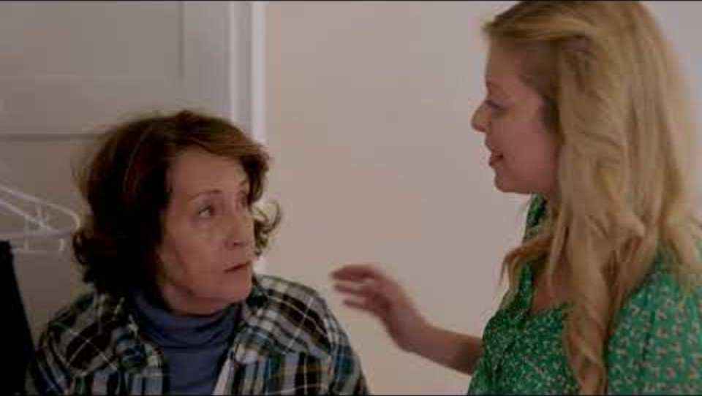
How to Handle Repetitiveness
Speak in a soothing, calm voice
Respond to the questions when asked.
Listen attentively.
Suggested not to correct the individual when they repeat something multiple times.
Quiz Part A

Slide 12
Paranoia and Suspicion
Causes:
What it Looks Like:
Disorientation
Confusion
Change in routine or environment
Believing others are stealing from or harming them.
Having suspicion without cause.

Slide 13

How to Handle Paranoia and Suspicion
Be reassuring
Listen attentively
Take note of what is being said (document)
Remain calm
Don’t blame

Slide 14
Confusion and Disorientation
Causes:
What it Looks Like:
Change in routine or environment
Trouble communicating
Restlessness
Tiredness
Difficulty understanding language
Getting lost
Being unable to complete familiar tasks

Slide 15
How to Handle Confusion and Disorientation
Remain calm
Speak in a soothing voice
Be reassuring
Avoid yelling and talking loudly

Slide 16
Restlessness and Fidgeting
Causes:
What it Looks Like:
Change in routine
Change in environment
Change to eating habit(s)
Difficulty communicating
Boredom
Tiredness
Wringing hands
Tapping/moving foot or feet
Squirming in chair
Folding/unfolding paper or napkins
Moving items around on table

Slide 17
How to Handle Restlessness and Fidgeting
Make sure the person has plenty to eat and drink
Have a daily routine, including daily walks
Give them something to occupy their hands if they fidget a lot (worry beads, fidget toy, box of items that has meaning to them)
Quiz Part B

Slide 18
Loss of Self-Confidence
Causes:
What it Looks Like:
Disorientation
Confusion
Change in routine
Change in environment
Unsteady hands
Memory impairment worsens
Saying that they can no longer do a particular task.
Not wanting to participate in an activity they once enjoyed.

Slide 19
How to Handle Loss of Self-Confidence
Reassure them that the activity, or getting there, will be straightforward.
Give clear explanations
Remain calm
Don’t argue

Slide 20
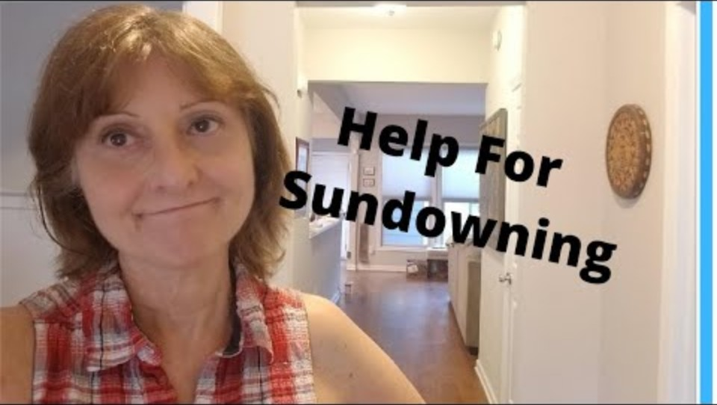
What is Sundowning?

Slide 21
Sundowning: Agitation in the Evening
Causes:
What it Looks Like:
Low lighting
Fatigue
Disrupted routines
Overstimulation
Unfamiliar surroundings
Increased confusion
Agitation and restlessness
Mood changes
Aggression
Difficulty with tasks
Paranoia, delusions, hallucinations

Slide 22
How to Handle Sundowning
Create a calm and consistent environment.
Establish a routine
Encourage daytime activity
Provide natural light
Reduce evening stimulation
Manage shadows
Create a calming bedtime routine
Remain calm and patient
Listen and reassure
Identify triggers
Distract and redirect

Slide 23
Inappropriate Behaviors
Unwanted touching
Unwanted comments
Hugging/touching when not asked for
Making comments about going home with other people (not the spouse)
Sexual comments
Trying to undress in public

Slide 24
How to Handle Inappropriate Behavior
Modify the environment:
Limit overstimulation (crowds, noise, bright lights)
Keep familiar settings and routines
Offer private, quiet areas when needed
Redirect gently:
Shift the topic or activity when behaviors happen
Avoid confrontation, and change the focus instead
Encourage meaningful activity:
Use music, art, or tactile tasks to reduce restlessness
Include light exercise or movement during the day
Build supportive routines:
Use consistent schedules and clear expectations
Reinforce boundaries with kindness and structure
Connect with caregiver communities:
Connecting with a local support group can offer tips and empathy from people navigating the same experiences
Post your questions on forums for others to respond to

Slide 25
Inappropriate Behavior: Video
Inappropriate Behaviors

Slide 26


Final Quiz: Part C
Quiz Part C

