Slide 1

Kitchen & Food Safety
Dr. christina parker, executive director

Slide 2
Why is food safety important?
Engaging in safe habits in the kitchen—whether preparing food, serving food, or cleaning up—is paramount to healthy decision making.
Food that is left to thaw and potentially drip contents onto other food is a health risk—food poisoning can occur.
It’s always important to check donated items, and ones you purchased, for dented cans, partially removed labels, tear in a box, etc. Any one of these issues could mean that the food inside the can/box is unsafe to serve.

Slide 3

Foodborne illness, or food poisoning, often presents itself as flu-like symptoms such as nausea, vomiting, diarrhea, or fever, so many people may not recognize that the illness may be caused by bacteria or other pathogens in food.
Bacteria that cause disease are called pathogens.When certain pathogens enter the food supply, they can cause foodborne illness. Millions of cases of foodborne illness occur each year and most can be prevented. Proper cooking or processing of food destroys bacteria.
This Photo by Unknown Author is licensed under CC BY-SA-NC

Slide 4
How bacteria gets into food
Bacteria may be present on products when you purchase them. Plastic-wrapped boneless chicken and ground meat, for example, were once part of live chickens or cattle. Raw meat, poultry, seafood, and eggs are not sterile. Neither is fresh produce such as lettuce, tomatoes, sprouts, and melons.
Foods, including safely cooked, ready-to-eat foods, can become cross-contaminated with bacteria transferred from raw products, meat juices or other contaminated products, or from food handlers with poor personal hygiene.

Slide 5
Cleanliness
Wash hands frequently, especially when in contact with other foods, shaking hands, using the restroom, handling cleaning supplies, etc.
Keep countertops cleaned.
Clean cutting boards between uses—if used for raw meat, clean before using for produce or anything else.
Keep cutlery clean between uses.
Keep raw meats/foods away from ready-to-eat foods to avoid cross contamination.

Slide 6
When you shop for foods
Do not purchase canned goods that are dented, leaking, bulging, or rusted. These are the warning signs that dangerous bacteria may be growing in the can.
Separate raw meat, poultry, and seafood from other foods in your grocery shopping cart and in your refrigerator. Buy cold foods last.
Plan to drive directly home from the grocery store. You may want to take a cooler with ice or frozen gel packs for perishables. Always refrigerate perishable food within 2 hours. Refrigerate within 1 hour when the temperature is above 90 °F.

Slide 7
Preparing foods
Keep raw meats separated from ready-to-eat foods.
If a raw meat touches the cutting board or counter top, immediately clean the area before cross contamination with another food.
Keep refrigerated foods at the proper temperature; make sure to seal food that is not eaten and place in refrigerator within a 1-2 hour time period.
Cook all foods to the correct temperatures. If unsure, follow this guide from the USDA.
USDA Guide to Food Safety

Slide 8
Wash hands and surfaces often. Bacteria can be spread throughout the kitchen and get onto cutting boards, utensils, and counter tops. To prevent this: Wash hands with soap and warm water for 20 seconds before and after handling food, and after using the bathroom, changing diapers, or handling pets.
Use paper towels or clean cloths to wipe up kitchen surfaces or spills. Wash cloths often in the hot cycle of your washing machine.
Wash cutting boards, dishes, utensils, and counter tops with hot, soapy water aft er preparing each food item and before you go on to the next item. A solution of 1 tablespoon of unscented, liquid chlorine bleach in 1 gallon of water may be used to sanitize washed surfaces and utensils.

Slide 9
Using cutting boards
When cutting boards are used:
Always use a clean cutting board.
Use one cutting board for fresh produce and a separate one for raw meat, poultry, and seafood.
Once cutting boards become excessively worn or develop hard-to-clean grooves, you should replace them.

Slide 10
Thawing food
Never thaw food at room temperature.
Thaw food:
In the refrigerator.
In the microwave, but cook the food immediately.
Food may also be thawed in cold water. Be sure that the sink or container that holds food is clean before submerging food.
Two methods may be used when thawing: Completely submerge airtight wrapped package. Change water every 30 minutes. Completely submerge airtight wrapped food in constantly running cold water.
Cook food immediately after thawing

Slide 11
Partially cooked food
Never partially cook food for finishing later because you increase the risk of bacterial growth on the food. Bacteria are killed when foods reach a safe internal temperature.
Don’t use recipes in which eggs remain raw or only partially cooked. Eggs should be prepared immediately after breaking. When possible, substitute pasteurized eggs for raw eggs in cooked dishes.
When preparing food in the oven, set the oven to at least 325 °F. Cook food to the safe internal temperature. Check temperature in several places with a food thermometer.
If a convection oven is used to prepare food, you may reduce oven temperature 25 °F. Refer to oven manufacturer’s instructions for additional information.

Slide 12
Can a microwave be used to cook food?
A microwave oven can be used to prepare food, but care must be taken to make sure food reaches a safe temperature throughout.
Know the wattage of your microwave.
Stir or rotate food midway through the microwaving time to eliminate cold spots, and for more even cooking. Cover food.
Partial cooking may be done in the microwave only if the food is to finish cooking immediately, either on the range, grill, or in a conventional oven.
Observe standing times given in recipes so cooking is completed.
Use a food thermometer or the oven’s temperature probe to be sure the food has reached a safe internal temperature. Check temperature in several places. Check manufacturer’s instructions.

Slide 13
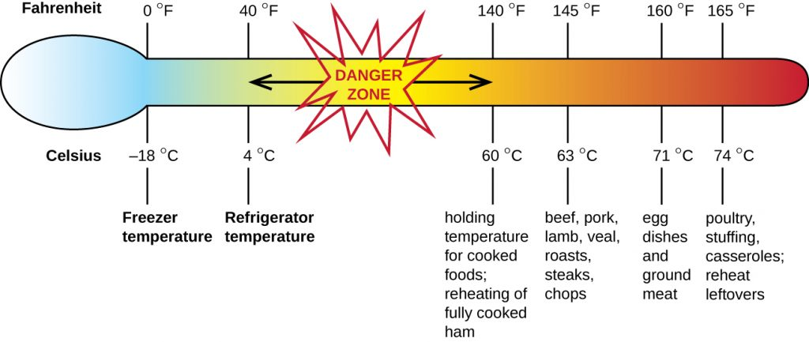
Danger zone
Bacteria multiply rapidly between 40 and 140 °F. To keep food out of this “Danger Zone,” keep cold food cold and hot food hot. Keep food cold in the refrigerator, in coolers, or on the serving line on ice. Keep hot food in the oven, in heated chafing dishes, or in preheated steam tables, warming trays and/or slow cookers.
This Photo by Unknown Author is licensed under CC BY

Slide 14
When you store food
Refrigerate
Freeze
Make sure the temperature in the refrigerator is 40 °F or below and 0 °F or below in the freezer. Check these temperatures with an appliance thermometer.
Refrigerate or freeze perishables, prepared foods, and leftovers within 2 hours (1 hour when the temperature is above 90 °F) of shopping or preparing. Place raw meat, poultry, and seafood in containers in the refrigerator, to prevent their juices from dripping on other foods. Raw juices may contain harmful bacteria.

Slide 15
When you reheat food
Heat cooked, commercially vacuum-sealed, ready-to-eat foods, such as hams and roasts, to 140 °F.
Foods that have been cooked ahead and cooled should be reheated to at least 165 °F.
Reheat leftovers thoroughly to at least 165 °F.
Reheat sauces, soups, and gravies to a boil.
On Stove Top—Place food in pan and heat thoroughly. The food should reach at least 165 °F on a food thermometer.
In Oven—Place food in oven set no lower than 325 °F. The food should reach at least 165 °F on a food thermometer.
In Microwave—Stir, cover, and rotate fully cooked food for even heating. Allow standing time. Heat food until it reaches at least 165 °F throughout.

Slide 16
In Slow Cooker, Steam Tables or Chafing Dishes— Not Recommended
Reheating leftovers in slow cookers, steam tables or chafing dishes is not recommended because foods may stay in the “Danger Zone,” between 40 °F and 140 °F, too long.
Bacteria multiply rapidly at these temperatures.

Slide 17
When you keep food hot
Once food is cooked or reheated, it should be held hot, at or above 140 °F.
Food may be held in an oven or on a serving line in heated chafing dishes, or on preheated steam tables, warming trays, and/or slow cookers.
Always keep hot food hot.
Hot holding for extended periods may reduce the quality of the food.

Slide 18
When you keep food cold
Store food in a refrigerator at 40 °F or below. If there is not enough room in the refrigerator, place food in coolers with ice, or frozen gel packs. Always keep cold food cold.
Do not stack foods that could drip or leak onto other foods and cause cross contamination.

Slide 19
When you serve food
Use clean containers and utensils to serve food.
Do not use a plate that previously held raw meat, poultry, or seafood unless the plate has first been washed in hot, soapy water.
When a dish is empty or nearly empty, replace with a fresh container of food, removing the previous container.
Place cold food in containers on ice. Hold cold foods at or below 40 °F.
Food that will be portioned and served on the serving line should be placed in a shallow container. Place this container inside a deep pan filled partially with ice to keep food cold.

Slide 20
Food like chicken salad and desserts in individual serving dishes can also be placed directly on ice, or in a shallow container set in a deep pan filled with ice. Drain off water as ice melts and replace ice frequently.
Once food is thoroughly heated on stovetop, oven or in microwave oven, keep food hot by using a heat source.
Place food in chafing dishes, preheated steam tables, warming trays, and/or slow cookers. Check the temperature frequently to be sure food stays at or above 140 °F.

Slide 21
What types of dietary restrictions do we look for?
Diabetes is the main restriction we look for. We know which participants are diabetic, and should be planning food and drinks around diabetic guidelines.
Drinking plenty of water is a big priority. Diabetic patients should consume enough water to keep their systems flushed of excessive sugars.
Coffee (unsweetened) and unsweetened tea are good for diabetics because they are typically low-calorie and do not have added sugars.

Slide 22
Basic dietary guidelines for those living with diabetes
Follow an eating plan that cuts down on carbs, focuses on lean proteins like fish and turkey and incorporates plenty of vegetables, especially leafy greens.
Follow an exercise plan that includes aerobic exercise and strength conditioning.
Take appropriate diabetes management medications.
Reduce stress, which can increase blood sugar.
Check with your loved one’s specialists to see if any dietary changes need to be made after starting a new medication or dose.

Slide 23
Helping those with dementia AND diabetes (suggestions)
Offer a balanced plate with nutrient-dense healthy fats such as nut butters and avocados. They are also packed with calories, so your loved one doesn't need to eat a lot. Other good choices include:
Smoothies with protein. Smoothies are a great way to incorporate high-fiber foods, like vegetables and many fruits, into a diet. Ideas for the protein source include protein powder, peanut butter or nut butter.
Oatmeal with nut butter
Omelets or egg scrambles
Tuna Casserole with noodles, cheese and garbanzos
Greek yogurt parfait
Cut back on empty-calorie refined sugars like cake and cookies, and consider replacing them with fruit.
Ill-fitting dentures often raise problems with chewing. Consider food that is soft, in small chunks and easier to swallow.
Adaptive eating devices can allow a person with dementia to eat on their own, which will help them maintain their independence and eat more. Examples include large-handled spoons, bowls and plates with higher rims and plates with suction cups on the bottom. In later stages of dementia, finger foods and using straws can be helpful.

Slide 24
Questions: Contact Dr. Parker or Dale Libby Quiz: Please complete the quiz below so we can ensure you went through the training.
Kitchen & Food Safety Quiz

