Slide 1
SAMPLE: Family Meeting

Slide 2
Agenda
Introduction
Goal today
Household Expectations (including 4 Non-Negotiable)
BREAK- 20 minutes
Manners
Chores
Hygiene
BREAK- 20 minutes
Family Meeting
Roll Out
Conclusion
Open Discussion

Slide 3
INTRODUCTION
We want to raise you to be kind, caring, confident, respectful, responsible, polite, independent people who never intentionally hurt others.
We want to teach you the household expectations, chores, hygiene and manners so that you can take care of yourself or others when you move out on your own.
We care about you, love you and want you to be successful, well rounded people able to function in the world. We are your parent, teacher and coach as well as your friend. We will be teaching you how to contribute to the household and be an active part of our family by being more responsible.

Slide 4
GOAL TODAY
Our goal today is to have you understand what our household expectations are. This way you can begin to follow/complete the expectations, manners, hygiene and chores without having to be prompted or asked.
We BOTH will be enforcing the expectations set today and addressing inappropriate behaviour, we will no longer ignore it.

Slide 5
HOUSEHOLD EXPECTATIONS
Get ready and follow along to see which ones you do already (check off as we go)! There are 4 that are not negotiable.
Each month at our Family Meeting we will go through these sheets again and see who is the most improved.
Prizes for increases in effort made and most improved!
Contest each month to see who doesn’t get fired…..

Slide 6
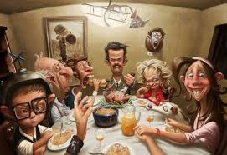
Family Meeting Once a Month

Slide 7
Total Media Time Max 2 hours (TV, Computer, Video Games – NO Devices at meals) Allowance for special occasions like Birthdays and Christmas

Slide 8
60 Minutes of Physical Activity a Day

Slide 9
Practice Daily Study Habits reading, piano, homework

Slide 10
LISTEN to Adults to prevent raised voices or yelling

Slide 11
Respect Each Other, the Internet and Us

Slide 12
Positive Attitude Don’t be Rude or Disrespectful

Slide 13
No Bad Language!!!

Slide 14
Keep Your Hands to Yourself! No wresting, hitting, kicking, throwing etc.

Slide 15
No Name Calling

Slide 16
No Yelling

Slide 17
Don’t Lie

Slide 18
Don’t Talk Back

Slide 19
#1 Non-Negotiable = Make Your Bed Make your bed before school and before noon on weekends (sofa bed back to couch too)

Slide 20
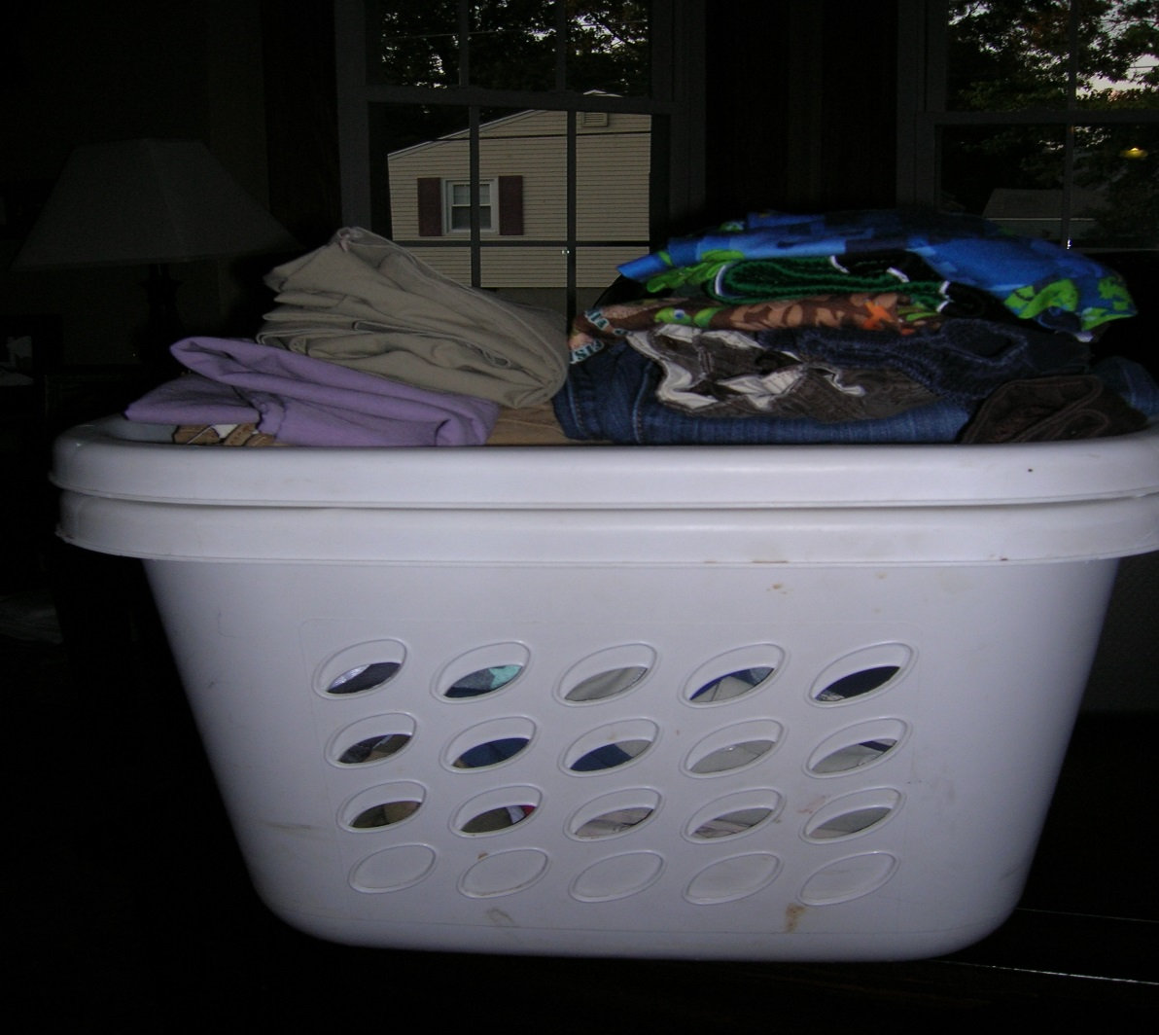
#2 Non-Negotiable = Dirty Clothes to Hamper Put your dirty clothes into the hamper NOT left on your floor!

Slide 21
Non-Negotiable #3 = Put Away Your Clean Laundry

Slide 22
Non-Negotiable #4 = Clear Dishes from Table/Counter Clear your dishes from the table and counter into dishwasher if available otherwise the sink Get rid of compost and garbage too….

Slide 23
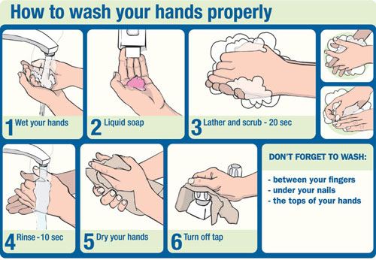
Wash Hands WITH Soap for 20 Seconds!

Slide 24
Flush The Toilet

Slide 25
Wash Your Hands Before Meals

Slide 26
Brush and Floss Your Teeth Brush for 160 strokes or 2 minutes, Floss before bed

Slide 27
Use Tissue To Pick Your Nose then sanitize your hands after or wash your hands after picking

Slide 28
Put Toilet Seat/Lid Down After Use

Slide 29
Shower Towels to Bathroom Hang them up to dry or put in hamper NOT on floor

Slide 30
Put on a new Toilet Paper Roll replace the roll if you finished it

Slide 31
All Toiletries Put Back in Drawers/Cupboards When Done toothbrush, floss, paste, brush, deodorant etc.

Slide 32
Turn On The Fan When You Have a Shower or Poop

Slide 33
Lights OFF When you leave the room

Slide 34
Turn TV, Electronics etc. OFF when you leave the room

Slide 35
Use Something???? Put It Back Where You Found It!!!!
Robes, Clothes, Blankets, Coat, etc.
Return to its home NOT left on the floor or chair etc.

Slide 36
Clean Up Your Toys bikes, scoters, boards, ramps, guns, Lego, etc. Put Them Back When You Are Done Playing

Slide 37
Clean Up and Put Away Electronics, Games, Etc. When finished playing with them (back in cases too)

Slide 38
Clean Up After Yourself! Garbage, cans, glasses, juice boxes, plastic milk clippings, etc. from food and drink into garbage or recycling or dishwasher. NOTHING to be left on tables etc.

Slide 39
Put it Back Where you Found it! All food, beverage used put back in cupboard, fridge etc. when done (cereal, milk, juice etc.)

Slide 40
Close Doors After You Open Them linen closet, bedroom closets, electronic cabinets, other closets etc.

Slide 41
No Eating Meals in the Family Room unless you have permission

Slide 42
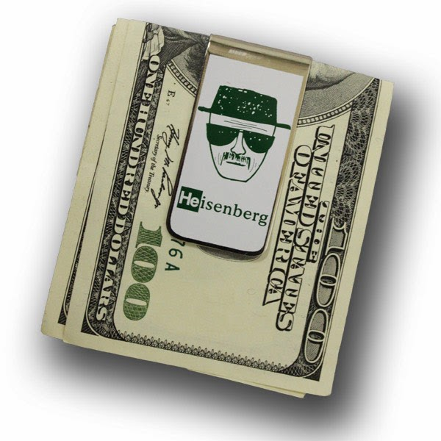
Keys and Wallets to Front Entrance Holder & Purses to Cubby

Slide 43
Coats on a Hook or Hanger

Slide 44
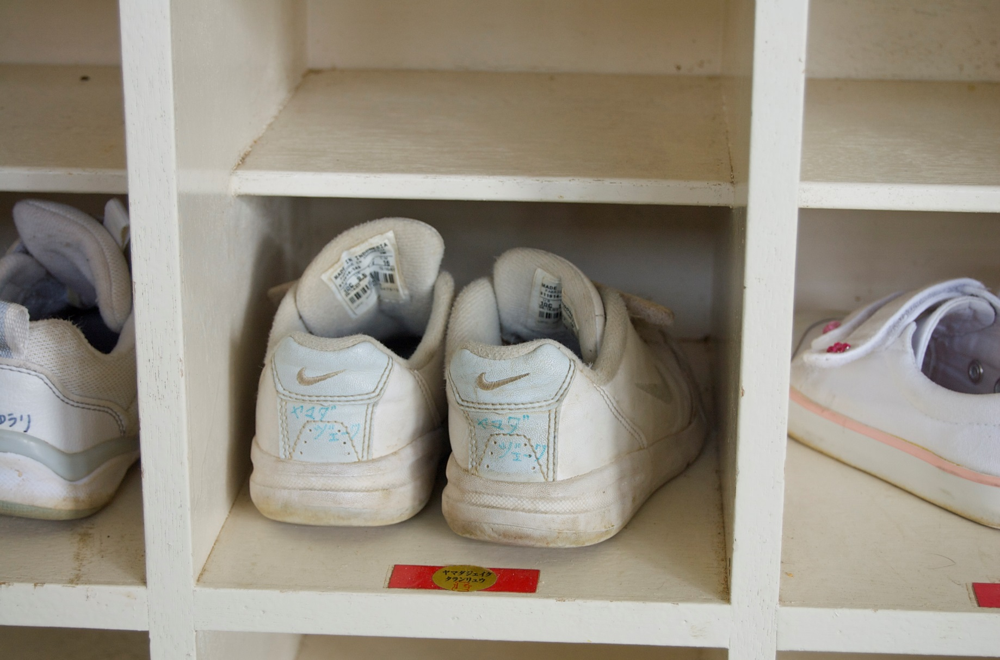
Shoes/Boots to Cubby or Closet

Slide 45
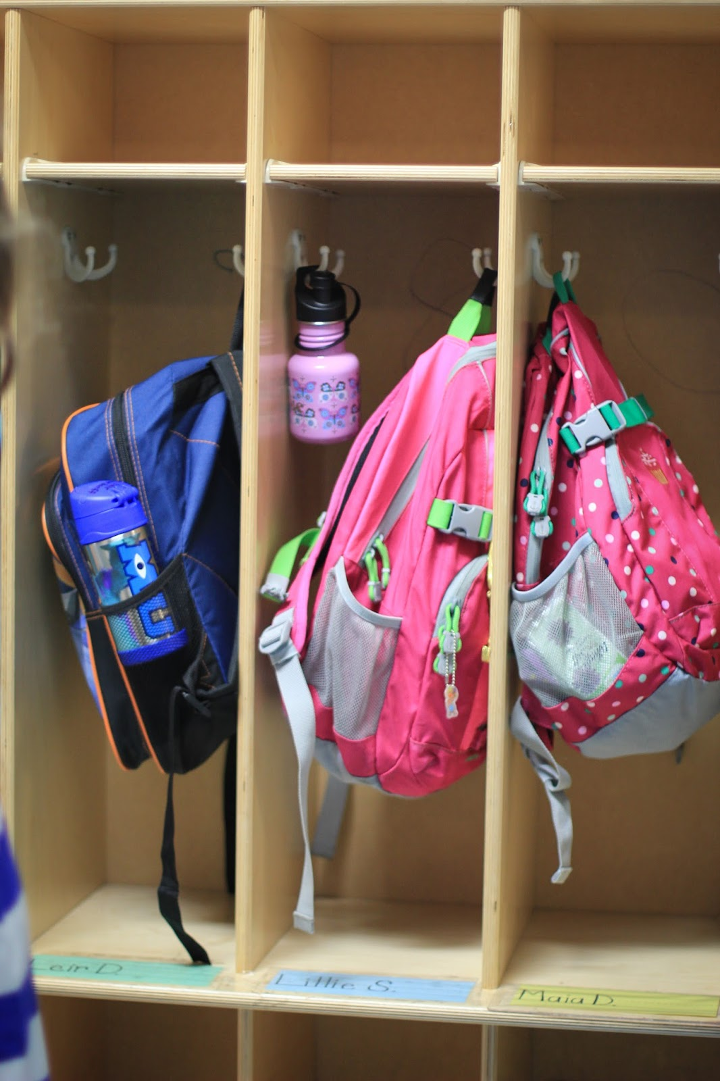
Backpacks into Cupboard

Slide 46
Used Socks into Hamper or Washing Machine NOT Left on Floor

Slide 47
Shirt/Pants ON at Dinner Table

Slide 48
Hats OFF at all meals

Slide 49
Push Your Chairs In When You Are Done Sitting or Eating

Slide 50
Replace Paper Towel If You Emptied It Last

Slide 51
Monthly Contest - You’re Fired!
When you have a job there are expectations set (as we just went through with our household expectations) that need to be followed.
If you don’t comply with the FAMILY CODE OF CONDUCT expectations and you are addressed by us you will be given a warning.
There are 3 warnings, then a final warning where you are FIRED for that month – FIRED, just like the real world.
If you can go the month without being FIRED you will receive 5 BONUS points!

Slide 52
BREAK- 20 minutes

Slide 53
MANNERS
We need you to do these
ON YOUR OWN
without needing to be asked or prompted

Slide 54
Say Please

Slide 55
Say Thank You

Slide 56
Say You’re Welcome

Slide 57
Say Excuse Me or Pardon Me after you burp, fart or need to get by someone

Slide 58
Say Bless You When Someone Sneezes

Slide 59
Don’t Talk With Your Mouth Full

Slide 60
Don’t Chew With Your Mouth Open

Slide 61
Ask to be Excused from table Don’t get up unless you have been….

Slide 62
Don’t Start Eating Unless Everyone Has Been Served or Parent or Host says so

Slide 63
Make Eye Contact When Talking To Someone

Slide 64
Share

Slide 65
Greet Guests In Our Home With A Genuine Hello

Slide 66
See Your Guests To The Door And Say Good-Bye

Slide 67
Shirts and Pants on at Dinner Table

Slide 68
Hats OFF at meals

Slide 69
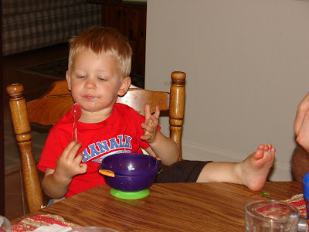
Elbows Off The Table When Eating and no Knees!

Slide 70
Cover Your Mouth When you Cough Into Your Elbow

Slide 71
Cover Your Mouth When You Sneeze Into Your Elbow

Slide 72
If You Are Not Feeling Well Wash Your Hands Often With Soap For 20 Seconds

Slide 73
CHORES
There are 4 chores that are not negotiable and are expected of you
1. Make your bed
2. Dirty laundry to hamper
3. Put clean laundry away
4. Clear your dishes from the table/counter into dirty dishwasher otherwise sink
Plus one other which gives you a $2.00 weekly allowance
Additional Chores have been given a point system that you can cash in for money $$$! Chores must be done on your own and not promoted.
1 point = $2.00
2 point = $4.00
3 point = $8.00
4 point = $16.00
5 point = $20.00
Here are the others for this household…..

Slide 74
Dust 2 POINTS

Slide 75
Vacuum= Nicole (main floor only)

Slide 76
Wash Floors 2 POINTS

Slide 77
Wash Mirrors 2 POINTS

Slide 78
Scrub toilets, sinks, bathtub, shower 5 POINTS

Slide 79
Load Dishwasher 1 POINT (DAILY)

Slide 80
Empty Dishwasher= Nick

Slide 81
Wash, dry and put away dishes that aren’t in dishwasher (pots, knives etc.) 2 POINTS (DAILY)

Slide 82
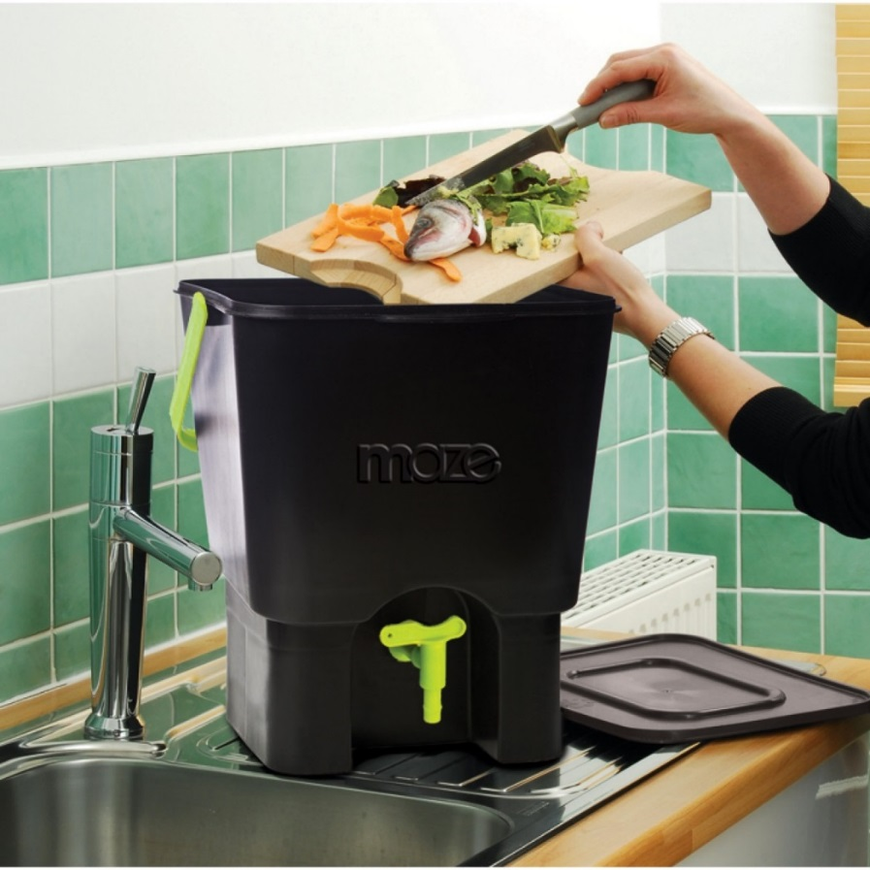
Collect Garbage's/compost and replace bags 1 POINT

Slide 83
Recycle to be sorted into bins in garage= Sam

Slide 84
Recycle, Garbage and Compost Bins out on pick up days 1 POINT

Slide 85
Bring back in recycle and compost bins to garage 1 POINT

Slide 86
Water plants and flowers 1 POINT

Slide 87
Clean your bedrooms 1 POINT

Slide 88
Set Table 1 POINT (DAILY)

Slide 89
Plan Meals 1 POINT (DAILY)

Slide 90
Make Meals 2 POINTS (DAILY)

Slide 91
Clear Table 1 POINT (DAILY)

Slide 92
Clean up after meals 2 POINTS (DAILY)

Slide 93
Clean Chloe’s Pen 3 POINTS (DAILY) pick up poop, wash towel, new towel down

Slide 94
Look After Chloe 1 POINT (DAILY) Clean her eyes, feed her, give fresh water daily and diaper her as needed

Slide 95
Clean up pee stains 3 POINTS

Slide 96
Wash Car 3 POINTS

Slide 97
Wash Windows 4 POINTS

Slide 98
Power Wash House 4 POINTS

Slide 99
Shovel Driveway/Walkway 4 POINTS

Slide 100
Pick Weeds 3 POINTS

Slide 101
Cut Grass 5 POINTS

Slide 102
Trim Bushes 3 POINTS

Slide 103
Trim Grass 3 POINTS

Slide 104
Rake Leaves 4 POINTS

Slide 105
Empty dehumidifier 1 POINT

Slide 106
Empty Diaper Genie and Load a New One 1 POINT

Slide 107
House Maintenance 3 POINTS +++ (Depends on task)

Slide 108
Hot tub maintenance 1 POINT

Slide 109
Grocery shopping and put away 1 POINT

Slide 110
Decorating n/a

Slide 111
Drive Kids to Activities n/a

Slide 112
Pay Bills n/a

Slide 113
Chore Points
1 point = $2.00
2 point = $4.00
3 point = $8.00
4 point = $16.00
5 point = $20.00

Slide 114
BREAK – 20 MINUTES

Slide 115
HYGIENE 101
Expectations are to complete without having to be prompted or asked.
We BOTH will be enforcing proper hygiene.
These are Basics that you should have under your belt by now

Slide 116
Bath / Shower at least every other day and actually WASH your body and hair

Slide 117
Brush your teeth with toothpaste for 2 minutes or 160 strokes

Slide 118
Floss your teeth

Slide 119
Wash your hands WITH SOAP!! EVERY time you use the washroom for 20 seconds or the length of ABC’s
Medical Quote:
“Washing your hands correctly (or using an alcohol-based hand rub) is the most effective thing you can do to protect yourself against a number of infectious diseases, such as influenza (the "flu") and the common cold. Not only will it help keep you healthy, it will help prevent the spread of infectious diseases to others.”

Slide 120
Brush your hair daily

Slide 121
Use deodorant daily

Slide 122
Wash your face at night to prevent acne

Slide 123
Q-tip your ears at least once a week

Slide 124
Wash your hands/sanitize after picking your nose, butt or privates

Slide 125
Trim your toe and fingernails minimum once a month

Slide 126
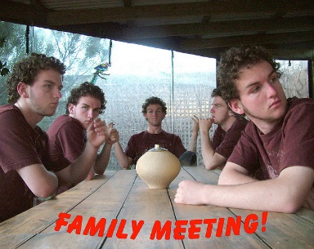
Family Meetings
Take place 1st Sunday of new Month together (1st one will be March 8th)
Review expectation sheets and reward for:
Most improved
Efforts made by each
Review if anyone got fired
Cash in your points for payout $$$$

Slide 127
The Roll Out
Starts Thursday February 5th
Hand out your household expectations package today
Expectations, Manners, Hygiene and Chores will be on the fridge if you need a review
Original Expectation sheet on fridge (for you’re fired)
Original Chore sheet for month on fridge to update (for points)
Calculate sheets on February 1st for first Family Meeting in March

Slide 128
NAME:______________________ |  | January |  |  | February |  |  | March |  |  | April |  |  | May |  |  | June |  |  | July |  |  | August |  |  | September |  |  | October |  |  | November |  |  | December
 |  | Y | N | S | Y | N | S | Y | N | S | Y | N | S | Y | N | S | Y | N | S | Y | N | S | Y | N | S | Y | N | S | Y | N | S | Y | N | S | Y | N | S
2015 Household Expectations
1. Family meeting once a month
2. Total media time (TV, computer, video games) MAX 2 hours a day unless it’s a special occasion like a b-day, Christmas.
3. 60 minutes of physical activity a day
4. Practice daily study habits (reading, piano, homework)
8. Listen to adults to prevent raised voices and yelling
6. Respect each other, the internet and us
7. Positive attitude (not rude, disrespectful)
8. No bad language
9. Keep your hands to yourself/ no wrestling/ no hitting/ no kicking/ no throwing etc.
10. No name calling
11. No yelling
12 Don’t lie
13. Don’t talk back
14. Make your beds before school and before noon on weekends– sofa bed back to couch too
15. Put your dirty clothes in the hamper not left on your floor
16. Put away your clean laundry
17. Clear dishes from the table/ counter into dishwasher if available otherwise the sink
18. Wash hands with soap for 15 seconds or the alphabet song after using the bathroom
19. Flush the toilet!
20. Wash your hands before meals
21. Brush your teeth for 160 strokes or for 2 minutes/floss
22. Use Kleenex to pick your nose, then sanitize or wash your hands after picking
23. Put the toilet seat/lid down after use
24. Shower towels to bathroom, hang up to dry or in laundry hamper
25. Put on a new toilet paper role if you were the one to finish the empty one
26. All toiletries (toothbrush, paste, brush etc.) put back in the drawer/cupboard when done
27. Turn on the fan when you have a shower or a poop
28. Lights off when you leave a room
29. Turn the TV, electronics etc. off when you are done or leave the room
30. Use something???? Put it back where you found it!!!
Robe, clothes, coat, blanket returned to its home NOT left on the floor or a chair etc.
31. Clean up your toys (includes bikes, scooters, boards, ramps etc.) and put them back when you are done playing with them
32. Clean up and put away electronics, games etc.
33. Put all garbage, cans, glasses, juice boxes, plastic milk clipping, etc. from food or drink into the garbage or recycling or dishwasher. Nothing to be left on any tables etc.
34. All food/beverage used put back in cupboard or fridge when done (cereal, milk, juice etc.)
35. Close doors after you open them (linen closet, bedroom closet, electronic cabinets etc.)
36. No eating meals in the family room unless you have been allowed by an adult
37. Keys to hook or entrance holder, purses to cubbies, wallets to entrance holder
38. Coats on a rack or hanger
39. Shoes in closet or cubbies
40. Backpacks into cupboards
41. Used socks into a hamper not left on the floor
42. Shirt/pants on at dinner table
43. No hats on at dinner table
44. Push your chairs in when your are done eating or sitting
45. Put on a new paper towel role if you were the one to finish the empty one

Slide 129
 | MONTH: ______________________ NAME: ___________________
POINTS | CHORE | Date |  |  |  |  |  |  |  |  | TOTAL
ALL | 1. Make beds
ALL | 2. Dirty laundry in hamper
ALL | 3. Put away your clean laundry
ALL | 4. Clear your dishes from the table/counter into dirty dishwasher otherwise the sink
SAM | · Recycle to be sorted into garbage bins | sam
NICK | · empty dishwasher | sam
NICOLE | · vacuum | sam
2 | · Dust
2 | · wash mirrors
2 | · wash floors
5 | · scrub toilets, sinks, bathtub, shower
1 | · load dishwasher
2 | · wash dishes, dry and put away that aren’t in dishwasher (pots, knives etc.)
1 | · collect all garbage/compost and replace bags
1 | · recycle, garbage out on pick up days
1 | · bring in recycle, compost bins to garage
1 | · water plants/flowers
1 | · clean your bedrooms
1 | · set table
1 | · plan meals
2 | · make meals
1 | · clear table
2 | · clean up after meals
1 | · empty dehumidifier
3 | · clean Chloe's pen (pick up poop, wash towel, new towel)
1 | · Look after Chloe (clean eyes, feed, fresh water and diaper)
3 | · clean up pee stains
3 | · wash car
4 | · wash windows
4 | · power wash house
4 | · shovel walkway and driveway
3 | · pick weeds
5 | · cut grass
3 | · trim bushes
3 | · whipper snip
4 | · rake leaves
1 | · empty diaper genie and load new one
3 + | · house maintenance
1 | · hot tub maintenance
1 | · grocery shopping and put away
na | · decorating
na | · pay bills
na | · drive kids to activities

Slide 130
Conclusion
We want to raise you to be kind, caring, confident, respectful, responsible, polite, independent people who never intentionally hurt others.
We want to teach you the household expectations, chores, hygiene and manners so that you can take care of yourself or others when you move out on your own.
We care about you, love you and want you to be successful and able to function in the world. We are your parent, teacher and coach NOT your buddy. We will be teaching you how to contribute to the household and be an active part of our family by being more responsible.
Like in the real world you will be recognized, rewarded, diciplined and paid for your work. There will also be an opportunity for Holiday Bonus Money at the end of the year for best in household.

Slide 131
Open Discussion

Slide 132
Thank you and Good Luck this Month!!!!! Love

