Slide 1
Introduction

Slide 2
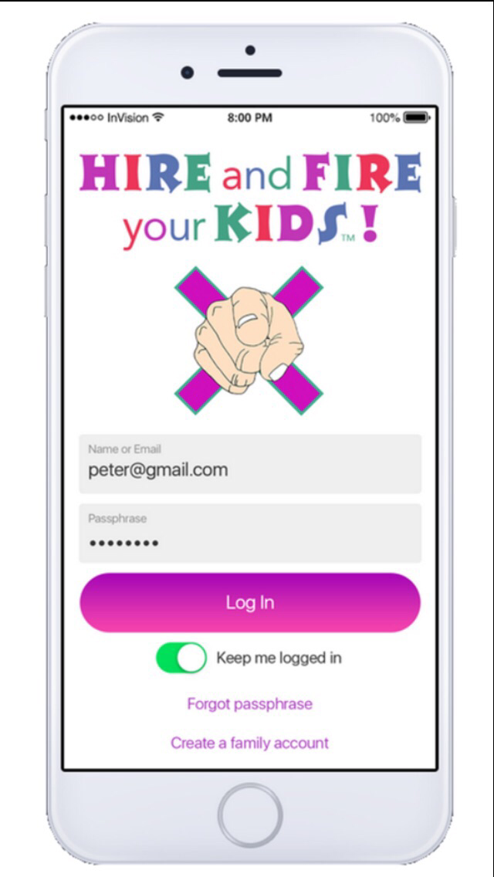
Hire and Fire your Kids
Mobile app
“HOW TO”
HIRE
Kids “apply” to rolling Job board & are HIRED!
FIRE
Kids follow family Values/Expectations or risk getting FIRED!
Object of the Game
Kids must go entire Pay Period without getting Fired.
Kids must earn as much as they can completing jobs for Hire before Pay Period ends.

Slide 3
Set up Hire and Fire your Kids app

Slide 4
Recognize your Kids with messages

Slide 5
Demo sending a message

Slide 6
How to give or remove a warning X

Slide 7
Demo giving a warning X

Slide 8
Demo removing a warning X

Slide 9
How Kids apply to jobs

Slide 10
Demo Kids applying for a job

Slide 11
How to re-open jobs

Slide 12
Pay Kids on payday

Slide 13
Demo pay Kids on payday

Slide 14
Chat with Founder of HFK

Slide 15
Object Of The Game
FIRED: Kids need to finish each Pay Period without getting Fired and earn the Incentive Bonuses making them eligible for the Employee of the Month.
HIRED: Kids can apply to rolling Job board for Hire, get rewarded upon completion and get paid out on Payday.
Kids do their best to follow the Family Values and Expectations you‘ve set together. If your Kid is caught NOT following a Value or an Expectation by you, they're given a warning X. After a certain amount of warning X's the Kid get's Fired. (Option to remove an X if the Kid corrects X immediately)
If the Kid can go the entire Pay Period without getting Fired they will receive a NOT FIRED Bonus.
If all Siblings can go the entire Pay Period without getting Fired they will each receive a TEAMWORK Bonus.
If your Kid does get Fired they are NOT entitled to the above Incentive Bonuses and a consequence that you set together at your last Team Meeting will activate.
Game Rules
Set your Pay Period (weekly, bi-weekly, monthly)
Set your recurring Pay Day Date
Set your Payment currency (dollars or points)
Set the number of Warning X's before getting Fired
Set the NOT FIRED Bonus reward amount
Set the TEAMWORK Bonus reward amount
Game On!
Set your recurring Family Team Meeting day and stick to it!
Stop giving your Kids money for their wants and stop buying their wants. Instead teach your Kids to EARN their wants.
Start playing with a Probationary Period in mind so everyone can get used to things...before getting Fired.
Kids apply for Jobs created by you and get rewarded upon completion (no assigning chores by you in this game)!
Kids follow the family values and expectations set, trying not to get Fired.
Kids get Paid out on Pay Day!

