Slide 1
Want to become a better parent?

Slide 2
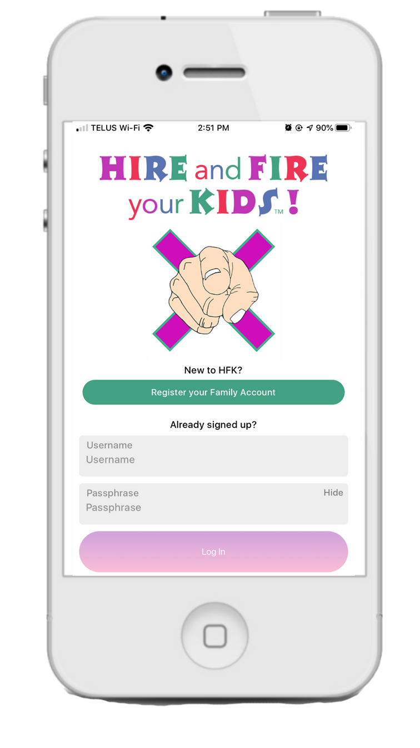
The World’s 1st
Gamified Parenting App

Slide 3
Problem
Parents are
overwhelmed
Communication is
changing
Limited financial literacy
Parents need help

Slide 4
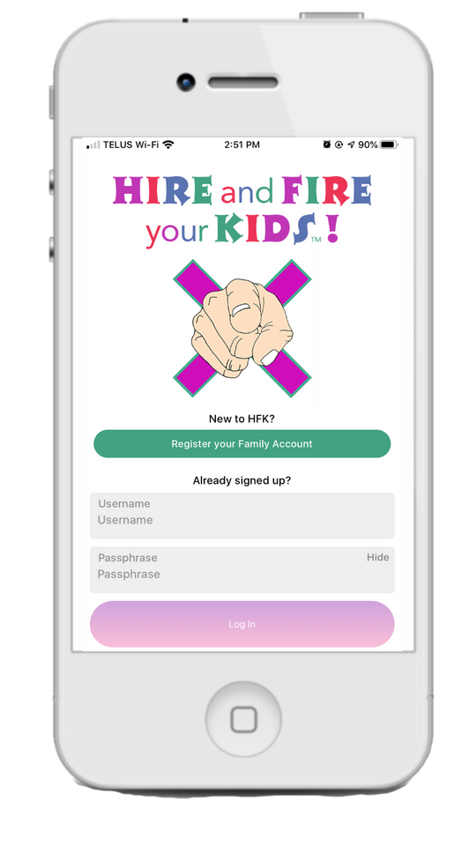
Current Resources
for Parenting
New Resource
Friends & Family
Gamified Parenting
Books, Podcasts, Articles
Professionals
=
Apps
ALL IN ONE

Slide 5
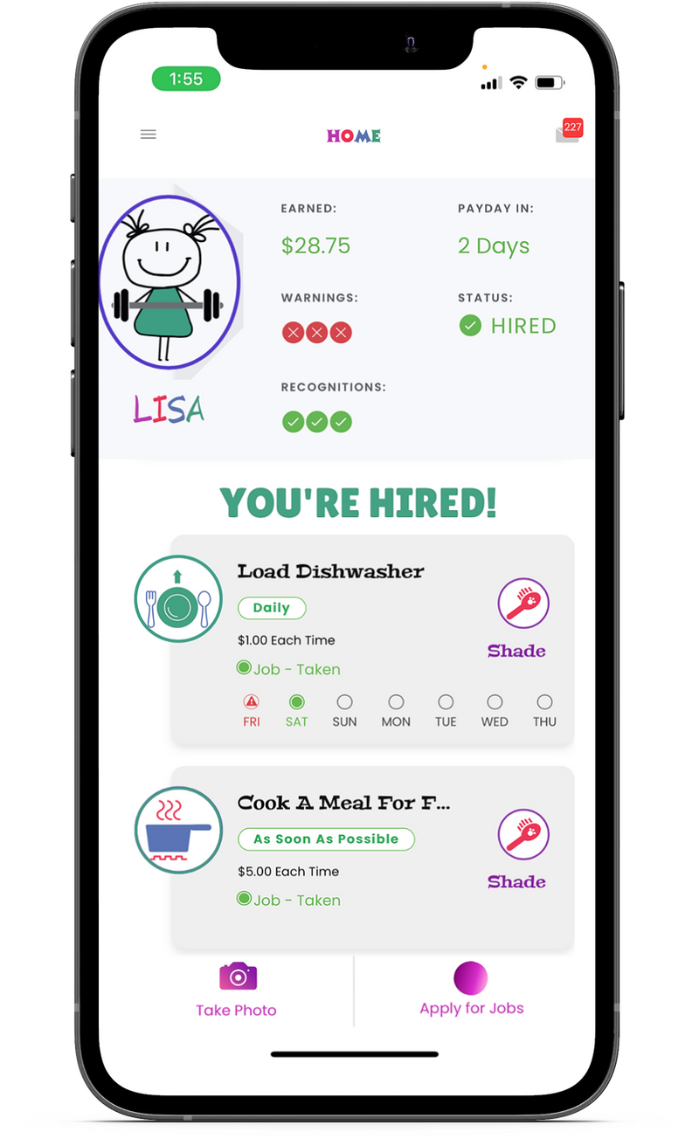
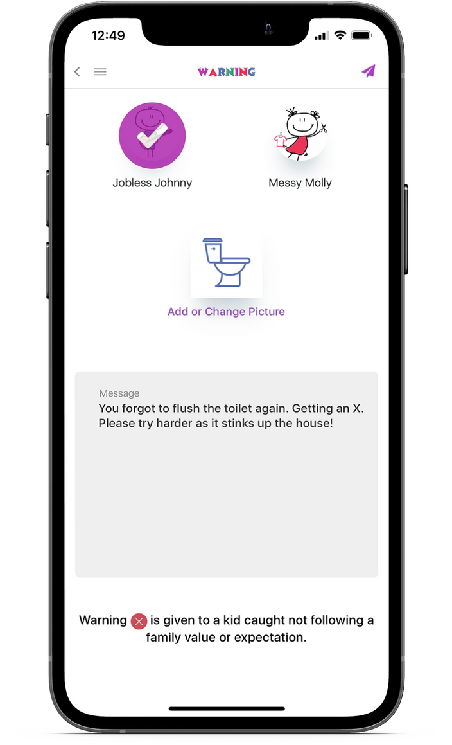
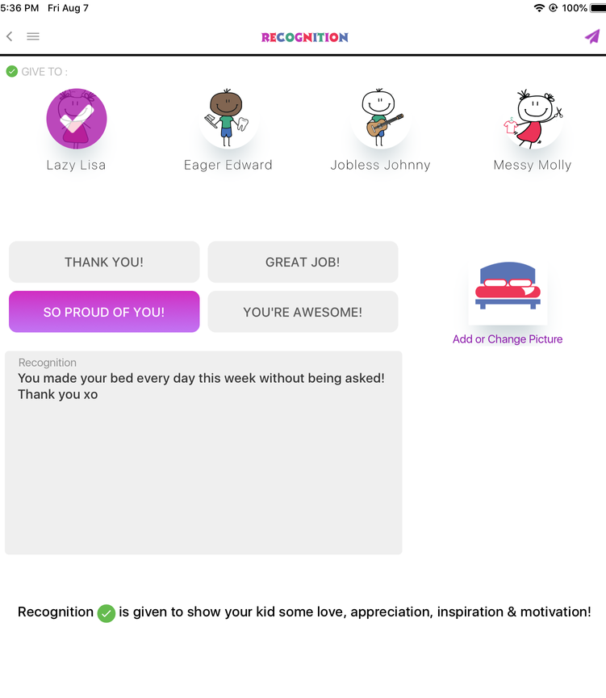
The Solution
Hire and Fire your Kids – Gamified Parenting App
Recognition
Reward
Consequence
YOU'RE RECOGNIZED!
YOU'RE FIRED!

Slide 6
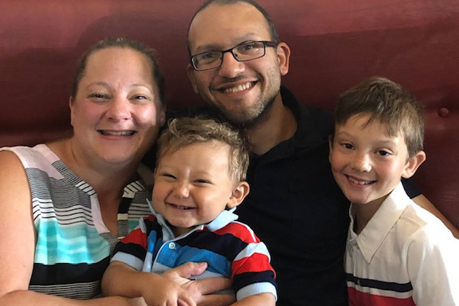
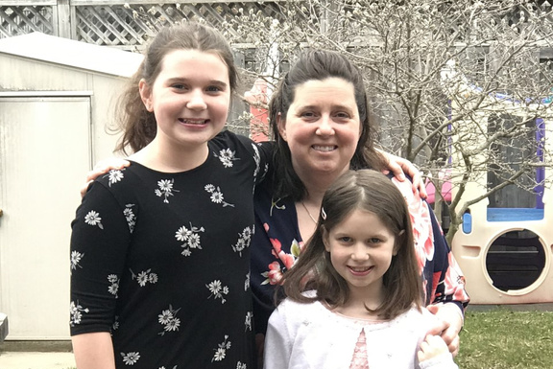
Testimonials
"He understands the expectations."
"My Teen’s at Work!"
“We Love Having Our Monthly Family Meetings."
Fantastic app! We have 3 teens at home and this keeps this mama sane and my home clean! I have MUCH more time to spend doing OTHER mom things! My teen's at work! Lol
- Lindsay
We love Hire and Fire your Kids. I have an 8 year old and this app helps him see what jobs are available and what he CAN do. He also takes responsibility for his jobs and understands the expectations in our house which is awesome! Definitely an app every family should have".
- Rachel, mother of 2 kids, ages 9 and 1
Hire and Fire your Kids has transformed the way we interact in the house. There is less complaining from my two kids and less nagging/yelling from me. We now work as a team to keep the house clean. We love having our monthly family meetings to discuss and revise expectations and discuss how the girls want to use the points they have earned.
- Michelle, mom of 2 ages 9 and 11

Slide 7
Recommendations
Psychologist
Social Worker
Behavioral Therapist
Dr. Kortney Peagram, Ph.D.
Stephanie Scott B.A (CYC) Child and Youth Counsellor
Janet Arnold, BA Psych., RECE
Behaviour Consultant,
"As a Psychologist and a Bully Teacher, I think this app is really important to have for every parent. It really drills down the importance of responsibility, accountability, and teaching our children about expectations. It builds character and promotes strong work ethics. It helps build problem solving and organizational skills. With the advance in technology, this app is easy to use and helps parents track progress. We highly recommend it in every home."
"This app (he loves electronics) has totally gained his interest in completing not only the simple chores he is expected to do, but take the lead and offer to complete other tasks that demonstrate he can contribute towards his household. It has been more enjoyable for the family to give praise and recognition where it is due, and has been a teachable tool for him to understand the real world, as he is approaching high school. I am happy to add Hire and Fire Your Kids app to my resource collection! I am eager to share it with other families in need, and watch how it makes a positive and fun, difference in their lives.'
RE: a youth on the spectrum
"Children feel confident when they try something on their own and master the skill. When we allow them the chance to do things on their own, we are teaching them core competency skills which is essential to lifelong success. It’s more than just doing their chores; it's about supporting our children to build independence in many different areas and to become self-reliant individuals who can become productive members in their communities. This app is a tool to help children develop these necessary skills from an early age."

Slide 8
Market
$260B
$600B
Facebook, Instagram & Google ads
In app advertising on apps with same target
PR firm to grow brand awareness and customer acquisition
buying power of pre-teens
of family spending influenced by pre-teen and teens.
Age 35-55
Age 7-16

Slide 9
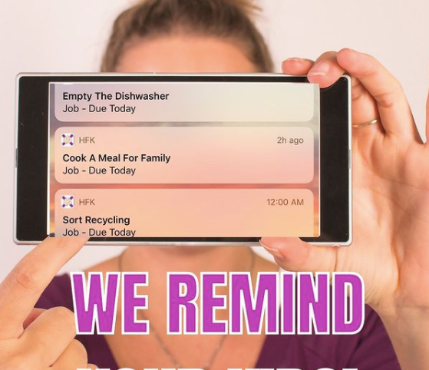
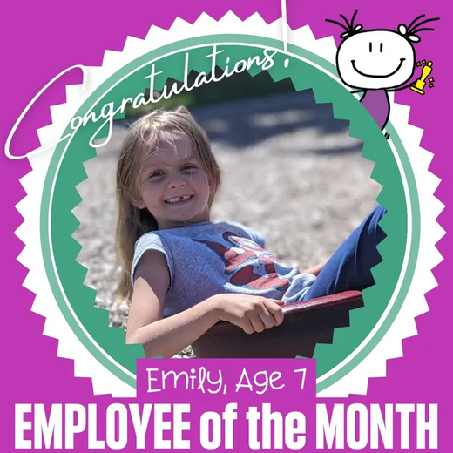
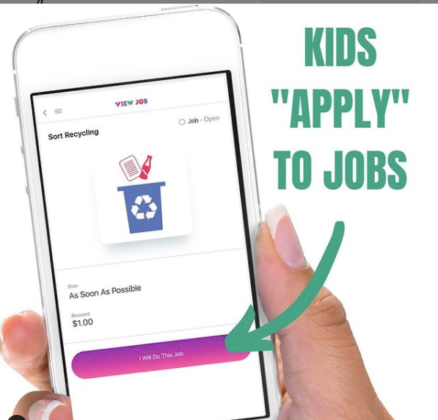
Competitive Advantage
World’s 1st Gamified Parenting App
helping to raise great kids
No other single app
offers all of this

Slide 10
The Team
Ted Tabisz
Co-Founder and COO
Ted’s career spans two decades in financial services with experience in product management, business case development, finance and operations. Ted also currently sits on the Board of Directors of a Public Traded company.
Lisa Swain
Director, Creative and Online Media
Lisa’s background includes 25+ years working in the software and tech industry. Lisa is an entrepreneur herself with in both merchandise and graphic design. She manages all the creative and marketing activities including user experience.
Jody Swain
Founder and CEO
Creware
Jody has 20+ years in business and consumer activities with a cross function of Senior Management experience in sales, marketing and operations
Development Partners
Creware is an India based software support and development company with multiple clients across North America and India

Slide 11
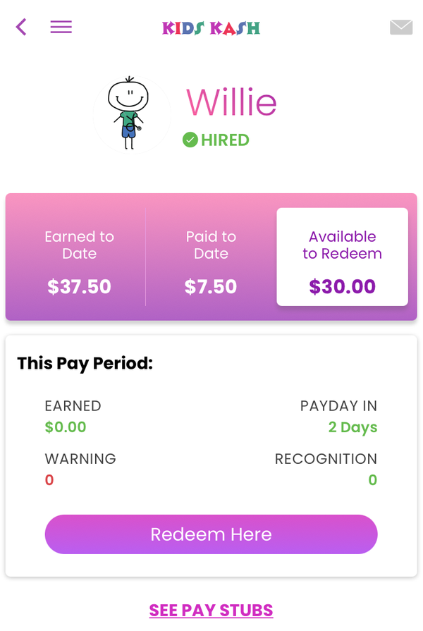
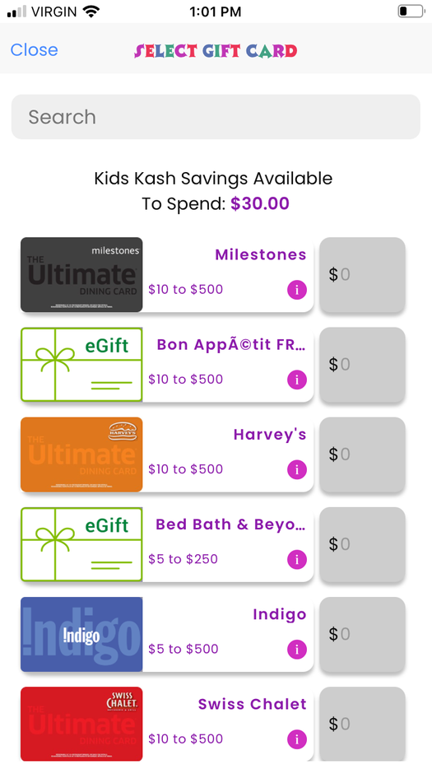
Monetization & Revenue Model
Implement Subscription Model
Gift Cards
Partnerships Secured
20+ Merchants
Fall 2021
Reloadable Debit Cards
Partnerships Established
Financial literacy enablement
(Keep, Give, Save)
In App Purchases
Basic vs $ for Customized Game Play
HFK Membership
Strategic Development On-going
Monetize Added Value Features of the App

Slide 12
Why You?
We are looking for support and guidance from industry leaders and subject matter experts to help us grow our connections, hone our pitch to secure investment and collaborate on our strategy to help us scale and monetize
‘THE WORLD’S 1ST’ GAMIFIED PARENTING APP’!
Support/Guidance
Community/Connections
Innovation/Execution

Slide 13
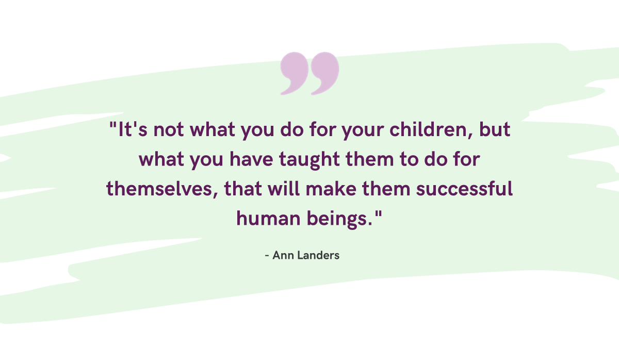
"It's not what you do for your children, but what you have taught them to do for themselves, that will make them successful human beings."
Ann Landers

Slide 14
Contact Us
905-665-0922
jody@hireandfireyourkids.com
www.hireandfireyourkids.com

Slide 15
Appendix

Slide 16
Company profile
Pre-revenue, cloud based Web and Mobile App company.
We focus on gamifying financial management, household responsibility and life skills for children.
The company was founded by Parents who see the need to embrace the digital age for communication, education and experiential learning.
Our goal is to provide our app free to parents and children, leveraging alternative monetization models.
We look to partner with brands who value the importance of teaching children financial acumen and differentiating life skills.

Slide 17
Current Status
Pre-revenue startup stage.
Poised to scale and we are in the process of raising capital.
Looking to partner with organizations who elevate the importance of children life skills.
HFK is currently expanding the brand awareness through public relations and other mediums including, social media, television, radio, influencers and live podcasts.

Slide 18
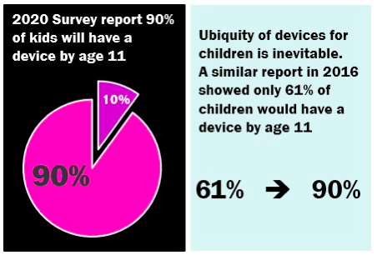
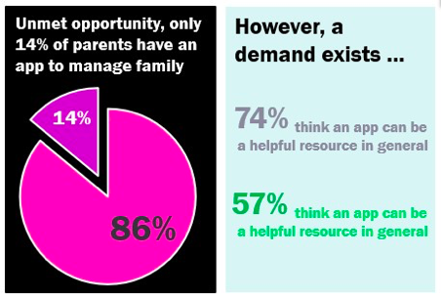
Statistics
90% of kids have their own device by age 11.
A parenting app is an unmet need, that parents want and is currently unavailable until now…

Slide 19
Gift Card Model
$21M at 6%
Kids can redeem their in-app earnings to purchase Gift Cards of their choice
HFK gets paid a 6% distribution fee on every card load
2022 Estimated Gift Card Spend is $21M
2
3

Slide 20
Milestones
2021
2022
Secure advertising and sponsorship partnerships
Employee of the Month and Year
Reloadable debit card launch offering Keep, Give, Save functionality
Trademark Kids Kash name
Expand team
CTO, Client Service, UI/UX engineer
Technology enhancements for gameplay & languages
Update UI/UX, more intuitive, vacation days, sick days, overtime, referral, cash advance, interest, self care reminders, employer contributions & more.
Automation for customer service and retention
Hybrid Virtual Adventure Video Game designed
Board game prototype
Hire & Fire Jr. home box rollout
HIRE & FIRE Membership launched
Login to web app for stats analytics, gameplay history, e-learning modules, parent point redemption, payment gift card history and orders, employee of the month, employee of the year nominations, random acts of kindness
Launch the Kids Kash card integration
Strategy Plan and Pitch Decks
Pitch to investors and raise capital $£$300,000
Ads begin on FB & IG in the US market
Engage influencer list and broaden influencer contacts
Licensed Hire and Fire your Kids India
Engage users Store reviews to 100 ea.
Technology enhancements based off customer feedback
Hire a PR team to increase brand awareness in radio, tv, publications, influencers
Secure partner for reloadable pre-paid debit cards
Test In-App purchases
Trademark registered in North America
Scale Operations
Expand our team
Technology enhancements
Tik Tok and Pinterest
2018/2019
2020
Alpha tested
Outsourced Canadian development
Registered Sole Proprietorship
Incorporated Hire & Fire Inc.
Lisa Swain Creative and Social joined team
Launched to social media
Hired new development team from India
Ted Tabisz COO joined team
Subscriber newsletter started
Joined Tech Accelerator, 1855 Whitby
Test Families
6 new versions released to stores
Partnered with Blackhawk cards
Top 50 in Canada’s Total Mom Pitch
1st Press Release released
Analytics added to HFK platform
Hired SEO team, ad campaign began on FB & IG
Added as a resource by Autism Speaks Canada and Boys and Girls Club
Trademark filed
Pre-Sales
Dragons’ Den pitch
Beta tested
“One to Watch”
“Game Changer of the Year”
“Innovative Idea of the Year”
Kickstarter Campaign, raised 10K
Dragons’ Den episode aired
Launched MVP app to App Store and Google Play
#1 paid app on the App Store in November

Slide 21
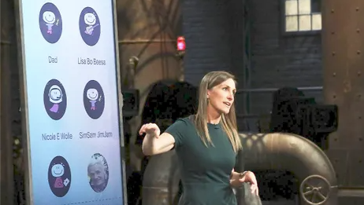
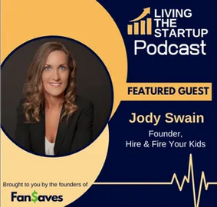
Media

