Slide 1
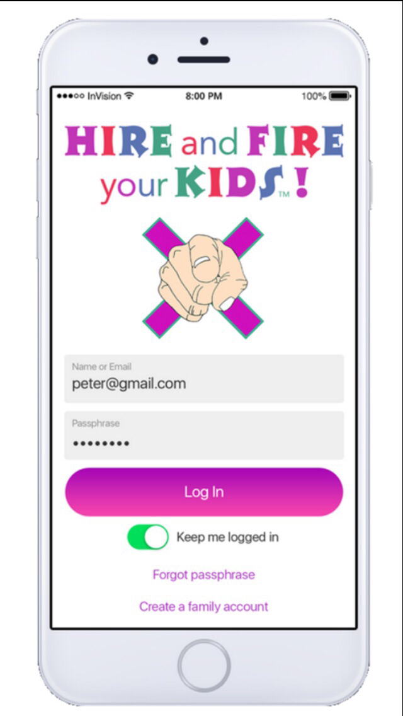
Hire and Fire your Kids
Mobile app
“HOW TO”
Object of the Game
Kids must go entire Pay Period without getting Fired.
Kids must earn as much as they can completing jobs for Hire before Pay Period ends.
HIRE
Kids “apply” to rolling Job board & are HIRED!
FIRE
Kids follow family Values/Expectations or risk getting FIRED!

Slide 2
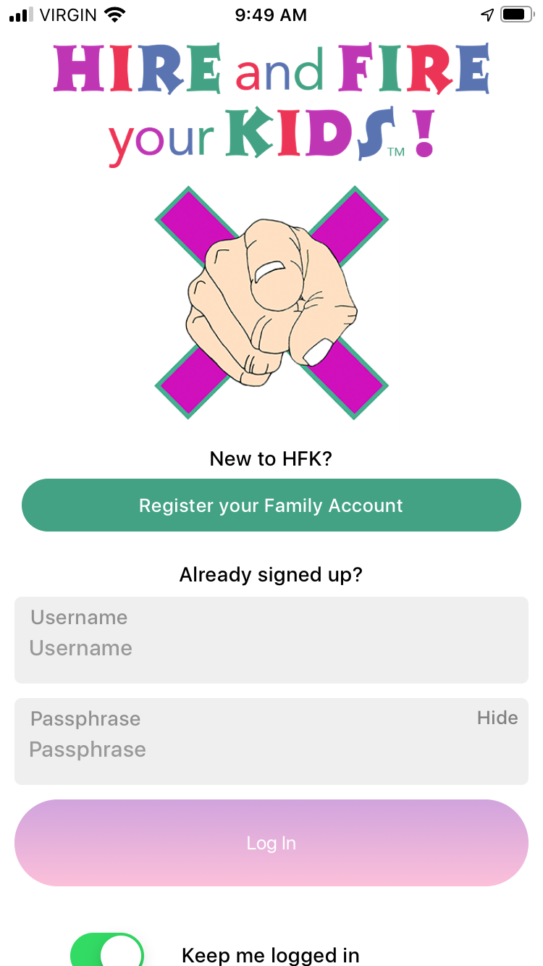
Click “Register a family account”

Slide 3
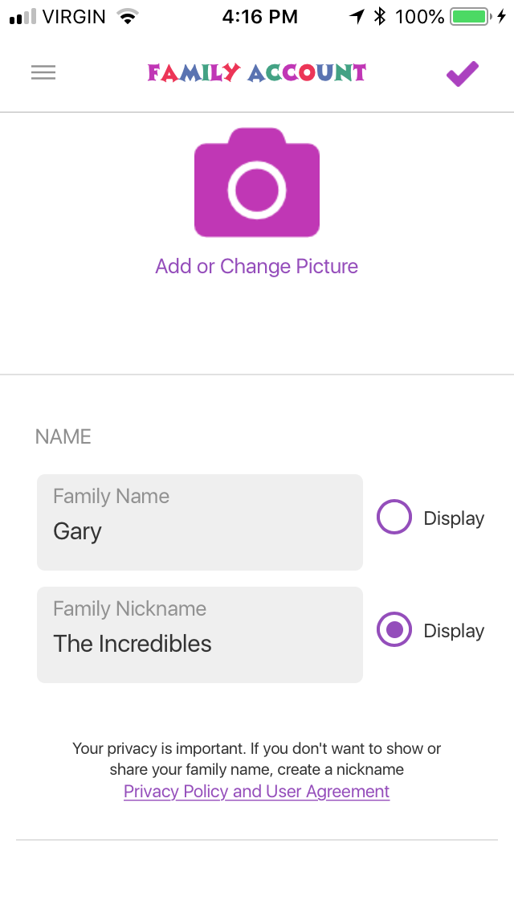
Fill in data, choose Family Name you want to display
Click “Add or Change Picture”
Save with checkmark top right hand corner

Slide 4
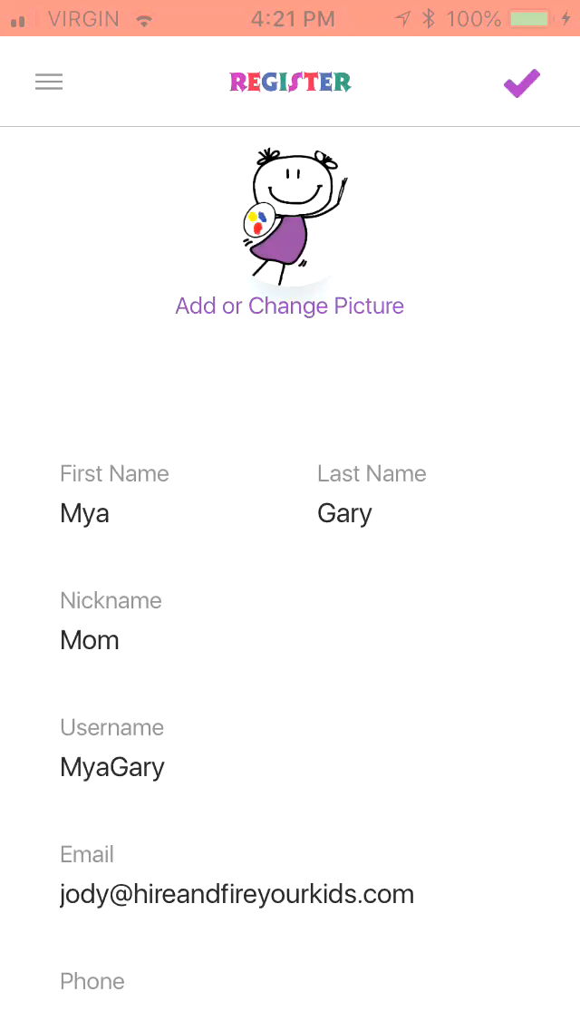
Fill in data
Create Username (e-mail will be sent with username for records)
Create & Remember your Passphrase (passphrase needs to be 14 characters and can have spaces)

Slide 5
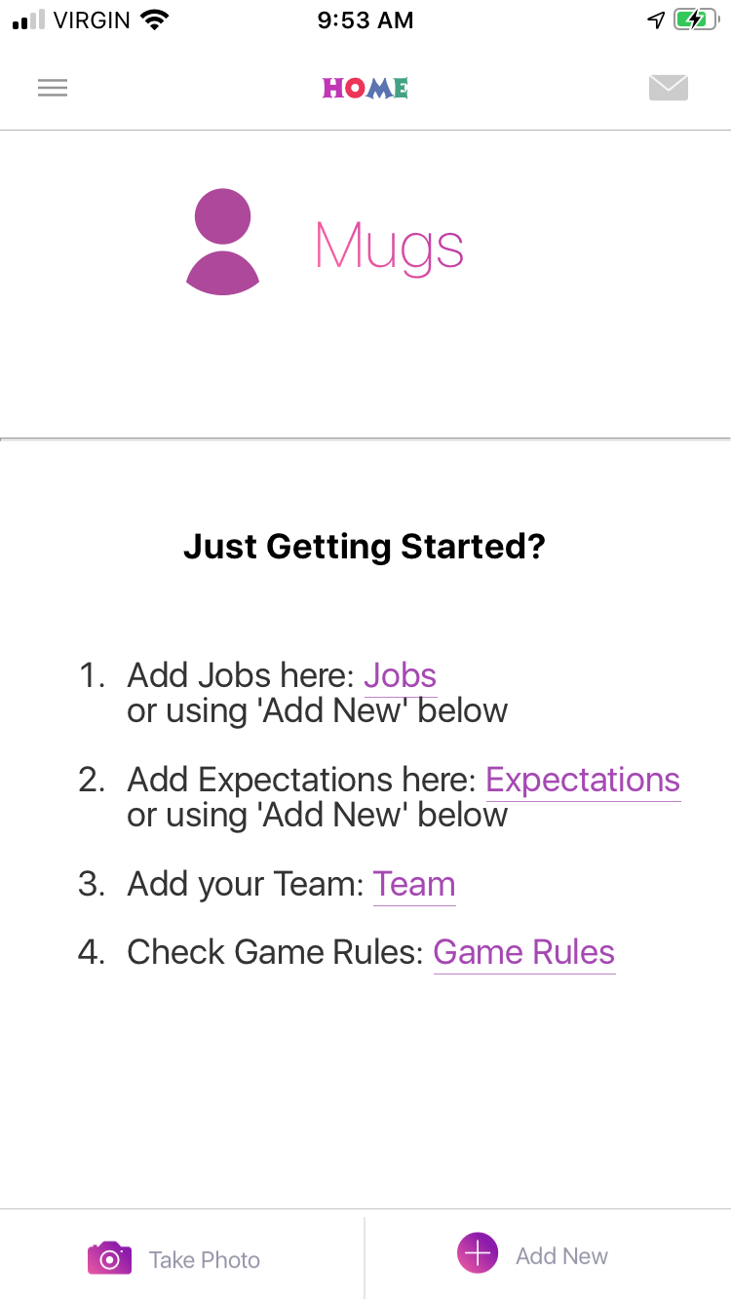
Home Screen Click Add “Jobs”

Slide 6
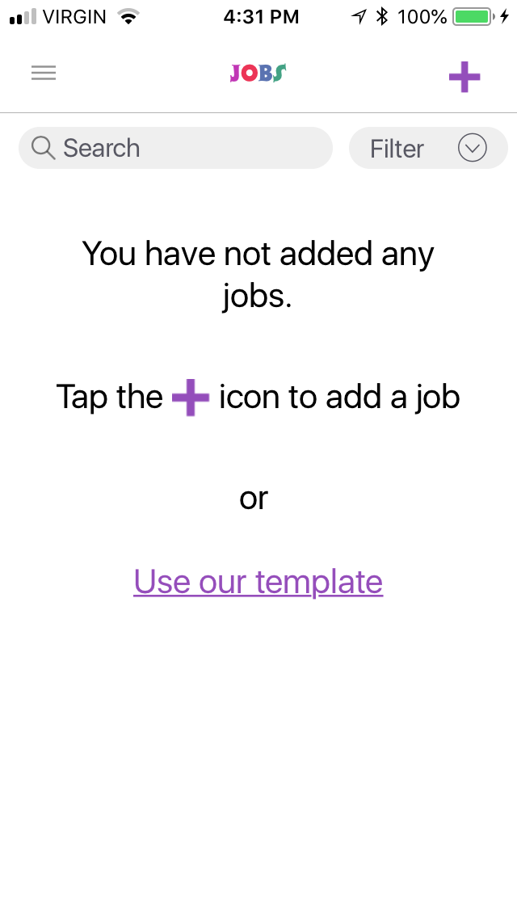
Click “Use our template” or you can add your own 1 by 1 using + sign top right
NOTE: If you choose to add your own you will NOT be able to go back and use template

Slide 7
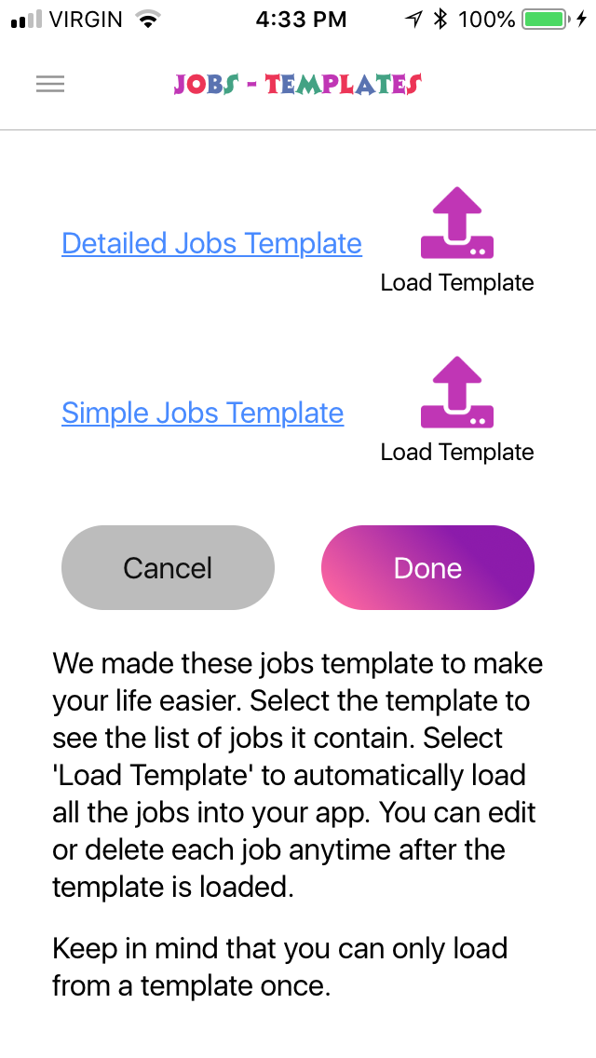
Load the detailed or simple template by clicking the arrow beside “Load Template”

Slide 8
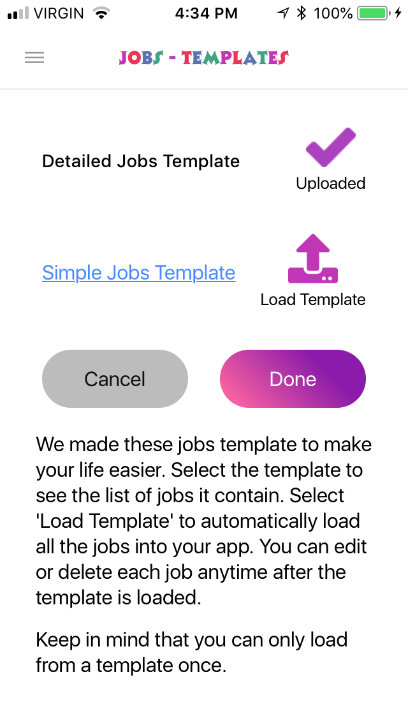
Click “Done” after checkmark appears

Slide 9
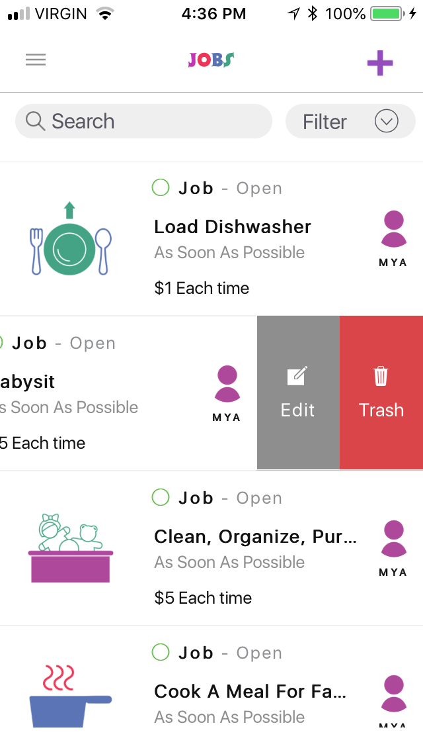
Jobs now loaded and you can begin to Customize to suit your family!
Slide left on the Job to see Edit and Trash
Use + top right to add Jobs of your own!

Slide 10
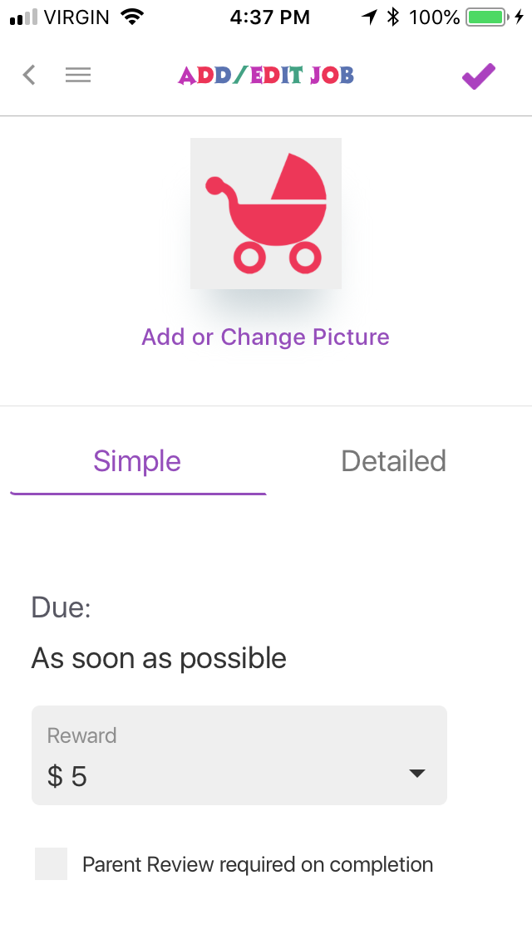
When you create your own or Edit a Job you can keep “Simple” and customize your reward amount with or without Parent Review
Use save checkmark when finished

Slide 11
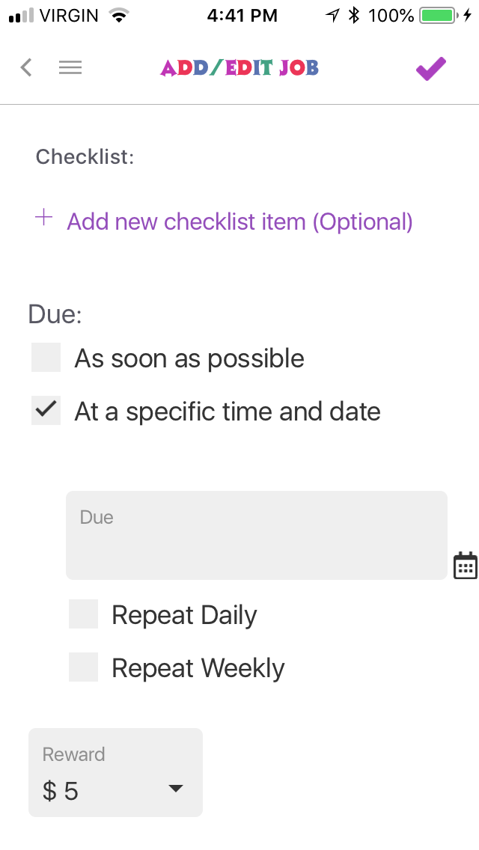
OR use “Detailed” allowing you to create a checklist of tasks and create due dates for Jobs with or without Parent Review
Use save checkmark when finished

Slide 12
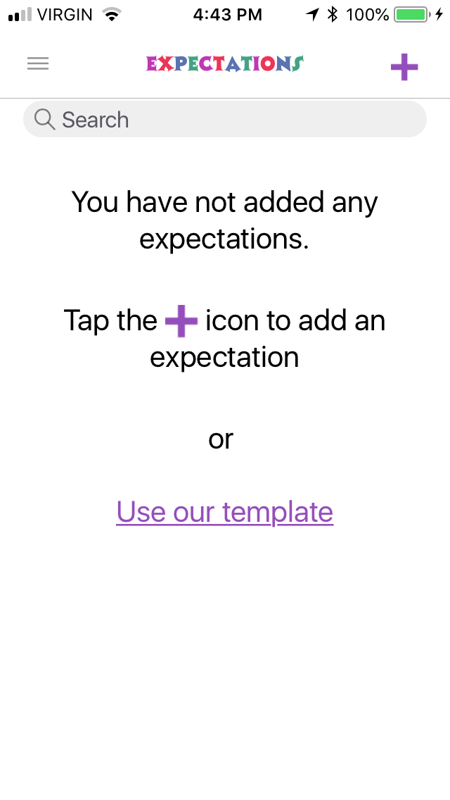
Click Menu Bar “3 lines” top left and go back to Home Page
Click “Expectations”
Use template to load in or use + on top right to add your own 1 by 1

Slide 13
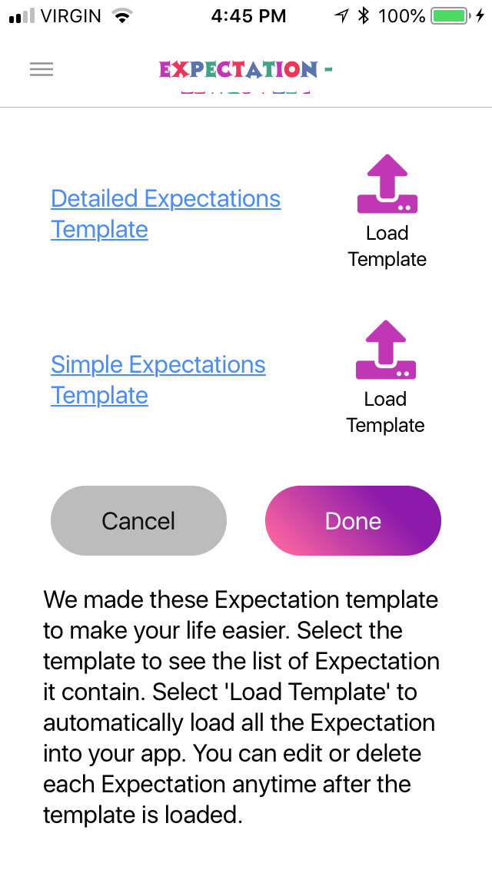
Load template of choice by clicking arrow “Load Template”
Confirm load with “YES”
Click “Done”

Slide 14
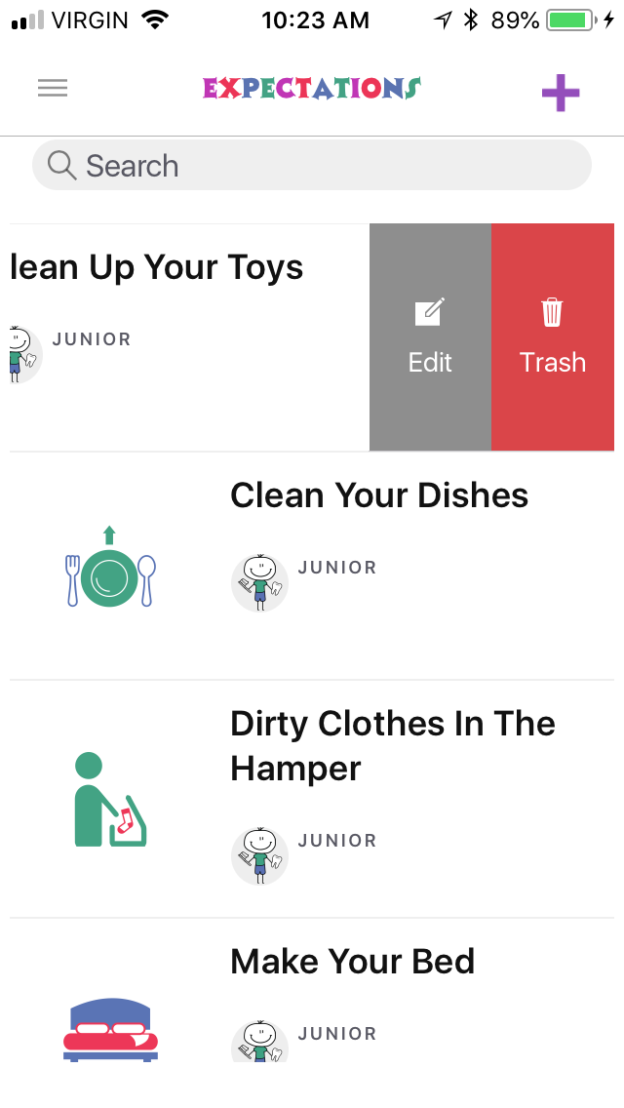
Customize Expectations to suit your family by swiping left to show Edit and Trash
Click menu (top left) and return to Home

Slide 15
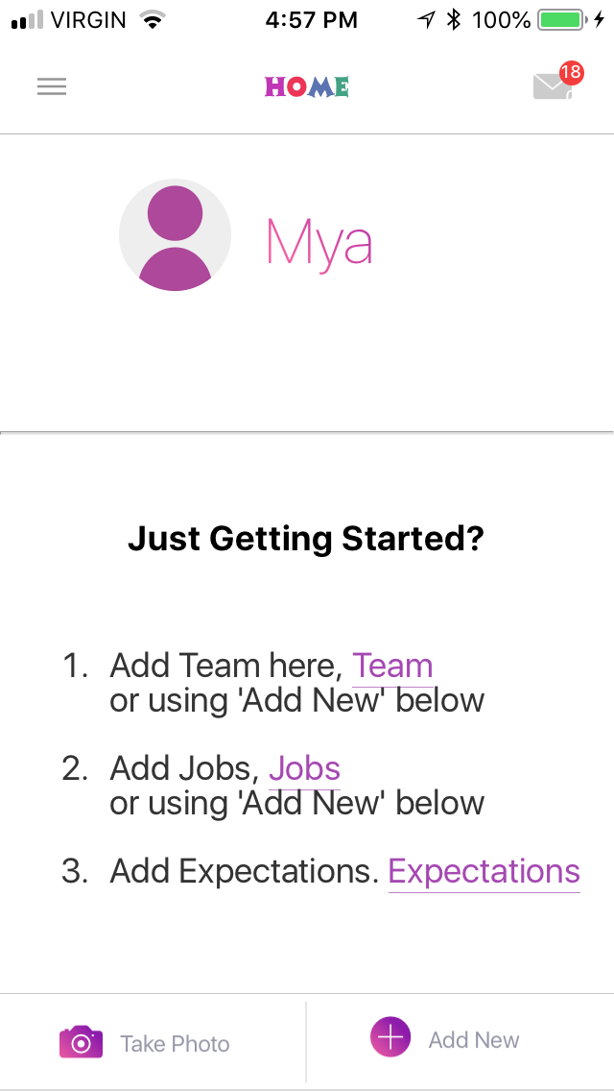
Click Add “Team”

Slide 16
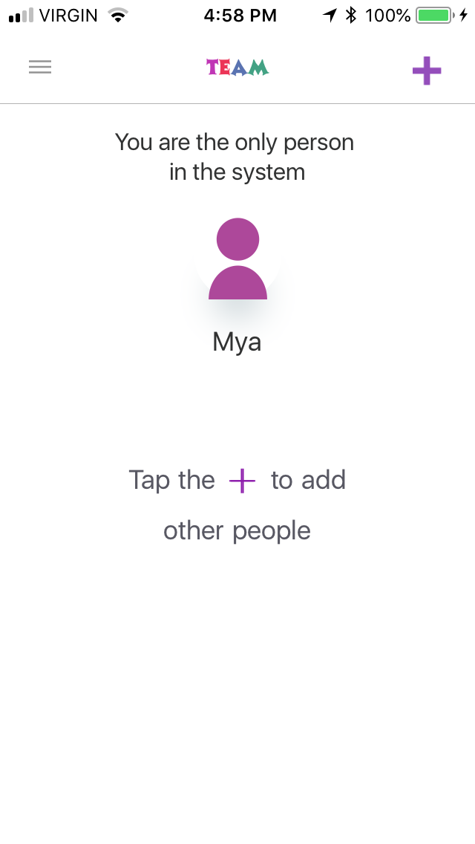
Click “+” top right and add you family members playing!

Slide 17
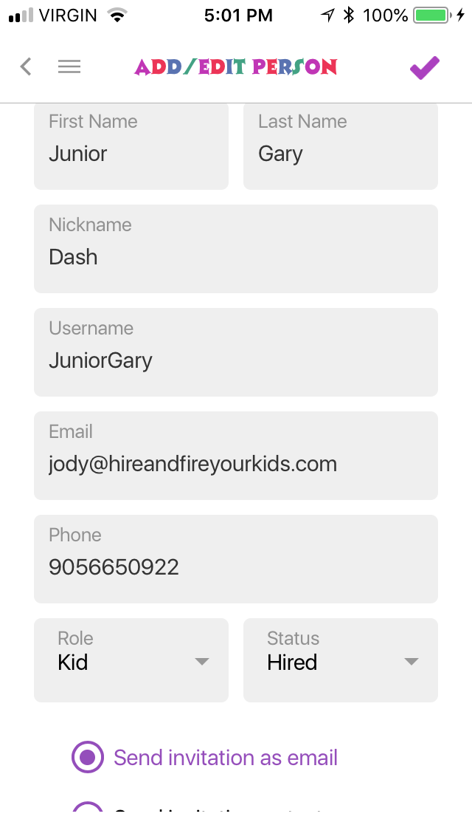
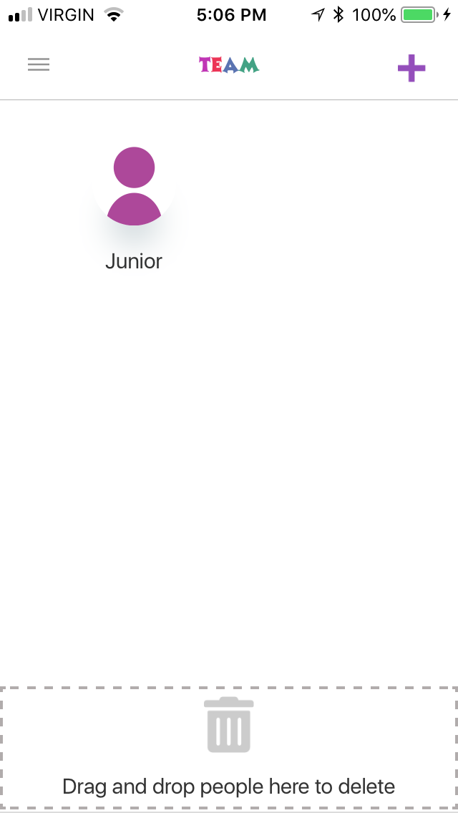
Enter data remembering the family members Username
If they have their own e-mail enter it, if not enter yours for the invitation
If they have their own phone # enter it, if not add yours
Choose if the player is a Kid or Parent and how you want to send the invite by e-mail or text
Tip! Choose a photo for your player by clicking “add or change picture” otherwise it will just be the purple body below
Save with “checkmark”, then your team will begin to appear as you add them

Slide 18
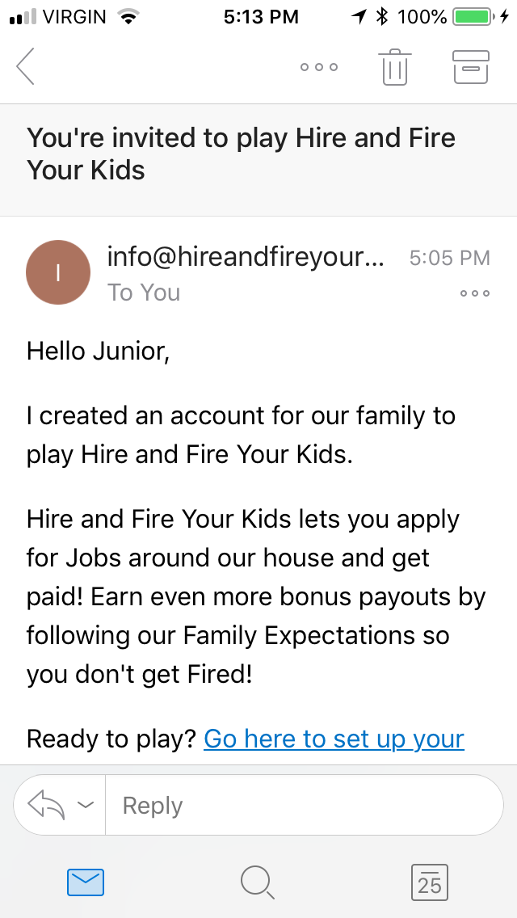
After entering all your family players head to their devices (text or e-mail) or your e-mail/text to accept the Invitation
Click link. The links do expire so set up right away or Re-Send invite through Team screen for new link.
NOTE: Do NOT invite your team to play until you have customized the game and understand how to play.

Slide 19

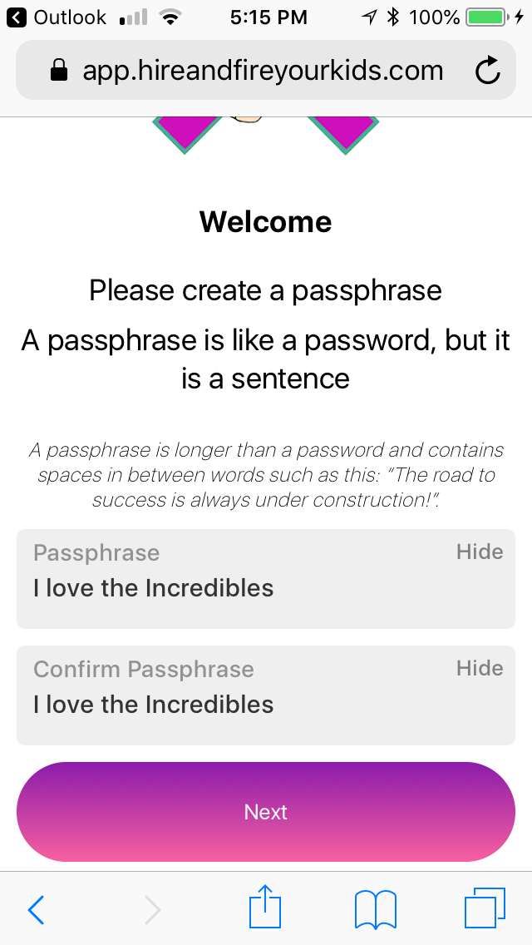
Player to create a passphrase that is at least 14 characters in length and can have spaces if you choose

Slide 20
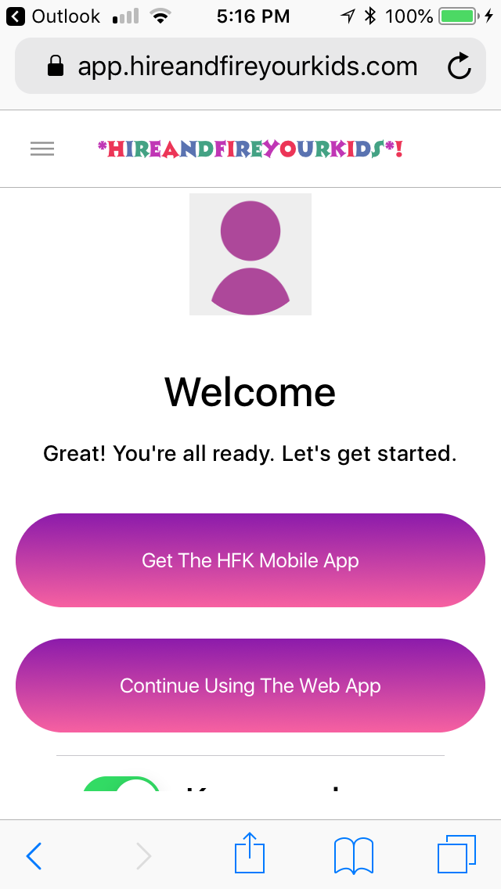
Once passphrase is set you can continue using Free web app (app.hireandfireyourkids.com) or family members who have previously download the app to their device can now login to the HFK app with their Username and Passphrase

Slide 21
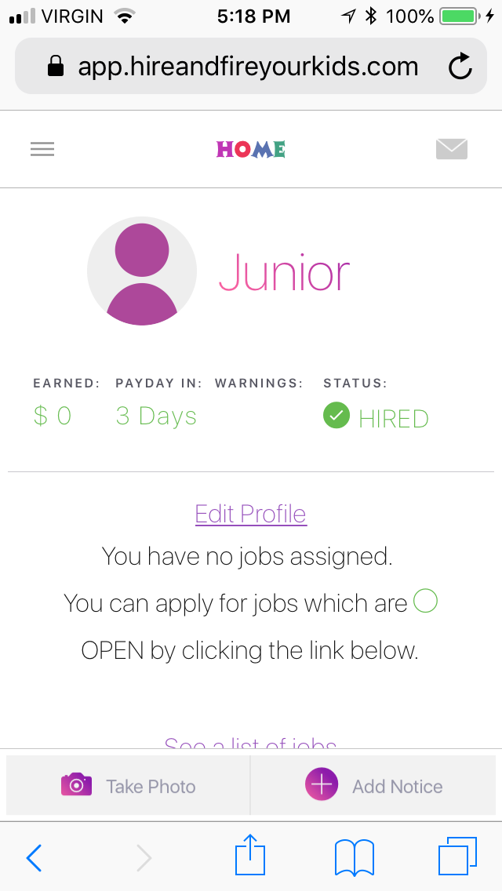
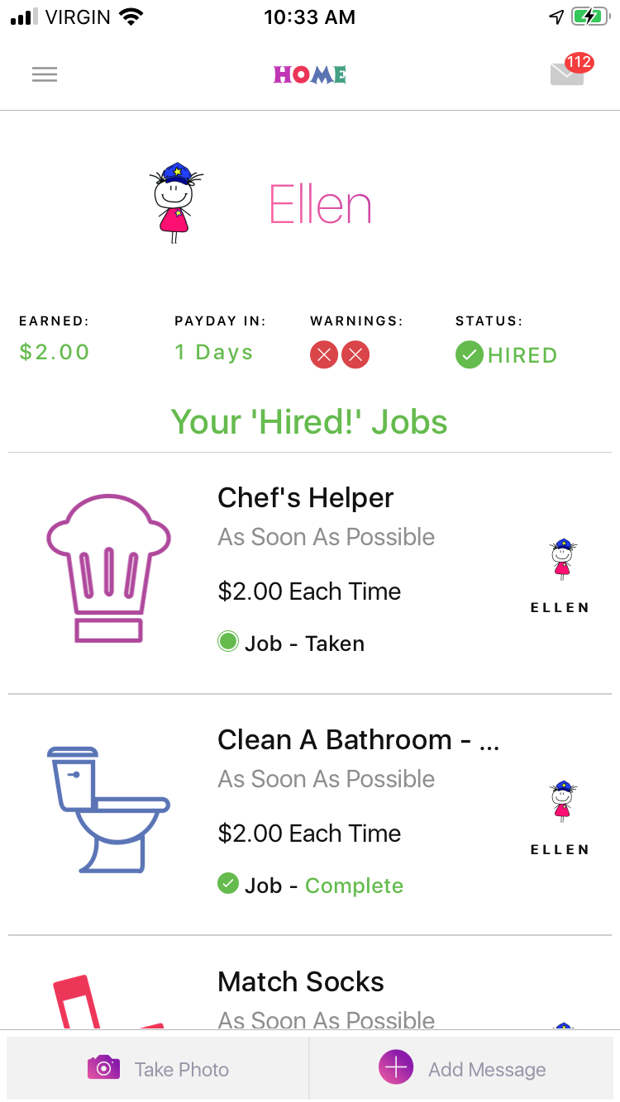
Kids Home Screen
Can Edit profile and change character or passphrase if they choose
Can start to apply for Jobs by clicking “see list of Jobs” or “Jobs” in menu drop down
Kids Home screen on web app
Kids Home screen with data

Slide 22
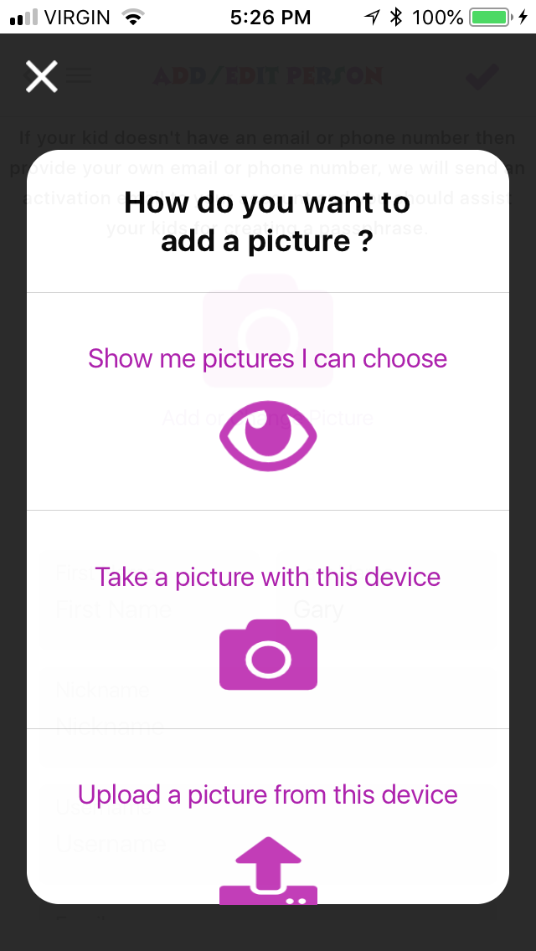
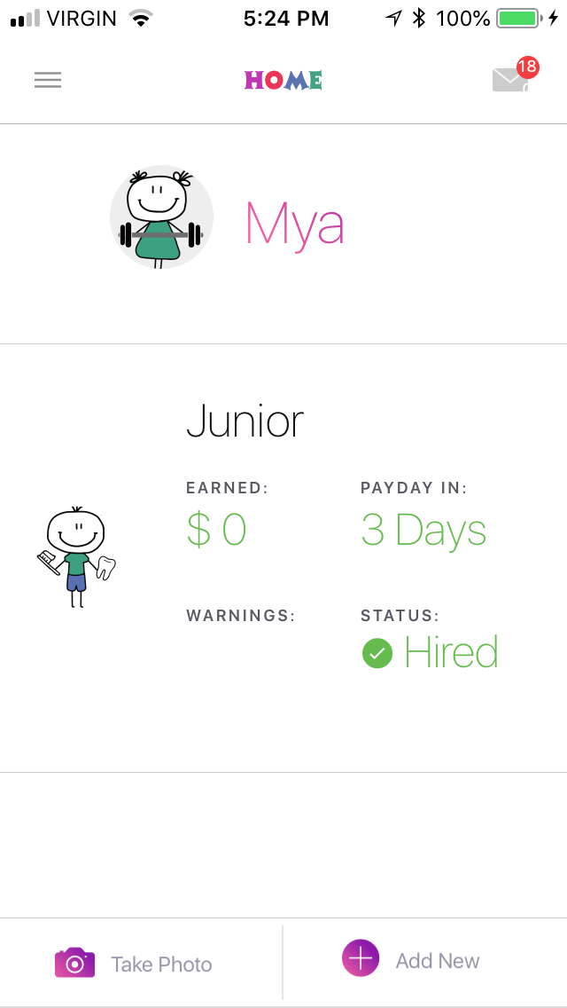
Parents Home Screen
Once Kids accepted the Invite you will see them on your Home screen
I have changed players profile pics by clicking “add/change picture” which opens up “how do you want to add a picture” I chose show me pictures I can choose

Slide 23
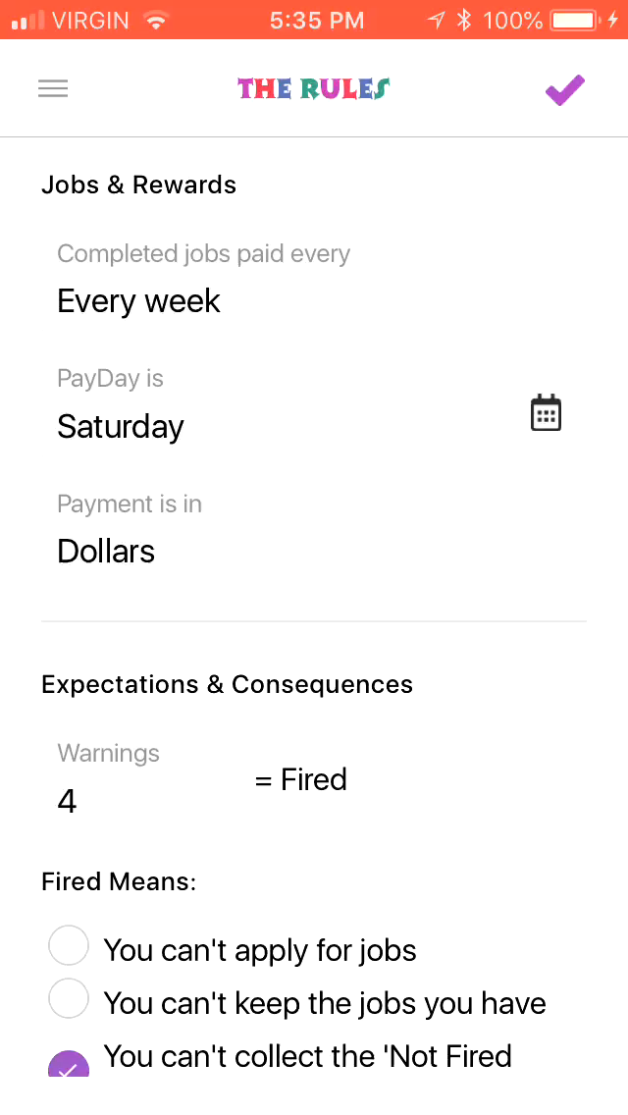
Rules on Parents side can be changed but will ONLY update and SHOW on Pay Day which defaults to Friday. On Friday you will see your changes made to suit your family!

Slide 24
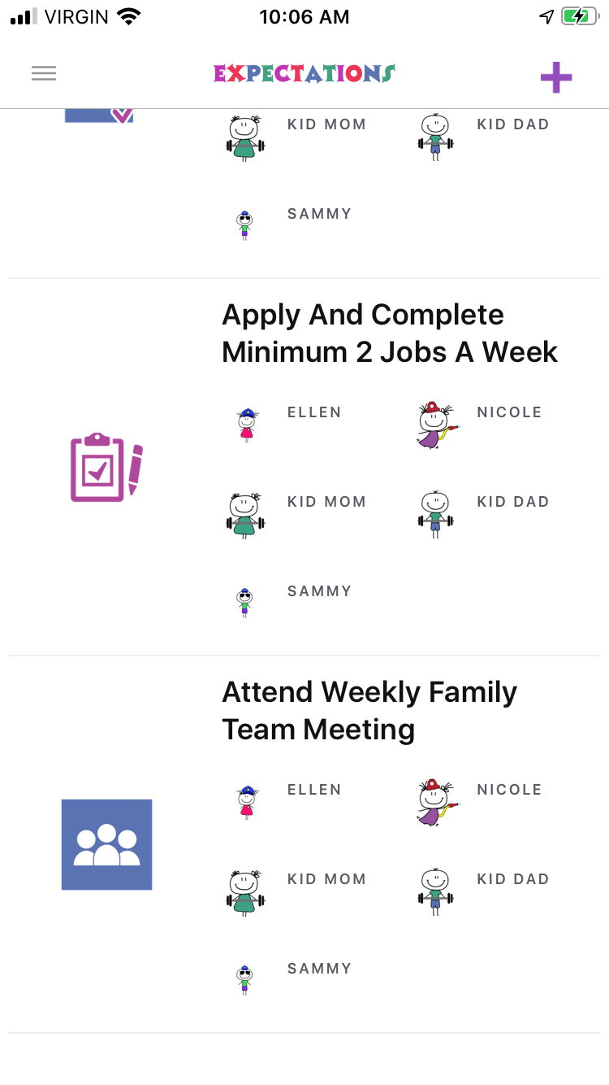
Game Rules
You can add more of your own through Expectations
These are things that would get them an X if not done.
Examples:
Volunteer for 1 Job a week
Save 20% of your PayDay
Give 5% of PayDay to charity

Slide 25
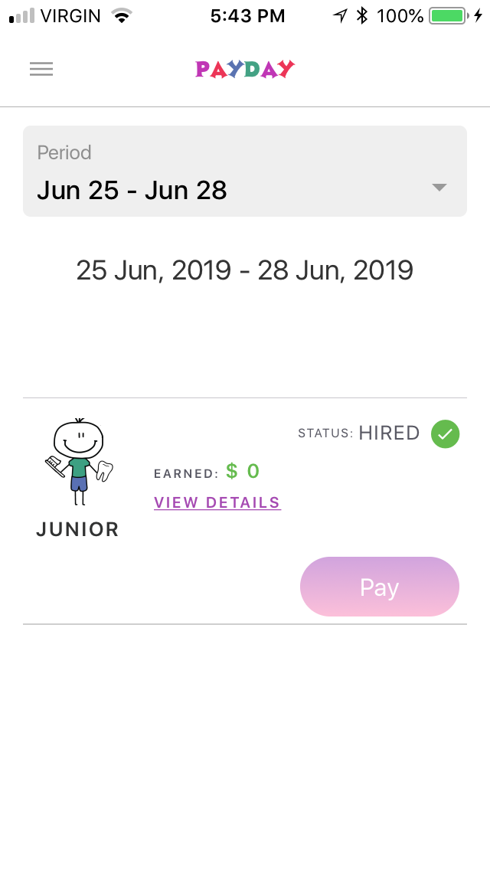
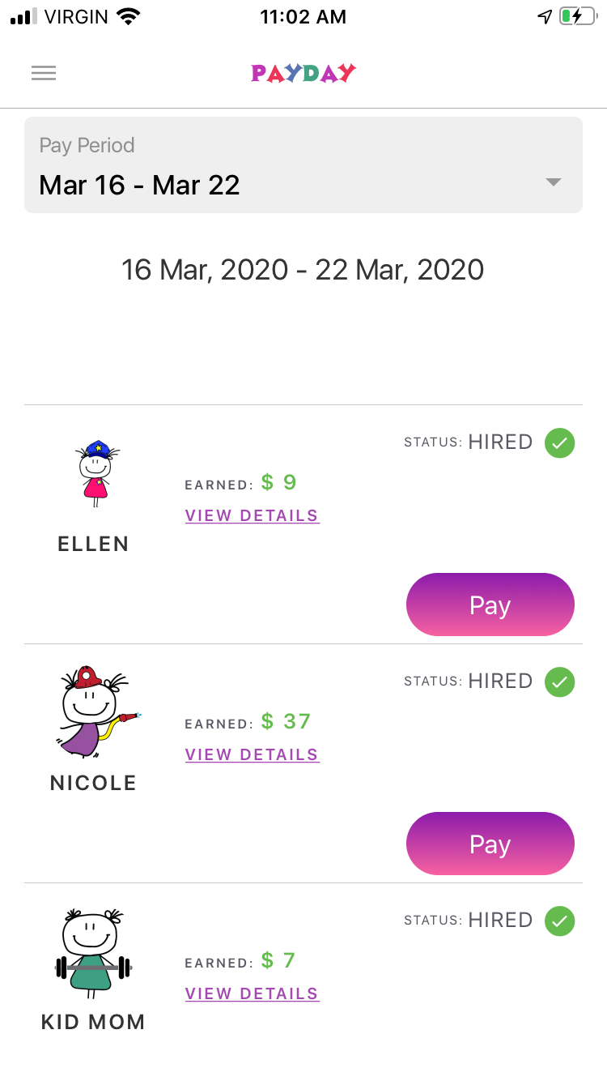
Pay Day allows you to see all your Kids and you can “view details” of what they did to earn reward
On Pay Day the Pay will become dark purple for you to payout your kids and the game resets every Pay Day!
Kids can do jobs right up to 11:59pm the night before a Pay Day
Before Pay Day
On Pay Day

Slide 26
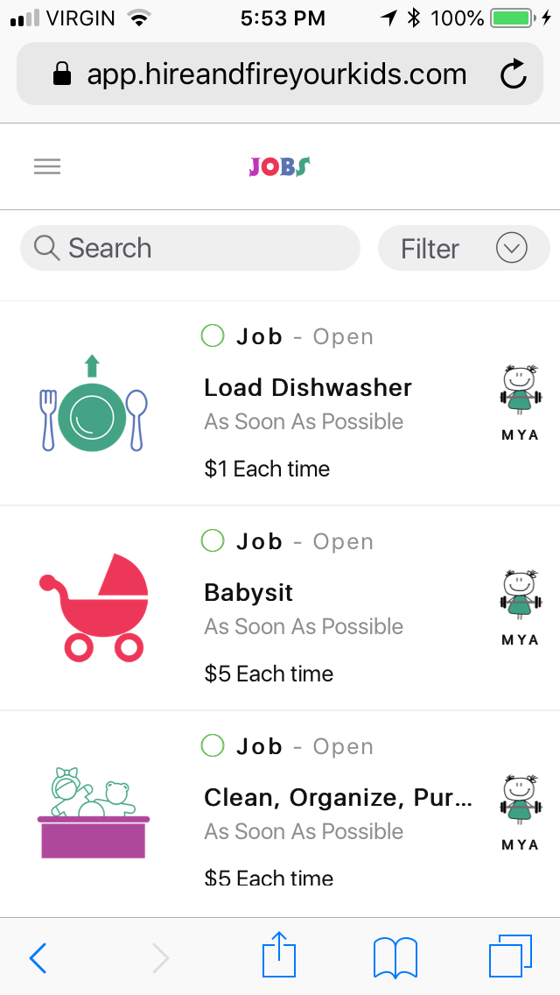
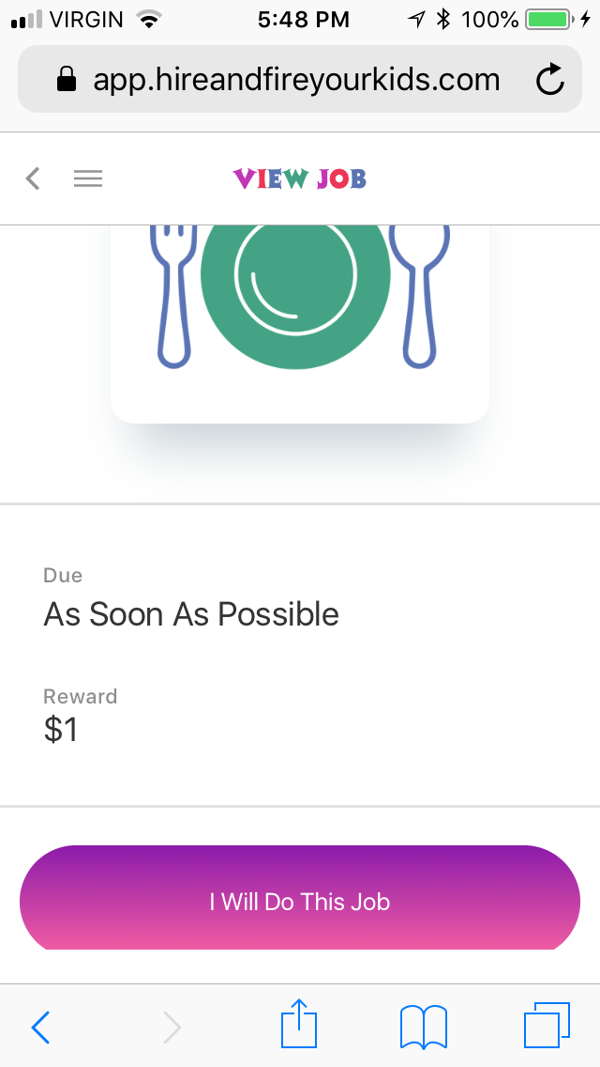
How do Kids apply for Jobs?
Click on “Jobs” and click on the Job you want to apply for!
Click “I Will Do This Job”

Slide 27
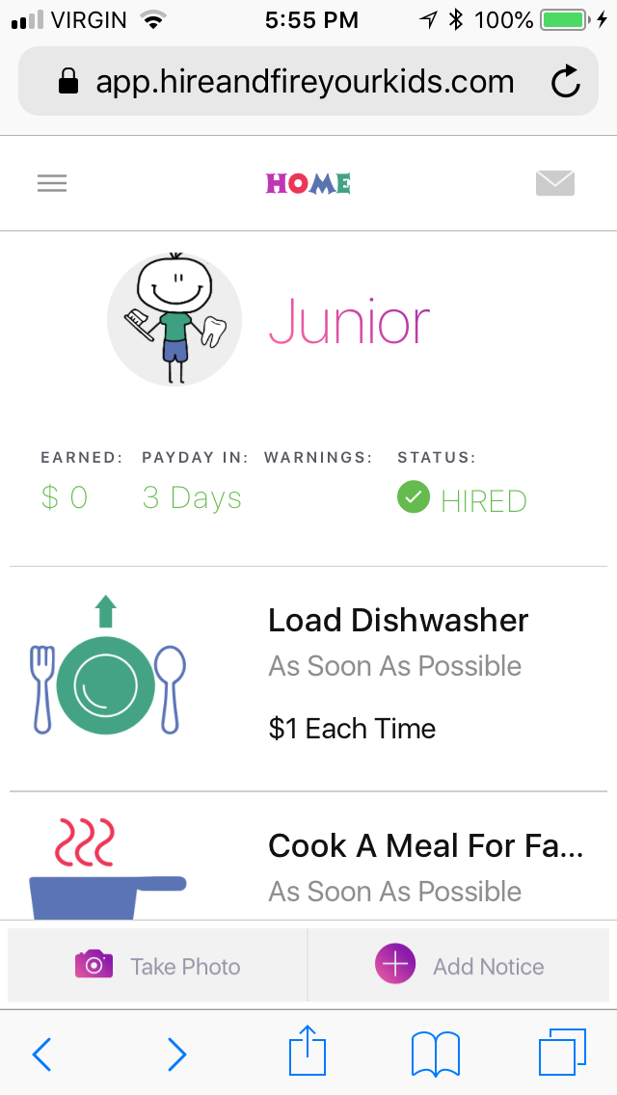
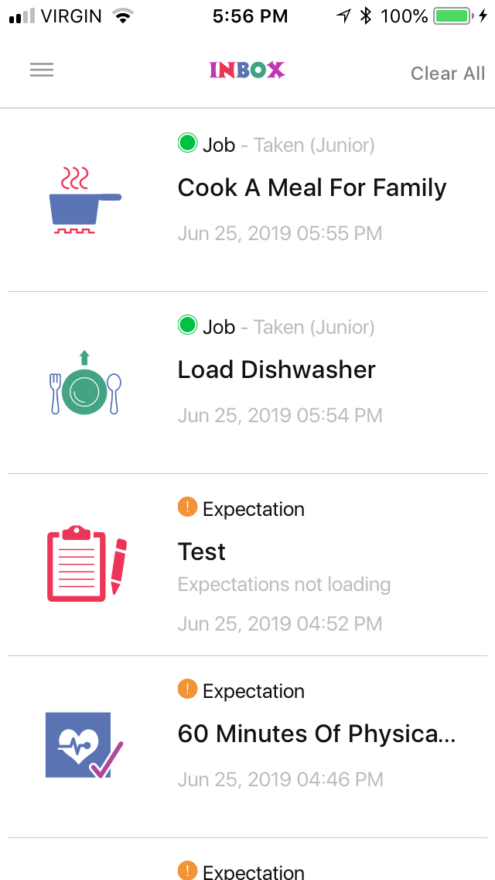
Jobs the Kid chose will NOW show up on their Home screen and Parents will get a Notice found in your Inbox
Kids Home with Jobs they applied for
Parents Inbox with Notices

Slide 28
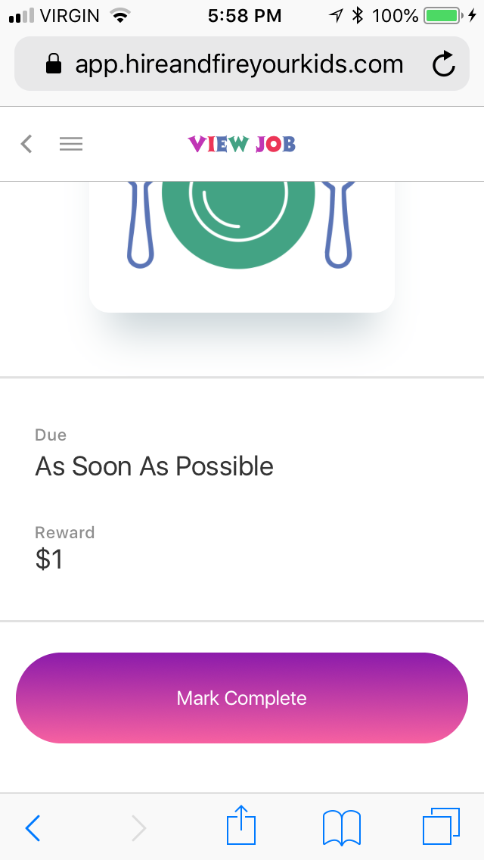
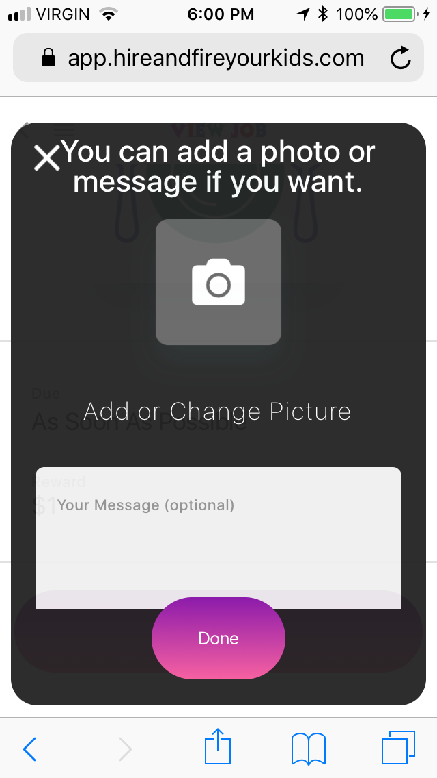
What do Kids do when they have completed a Job?
Click on “Job” from Home screen and “Mark Complete”
Kid can take a picture of their work if they choose or send a message if they choose and clicks “Done”

Slide 29
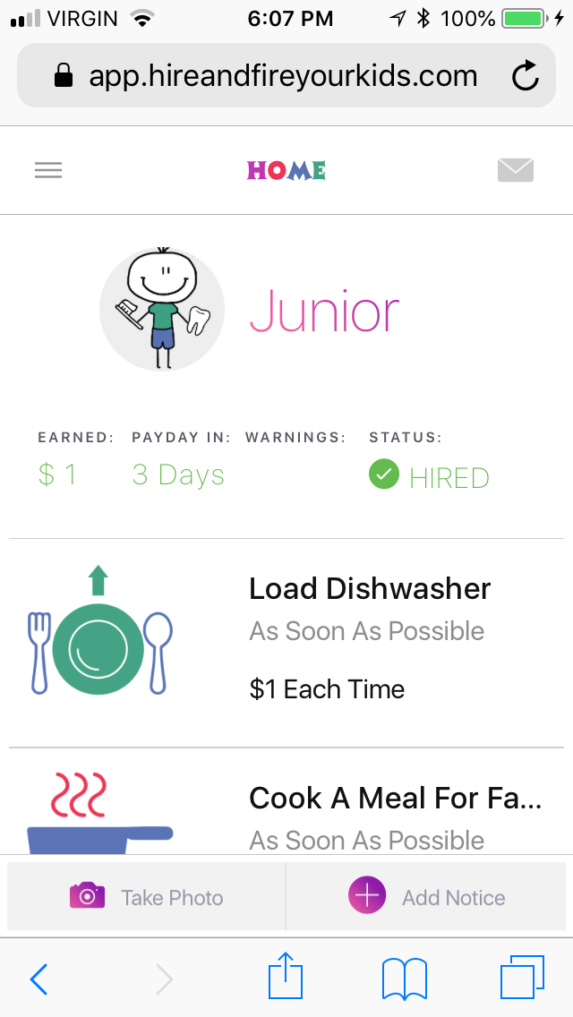
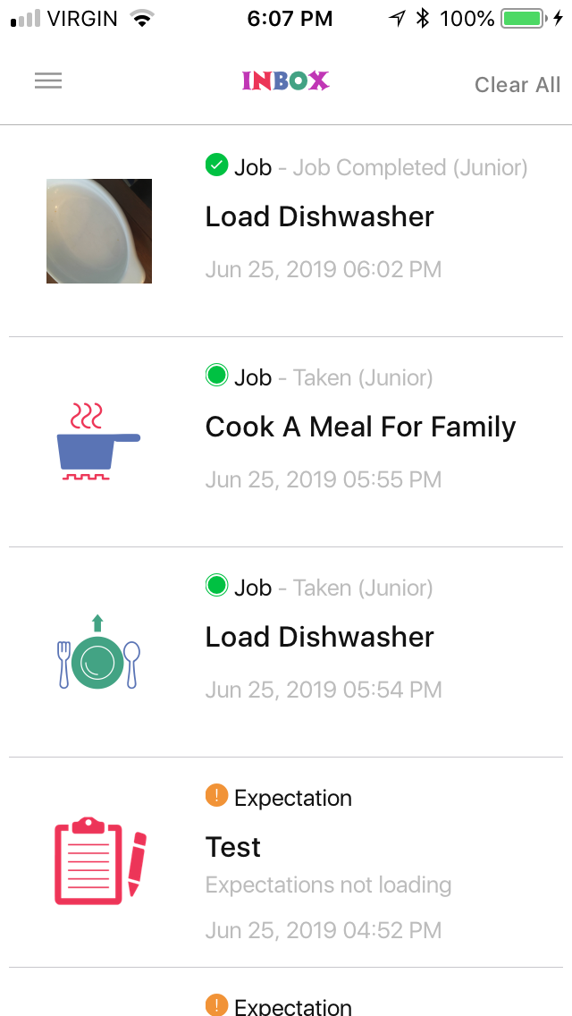
Kids Home screen adds the Pay automatically upon completion UNLESS Parent Review required upon completion was chosen. Then you would get a notice to approve, then Kid would be rewarded.
Parents get a Notice of Job Completion found in their Inbox and they too can see the rewards on their Home page of what their Kids earned.

Slide 30
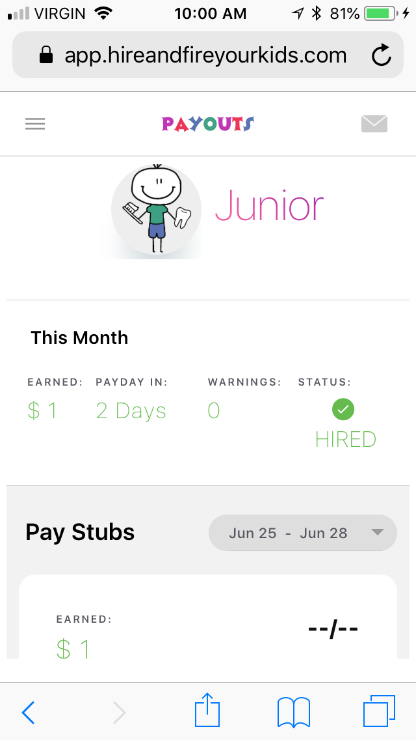
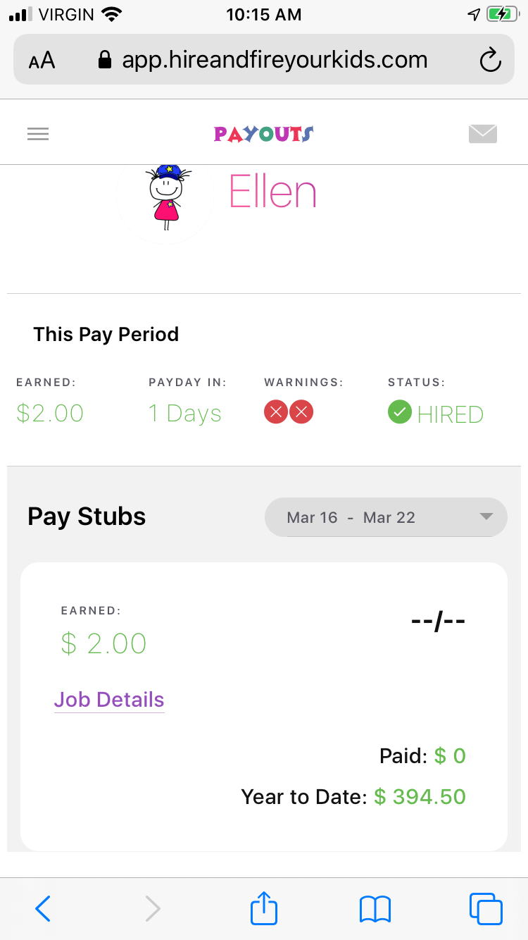
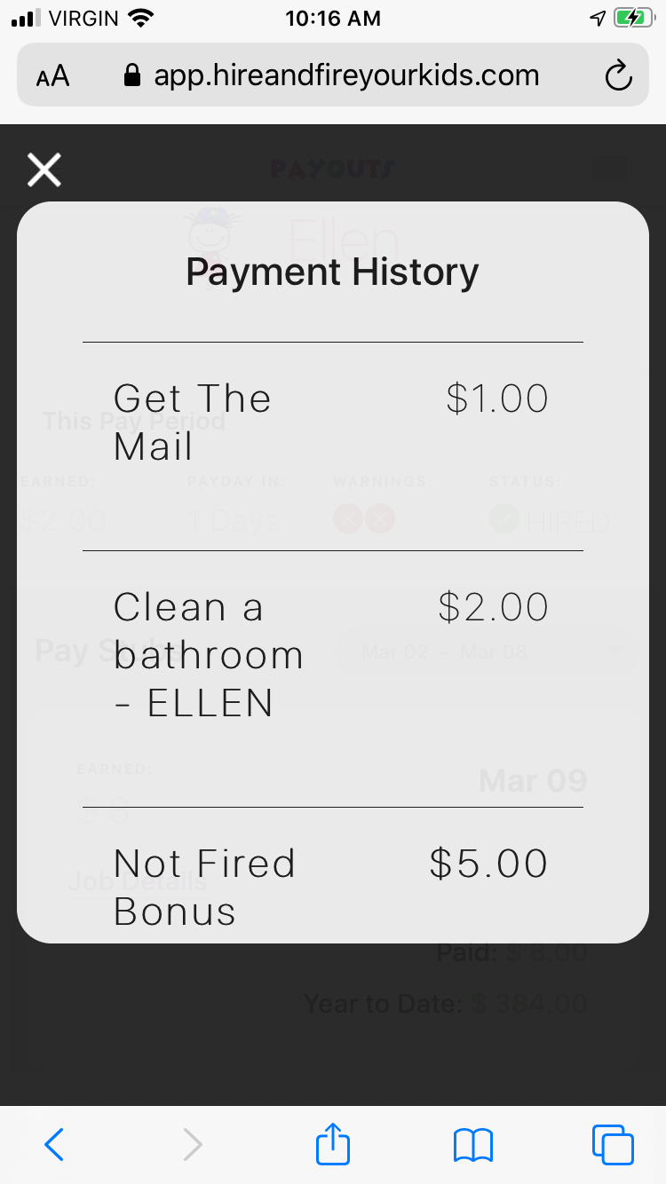
Kids PayOut Screen
Shows History too with Job details

Slide 31
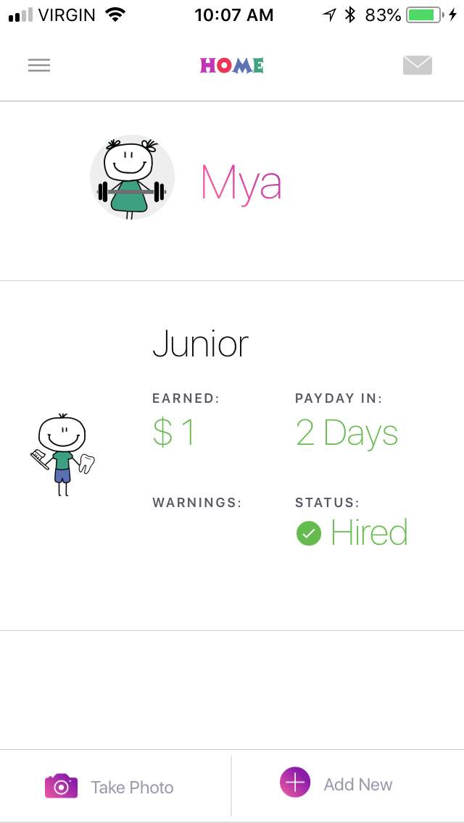

How do Parents give a Warning X? 2 ways…
Choose Warning, pick unmet Expectation, pick Kid, add a message and send!
1st is by clicking Take Photo (bottom left)
Take a picture of the unmet Expectation, click Use Photo

Slide 32
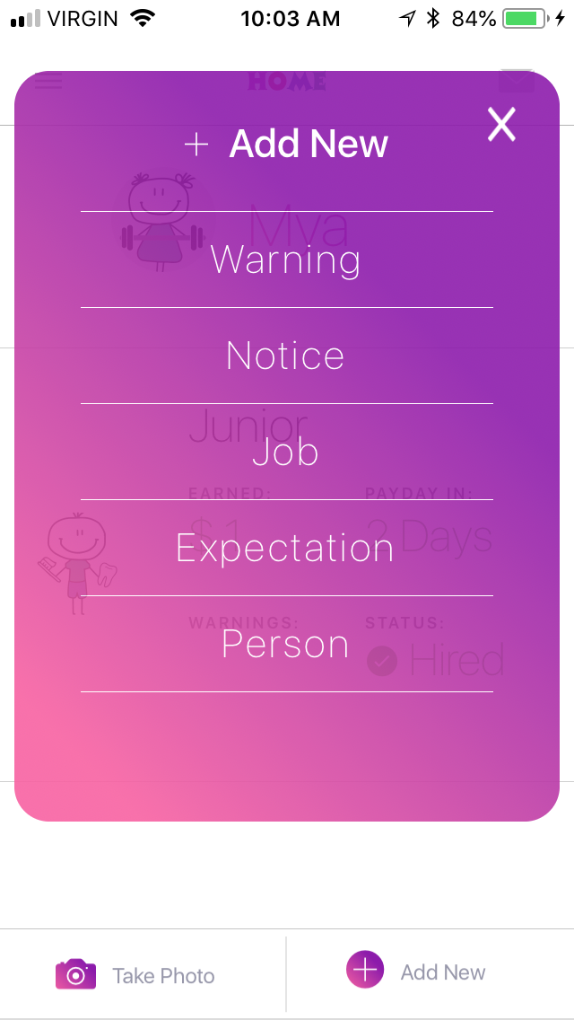
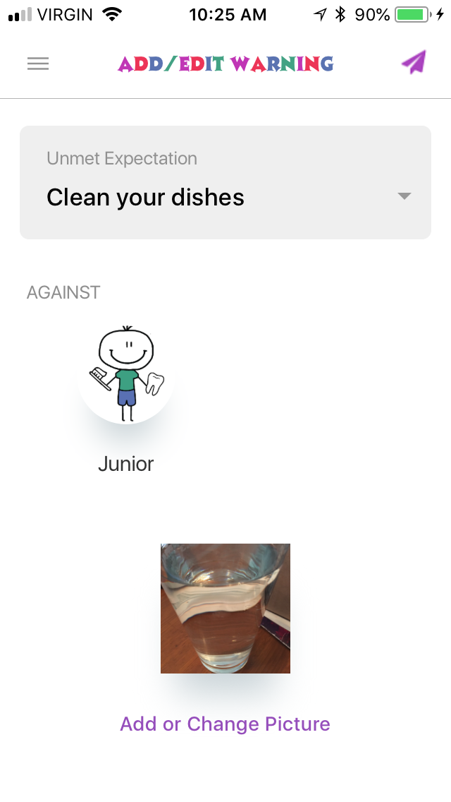
Give a Warning X
Choose the Unmet Expectation from drop down. You can start typing and it will bring up search function or you can scroll.
Choose Kid that’s getting X by clicking on them.
Use (optional) message to share your thoughts i.e. “Hi Junior, saw you forgot to put your dishes away. Please do your best to bring them to the dishwasher. Thanks, love you… xoxo.”
And Send (top right)
Click Warning

Slide 33
2nd way to give a Warning X
2nd is by clicking “Add New” (bottom right)
Click “Warning”

Slide 34
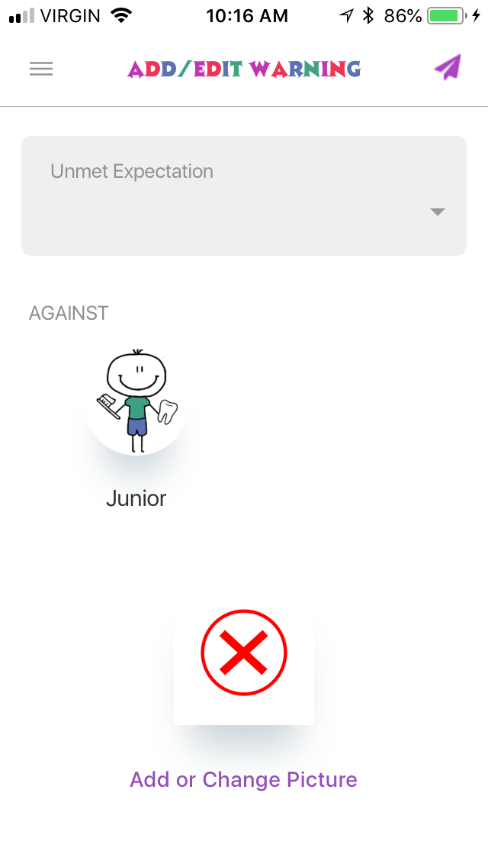
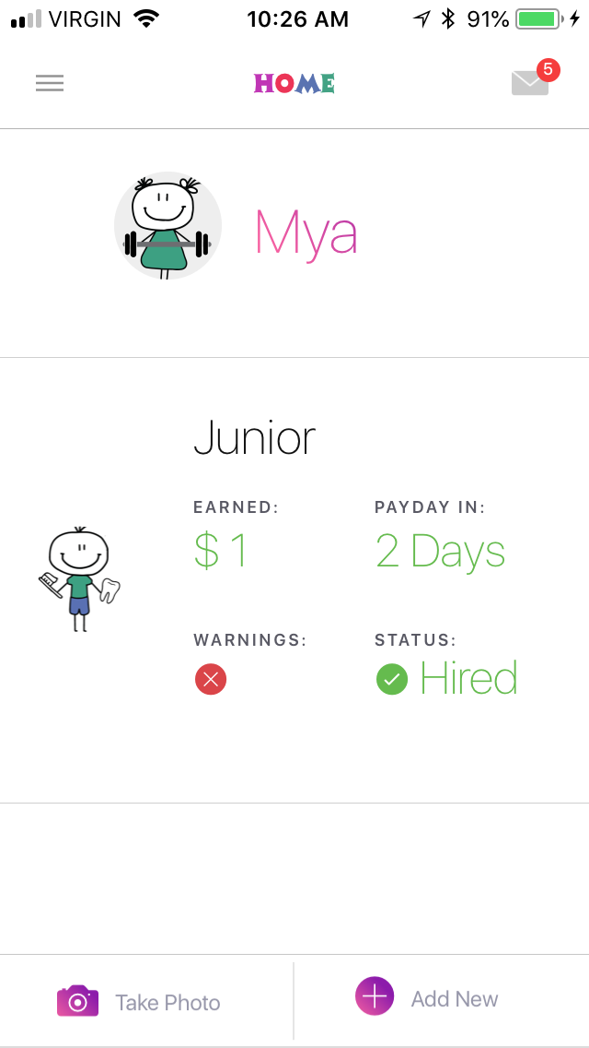
Choose the Unmet Expectation from drop down. You can start typing and it will bring up search function or you can scroll.
Choose Kid that’s getting X by clicking on them.
You can leave the X or change and take your own photo of the LIVE unmet expectation here.
Use (optional) message to share your thoughts i.e. “Hi Junior, saw you forgot to put your dishes away. Please do your best to bring them to the dishwasher. Thanks, love you… xoxo.”
And Send (top right)
Kid will get a push notification on their device in real time and the X will be added to their inbox and show on their Home screen and Payout screen. Will show on Parents too as seen below.

Slide 35
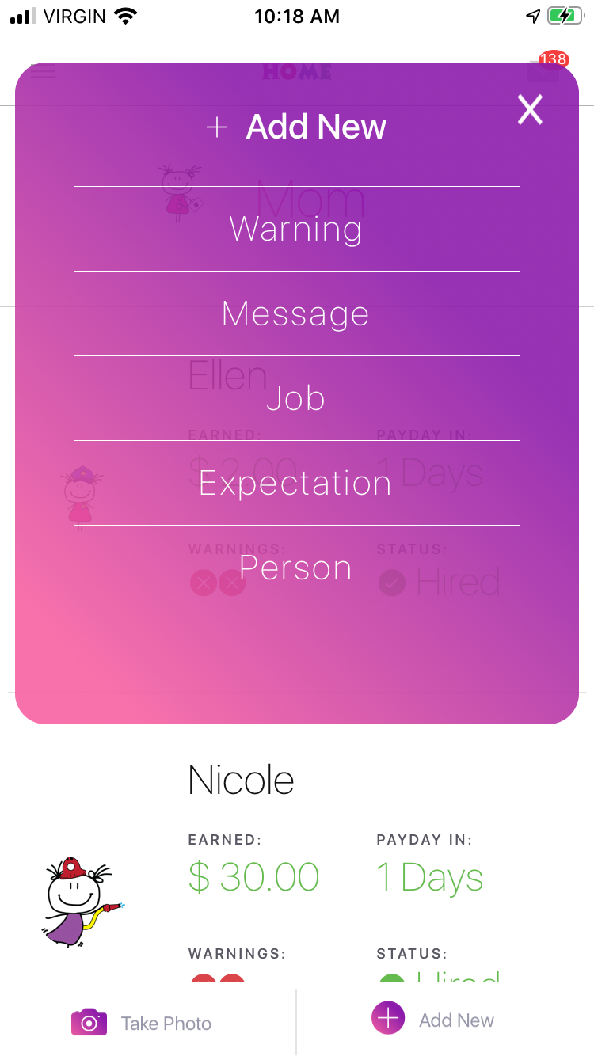
How do we send a Message?
Use “Add New” (bottom right)
Click “Message”

Slide 36
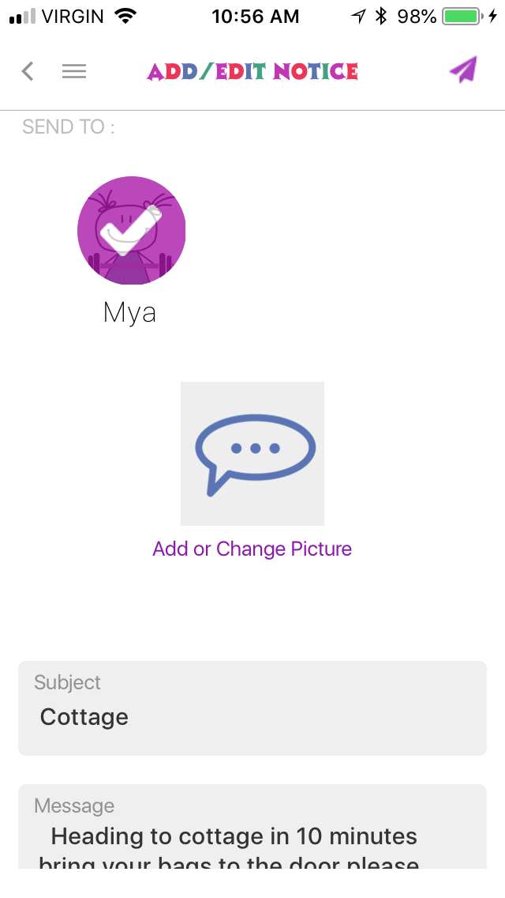
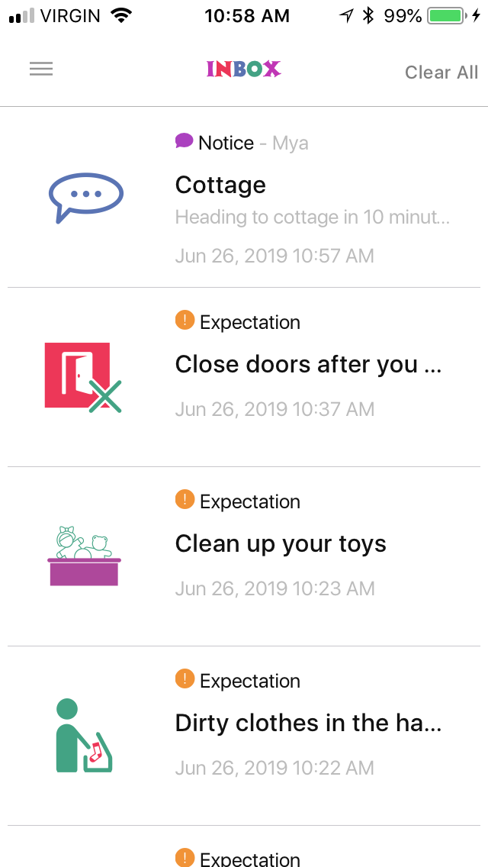
Messages work the same for Parents and Kids
Add New for Parent Add Message for Kid (bottom right of Home page)
Click on Kids you want to send message/notice to.
Write message and send (top right)
Kids will get a live push notification and it will go into all Inbox’s

Slide 37
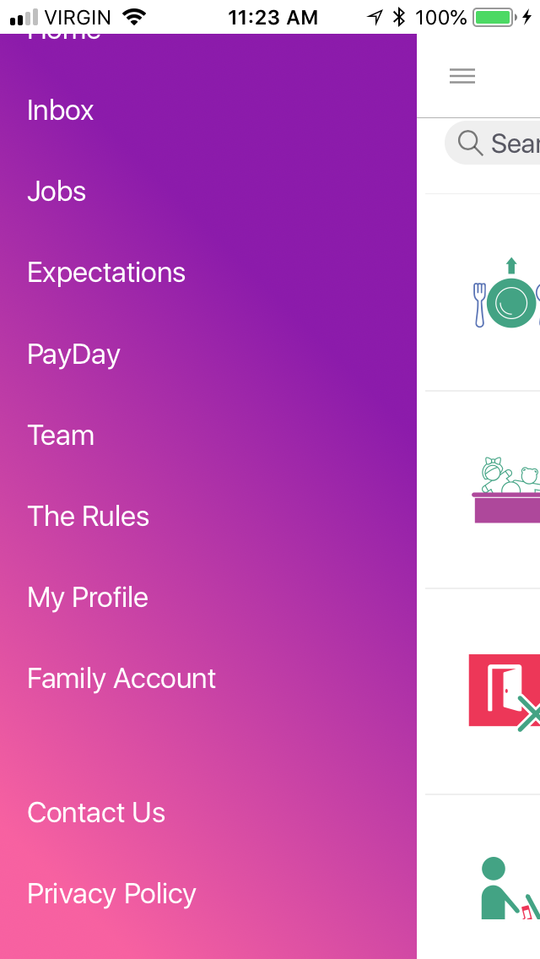
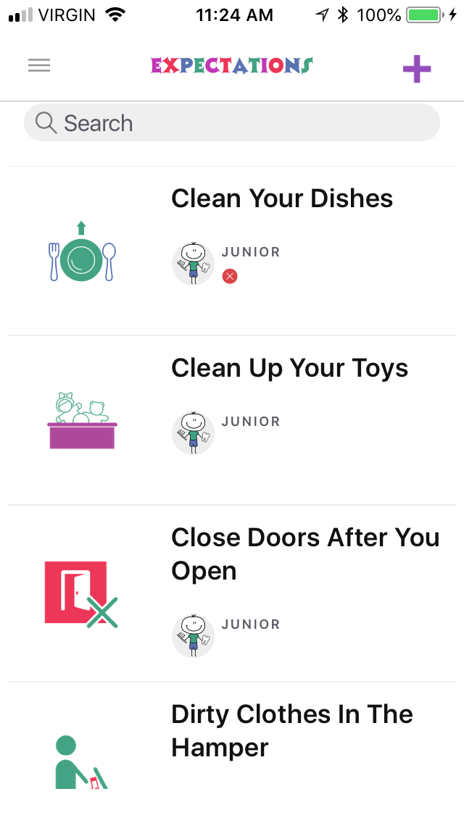
Probationary Period
How to Remove a Warning X
We want to reduce family friction and help teach the Kids what your Expectations are over time. So as you play the Kids can get the opportunity to correct their X after you have given it to them.
Here is how you would Remove an X if it was corrected as per your guidelines (ie in our house they have to do right away if they are home)
Click on “Expectations” from drop down menu
Shows all the Kids X’s as they float to the top. Click on the Expectation you want to Remove the X from

Slide 38


How to Remove an X
Then click “Remove” beside the Kid you want to remove the X from
Junior’s X is now removed!

Slide 39
Object Of The Game
FIRED: Kids need to finish each Pay Period without getting Fired and earn the Incentive Bonuses making them eligible for the Employee of the Month.
HIRED: Kids can apply to rolling Job board for Hire, get rewarded upon completion and get paid out on Payday.
Kids do their best to follow the Family Values and Expectations you‘ve set together. If your Kid is caught NOT following a Value or an Expectation by you, they're given a warning X. After a certain amount of warning X's the Kid get's Fired. (Option to remove an X if the Kid corrects X immediately)
If the Kid can go the entire Pay Period without getting Fired they will receive a NOT FIRED Bonus.
If all Siblings can go the entire Pay Period without getting Fired they will each receive a TEAMWORK Bonus.
If your Kid does get Fired they are NOT entitled to the above Incentive Bonuses and a consequence that you set together at your last Team Meeting will activate.
Game Rules
Set your Pay Period (weekly, bi-weekly, monthly)
Set your recurring Pay Day Date
Set your Payment currency (dollars or points)
Set the number of Warning X's before getting Fired
Set the NOT FIRED Bonus reward amount
Set the TEAMWORK Bonus reward amount
Game On!
Set your recurring Family Team Meeting day and stick to it!
Stop giving your Kids money for their wants and stop buying their wants. Instead teach your Kids to EARN their wants.
Start playing with a Probationary Period in mind so everyone can get used to things...before getting Fired.
Kids apply for Jobs created by you and get rewarded upon completion (no assigning chores by you in this game)!
Kids follow the family values and expectations set, trying not to get Fired.
Kids get Paid out on Pay Day!

