Slide 1
Jen Sias-Lyke Las Vegas, NV
New Market Appt Date: January 1, 2008
Statistics as of March 1, 2018
Total households: 6,500+
Policies: 16,000+
Authorized Team Members: 24
Incentive Travel Qualifier:
2017 Exotic Plus Traveler
10 Time Ambassador Club Qualifier
Chairman’s Circle: 9 Time Total Qualifier
President’s Club: Lifetime Member
35 Time Total Qualifier
MDRT: 2011-2017: Qualified
MOA New Market Appt Date: January 1, 2014
Statistics as of February 1, 2018
Total households: 2,500+
Policies: 6,000+
Incentive Travel Qualifier: 2017 Exotic Traveler
3 Time Total Qualifier
Chairman’s Circle: 2014-2017: Qualified
New Market Appt Date: August 1, 2006
Statistics as of March 1, 2018
Total households: 6,600+
Policies: 16,000+
Authorized Team Members: 36
Incentive Travel Qualifier:
2017 Exotic Traveler
11 Time Ambassador Club Qualifier
Chairman’s Circle: 9 Time Total Qualifier
President’s Club: Lifetime Member
28 Time Total Qualifier
MDRT: 2014-2017: Qualified
MOA New Market Appt Date: January 1, 2014
Statistics as of February 1, 2018
Total households: 2,300+
Policies: 6,000+
Incentive Travel Qualifier: 2017 Exotic Traveler
3 Time Total Qualifier
Chairman’s Circle: 2014-2017: Qualified
Perry Olson Las Vegas, NV

Slide 2
Perry Olson – Jen SiAS LYKE Dynamic Duo
Winning Systems Replicated

Slide 3
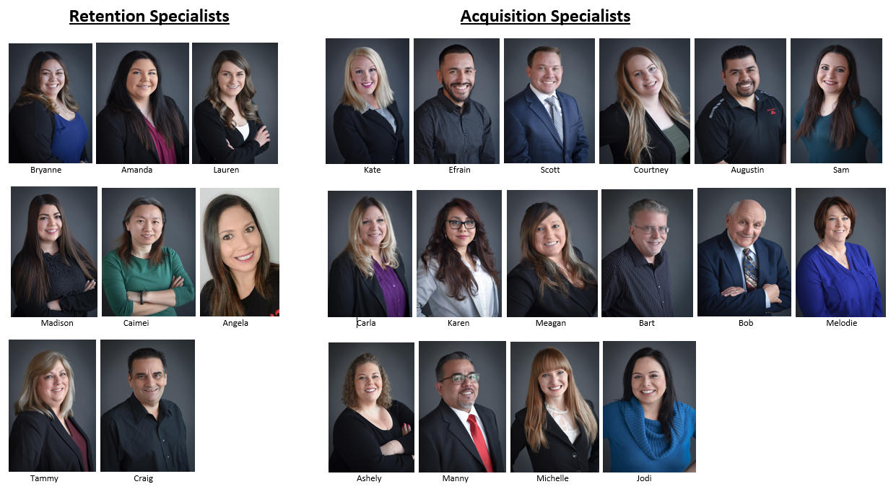
The “SECRET” to our success.

Slide 4
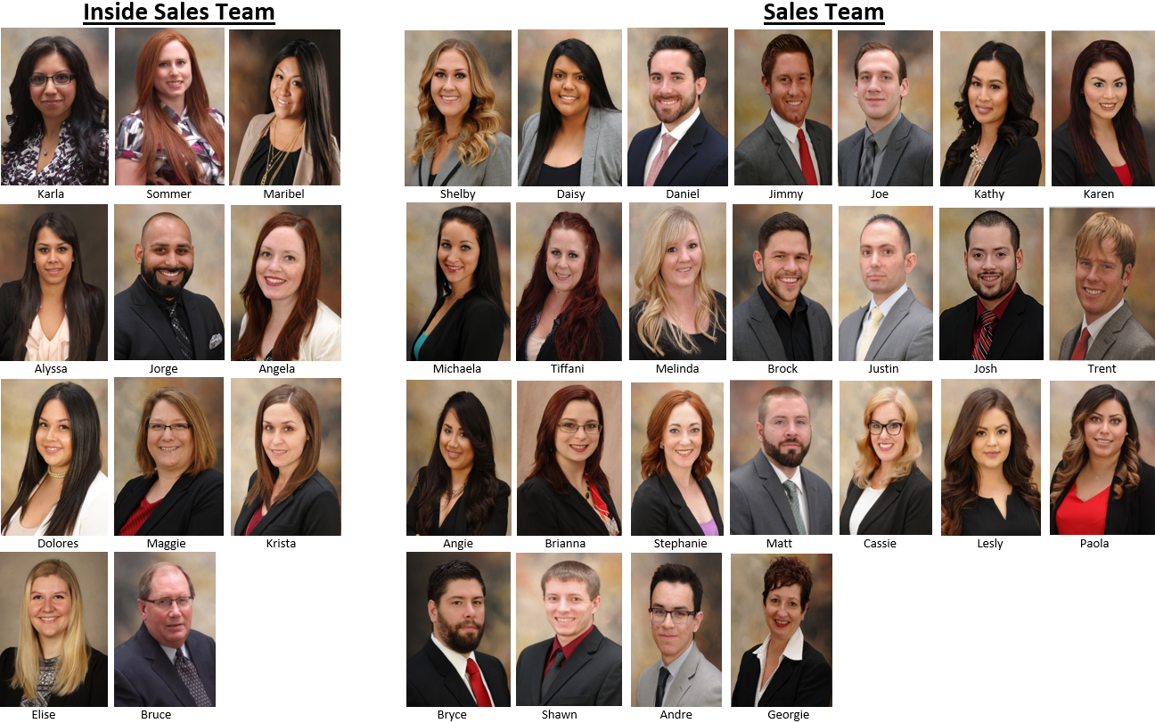
The only reason my name’s on the door is because of the talented team inside.

Slide 5
Winning Systems Replicated
Perry
Jen
Internet lead process
Live transfers
Setting IFR Appts.
Know your team
Back to the Basics
Referral & Binder Systems

Slide 6
Six Step Internet Lead Process
Call Lead
Email Lead
Mail Lead
Start Journey
Two Day Task Call
Pend Lead For Five Month Follow Up

Slide 7
Winning Systems Replicated
Perry
Jen
Internet lead process
Live transfers
Setting IFR Appts.
Know your team
Back to the Basics
Referral & Binder Systems

Slide 8
What makes them tick?
Team Member Wish List
If you could go on a 3 night trip anywhere where would it be and why?_________________
Rank the items below in order of importance to you:
______Additional money _______ Time off ______ Plaques/Awards/Verbal Recognition
Where are the top 2 places you like to shop?
1.____________________2.___________________3.____________________
What are your favorite restaurants?
1.____________________2.___________________3.____________________
If money were not a concern, what 3 things would you purchase immediately?
1.____________________2.___________________3.____________________
If someone were to offer you $100 cash or a ½ day off work, which one would you choose?
List 5 prizes you would like to receive valued up to $500 each.
1._________________2.___________________3.____________________4.___________________5._____________

Slide 9
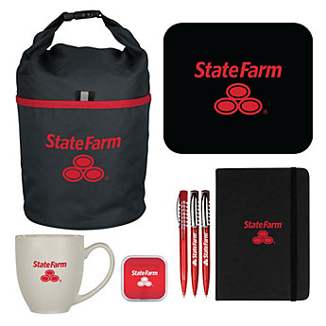
New Hire Orientation
State Farm Shirt
New Hire Kit SF00003207
90 Day Ramp Up Period
Week 1 – Paperwork/New Hire Binders,
begin SF Modules
Week 2 – Modules continued./ Submit SSA
Weeks 3 – Personal Referrals
Week 4 – Vehicle Loans / Sales Calls
Week 5 – Shadow Retention Specialist & Acquisition Specialists / Start answering phones
Week 6 – Product Specific Training – alternates daily
Weeks 7 – 12 Practice of EXECUTION! CLOSING!
GOALS are LIVE month 3!

Slide 10
Winning Systems Replicated
Perry
Jen
Internet lead process
Live transfers
Setting IFR Appts.
Know your team
Back to the Basics
Referral & Binder Systems

Slide 11
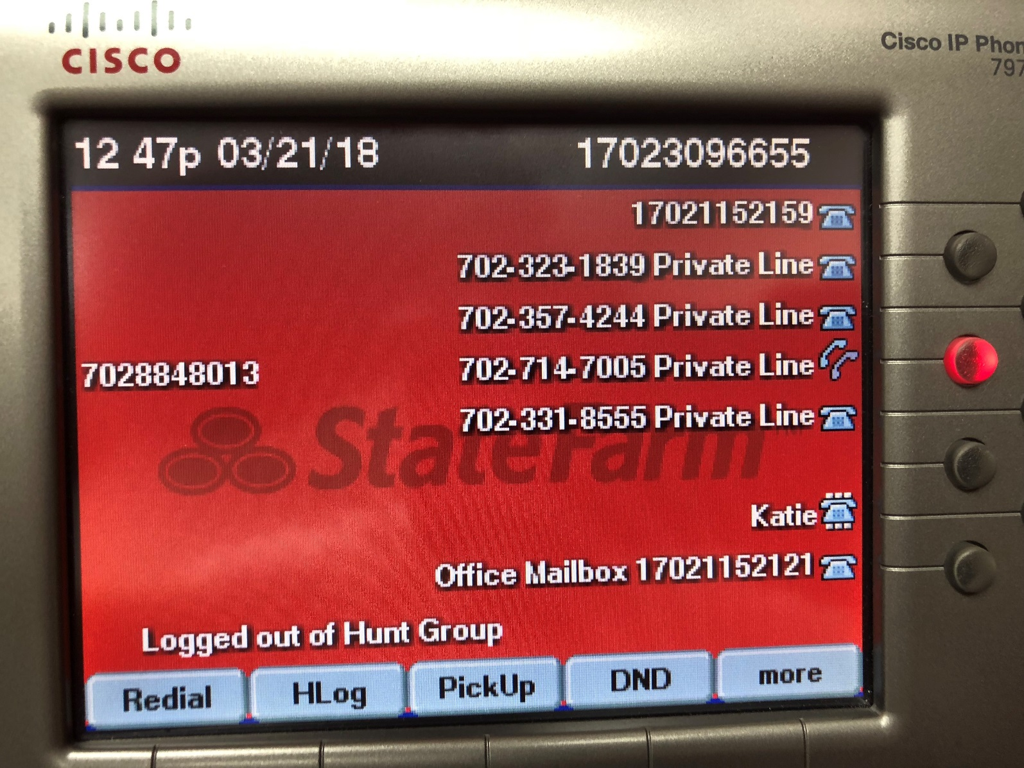
Live Transfers

Slide 12
Winning Systems Replicated
Perry
Jen
Internet lead process
Live transfers
Setting IFR Appts.
Know your team
Back to the Basics
Referral & Binder Systems

Slide 13
Who are your clients?
1
2
Generation X – born 1965-1976
3
Generation Y – born 1977-1995
Looking for a resource, not a salesperson, needs immediate response, continuously “saved” by their parents
Naturally skeptical, their attitude is prove it to me, most loyal generation to individuals not organizations
Loyal to organizations, believe that there is no shortcuts to success, must earn their business
Baby Boomers – born 1946 to 1964
4
Millennials – born 1981 to 2000
DEMANDING! Tech savvy, need instant answers and self-service, floods internet with negative feedback

Slide 14
Winning Systems Replicated
Perry
Jen
Internet lead process
Live transfers
Setting IFR Appts.
Know your team
Back to the Basics
Referral & Binder Systems

Slide 15
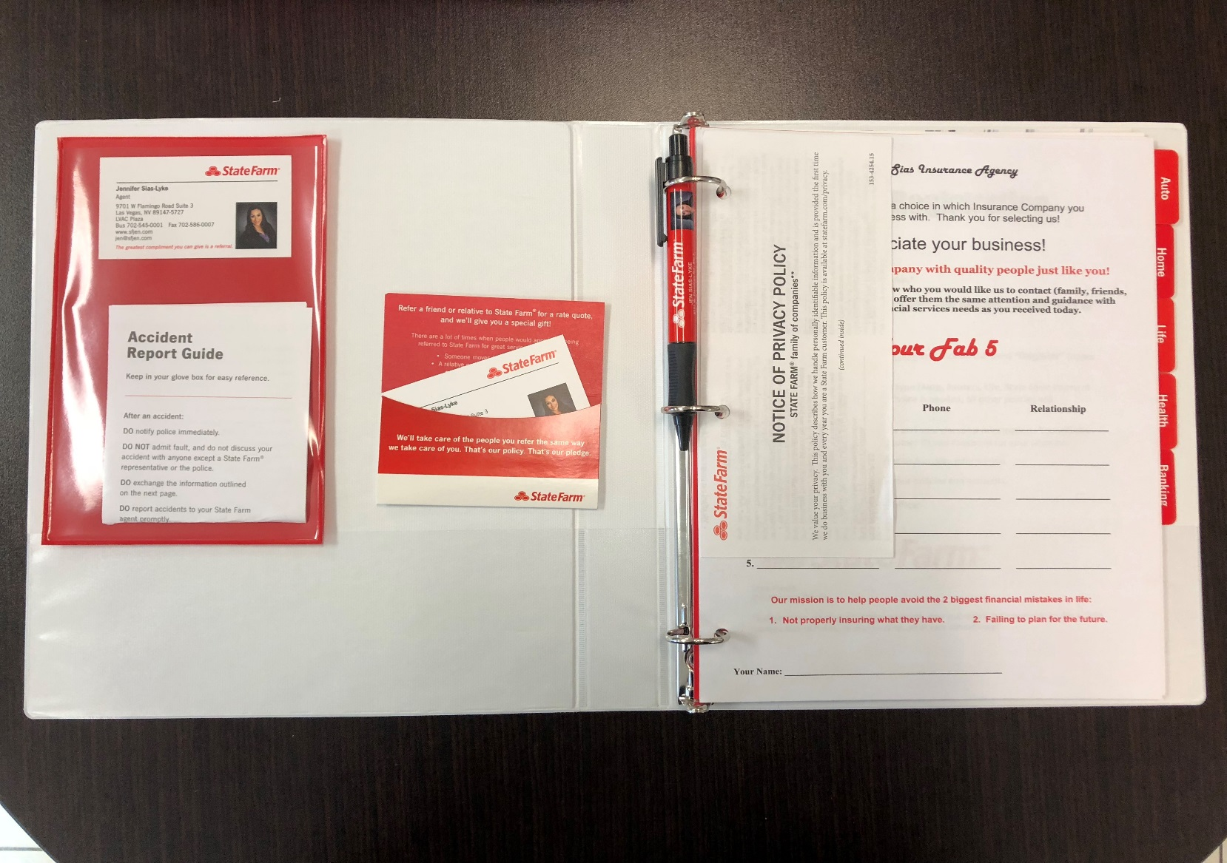
Referral Process & Program: Utilize Customer Choice Program
Binder Program Investment

Slide 16
Q & A

Slide 17
Contact Info
Jen Sias-Lyke
(MDE6)
Perry Olson
(PIEG)

