Slide 1
A review of the leadership styles best suited to creating an ethical workplace
ICHLBOM - 25
Peter Clitheroe
University of Chester; Ethical Leadership Doctoral Research
Notes:
My name is Peter Clitheroe
Delighted to be here supporting your conference today
Currently VP of sales at tyk technology - over 16 years in sales and sales leadership positions
Undertaking my doctoral research at the university of chester - my research is looking unto the unethical practice of sales managers within the enterprise software industry

Slide 2
Discussion today
Define the construct of leadership
Review the different elements of a workplace structure that can impact the ethical environment
Highlight under what circumstances should a leadership style be used
Notes:
I will be talking to you today about
What are the varying leadership styles and why are they important
The two most important influences that can occur within a workplace to directly influence the climate within which you work
What scenarios are best suited for what leadership styles
Yet, before we do that, lets just look at how you can define this phrase ethical

Slide 3
A discussion on what is ‘ethical’
Doing the right thing
Normatively appropriate conduct through personal actions and interpersonal relationships
When you lead ethically, others around you imitate and develop their own self leadership style
Source: Brown & Treviño (2006), Brown et al., (2005) and Kalra et al., (2024)

Slide 4
67%
of board members are willing to operate unethically to improve their own position within the company
Source: EY; Global Integrity Report 2024

Slide 5
54%
of participants said they face pressure not to report unethical practices
Source: EY Global Integrity Report 2024

Slide 6
51%
of respondents believe non-ethical behaviour is tolerated when senior management would sacrifice integrity for short term financial gains
Source: EY (2020)

Slide 7
Defining
01
What is Leadership
Notes:
Look at the responsibilities of leadership

Slide 8

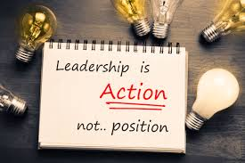
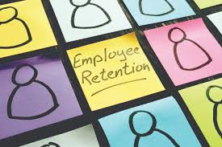
Leadership is….
Navigating complexity
Outcomes
People
Ambidextrous in every way possible
Zhang et al., 2022
Delivery of corporate objectives paramount
Inyang et al., 2018
Creating job embeddedness for people
Lee & Huang, 2019
Notes:
Defining leadership….
Navigating complexity
leadership is about navigating competing demands
Battling with innovation vs. stability tensions
Exploring change and vision
maintaining control while allowing flexibility
Outcomes
boundary spanner between the corporate objectives of the firm and the activities that determine if the objectives are to be obtained.
Focus on generating shareholder value
Focus on meeting customer demands
People
Creating job embeddedness is all about creating the environment that people want to work in, want to collaborate in and want to feel connected within
Make people feel safe within the workplace
Make people develop and fulfil their own career ambitions

Slide 9
Structure
02
Influences on the workplace structure and operating climate
Notes:
What are the environmental aspects to the creation of an ethical structure to support or hinder your leadership approach

Slide 10

Executive Strategy
The executive function in a business is the origin for organisational behaviour
Chan, 2021
Notes:
while company executives can place ethical decision making within their corporate agenda, not all decisions are made without an unethical component to them, creating risk and exposure, especially when financial decisions are involved.

Slide 11
Executive Strategy
Organisation Structure
Executive Behaviour
Sustainable Growth
Flat over Hierarchy
Others over Self
Long term operation
Notes:
Org Structure - the closer an executive can get to the operation of the business, the greater insight the executive will have into the daily functions and be able to course correct in real time from first hand knowledge and not from 3rd level information. Understanding what happens within your business will enable you to create and lead with an ethical posture in real time
Executive Behaviour - Put the interest of your team member, your suppliers, your customers over yourself and your personal ambitions: Remember the EY 2024 Integrity report > 67% 54% board members do things for themselves over others
Putting others first gets you enhanced customer loyalty, stronger brand reputation - most importantly - increased employee loyalty engagement > wealth of flow down benefits
Sustainable Growth - Focus on having a long term plan that is meaningful and tangible. Ensure it is known by all stakeholders within the business. Each understands their role and responsibility and they also understand the rewards that relate to their role - with this, set metrics to reward people for behavioural and performance inputs doing their job and not performance related to the output of their job all based on longer term ambitions and not short term financial results > this alone will have a big effect on an ethical posture

Slide 12
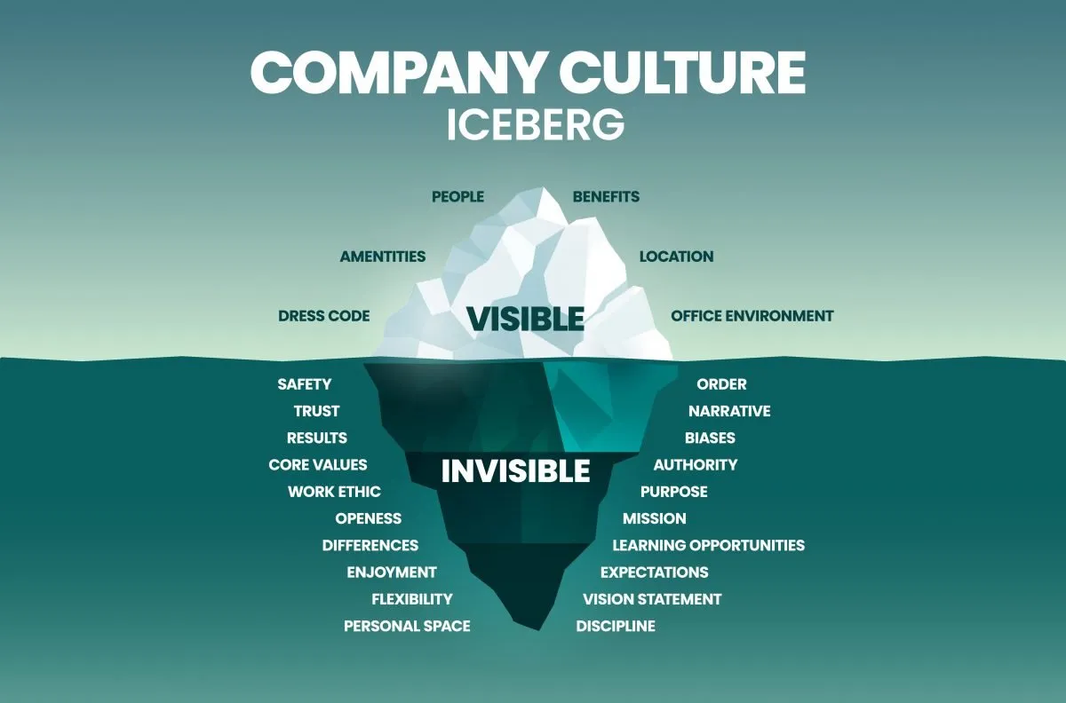
Company Culture
Ethical leadership establishes and sustains an ethical corporate culture
Roque, 2020
Notes:
Your company culture just is. You can’t create it. It occurs as a result of your actions
The values your instill within the company, the behaviours that everyone exhibits is the culture of the company regardless of what is written in the company manual or on the office wall.

Slide 13
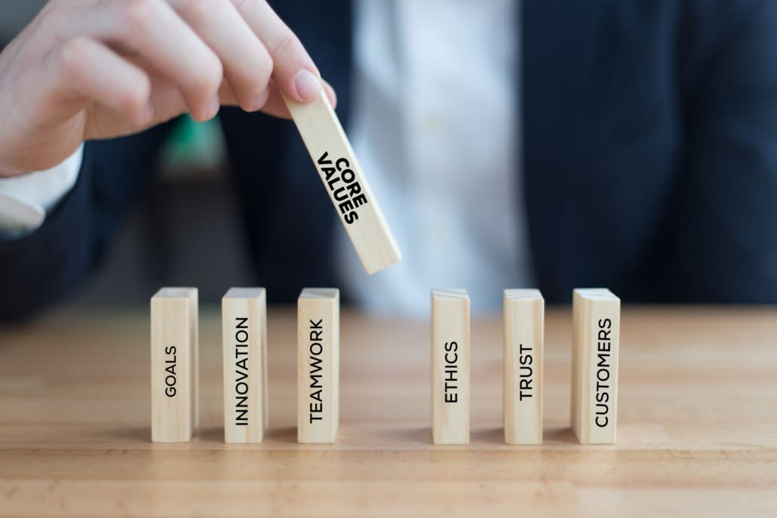
Company Values
The ethical environment of a firm plays a strong role in decision making
Merkle, 2020
Notes:
And let’s take this a step further and be detailed about it
The culture you have within your company is derived from the values that your team members live by
Meaningful values - values that can be lived, and again, not just words on a wall - what you create is an environment where you establish boundaries for acceptable behavior, making it easier for employees to identify and avoid deceptive practices within colleagues.

Slide 14
Company Values
Psychological Safety
Person-Organisation fit
Collaboration
Reduced fear of consequences
Hire for who you want to become
Long term, sustainable focus
Notes:
Psychological safety - When people feel psychologically safe, they're less afraid of negative repercussions for sharing difficult truths or admitting mistakes - ​​you then builds trust among team members, making deception both less necessary and more difficult to maintain - you will then find sales teams, product teams, marketing teams all feel comfortable engaging with one another in a meaningful manner - resulting in people being less defensive in their attitude
Person-Organisation fit - Work to generate an environment where the compatibility between individuals and organizations exists. This is particularly important for job functions where alignment with company values and culture directly impacts performance. Reward people who perform their job with High P-O fit, in doing so you will receive (1) Lower turnover rates (2) Higher job satisfaction (3) Stronger organizational commitment (4) Better citizenship behaviors (helping colleagues, representing company positively)
Collaboration - employees will then focus on a cause that is greater than just themselves as people and the company. Doing so creates Competitive advantage through trust: Companies that establish boundaries for acceptable behavior, making it easier for employees to identify and lead with their own version of ethical practice within the workplace.
Collaboration also Empowers employee accountability: When values are genuinely embraced, employees feel responsible for upholding the values, giving you every opportunity to maximise the opportunity for ethical decision making at any level to occur

Slide 15
Choosing
03
Using the right leadership style for the right situation
Notes:
The decision lies with you based on your lived experience and what you believe is the right thing to do

Slide 16
Five Leadership Styles
Paradoxical (PDL)
Transformational (TFL)
Transactional (TAL)
Laissez-Faire (LF)
COMPLEXITY
OUTCOMES
Dark (DL)
Abusive
Aversive
Corrupt
Derailed
Despotic
Exploitative
Insincere
Bullying
PEOPLE
Narcissism
Undermining
Pseudo-Transformational
Petty Tyranny
Toxic
Tyrannical
Self-Serving
Incivility
Active & Engaged
Destructive
Notes:
Leaders who demonstrate and communicate ethical standards can positively influence employees' internalization of organizational ethical values.
Ethical leaders help employees align their personal values with organizational ethical values
TFL is not a static style. Motivating work characteristics → increased vigor in their work. Leaders who go beyond self-interest, demonstrate intellectual stimulation, charisma, inspirational motivation, and individualized consideration
TAL often orientated around process: Leaders who motivate through contingent rewards and active monitoring, taking corrective measures when necessary, focussed on details and individual interactions that matter
Some researchers believe they are opposite ends of the spectrum from one another, and therefore you have people who can be one but not the other, some believe that you can interchange and be either within the person you are (i believe the latter)
Laissez-faire: Leaders avoid involvement, essentially abdicating leadership responsibilities - a highly disruptive style - “no decision is worse than the wrong decision”
Dark Leadership: A collection of behaviours that exists within people, drawn out by the executive leadership, the culture or environment within which they operate, environmental factors spawn from the industry norms and competitive positioning all through to experiences they had when they were led by someone > the taught becomes the teacher. If the taught was incorrect then who is there to correct them?
Whether you are a TFL or TAL > if you can combine both, you operate in a Paradoxical manner which inherently ambidextrous, by embracing both "open leadership behaviors" (similar to aspects of transformational leadership) and "closing leadership" behaviors (similar to aspects of transactional leadership) simultaneously.
Destructive in nature > destructive against the people
Active & engaged in nature > supportive in managing complexity and also in achieving outcomes for the company

Slide 17
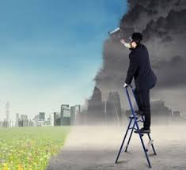
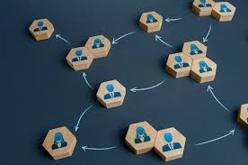

Situational implementation
Transformational
Transactional
Paradoxical
Inspire innovation and risk taking
Klein, 2023
Lead with compliance and control
Klein, 2023
Embracing a "both/and" approach
Batool et al., (2023)
Notes:
TFL demonstrate behaviours that (1) Inspire followers with an appealing vision (2) Serve as role models (3) Stimulate creativity and personal growth in followers (4) Express positive energy and authentic emotions > in doing so drive people to want to be part of an ethical community if led in this fashion
TAL is a task-oriented style focused primarily on task completion and rewarding compliance. It includes (1) Using rewards, promises, and praise to motivate followers to achieve agreed-upon performance levels (2) Management by exception (Active): Monitoring followers' performance for deviations from standards and taking corrective action in anticipation of irregularities
Paradoxical leadership deliberately integrates seemingly contradictory behaviors. This allows paradoxical leaders to: (1) Promote knowledge sharing (through autonomy and empowerment) (2) Discourage knowledge hiding (through control and clear expectations) (3) Navigate complex organizational contexts that require both structure and flexibility

Slide 18
Creating an ethical workplace
As a leader, your focus is on: navigating complexity, achieving outcomes and supporting your people
Leadership styles are situational dependant, knowing when to approach with either style is a skill in itself
Look to inspire and look to hold others accountable for their own actions
Notes:
In summary - to create an ethical workplace

Slide 19
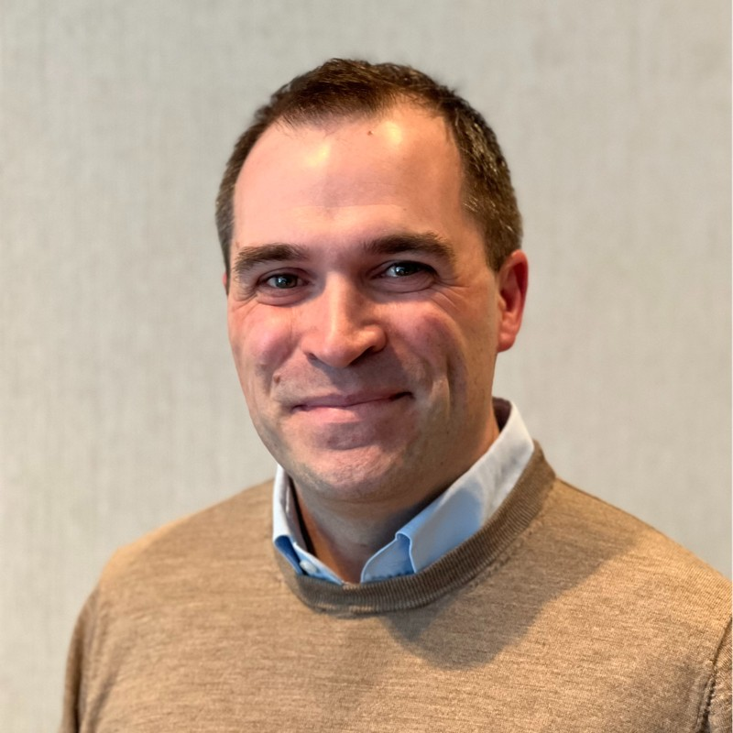
THANKS!
2428148@chester.ac.uk
linkedin.com/peterclitheroe83
Notes:
Thank you for listening to this short introduction here on ways to implement an ethical workplace environment through your own leadership style - i wish you a successful conference and a great day of learning ahead

Slide 20
References
Brown & Treviño (2006): https://www.sciencedirect.com/science/article/abs/pii/S104898430600110X?getft_integrator=tfo&pes=vor&utm_source=tfo
Brown et al., (2005): https://www.sciencedirect.com/science/article/abs/pii/S0749597805000397
Kalra et al., (2024): https://www.proquest.com/docview/3158253923?pq-origsite=summon&sourcetype=Scholarly%20Journals
EY 20204 Report: https://www.ey.com/en_uk/insights/forensic-integrity-services/global-integrity-report
EY 2020 Report: https://www.ey.com/en_uk/insights/forensic-integrity-services/why-corporate-integrity-is-more-crucial-now-than-ever
Inyang et al., (2018): https://www.emerald.com/insight/content/doi/10.1108/jbim-09-2017-0230/full/html
Lee & Huang (2019): https://www.emerald.com/insight/content/doi/10.1108/cms-05-2018-0517/full/html
Zhang et al., (2022): https://journals.aom.org/doi/full/10.5465/amj.2017.1265
Roque (2020): https://www.proquest.com/docview/2425784453?pq-origsite=summon&sourcetype=Scholarly%20Journals
Merkle, (2020): https://www.tandfonline.com/doi/full/10.1080/10696679.2020.1777434
Klein, (2023): https://www.sciencedirect.com/science/article/pii/S2444883423000025
Batool et al.,: (2023) https://www.sciencedirect.com/science/article/abs/pii/S1053482223000360

