Slide 1
Combating deceptive sales tactics for transparent and honest customer interactions
ICBAFMMA - 25
Peter Clitheroe
VP of Sales, Tyk Technologies
University of Chester, Sales Ethics Doctoral Research
Notes:
My name is Peter Clitheroe
Delighted to be here supporting your conference today
Currently VP of sales at tyk technology - over 16 years in sales and sales leadership positions
Undertaking my doctoral research at the university of chester - my research is looking unto the unethical practice of sales managers within the enterprise software industry

Slide 2
37%
Online retailers use at least one deceptive pricing tactic
Most common is “2 left in stock” used 42% of the time
Source: Forrester Buying Study, 2021
Notes:
My mind always thinks - really - you have only two left in stock, you should be having a discussion with your supply chain team on the inventory management process - my mind also thinks - oh quick I need to buy this before they run out or the price goes up.

Slide 3
68%
Car buyers in USA reported receiving at least one deceptive tactic
Hidden Fees: 54%
Misleading finance: 41%
Fales conditions: 38%
Source: FTC.gov
Notes:
Federal Trade Commision in USA created the CARS rule in 2023 - save consumers nationwide more than $3.4 billion and an estimated 72 million hours each year shopping for vehicles

Slide 4
10%
Fine of global group turnover for deceptive sales, marketing and advertising practices from April, 2025
Source: Morgan Lewis
Notes:
From April 2025 - here in the UK - company can be fined up to 10% of their turnover if they are found guilty of using deceptive sales tactics in selling their products or services

Slide 5
Deceptive tactics include
Inadequate Pricing Disclosures
Misrepresentation of Consumer Rights
Aggressive or Pressure-Based Sales Tactics
Subscription Traps
Source: Morgan Lewis
Notes:
Here are four examples of deceptive tactics here that are to be looked at when considering companies breach of what is soon to be released regulations

Slide 6
Discussion today
Define deceptive sales tactics
Structural actions within a company to prevent and combat deceptive sales tactics
Benefits of transparency and honesty in customer interactions
Notes:
Today we will look into …. Defining deceptive sales tactics, understand structural and proactive actions companies can take to combat deceptive sales tactics and lastly the benefits of transparency and honesty
Applicable for both Business to Business and Business to Consumer
Information I am sharing with you today is based on the research I am undertaking

Slide 7
Defining
01
deceptive sales tactics

Slide 8
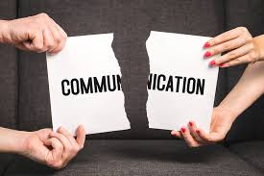

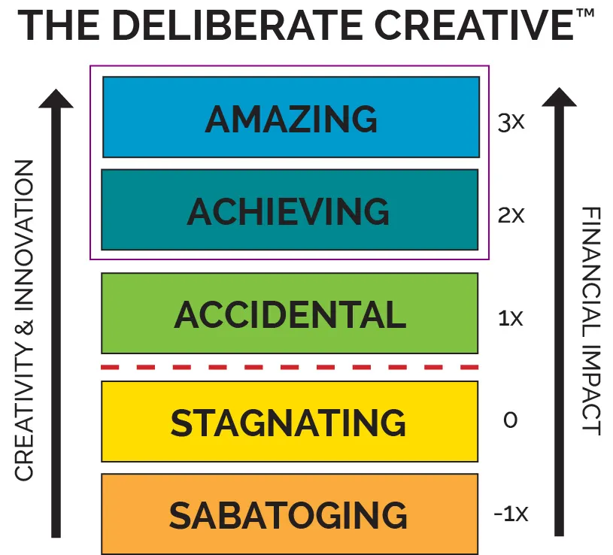
What is deception?
False Communication
Selfishness
Deliberate attempt
For the sole benefit of the communicator
Ferguson, 2014
Misleading someone for personal gain
Hermann, 2017
Create an untruth that someone else believes to be true
Vrij, 2001
Notes:
Deception is - creating and sharing false information, doing so for personal gain (individual or a company) and doing so deliberately - when you are deliberate in your actions you can achieve amazing results (regular exercise, healthy diet, learning) - however, when you do so in a negative sense, the results can be conflicting and quite destructive for all involved

Slide 9
Common Deceptive Tactics
Pricing Manipulation
Psychological Manipulation
False original pricing
Artificial discounts
Hidden fees
Bait-and-switch tactics
Artificial scarcity
Urgency creation
Emotional manipulation
Social proof fabrication
Notes:
Pricing
False original pricing - Online retail giant > 50% off original price > small print - price tracked between (date A and date B) > between those two dates the price of that item has been artificially inflated for the purpose of offering this discount
Hidden fees - online event ticketing companies > ticket price for the concert > add on an event fee > add on a booking fee > add on a payment fee - then your price isn’t your price, it becomes something wildly different that what you imagined it to be - by now you are caught and can’t go anywhere else so you buy
Psychological
Made up testimonials, incorrect statistics, statistics without the reference or the correct description gain a psychological advantage over you - the buyer
Biggest example of social proof fabrication - wasnt to do with selling a product you could buy - included Cambridge Analytica - their data algorithms were allegedly used to create posts on Facebook that insinuated scenarios that were not true for the purpose social proof fabrication over how the US election was developing when Trump was in his first candidacy. This approach was also aledgedly used in the campaign for BREXIT here in the UK

Slide 10
Structure
02
Actions to prevent and combat deceptive sales tactics
Notes:
To reduce something is to starve it of the fuel it craves in order to survive - here we will cover 4 areas of your business to remove the fuel for deceptive sales tactics to occur

Slide 11

Executive Strategy
The executive function in a business is the origin for organisational behaviour
Chan, 2021
Notes:
while company executives can place ethical decision making within their corporate agenda, not all decisions are made without an unethical component to them, creating risk and exposure, especially when financial decisions are involved.

Slide 12
Executive Strategy
Organisation Structure
Executive Behaviour
Sustainable Growth
Flat over Hierarchy
Customer over Self
Long term operation
Notes:
Org Structure - the closer an executive can get to the operation of the business, the greater insight the executive will have into the daily functions and be able to course correct in real time from first hand knowledge and not from 3rd level information. Understanding what happens within your business will enable you to prevent the presence of any deception in real time
Executive Behaviour - Put the interest of your customers over yourself and your personal ambitions: EY 2024 Integrity report (EY, 2024) reports 67% of boards are willing to operate unethically to improve their own position within the company. Putting customers in return first gets you enhanced customer loyalty, stronger brand reputation - most importantly - increased employee engagement > wealth of flow down benefits
Sustainable growth - Focus on having a long term plan that is meaningful and tangible. Is known by all stakeholders within the business. Each understands their role and responsibility and they also understand the rewards that relate to their role - with this, set metrics to reward people for behavioural and performance inputs doing their job and not performance related to the output of their job

Slide 13
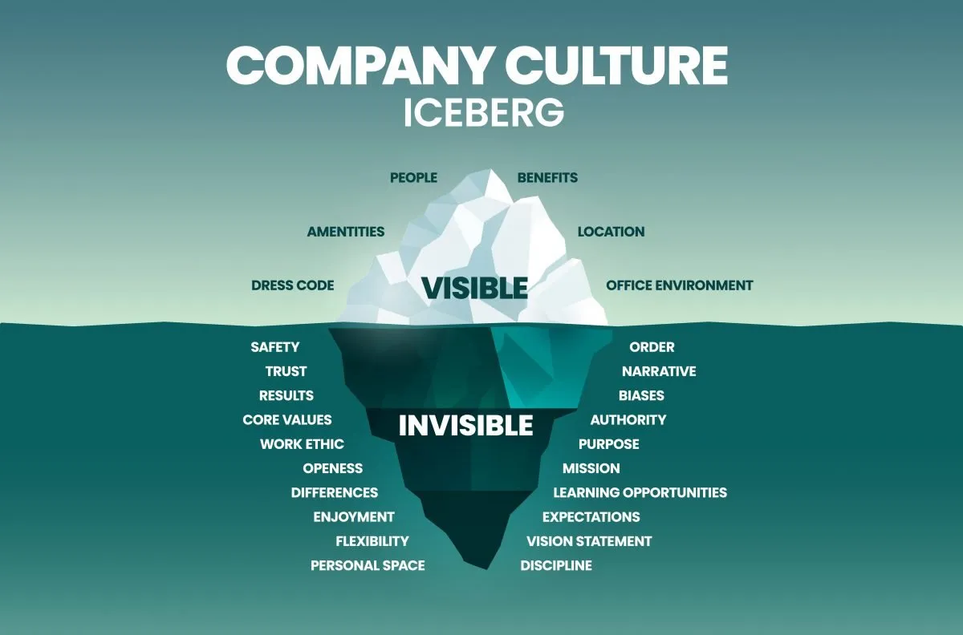
Company Culture
The ethical environment of a firm play a strong role in decision making
Merkle, 2020
Notes:
Your company culture just is. You cant create it. It occurs as a result of your actions
The values your instill within the company, the behaviours that everyone exhibits is the culture of the company regardless of what is written in the company manual or on the office wall.

Slide 14
Company Culture
Psychological Safety
Meaningful Values
Collaboration
Reduced fear of consequences
An ethical framework
Long term, sustainable focus
Notes:
Psychological safety - When people feel psychologically safe, they're less afraid of negative repercussions for sharing difficult truths or admitting mistakes - ​​you then builds trust among team members, making deception both less necessary and more difficult to maintain - you will then find sales teams, product teams, marketing teams all feel comfortable engaging with one another in a meaningful manner - resulting in people being less defensive in their attitude
Meaningful values - values that can be lived, and again, not just words on a wall - what you create is an environment where you establish boundaries for acceptable behavior, making it easier for employees to identify and avoid deceptive practices within colleagues. Empowers employee accountability: When values are genuinely embraced, employees feel responsible for upholding them give you every opportunity to minimise the opportunity for deception at any level to occur
Collaboration - employees will then focus on a cause that is greater than just themselves as people and the company. Doing so creates Competitive advantage through trust: Companies that establish reputations for honesty can gain sustainable competitive advantages through customer loyalty and positive word-of-mouth. Deception here does not have a chance to survive.

Slide 15

Sales Subculture
A subculture can differ from company culture as a result of behaviours exhibited by the manager
Merkle, 2020
Notes:
The manager layer within a company - assume the role of middle management or country management in a large corporation - are the people who determine both the environment and the values by which the team operate against. If deception exists within sales, it is the management layer that is either encouraging it or it is the management layer that is allowing it by not punishing it

Slide 16
Sales Subculture
Management Behaviour
Sales People Behaviour
Training & Development
Leadership by example
Positive pattern of activity
Development of techniques
Notes:
Management Behaviour - A managers supervisory style directly impacts the operating style of the members within your control. A positive leadership style of transformational behaviour - motivating employees, guiding employees through decision making moments, will inspire people to achieve beyond their capabilities. The manager behaviour should also align their department or team subculture to the company culture - Manager is the link between everyone - a manager can eradicate deceptive behaviour within salespeople as a result of their own approach to leadership.
Sales People Behaviour - Lead with Transparency - Transparency-focused interactions look like (1) disclosing information relating to your product or service in its completeness - you can do this through documentation to support any verbal discussions that can take place (2) document all verbal interactions to ensure that consistency is maintained and all parties are fully disclosing information for clarity (3) make sales people responsible for the customers product adoption - doing so will ensure the focus is not just on the initial sale, but also on the longer term value that someone generates from the product or service sold (4) as a result of the sales subculture and the values within the company - customers rate the service they receive by the sales person against the values you decide as a company are ones you want your customers to see
Training & Development - Developing your sales people to exhibit the right behaviours, techniques and consultative approach to selling will provide a foundation upon which the oxygen that deception requires to live and thrive is reduced. Varying training topics and holding regular training sessions will create an atmosphere of learning and development for long term personal and company gain over the short term compensation

Slide 17

Compensation Structure
Measure and compensate strategically
DeTienne et al., 2022
Notes:
Lastly here, compensation should not just be about money for product sales by any means, it should be about a holistic approach to reward schemes

Slide 18
Employee Compensation
Balanced scorecard
Recognition programs
Long term targets
Multi activity, multi scenario
Practice of behaviour over outcome
Health of the company
Notes:
Balanced scorecard - employees of all levels should be reviewed based not just on results. Including customer feedback, evidence of ethical decision making through colleague feedback, ultimately rate the number of units sold not just the value of units sold - all together, this will reduce the ability of a sales based employee to use deception to sell something as their overall compensation is multi faceted - by doing so you also reduce the emotional burden on a sales person who has to be fixated on target attainment
Recognition programs - compensation does not just have to be paid for an initial sales, holding monthly awards within team and across the business for exhibiting the values of the company along with other key metrics you as a company want to implement will reduce the desire of an individual to act with deception towards act with desire - having incentive funds - or SPIFs as they are know - for key metrics in a time period will drive behaviour in the right way
Long term targets - linking cultures and subcultures, executive behaviour and the structure of your company values towards focussing on a company mission whereby attainment over a long term time period in the right way, gives employees a reward that will be far superior over the short term reward of money for sale that can drive deception. If you remove that desire for short term gratification and incentivise loyalty - the ability of individuals to act with deception will be minimised as heard mentality will circle on the offending parties and drive it out - you also in doing so retain staff for longer therefore driving the quality of your workplace and the quality of your customer service higher

Slide 19
Benefits
03
Transparency and honesty in customer interactions
Notes:
As a company, as a sales person and as a customer there is significant upside to deception being eradicated

Slide 20
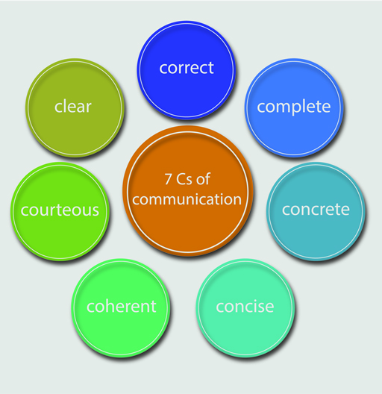
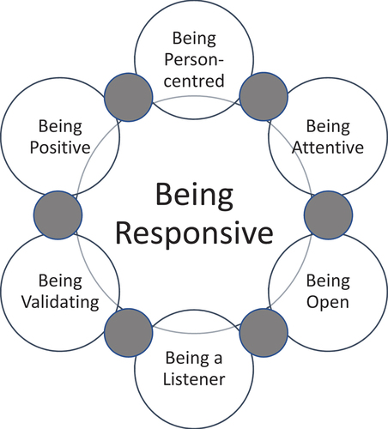
Customer First Approach
Clear Communication
Responsiveness
Deliberately creative
Minimise a lack of understanding
Malse and Krush, 2020
Acting in a quick and positive way
Cambridge
Be intentional to achieve those amazing experiences for all
Climer
Notes:
If you are able to effect Executive strategy, company culture, a sales subculture and have the right compensation and reward scheme, you have the ability to attain transparency and honesty in customer interactions
In doing so you should experience
Clear communication of your product or service - you will minimise any lack of understanding that anyone has both internally through training and externally to your buying community through precise information sharing
Responsiveness from sales team members towards the customer whereby the result to achieve is not just the sale but is the designed for experience that the person should be delivering and should be receiving
Deliberately creative employees are an output of employees who feel coached, feel supported and feel motivated to act on the best interests of themselves and of a company and not wholly on themselves and a paycheck.

Slide 21
Combat deceptive tactics through
Executive strategy based on Customers
Company culture driven by practical and meaningful values
A sales subculture whereby management leads ethically and responsibly
Compensation structures are based on behaviours and not just sales attainment
Notes:
In summary
Four elements to combating deceptive sales tactics are

Slide 22
THANKS!
2428148@chester.ac.uk
linkedin.com/peterclitheroe83
Notes:
Thank you for listening to this short introduction here on ways to combat deceptive sales tactics - i wish you a successful conference and a great day of learning ahead

Slide 23
References
False communication: https://www.sciencedirect.com/science/article/abs/pii/B9781455731749000082
Selfishness: https://www.sciencedirect.com/science/article/abs/pii/B978012805372000002X
Deliberate attempt: https://www.sciencedirect.com/science/article/abs/pii/B0080430767018143
Amazon Price manipulation https://www.heise.de/en/news/Fake-discounts-at-Amazon-US-citizen-files-class-action-lawsuit-9876541.html
Online ticketing companies hiding fees https://www.rollingstone.com/music/music-news/ftc-bans-hidden-ticket-fees-1235208143/
Cambridge Analytica: https://www.bbc.co.uk/news/technology-64075067
Chan et al: https://doi.org/10.5465/amp.2017.0215
EY Integrity report: https://www.ey.com/en_uk/insights/forensic-integrity-services/global-integrity-report
Merkle, 2020: https://www.tandfonline.com/doi/full/10.1080/10696679.2020.1777434
DeTienne et al., 2022: https://journals.sagepub.com/doi/full/10.1177/23949643221093455?journalCode=jcva
Malshe and Krush, 2020: https://www.emerald.com/insight/content/doi/10.1108/jbim-03-2020-0125/full/html
Cambridge dictionary: https://dictionary.cambridge.org/dictionary/english/responsive
Dr Amy Climer: https://climerconsulting.com/deliberate-creative-mentoring/

