Slide 1


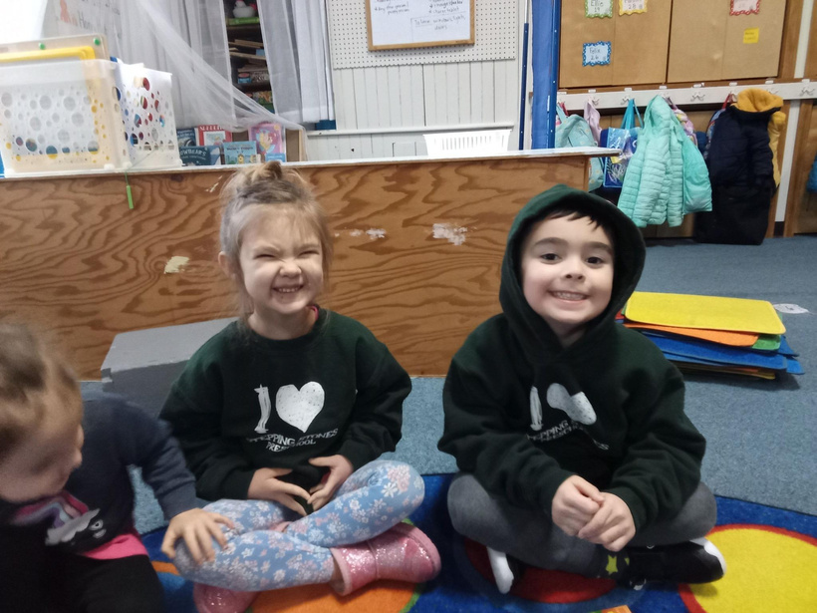









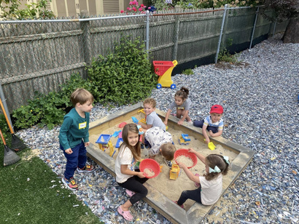
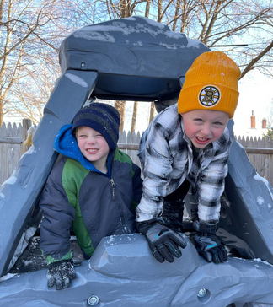

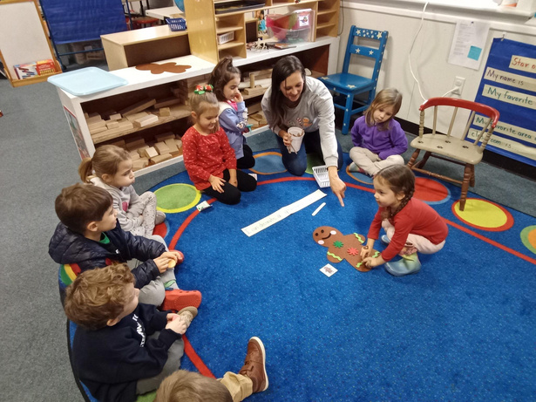

Contact Us Today
Discover a world of love, learning, and laughter at our school!
978-777-9370
steppingstones01923@gmail.com
Authentically Educating
www.steppingstonesdanvers.org
Play-Based Curriculum
Our literature based curriculum combines reading and play in an authentic way to build on curiosity and foster self expression
Stepping Stones Preschool
Built for Growing Minds
A LEADER IN QUALITY
PRESCHOOL CARE IN DANVERS
SINCE 1969
Our teachers adapt daily activities to meet each child at their current stage of physical, emotional, and cognitive growth, making lessons developmentally appropriate.

Slide 2
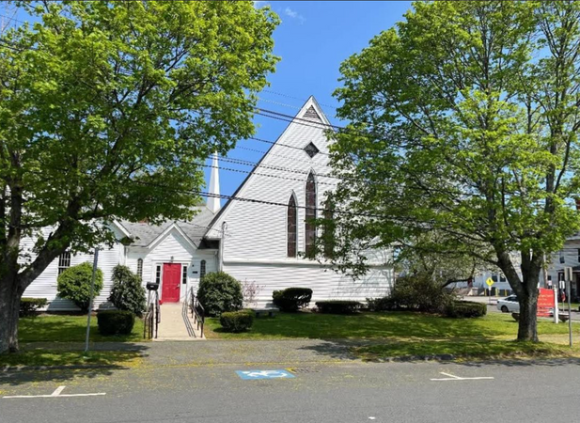
Take a Walk through the “BIG RED DOOR”
Price List
Stepping Stones is a non-profit pre-school
for children ages 2.9 to 5 years old
sponsored by All Saints Episcopal Church,
meeting Monday through Friday in the
Nursery room of the Parish House.
Class | Price (Per Year) | Times | Ages | Price (Per Month)
2 Day | $2400 | 8:30-12:00 | 2.9-4 | $240
3 Day | $3600 | 8:30-12:00 | 3.9-5 | $360
5 Day | $6000 | 8:30-12:00 | 3.9-5 | $600
A nurturing Environment
Our cozy classroom is designed to make students feel at home and ready to play.
A fixed registration fee of $125 to secure the child’s place.
Registration is ongoing and includes a visit to the school, an interview with the director, completed application, consent and medical forms, and payment of the non-refundable registration fee.
Expert Educators
Our caring and certified staff are dedicated to fostering a love for learning through play, exploration, and creativity.

