Slide 1
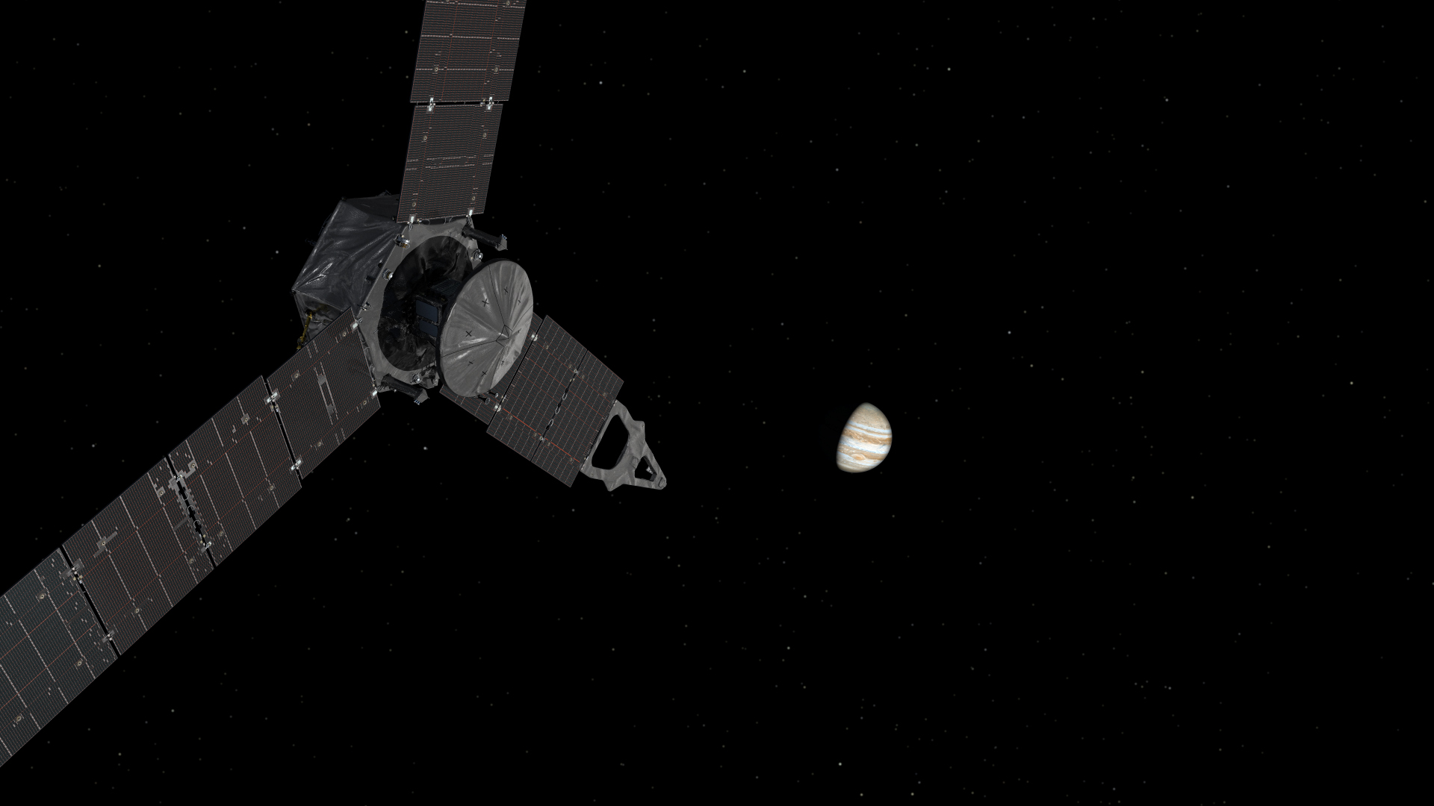
Uncertainties in the Determination of Jupiter’s Core
Alexander C. English
Mentor: David J. Stevenson

Slide 2
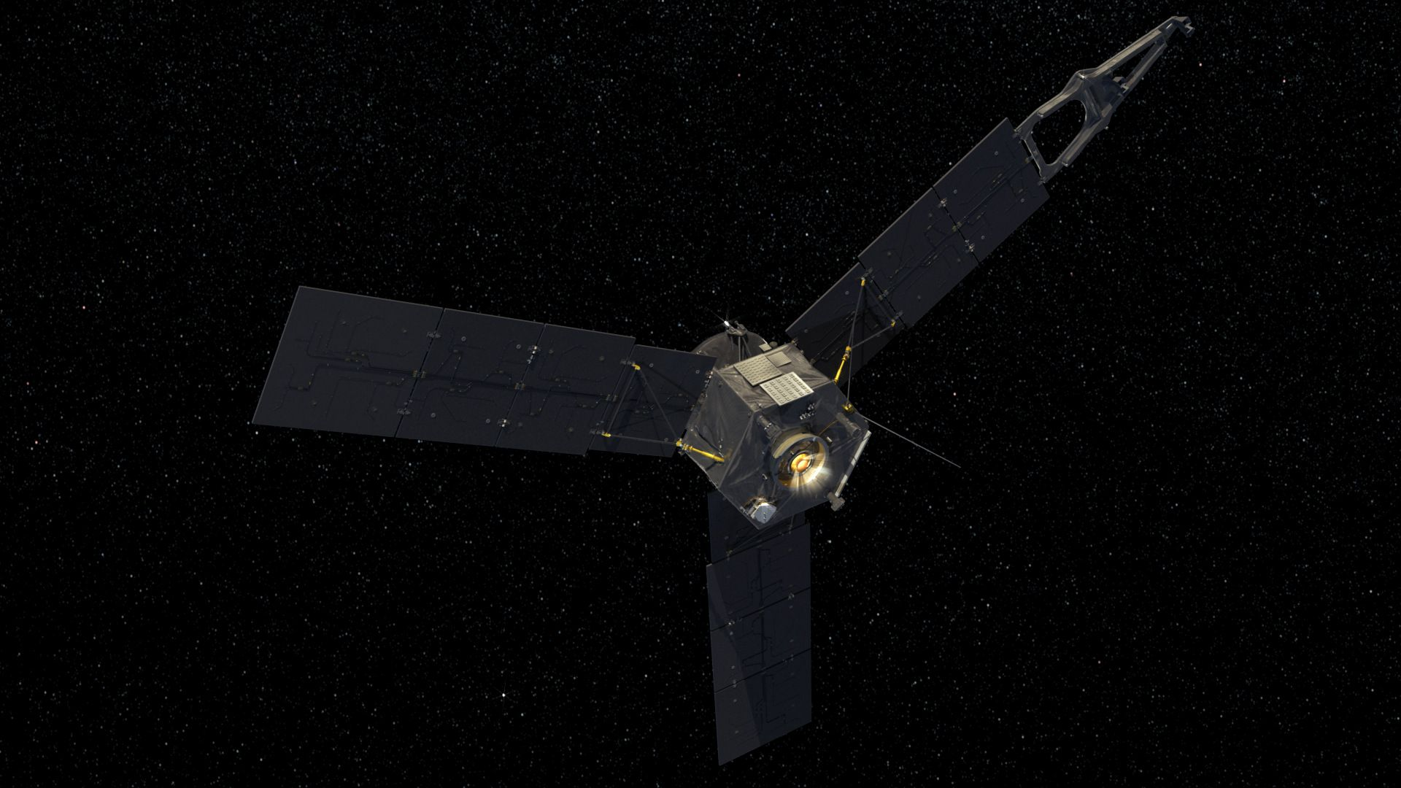
Juno
Launched on August 5, 2011
Successfully entered Jupiter’s orbit on July 4, 2016
“Jupiter Orbital Insertion” (JOI)
In the process of completing two 53.5-day staging orbits
Will tighten its orbit into 2-week science orbits to take data
Will measure Jupiter’s normalized moment of inertia ($α$) to 0.2%
This is the moment of inertia divided by MR²
Gravity Science Experiment (GSE)
Tells us about distribution of mass within the planet

Slide 3
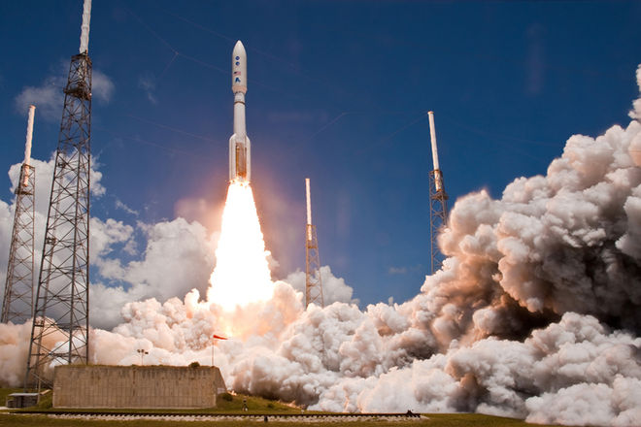
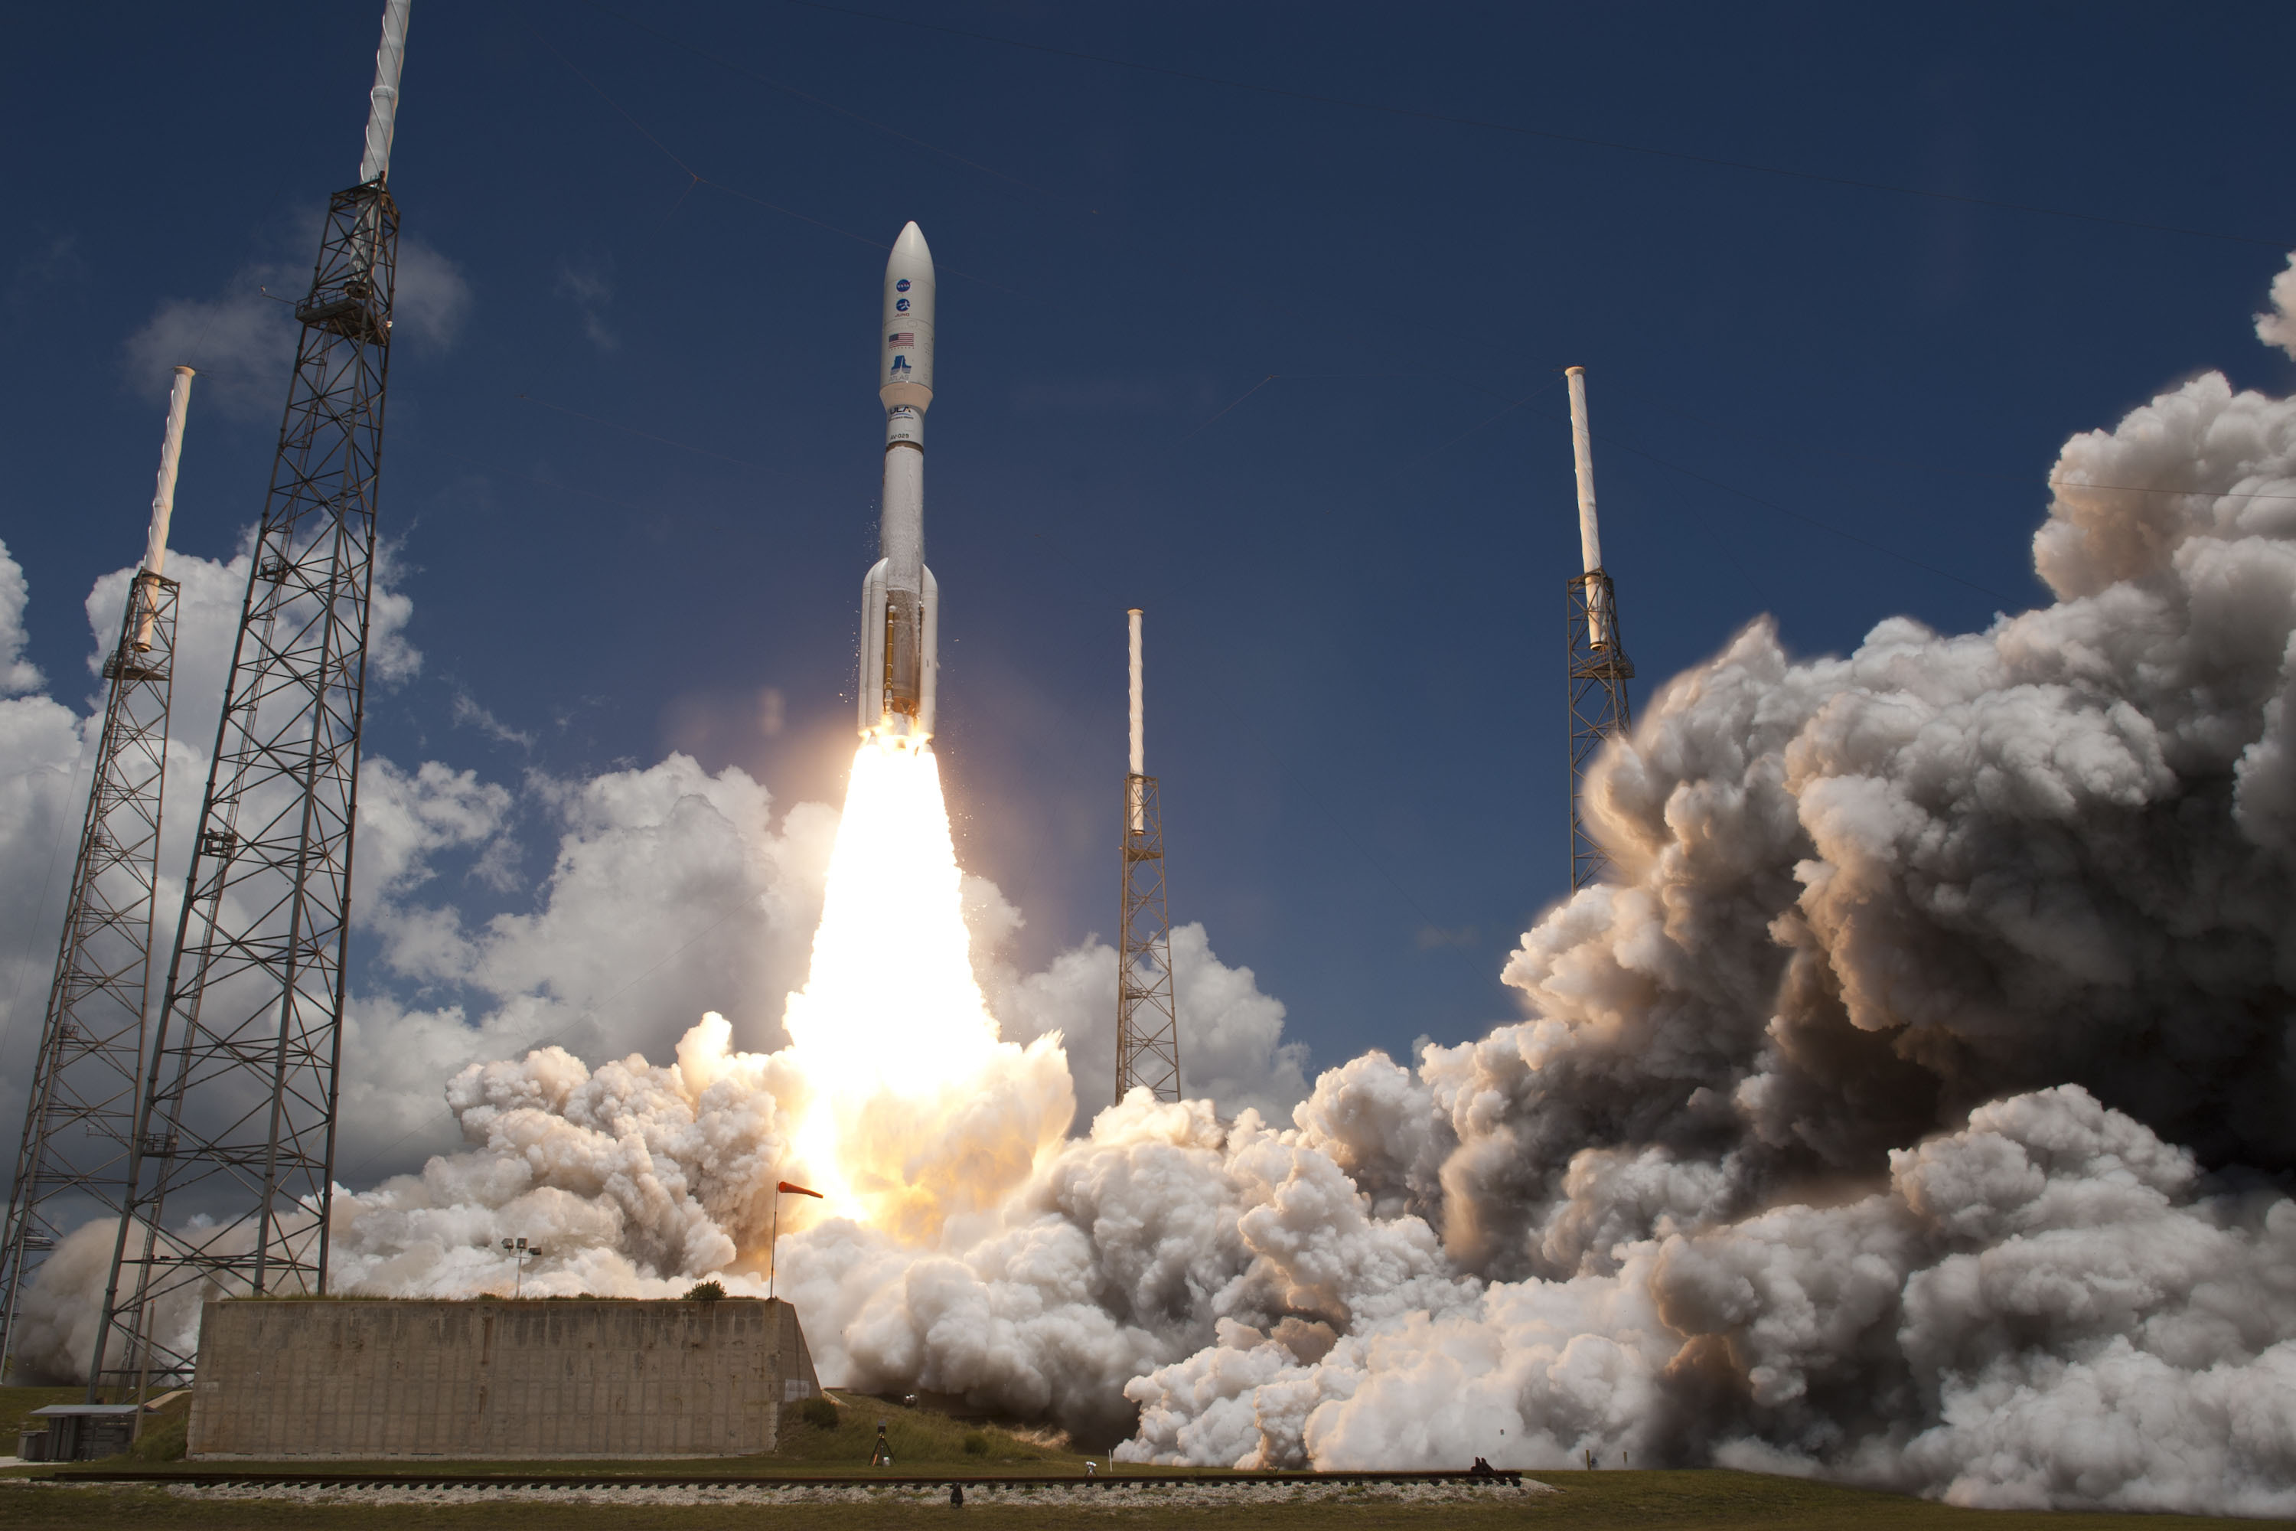

Slide 4
The Core
“Central concentration of elements heavier than H and He”¹
Very little is known about it²
My focus is on learning about the size and mass of the core
We know precisely Jupiter’s mean radius and total mass
Combine these with Juno’s measurement of $α$ to narrow range
Will provide better understanding of Jupiter’s structure as a whole
Insight into Jupiter’s formation and origin of our solar system
My analysis quantifies extent to which uncertainties in the equation of state affect the determination of the core

Slide 6
The Equation of State
Equation that describes how a substance’s atoms interact
Jupiter is comprised mostly of hydrogen³
Hydrogen has a complex EOS
N = 1 polytrope is a good approximation for hydrogen:
$\text{Relates} \text{pressure}\text{ (}P\text{)} \text{to} \text{density}\text{ (}ρ\text{):} P = Kρ$²
Only applies to Jupiter’s envelope (region external to core)
Gives rise to a solution for density as a function of radius
Allows us to solve for core mass ($m_{c}$), envelope mass ($m_{e}$), and $α$ depending on choice of core radius ($r_{c}$) and $K$

Slide 7
The Gravitational Harmonic ($J_{2}$)
Separate yet similar property to $α$ that Juno will also measure
Jupiter’s $J_{2}$ already known to more precision than $α$
Interest lies in seeing how $α$ behaves in relation to $J_{2}$
If we choose a reference value of $J_{2}$ that we can keep fixed, we can vary $K$ and $r_{c}$ to see how $α$ changes
Corresponds to a core mass of about 10 Earth masses and a small core radius (based on best current models)

Slide 8
Table of values in SI units for fixed $Λ_{2,0}$ = 0.154949
$$r_{c}$$ | $$k$$ | $$K$$ | $$α$$ | $$m_{c}$$
R/3 | 4.32069*10⁻⁸ | 222766 | 0.247286 | 3.00436*10²⁶
R/4 | 4.35222*10⁻⁸ | 221004 | 0.248913 | 1.66540*10²⁶
R/5 | 4.36060*10⁻⁸ | 220441 | 0.249291 | 1.16295*10²⁶
R/6 | 4.36348*10⁻⁸ | 220218 | 0.249374 | 9.33123*10²⁵
R/7 | 4.36465*10⁻⁸ | 220117 | 0.249380 | 8.12835*10²⁵
R/8 | 4.36519*10⁻⁸ | 220067 | 0.249367 | 7.43486*10²⁵
R/9 | 4.36546*10⁻⁸ | 220042 | 0.249349 | 7.00532*10²⁵
R/10 | 4.36560*10⁻⁸ | 220028 | 0.249332 | 6.72419*10²⁵
R/12 | 4.36573*10⁻⁸ | 220015 | 0.249305 | 6.39470*10²⁵
R/15 | 4.36579*10⁻⁸ | 220009 | 0.249279 | 6.16173*10²⁵
R/16 | 4.36580*10⁻⁸ | 220008 | 0.249274 | 6.11655*10²⁵
R/18 | 4.36581*10⁻⁸ | 220007 | 0.249264 | 6.05180*10²⁵
R/20 | 4.36581*10⁻⁸ | 220007 | 0.249257 | 6.00894*10²⁵
R/25 | 4.36582*10⁻⁸ | 220006 | 0.249247 | 5.94860*10²⁵
0 | 4.36582*10⁻⁸ | 220006 | 0.249227 | 5.86775*10²⁵

Slide 9
Changing $K$ is akin to changing the composition of the envelope
Altering the temperature, heavy element makeup, etc.
As core radius increases, so does core mass
Also, $α$ should increase with core radius because our model assumes a constant core density
Larger core results in less central concentration of mass
Holds true for smaller core radii, then the trend reverses
Most importantly, change in $α$ is very small
On the order of a few hundredths of a percent
Confirms that $J_{2}$ is good approximation for $α$
Change in $α$ not very dependent on core radius

Slide 10
Juno’s first picture of Jupiter!

Slide 11
Perturbing the Equation of State
“Unperturbed” analysis uses simple n = 1 polytrope
Jupiter’s true EOS is more complex⁴
Perturbation theory: add a small correction term ($y\left(z\right)$) to the solution for density to simulate a change in the EOS⁵
This correction is customizable, which is why it is useful
Changes the solutions for $m_{c}$, $m_{e}$, and $α$
We can change $y\left(z\right)$ for each pair of values of $K$ and $r_{c}$ that kept $J_{2}$ constant in the unperturbed case to keep $α$ fixed
Want to understand what differing models for the interior of the planet would result in the same exterior value of $α$

Slide 12
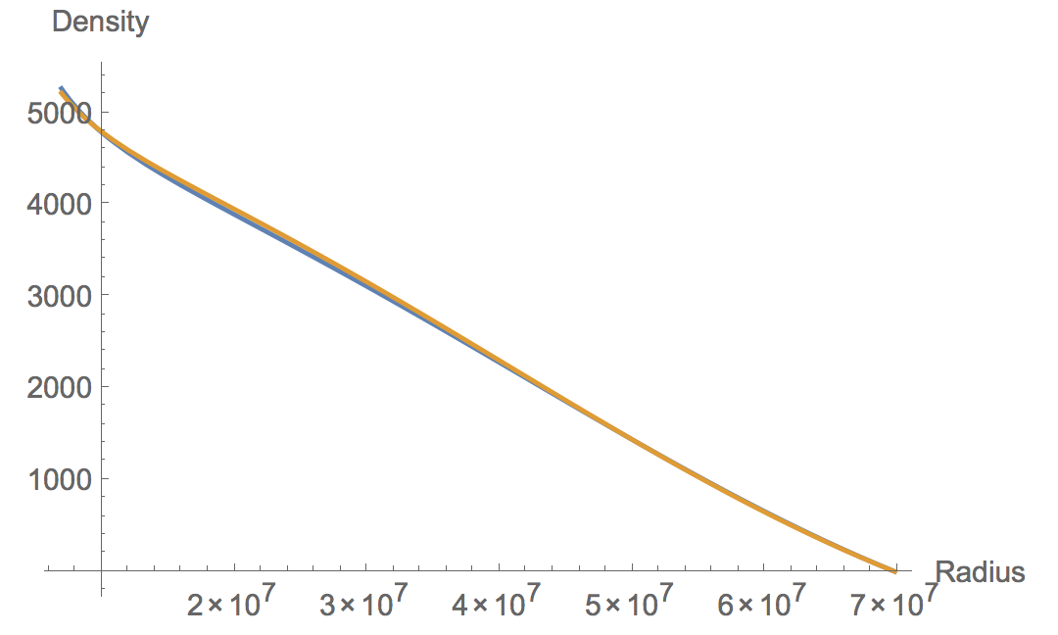
Unperturbed and perturbed plots of density vs. radius outside the core for $k$ = 4.36560*10⁻⁸,
$r_{c}$ = R/10, $β$ = 1.0100 (SI units)

Slide 13
Table of values in SI units for $y(z)$ and resulting $m_{c}$,
keeping $α$ fixed from the unperturbed case
$$r_{c}$$ | $$k$$ | $$α$$ | $$y(z)$$ | $$m_{c}$$ unperturbed | $$m_{c}$$ perturbed
R/3 | 4.32069*10⁻⁸ | 0.247286 | (sin(z)-0.4621*cos(z))/100 | 3.00436*10²⁶ | 3.03311*10²⁶
R/4 | 4.35222*10⁻⁸ | 0.248913 | (sin(z)+0.5841*cos(z))/100 | 1.66540*10²⁶ | 1.61031*10²⁶
R/5 | 4.36060*10⁻⁸ | 0.249291 | (sin(z)+0.8490*cos(z))/100 | 1.16295*10²⁶ | 1.08187*10²⁶
R/6 | 4.36348*10⁻⁸ | 0.249374 | (sin(z)+0.9391*cos(z))/100 | 9.33123*10²⁵ | 8.43241*10²⁵
R/7 | 4.36465*10⁻⁸ | 0.249380 | (sin(z)+0.9763*cos(z))/100 | 8.12835*10²⁵ | 7.19628*10²⁵
R/8 | 4.36519*10⁻⁸ | 0.249367 | (sin(z)+0.9940*cos(z))/100 | 7.43486*10²⁵ | 6.48946*10²⁵
R/9 | 4.36546*10⁻⁸ | 0.249349 | (sin(z)+1.0041*cos(z))/100 | 7.00532*10²⁵ | 6.05502*10²⁵
R/10 | 4.36560*10⁻⁸ | 0.249332 | (sin(z)+1.0100*cos(z))/100 | 6.72419*10²⁵ | 5.77229*10²⁵
R/12 | 4.36573*10⁻⁸ | 0.249305 | (sin(z)+1.0167*cos(z))/100 | 6.39470*10²⁵ | 5.44350*10²⁵
R/15 | 4.36579*10⁻⁸ | 0.249279 | (sin(z)+1.0211*cos(z))/100 | 6.16173*10²⁵ | 5.21330*10²⁵
R/16 | 4.36580*10⁻⁸ | 0.249274 | (sin(z)+1.0215*cos(z))/100 | 6.11655*10²⁵ | 5.16877*10²⁵
R/18 | 4.36581*10⁻⁸ | 0.249264 | (sin(z)+1.0229*cos(z))/100 | 6.05180*10²⁵ | 5.10564*10²⁵
R/20 | 4.36581*10⁻⁸ | 0.249257 | (sin(z)+1.0239*cos(z))/100 | 6.00894*10²⁵ | 5.06411*10²⁵
R/25 | 4.36582*10⁻⁸ | 0.249247 | (sin(z)+1.0250*cos(z))/100 | 5.94860*10²⁵ | 5.00588*10²⁵
0 | 4.36582*10⁻⁸ | 0.249227 | (sin(z)+1.0270*cos(z))/100 | 5.86775*10²⁵ | 4.92953*10²⁵

Slide 14
I chose a simple $y\left(z\right)$ with an adjustable parameter ($β$)
$y\left(z\right)=(sinz+βcosz)/100$
Perturbed density greater on average than unperturbed
Extra envelope mass made up for by less massive core
All perturbed core masses are smaller than the unperturbed (except for R/3)
Not much variation in $β$ (a few percent or less)
Indicates that the model is not heavily dependent on choice of core radius

Slide 15
A Physically Motivated Model
Let $y\left(z\right)=0.015(1+z−0.2z^{2})/(1+e^{5(z−2.5)})$ to represent a specific model of Jupiter’s interior
Represents a thermal correction to the equation of state due to a temperature difference inside Jupiter of about 1000K at 1 megabar pressure
This is a deviation from current models of Jupiter
As usual, we keep $α$ fixed from the unperturbed case

Slide 16
$$r_{c}$$ | $k$ unperturbed | $k$ perturbed | $$α$$ | $m_{c}$ unperturbed | $m_{c}$ perturbed
R/6 | 4.36348*10⁻⁸ | 4.28870*10⁻⁸ | 0.249374 | 9.33123*10²⁵ | 8.16853*10²⁵
R/8 | 4.36519*10⁻⁸ | 4.28794*10⁻⁸ | 0.249367 | 7.43486*10²⁵ | 6.31780*10²⁵
R/10 | 4.36560*10⁻⁸ | 4.28732*10⁻⁸ | 0.249332 | 6.72419*10²⁵ | 5.63880*10²⁵
R/12 | 4.36573*10⁻⁸ | 4.28688*10⁻⁸ | 0.249305 | 6.39470*10²⁵ | 5.33010*10²⁵
Because $y\left(z\right)$ is fixed, only $K$ can be varied to keep $α$ constant
Decreases by a couple percent for mid-range core radii
Core mass drops by about 10-20% from unperturbed case
More substantial change than before
However, core mass is only a few percent of the total mass of Jupiter, so this change doesn’t affect $α$ much

Slide 17
Discussion
We now have a way to create a perturbation of choice to the EOS and see how it affects the core
Our model can be made more realistic for greater accuracy
Treat Jupiter as a non-uniform rotating body
It has been demonstrated that depending on the EOS, Jupiter’s core can take on a range of possible masses and radii
Further examination of the heavy element makeup of Jupiter’s core and envelope, as well as its equation of state, is needed

Slide 18
References
1. Stevenson, D. J. Unpublished. Limits on Determining the Core of Jupiter.
2. Guillot, T., D. J. Stevenson, W. B. Hubbard, and D. Saumon 2004. The interior of Jupiter. In Jupiter - The Planet, Satellites and Magnetosphere.
3. Saumon, D., G. Chabrier, and H. M. van Horn 1995. An Equation of State for Low Mass Stars and Giant Planets. Astrophys. J. Suppl. 99, 713.
4. Hubbard, W. B., and B. Militzer 2016. A Preliminary Jupiter Model. In The Astrophysical Journal.
5. Stevenson, D. J. Unpublished. P41B-2072, Limits to the Core Mass of Jupiter.

Slide 19
A huge thank you to SURF and my mentor, Professor David Stevenson!

