Slide 1
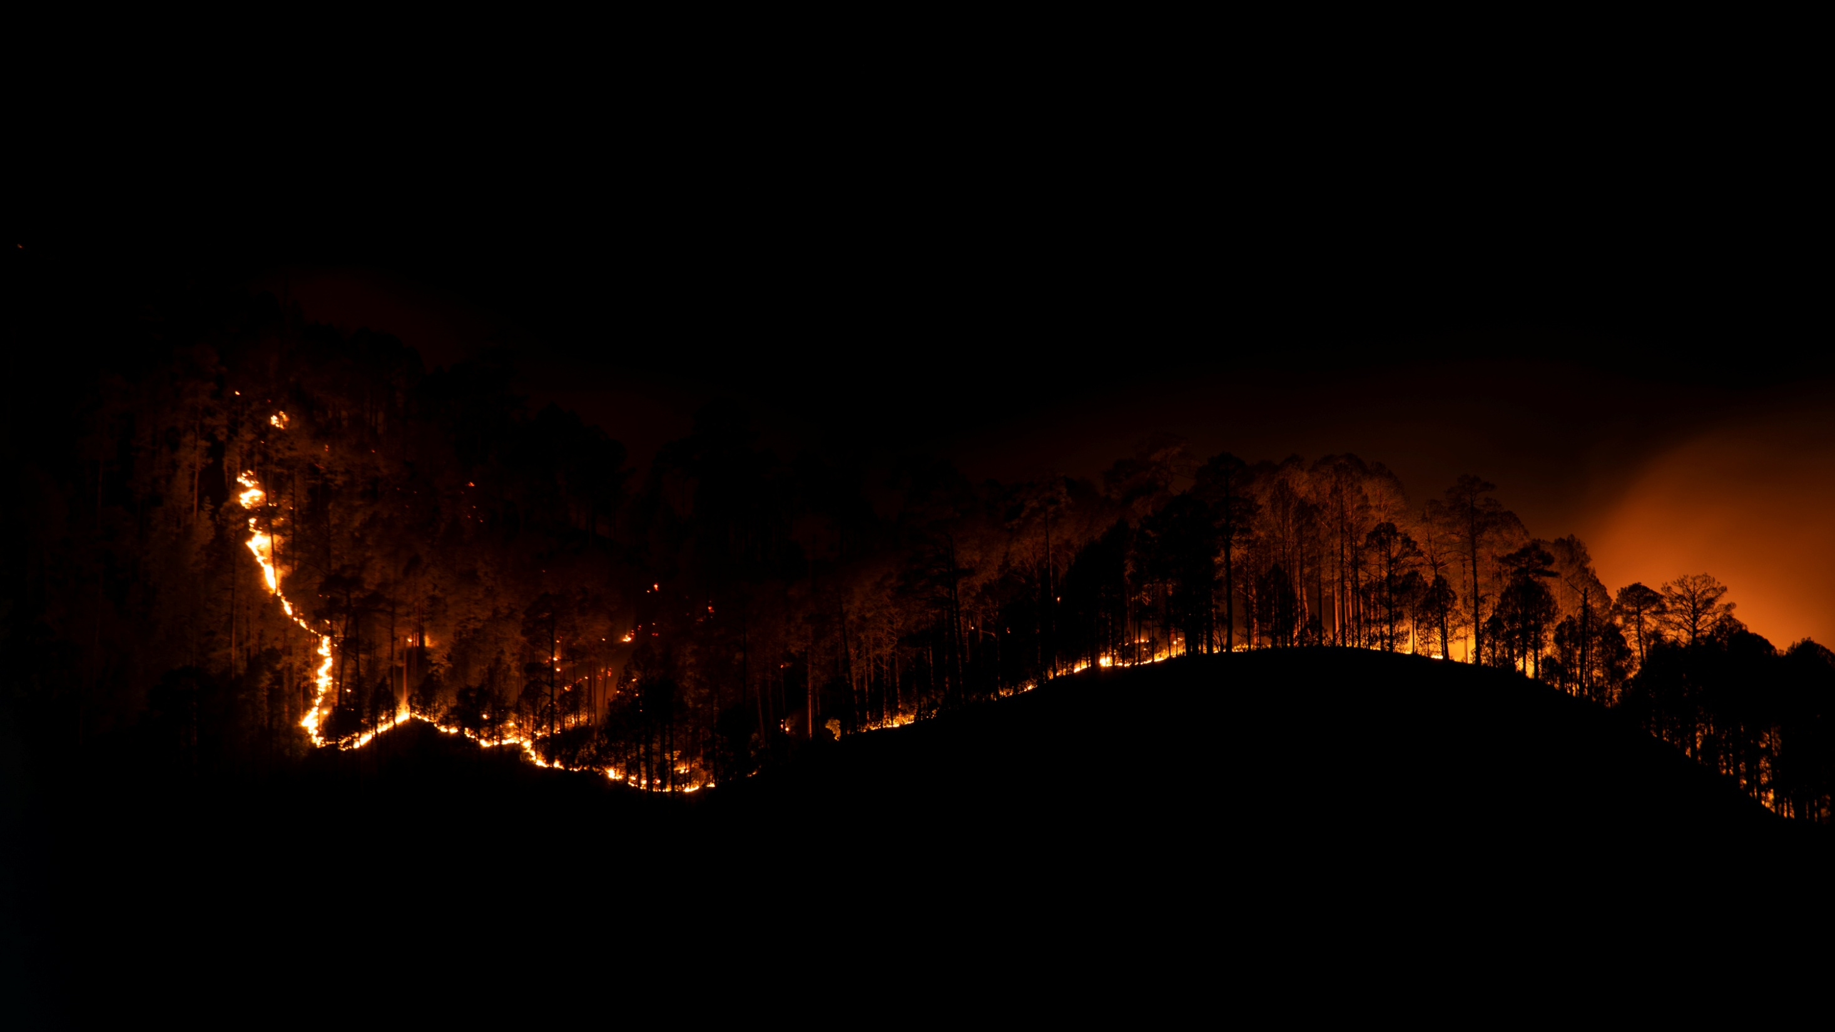




NATURE
New Presentation Template
A Wildlife Consulting Company...
exploringthenature2021
ExploringNat007
exploringnature2021
www.exploringnature.net

Slide 2

Exploring Nature is a Community of like-minded people who loves to be in Nature amidst. Mother Nature has its own rhythm and we must tune up to it for a better tomorrow.
Our Mission is to make people cherish nature's beauty and protect it's novelty.
About Exploring Nature
exploringthenature2021
ExploringNat007
exploringnature2021
www.exploringnature.net

Slide 3
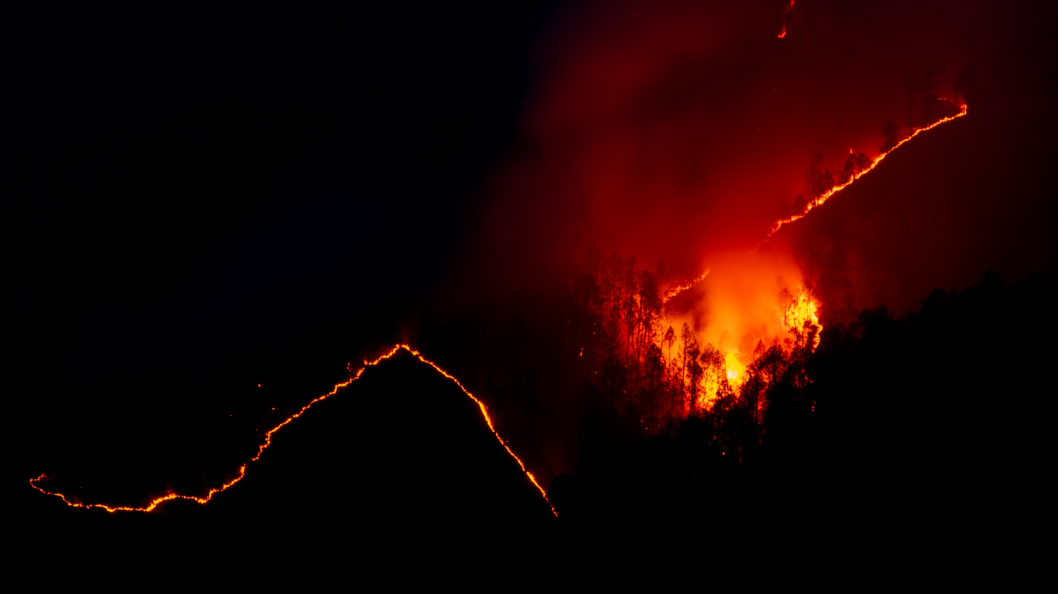
Our Nature Trails & Photo walks are designed for all Age Groups, Educational Institutions, Corporate Organisations and Forest Departments.
We felt there is a dire need to create awareness about “Nature” as well as our Co-Existence. Documenting the same is a challenging task; yet rewarding and confer a strong message to the society.
So, we introduced Nature Trails and Photo Walks for all age groups where we guide you to read signs and signals of Nature and to capture the Natural History world in a presentable manner.
Beautifull Flower’s
KIND OF FLOWER
KIND OF FLOWER
A category
A category
Occidental Petroleum Corporation is an international oil and gas exploration and production company with operations in the
Occidental Petroleum Corporation is an international oil and gas exploration and production company with operations in the
Nature Trails & Photo Walks
Occidental Petroleum Corporation is an international oil and gas exploration and production company with operations in the United States, Middle East and Latin America. Headquartered in Houston, Occidental is one of the largest U.S. oil and gas companies, based on equity market capitalization.
exploringthenature2021
ExploringNat007
exploringnature2021
www.exploringnature.net

Slide 4
Nature trails and photo walks are two activities that involve exploring and appreciating the natural world through different means.
A nature trail is a path or route that takes you through a natural environment, such as a forest, park, or wilderness area. Along the trail, you can observe and learn about the various flora and fauna that inhabit the area.
A photo walk, on the other hand, is a guided or self-guided walk that is focused on photography. The goal is to capture images of the natural environment or other subjects of interest along the way.
Beautifull Flower’s
KIND OF FLOWER
KIND OF FLOWER
A category
A category
Occidental Petroleum Corporation is an international oil and gas exploration and production company with operations in the
Occidental Petroleum Corporation is an international oil and gas exploration and production company with operations in the
Nature Trails & Photo Walks
Occidental Petroleum Corporation is an international oil and gas exploration and production company with operations in the United States, Middle East and Latin America. Headquartered in Houston, Occidental is one of the largest U.S. oil and gas companies, based on equity market capitalization.
exploringthenature2021
ExploringNat007
exploringnature2021
www.exploringnature.net

Slide 5
Both nature trails and photo walks can be great ways to connect with nature and appreciate the beauty of the natural world. They can also be good forms of exercise and stress relief, as well as opportunities for social interaction and learning.
Our Nature trails and photo walks are often accompanied by experts in their respective fields, such as naturalists or photographers. These experts can enhance the experience by providing valuable insights and information about the natural environment or photography techniques.
Overall, the presence of experts in nature trails and photo walks can greatly enhance the learning and enjoyment of participants, and deepen their appreciation of the natural world and photography as an art form.
Beautifull Flower’s
KIND OF FLOWER
KIND OF FLOWER
A category
A category
Occidental Petroleum Corporation is an international oil and gas exploration and production company with operations in the
Occidental Petroleum Corporation is an international oil and gas exploration and production company with operations in the
Nature Trails & Photo Walks
Occidental Petroleum Corporation is an international oil and gas exploration and production company with operations in the United States, Middle East and Latin America. Headquartered in Houston, Occidental is one of the largest U.S. oil and gas companies, based on equity market capitalization.
exploringthenature2021
ExploringNat007
exploringnature2021
www.exploringnature.net

Slide 6
  Things to Carry:
  Carry your own Water Bottles
  Carry Munching Items like Dry Fruits, Fruits, Chocolates or Energy Bars
  Wear comfortable trail shoes
  Bring your Cap or Hat
  Carry your camera and Binoculars
  Apply insect repellant
  keep some basic medication and personal medication
  Don'ts:
  Bright colored clothing's.
  Use any strong Deo's or Perfumes.
  Feed Birds
  Go near birds or any wildlife
  Shout inside the park
  Go off the trail.
  Leave any trash
  *Note – Maximum 20-50 Participants can attend.
Beautifull Flower’s
KIND OF FLOWER
KIND OF FLOWER
A category
A category
Occidental Petroleum Corporation is an international oil and gas exploration and production company with operations in the
Occidental Petroleum Corporation is an international oil and gas exploration and production company with operations in the
Nature Trails & Photo Walks
Occidental Petroleum Corporation is an international oil and gas exploration and production company with operations in the United States, Middle East and Latin America. Headquartered in Houston, Occidental is one of the largest U.S. oil and gas companies, based on equity market capitalization.
exploringthenature2021
ExploringNat007
exploringnature2021
www.exploringnature.net

Slide 7
Exclusions:
Park Fees
Camera Charges and Parking Fees.
Snacks and Lunch
Water bottles.
  Duration - 4 hrs
  Pricing – 500/- per person
  Lump sum Pricing – 5000/- for 20 Candidates
  Lump sum Pricing – 10000/- for 50 Candidates
  Lump sum Pricing – 15000/- for 100 Candidates
  Guide Fees – At Actuals.
  Optional Pricing – FREE upto 20 Candidates
  Traveling, Fooding, Lodging and Boarding at Actuals.
  *Note – Maximum 20-100 Participants can attend.
Beautifull Flower’s
KIND OF FLOWER
KIND OF FLOWER
A category
A category
Occidental Petroleum Corporation is an international oil and gas exploration and production company with operations in the
Occidental Petroleum Corporation is an international oil and gas exploration and production company with operations in the
Nature Trails & Photo Walks
Occidental Petroleum Corporation is an international oil and gas exploration and production company with operations in the United States, Middle East and Latin America. Headquartered in Houston, Occidental is one of the largest U.S. oil and gas companies, based on equity market capitalization.
exploringthenature2021
ExploringNat007
exploringnature2021
www.exploringnature.net

Slide 8
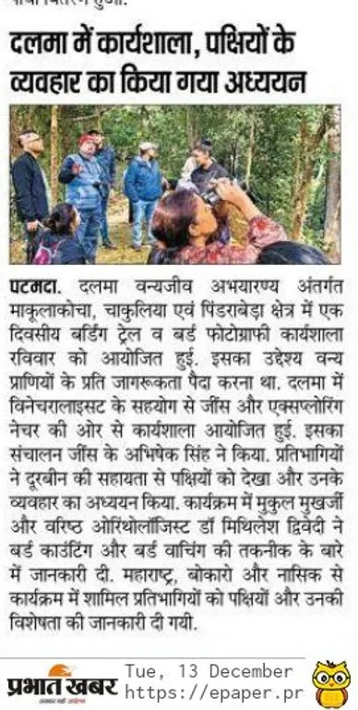
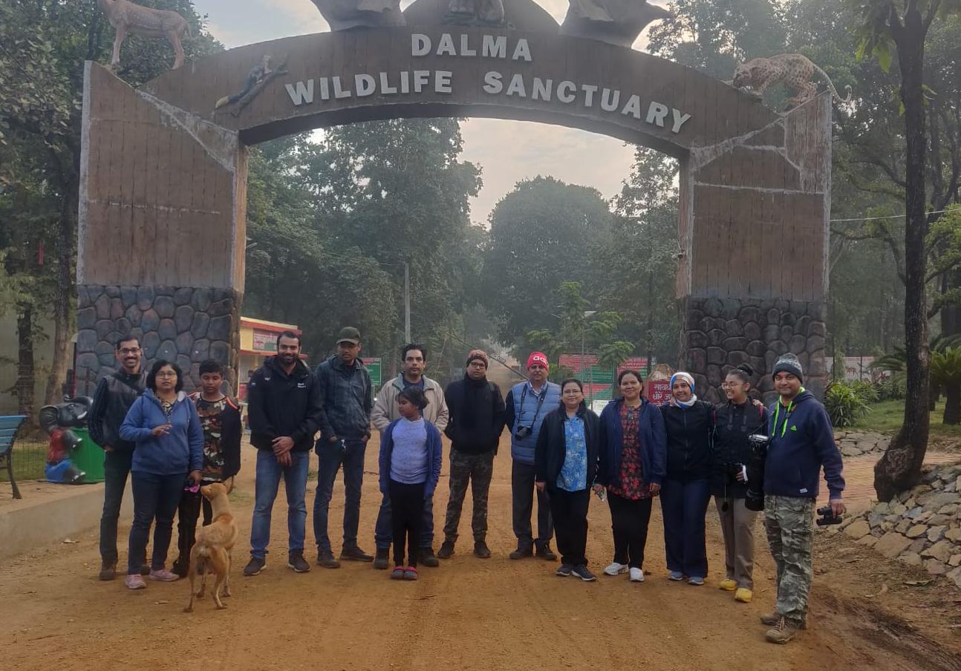
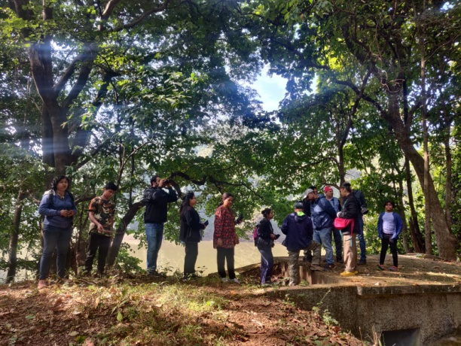
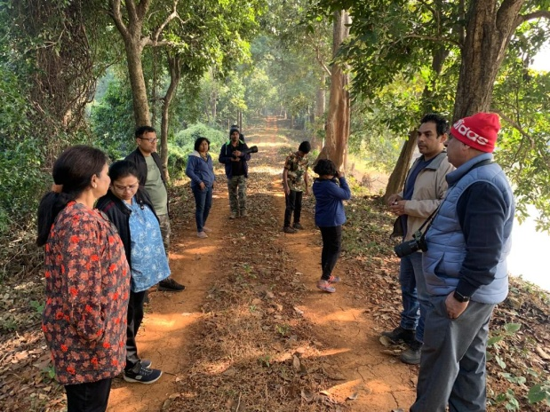
Beautifull Flower’s
KIND OF FLOWER
KIND OF FLOWER
A category
A category
Occidental Petroleum Corporation is an international oil and gas exploration and production company with operations in the
Occidental Petroleum Corporation is an international oil and gas exploration and production company with operations in the
Nature Trails & Photo Walks
Occidental Petroleum Corporation is an international oil and gas exploration and production company with operations in the United States, Middle East and Latin America. Headquartered in Houston, Occidental is one of the largest U.S. oil and gas companies, based on equity market capitalization.
Conducted Nature Trails & Photo walk along with ZEISS Nature India at Dalma Wildlife Sanctuary
exploringthenature2021
ExploringNat007
exploringnature2021
www.exploringnature.net

Slide 9
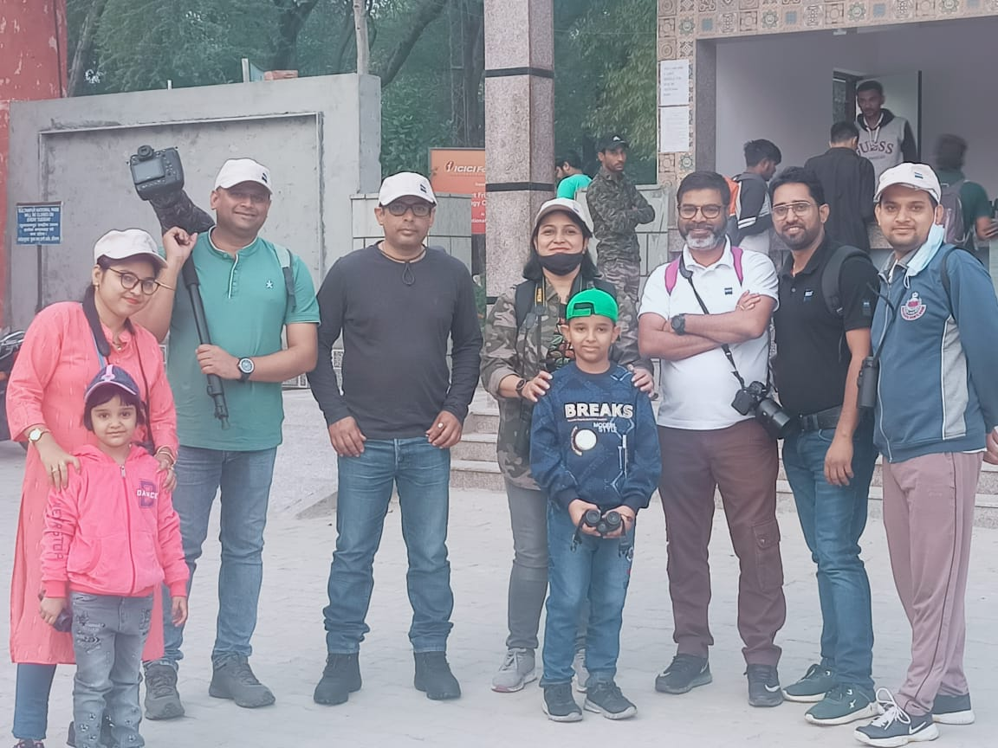
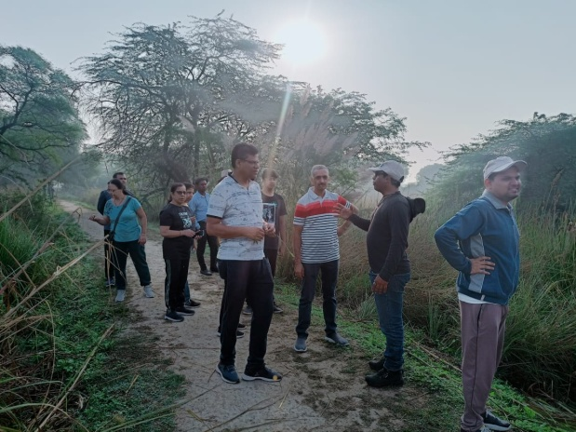
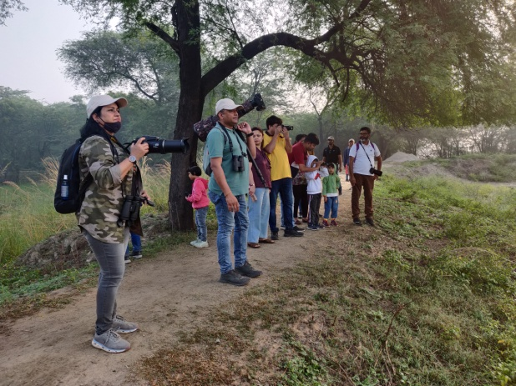
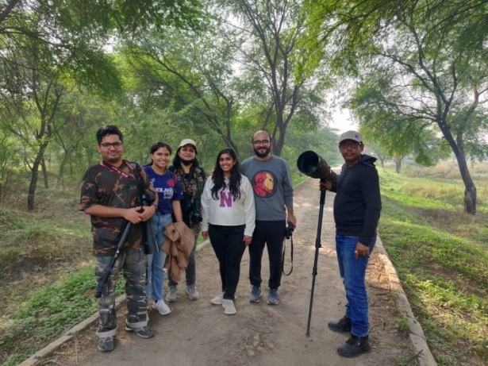
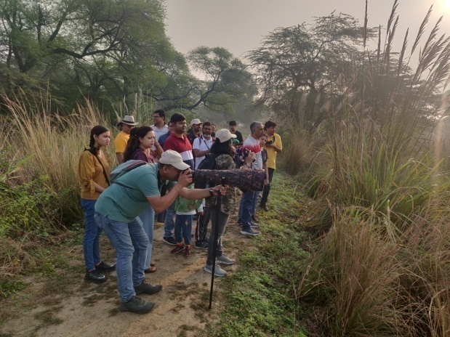
Beautifull Flower’s
KIND OF FLOWER
KIND OF FLOWER
A category
A category
Occidental Petroleum Corporation is an international oil and gas exploration and production company with operations in the
Occidental Petroleum Corporation is an international oil and gas exploration and production company with operations in the
Nature Trails & Photo Walks
Occidental Petroleum Corporation is an international oil and gas exploration and production company with operations in the United States, Middle East and Latin America. Headquartered in Houston, Occidental is one of the largest U.S. oil and gas companies, based on equity market capitalization.
Conducted Nature Trails & Photo walk along with ZEISS Nature India at Sultanpur Bird Sanctuary
exploringthenature2021
ExploringNat007
exploringnature2021
www.exploringnature.net

Slide 10
“Exploring and Connecting People for the Environment"
Environmental Awareness and Connection through Nature Exploration
fostering a strong bond between people and the Natural World
for the betterment of the Environment.
Beautifull Flower’s
KIND OF FLOWER
KIND OF FLOWER
A category
A category
Occidental Petroleum Corporation is an international oil and gas exploration and production company with operations in the
Occidental Petroleum Corporation is an international oil and gas exploration and production company with operations in the
Thank You
Occidental Petroleum Corporation is an international oil and gas exploration and production company with operations in the United States, Middle East and Latin America. Headquartered in Houston, Occidental is one of the largest U.S. oil and gas companies, based on equity market capitalization.
exploringthenature2021
ExploringNat007
exploringnature2021
www.exploringnature.net

