Slide 1
Introduction to Championships
Able Body

Slide 2
The Spirit of Curling

Slide 3
The Spirit of Curling
Curling is a game of skill and of traditions. A shot well executed is a delight to see and so, too, it is a fine thing to observe the time-honoured traditions of curling being applied in the true spirit of the game.

Slide 4
The Spirit of Curling
Curlers play to win but never to humble their opponents. A true curler would prefer to lose rather than win unfairly.

Slide 5
The Spirit of Curling
A good curler never attempts to distract an opponent or otherwise prevent him from playing his best.

Slide 6
The Spirit of Curling
No curler ever deliberately breaks a rule of the game or any of its traditions. But, if he should do so inadvertently and be aware of it, he is the first to divulge the breach.

Slide 7
The Spirit of Curling
While the main object of the game of curling is to determine the relative skill of the players, the spirit of the game demands good sportsmanship, kindly feeling and honourable conduct.

Slide 8
The Spirit of Curling
This spirit should influence both the interpretation and application of the rules of the game and also the conduct of all participants on and off the Ice.

Slide 9
Pre-event Documents

Slide 10
Competitors Guide
This document will serve as a guide to the event. It provides information about travel, accommodations, contacts, the venue, host city, official functions, anti-doping and uniforms.

Slide 11
Team Meeting Document
Prepared by the Chief Umpire and WCF Technical Delegate, this document will detail specific information about the rules and procedures of the event.

Slide 12
Team Meeting Document
It should be reviewed by all players and coaches in advance of the Team Meeting.

Slide 13
Team Meeting Document
Any questions arising from the document should be raised at the Team Meeting.

Slide 14
Official Functions

Slide 15
Official Functions
During the event, there will be functions to be attended by all team members and coaches in team uniforms appropriate to the occasion.

Slide 16
Team Meeting
Attendance is mandatory for all of the athletes and the team coach.
Failure to attend means the team forfeits the last stone advantage for the first game.

Slide 17
Welcome Reception
The dress code for the Welcome Reception is playing jersey or jacket with your choice of pants.

Slide 18
Closing Ceremony
Playing uniform and curling shoes are to be worn at the Closing Ceremony.
Attendance is mandatory for all of the athletes and the team coach.

Slide 19
Farewell Banquet
The Farewell Banquet is considered semi-formal so business attire is required.

Slide 20
NO Blue Jeans at Receptions, Ceremonies or Banquets

Slide 21
Forms

Slide 22
Original Team Line-up
This form is to be submitted at the Team Meeting.

Slide 23
Game Line-up
Before each game, a Game Line-up form must be submitted.

Slide 24
Change of Line-up
If an alternate is being substituted into the line-up after pre-game practice, a Change of Team Line-up form must be submitted to the Chief Umpire before the change.

Slide 25
Official Scorecard
At the end of each game, both teams need to confirm the score and LSDs by having one player sign the Official Scorecard.

Slide 26
CuCoS
An electronic version of the Line-up Forms will be used at some events.
Any changes will be entered into your team line-up and confirmed with the Chief Umpire.

Slide 27
Team Health Information Form
All members of the team, including coaches, must complete a health information form prior to the competition.

Slide 28
Team Health Information Form
One team member will keep the forms with them at all times in case of a medical emergency.

Slide 29
Team Uniforms

Slide 30
Team Uniforms
Teams listed first in the playing schedule will play dark stones and wear dark uniforms.
Red is considered a dark colour.

Slide 31
Team Uniforms
Teams listed second in the playing schedule will play light stones and wear light uniforms.
All uniforms must conform to the WCF Cresting Guidelines.

Slide 32
Team Uniforms
All players must wear identical uniforms when accessing the field of play.

Slide 33
Team Uniforms
All coaches and team officials must wear team or national uniforms when accessing the field of play.

Slide 34
Cresting Guidelines

Slide 35
Role of the Umpire

Slide 36
Role of the Umpire
Their role is to ensure fair play between teams in the competition.

Slide 37
Role of the Umpire
Umpires act as a complement to the game, working with the teams in a fair and neutral manner within the rules of the game.

Slide 38
Role of the Umpire
Umpires will do all measurements and intervene only to make a correction or following a breach of the rules.

Slide 39
Electronic Handles

Slide 40
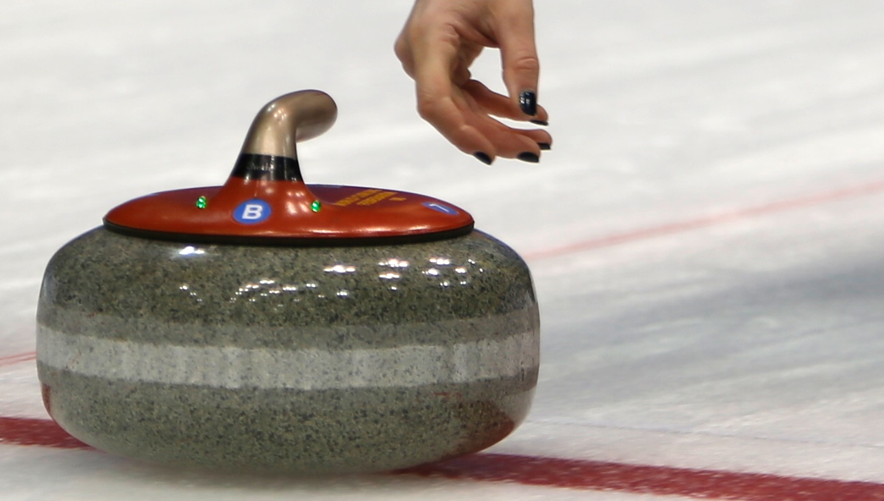
Electronic Handles

Slide 41
Electronic Handles
No form of glove may be used during the delivery of a stone.
Handles are activated by tipping the stone at a minimum 70° angle.

Slide 42
Electronic Handles
Failure to activate the handle or wearing a glove when delivering the stone will result in the stone being considered a hog line violation and the stone will be removed from play.

Slide 43
Electronic Handles
Flashing red lights after hog line
remove the stone from play immediately

Slide 44
Electronic Handles
Flashing red lights before hog line
if you believe the lights started to flash before stone reached delivery end hog line, stop stone immediately
call for an umpire using the technical timeout “X” signal

Slide 45
Electronic Handles
Flashing red lights before hog line
umpire will have ice technician test handle
functioning: hog line violation
faulty: player is allowed to redeliver

Slide 46
Electronic Handles
Alternating red & green lights flashing quickly
indicate handle has not been properly set
handle must be reset before delivery

Slide 47
Electronic Handles
Alternating red & green lights flashing slowly
indicate a low battery
call for an umpire using the technical timeout “X” signal

Slide 48
Electronic Handles
Alternating red & green lights flashing slowly
option to change handle before delivery or have release viewed at hog line by an umpire

Slide 49
Electronic Handles
No lights
indicate faulty connection
option to change handle before delivery or have release viewed at hog line by an umpire

Slide 50
Pins and Banners

Slide 51
Pins and Banners
Before the start of all round robin games each team member exchanges with opposite player a pin and/or banner from their club, region and/or Member Association.

Slide 52
Pins and Banners
The teams' Member Association should arrange the required supply of these items.

Slide 53
Dope Testing

Slide 54
World Anti-Doping Agency (WADA)
The WCF is required by WADA to follow their procedures.
Athletes must be fully aware of all requirements.

Slide 55
Dope Testing
Testing may be carried out at any time during the event.
Athletes will be randomly or target selected.

Slide 56
Dope Testing
All athletes including alternates are eligible for testing.

Slide 57
Doping Control Officer
will be the same gender as you
will ask to have a clear and unobstructed view of the sample collection

Slide 58
Doping Control Officer
will not handle the sample-collection container or A- and B-bottles before the samples are sealed by the athlete

Slide 59
Athlete’s Rights
see official ID from Doping Control Officer (DCO)
be accompanied by a representative of your choice to the Doping Control Station

Slide 60
Athlete’s Rights
request a delay in reporting to the Doping Control Station for valid reasons including:
participate in award ceremony
media commitments
warm-down or medical treatment

Slide 61
Athlete’s Rights
a DCO of the same gender to observe provision of sample
ask for more information about the sample-collection process
receive a copy of the doping control form

Slide 62
Athlete’s Rights
ensure confidentiality: no name should be on any documentation intended for the laboratory
request modifications if a minor (under 18 years old) or have a disability

Slide 63
Athlete’s Responsibilities
remain within direct observation of DCO/Chaperone from time of notification until completion of testing
produce photo identification

Slide 64
Athlete’s Responsibilities
comply with procedures
report immediately for the test unless there are valid reasons for a delay

Slide 65
Therapeutic Use Exemption (TUE)
Sometimes, an athlete may need to take a banned substance for a legitimate medical condition.

Slide 66
Therapeutic Use Exemption
Athletes should check with their doctor or medical personnel to see if an alternative medication or treatment is available.

Slide 67
Therapeutic Use Exemption
If there are no alternatives, the athlete will need to apply for a TUE.

Slide 68
Therapeutic Use Exemption
The application form can be found on the WCF website.
Completed forms need to be returned to the WCF office before the specified deadline in order to be granted.

Slide 69
Prohibited List
revised every year
current version:
www.wada-ama.org

Slide 70
The Doping Control Process

Slide 71
Online Resources
www.worldcurling.org
www.wada-ama.org
www.globaldro.com

Slide 72
Length of Games

Slide 73
Length of Games
If 10 ends are scheduled, a minimum of 6 ends must be completed during round robin and tie-breaker games and 8 ends during play-off games.

Slide 74
Length of Games
If 8 ends are scheduled, a minimum of 6 ends must be completed in all games.

Slide 75
Length of Games
Teams have to concede once the minimum number of ends has been completed and they are arithmetically eliminated.

Slide 76
Pre-game Practice

Slide 77
Pre-game Practice
Each team is allowed a pre-game practice on the sheet they will be playing.

Slide 78
Pre-game Practice
Each team is given a pre-determined amount of time as outlined in the Team Meeting Document.

Slide 79
Pre-game Practice
Pre-game practice usually starts 30 minutes before the scheduled game time.
You can only practice with your designated stones.

Slide 80
Pre-game Practice
The team listed first in the schedule practices first.
5 players, coach and the second team official are allowed on-ice.

Slide 81
Pre-game Practice
An umpire will control the practice.
Please wait for the appropriate announcement before beginning practice or checking the stones.

Slide 82
Pre-game Practice
Speed traps are not allowed to be used during pre-game practice.

Slide 84
Last Stone Draw

Slide 85
Last Stone Draw (LSD)
At the conclusion of each team’s pre-game practice, two stones will be delivered to the tee at the home end by different players.
One minute will be allocated for each delivery.

Slide 86
Last Stone Draw
An umpire will control the LSDs.
Please wait for the appropriate announcement before delivering your LSD.

Slide 87
Last Stone Draw
The first stone is delivered with a clockwise rotation then measured.
The second stone is delivered with a counter-clockwise rotation then measured.

Slide 88
Last Stone Draw
Any one of the five players on the team can deliver the stone.
The player does not have to play in the upcoming game.

Slide 89
Last Stone Draw
One team member will hold the brush in the house at the home end.
Normal sweeping rules will apply.

Slide 90
Last Stone Draw
Stones stopping outside the house will be recorded with 199.6 cm (maximum distance).

Slide 91
Last Stone Draw
Stones covering the tee will be measured from two holes at the edge of the 4 foot circle.
These two locations make a 90° angle from the centre hole.

Slide 92
Last Stone Draw
The team with the lesser LSD total will have the choice of first or second stone in the first end.

Slide 93
Last Stone Draw
It is assumed the team will choose second stone in the first end.
If a team chooses not to take last stone first end, they must notify the umpire before the start of their pre-game practice.

Slide 95
Game Timing

Slide 96
Game Timing
30 minutes for 8 end game. 38 minutes for 10 end game.

Slide 98
Game Timing
Clock starts:
after the first and subsequent stones of an end has come to rest (or crossed the backline) and the field of play is relinquished to the other team

Slide 99
Game Timing
Clock starts:
all stones displaced due to violations by the delivering team have been replaced

Slide 100
Game Timing
Clock runs:
the delivering team is thinking about the shot to be played

Slide 101
Game Timing
Clock stops:
once the teams stone has reached the tee line at the delivery end
a team or technical time-out is called

Slide 102
Game Timing
Clock stops:
between ends and during the mid-game break

Slide 103
Game Timing
A team forfeits the game if they run out of time.

Slide 104
Game Timing
If an extra end is required, game clocks are reset and each team is given 4 minutes 30 seconds.

Slide 105
Time-outs

Slide 106
Team Time-outs
Each team is allowed one 60 second time-out per game and one 60 second time-out during an extra end.
Unused time-outs cannot be carried forward to an extra end.

Slide 107
Team Time-outs
Only the players of the delivering team on the ice may call a team time-out.
Players signal a team time-out by using a “T” hand signal.

Slide 108
Team Time-outs

Slide 109
Team Time-outs
A pre-determined travel time will be added to the 60 second time-out.

Slide 110
Team Time-outs
Teams will be notified when there is 10 seconds left in the time-out.

Slide 112
Technical Time-outs
Players signal a technical time-out by using an “X” hand signal.
This time-out can be called to request a ruling, for an injury or in other extenuating circumstances.

Slide 113
Technical Time-outs

Slide 114
Game Breaks

Slide 115
Between Ends
There may be a timed break between ends.
Teams cannot meet or communicate with their coach, alternate or other team officials.

Slide 117
Mid-game
There will be a longer timed break at the mid-point of the game.
Teams can meet, within the playing area, with any player and team official designated to be on the coach bench for that game.

Slide 119
Before an Extra End
There will be a timed break before an extra end.
Teams cannot meet or communicate with their coach, alternate or other team officials.

Slide 120
During the Game

Slide 121
Player Positioning
Non-Delivering Team:
players take stationary position along the side lines between the courtesy lines

Slide 122
Player Positioning
Non-Delivering Team:
skips and/or vice-skips take stationary positions behind the back line at the playing end

Slide 123
Player Positioning
Non-Delivering Team:
the player who is to deliver next may take a stationary position to the side of the sheet, behind the hacks, at the delivery end

Slide 124
Player Positioning
Non-Delivering Team:
at no time can any player take any position, nor cause any motion, which could obstruct, interfere with, distract or intimidate the delivering team

Slide 125
Player Positioning
Delivering Team:
the skip, or the vice-skip when it is the skip’s turn to deliver, or when the skip is not on the ice, is in charge of the house

Slide 126
Player Positioning
Delivering Team:
the player in charge of the house must be positioned inside the hog line, with at least one foot on the ice surface of the playing end of the team’s sheet

Slide 127
Scoring
At the conclusion of the end, the score is decided when the skips or vice-skips in charge of the house agree upon the score.

Slide 128
Scoring
If a measurement is required, only the persons in charge of the house may observe.
The decided score should be communicated to the Game Umpire.

Slide 129
After the Game

Slide 130
After the Game
Upon completion of the game the alternate, coach and second team official are not allowed onto the Field of Play and players are not allowed on the Coach Bench.

Slide 131
After the Game
Both teams need to confirm the score and LSDs by having one player sign the Official Scorecard.

Slide 132
After the Game
Please remove all belongings from the Field of Play and be aware of any games that may be in progress.

Slide 133
Evening Practice

Slide 134
Pre-Allocated Evening Practice
Sessions of 10 minutes are allotted for evening practice on each sheet.

Slide 135
Pre-Allocated Evening Practice
These sessions are reserved for the teams who will play on that sheet in the next day's draw in the order they appear on the schedule.

Slide 136
Pre-Allocated Evening Practice
Teams are asked to let the Chief Umpire know if they are not going to use the session reserved for them, but there is no penalty for failing to do so.

Slide 137
Pre-Allocated Evening Practice
Teams will only train on the sheets on which they will play the next day.
No team will be allowed to have extra training if any sessions are unused.

Slide 138
Pre-Allocated Evening Practice
Practice will start approximately five minutes after the last game of the day, as soon as the Ice Technicians finish preparing the ice.

Slide 139
Pre-Allocated Evening Practice
Any stones from the sheet may be used in training.
Speed traps may be used.

Slide 140
Pre-Allocated Evening Practice
A maximum of seven persons will be allowed into the Field of Play; five players, one coach and one other team official / translator.

Slide 141
Pre-Allocated Evening Practice
All team members must wear identical uniforms.
Coaches / Officials / Translators must wear a proper team or Association uniform.

Slide 142
Pre-Allocated Evening Practice
No player will be allowed to participate in more than two practice sessions on any evening.

Slide 143
Evening Practice
Some events will have a sign-up procedure for evening practice.

Slide 144
Post Round Robin Meeting

Slide 145
Post Round Robin Meeting
All teams involved in a post round robin / tie-breaker game will meet with the Chief Umpire approximately 30 minutes following the last round robin session.
maximum of 2 persons / team

Slide 146
Post Round Robin Meeting
The details about the post round robin games will be discussed.
Any team decision(s) must be made at that time, before leaving the meeting.

Slide 147
Post Round Robin Meeting
Mobile phones or use of any other forms of electronic communication to communicate with persons outside of the meeting are not permitted.

Slide 148
Post Round Robin Meeting
A team that does not attend or is not prepared to make a decision, forfeits the game choices (last stone advantage, stone colour, etc.) to which the team is entitled.

